Slide 1
Application for State School Aid (ASSA) Software
Office of School Finance
Division of Finance and Business Services
October 15, 2024

Slide 2
ASSA Software Overview
Estimated Timeline
Software Features
ASSA Workpapers, Audit Documentation, and Instructions

Slide 3
ASSA Timeline and Important Dates
Enrollment count date is 10/15.
October:
Prepare Workpapers.
Review NJSMART Enrollment Report in NJSMART prior to October 15.
Early November:
ASSA system opens.
Sent/Received edits are live on the system.
Early December:
ASSA is Due. Exact date to be announced later.

Slide 4
ASSA Software Features
Web-based, accessed through the Homeroom.
Data entry screens.
Reports.
Preloaded enrollment data for On Roll, Sent, Received, Charters Schools, and State Facilities.
Instant send-receive edits.
Electronic certification.

Slide 5
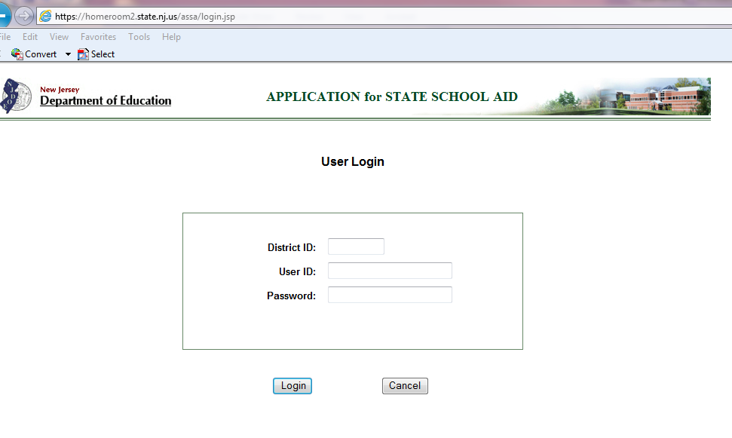
ASSA on Homeroom
District’s Homeroom Administrator provides access to users responsible for data entry, review, and certification.
Username and passwords managed by school districts.
Data must be saved prior to leaving a page.

Slide 6
ASSA: Data Entry Menu
Data Entry tab includes On Roll, Sent, Received, On Roll Choice and Regional Enrollment Breakdown.

Slide 7
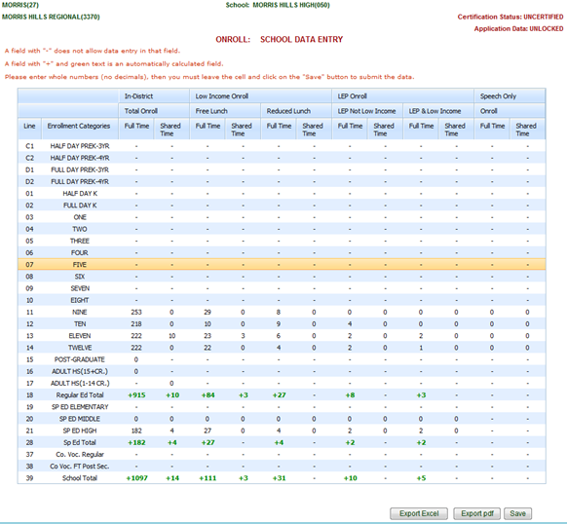
ASSA: Data Entry
Data Entry screen after selecting a school or district.

Slide 8
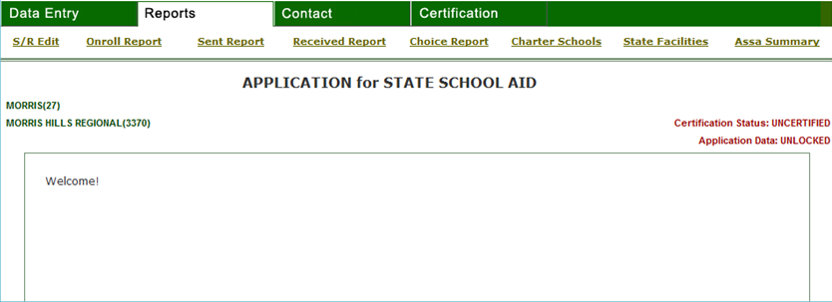
ASSA: Reports Menu
Reports tab includes Sent/Received Edits, On Roll, Sent, Received, Choice On Roll, Charter Schools, State Facilities, and ASSA Summary.

Slide 9
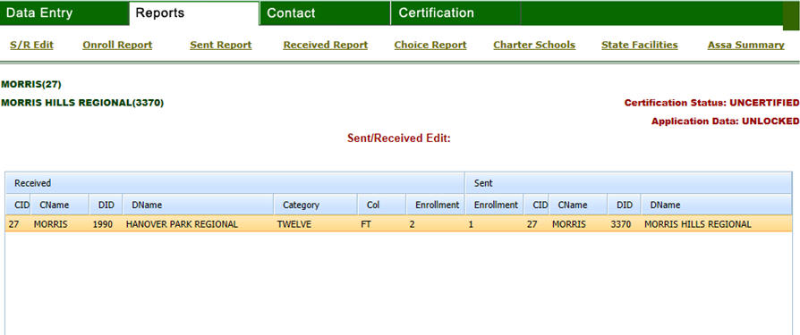
ASSA: Sent/Received Report
S/R Reports include instant sent/received edits.

Slide 10
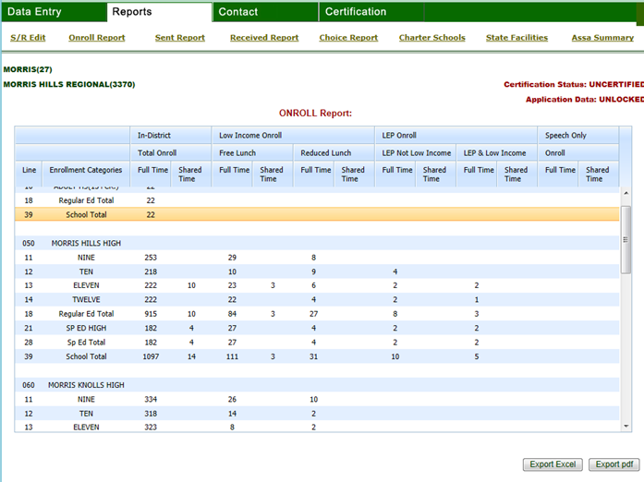
ASSA: On Roll Report
On Roll Report summarizes the on-roll students by individual schools.

Slide 11
ASSA: Summary Report Features
Resident Enrollment
Errors
Certification Link

Slide 12
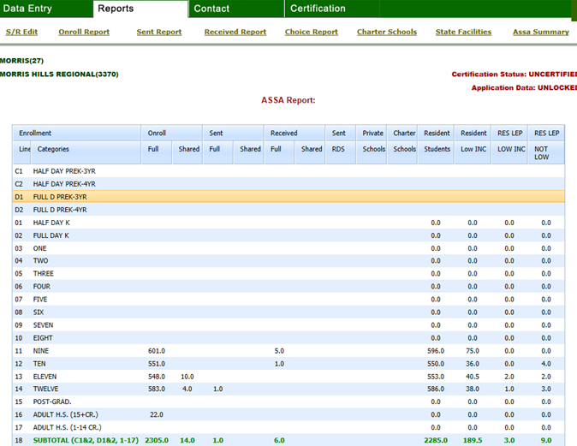
ASSA: Summary Report
Summary Report summarizes all the school enrollments for the districts, charter schools and state facilities.

Slide 13
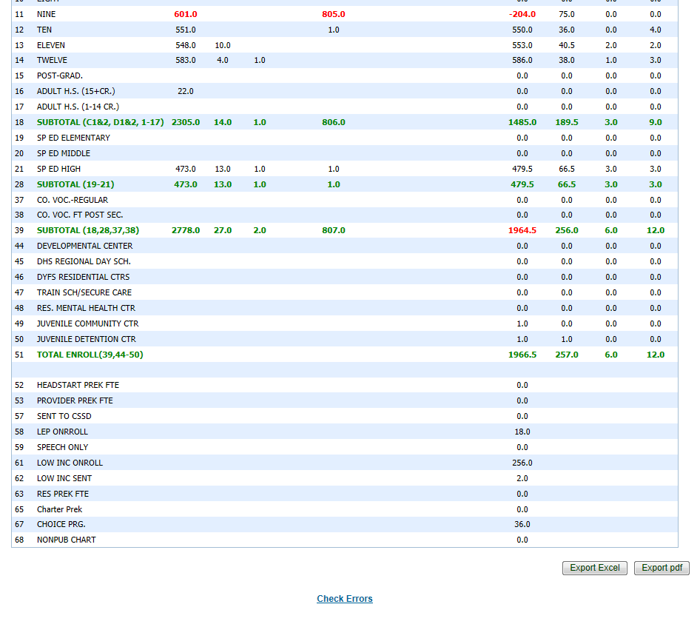
ASSA: Summary Report Errors
Errors on the summary report must be corrected by the district.

Slide 14
ASSA: Summary Report Error Details
Reason for errors on the summary report. These enrollment inconsistencies that must be corrected before the district can certify its enrollments.

Slide 15
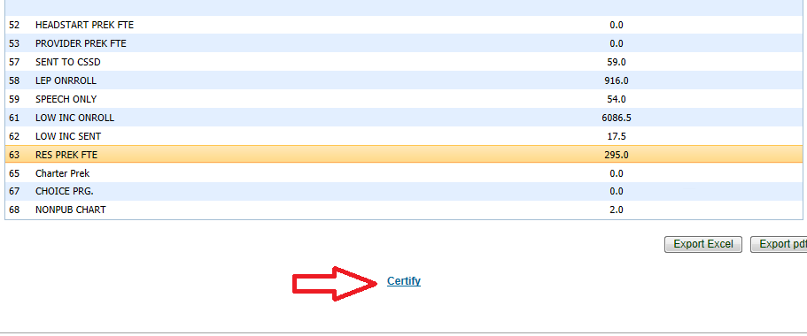
ASSA: Certify
District must click on the certify link to complete the certification process.

Slide 16
District Web Enrollment Report in NJSMART
District Enrollment Report is a report included in NJSMART. It summarizes the current SID Management data that will be preloaded in the ASSA.
Prior to the NJSMART snapshot date of October 15, districts must log into NJSMART and view their district’s Enrollment Report.
All corrections in NJSMART must be made prior to the October 15 snapshot. After this date, any changes applicable to October 15 can be made only in the ASSA.

Slide 17
ASSA: Preloaded Enrollments
On Roll, Sent, Received, Choice On Roll, Charter School, and State Facilities enrollments are preloaded.
On Roll, Sent, Received, Choice On Roll are based on the October 15 NJSMART SID Management submission.
These enrollments can be modified in the ASSA.
Must “save” data for the enrollment to be updated.
Student records must have valid values in the district and school codes, grade levels, tuition codes, free/reduced lunch, special education classification, LIEP dates, speech, municipal code, etc… to be used in the ASSA preload.

Slide 18
ASSA: Possible Preload Adjustments
Students that were not included on the October 15 NJSMART submission.
Students that were incorrectly reported in the NJSMART submission.
Add district-placed and district-paid public school special education students that are placed in nonpublic schools. Only students that are attending Approved Private Schools for Students with Disabilities (APSSDs) are preloaded. Students placed in schools that are not on this list must be Commissioner-approved placements or court ordered.
Adjust for shared-time students not attending a vocational district.

Slide 19
ASSA: Other Preloaded Enrollments
Charter school enrollments are based on the Charter School Enrollment (CHE) system.
These enrollments cannot be modified in the ASSA.
State facilities enrollments are based on the enrollments submitted by the state facilities and the County Office district assignments in the State Facilities Enrollment System.
These enrollments cannot be modified in the ASSA.

Slide 20
ASSA: Workpapers and Instructions
Workpapers are required to be kept on file in the district.
Attendance register for October is required and must be kept on file in the district.
The manual is available on the Finance web page.

Slide 21
ASSA Help
All ASSA program and technical questions must be emailed to:
Office of School Finance at ASSA@doe.nj.gov
Next fiscal year’s state aid calculation will be based on the October 15 ASSA Collection.
New Jersey Department of Education Website nj.gov/education
Thank You!

