Slide 1
LEARning about Literacy for Families Series
Series Introduction
Office of Learning Equity & Academic Recovery (LEAR)
2026
nj.gov/education/lear
Notes:
Facilitator Narration:
Welcome to the LEARning about Literacy for Families series from the New Jersey Department of Education’s Office of Learning Equity and Academy Recovery, or LEAR. LEAR was established in August 2024 to transform New Jersey’s approach to literacy instruction and advance academic recovery.
Along with the LEAR office, a Working Group on Student Literacy was created to make recommendations on best practices and evidence-based strategies to help all children learn. Through the group’s research, it was determined that states that mirrored the language and formats used with teachers successfully communicated information about early literacy learning to families. As a result, one of the group's recommendations was to develop clear, accessible information for families to support aligned language around early literacy development. In response to this recommendation, the LEAR office created this series for parents, families, and caregivers, providing research and information on early literacy, along with practical applications and activities they can do with their children at home.
For more information about LEAR and the New Jersey Department of Education, visit the link on the screen.
Facilitator Note: Hide this slide if this is not the first session you are facilitating with this group.

Slide 2
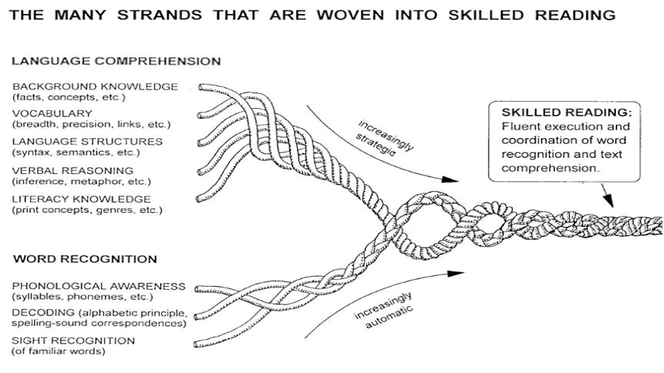
Scarborough’s Reading Rope
Scarborough, 2001
Notes:
Facilitator Narration:
To get started, let’s ground our work in this helpful visual. Scarborough’s Reading Rope is a visual model created by Dr. Hollis Scarborough in the 1990s. It shows how different reading skills come together to help children become successful readers.
The upper strands under Language Comprehension include background knowledge, vocabulary, understanding sentence structure, reasoning with language, and general literacy knowledge. These are the skills that help children understand what they read. The lower strands under Word Recognition include phonological awareness—like recognizing sounds in words—decoding using phonics, and recognizing familiar words by sight. These are the skills that help children recognize and read the words on the page.
After using the lower strands to decode words, a child uses the upper strands to understand the meaning of the text. The upper strands work in tandem with the lower strands, and over time, they become more automatic and strategic, resulting in skilled reading. They weave together like a rope, making reading smoother and more fluent. As parents, understanding this model helps us see where our children might need support—whether it's with sounding out words or understanding what they read. All strands are essential for strong reading development. By supporting the lower and upper strands of the rope, we can help our children become confident, skilled readers.

Slide 3
Text Version: Scarborough’s Reading Rope
The many strands that are woven into skilled reading.
The Reading Rope consists of lower and upper strands. The word recognition strands (phonological awareness, decoding, and sight recognition of familiar words) work together as the reader becomes accurate, fluent, and increasingly automatic with repetition and practice.
Language Comprehension (Upper Strands)
Strands include:
Background knowledge (facts, concepts, etc.)
Vocabulary (breadth, precision, links, etc.)
Language structures (syntax, semantics, etc.)
Verbal reasoning (inference, metaphor, etc.)
Literacy knowledge (print concepts, genres, etc.)
Word Recognition (Lower Strands)
Strands include:
Phonological awareness (syllable, phonemes, etc.).
Decoding (alphabetic principle, spelling-sound correspondences
Sight recognition (of familiar words).
Skilled Reading
Language comprehension becomes increasingly strategic and word recognition becomes increasingly automatic in the progression to becoming a skilled reader.
A skilled reader displays fluent execution and coordination of word recognition and text comprehension.

Slide 4
Session 1: Phonological Awareness
Scarborough, 2001
Notes:
Facilitator Narration:
Together, through the series, we’ll explore how each strand supports your child’s literacy journey—aligned with New Jersey’s commitment to high-quality reading instruction for all students. Research shows that children whose families are actively involved in literacy activities at home are twice as likely to become successful readers, highlighting the power of a strong home-school connection. Over the course of this experience, you’ll learn about the literacy components shown here, and you will leave each session with sample questions to ask your child’s teacher, along with suggestions on how to support your child at home. As we mentioned, today’s focus will be on phonological awareness, which is the recognition and manipulation of the sounds of language.

Slide 5

What is Phonological Awareness?
Phonological awareness means hearing and playing with the sounds in spoken words.
It includes skills like recognizing rhymes, clapping out syllables, and identifying beginning sounds.
This skill is all about sounds—not letters or written words yet.
Notes:
Facilitator Narration:
Phonological awareness is all about hearing and playing with sounds in spoken words. This means noticing rhymes (such as bat, hat, rat), breaking words into parts like syllables (for example: breaking the word cupcake into cup/cake=2 syllables), and recognizing sounds at the beginning or end of words. Importantly, it’s focused on sounds you hear—not the letters or writing yet.

Slide 6

Why is Phonological Awareness Important?
It is a key building block for learning to read.
Children who hear and play with sounds in words find it easier to connect sounds to letters later on.
Strong phonological awareness helps with spelling, reading fluency, and comprehension.
Notes:
Facilitator Narration:
Phonological awareness is a key building block for learning to read. When children can hear and work with sounds, which is phonemic awareness and a skill within phonological awareness, it becomes easier for them to link those sounds to letters later on. This skill supports not only reading but also spelling and understanding what they read.

Slide 7
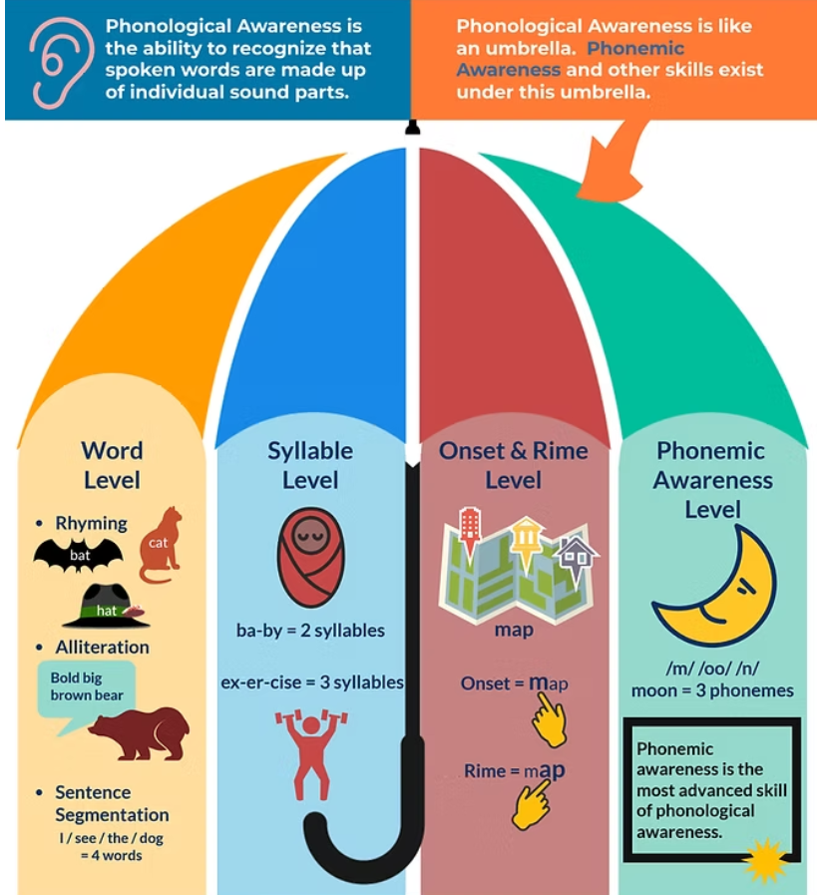
Phonological Awareness vs. Phonemic Awareness
Link to image
Notes:
Facilitator Narration:
Let’s take a closer look at two important terms and how they are related yet distinct. The terms are: phonological and phonemic awareness.
Phonological awareness is the big umbrella term. It refers to a child’s ability to recognize and work with sounds in spoken language. This includes skills like hearing rhymes, clapping out syllables, and identifying the first sound in a word.
Phonemic awareness is a more specific skill under that umbrella. It’s the ability to hear and manipulate the smallest units of sound in words—called phonemes. For example, when a child can break the word “cat” into the sounds /k/, /a/, and /t/, they are demonstrating phonemic awareness.
Why is this important? Because strong phonemic awareness is a key predictor of reading success. It helps children connect sounds to letters when they begin to read and spell.
So, as you support your child at home, remember: playing rhyming games, clapping syllables, and practicing sound games are all great ways to build these foundational skills.

Slide 8
Text Version: Phonological Awareness Umbrella Diagram
A colorful umbrella graphic shows the concept of phonological awareness as an umbrella term.
At the top, text explains that phonological awareness is the ability to recognize that spoken words are made up of individual sound parts, and that phonemic awareness and other skills fall under this umbrella.
The umbrella is divided into four vertical sections, each labeled with a different level of phonological awareness. Phonemic awareness is the most advanced skill of phonological awareness.
Word Level (left section) — Illustrated with a bat, cat, and hat to represent rhyming; a bear to represent alliteration with the example “Bold big brown bear”; and an example of sentence segmentation: “I / see / the / dog = 4 words.”
Syllable Level (second section) —Shows a bundled baby icon with examples: “ba-by = 2 syllables” and “ex-er-cise = 3 syllables.”
Onset & Rime Level (third section) — Depicts houses with the example “map.” A pointing hand indicates “Onset = /m/,” and another hand indicates “Rime = /ap/.”

Slide 9
What is a Phoneme?
A phoneme is the smallest unit of sound in a word. For example, the word cat has three phonemes: /k/ /a/ /t/. Changing just one sound can make a whole new word!
house
Change the
/h/ to /m/
mouse
Notes:
Facilitator Narration:
As just mentioned, phonological awareness is a broad skill that includes many ways of playing with sounds in spoken language—including phonemic awareness, which focuses on the smallest units of sound, called phonemes, in words. For example, the letter p makes the /p/ sound. When working with phonemes, focus on “clipping” the sound and try to avoid adding additional sounds like /puh/.
In a word, like cat there are three phonemes or sounds: /k/ /a/ /t/.
Changing just one sound can make a whole new word!
Now you try with the images on the screen.
Take the word house and change the /h/ to /m/. By changing one phoneme, you created an entirely new word, “mouse!”

Slide 10
How many Phonemes are in these Words?
gate
shoe
queen
3
2
4
Notes:
Facilitator Narration:
Next, let’s count the number of phonemes in the words you see pictured here. Remember, phonemes are the smallest units of sound in a word. The word itself may have more letters than sounds.
You try, and then I’ll share the correct answer.
In Image 1, you’ll hear: gate = /g/ /ā/ /t/, 3 sounds.
In Image 2, you’ll hear: shoe = /sh/ /ü/, 2 sounds.
In Image 3, you’ll hear: queen = /k/ /w/ /ē/ /n/, 4 sounds.
Facilitator Note:
gate = /g/ /ā/ /t/, 3 sounds (4 letters; graphemes g-a-t[e])
shoe = /sh/ /ü/, 2 sounds (4 letters; graphemes sh-oe)
queen = /k/ /w/ /ē/ /n/, 4 sounds (5 letters; graphemes q-u-ee-n)

Slide 11

Questions to Ask Your Child’s Teacher
What phonological awareness skills is my child working on right now?
How do you practice these skills in the classroom?
How do you know if my child is on track with sound awareness?
What specific skills should we practice at home?
Notes:
Facilitator Narration:
It’s helpful to talk with your child’s teacher about how phonological awareness is taught and how your child is doing. You can ask what specific sound skills your child is working on and how these are practiced in class. Teachers can also recommend simple ways to build on these skills at home—like games or reading activities. Open communication helps make sure your child gets consistent support in both school and at home.

Slide 12

How You Can Help Your Child at Home (1 of 2)
Sing nursery rhymes.
Play rhyming games together.
Clap out syllables in words.
Identify beginning, middle, and final sounds in everyday words.
Read aloud and talk about sounds in words.
Count and clap the words in an oral sentence.

Slide 13


How You Can Help Your Child at Home (2 of 2)
Phonological and Phonemic Awareness: Activities for your Kindergartner
Phonological and phonemic awareness are important pre-reading skills, related to the ability to hear, identify, and play with the sounds in spoken language—including rhymes, syllables, and the smallest units of sound (phonemes). Children with strong phonological awareness skills are ready to become readers.
Notes:
Facilitator Narration:
Additional ideas, activities, directions, and examples can be found on Reading Rockets website. The QR code is linked to the Kindergarten page. Activities for other age and grade levels are accessible from the Reading 101: A Guide for Parents menu.
Facilitator Note: Link to resource: https://www.readingrockets.org/literacy-home/reading-101-guide-parents/your-kindergartener/phonological-and-phonemic-awareness

Slide 14


In Closing
Reading 101 for Parents: Phonological and Phonemic Awareness
Phonological and phonemic awareness is the ability to hear, identify, and play with the sounds in spoken language—including rhymes, syllables, and the smallest units of sound (phonemes).
Notes:
Facilitator Narration:
In closing, we hope that you have enjoyed this session. To solidify your learning, we recommend reading this brief article from the Reading Rockets Reading: 101 series for Parents prior to our next session. The resource is linked to the QR code on the screen.
Facilitator Note: Link to resource: https://www.readingrockets.org/literacy-home/reading-101-guide-parents/reading-basics/phonological-and-phonemic-awareness

Slide 15
References (1 of 2)
National Center on Improving Literacy. (2022). Phonemic awareness: What is it and why is it important? Retrieved July 1, 2025, from https://www.improvingliteracy.org/resource/phonemic-awareness-what-is-it-and-why-is-it-important
National Center on Improving Literacy. (2022). Phonological awareness: What is it and how does it relate to phonemic awareness? Retrieved July 1, 2025, from https://www.improvingliteracy.org/resource/phonological-awareness-what-is-it-and-how-does-it-relate-to-phonemic-awareness
Read by 4th. (n.d.). Parent workshop on early reading skills. Retrieved July 1, 2025, from https://www.readby4th.org/initiatives-family/parent-workshop-early-reading-skills
Reading Rockets. (n.d.). Phonological and phonemic awareness: Activities for your kindergartener. Retrieved December 10, 2025, from https://www.readingrockets.org/literacy-home/reading-101-guide-parents/your-kindergartener/phonological-and-phonemic-awareness

Slide 16
References (2 of 2)
Reading Rockets. (n.d.). Phonological and phonemic awareness: Introduction. Retrieved July 1, 2025, from https://www.readingrockets.org/reading-101/reading-101-learning-modules/course-modules/phonological-and-phonemic-awareness
Reading Rockets. (n.d.). Reading 101 for Parents: Phonological and phonemic awareness. Retrieved December 10, 2025, from https://www.readingrockets.org/literacy-home/reading-101-guide-parents/reading-basics/phonological-and-phonemic-awareness
Scarborough, H. S. (2001). Connecting early language and literacy to later reading (dis)abilities: Evidence, theory, and practice. In S. Neuman & D. Dickinson (Eds.), Handbook for research in early literacy (pp. 97-110). New York: Guilford Press.

Slide 17
Follow the New Jersey Department of Education
Facebook
@njdeptofed
X
@newjerseydoe
Instagram
@newjerseydoe
LinkedIn
New Jersey Department of Education
nj.gov/education
Threads
@newjerseydoe
YouTube
@newjerseydepartmentofeduca6565

