Slide 1
LEARning about Literacy for Families Series
Series Introduction
Office of Learning Equity & Academic Recovery (LEAR)
2026
nj.gov/education/lear
Notes:
Facilitator Narration:
Welcome to the LEARning about Literacy for Families series from the New Jersey Department of Education’s Office of Learning Equity and Academy Recovery, or LEAR. LEAR was established in August 2024 to transform New Jersey’s approach to literacy instruction and advance academic recovery.
Along with the LEAR office, a Working Group on Student Literacy was created to make recommendations on best practices and evidence-based strategies to help all children learn. Through the group’s research, it was determined that states that mirrored the language and formats used with teachers successfully communicated information about early literacy learning to families. As a result, one of the group's recommendations was to develop clear, accessible information for families to support aligned language around early literacy development. In response to this recommendation, the LEAR office created this series for parents, families, and caregivers, providing research and information on early literacy, along with practical applications and activities they can do with their children at home.
For more information about LEAR and the New Jersey Department of Education, visit the link on the screen.
Facilitator Note: Hide this slide if this is not the first session you are facilitating with this group.

Slide 2
LEARning about Literacy for Families Series
Session 3: Fluency
Office of Learning Equity & Academic Recovery
2026
nj.gov/education/lear
Notes:
Facilitator Narration:
Welcome! We’re excited to have you join us for this third session in the LEARning about Literacy for Families series created for New Jersey Families supporting their children’s literacy journey at home. Today, we will focus on fluency as the bridge to comprehension.

Slide 3
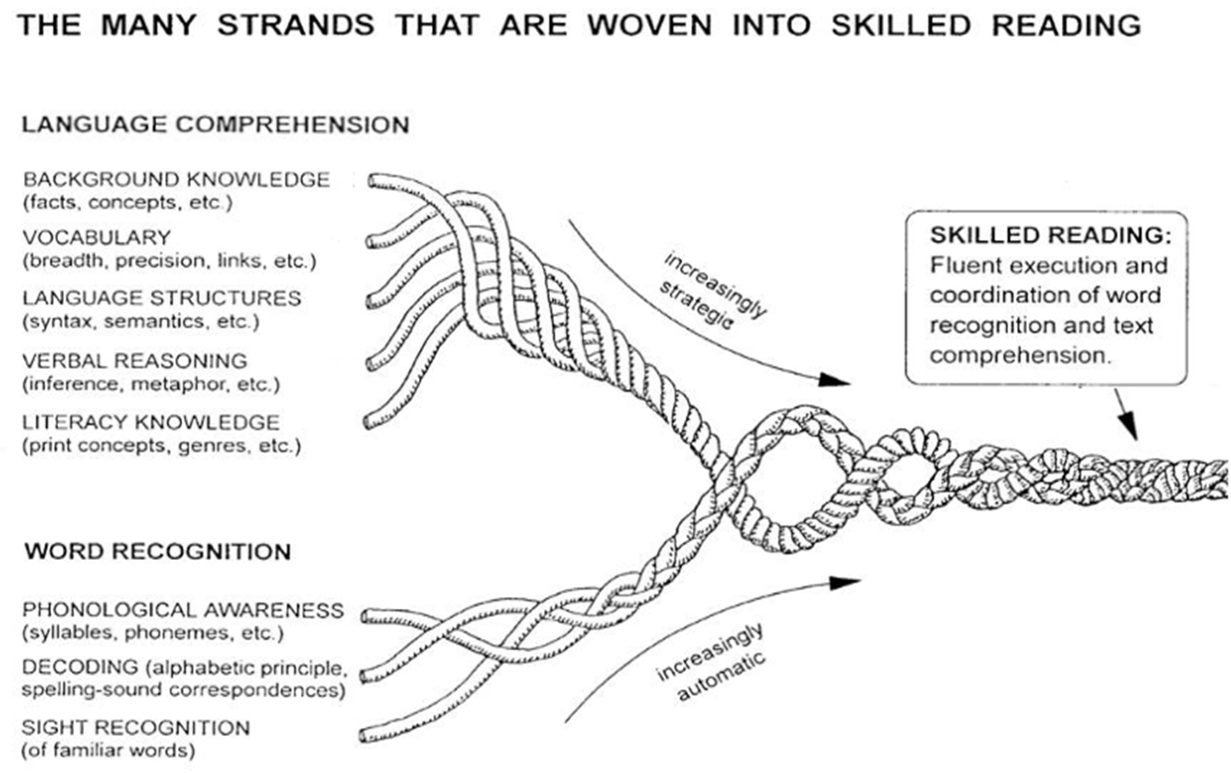
Session 3: Fluency
Scarborough, 2001
Notes:
Facilitator Narration:
To start, let’s again look at Scarborough’s Reading Rope, which shows how different skills come together to make a strong reader. Today, we’re focusing on sight recognition—being able to recognize words instantly—and fluency, which means reading smoothly and with expression.
These skills work together to help children move from just reading words to actually understanding what they read. At home, you can support your child by practicing sight words, reading together, and encouraging smooth, expressive reading.
By the end of this session, you’ll understand not just what sight recognition and fluency are, but also simple ways to help your child become a confident reader who truly comprehends and enjoys reading texts.

Slide 4
Text Version: Scarborough’s Reading Rope
The many strands that are woven into skilled reading.
The Reading Rope consists of lower and upper strands. The word-recognition strands (phonological awareness, decoding, and sight recognition of familiar words) work together as the reader becomes accurate, fluent, and increasingly automatic with repetition and practice.
Language Comprehension (Upper Strands):
Strands include:
Background knowledge (facts, concepts, etc.)
Vocabulary (breadth, precision, links, etc.)
Language structures (syntax, semantics, etc.)
Verbal reasoning (inference, metaphor, etc.)
Literacy knowledge (print concepts, genres, etc.)
Word Recognition (Lower Strands)
Strands include:
Phonological awareness (syllable, phonemes, etc.).
Decoding (alphabetic principle, spelling-sound correspondences
Sight recognition (of familiar words).
Skilled Reading:
Language comprehension becomes increasingly strategic and word recognition becomes increasingly automatic in the progression to becoming a skilled reader.
A skilled reader displays fluent execution and coordination of word recognition and text comprehension.

Slide 5
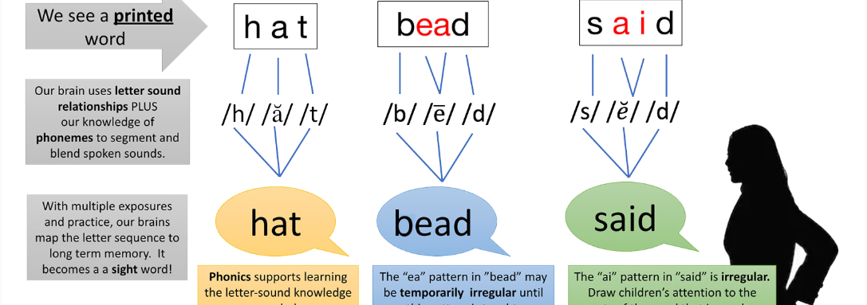
Sight Recognition & Orthographic Mapping (1 of 4)
Building Sight Recognition through Phonics & Word Analysis Instruction
Copyright © 2026 WETA Washington, D.C.
Notes:
Facilitator Narration:
As children practice reading and spelling, they start to recognize many words instantly—this is called sight recognition. This builds on the skills you’ve already learned about: phonological awareness, phonics, and decoding, which give children the tools to break words into sounds and spell them.
Behind the scenes, their brains link the letters of words to their sounds and meanings, essentially mapping out the process in their minds, a process called orthographic mapping.

Slide 6
Text Version: Decoding Diagram
Building Sight Recognition through Phonics & Word Analysis Instruction
We see a printed word. (examples: hat, bead, said)
Our brain users letter sound relationships plus our knowledge of phonemes to segment and blend spoken sounds. Examples: /h/ /ă/ /t/ for hat, /b/ /ē/ /d/ for bead and /s/ /ĕ/ /d/ for said.
With multiple exposures and practice, our brains map the letter sequence to long-term memory. It becomes a sight word!
Notes:
Hat: phonics supports learning the letter-sound knowledge needed.
Bead: the “ea” pattern in “bead” may be temporarily irregular until this pattern is taught.
Said: the “ai” pattern in “said” is irregular. Draw children’s attention to the parts of the word that are regular.
Notes:
Facilitator Narration:
As children practice reading and spelling, they start to recognize many words instantly—this is called sight recognition. This builds on the skills you’ve already learned about: phonological awareness, phonics, and decoding, which give children the tools to break words into sounds and spell them.
Behind the scenes, their brains link the letters of words to their sounds and meanings, essentially mapping out the process in their minds, a process called orthographic mapping.

Slide 7
Sight Recognition & Orthographic Mapping (2 of 4)
Building Sight Recognition through Phonics & Word Analysis Instruction
hat
We see a printed word
Notes:
Facilitator Narration:
Let’s take a look at an example. A student sees the letters in the word, “hat.” “H” “A” and “T.”

Slide 8
Sight Recognition & Orthographic Mapping (3 of 4)
Building Sight Recognition through Phonics & Word Analysis Instruction
We see a printed word
hat
Our brain users letter sound relationships plus our knowledge of phonemes to segment and blend spoken sounds
/h/ /ă/ /t/
Notes:
Facilitator Narration:
Next, behind the scenes in the student’s brain, they break down the letters they see in the word, “hat,” into phonemes, or spoken sounds /h/ /a/ /t/ to read the word.

Slide 9
Sight Recognition & Orthographic Mapping (4 of 4)
Building Sight Recognition through Phonics & Word Analysis Instruction
We see a printed word
hat
Our brain users letter sound relationships plus our knowledge of phonemes to segment and blend spoken sounds
/h/ /ă/ /t/
With multiple exposures and practice, our brains map the letter sequence to long-term memory. It becomes a sight word!
hat
Phonics supports learning the letter-sound knowledge needed
Notes:
Facilitator Narration:
Finally, after multiple exposures to seeing the word “hat,” the student’s brain moves the map into their long-term memory, so that now when they see the letters “h” “a” “t”, in that order, they know it is the word “hat” without having to decode the word first.
Phonics instruction helps children make these connections by teaching spelling patterns and letter-sound relationships in a step-by-step way. Over time, this makes reading faster, easier, and more confident, helping children focus on understanding what they read. When children spend less time trying to read the word, they can devote more time and mental energy to creating meaning.

Slide 10
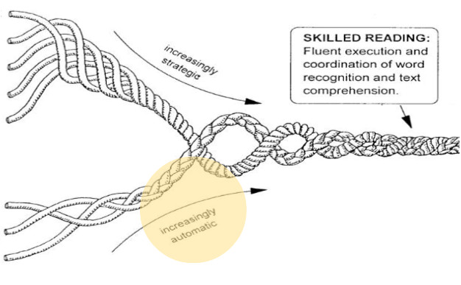
Session 3- Fluency
The many strands that are woven into skilled reading
Language Comprehension
Background knowledge (facts, concepts, etc.)
Vocabulary (breadth, precision, links, etc.)
Language structures (syntax, semantics, etc.)
Verbal reasoning (inference, metaphor, etc.
Literacy knowledge (print concepts, genres, etc.)
Word Recognition
Phonological awareness (syllable, phonemes, etc.)
Decoding (alphabetic principle, spelling-sound correspondences
Sight recognition (of familiar words)
Scarborough, 2001
Notes:
Facilitator Narration:
As children practice reading, the skills we’ve talked about—phonemic awareness, decoding, and sight recognition—start to become automatic. When this happens, they can read words accurately and quickly without stopping to sound them out.
This growing automaticity at the word level is what we call reading fluency. Fluency is important because it allows children to focus on understanding the story or information, rather than just figuring out each word. As you can see on Scarborough’s Reading Rope, these word recognition skills are tightly connected to comprehension, helping children become confident, skilled readers.

Slide 11
High-Frequency Words vs. Sight Words
High-Frequency Words | Sight Words
High-frequency words are those that researchers, through counting and analysis, have determined appear most often in written language. | Sight words are any words we can recognize instantly and automatically, without needing to decode or work them out.
Notes:
Facilitator Narration:
One item to note is the difference between high-frequency words and sight words. You may hear your child’s teachers reference these terms when discussing increasing automaticity.
High-frequency words are regularly and irregularly spelled words that are most often included in English texts. Memorizing high-frequency word lists does not lead to sight vocabulary if not connected with phonics and phonemic awareness instruction.
Irregular (or trick) words are words that have unpredictable features with some decodable sounds. Readers can use phonics to decode most of an irregular word and memorize the irregular features. Some words are irregular until the spelling pattern is taught.
On the other hand, the terms sight words or sight vocabulary refer to a student’s bank of regularly and irregularly spelled words that are instantly and effortlessly recognized.
Readers with proficient decoding skills accumulate a more robust sight vocabulary quicker than readers with underdeveloped and inaccurate decoding skills.

Slide 12
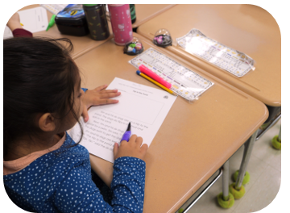
In the Classroom
Carefully ordered scope and sequence of skills
Letter-sound correspondence automaticity
Word-level reading fluency
Decodable, connected text and repeated reading practice
Volume of reading and exposure to texts to build word recognition and comprehension skills simultaneously
Notes:
In school, fluency helps children move from reading words to understanding what they read. In the classroom, teachers use structured lessons to build word recognition and accuracy first, then practice reading words quickly and smoothly.
Students read and reread decodable texts containing words with previously learned phonics patterns, helping readers decode words and build fluency. Children are introduced to slightly more challenging texts when they become successful with phonics patterns. Reading a variety of texts—both in lessons and independently—helps children notice patterns, vocabulary, and meaning, so they become confident, fluent readers who understand what they read.

Slide 13

Questions to Ask Your Child’s Teacher
How does my child practice reading words accurately and automatically in the classroom?
What strategies are used to help my child read connected text with proper expression and phrasing?
How do you choose texts for fluency practice to make sure they are just right for my child?
How can I support my child’s fluency and comprehension at home with reading and repeated practice?
Notes:
Facilitator Narration:
As families, you play an important role in supporting your child’s reading. Here are some questions you might ask your child’s teacher to better understand how fluency and comprehension are being developed in the classroom:
How does my child practice reading words accurately and automatically?
What strategies are used to help my child read connected text with proper expression and phrasing?
How do you choose texts for fluency practice to make sure they are just right for my child?
How can I support my child’s fluency and comprehension at home with reading and repeated practice?
Asking these questions gives you insight into your child’s reading instruction and helps you know how to reinforce these skills at home in fun and meaningful ways.

Slide 14

How You Can Help Your Child at Home (1 of 2)
Listen to your child read aloud
Encourage them to read smoothly, accurately, and with expression.
Practice repeated reading
Have your child reread favorite books or passages to build speed and confidence.
Model phrasing and expression
Read aloud together and demonstrate how to group words into meaningful phrases.
Provide a variety of texts
Offer books on different topics and genres, and talk about vocabulary, themes, and meaning to strengthen comprehension.
Notes:
Facilitator Narration:
There are simple ways you can help your child build fluent reading at home:
Listen to your child read aloud and encourage them to read smoothly, accurately, and with expression.
Have your child reread favorite books or passages—this repeated practice helps them read faster and with more confidence.
Model how to group words into meaningful phrases and read with expression when you read together.
Offer a variety of books and talk about the words, themes, and ideas, so your child can understand and enjoy what they’re reading.
These small, fun activities make a big difference in helping your child become a confident, fluent reader who can understand and enjoy stories and information.

Slide 15
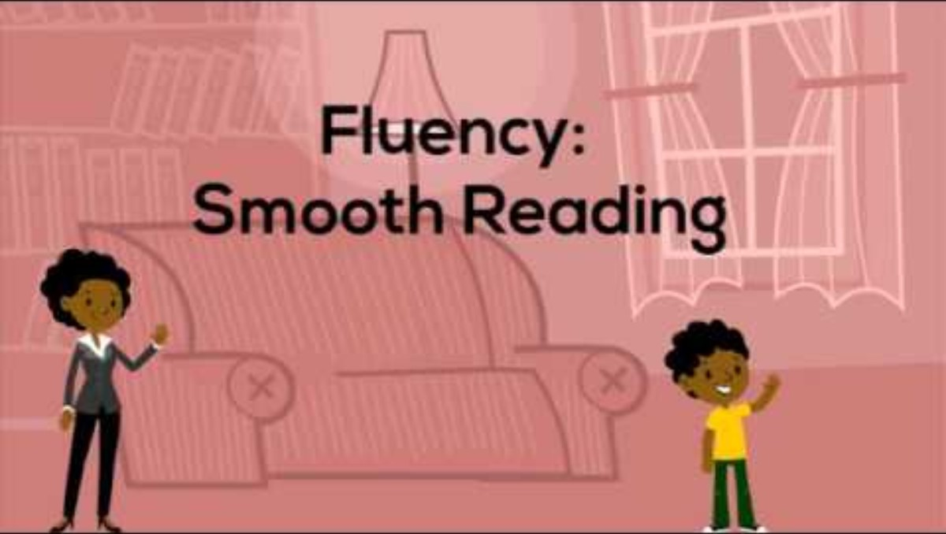
Fluency at Home
Fluency: Smooth Reading (Read by 4th)
Notes:
Facilitator Narration:
Here is an example of what this can look like at home. In this video from Philadelphia's Read by 4th organization, we see a parent and child practice reading smoothly and fluently.
Facilitator Note: Play the video.
Facilitator Narration:
What did you notice in the video? What questions did the parent ask?
Possible responses:
What is your favorite book?
What is it about?
What is your favorite part of the story?
What feedback did the parent give the child?
Possible responses:
You are a good reader.
You fix your mistakes.
You really practiced.
You are a fluent reader that reads with expression.
Asking questions and providing positive feedback help support reading fluency and comprehension.
Facilitator Note: This video is from Philadelphia's Read by 4th's Parent Workshop on Early Reading Skills (https://www.readby4th.org/initiatives-family/parent-workshop-early-reading-skills). It is 3 minutes and 31 seconds long and includes sound. If this video is shared virtually, ensure that the computer's audio is shared on the virtual meeting platform. If the video is shared in-person, consider utilizing a speaker to amplify the sound.

Slide 16


How You Can Help Your Child at Home (2 of 2)
Fluency: Activities for Your Kindergartener
"Reading fluency is a child's ability to read a book or other text accurately, with reasonable speed, and with appropriate expression. A fluent reader doesn't have to stop and "decode" each word and can focus attention on what the story or text means. Fluency is the bridge between decoding words and understanding what has been read!" - Redingrockets.org
Notes:
Facilitator Narration
Additional ideas, activities, directions, and examples can be found on Reading Rockets website. The QR code is linked to the Kindergarten page. Activities for other age and grade levels are accessible from the Reading 101: A Guide for Parents menu.
Facilitator Note: Link to resource: https://www.readingrockets.org/literacy-home/reading-101-guide-parents/your-kindergartener/fluency-activities

Slide 17

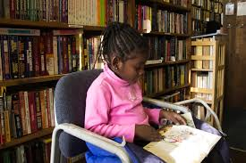
In Closing
Reading 101 for Parents: Fluency
"Fluency is a child's ability to read a book or other text with accuracy, at a reasonable rate, and with appropriate expression. Reading fluency is important because it provides a bridge between word recognition and comprehension." - Readingrockets.org
Notes:
In closing, we hope that you have enjoyed this session. To solidify your learning, we recommend reading this article from Reading Rockets: Reading 101 series for Parents prior to our next session. The resource is linked to the QR code on the screen.
Facilitator Note: link to resource: https://www.readingrockets.org/literacy-home/reading-101-guide-parents/reading-basics/fluency

Slide 18
References (1 of 2)
Butler, K. (2025, April 23). What Is Fluency? Reading Universe. Retrieved September 1, 2025, from https://readinguniverse.org/article/explore-teaching-topics/fluency/what-is-fluency
Philadelphia's Read by 4th. (n.d.). Fluency: smooth reading [Video]. https://www.youtube.com/watch?v=THUsj_Cuj6Q
Reading Rockets. (n.d.). Basics: Sight words and orthographic mapping. Retrieved December 10, 2025, from https://www.readingrockets.org/reading-101/reading-and-writing-basics/sight-words-and-orthographic-mapping
Reading Rockets. (n.d.). Fluency. Retrieved September 1, 2025, from https://www.readingrockets.org/reading-101/reading-and-writing-basics/fluency

Slide 19
References (2 of 2)
Reading Rockets. (n.d.). Fluency: Activities for your kindergartener. Retrieved December 10, 2025, from https://www.readingrockets.org/literacy-home/reading-101-guide-parents/your-kindergartener/fluency-activities
Reading Rockets. (n.d.). Reading 101 for Parents: Fluency. Retrieved December 10, 2025, from https://www.readingrockets.org/literacy-home/reading-101-guide-parents/reading-basics/fluency
Scarborough, H. S. (2001). Connecting early language and literacy to later reading (dis)abilities: Evidence, theory, and practice. In S. Neuman & D. Dickinson (Eds.), Handbook for research in early literacy (pp. 97–110). New York: Guilford Press.

Slide 20
Follow the New Jersey Department of Education
Facebook
@njdeptofed
X
@newjerseydoe
Instagram
@newjerseydoe
LinkedIn
New Jersey Department of Education
nj.gov/education
Threads
@newjerseydoe
YouTube
@newjerseydepartmentofeduca6565

