Slide 1
LEARning about Literacy for Families Series
Series Introduction
Office of Learning Equity & Academic Recovery (LEAR)
2026
nj.gov/education/lear
Notes:
Facilitator Narration:
Welcome to the LEARning about Literacy for Families series from the New Jersey Department of Education’s Office of Learning Equity and Academy Recovery, or LEAR. LEAR was established in August 2024 to transform New Jersey’s approach to literacy instruction and advance academic recovery.
Along with the LEAR office, a Working Group on Student Literacy was created to make recommendations on best practices and evidence-based strategies to help all children learn. Through the group’s research, it was determined that states that mirrored the language and formats used with teachers successfully communicated information about early literacy learning to families. As a result, one of the group's recommendations was to develop clear, accessible information for families to support aligned language around early literacy development. In response to this recommendation, the LEAR office created this series for parents, families, and caregivers, providing research and information on early literacy, along with practical applications and activities they can do with their children at home.
For more information about LEAR and the New Jersey Department of Education, visit the link on the screen.
Facilitator Note: Hide this slide if this is not the first session you are facilitating with this group.

Slide 2
LEARning about Literacy for Families Series
Session 4: Background Knowledge
Office of Learning Equity & Academic Recovery
2026
nj.gov/education/lear
Notes:
Facilitator Narration:
Welcome! We’re so glad you could join us for this session in the LEARning about Literacy for Families series. This session will focus on the importance of background knowledge in skilled reading and is designed to support New Jersey families as you help your children grow as confident readers at home.

Slide 3
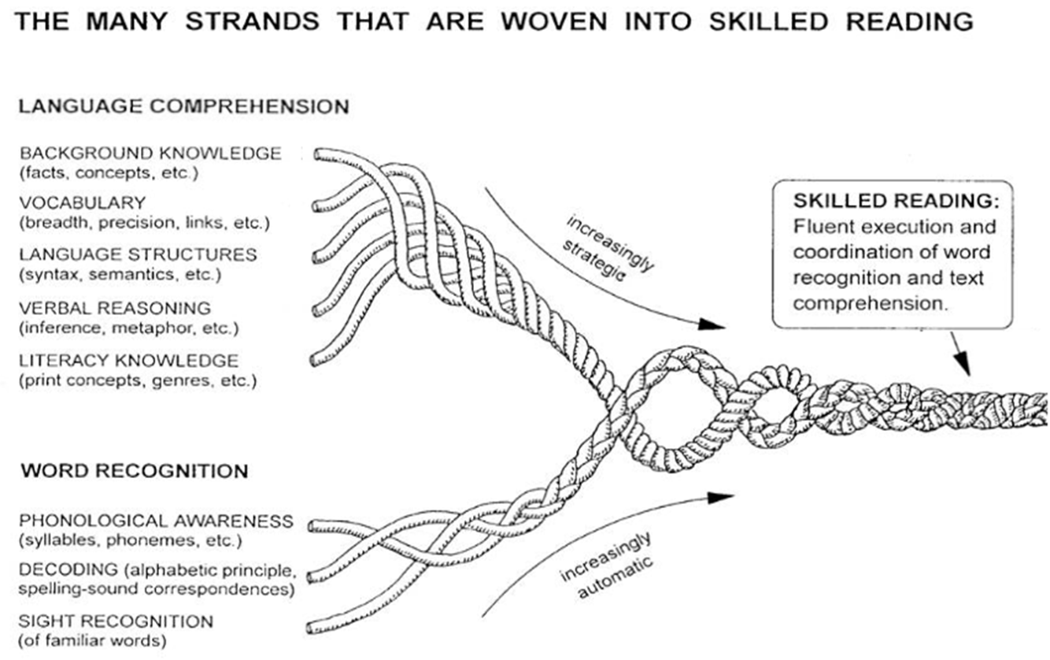

Session 4: Background Knowledge
Scarborough, 2001
Notes:
Facilitator Narration:
Referring back to our conceptual framework for skilled reading, Scarborough’s Reading Rope, let’s spend some time exploring the role of background knowledge in reading comprehension. Background knowledge is the existing information, experiences, and understanding a child has about a topic.

Slide 4
Text Version: Scarborough’s Reading Rope
The many strands that are woven into skilled reading.
The Reading Rope consists of lower and upper strands. The word-recognition strands (phonological awareness, decoding, and sight recognition of familiar words) work together as the reader becomes accurate, fluent, and increasingly automatic with repetition and practice.
Language Comprehension (Upper Strands):
Strands include:
Background knowledge (facts, concepts, etc.)
Vocabulary (breadth, precision, links, etc.)
Language structures (syntax, semantics, etc.)
Verbal reasoning (inference, metaphor, etc.)
Literacy knowledge (print concepts, genres, etc.)
Word Recognition (Lower Strands)
Strands include:
Phonological awareness (syllable, phonemes, etc.).
Decoding (alphabetic principle, spelling-sound correspondences
Sight recognition (of familiar words).
Skilled Reading:
Language comprehension becomes increasingly strategic and word recognition becomes increasingly automatic in the progression to becoming a skilled reader.
A skilled reader displays fluent execution and coordination of word recognition and text comprehension.

Slide 5
Why Background Knowledge Matters
Helps children understand what they read
Knowing about a topic makes it easier to make sense of new information.
Supports comprehension
The more children know, the better they can connect ideas and follow the story or information.
Builds confidence and engagement
Children are more motivated to read when they recognize concepts and vocabulary.
Strengthens connections across texts
Background knowledge allows children to link new reading to prior learning, other books, and real-life experiences.
Notes:
Facilitator Narration:
When children read, they aren’t just figuring out words—they’re trying to understand ideas and stories. Background knowledge is what they already know about a topic, and it is the foundation for learning new material. It evolves through life experiences, formal education, reading, and conversations. Having background knowledge about a topic can make reading a new text much easier.
For example, if a child knows a lot about farms, reading a story about farm animals will make more sense and be more enjoyable. Background knowledge helps children connect ideas, follow the story, and even recognize new words more quickly.
By supporting your child’s knowledge about different topics—through conversation, reading together, or exploring new experiences—you’re helping them become a confident, skilled reader who can truly understand and enjoy what they read.

Slide 6
The ABCs of Background Knowledge (1 of 2)
Activate and Assess | Build | Connect
A- Activate & Assess: Ask your child what they already know about the topic before reading. | B- Build: Share new information through books, videos, experiences, and conversations to strengthen understanding. | C- Connect: Help your child link what they learned to other books, experiences, and school topics.
Notes:
Facilitator Narration:
When children read, their understanding of a story or text is strongly influenced by what they already know about the topic. This “background knowledge” helps them make sense of new ideas, connect details, and fully understand what they’re reading.
Reading expert Nancy Hennessy developed something called the ABCs of Background Knowledge to help teachers—and families—think about how to support kids in this area before, during, and after reading. The ABCs stand for:
A – Activate and Assess: Help your child think about what they already know before reading to help build context. For example, if the story is about animals on a farm, you might ask, “What do you already know about cows or chickens?”
B – Build: If your child doesn’t know much about the topic, you can build their knowledge to help make connections and clarify meaning. You might read a short nonfiction book together, watch a short video, or share information in kid-friendly language.
C – Connect: After reading, encourage your child to connect what they learned to something else—another book, an experience they’ve had, or something they’re learning in school to help deepen their understanding.
By activating, building, and connecting knowledge, children have a stronger foundation for comprehension. As parents, you can support this by asking questions, talking about experiences, and helping your child see connections between what they already know and what they are reading.

Slide 7
The ABCs of Background Knowledge (2 of 2)
Story: Animals on a Farm
Activate & Assess | Build | Connect
Notes:
Facilitator Narration:
Let’s spend a few minutes brainstorming some ideas for the ABCs of Background Knowledge.
Facilitator Note: As participants respond, record ideas in the table on the slide or on chart paper.
A – Activate and Assess: Staying with the story topic: animals on a farm, what are some questions we might ask a child to help activate their prior knowledge and build context?
Sample responses:
What kinds of animals might you find on a farm?
What do you already know about those animals?
Why are farms important?
B – Build: While reading the story, what are some things we could do to help students make connections and clarify meaning?
Sample responses:
Watch a video.
Visit a farm.
Read a related book or story.
C – Connect: After reading the story, what are some ways that we could help connect and deepen children’s understanding?
Sample responses:
Connect the story with some topics students have learned about in science, such as the life cycle or plant growth stages.
Read a book on a similar topic.
Relate the book to a shared experience.
These activities and ideas help students build background knowledge about farm animals. When students have a strong understanding of a topic, it becomes easier for them to read about it, make sense of the information, and remember what they’ve learned.

Slide 8
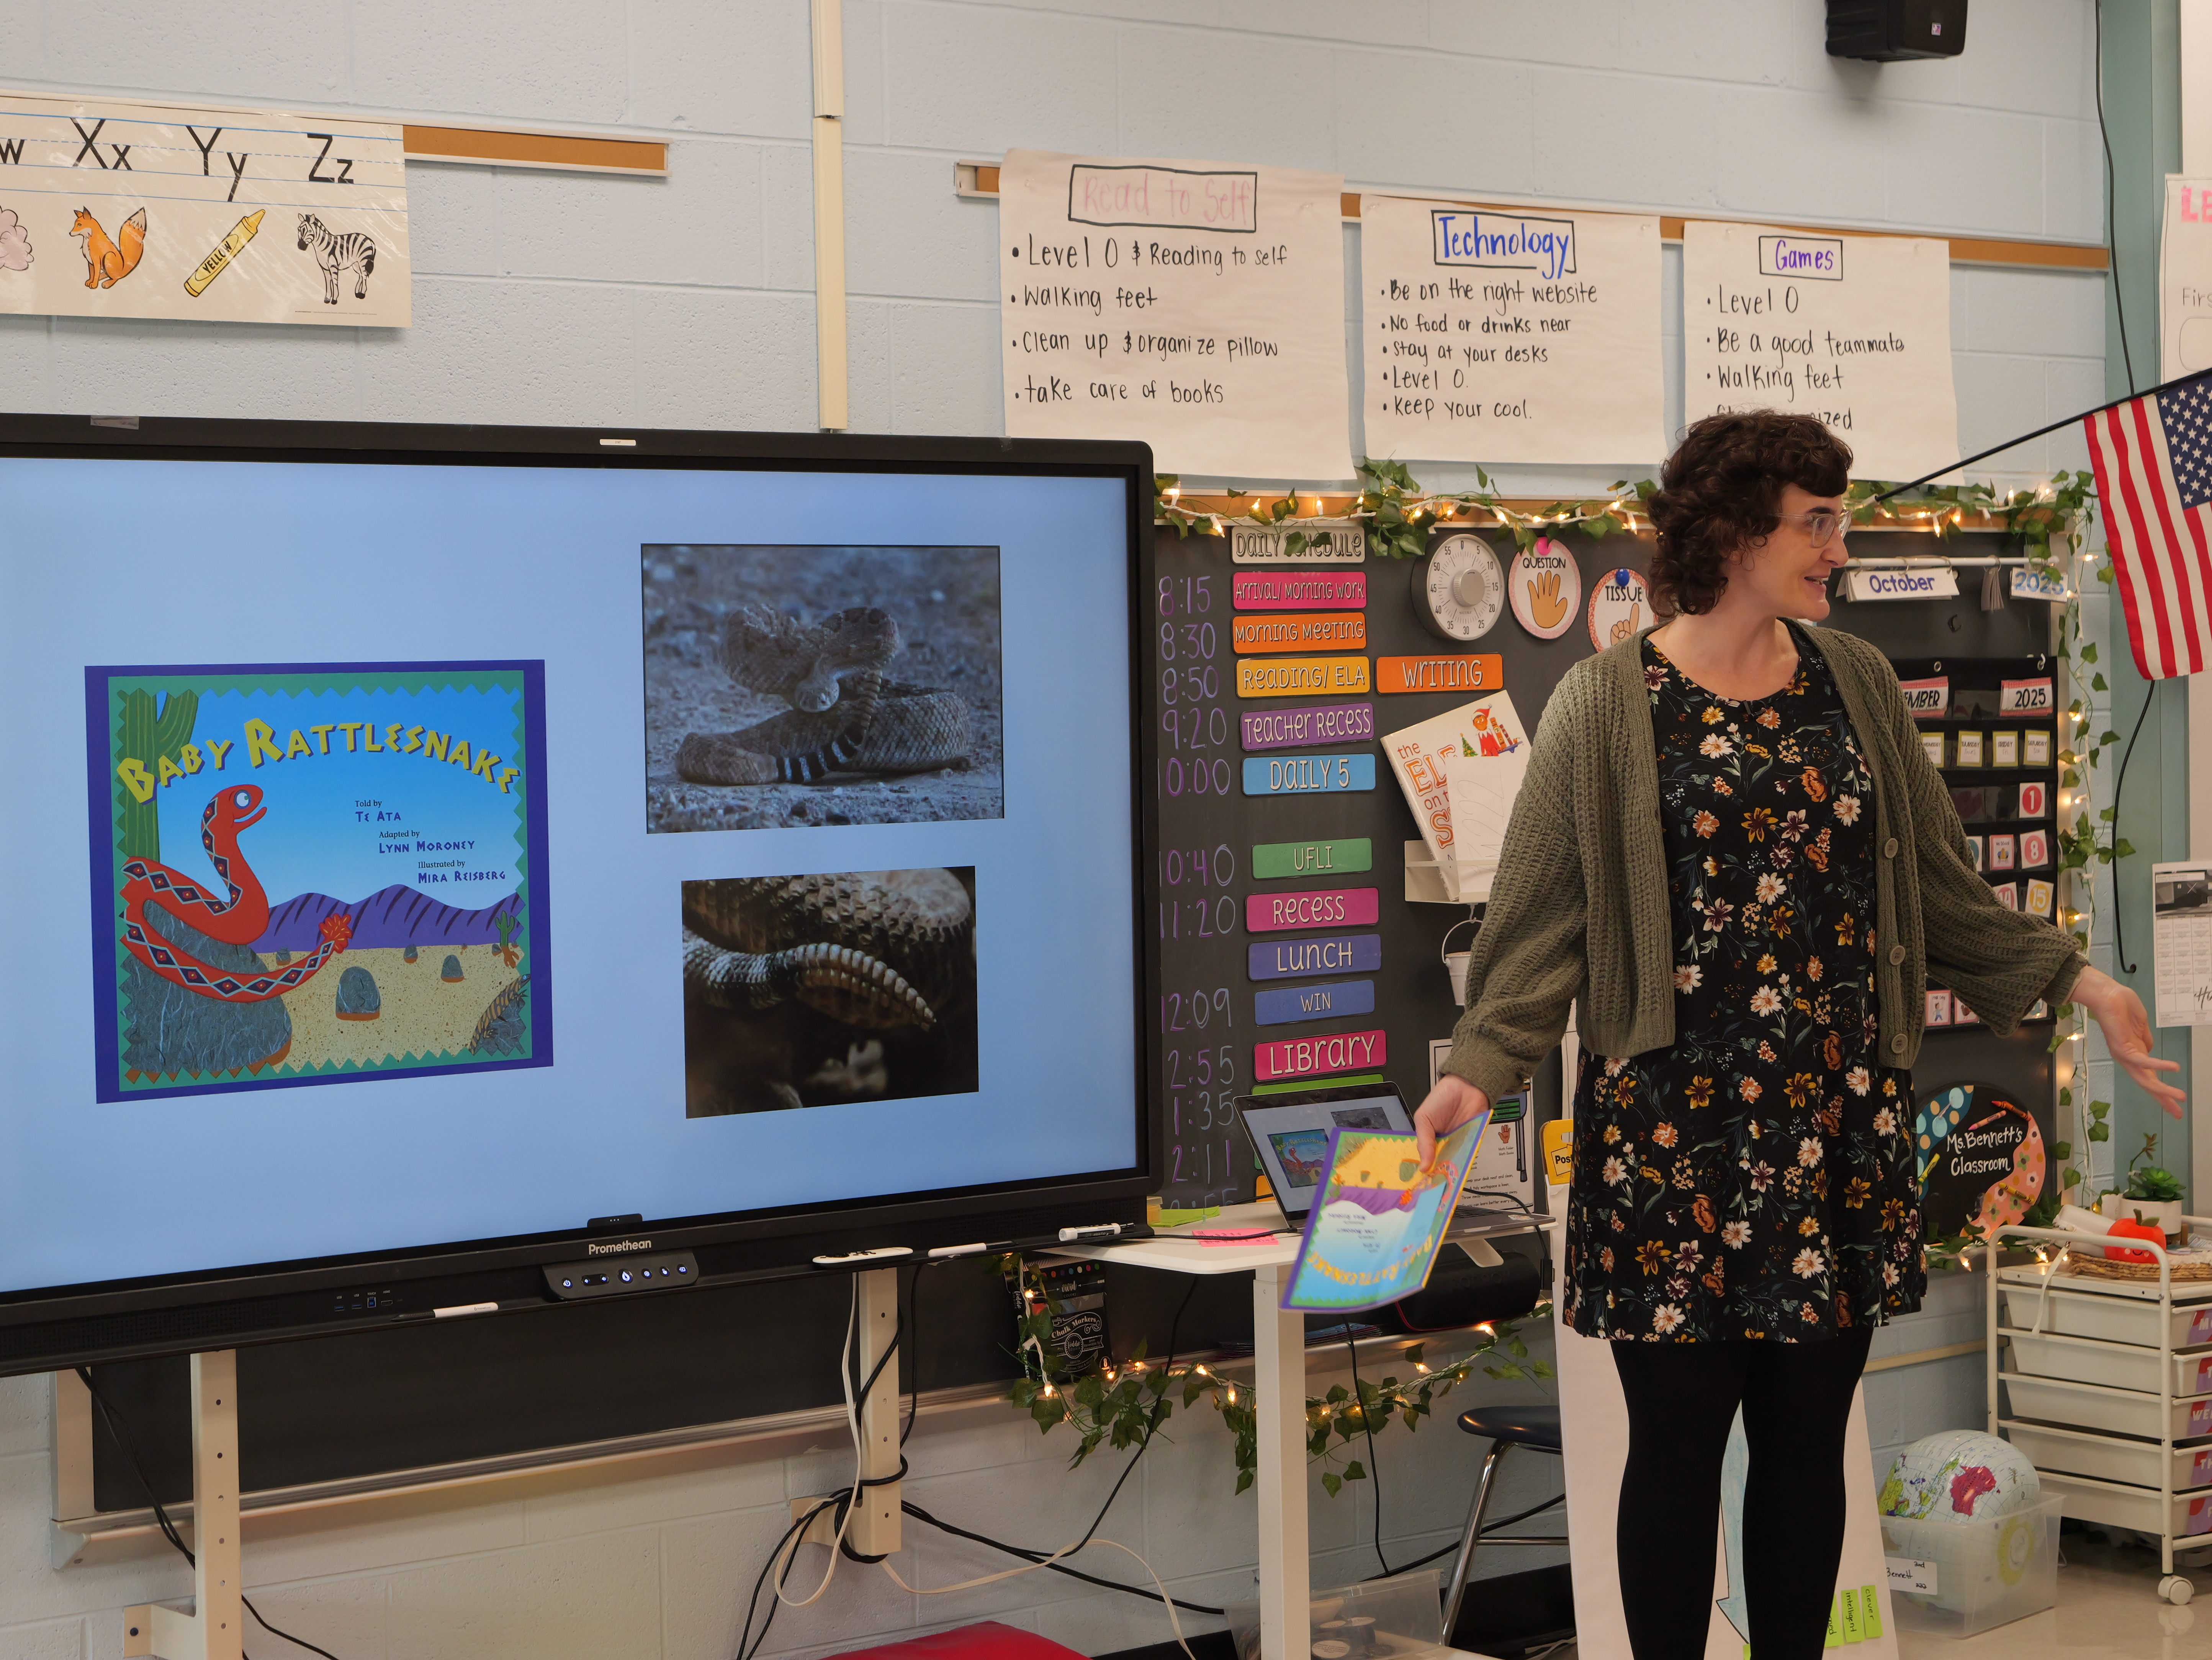
In the Classroom
Teachers introduce and explain key ideas or concepts before reading a text.
Students discuss what they already know and ask questions about the topic.
Teachers use books, videos, or hands-on activities to add new information.
Students make connections between the text and their own experiences or other things they have learned.
Notes:
Facilitator Narration:
In the classroom, teachers help children understand new topics by building their background knowledge before and during reading. This might look like introducing key ideas or concepts before a story, discussing what students already know, and asking questions about the topic.
Teachers may also use books, videos, or hands-on activities to give students more information and encourage them to make connections to their own experiences or other things they have learned. By doing this, students are better prepared to understand and enjoy what they read.

Slide 9

Questions to Ask Your Child’s Teacher
How do you help students understand key ideas or concepts before, during, and after reading a text?
What activities or resources are used to build students’ background knowledge on different topics?
How are students encouraged to connect what they already know to new reading material?
How can I support my child at home to build knowledge about topics they will read in school?
Notes:
Facilitator Narration:
As families, you can play an important role in supporting your child’s understanding of what they read. Here are some questions you might ask your child’s teacher:
How do you help students understand key ideas or concepts before reading a text?
What activities or resources are used to build students’ background knowledge on different topics?
How are students encouraged to connect what they already know to new reading material?
How can I support my child at home to build knowledge about topics they will read in school?
Asking these questions gives you a clear picture of how your child is learning, and helps you know ways to reinforce and extend that learning at home.

Slide 10

How You Can Help Your Child at Home (1 of 2)
Talk about topics together
Discuss new ideas or concepts your child will read about in school.
Read a variety of books
Include nonfiction and fiction on different subjects to broaden knowledge.
Use real-life experiences
Explore museums, nature, or everyday experiences to connect learning to the world.
Ask and answer questions
Encourage your child to ask questions about what they’re reading and help them find answers.
Notes:
Facilitator Narration:
There are simple, fun ways you can help your child build background knowledge at home:
Talk about topics together. Before or after reading, discuss new ideas or concepts your child is learning in school.
Read a variety of books. Include both nonfiction and fiction to broaden your child’s knowledge about different subjects.
Use real-life experiences. Trips to museums, exploring nature, or everyday experiences can all connect learning to the real world.
Ask and answer questions. Encourage your child to ask questions about what they’re reading and help them find answers.
These activities help your child understand new reading material more easily and make learning more meaningful and engaging.

Slide 11
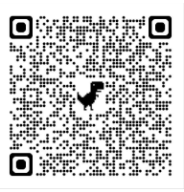
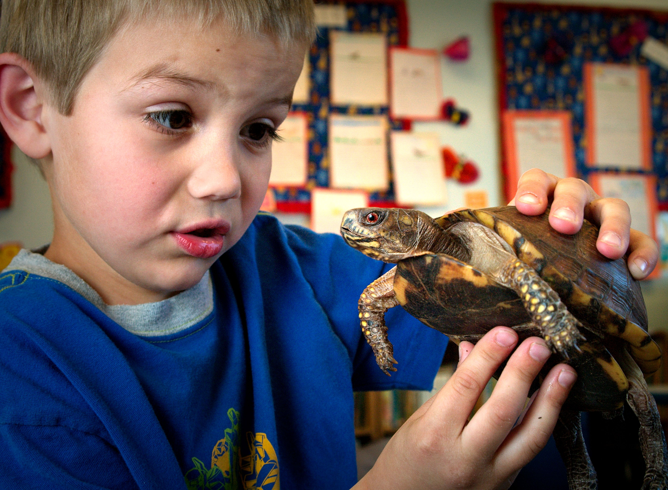
How You Can Help Your Child at Home (2 of 2)
Building Background Knowledge
By: Susan Neuman, Tanya Kaefer, Ashley Pinkham
"To comprehend a story or text, young readers need a threshold of knowledge about the topic, and tougher state standards place increasing demands on children's prior knowledge. This article offers practical classroom strategies to build background knowledge such as using contrasts and comparisons and encouraging topic-focused wide reading."
Notes:
Facilitator Narration
Additional ideas, activities, directions, and examples can be found on Reading Rockets website. The QR code is linked to an article that includes activities that can be implemented at home to support building background knowledge, like grouping words into categories (for example, strawberries, bananas, and papayas are all types of fruit), using comparison and contrasts (Is a tomato a fruit? Why or why not?), and finally embracing multimedia.
Facilitator Note: Link to resource: https://www.readingrockets.org/topics/background-knowledge/articles/building-background-knowledge

Slide 12
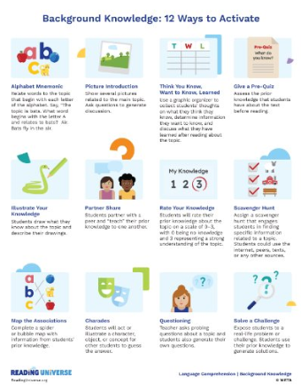
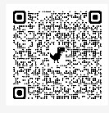
In Closing
12 Ways to Activate Background Knowledge
Notes:
Facilitator Narration:
In closing, we hope that you have enjoyed this session. To reinforce your learning, we recommend reviewing this resource from Reading Universe prior to our next session. The resource is linked to the QR code on the screen.
Facilitator Note: Link to resource: https://readinguniverse.org/resources/pdf/building-student-knowledge/knowledge-skill-explainer/12-ways-to-activate-background-knowledge

Slide 13
References
Hennessy, N. L. (2020). The reading comprehension blueprint: Helping students make meaning from text. Paul H. Brookes Publishing Co.
Neuman, S., Kaefer, T., & Pinkham, A. (n.d.). Building background knowledge. Reading Rockets. https://www.readingrockets.org/topics/background-knowledge/articles/building-background-knowledge
Reading Rockets. (n.d.). Reading 101 for parents: comprehension. Retrieved September 1, 2025, from https://www.readingrockets.org/literacy-home/reading-101-guide-parents/reading-basics/comprehension
Reading Universe. (2023, April 17). 12 Ways to activate Background Knowledge. Retrieved September 1, 2025, from https://readinguniverse.org/resources/pdf/building-student-knowledge/knowledge-skill-explainer/12-ways-to-activate-background-knowledge
Scarborough, H. S. (2001). Connecting early language and literacy to later reading (dis)abilities: Evidence, theory, and practice. In S. Neuman & D. Dickinson (Eds.), Handbook for research in early literacy (pp. 97–110). New York: Guilford Press.

Slide 14
Follow the New Jersey Department of Education
Facebook
@njdeptofed
X
@newjerseydoe
Instagram
@newjerseydoe
LinkedIn
New Jersey Department of Education
nj.gov/education
Threads
@newjerseydoe
YouTube
@newjerseydepartmentofeduca6565

