Slide 1
LEARning about Literacy for Families Series
Series Introduction
Office of Learning Equity & Academic Recovery (LEAR)
2026
nj.gov/education/lear
Notes:
Facilitator Narration:
Welcome to the LEARning about Literacy for Families series from the New Jersey Department of Education’s Office of Learning Equity and Academy Recovery, or LEAR. LEAR was established in August 2024 to transform New Jersey’s approach to literacy instruction and advance academic recovery.
Along with the LEAR office, a Working Group on Student Literacy was created to make recommendations on best practices and evidence-based strategies to help all children learn. Through the group’s research, it was determined that states that mirrored the language and formats used with teachers successfully communicated information about early literacy learning to families. As a result, one of the group's recommendations was to develop clear, accessible information for families to support aligned language around early literacy development. In response to this recommendation, the LEAR office created this series for parents, families, and caregivers, providing research and information on early literacy, along with practical applications and activities they can do with their children at home.
For more information about LEAR and the New Jersey Department of Education, visit the link on the screen.
Facilitator Note: Hide this slide if this is not the first session you are facilitating with this group.

Slide 2
LEARning about Literacy for Families Series
Session 5: Vocabulary
Office of Learning Equity & Academic Recovery
2026
nj.gov/education/lear
Notes:
Facilitator Narration:
Welcome! We’re so glad you could join us for this session in the LEARning about Literacy for Families series. This session will focus on vocabulary and is designed to support New Jersey families as you help your children grow as confident readers at home.

Slide 3
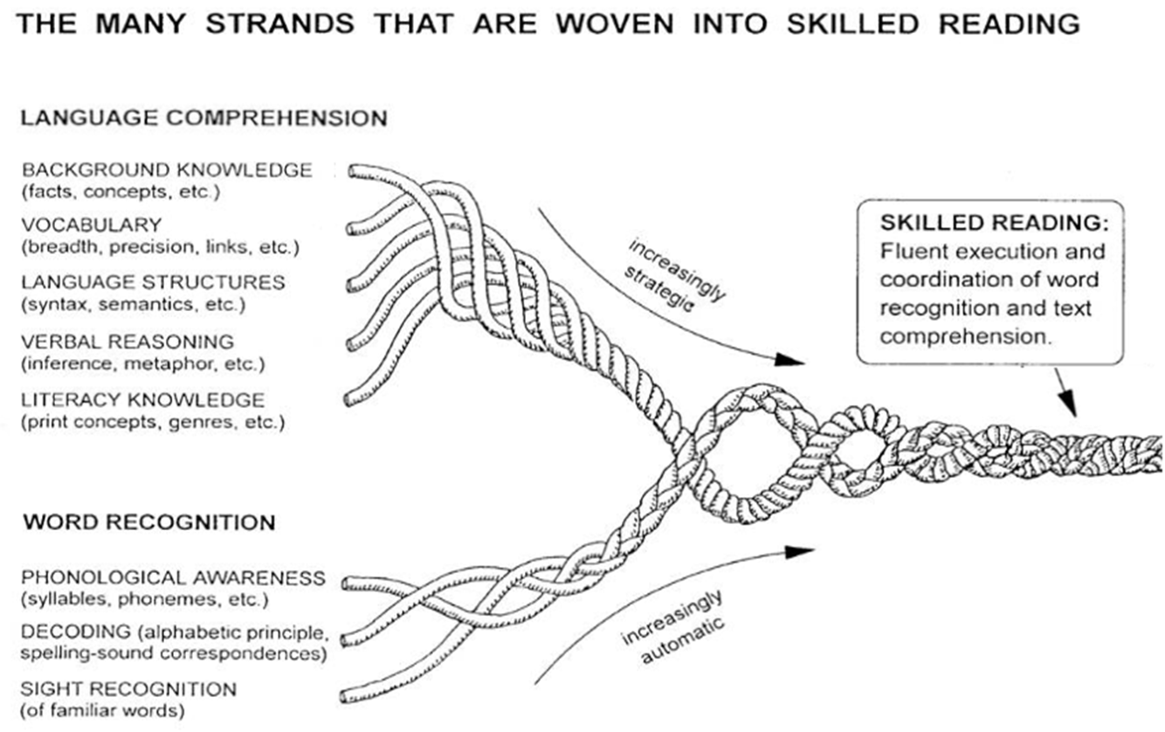
Session 5: Vocabulary
Scarborough, 2001
Notes:
Facilitator Narration:
As always, we are starting with our conceptual framework for skilled reading: Scarborough’s Reading Rope. Today’s session will explore the role of vocabulary in reading comprehension.

Slide 4
Text Version: Scarborough’s Reading Rope
The many strands that are woven into skilled reading.
The Reading Rope consists of lower and upper strands. The word-recognition strands (phonological awareness, decoding, and sight recognition of familiar words) work together as the reader becomes accurate, fluent, and increasingly automatic with repetition and practice.
Language Comprehension (Upper Strands):
Strands include:
Background knowledge (facts, concepts, etc.)
Vocabulary (breadth, precision, links, etc.)
Language structures (syntax, semantics, etc.)
Verbal reasoning (inference, metaphor, etc.)
Literacy knowledge (print concepts, genres, etc.)
Word Recognition (Lower Strands)
Strands include:
Phonological awareness (syllable, phonemes, etc.).
Decoding (alphabetic principle, spelling-sound correspondences
Sight recognition (of familiar words).
Skilled Reading:
Language comprehension becomes increasingly strategic and word recognition becomes increasingly automatic in the progression to becoming a skilled reader.
A skilled reader displays fluent execution and coordination of word recognition and text comprehension.

Slide 5
The Importance of Vocabulary
Knowing words helps kids understand what they read.
Children with strong vocabulary tend to do better at reading and understanding stories and information later on.
Repeated exposure to words makes learning easier.
Seeing, hearing, and using a word many times helps children understand its meaning more deeply and remember it more easily.
Understanding most words in a text is important.
Kids usually need to know about 9 or 10 out of every 10 words in a book to fully understand what they’re reading.
Notes:
Facilitator Narration:
Vocabulary is the knowledge and meaning of words, and it is one of the most important building blocks for reading comprehension.
First, knowing words helps kids understand what they read. Children with strong vocabulary tend to do better at understanding stories and information as they grow.
Second, repeated exposure to words makes learning easier. When children hear, see, and use a word many times, its meaning becomes clearer and easier to remember.
Finally, understanding most of the words in a text is important. Kids usually need to know about 9 or 10 out of every 10 words in a book to really understand the story or information.
By helping children learn and practice new words at home, you are giving them a key tool to become confident, skilled readers.

Slide 6
Vocabulary Instruction (1 of 2)
Breadth | Breadth is the number of words a child recognizes or knows at a certain level, which contributes to the overall size of their vocabulary.
Depth | Depth is the richness of a child's knowledge about a word. It's not just about recognizing a word (breadth), but understanding its definition, context, and connections to other words.
Notes:
Facilitator Narration:
Children need to know many words—that’s breadth—and also understand each word deeply, including its meaning, uses, and connections to other words. Having both breadth and depth helps kids read more confidently, understand what they read, and express themselves clearly. The more words they know and truly understand, the stronger readers and learners they become.
An example of this, is the word bank. A student recognizing the word would be considered “breadth” and understanding its meaning, whether a financial institution or the land alongside a river would be considered “depth.” In this example, the context in which the word bank is used would be important to identifying its meaning.
To build depth, seeing vocabulary in rich contexts provided by authentic texts, rather than in isolated vocabulary drills, yields robust vocabulary learning.

Slide 7
Vocabulary Instruction (2 of 2)
word-rich environment
Teach important words directly.
Talk about words in everyday life.
Encourage independent word learning.
Notes:
Facilitator Narration:
Children learn words best when they are surrounded by language and given many opportunities to explore it. Here are some ways families can create a word-rich environment at home:
Teach important words directly. Spend time helping your child learn the meaning of key words they will see in reading or schoolwork.
Talk about words in everyday life. Notice and use new words during conversations, outings, or shared activities.
Encourage independent word learning. Help your child explore new words on their own through reading, asking questions, and looking up meanings.
By using these strategies, you are giving your child a strong foundation in vocabulary, which helps them understand what they read, communicate clearly, and enjoy learning new things every day.

Slide 8
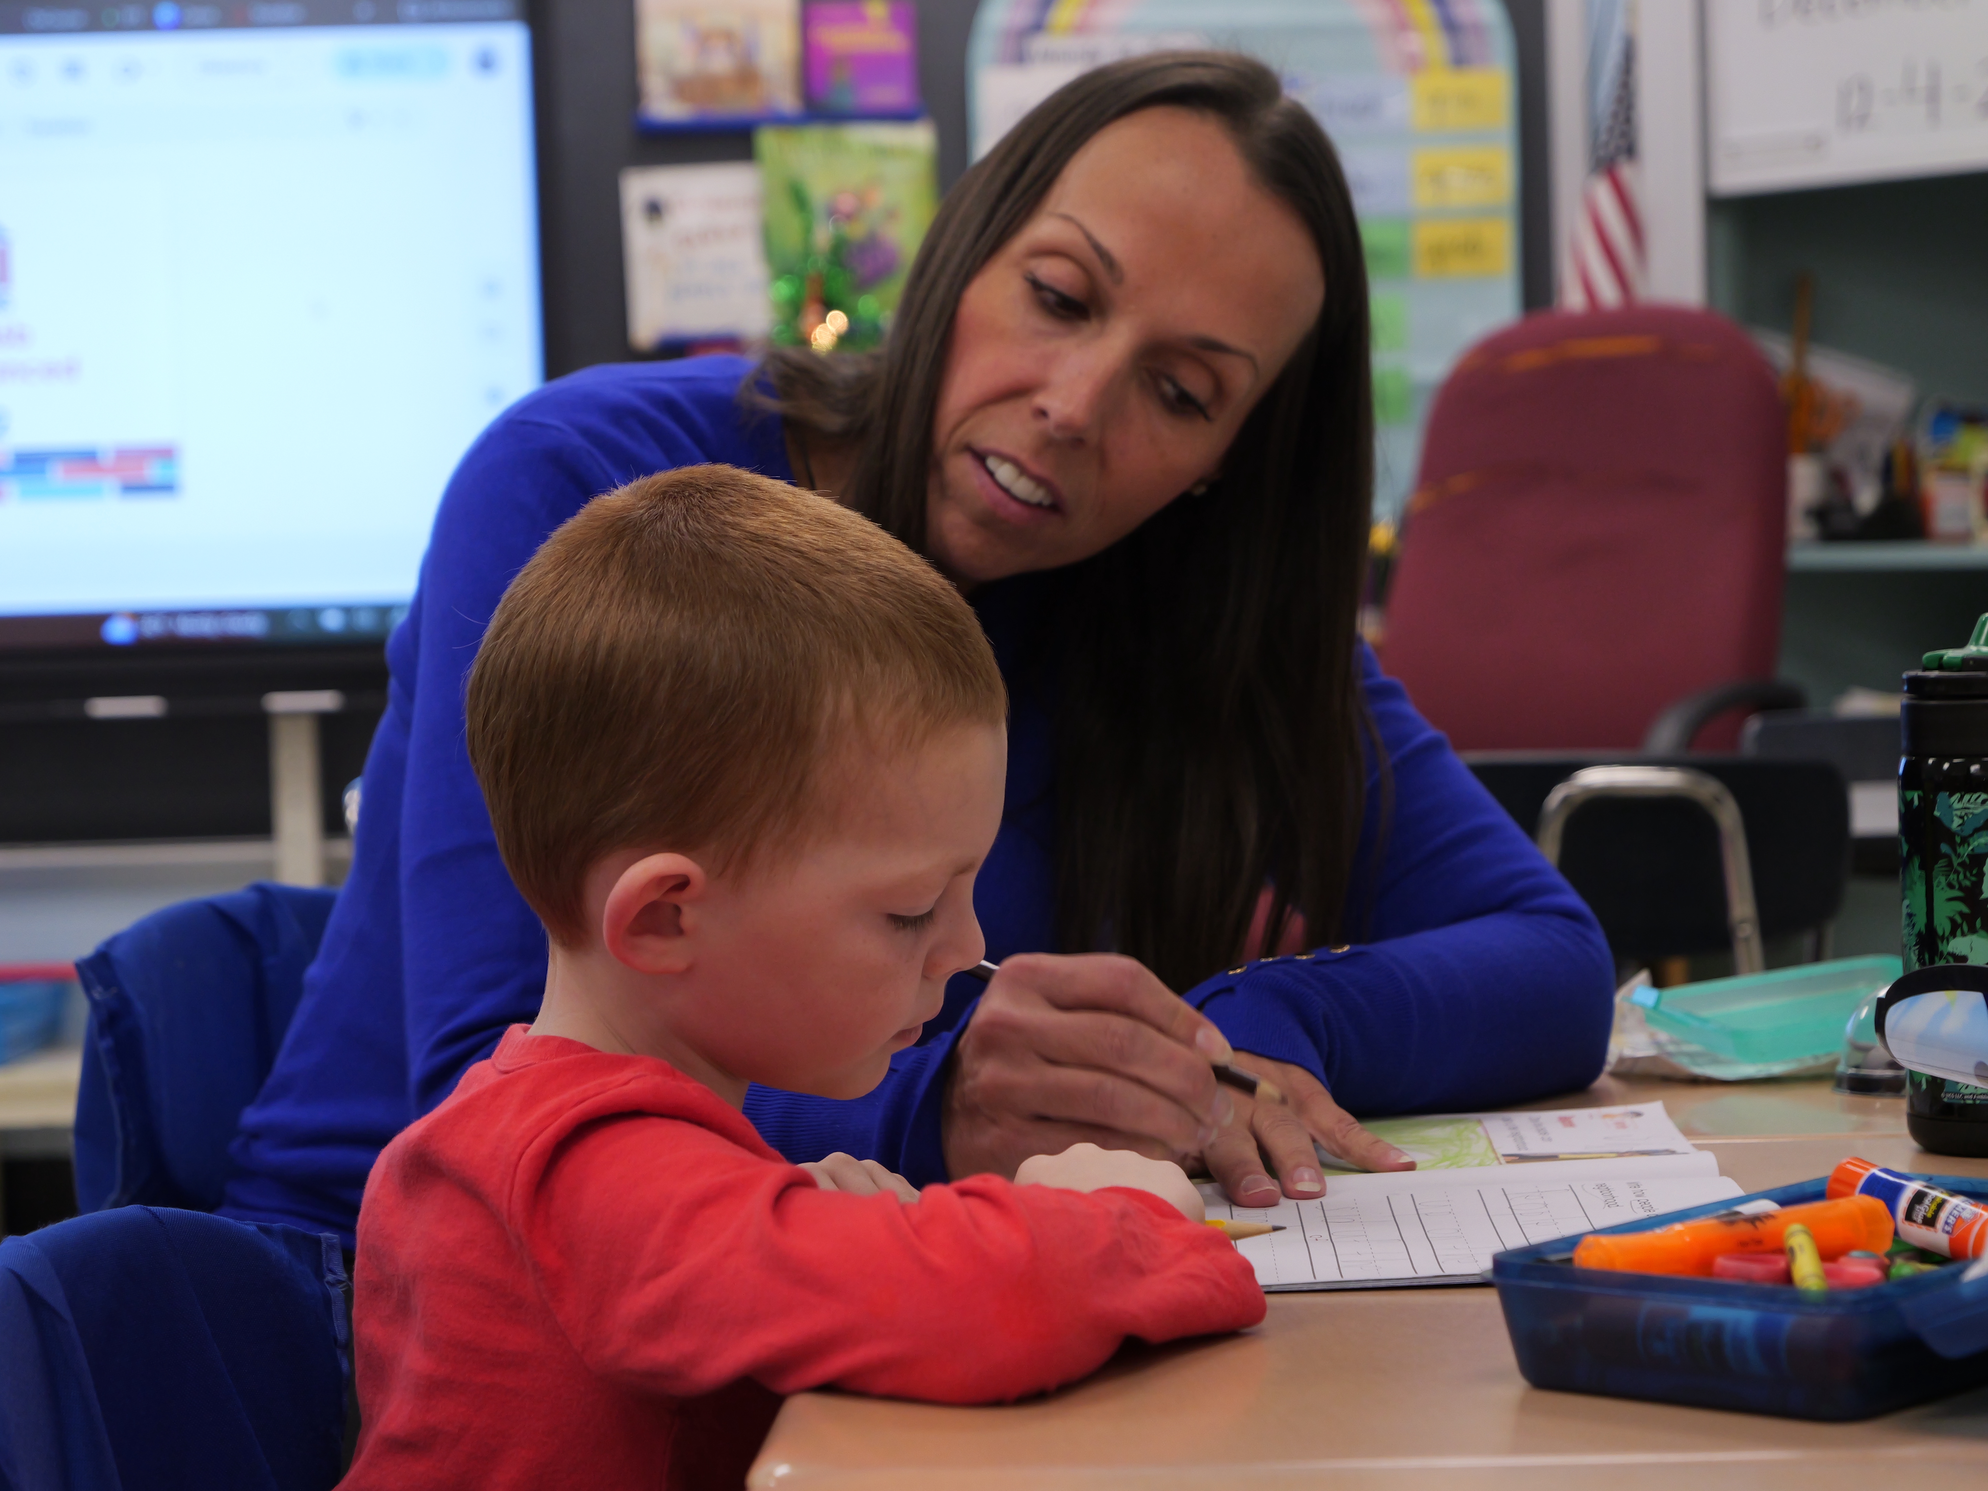
In the Classroom
Explicit teaching of new words
Teachers introduce important words, explain their meanings, and show how to use them in sentences.
Opportunities to practice and explore words
Students read texts, discuss words in context, and connect new vocabulary to what they already know.
Notes:
Facilitator Narration:
In school, teachers provide a variety of experiences to help children learn and use new words.
First, there is explicit teaching of new words. This means the teachers introduce important words, explain their meanings, and show students how to use them in sentences.
Second, children get opportunities to practice and explore words. They might read texts, talk about words in context, and connect new vocabulary to what they already know.
These classroom experiences help children build a strong vocabulary, which supports reading comprehension and confident communication.

Slide 9

Questions to Ask Your Child’s Teacher
How do you introduce and explain new words in the classroom?
What opportunities do students have to practice and use new vocabulary?
How does my child learn to connect new words to what they already know?
Are there ways I can support my child's vocabulary learning at home?
Notes:
Facilitator Narration:
As families, you can support your child’s vocabulary growth by understanding how it’s taught in school. Here are some questions you might ask your child’s teacher:
How do you introduce and explain new words in the classroom?
What opportunities do students have to practice and use new vocabulary?
How does my child learn to connect new words to what they already know?
Are there ways I can support my child’s vocabulary learning at home?
Asking these questions gives you insight into your child’s learning and helps you reinforce vocabulary development at home in meaningful ways.

Slide 10

How You Can Help Your Child at Home (1 of 2)
Read a variety of books together.
Talk about new words.
Use words in multiple ways.
Connect words to what your child knows.
Ask questions about words.
Notes:
Facilitator Narration:
There are many simple ways families can help children grow their vocabulary, both in breadth—learning lots of words—and in depth—really understanding them.
Read a variety of books together. Different topics and types of stories introduce many new words.
Talk about new words. Explain what a word means, give examples, and use it in conversation.
Use words in multiple ways. Encourage your child to write, say, draw, or act out the meaning of new words.
Connect words to what your child knows. Relate new vocabulary to experiences, other books, or real-life examples.
Ask questions about words. Invite your child to predict meanings, find similar words, or explain words in their own language.
By practicing these strategies, you help your child understand more words, remember them better, and become a stronger, more confident reader.

Slide 11


How You Can Help Your Child at Home (2 of 2)
Vocabulary: Activities for Your Kindergartener
"Building a large "word bank" is one of the best ways to help children with reading comprehension. Beginning readers use knowledge about words to help them make sense of what they're reading. The more words a reader knows, the more they are able to comprehend what they're reading or listening to."
Notes:
Facilitator Narration:
Additional ideas, activities, directions, and examples can be found on Reading Rockets website. The QR code is linked to the Kindergarten page. Activities for other age and grade levels are accessible from the Reading 101: A Guide for Parents menu.
Facilitator Note: Link to resource: https://www.readingrockets.org/literacy-home/reading-101-guide-parents/your-kindergartener/vocabulary-activities

Slide 12

Thanks for Participating!
Reading 101 for Parents: Vocabulary
"Vocabulary is word knowledge — knowing what the words mean. Word learning is an ongoing process — we are always adding to our "word bank." The goal is to recognize and understand the meaning of spoken and written words."
Notes:
Facilitator Narration:
In closing, we hope that you have enjoyed this session. To reinforce your learning, we recommend reviewing this one-page article from Reading Rockets prior to our next session. The resource is linked to the QR code on the screen.
Facilitator Note: Link to resource: https://www.readingrockets.org/literacy-home/reading-101-guide-parents/reading-basics/vocabulary

Slide 13
References
Eunice Kennedy Shriver National Institute of Child Health and Human Development, NIH, DHHS. (2000). Report of the National Reading Panel: Teaching Children to Read: Reports of the Subgroups (Reference Only) (00-4754). Washington, DC: U.S. Government Printing Office.
Reading Rockets. (n.d.). Reading 101 for Parents: Comprehension. Retrieved September 1, 2025, from https://www.readingrockets.org/literacy-home/reading-101-guide-parents/reading-basics/vocabulary
Reading Rockets. (n.d.). Vocabulary: Activities for your kindergartener. Retrieved December 10, 2025, from https://www.readingrockets.org/literacy-home/reading-101-guide-parents/your-kindergartener/vocabulary-activities
Scarborough, H. S. (2001). Connecting early language and literacy to later reading (dis)abilities: Evidence, theory, and practice. In S. Neuman & D. Dickinson (Eds.), Handbook for research in early literacy (pp. 97–110). New York: Guilford Press.

Slide 14
Follow the New Jersey Department of Education
Facebook
@njdeptofed
X
@newjerseydoe
Instagram
@newjerseydoe
LinkedIn
New Jersey Department of Education
nj.gov/education
Threads
@newjerseydoe
YouTube
@newjerseydepartmentofeduca6565

