Slide 1
LEARning about Literacy for Families Series
Series Introduction
Office of Learning Equity & Academic Recovery (LEAR)
2026
nj.gov/education/lear
Notes:
Facilitator Narration:
Welcome to the LEARning about Literacy for Families series from the New Jersey Department of Education’s Office of Learning Equity and Academy Recovery, or LEAR. LEAR was established in August 2024 to transform New Jersey’s approach to literacy instruction and advance academic recovery.
Along with the LEAR office, a Working Group on Student Literacy was created to make recommendations on best practices and evidence-based strategies to help all children learn. Through the group’s research, it was determined that states that mirrored the language and formats used with teachers successfully communicated information about early literacy learning to families. As a result, one of the group's recommendations was to develop clear, accessible information for families to support aligned language around early literacy development. In response to this recommendation, the LEAR office created this series for parents, families, and caregivers, providing research and information on early literacy, along with practical applications and activities they can do with their children at home.
For more information about LEAR and the New Jersey Department of Education, visit the link on the screen.
Facilitator Note: Hide this slide if this is not the first session you are facilitating with this group.

Slide 2
LEARning about Literacy for Families Series
Session 7: Inferences
Office of Learning Equity & Academic Recovery
2026
nj.gov/education/lear
Notes:
Facilitator Narration:
Welcome! We’re excited to have you join us for this seventh session in the LEARning about Literacy for Families series created for New Jersey Families supporting their children’s literacy journey at home. We will focus on inferencing or making conclusions based on evidence and reasoning.

Slide 3
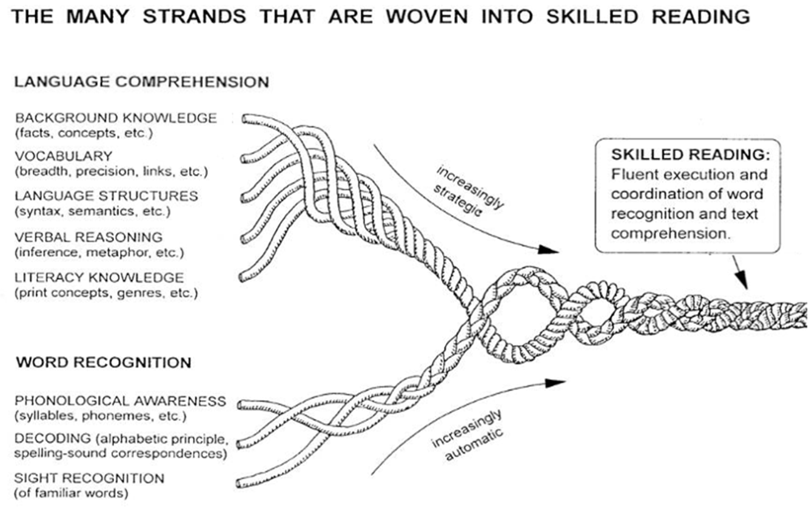
Session 7: Verbal Reasoning
Scarborough, 2001
Notes:
Facilitator Narration:
Always starting with our conceptual framework for skilled reading, Scarborough’s Reading Rope. This model shows us that reading is more than just recognizing words on a page—it’s about weaving together many different skills.
In session seven, we’ll focus on one strand of that rope: verbal reasoning, which is how words can be used literally and figuratively in text. Within verbal reasoning, we’ll look closely at inferencing. You may have heard of the saying, “Reading between the lines.” This expression means understanding the hidden meaning in a statement or situation. Inferencing is the skill of ‘reading between the lines’—using clues from the text along with what we already know to understand meaning that isn’t directly stated. This is a higher-level skill and an essential part of making sense of stories and information.
It’s important to know that inferencing doesn’t stand alone. Children need to pull together all of their language comprehension skills—like vocabulary, background knowledge, and understanding sentence structure—to make strong inferences while reading.
Helping students understand when information is implied rather than directly stated will improve their ability to draw conclusions. Inferential thinking is a complex skill that will develop over time and with experience.

Slide 4
Text Version: Scarborough’s Reading Rope
The many strands that are woven into skilled reading.
The Reading Rope consists of lower and upper strands. The word-recognition strands (phonological awareness, decoding, and sight recognition of familiar words) work together as the reader becomes accurate, fluent, and increasingly automatic with repetition and practice.
Language Comprehension (Upper Strands):
Strands include:
Background knowledge (facts, concepts, etc.)
Vocabulary (breadth, precision, links, etc.)
Language structures (syntax, semantics, etc.)
Verbal reasoning (inference, metaphor, etc.)
Literacy knowledge (print concepts, genres, etc.)
Word Recognition (Lower Strands)
Strands include:
Phonological awareness (syllable, phonemes, etc.).
Decoding (alphabetic principle, spelling-sound correspondences
Sight recognition (of familiar words).
Skilled Reading:
Language comprehension becomes increasingly strategic and word recognition becomes increasingly automatic in the progression to becoming a skilled reader.
A skilled reader displays fluent execution and coordination of word recognition and text comprehension.

Slide 5

Set the Scene: What's Going on Here?
Notes:
Facilitator Narration:
We will now try a short activity to support your understanding in the skill of inferencing, what your child will experience in school, and how to support this skill at home.
Take a look at this picture. What do you think is happening? What clues help you make that guess?
Facilitator Note: Invite families to share what they notice, if possible, via the chat feature, or have them note this on their own.
Highlight their thinking or note on the following aloud:
“You noticed the boots and jacket—great details!”
“Yes, splashing in the puddle tells us it probably rained just before this.”
Explain and share with the group: “You combined clues in the picture with what you already know about rain and puddles. That’s inferencing!”

Slide 6
Apply to Text
Maya pulled on her raincoat and boots. She ran outside and laughed as water splashed everywhere. The sun peeked out from behind the clouds.
Notes:
Facilitator Narration:
Now we’ll try to make some inferences based on text. Read the sentence on the screen: Maya pulled on her raincoat and boots. She ran outside and laughed as water splashed everywhere. The sun peeked out from behind the clouds.
Ask the group out loud: “What can we figure out that the author didn’t directly say?”
Then, share the possible inferences:
It has just rained.
Maya is jumping in a puddle.
The rain has stopped.
Facilitator Note: Consider collecting additional inferences from participants using the chat feature or another method.

Slide 7
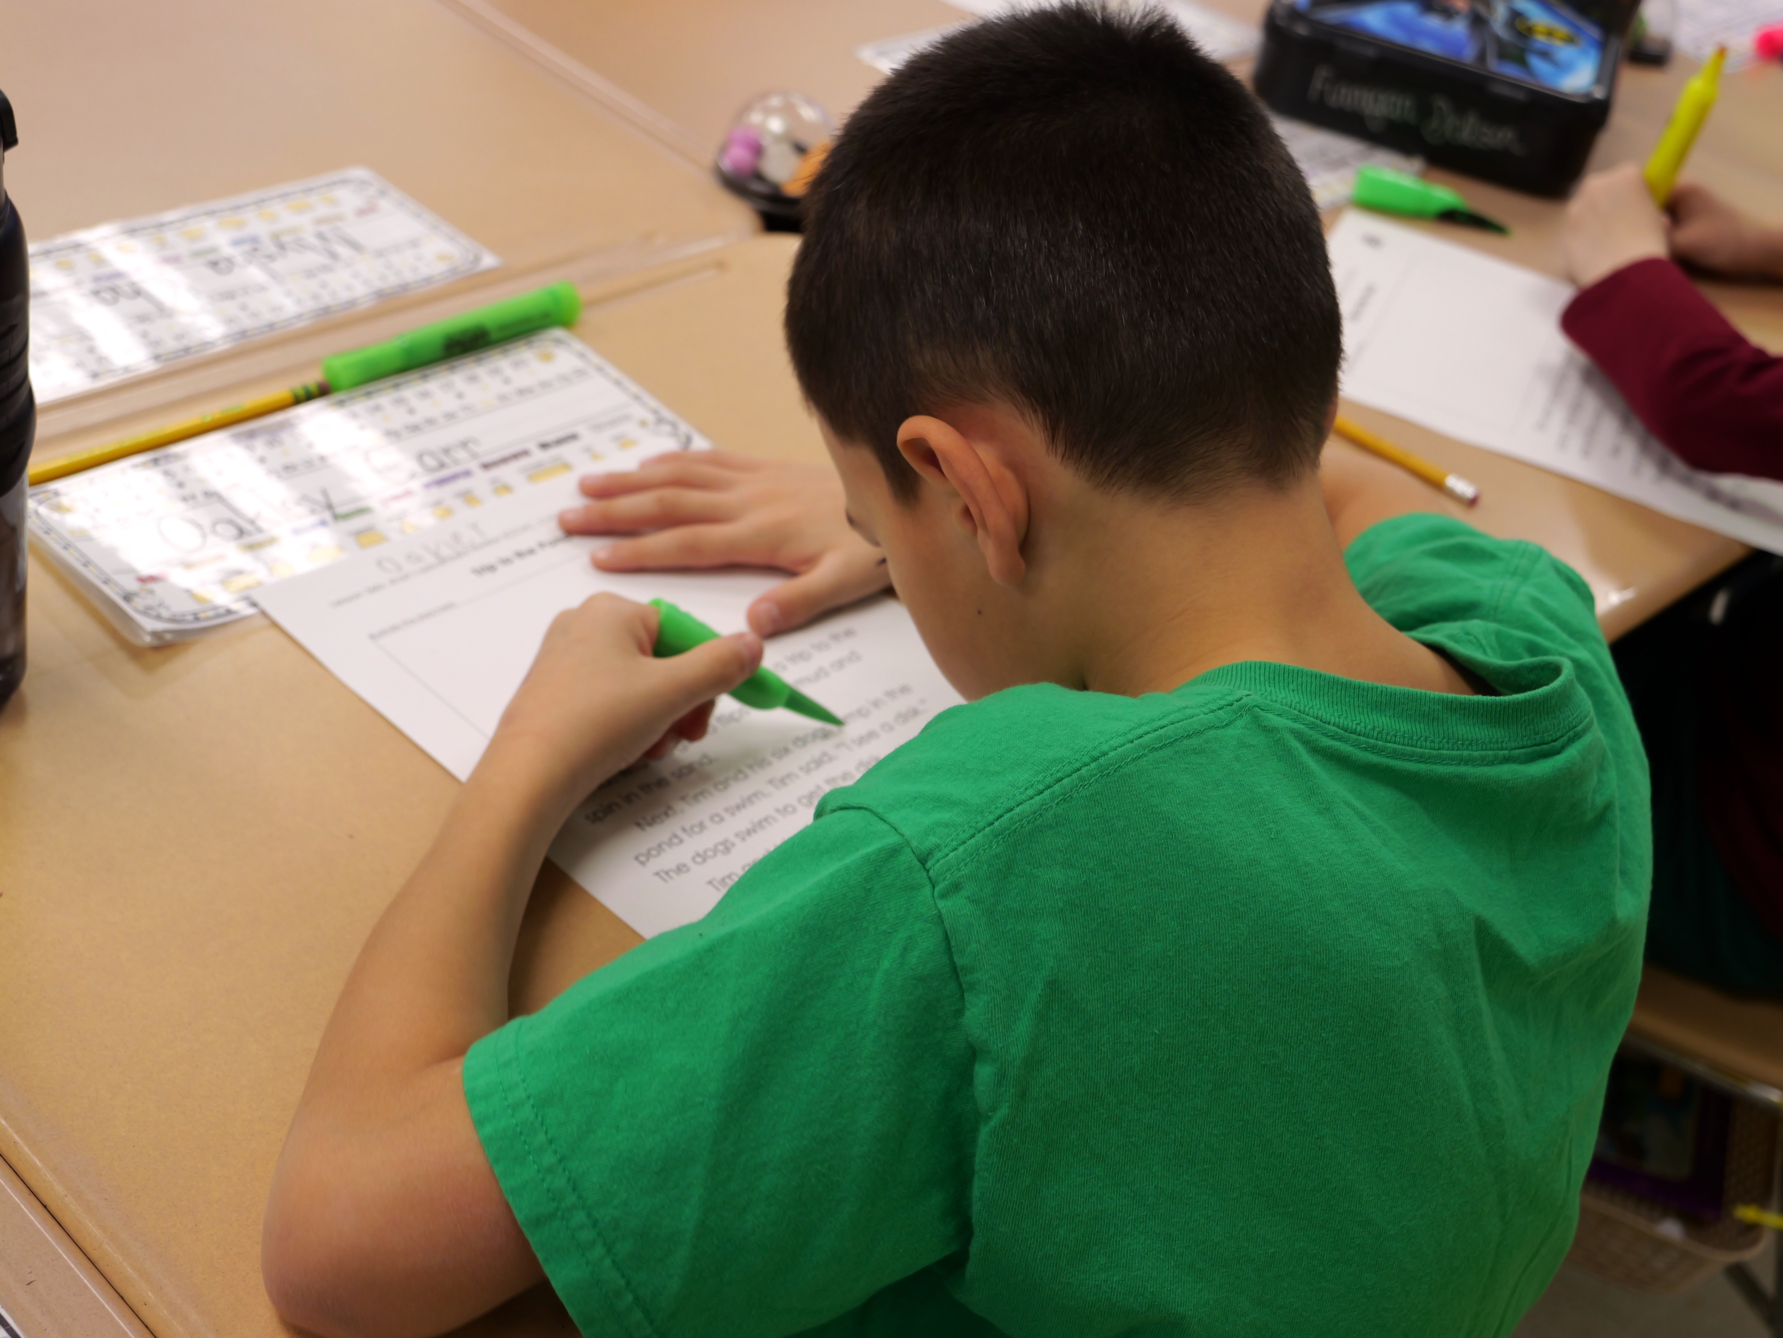
In the Classroom
Use real-life situations to introduce and build knowledge
Prompt students to check their thinking, ensure it makes sense, and adjust inferences with new information
Foster strong inferencing skills by asking guiding questions and modeling
Notes:
Facilitator Narration:
The skills we practiced are the same ones your child uses in school—making smart guesses using clues and background knowledge.
In the classroom, teachers provide a variety of opportunities to help students use what they know and draw conclusions.
Teachers often use real-life situations to introduce inferential thinking to students. This helps students recognize the inferences they make about their real-life experiences and their reading, check their thinking to make sure it makes sense, and adjust their inferences as they gain new information.
Teachers foster strong inferencing skills when reading text by asking guiding questions about pictures and photos along with story elements in stories and using modeling to scaffold students’ understanding. Modeling includes the teacher “thinking aloud” to show students how they would use text and their own background knowledge to develop an inference.

Slide 8

Questions to Ask Your Child’s Teacher
How do you teach inferencing in the classroom, and what does it look like during reading lessons?
How can I tell if my child is developing strong inferencing skills when we read together at home?
What kinds of books, stories, or activities best support my child in practicing inferencing?
If my child struggles with inferencing, what strategies do you use at school—and how can I reinforce those at home?
Notes:
Facilitator Narration:
Here are a few questions you can ask your child’s teacher to better understand how inferencing is taught and how you can support it at home.
You might ask:
How do you teach inferencing in the classroom, and what does it look like during reading lessons? This helps you picture what your child is doing at school.
How can I tell if my child is developing strong inferencing skills when we read together at home? This gives you some signs to look for as you listen to your child read.
What kinds of books, stories, or activities best support my child in practicing inferencing? This way, you can choose materials that match what’s happening in school.
If my child struggles with inferencing, what strategies do you use at school—and how can I reinforce those at home? This ensures you and the teacher are working as a team.
The goal is to open the conversation and get clear, practical ways to support your child’s reading growth.

Slide 9

How You Can Help Your Child at Home (1 of 2)
Think Aloud:
Pause during read-alouds → “What makes you think that?”
Picture Clues:
Use photos/books/TV → “What’s going on here?”
Play Detective
Notice everyday clues → “What can we figure out?”
Notes:
Facilitator Narration:
When you’re at home, there are so many simple ways to help your child grow their inferencing skills.
First, during read-alouds, pause and think out loud. Show your child how you make a smart guess from clues in the text by saying things like, ‘Her hair is wet… I think it must have rained. What makes me think that? The clue is her hair!’
Second, use pictures—family photos, storybook illustrations, or even pausing a TV show. Ask, ‘What’s going on here? What clues helped you figure that out?’
And third, play detective in everyday life. Notice things like muddy shoes, an empty plate, or a backpack left out, and ask, ‘What can we figure out from this?’
These small, playful moments help children see that inferencing is a skill they can use all the time—not just when reading.

Slide 10


How You Can Help Your Child at Home (2 of 2)
Comprehension: Activities for Your Kindergartener
"Kindergarteners are just beginning their journey as readers, yet they are actively absorbing language and experiences to make sense of the world around them. Encourage your child to think and talk about shared oral stories and books that are read aloud. You can also help by exposing your child to lots of interesting words – vocabulary is key to comprehension."
Notes:
Facilitator Narration:
Additional ideas, activities, directions, and examples can be found on Reading Rockets website. The QR code is linked to the Kindergarten page. Activities for other age and grade levels are accessible from the Reading 101: A Guide for Parents menu.
Facilitator Note: Link to Resource: https://www.readingrockets.org/literacy-home/reading-101-guide-parents/your-kindergartener/comprehension-activities

Slide 11


In Closing
Making Inferences and Drawing Conclusions
By: Reading Rockets
"Inferences are what we figure out based on an experience. Helping your child understand when information is implied (or not directly stated) will improve her skill in drawing conclusions and making inferences. These skills will be needed for all sorts of school assignments, including reading, science and social studies."
Notes:
Facilitator Narration:
In closing, we hope that you have enjoyed this session. To reinforce your learning, we recommend reviewing this article from Reading Rockets prior to our next session. The resource is linked to the QR code on the screen.
Facilitator Note: Link to resource: https://www.readingrockets.org/topics/comprehension/articles/making-inferences-and-drawing-conclusions

Slide 12
References
Reading Rockets. (n.d.). Comprehension: Activities for your kindergartener. Retrieved December 10, 2025, from https://www.readingrockets.org/literacy-home/reading-101-guide-parents/your-kindergartener/comprehension-activities
Reading Rockets. (n.d.). Making inferences and drawing conclusions. Retrieved December 10, 2025, from https://www.readingrockets.org/topics/comprehension/articles/making-inferences-and-drawing-conclusions
Reading Rockets. (n.d.). Reading 101 for Parents: Comprehension. Retrieved September 19, 2025, from https://www.readingrockets.org/literacy-home/reading-101-guide-parents/reading-basics/comprehension
Scarborough, H. S. (2001). Connecting early language and literacy to later reading (dis)abilities: Evidence, theory, and practice. In S. Neuman & D. Dickinson (Eds.), Handbook for research in early literacy (pp. 97-110). New York: Guilford Press.

Slide 13
Follow the New Jersey Department of Education
Facebook
@njdeptofed
X
@newjerseydoe
Instagram
@newjerseydoe
LinkedIn
New Jersey Department of Education
nj.gov/education
Threads
@newjerseydoe
YouTube
@newjerseydepartmentofeduca6565

