Slide 1
LEARning about Literacy for Families Series
Series Introduction
Office of Learning Equity & Academic Recovery (LEAR)
2026
nj.gov/education/lear
Notes:
Facilitator Narration:
Welcome to the LEARning about Literacy for Families series from the New Jersey Department of Education’s Office of Learning Equity and Academy Recovery, or LEAR. LEAR was established in August 2024 to transform New Jersey’s approach to literacy instruction and advance academic recovery.
Along with the LEAR office, a Working Group on Student Literacy was created to make recommendations on best practices and evidence-based strategies to help all children learn. Through the group’s research, it was determined that states that mirrored the language and formats used with teachers successfully communicated information about early literacy learning to families. As a result, one of the group's recommendations was to develop clear, accessible information for families to support aligned language around early literacy development. In response to this recommendation, the LEAR office created this series for parents, families, and caregivers, providing research and information on early literacy, along with practical applications and activities they can do with their children at home.
For more information about LEAR and the New Jersey Department of Education, visit the link on the screen.
Facilitator Note: Hide this slide if this is not the first session you are facilitating with this group.

Slide 2
LEARning about Literacy for Families Series
Session 8: Text Structures and Comprehension Strategies
Office of Learning Equity & Academic Recovery
2026
nj.gov/education/lear
Notes:
Facilitator Narration:
Welcome! We’re excited to have you join us for this eighth and final session in the LEARning about Literacy for Families series, created for New Jersey Families supporting their children’s literacy journey at home. We will focus on text structures and comprehension.

Slide 3
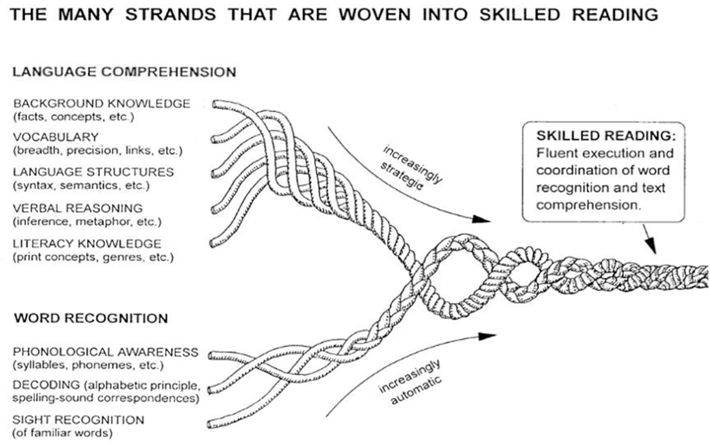
Session 8: Literacy Knowledge
Scarborough, 2001
Notes:
Facilitator Narration:
Let’s revisit Scarborough’s Reading Rope one last time. The Reading Rope shows us how many skills weave together to make a skilled reader. One strand is called literacy knowledge.
This includes knowing how print works, recognizing different kinds of books, and noticing how texts are organized. When children understand these patterns, it helps them make sense of and remember what they read.

Slide 4
Text Version: Scarborough’s Reading Rope
The many strands that are woven into skilled reading.
The Reading Rope consists of lower and upper strands. The word-recognition strands (phonological awareness, decoding, and sight recognition of familiar words) work together as the reader becomes accurate, fluent, and increasingly automatic with repetition and practice.
Language Comprehension (Upper Strands):
Strands include:
Background knowledge (facts, concepts, etc.)
Vocabulary (breadth, precision, links, etc.)
Language structures (syntax, semantics, etc.)
Verbal reasoning (inference, metaphor, etc.)
Literacy knowledge (print concepts, genres, etc.)
Word Recognition (Lower Strands)
Strands include:
Phonological awareness (syllable, phonemes, etc.).
Decoding (alphabetic principle, spelling-sound correspondences
Sight recognition (of familiar words).
Skilled Reading:
Language comprehension becomes increasingly strategic and word recognition becomes increasingly automatic in the progression to becoming a skilled reader.
A skilled reader displays fluent execution and coordination of word recognition and text comprehension.

Slide 5
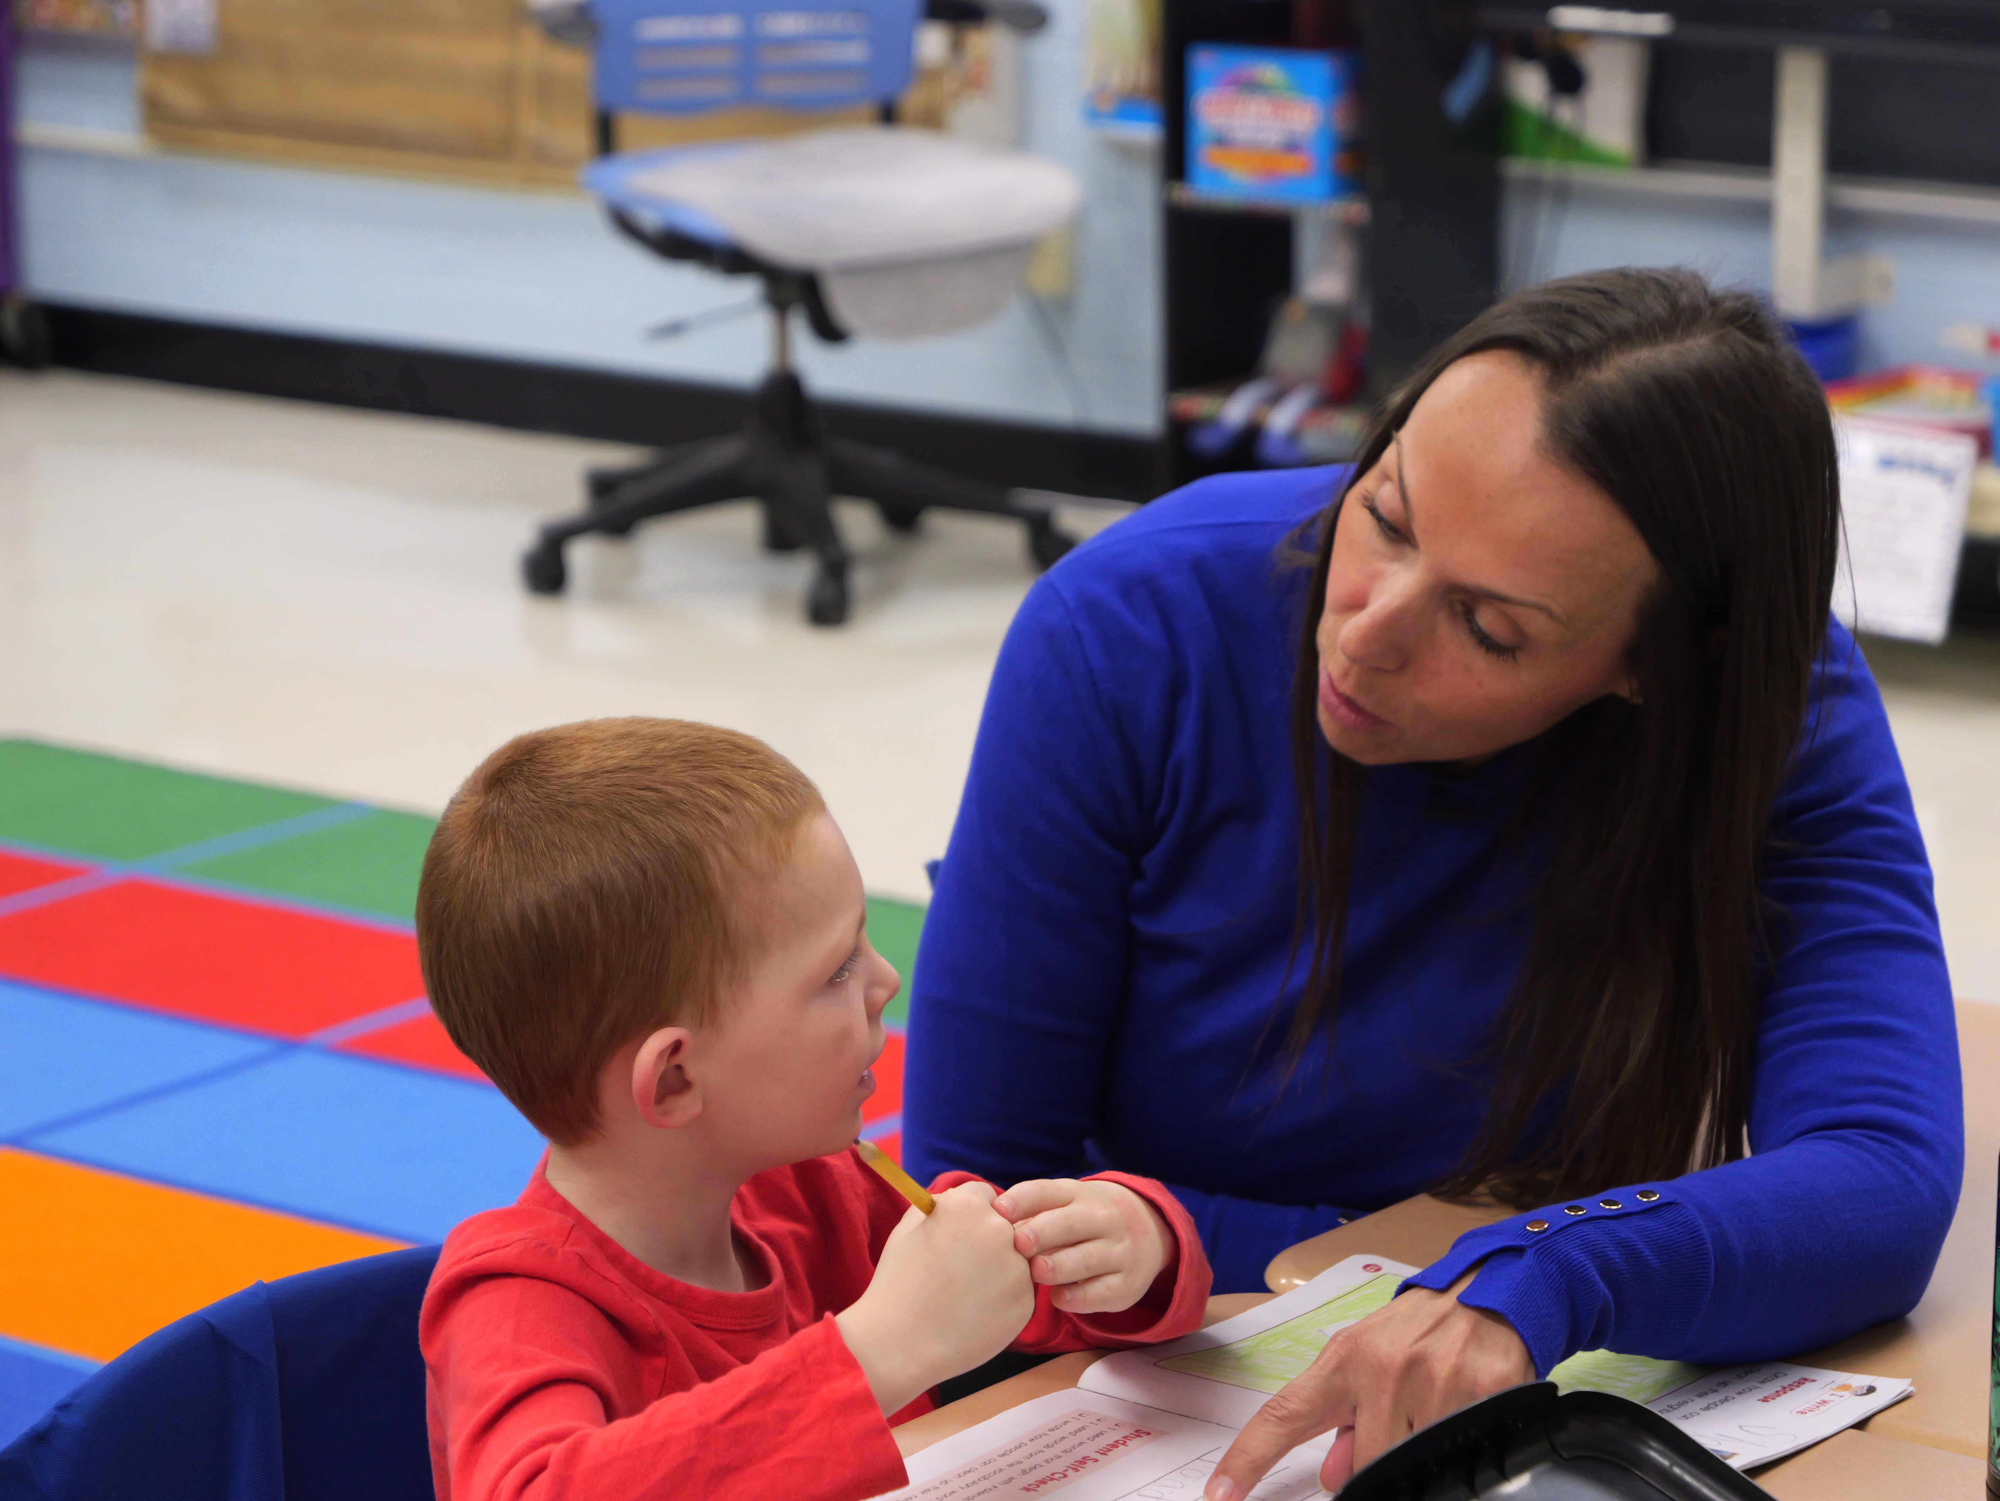
Print Concepts
Print awareness is understanding that written words carry meaning and follow rules that help us read and write.
Reading Direction
In English, we read from left to right and top to bottom.
Book Parts
Books have a cover, title, author, illustrator, spine, and pages.
Word Boundaries
Spaces show where one word ends and another begins.
Units of Print
Letters make words, and words make sentences.
Punctuation
Periods, question marks, and exclamation points tell us how to read and understand sentences.
Notes:
Facilitator Narration:
Print awareness is all about understanding that written words carry meaning and follow certain rules that help us read and write.
Some of the things children learn include:
Reading direction: In English, we read from left to right and top to bottom.
Book parts: Books have a cover, title, author, illustrator, spine, and pages. Knowing these helps children navigate books.
Word boundaries: Spaces show where one word ends and the next begins.
Units of print: Letters come together to make words, and words come together to make sentences.
Punctuation: Marks like periods, question marks, and exclamation points help children know how to read and understand sentences.
By noticing these features, children are building the foundation for strong reading and writing skills.

Slide 6
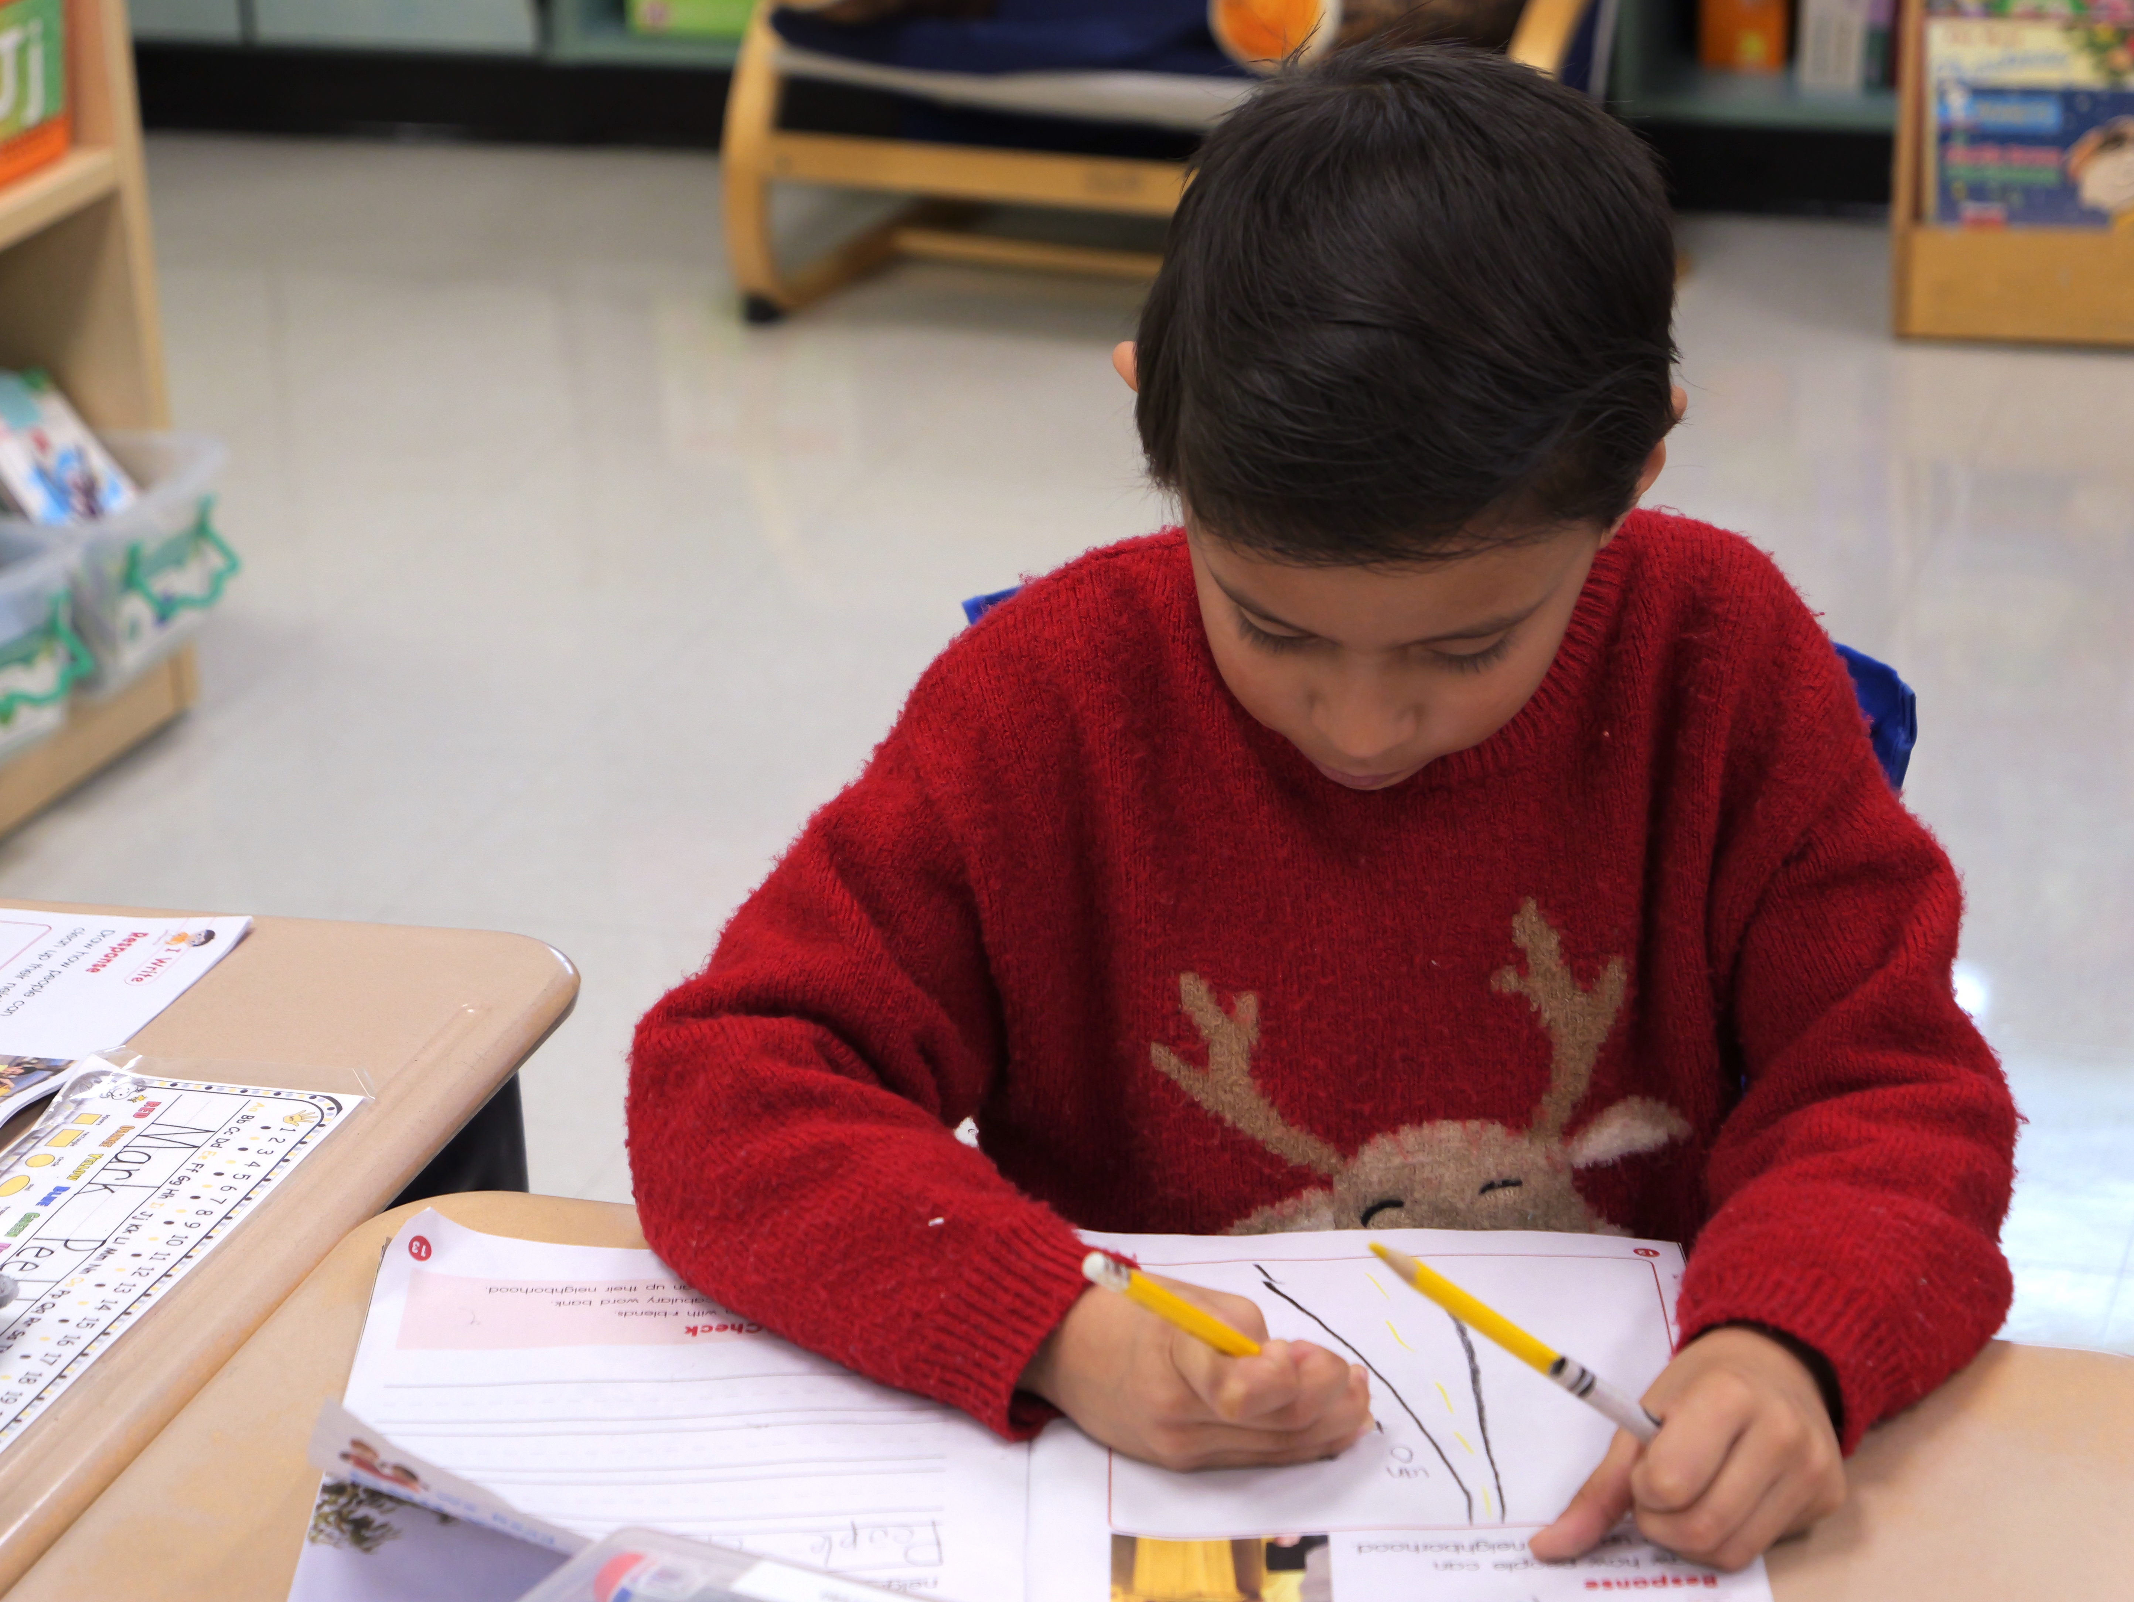
Text Structures
Text structure is how a book or passage is organized.
  Description
  Sequence
  Problem/Solution
  Cause and Effect
  Compare and Contrast
Helps children understand what the author is trying to say
Supports reading comprehension and writing
Assists children with following along and remembering key ideas
Notes:
Facilitator Narration:
Text structure is simply how a book or passage is organized. Common text structures include: description, sequence, problem/solution, cause and effect, and compare and contrast.
When children understand how a text is put together, it helps them figure out what the author is trying to say.
Learning about text structures also helps with writing, because it shows children ways to organize their own ideas.
By noticing the features of stories and informational books, children can follow along more easily and remember the important points.

Slide 7
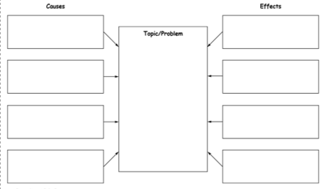
Graphic Organizers: A Tool for Comprehension
Graphic organizers are charts, maps, or diagrams that make the structure of a text visible.
They help children see how ideas connect in what they read.
Using them also supports children in organizing their own writing.
Notes:
Facilitator Narration:
Before we try the practice activity, let’s review the importance of graphic organizers. As adults, we use graphic organizers such as shopping lists and calendars to help organize our lives.
For children, graphic organizers are tools like charts, story maps, or diagrams that help children see how a text is organized.
For example, a cause-and-effect chart can show why something happened and what the result was. A story map can show the characters, setting, problem, and solution.
These tools make the structure of a text visible, which helps kids understand and remember what they read. They also give children a model for how to organize their own writing.

Slide 8
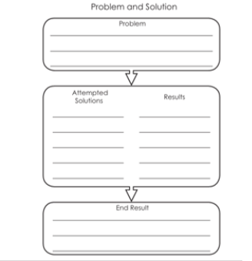
Find the Structure Together (1 of 2)
The Park
The park was full of trash after the holiday weekend. This made the community worried about safety and the environment. To solve the problem, volunteers organized a cleanup day. As a result, the park looked beautiful again, and everyone enjoyed it.
Notes:
Facilitator Narration:
Let’s practice how text structure works by looking at this short passage together:
‘The park was full of trash after the holiday weekend. This made the community worried about safety and the environment. To solve the problem, volunteers organized a cleanup day. As a result, the park looked beautiful again, and everyone enjoyed it.’
Now, let’s ask a few simple questions:
What was the problem? (The park was full of trash.)
What was the solution? (The community organized a cleanup day.)
What was the result? (The park looked beautiful again and people enjoyed it.)
This is called a problem–solution text structure.
One way we help kids see this more clearly is by using a graphic organizer—a simple chart with three boxes: Problem, Solution, and Goal/Result. At home, you can practice this too. When reading a story or even talking about real-life situations, you might ask: What’s the problem? How was it solved? What happened in the end?
This simple routine helps kids recognize text structures, which makes it easier for them to understand and remember what they read.

Slide 9
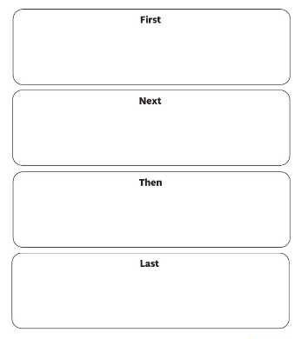
Find the Structure Together (2 of 2)
Making Cookies
First, the kids gathered the ingredients to make cookies. Next, they mixed the flour, sugar, and eggs in a bowl. Then, they shaped the dough into circles on a baking tray. Finally, they baked the cookies in the oven and enjoyed a warm treat.
Notes:
Facilitator Narration:
Here’s another short passage. Let’s read it together:
‘First, the kids gathered the ingredients to make cookies. Next, they mixed the flour, sugar, and eggs in a bowl. Then, they shaped the dough into circles on a baking tray. Finally, they baked the cookies in the oven and enjoyed a warm treat.’
Now let’s think about the questions:
What happened first? (They gathered the ingredients.)
What happened next? (They mixed them together.)
What happened then? (They shaped the dough.)
What happened last? (They baked the cookies and ate them.)
This passage follows a sequence structure—steps in order.
We can show this with a simple organizer, like a flow chart with boxes labeled First, Next, Then, Finally.
At home, you can practice this by asking your child to retell the steps of a recipe you cook together, or even the steps of a bedtime routine. Recognizing sequences helps children follow directions in texts and remember the order of events in stories.
One way we help kids see this more clearly is by using a graphic organizer—a simple chart with three boxes: Problem, Solution, and Result. At home, you can practice this too. When reading a story or even talking about real-life situations, you might ask: What’s the problem? How was it solved? What happened in the end?
This simple routine helps kids recognize text structures, which makes it easier for them to understand and remember what they read.

Slide 10

Questions to Ask Your Child’s Teacher
How do you teach text structures in class?
How can I tell if my child is recognizing text structures when we read at home?
What kinds of books or passages are best for practicing text structures?
How can I support my child’s comprehension and writing with text structures at home?
Notes:
Facilitator Narration:
Here are some questions you might ask your child’s teacher to learn more about how text structures support reading:
How do you teach text structures in class? — This gives you a window into what your child is practicing every day.
How can I tell if my child is recognizing text structures when we read at home? — This helps you know what signs to look for during reading.
What kinds of books or passages are best for practicing text structures? — Teachers can point you toward texts that make these patterns easier to see.
How can I support my child’s comprehension and writing with text structures at home? — This connects what happens in school with what you can do at home to reinforce the skill.
The goal is to have meaningful comprehension conversations to help your child become a strong and confident reader.

Slide 11

How You Can Help Your Child at Home (1 of 2)
Talk about how books are organized.
Use every day routines to practice sequences.
Spot problems and solutions in real life.
Try simple charts or story maps together.
Notes:
Facilitator Narration:
Here are a few simple ways you can help your child practice text structures at home:
Talk about how books are organized. When you read, point out whether the book is telling a story, explaining steps, or describing a problem and solution.
Use everyday routines to practice sequences. Ask your child to retell the steps in brushing teeth, making a sandwich, or getting ready for bed. This builds their understanding of sequence structure.
Spot problems and solutions in real life. If a toy breaks or the family runs out of milk, ask: What’s the problem? How can we solve it? What happened after? This mirrors the problem–solution structure in texts.
Try simple charts or story maps together. Draw three boxes labeled Beginning, Middle, End, or Problem, Solution, Result, and fill them in after reading a short story.
These little activities don’t take much time, but they help your child notice patterns in reading and build stronger comprehension skills.

Slide 12

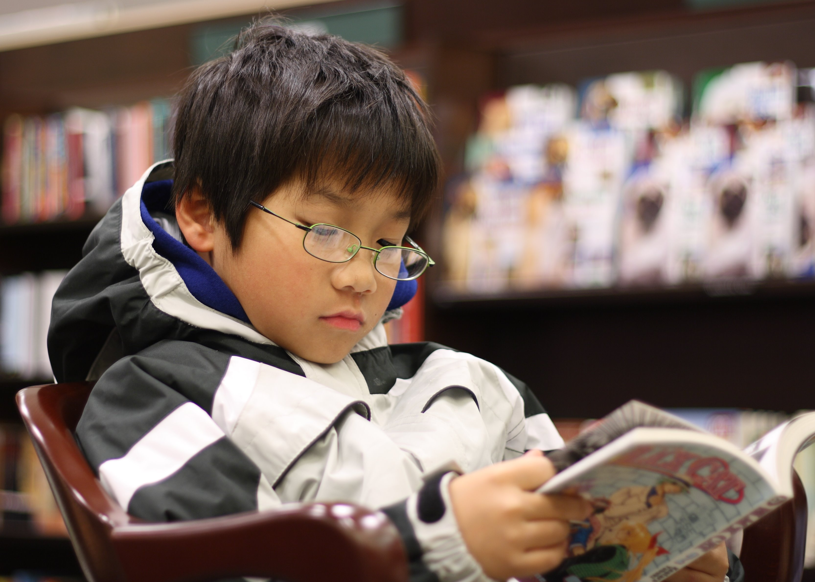
How You Can Help Your Child at Home (2 of 2)
Comprehension: Activities for Your Second Grader
"Second graders are learning to think actively as they read. They use their experiences and knowledge of the world, vocabulary, a growing understanding how language words, and reading strategies to make some sense of what they are reading." readingrockets.org
Notes:
Facilitator Narration:
Additional ideas, activities, directions, and examples can be found on Reading Rockets website. The QR code links to the second-grade page and includes a number of ideas, including book-mapping and sequencing activities. Activities for other age and grade levels are accessible from the Reading 101: A Guide for Parents menu.
Facilitator Note: https://www.readingrockets.org/literacy-home/reading-101-guide-parents/your-second-grader/comprehension-activities

Slide 13
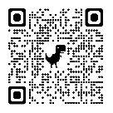

In Closing
Reading 101: A Guide for Parents
"It's not an easy thing, learning to read and write. Discover what it takes to build important literacy skills, and how you can help your children grow as readers, writers, and thinkers." Readingrockets.org
Notes:
Facilitator Narration:
In closing, we hope that you have enjoyed this session. To solidify your learning, we recommend reviewing “Reading 101: A Guide for Parents” on the Reading Rockets website. The resource is linked to the QR code on the screen.
Facilitator Note: Link to resource: https://www.readingrockets.org/literacy-home/reading-101-guide-parents

Slide 14
References
Florida Center for Reading Research. (2005). Text structure reflection: 4‑5 student center activities: Comprehension (C.023). Retrieved December 10, 2025, from https://fcrr.org/sites/g/files/upcbnu2836/files/media/PDFs/student_center_activities/45_expository_text_structure/45_c023_text_structure_reflection.pdf
Reading Rockets. (n.d.). Comprehension: Activities for your second grader. Retrieved December 10, 2025, from https://www.readingrockets.org/literacy-home/reading-101-guide-parents/your-second-grader/comprehension-activities
Reading Rockets. (n.d.). Reading 101: A Guide for Parents. Retrieved September 19, 2025, from https://www.readingrockets.org/literacy-home/reading-101-guide-parents
Reading Rockets. (2023, November). Story sequence graphic organizer [PDF]. Retrieved December 10, 2025, from https://www.readingrockets.org/sites/default/files/2023-11/graphic-organizer-story-sequence.pdf
ReadWriteThink. (n.d.). Cause and effect graphic organizer [PDF]. Retrieved December 4, 2025, from https://www.readwritethink.org/sites/default/files/resources/lesson_images/lesson1035/cause.pdf
Scarborough, H. S. (2001). Connecting early language and literacy to later reading (dis)abilities: Evidence, theory, and practice. In S. Neuman & D. Dickinson (Eds.), Handbook for research in early literacy (pp. 97-110). New York: Guilford Press.

Slide 15
Follow the New Jersey Department of Education
Facebook
@njdeptofed
X
@newjerseydoe
Instagram
@newjerseydoe
LinkedIn
New Jersey Department of Education
nj.gov/education
Threads
@newjerseydoe
YouTube
@newjerseydepartmentofeduca6565

