Slide 1
LEARning about Literacy for Families Series
Series Introduction
Office of Learning Equity & Academic Recovery (LEAR)
2026
nj.gov/education/lear
Notes:
Facilitator Narration:
Welcome to the LEARning about Literacy for Families series from the New Jersey Department of Education’s Office of Learning Equity and Academy Recovery, or LEAR. LEAR was established in August 2024 to transform New Jersey’s approach to literacy instruction and advance academic recovery.
Along with the LEAR office, a Working Group on Student Literacy was created to make recommendations on best practices and evidence-based strategies to help all children learn. Through the group’s research, it was determined that states that mirrored the language and formats used with teachers successfully communicated information about early literacy learning to families. As a result, one of the group's recommendations was to develop clear, accessible information for families to support aligned language around early literacy development. In response to this recommendation, the LEAR office created this series for parents, families, and caregivers, providing research and information on early literacy, along with practical applications and activities they can do with their children at home.
For more information about LEAR and the New Jersey Department of Education, visit the link on the screen.
Facilitator Note: Hide this slide if this is not the first session you are facilitating with this group.

Slide 2
LEARning about Literacy for Families Series
Session 2: Phonics & Decoding
Office of Learning Equity & Academic Recovery
2026
nj.gov/education/lear
Notes:
Facilitator Narration:
We’re so glad you could join us for this session in the LEARning about Literacy for Families series. This session will focus on phonics & decoding and is designed to support New Jersey families as you help your children grow as confident readers at home.

Slide 3
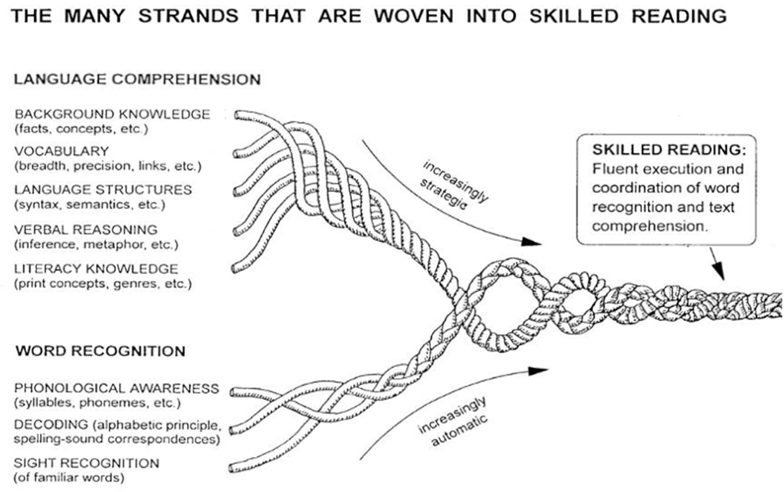
Session 2: Phonics & Decoding
Scarborough, 2001
Notes:
Facilitator Narration:
To begin, let’s revisit Scarborough’s Reading Rope, a powerful visual that illustrates the many strands woven together to create skilled reading. In this session, we will focus on one of the foundational strands within the Word Recognition section of the rope: decoding—the ability to translate written words into spoken language. Alongside decoding, we’ll also explore its closely related and reciprocal skill, encoding, which refers to spelling and writing words based on their sounds.
This session is designed to help parents, families and caregivers gain a deeper understanding of how these two skills—decoding and encoding—work together to support early reading development. We’ll break down what phonics really means, how children learn to connect letters with sounds, and why this process is essential for fluent reading. Parents will also learn practical strategies and activities they can use at home to reinforce these skills, making reading a more engaging and successful experience for their children.
By the end of this session, parents will not only understand the "what" and "why" of phonics and word analysis, but also the "how"—how to support their child’s journey toward becoming a confident and capable reader.

Slide 4
Text Version: Scarborough’s Reading Rope
The many strands that are woven into skilled reading.
The Reading Rope consists of lower and upper strands. The word-recognition strands (phonological awareness, decoding, and sight recognition of familiar words) work together as the reader becomes accurate, fluent, and increasingly automatic with repetition and practice.
Language Comprehension (Upper Strands):
Strands include:
Background knowledge (facts, concepts, etc.)
Vocabulary (breadth, precision, links, etc.)
Language structures (syntax, semantics, etc.)
Verbal reasoning (inference, metaphor, etc.)
Literacy knowledge (print concepts, genres, etc.)
Word Recognition (Lower Strands)
Strands include:
Phonological awareness (syllable, phonemes, etc.).
Decoding (alphabetic principle, spelling-sound correspondences
Sight recognition (of familiar words).
Skilled Reading:
Language comprehension becomes increasingly strategic and word recognition becomes increasingly automatic in the progression to becoming a skilled reader.
A skilled reader displays fluent execution and coordination of word recognition and text comprehension.

Slide 5
What is Phonics?
Phonics is the relationship between letters and the sounds they represent.
It teaches children how to connect written letters (graphemes) with spoken sounds (phonemes).
Phonics helps children 'sound out' unfamiliar words when reading.
It is a foundational skill for learning to read and spell.
In the classroom, phonics looks like children learning how letters and sounds go together so they can read and spell words.
Notes:
Facilitator Narration:
Phonics is simply the way we connect letters with the sounds they make. For example, when children see the letter s, they learn it makes the /s/ sound. By putting sounds together, they can read words like sun, and by taking words apart, they can spell them.
In the classroom, this looks like children practicing these connections every day—sounding out new words, blending sounds to read, and writing words by listening to the sounds they hear. For example, they might practice saying the /s/ sound when they see the letter s, then blend sounds together to read a word like sun. Phonics gives children the tools to “sound out” new words on their own, building the strong foundation they need to become confident readers and writers.

Slide 6
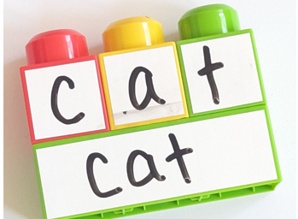
What is Decoding?
Decoding is the process of sounding out words using phonics knowledge.
Children break a word into sounds and blend them to read (e.g., 'c-a-t' becomes 'cat’).
Decoding helps readers figure out new or unfamiliar words.
Strong decoding skills lead to fluent and confident reading.
In the classroom, decoding practice looks like children saying the sounds in a word—like /c/ /a/ /t/—and then blending them together to read the whole word cat, giving them the confidence to figure out new words on their own.
Notes:
Decoding is when children use their phonics knowledge to sound out words. For example, if they see the word cat, they break it into sounds—/c/ /a/ /t/—and then blend them together to read the whole word, cat.
In the classroom, decoding practice looks like students saying the sounds slowly, then putting them together until the word makes sense. This helps them tackle new or unfamiliar words on their own. Over time, as their decoding gets stronger, students’ reading becomes smoother and more confident.

Slide 7
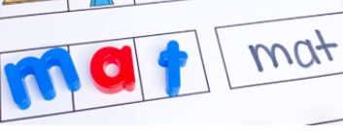
What is Encoding?
Encoding is using sounds to write words.
Children listen to a word, break it into sounds, and write the matching letters.
Encoding practice strengthens phonics understanding and supports reading development.
In the classroom, encoding looks like children listening to a word, breaking it into sounds, and writing down the letters that match those sounds.
Notes:
Encoding is really just the reverse of decoding. Instead of reading a word, children listen to a word, break it into sounds, and then write down the letters that match those sounds. For example, if they hear the word dog, they might say the sounds /d/ /o/ /g/ and then write d-o-g.
In the classroom, this looks like children stretching out words as they say them, and then matching each sound to a letter on the page. This practice not only helps them become stronger writers but also reinforces the same phonics skills they use in reading. Over time, they also learn about conventional spelling—those tricky words like knock or said that don’t always sound the way they’re spelled.

Slide 8

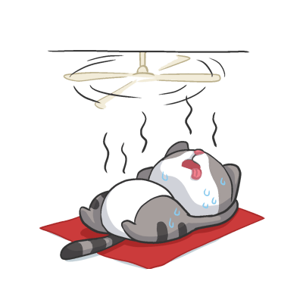
Word Ladder
C
A
T
H
A
T
H
O
T
Notes:
Facilitator Narration:
Let’s review a quick and fun activity you can try with your child at home to practice these skills. The activity is a Word Ladder, and we use in it by changing one letter and sound at a time to make a new word.
We are going to start with the word cat. The sounds in cat are /c/ /a/ /t/ and it is spelled “c” “a” “t.” (Facilitator Note: Each letter animated on click)
Let’s change one letter to make the word hat. How do we spell hat? That’s right! “H” “a” “t.” (Facilitator Note: Each letter animated on click)
Let’s change one more letter to make the word hot. How do we spell hot? That’s right! “H” “o” and “t.” (Facilitator Note: Each letter animated on click)
Using word ladders where students can see each word as they build and change it is a way to strengthen letter–sound correspondences and support the development of both reading and spelling skills. This activity is effective because it strengthens both phonemic awareness and phonics simultaneously. As students compare the original word to the new one, they use phonemic awareness to analyze and contrast the sounds. Then, by linking those sounds to the corresponding letter patterns, they engage in both phonemic awareness and phonics to build the new word.

Slide 9

Questions to Ask Your Child’s Teacher
How is decoding taught and practiced?
What strategies are used to support spelling and encoding?
Does the phonics program have home support activities?
What specific skills can we work on at home?
Notes:
Facilitator Narration:
It’s helpful to talk with your child’s teacher about how phonological awareness is taught and how your child is doing. You can ask what specific sound skills your child is working on and how these are practiced in class. Teachers can also recommend simple ways to build on these skills at home—like games or reading activities. Open communication helps make sure your child gets consistent support in both school and at home.

Slide 10

How You Can Help Your Child at Home (1 of 2)
Practice letter-sound games and activities.
Read aloud with your child and point out letter patterns.
Encourage your child to sound out words when reading and writing.
Use magnetic letters or writing tools to build and spell words together.
Notes:
There are many fun ways you can support your child’s reading and writing at home. You can play letter-sound games or do activities that help them practice connecting letters and sounds. Reading aloud together is another great opportunity—point out letters and patterns in words as you read.
Encourage your child to sound out words when they read or write and make it hands-on by using magnetic letters or other writing tools to build and spell words together. These simple, everyday activities reinforce the phonics, decoding, and encoding skills your child is learning in the classroom and make reading and writing a fun part of your day.

Slide 11


How You Can Help Your Child at Home (2 of 2)
Phonics and Decoding: Activities for Your Kindergartener
The goal of phonics instruction is to help children learn the alphabetic principle—the idea that letters represent sounds of spoken language—and that there is an organized, logical, and predictable relationship between written letters and spoken sounds.
Notes:
Facilitator Narration:
Additional ideas, activities, directions, and examples can be found on Reading Rockets website. The QR code is linked to the Kindergarten page. Activities for other age and grade levels are accessible from the Reading 101: A Guide for Parents menu.
Facilitator Note: Link to resource: https://www.readingrockets.org/literacy-home/reading-101-guide-parents/your-kindergartener/phonics-and-decoding-activities

Slide 12


In Closing
Reading 101 For Parents: Phonics and Decoding
"Phonics is a step-by-step way to teach the alphabetic principle—the idea that letters represent the sounds of spoken language —and there is a predictable relationship between letters and sounds. “ Decoding” is the act of sounding out words and using phonics. " Readingrockets.org
Notes:
Facilitator Narration:
In closing, we hope that you have enjoyed this session. To reinforce your learning, we recommend reading this 1-page article from the Reading Rockets: Reading 101 series for Parents prior to our next session.
Facilitator Note: Link to resource: https://www.readingrockets.org/literacy-home/reading-101-guide-parents/reading-basics/phonics-and-decoding

Slide 13
References
Cárdenas-Hagan, E. (2020). Literacy foundations for English learners: A comprehensive guide to evidence-based instruction. Paul Brookes Publishing Co.
Reading Rockets. (n.d.). Phonics and decoding: Activities for your kindergartener. Retrieved December 10, 2025, from https://www.readingrockets.org/literacy-home/reading-101-guide-parents/your-kindergartener/phonics-and-decoding-activities
Reading Rockets. (n.d.). Reading 101 for Parents: Phonics and decoding. Retrieved December 10, 2025, from https://www.readingrockets.org/literacy-home/reading-101-guide-parents/reading-basics/phonics-and-decoding
Scarborough, H. S. (2001). Connecting early language and literacy to later reading (dis)abilities: Evidence, theory, and practice. In S. Neuman & D. Dickinson (Eds.), Handbook for research in early literacy (pp. 97–110). New York, NY: Guilford Press.

Slide 14
Follow the New Jersey Department of Education
Facebook
@njdeptofed
X
@newjerseydoe
Instagram
@newjerseydoe
LinkedIn
New Jersey Department of Education
nj.gov/education
Threads
@newjerseydoe
YouTube
@newjerseydepartmentofeduca6565

