Slide 1
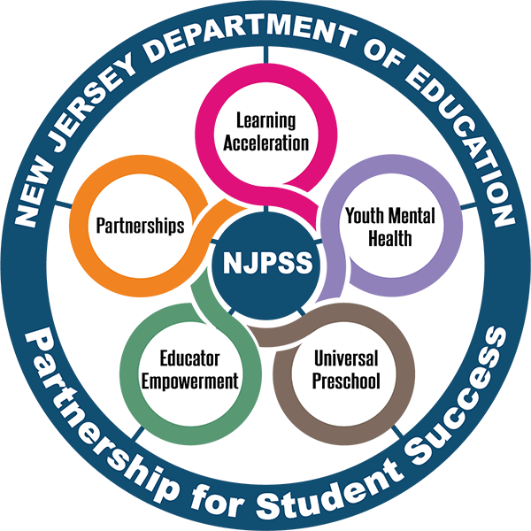
Providing Equitable Access to
Grade-Level Content
Office of Educator Effectiveness
Division of Teaching and Learning Services
Spring 2023
An NJPSS Resource

Slide 2
Agenda
Introduction
Resource Review
Exploring Tools and Rubrics
Your Next Steps
Questions

Slide 3
Introduction

Slide 4

Norms
Students should be at the center of our work
Be present
Do not hesitate to ask questions as they arise

Slide 5
New Jersey Partnership for Student Success (NJPSS)
A system of supports and programs for students and educators to be used at the local level to meet the specific needs of each district
The supports and programs are designed to be tailored and molded to provide the necessary supports to assist students and educators as they move forward

Slide 6
NJPSS: The Five Areas of Focus
Learning Acceleration: A collection of resources, guidance, and tools designed to move students forward through increased instructional time and accelerated learning opportunities.
Youth Mental Health: Support designed with social and emotional learning at the forefront helping students lead a balanced and healthy life, through their educational years and beyond.
Universal Preschool: Enhanced support for existing programs and increased funding opportunities to expand the program into new districts, with support and partnership from New Jersey’s licensed child care and Head Start providers, and to increase the number of available seats in existing programs.
Educator Empowerment: Targeted and enhanced professional development opportunities focused on techniques to accelerate learning, mental health and well-being supports for school staff, and the recruitment and retention of diverse and highly-qualified educators with the understanding that these endeavors are necessary to grow the educational ecosystem and provide the best environment for students.
Partnerships: The New Jersey Department of Education looks forward to expanding partnerships to positively impact outcomes through the reach of partnerships.

Slide 7


Grade-Level Content Access Area of Focus
This resource intersects with two of the areas of focus:
Learning Acceleration
Educator Empowerment

Slide 8
Resource Review

Slide 9
Four Key Takeaways
#1 - Ensuring students have access to grade-level content every day allows them to:
  Show mastery of grade-level standards,
  Engage with complex content, and
  Advance socially and academically.
#2 - When students' access to grade-level content is protected, achievement and opportunity gaps may shrink.
#3 - Needing intervention, remediation, enrichments, or other supports may be necessary, but should not continuously interfere with opportunities for regular and meaningful access to grade-level content.
#4 - When students are given the opportunity to prove themselves, they almost always do.

Slide 10
Moment of Reflection #1
What is your definition of
Grade-Level Content?

Slide 11

What is Grade-Level Content?
Grade-Level Content are the rigorous grade-appropriate instructions and tasks, driven by the New Jersey Student Learning Standards (NJSLS) which support students in meeting learning objectives.

Slide 12
Moment of Reflection #2
Share one example, of a typical way you would ensure an assignment or task was grade-level?

Slide 13
What Grade-Level Content is Not:
What it is Not: | What it is:
Arbitrary | Heavily aligned to the standards (skills) students should acquire year to year, according to their biological age and corresponding grade level
Unvetted | Third-party reviewed high-quality resources
Unrelatable | Applicable to student's present life/circumstance…evoke action and everyday use of skills

Slide 14
Is Grade-Level Content Access at Risk?
Yes, Studies Report: | Yes, Studies Report: | Yes, Studies Report:
Students can spend up to 500 hours on non-grade-level tasks | Teachers can spend 7–12 hours a week creating/researching for instructional resources | Implicit biases can cause students of color to have far less access to rigorous (grade-level) instruction, than their peers

Slide 15
Moment of Reflection #3
Do you know a student that has missed their opportunity to engage with grade-level content lately? ​
Do your experiences ring true to the studies?​

Slide 16
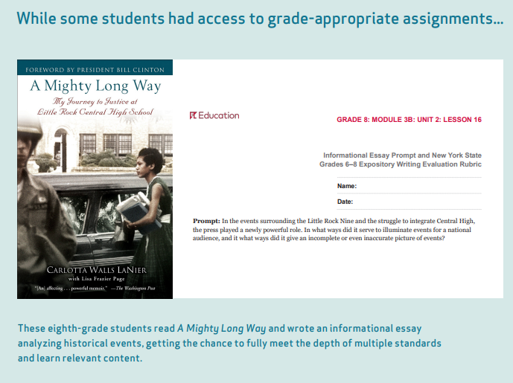
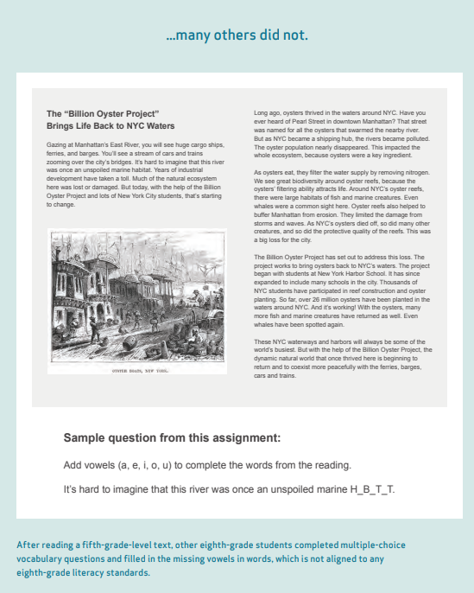
What Inequitable Access Can Look Like:

Slide 17
Why Protect Grade-Level Access?
So students do not suffer a lack of: | They instead have regular and prioritized opportunity to:
Exposure | Show mastery of grade-level
Rigor | Engage with complex content, and
Access | Advance socially and academically

Slide 18
How to Protect Grade-Level Content Access? (1)
Setting the Foundation for Building Leaders:
  Maximize Curriculum
  Dedicate Time to Learning Acceleration
  Invest in High-Quality Instructional Materials
  Use Culturally Responsive Assessments

Slide 19
How to Protect Grade-Level Content Access? (2)
Strategies to Reimagine for Classroom Educators:
  Use High Quality Instructional Materials
  Pre-Assess for Proficiency of Prerequisite Skills
  Find Time to Address Additional Areas for Growth
  Confront Unconscious Biases
  Engage with Families and Caregivers
  Evaluate Curriculum for Cultural Responsiveness
  Normalize Struggling
  Employ “Previously On” Style Introductions
  Ensure Students Get Started
  Implement Academic Teaming

Slide 20
Exploring Tools & Rubrics

Slide 21
Protecting Access: Maximizing Curriculum
Evaluating curriculum often and regularly will help ensure it is:
Aligned to current standards,
Accessible for diverse learners,
Culturally relevant and relatable,
Of overall quality, and
Easy for educators to use.

Slide 22
Protecting Access: HQIM’s
High-Quality Instructional Materials (HQIM) are those which are vetted and proven to promote learning
Increasing the quality of materials used in classrooms will help ensure students are engaged in grade-level learning
Allowable investment of ESSER Funds
EdReports – Would anyone like to check out theirs?

Slide 23
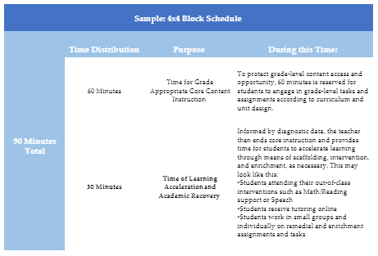
Protecting Access: Find Time to Address Additional Areas for Growth
An additional strategy to find time may be Micro-Scheduling:
A teacher-driven strategy to meet students' needs without compromising or obstructing time for grade-level instruction:
  Secondary Level
  When a school does not have a flexible period

Slide 24
Moment of Reflection #4
What other strategies can you reimagine
to increase or protect students access to
grade-level content?​

Slide 25
What are Possible Next Steps?
Take time to reflect on your classroom practices, reconsider your assignments for High Quality, Vetted, Relatable
Assess current curriculum (classroom, school, district-wide)
Have open conversations around Grade-Level Content… Involve stakeholders
Be an advocate, if it is time for change, say something.

Slide 26
Questions?

Slide 27
Thank You!
New Jersey Department of Education: nj.gov/education
Office of Educator Effectiveness: EduEval@doe.nj.gov
Follow Us!
Facebook:
@njdeptofed
Twitter: @NewJerseyDOE
Instagram:
@NewJerseyDoe

