Slide 1
Maximizing Schedules to Support Learning Acceleration
Office of Educator Effectiveness
Division of Teaching and Learning Services
Spring 2023
An NJPSS Resource

Slide 2
Norms
Students should be at the center of our work
Be present
Do not hesitate to ask questions as they arise

Slide 3
New Jersey Partnership for Student Success (NJPSS)
A system of supports and programs for students and educators to be used at the local level to meet the specific needs of each district
The supports and programs are designed to be tailored and molded to provide the necessary supports to assist students and educators as they move forward

Slide 4
NJPSS: The Five Areas of Focus
Learning Acceleration: A collection of resources, guidance, and tools designed to move students forward through increased instructional time and accelerated learning opportunities.
Youth Mental Health: Support designed with social and emotional learning at the forefront helping students lead a balanced and healthy life, through their educational years and beyond.
Universal Preschool: Enhanced support for existing programs and increased funding opportunities to expand the program into new districts, with support and partnership from New Jersey’s licensed child care and Head Start providers, and to increase the number of available seats in existing programs.
Educator Empowerment: Targeted and enhanced professional development opportunities focused on techniques to accelerate learning, mental health and well-being supports for school staff, and the recruitment and retention of diverse and highly-qualified educators with the understanding that these endeavors are necessary to grow the educational ecosystem and provide the best environment for students.
Partnerships: The New Jersey Department of Education looks forward to expanding partnerships to positively impact outcomes through the reach of partnerships.

Slide 5
Learning Acceleration Area of Focus
This resource falls under the “Learning Acceleration” area of focus.
“Maximizing Schedules to Support Learning Acceleration” provides information on the advantages of flexible scheduling, with the purpose of adding time for a learning acceleration block designed to meet students’ needs.

Slide 6
Agenda
Schedules Matter
Maximizing Schedules Resource Overview
Sample Scheduling Approaches
Utilizing the Time
Panel: How is this Work Accomplished?

Slide 7
Schedules Matter
Schools that align their mission, vision and core values with a precise focus on student learning many times strategically align structures, policies, and practices to do
the same.

Slide 8
Reconsidering Traditional Schedules
Schedules impact every moment of a teacher and learner’s educational experience, yet we don’t think about it as a thing to leverage.
"Rethinking School Schedules to Support Innovation" (Matthewson, 2019)

Slide 9
The Power of Innovative Scheduling
Three Issues all Schools Face
A Thoughtful Schedule Can
Providing quality time
Creating a school climate
Providing varying learning time
Result in more effective use of time, space, and resources
Improve instructional climate
Help solve problems related to the delivery of instruction
Assist in establishing desired programs and instructional practices
Canady & Rettig, 1995

Slide 10
Maximizing Schedules Resource Overview
This resource is for local education agencies (LEAs) who are interested in maximizing schedules to meet their students’ needs, as well as support those which currently have implemented flexible scheduling.

Slide 11
Maximizing Schedules to Meet Student Needs
This resource is intended to:
Provide details for building schedules which support time for learning acceleration.
Address ways in which local education associations (LEAs) can implement these practices with both minimal and full changes to school schedules.
Provide LEAs with sample schedules which provide time within the school day for intervention, acceleration, and enrichment while honoring time for high-quality core instruction.

Slide 12
Key Points to Remember
Maximizing bell schedules to support accelerated learning is an achievable goal.
All students with unfinished learning deserve access to extra time for acceleration and this time can be built into students’ daily schedules.
Ensure adequate time for high-quality core instruction is maintained.
A strategic schedule that has protected Tier 1 instructional blocks and has a place for students to receive intervention and enrichment support (I/E) without missing new instruction in core subject areas is one that facilitates learning.
The process will take time, but it will be time well spent.
Building a master schedule requires thoughtful decision making, stakeholder engagement and consultation with local collective bargaining units.

Slide 13
Sample Scheduling Approaches
Traditional bell schedules can be adjusted to incorporate time for learning acceleration activities, while innovative scheduling techniques also serve this purpose.

Slide 14
Flexible Scheduling
Flexible Scheduling: A creative use of the time in the school day in an attempt to match the instructional time and format to the learning needs of students.
National Middle School Association, 2007

Slide 15
What I Need (WIN) Periods
A dedicated time schools use to meet students’ needs.
These provide students with accelerated instruction in the form of:
High Impact Tutoring.
Enrichment activities or additional activities to support students’ social, emotional, and academic needs.
Meeting with a specific teacher to catch up on work.
While many schools may not refer to this by the name "WIN period," it is the activities which define the time.
Notes:
Also referred to by other names.

Slide 16
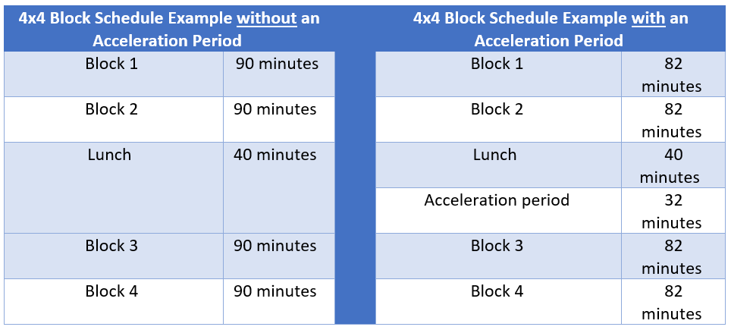
4x4 Block Schedule
Some advantages of this type of schedule are:
Teachers see fewer students per day
Students have the opportunity to take more elective classes during a school year
Teachers have time to vary the activities they plan for each class period

Slide 17
Rotating Drop Schedule
Many high schools across New Jersey have adopted this option
Students typically only attend 5 or 6 of the 8 total available classes each day
This schedule creates space for an acceleration period

Slide 18
Micro-Scheduling
A useful strategy to create time for acceleration without adding a flexible block to an existing schedule
This elementary example compares how micro-scheduling can be used to create acceleration time within a traditional math or ELA block
Core instructional time is prioritized and protected

Slide 19
Utilizing the Time
The aim of implementing a flexible scheduling approach is to ensure all students with unfinished learning receive increased time built into their daily schedules to improve students’ access to and mastery of grade-level standards.

Slide 20
Promising Practices to Support Academic Recovery
Use high-quality diagnostic and formative assessments to inform and personalize instruction.
Implement high-quality and effective tutoring (High Impact Tutoring).
Integrate and prioritize the social, emotional and academic needs of all students.
Provide students with tailored learning acceleration opportunities.
Support the successful transition of students.
Use high-quality out of school time learning experiences to support students’ social, emotional and academic needs.
US Department of Education, 2022

Slide 21
High Impact Tutoring
One-on-one or small group instruction, towards a specific goal
Leads to substantial learning gains for students by supplementing (but not replacing) students’ classroom experiences; and
Responsive and complements students’ existing curriculum and focuses on scaffolding academic content.
Robinson, Carly D., and Susanna Loeb, 2021

Slide 22
Implementing a High Impact Tutoring Program as Part of a Flexible Schedule
High impact tutoring has been proven to:
Produce large learning gains in a short period of time;
Increase learning for a wide variety of K-12 students; and
Be scaled and still improve student learning outcomes.
A flexible schedule allows for:
Regularly provide opportunities for tutoring.
Scheduled tutoring sessions during the school day.
The alignment of tutoring with an evidence-based curriculum.

Slide 23
Panel: How is this Work Accomplished?

Slide 24
Thank You!
New Jersey Department of Education: nj.gov/education
Follow Us!
Facebook: @njdeptofed
Twitter: @NewJerseyDOE
Instagram: @NewJerseyDoe

