Slide 1
Professional Learning series: New Jersey Tiered System of Supports (NJTSS) Effective District and School Leadership
Office of Student Support Services
Division of Educational Services

Slide 2
Quote
“Leadership and learning are indispensable to each other.”
John Kennedy

Slide 3
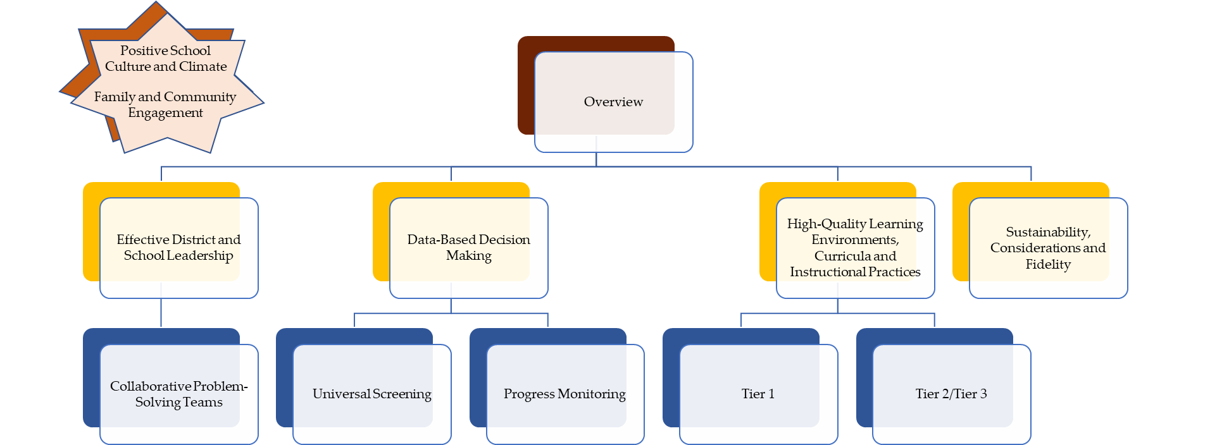
NJTSS series: Navigation

Slide 4
Purpose
After this presentation, you will better understand Effective District and School Leadership, an Essential Component of the New Jersey Tiered System of Supports (NJTSS) framework.

Slide 5
NJTSS: Defined
New Jersey Tiered System of Supports: A framework for supporting the academic, behavioral, social-emotional and health needs of all students through a layered continuum of evidence-based practices, interventions and services.
Source: https://www.nj.gov/education/njtss/guidelines.pdf

Slide 6
Essential Components
Effective district and school leadership
Family and community engagement
Positive school culture and climate
High-quality learning environments, curricula, and instructional practices
Universal screening
Data-based decision making
Collaborative problem-solving teams
Progress monitoring
Staff professional development

Slide 7
Effective District and School Leadership
Definition
Effective district and school leadership, for the purposes of implementing NJTSS, is the establishment of, or use of existing, district- and school-level leadership teams to support the implementation of the components of NJTSS with fidelity.
Source: https://www.nj.gov/education/njtss/guidelines.pdf

Slide 8
Sample Layers of Leadership
District Level
Building Lead
District vision and goal setting.
Set the implementation fidelity plan.
Consists of building lead stakeholders
Director of Curriculum, Director of Special Education, Supervisor, Principal, Assistant Principal, etc.
Building Level
Drive building level NJTSS.
Use data for curriculum and professional development planning purposes.
Consists of building leadership and content specific coaches
Principal, Assistant Principal, School Psychologist, Literacy/ Math Coach, etc.
Intervention
All data meetings.
Student progress monitoring meeting.
Consists of building-level stakeholders
Literacy/Math Coach, School Counselor, School Psychologist, 504 Coordinator, Teacher representative, etc.
Analyze classroom or grade-specific data.
Create and discuss intervention plans.
Provide direct assistance to teachers.
Literacy/Math Coach, Interventionist, Teacher.

Slide 9
Communications Process
Intervention Team
District Level
Building Lead
Building Level
Director of Curriculum, Director of Special Education, Supervisor, Principal, Assistant Principal, etc.
Principal, Assistant Principal, School Psychologist, Literacy/Math Coach, etc.
School Psychologist, Literacy/Math Coach, School Counselor, 504 Coordinator, Teacher, etc.
Literacy/Math Coach, Interventionist, Teacher.

Slide 10
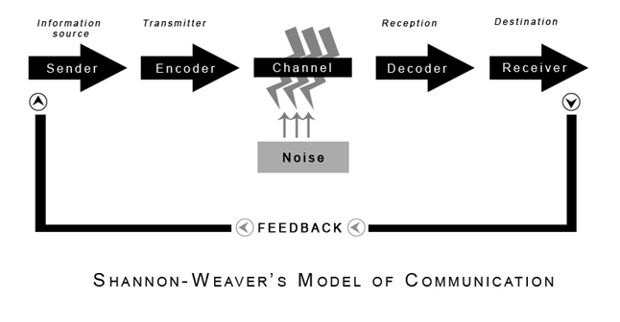
Weaver’s Model of Communication

Slide 11
Leadership Traits Across NJTSS
RESOURCEFUL
Plans for and honors the resources needed (time, personnel, etc.) to operationalize strong practices and procedures within their context.
SYSTEMS ORIENTED
Employs critical thinking to evaluate the functions of larger systems and when trying to understand plausible factors contributing to identified needs.
DATA-DRIVEN
Focuses on an effective use of data to make decisions about student-level and system-level progress.
PROBLEM-SOLVER
Promotes a problem-solving culture within among the team they are charged to lead.

Slide 12
Readiness to Implement
Readiness is the degree to which the organization and the people working within it are positioned to undertake the complex process of change (Arden & Pierce, 2019, Fixsen, Blase, Horner, & Sugai, 2009).
Find the balance between effectiveness and efficiency, landing at the right number and configuration for each school’s need, so that teams can find the time to meet and get through their agendas (Goodman & McIntosh, 2016).
Source: https://www.cde.state.co.us/mtss/dbireadinessslides

Slide 13
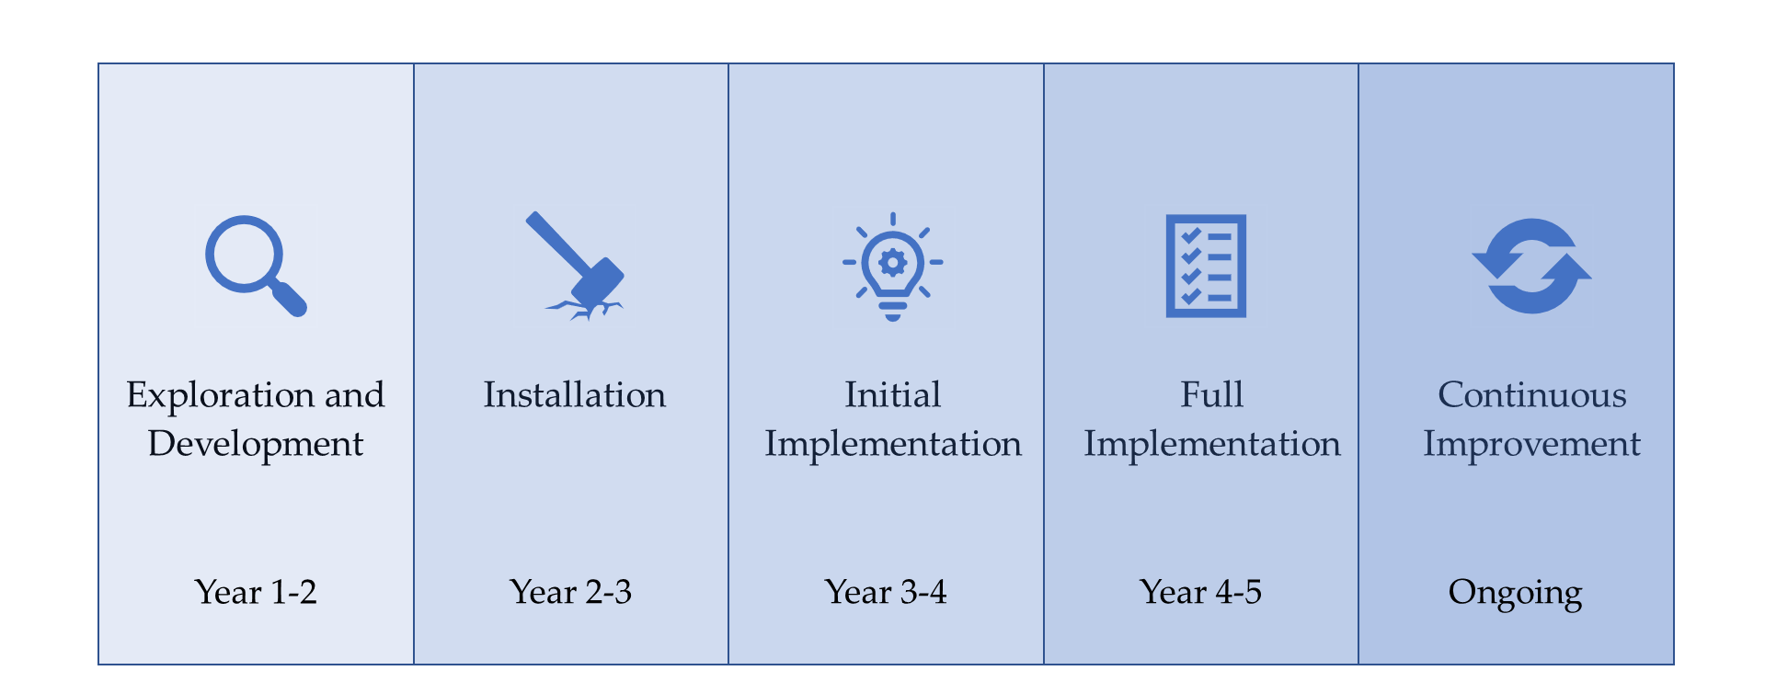
Five Phases of Implementation
Sample Timeframe

Slide 14
Take a Pulse
Reflection Questions:
Considering your unique situation, do you believe you have a leadership team in place to establish a NJTSS?
Which types professional development opportunities can you and your district and school leadership teams participate in to improve your ability to operate a strong NJTSS?

Slide 15
Operationalizing New Jersey Tiered System of Supports

Slide 16
Evidence of Strong and Engaged Site Leadership (1 of 4)
Convene stakeholders.
Evaluable system capacity.
Reflect on current challenge.
Set sights on what can be.
Clear Vision Statement

Slide 17
Evidence of Strong and Engaged Site Leadership (2 of 4)
Convene stakeholders.
Evaluable system capacity.
Reflect on current challenge.
Set sights on what can be.
Create opportunities for stakeholders in varying modalities
Surveys
Focus
Groups
Town Halls
Collaboration
Clear Vision Statement

Slide 18
Evidence of Strong and Engaged Site Leadership (3 of 4)
Convene stakeholders.
Evaluable system capacity.
Reflect on current challenge.
Set sights on what can be.
Create opportunities for stakeholders in varying modalities
Surveys
Focus
Groups
Town Halls
Regularly attend instructional meetings.
Conduct classroom visits.
Collaboration
Clear Vision Statement
Time Management

Slide 19
Evidence of Strong and Engaged Site Leadership (4 of 4)
Convene stakeholders.
Evaluable system capacity.
Reflect on current challenge.
Set sights on what can be.
Create opportunities for stakeholders in varying modalities
Surveys
Focus
Groups
Town Halls
Regularly attend instructional meetings.
Conduct classroom visits.
Building Lead
Grades
Attendance
Building Level
Formative Assessments
Intervention
Progress Monitoring
Tiered Support
Collaboration
Clear Vision Statement
Time Management
Sample Data Sources to Consult

Slide 20
NJTSS Operational Components (1 of 2)
FORMAT | PURPOSE | FREQUENCY | FACILITATOR | PARTICIPANTS
School Climate Assessment | Collect the perceptions of students, staff, and families on the conditions of a school that indicate the quality of the teaching and learning environment | Once per year (October -May) | School Safety/School Climate Team | Students Staff Families
Universal Screening (US) Meeting | Evaluate the results of the universal screening and group students that are at risk for poor learning or behavioral outcomes. | 3x per year (fall, winter, spring) | School-based leader | School-based teams
Data Meetings | Analyze data from universal screening, interim assessments, climate survey, etc. Review data collected and elevated by School-based teams. | Biweekly | School-based leader | School-based teams
Progress Monitoring Meetings | Monitor progress of Tier 2 and Tier 3 interventions and outcome data. | Regular intervals, i.e. once a month | School-based leader | School-based teams

Slide 21
NJTSS Operational Components (2 of 2)
FORMAT | PURPOSE | FREQUENCY | FACILITATOR | PARTICIPANTS
Ongoing data-informed Staff Professional Development | Continuous development of skills in the use of integration of assessments, data-based decision-making and high-quality instruction and interventions as informed by the school-based teams. | Ongoing | School-based leader/Instructional Specialists | All relevant staff
Fidelity Meeting | Assess implementation of NJTSS and LA. Continuously identify and address needs or gaps in fidelity. | Biweekly, can be part of data meetings as time allows | School-based Leader | School-based team
ScIP Team Meetings | School Improvement Panels (SCiP) ensure, oversee, and support the implementation of the district’s evaluation, professional development (PD), and mentoring policies at the school level. | As needed to meet requirement included in N.J.S.A 18A 6-117 et al. aka TEACHNJ Act | School-based Leader | School principal, assistant/vice principal, designee, and a teacher
Summative Assessment Meeting | Reflect on student performance relative to grade-level standards mastery. Initiate planning to improve curriculum, instruction and learning the next year. | End of school year | School-based leader/instructional Specialists | School-based team

Slide 22
NJTSS Sample School Calendar: “At A Glance”
September-October
Administer: Universal Screening (1 of 3): fall (students)
Administer: School climate survey (students, staff, families)
Establish school-level leadership team that will support the implementation of the components of NTJSS with fidelity
Universal Screening Meeting: Assess results to determine needs
Data Meeting: Analyze relevant data i.e. assessment, attendance, discipline, teacher attendance, school climate, etc.
Progress Monitoring Meetings: Progress monitoring for Tier 2/3 interventions
Fidelity Meetings: Assess implementation of NTJSS and identify areas for improvement
Ongoing: Staff Professional Development
March-April
Administer: Universal Screening (3 of 3): spring (students)
Universal Screening Meeting: Assess results to determine needs
Data Meeting: Analyze relevant data i.e. assessment, attendance, discipline, teacher attendance, school climate, etc.
Progress Monitoring Meetings: Progress monitoring for Tier 2/3 interventions
Fidelity Meetings: Assess implementation of NJTSS and areas for improvement
Ongoing: Staff Professional Development
October-February
Administer: Diagnostics
Administer: Universal Screening (2 of 3): winter (students)
Universal Screening Meeting: Assess results to determine needs
Data Meeting: Analyze relevant data i.e. assessment, attendance, discipline, teacher attendance, school, climate, etc.
Progress Monitoring Meetings: Progress monitoring for Tier 2/3 interventions
Fidelity Meetings: Assess implementation of NJTSS and areas for improvement
Ongoing: Staff Professional Development
May-June
Administer: Summative Assessment (students)
Summative Assessment Meeting: Assess results to determine needs
Data Meeting: Analyze relevant data i.e. assessment, attendance, discipline, teacher attendance, school climate, etc.
Progress Monitoring Meetings: Progress monitoring for Tier 2/3 interventions
Fidelity Meetings: Assess implementation of NJTSS and areas for improvement
Ongoing: Staff Professional Development

Slide 23
Sample Resource Inventory
Resource | Intention | Task | Assignment | Questions
Personnel | Increase thinking, about all human resources that may be accessed, regardless of current role and responsibilities | List, by position, all personnel working in the building (e.g. Teacher Algebra 1: Ms. Hardey)
Facilities | List all rooms and spaces available in the building | Consider all of the space available to the school (e.g., Rm 351-small room next to cafeteria in basement)
Curriculum & Interventions | Identify all available instructional resources and materials used for both … for academic, behavior, and social emotional learning instruction | List the curricular material available for core curriculum interventions and supports for academics and behavior (e.g., core reading curriculum. Wonder series)
Time Allocations & Requirements | Identify specified time requirements for core instruction and time currently allocated for providing additional interventions and supports. | List the current schedule for delivery of content (e.g., 120 minute daily intervention block)
Additional Resources | Identify any supplementary resources available to support MTSS implementation. | List the additional resources available to meet student need across tiers (e.g., Boys & Girls Club’s Homework Club)
Schoolwide Data | Provide a general overview of the percentage of students who need additional support | Indicate schoolwide need as determined by data (e.g., 38% of students who may need additional reading instruction)
Source: https://guide.swiftschools.org/resource/104/swift-resource-map

Slide 24
Best Practices for Facilitating Meetings through the Phrases of Implementation
Team member roles and responsibilities clearly defined.
Collective focus on solutions-based collaboration.
Use of team norms, meeting agendas and local templates to facilitate and document meetings.
Data and root-cause analysis are used to determine strategies to support the instruction and learning process.
Focused on improving educational outcomes for students.

Slide 25
Reflective Questions
Do we have the capacity to implement NJTSS with fidelity? What do we need to get started?
Do we have the professional learning available for implementation in a systemic and methodical way?
How can we mobilize a team/teams that support effective implementation?

Slide 26
NJTSS: Start Where You Are
District-level leadership team:
Guide the district in assessing what is needed to implement and maintain a cohesive system that engages all students, staff, families and community resources.
Review the NJTSS Manual.
Implement using Getting Started with NJTSS.
NJTSS Manual - https://www.state.nj.us/education/njtss/guidelines.pdf
Getting Started with NJTSS - https://www.state.nj.us/education/njtss/started.pdf

Slide 27
Thank You
New Jersey Department of Education
@NewJerseyDOE
@newjerseydoe
Thank You!
New Jersey Department of Education
New Jersey Department of Education
@newjerseydoe

