Slide 1

Nonpublic School
Security Aid Program
2017-2018
Office of Interdistrict Choice and Nonpublic Schools
Office of School Preparedness and Emergency Planning

Slide 2
Collaboration within NJDOE
Office of Nonpublic Schools
Office of School Preparedness and Emergency Planning
Office of Finance

Slide 3
Nonpublic School Security Aid Program
Statute passed in 2016
  Regulations in process
$75.00/ student, regardless of state of residence
  Note that the dollar amount of the support limit is
  dependent on the annual Appropriations Act.
No administration fee for school districts
Funds sent to the public school district

Slide 4
District Responsibilities
District consults with nonpublic schools:
May
BOE approves nonpublic school request:
Spring/summer
District submits agreement (consultation form) to Executive County Superintendent
Oct. 1
District orders equipment and/or services:
Prior to start of school year

Slide 5
District Responsibilities
Consultation
(By the end of May)
Advise nonpublic of funding amount
Agree on security services, equipment and technology to be provided to the nonpublic school
Set date when the BOE will meet to approve the security services, equipment and technology to be provided to the nonpublic school

Slide 6
District Responsibilities
District sends to the Executive County Superintendent and nonpublic administrator(s):
(By mid Oct.)
A written statement (consultation form) verifying that the required conference with the nonpublic school administrator was held, with agreed upon security services, equipment and technology to be purchased and the timelines for purchases and implementation.
The minutes of the board of education meeting at which the security services, equipment and technology that will be provided to the nonpublic school was granted approval.

Slide 7
District Responsibilities
Purchasing
District creates and prepares purchase orders in accordance with district procurement procedures and Public School Contracts law
District arranges delivery

Slide 8
Procurement Details
Purchases must follow the local school district’s procurement procedures and Public School Contracts Law
Services, technology and equipment must be used for secular, neutral, non-religious and non-ideological purposes
    Only the school district can dispose of technology and equipment purchased for this program, in accordance with the provisions of the Public School Contracts Law
    Nonpublic School Security Aid Program funding can be used for the disposal of technology and equipment

Slide 9
District Responsibilities
Accounting
The Nonpublic Security Aid Program must be recorded in the special revenue fund as “Restricted Grants in Aid” in the general ledger revenue account 20-3241-511
Appropriations and expenditures must be recorded in the special revenue fund as “Nonpublic School Programs” in account #20-511-XXX-XXX
Maintain separate costs for each nonpublic school’s Security Aid Program activities
Notes:
Ask Cindy

Slide 10
District Responsibilities
Project Completion Report
Opens in mid-August and closes in mid-October
The Nonpublic Project Completion Report (NPCR) can be found on the NJ Homeroom web page:
http://homeroom.state.nj.us

Slide 11
District Responsibilities
Do not send a paper check of unexpended funds to the DOE. They will be deducted from the district through the State Aid payment deduction.
Notes:
All refunds will be collected through a state aid payment deduction after you have completed the FY15 Nonpublic Project Completion Report (NPCR). Section 10 of Guidelines

Slide 12
District Responsibilities
Auditing
The Nonpublic School Security Aid Program expenditure
records will be audited locally.
All records relating to the program must be retained
for audit purposes.

Slide 13
Disagreement Resolution
In the event that the chief school administrator or designee and the nonpublic school administrator cannot reach agreement regarding the services, equipment or technology to be provided, the Executive County Superintendent shall make the final determination.

Slide 14
Contact
Program and Funding Questions:
  Greg Kocher: 609-633-0251 or
  nonpublicschoolservices@doe.state.nj.us
Program information:
http://www.state.nj.us/education/nonpublic/state/security.htm

Slide 15

N.J. Nonpublic School Security Aid Program
Purchases and Strategies
Office of School Preparedness and
Emergency Planning (OSPEP)

Slide 16
Assessment
Determinations should be guided by
facility assessments considering:
          Security posture
          Student population
            Size
            Special needs
          Urban/suburban/rural
          Location
          Age of building(s)

Slide 17
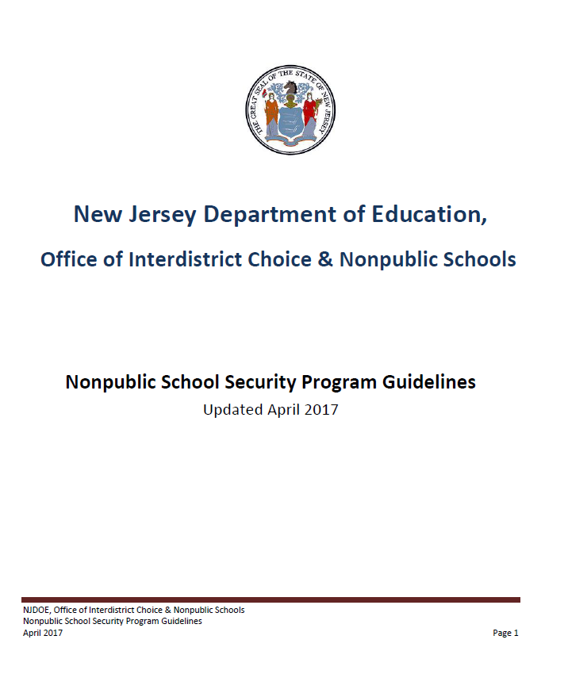
Purchases
What may be purchased?
Although NOT inclusive of all security enhancements, the following slides show some examples of acceptable safety and security measures under this program. For further guidance on purchases, please refer to pages 12 – 15 of the Nonpublic School Security Program Guidelines.

Slide 18
Purchases
Installation of, or improvements to…
Exterior doors, frames, and/or hardware
Exterior windows and/or hardware
Mechanisms designed to prevent entry into the classroom
Security vestibules
Bullet resistant glazing in the interior vestibule doors and windows
Ballistic or shatter resistant film for glass entrance door sidelights or vulnerable areas on first floor
Access control systems to allow for remote locking and unlocking of all building access doors
Fire-rated blinds, shades or similar devices for doors and windows that can be used during lockdowns

Slide 19
Purchases
Costs associated with the following security services…
Alarm services, security assessments, video security surveillance systems, and security guards
Construction / Equipment / Signs…
Separate bus drop-off/pick-up areas
Separate pedestrian routes from vehicular routes
Stop signs and other traffic calming devices to keep vehicles at a reasonable speed

Slide 20

Strategy
Layers of School Security
The Perimeter,
The School,
The Classrooms,
The Staff & Students

Slide 21
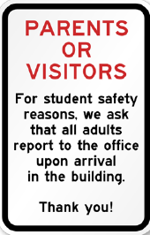




Strategy
Push threat outward - Perimeter

Slide 22

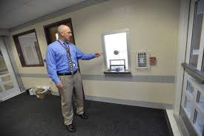
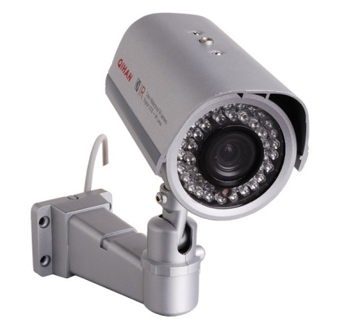
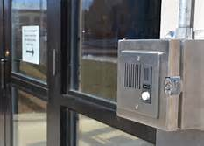
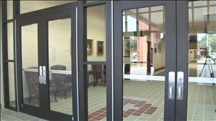
Strategy
Access/Entrance - School

Slide 23

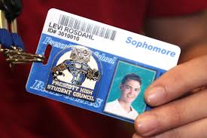

Strategy
Identification procedures - School

Slide 24
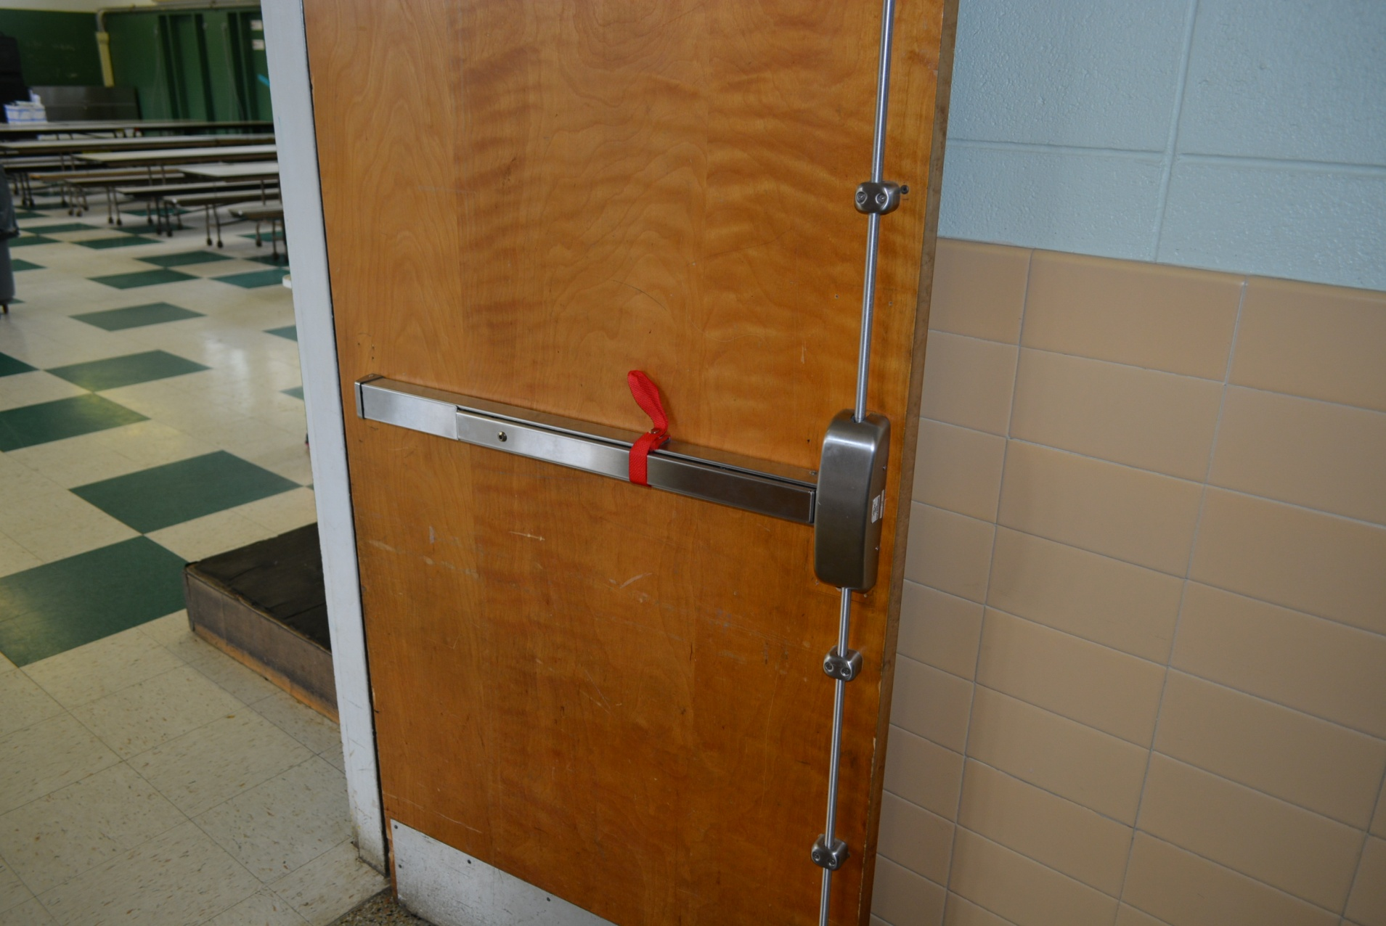
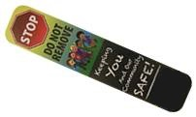
Ways to quickly lock doors - Classroom
Strategy
Panic Bar Straps
Door Magnets

Slide 25

Locking Common Areas
Strategy
Consider ways to quickly lock common areas or unattended rooms such as:
Faculty rooms
Copy rooms
Staff rooms

Slide 26
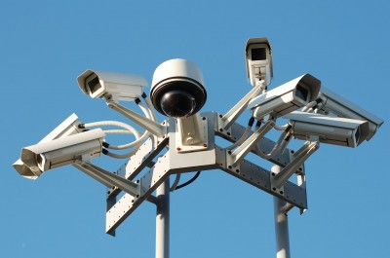

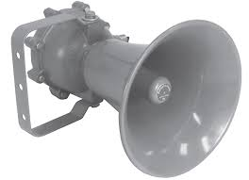
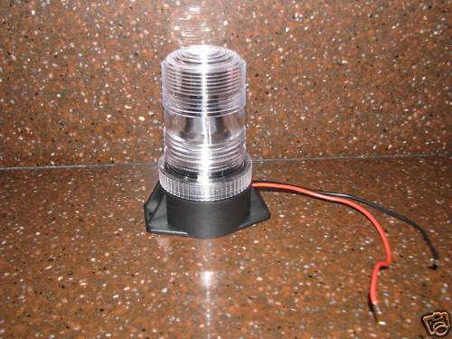
Strategy
Consider redundancy

Slide 27

New Jersey Department of Education
Office of School Preparedness and Emergency Planning http://www.state.nj.us/education/schools/security/ schoolsecurity@doe.state.nj.us
609-588-2323
Technical Assistance
Training and Technical Assistance
available from the
□ School Safety and Security Plan Assistance
□ Drill Observations
□ In-Service or Professional Development
□ Town Hall Meetings, PTA Meetings, Other
□ Site Visits

