Slide 1
Chapter 9C Regulations and Professional Learning: 2023-2024 and Beyond
Office of Educator Effectiveness

Slide 2
Session Objectives
By the end of this session participants will be able to:
  Understand the key changes to Chapter 9C (Professional Development) regulations.
  Explain the rationale behind the key changes.
  Understand how to leverage the New Jersey Standards for Professional Learning (NJSPL) to support individual and collective educator growth.

Slide 3
Underlying Principles of the Work of Professional Learning in the Office of Educator Effectiveness
Educator development occurs along a continuum of rigorous pre-professional preparation, certification, and professional development to prepare educators.
An effective professional learning system continuously serves educators’ individual and collective professional learning and practice in support of positive learning outcomes for all of New Jersey’s students.
An effective evaluation system drives and supports the continuous growth of educators.

Slide 4
Major Changes to Chapter 9C
Strengthening Support for Novice Teachers
Ensuring the District Mentoring Plan is a Collaborative and Transparent Process
Increased Specificity of What Counts in Professional Development for Teachers
Required Professional Development Plans for Educational Interpreters and Preschool Paraprofessionals
Revised New Jersey Standards of Professional Learning

Slide 5
Strengthening Support for Novice Teachers: Regulatory Revisions
Novice teachers are now required to receive more frequent and targeted support.
Weekly, in-person contact time for a minimum of 30 weeks.
Increased meeting frequency to twice per week for novice provisional teachers holding a Certificate of Eligibility with Advanced Standing (CEAS) or a Certificate of Eligibility (CE).
  Those holding a CEAS: 2x/week for the first 4 weeks.
  Those holding a CE: 2x/week for the first 8 weeks.
Nontenured teachers in their first year of employment will be provided individualized support and activities based on the nontenured teacher’s individual needs.

Slide 6
Strengthening Support for Novice Teachers: A Reflection
Revised Regulations
Weekly, in-person contact time for a minimum of 30 weeks.
Increased meeting frequency to twice per week for novice provisional teachers holding a CEAS or a CE.
  Those holding a CEAS: 2x/week for the first 4 weeks.
  Those holding a CE: 2x/week for the first 8 weeks.
Nontenured teachers in their first year of employment will be provided individualized support and activities based on the nontenured teacher’s individual needs.
Local Impact
Does your program already meet these requirements?
What could the increased time be used for?
What process could be used to ensure compliance with the third revision?

Slide 7
Ensuring the District Mentoring Plan is a Collaborative and Transparent Process: Regulatory Revisions
Updating the district mentoring plan should be a collaborative and transparent process.
The district mentoring plan shall include formal and informal resources and support to guide novice provisional teachers throughout the entire provisional period.
The chief school administrator (CSA) or designee shall:
  Collaborate annually with each School Improvement Panel (ScIP) to review the district mentoring plan, consider ways to support the plan at the school level, and take steps to ensure that all new teachers are receiving the necessary professional support.
  Make available to staff an electronic copy of the current district mentoring plan.
Each ScIP shall oversee the school-level implementation of the district mentoring plan and shall communicate the plan to all nontenured teachers and their mentors.

Slide 8
Ensuring the District Mentoring Plan is a Collaborative and Transparent Process: A Reflection
Revised Regulations
The district mentoring plan shall include formal and informal resources and support to guide novice provisional teachers throughout the entire provisional period.
The CSA or designee shall:
  Collaborate annually with each ScIP to review the district mentoring plan, consider ways to support the plan at the school level, and take steps to ensure that all new teachers are receiving the necessary professional support.
  Make available to staff an electronic copy of the current district mentoring plan.
Each ScIP shall oversee the school-level implementation of the district mentoring plan and shall communicate the plan to all nontenured teachers and their mentors.
Local Impact
Does your program already meet these requirements?
What is one way in which these revisions could strengthen a district mentoring plan?
What might these regulations look like in practice?

Slide 9

Additional Changes: Increased Specificity of What Counts in Professional Development for Teachers
Ensuring what counts in professional development meets the regulatory intent.
Each teacher must have at least 20 hours per year of qualifying experiences that support student achievement, including achievement in academic, physical, social, and emotional learning.
Professional learning experiences may include in-person, virtual or remote courses.

Slide 10
Additional Changes: Required Professional Development Plans for Educational Interpreters
An individual PDP must include at least 10 hours per year of qualifying experiences that support improved practice;
The 10-hour annual qualifying experience shall be based on the length of full-time employment and reduced by a pro rata share reflecting part-time employment, or an absence, including the use of family or medical leave;
The content of each individual PDP shall be developed by the educational interpreter’s supervisor in consultation with the educational interpreter; and
The PDP requirements applicable to teachers at N.J.A.C. 6A:9C-4.4(c), (e) through (h), and (j) shall apply to educational interpreter PDPs.

Slide 11
Additional Changes: Required Professional Development Plans for Preschool Paraprofessionals
Preschool paraprofessionals shall be guided by an individual PDP that must include at least 20 hours per year of qualifying experiences that support improved practice;
The 20-hour annual qualifying experience shall be based on the length of full-time employment and reduced by a pro rata share reflecting part-time employment, or an absence, including the use of family or medical leave;
The content of each individual PDP shall be developed by the preschool paraprofessional’s supervisor in consultation with the paraprofessional;
The PDP shall include coaching by a preschool instructional coach, a preschool intervention and referral specialist (PIRS), and any other coach the school district assigns to work with the preschool paraprofessional; and
The PDP requirements applicable to teachers at N.J.A.C. 6A:9C-4.4(c), (e) through (h), and (j) shall apply to preschool paraprofessionals.

Slide 12
Implementing the Changes: A Reflection
Strengthening Support for Novice Teachers
Ensuring the District Mentoring Plan is a Collaborative and Transparent Process
Increased Specificity of What Counts in Professional Development for Teachers
Required Professional Development Plans for Educational Interpreters and Preschool Paraprofessionals
For each change:
Are you already in compliance?
If not, what immediate next steps will need to be completed?
What questions do you have?

Slide 13
Leveraging the New Jersey Standards for Professional Learning (NJSPL) in Supporting Educator Growth

Slide 14
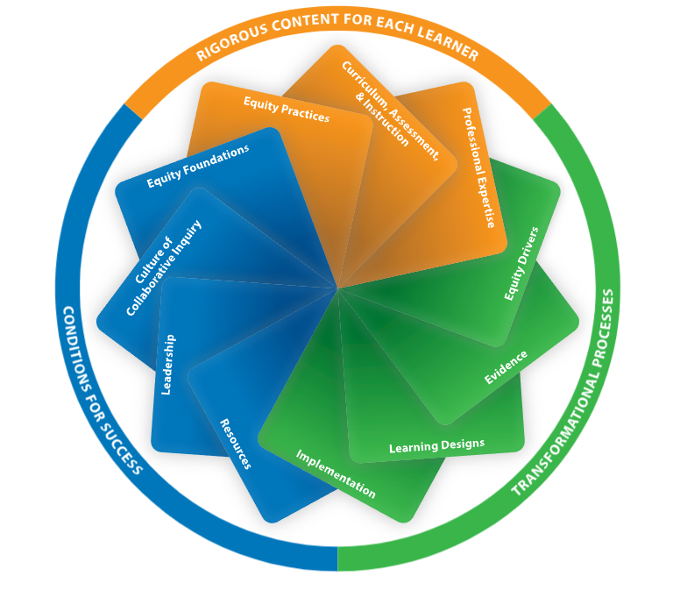
The Revised New Jersey Standards for Professional Learning (NJSPL)
Based on Learning Forward’s research.
The revised standards continue to support ongoing, embedded professional learning with a more explicit focus on equity.
The cyclical and iterative nature of the standards work within a framework of three categories to create high-quality professional learning that:
  Results in improved educator practices and improved student results; and
  Align to current evidence-based practices.

Slide 15

Rigorous Content for Each Learner
Professional learning results in equitable opportunities and excellent outcomes for all students when:
Equity Practices: Educators understand their students’ historical, cultural, and societal contexts; embrace student assets through instruction; and foster relationships with students, families, and communities;
Curriculum, Assessment, and Instruction: Educators prioritize high-quality curriculum and instructional materials for students, assess student learning, and understand curriculum and implement through instruction; and
Professional Expertise: Educators apply the NJSLS and research to their work, develop the expertise essential to their roles, and prioritize coherence and alignment in their learning.

Slide 16
Transformational Processes
Professional learning results in equitable opportunities and excellent outcomes for all students when:
Equity Drivers: Educators prioritize equity in professional learning practices, identify and address their own biases and beliefs, and collaborate with diverse colleagues;
Evidence: Educators create expectations regarding, and build capacity for, the use of evidence from multiple sources to plan educator learning, and measure and report the impact of professional learning;
Learning Designs: Educators set relevant and contextualized learning goals, ground their work in research and theories about learning, and implement evidence-based learning designs; and
Implementation: Educators understand and apply research on change management, engage in feedback processes, and implement and sustain professional learning.

Slide 17
Conditions for Success
Professional learning results in equitable opportunities and excellent outcomes for all students when:
Equity Foundations: Educators establish expectations for equity, create structures to ensure equitable opportunities for access to learning, and sustain a culture of support for all staff;
Culture of Collaborative Inquiry: Educators engage in continuous improvement, build collaboration skills and capacity, and share responsibility for improving learning for all students;
Leadership: Educators establish a compelling and inclusive vision for professional learning, sustain coherent support to build educator capacity, and advocate for professional learning by sharing the importance and evidence of the impact of professional learning; and
Resources: Educators allocate resources for professional learning, prioritize equity in their resource decisions, and monitor the use and impact of resource investments.

Slide 18
Aligning Individual Professional Plans to the NJSPL
Professional development planning is required for individual educators.
The Department provides optional templates with examples to assist districts in planning.
Individual professional development plans must align with the NJSPL.
The following slides provide:
  The basic requirements for individual professional development planning.
  Exemplars of an area of one teacher and one leader professional development plan displaying alignment to various NJSPL standards.

Slide 19
General Requirements for Individual Professional Development Planning
Planning Basics:
  PDPs are in place by October 31 or within 25 days of receiving a summative score
  Replaced by a Corrective Action Plan in the case of a less-than-effective summative rating the prior year (<2.65)
Teachers:
  One goal linked to results from individual performance evaluation
  One goal linked to district, school, team or individual goals
Leaders:
  Derived from performance evaluation
  Address specific individual, school, or school district goals

Slide 20
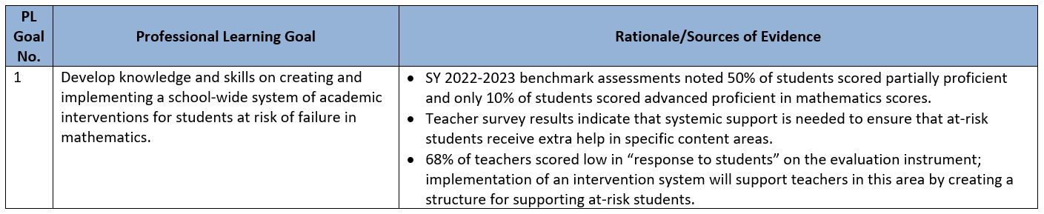
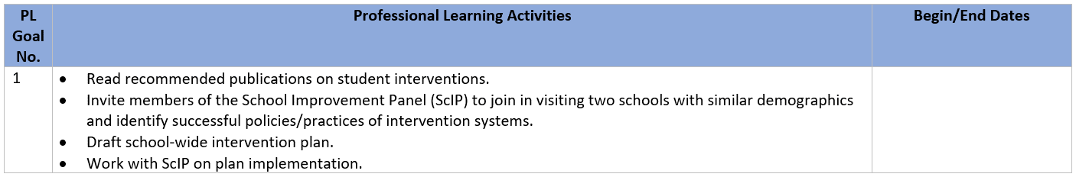
Principal Professional Development Planning Exemplar
Which NJSPL standard(s) is/are highlighted in the following goal, rationale and professional learning activities?
Provide a rationale for each standard chosen.

Slide 21
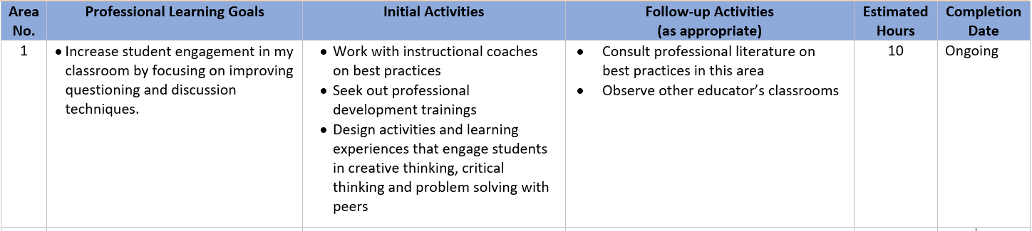
Teacher Professional Development Planning Exemplar
Which NJSPL standard(s) is/are highlighted in the following goal and administrator support activities?
Provide a rationale for each standard chosen.

Slide 22
Aligning School and District Professional Plans to the NJSPL
Professional development planning is required for districts and schools.
The Department provides optional templates with examples to assist districts in planning.
District and school professional development plans must align with the NJSPL.
The following slides provide:
  The basic requirements for district and school professional development planning.
  Exemplars highlighting an area of one district and one school professional development plan displaying alignment to various NJSPL standards.

Slide 23
General Requirements for School and District Professional Development Planning
Districts:
  The CSA or their designee, shall oversee the development and implementation of the school district plan to address school district’s professional development needs.
  Assess the learning needs of students, teachers, and school leaders based on educator evaluation data, school-level plans, and data from school- and district level performances in developing the plan.
Schools:
  The principal shall oversee the development and implementation of a plan for school level professional development.
  Includes a description of school-level and team-based professional learning aligned with identified school goals; and
  Includes teacher and student learning needs; and
  All teachers receive the necessary opportunities, support, and resources to complete individual professional development requirements.

Slide 24
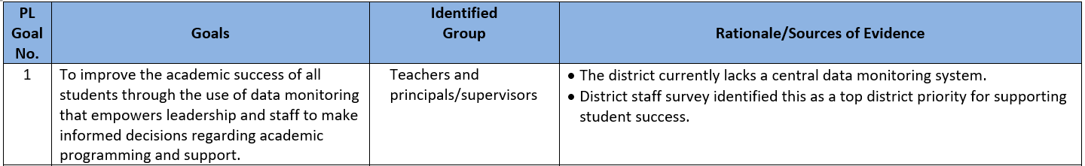
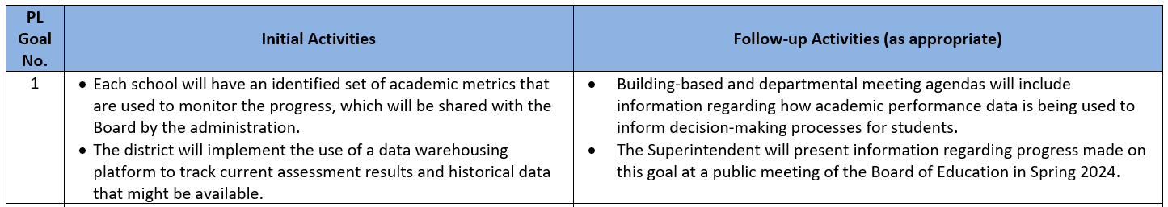
District Professional Development Planning Exemplar
Which NJSPL standard(s) is/are highlighted in the following goal, rationale and activities?
Provide a rationale for each standard chosen.

Slide 25
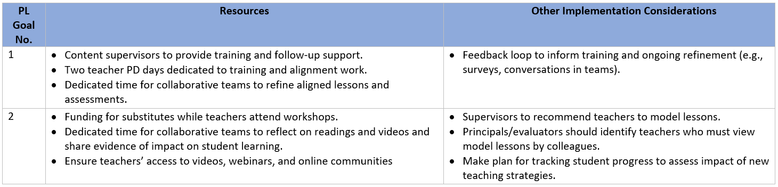
School Professional Development Planning Exemplar
Which NJSPL standard(s) is/are highlighted in the following resources and implementation considerations?
Provide a rationale for each standard chosen.

Slide 26
Aligning PD to the NJSPL: A Reflection
Consider your role in your school and/or district.
Identify where you believe your school and/or district is in leveraging NJSPL in constructing professional development plans.
What is/are one or two next steps you need to consider in aligning professional development to the NJSPL?

Slide 27
Thank You!
New Jersey Department of Education: nj.gov/education
Office of Educator Effectiveness
EduEval@doe.nj.gov
Follow Us!
Facebook:
@njdeptofed
Twitter: @NewJerseyDOE
Instagram:
@NewJerseyDoe

