Slide 1
2023 New Jersey
Lighthouse Awardees
Office of Educator Effectiveness
Division of Teaching and Learning Services
September 6, 2023

Slide 2

What is the Lighthouse Award?
The New Jersey Department of Education (NJDOE) launched the Lighthouse Award in 2017 to recognize the advancements made by New Jersey Local Educational Associations (LEAs).
The award is given to LEAs that have shown measurable progress toward educational improvement and equitable outcomes.
The 2023 cohort consists of five LEAs.

Slide 3

Lighthouse Awardee Categories
The focus of cohort four is educational improvement in equity to support Governor Murphy’s vision for a stronger, fairer New Jersey.
Increasing Equity in Dual Enrollment
Increasing Equity in Course Enrollment in Advanced Placement/International Baccalaureate (AP/IB)
Increasing Diversity in the Teacher Workforce

Slide 4
Lighthouse Selection Process
Step 1: Data Analysis
  Initial pool of LEAs was identified through a quantitative data review.
Step 2: Internal Review
  Offices throughout the NJDOE reviewed the initial pool of LEAs through their respective programmatic lenses.
Step 3: Application Narratives
  Select LEAs were asked to share narratives describing their efforts within one category.
  Panel of internal NJDOE staff and external experts scored the narrative statements.

Slide 5



2023 Lighthouse Awardees

Slide 6
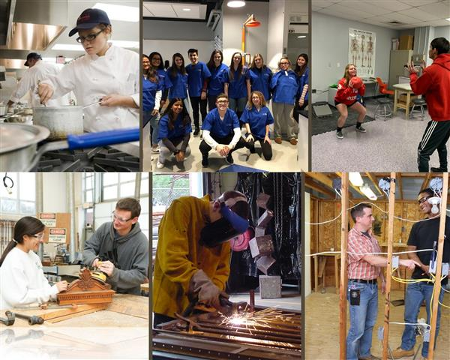
Morris County Vocational School District
“Increasing Equity in Dual Enrollment”
In 2019, Morris County created an equity task force to determine strategies of increasing access to the district’s programming by attracting a retaining a more diverse student population.
Faculty members and administrators have worked to develop relationships with a variety of local colleges and universities to increase dual enrollment opportunities for students.
Hired two college and career counselors to support students participating in dual enrollment by helping students understand how to qualify for dual enrollment opportunities, register and schedule courses, and meet college requirements.

Slide 7
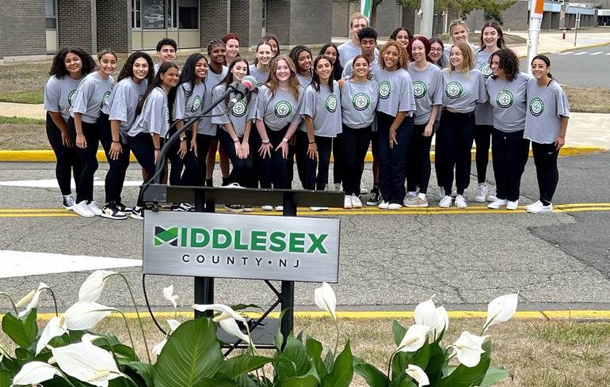
Middlesex County Vocational and Technical School District
“Increasing Equity in Dual Enrollment”
Middlesex County has worked to ensure every student has open access to every career and technical education program across the district, as well as the choice of school they attend.
Advertising programs to underrepresented, non-traditional, and marginalized populations was the focus of the 2022-2023 school year.
Have partnered with an equity consultant to develop a 3-5 year equity plan and has focused 2022-2023 staff development efforts on culturally responsive pedagogy.

Slide 8
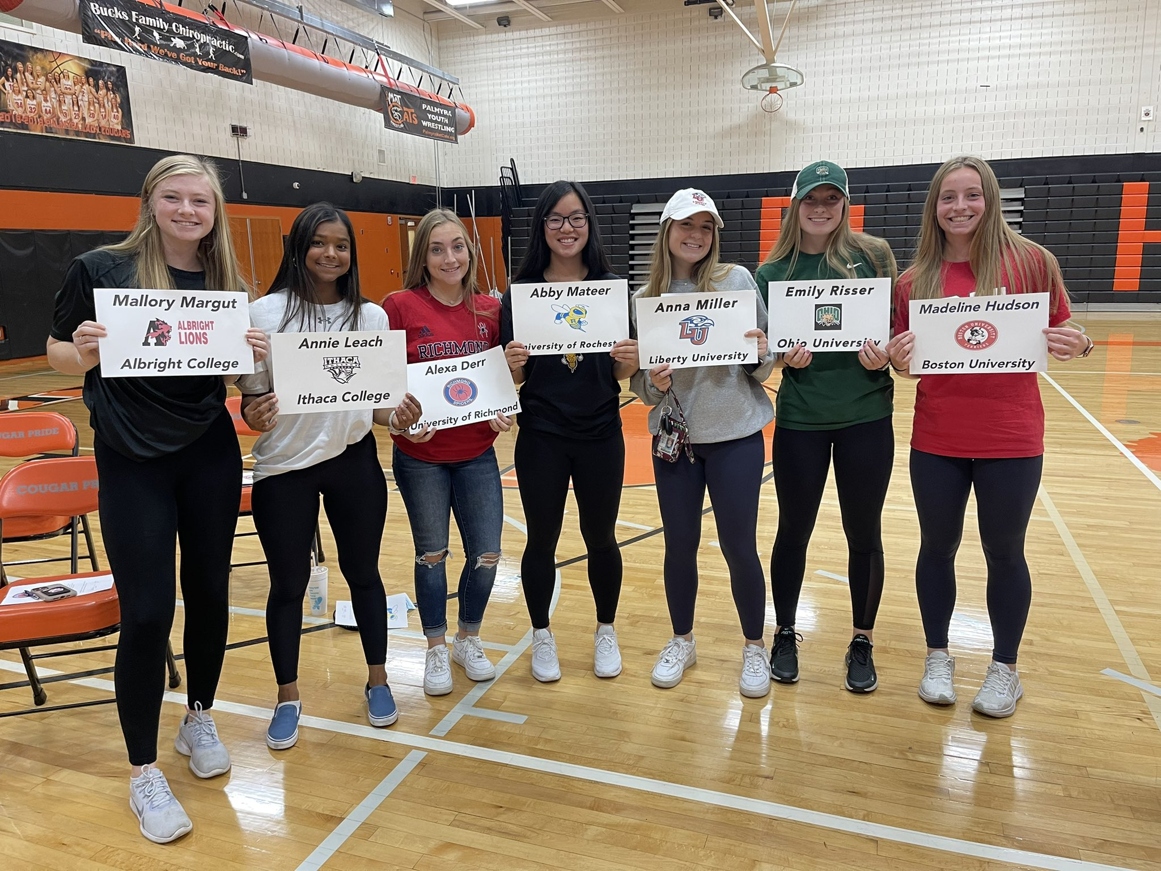
Palmyra Public School District
“Increasing Equity in AP/IB Enrollment”
Palmyra’s Board of Education prioritized equity as a five-year strategic goal.
Partnered with Equal Opportunity Schools, an organization that works with LEAs to increase equitable enrollment in rigorous courses.
Through this partnership, they solicited feedback from students and educators with a focus on improving enrollment in advanced courses, in addition to establishing open lines of communication with families.

Slide 9
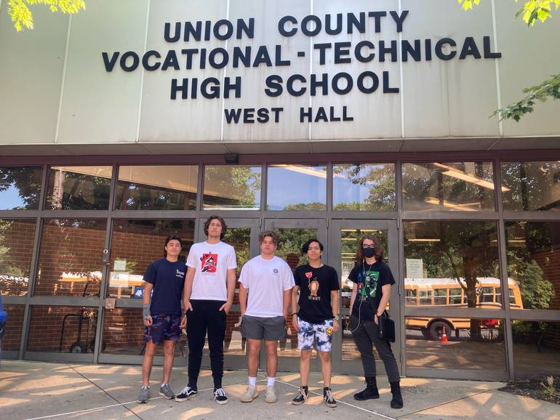
Union County Vocational School District
“Increasing Equity in AP/IB Enrollment”
Union County eliminated prerequisite grades for AP class registration during the 2020-2021 school year, leading to an increase in the number of students taking AP courses.
Focused on increasing the number of historically underrepresented students in AP courses. This effort has included requiring all students to complete the AP Computer Science Principles course.
Partnered with the Anti-Defamation League to be a part of the No Place for Hate initiative, which promotes diversity, inclusion, and equity for all students through team-building programs.

Slide 10
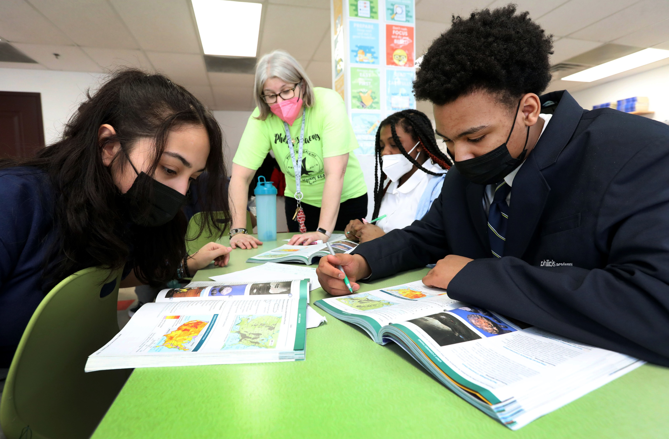
Philips Academy Charter School
“Diversifying the Teacher Workforce”
After working with a third-party consultant to complete a needs assessment, Philip’s Academy began a push to recruit teachers and staff members who were reflective of the student body.
Launched a Recruit and Retain Committee that leveraged teachers to refer diverse candidates to the school. This Committee also worked to update interview policies and procedures to facilitate the hiring process.
Continually leverage data to track the demographics of their student population and inform hiring goals.

Slide 11
Cohort Four: Lighting the Way for Others
Throughout this award term, Lighthouse Awardees will be asked to exchange ideas and practices with others throughout the state. This includes:
  Conducting school visits;
  Sharing lessons learned; and,
  Expanding NJDOE supports in the award categories to LEAs throughout the state.

Slide 12

Thank You!
New Jersey Department of Education: nj.gov/education
Office of Educator Effectiveness: EduEval@doe.nj.gov
Follow Us!
Facebook:
@njdeptofed
Twitter: @NewJerseyDOE
Instagram:
@NewJerseyDoe

