Slide 1


New Jersey Department of Education
Completing the 2024-2025 Title I, Part A Performance Report
Office of Fiscal and Data Services
December 2025
nj.gov/education

Slide 2
User Guide to the Title I, Part A Performance Report
Contents of this PowerPoint Presentation
Purpose of the report;
Which local education agencies (LEAs) are required to complete the report;
Information needed to complete the report;
How to log on to the NJDOE’s Grants Management System (NJGMS);
Navigating NJGMS and creating the report;
Completing the report;
Submitting the report;
Revising the report; and
Helpful resources and contact information.

Slide 3
Purpose of the Title I, Part A Performance Report
Contributes data to the Consolidated State Performance Report, which the New Jersey Department of Education (NJDOE) must submit to the United States Department of Education per ESEA §8303; and
Provides a summative analysis of Title I, Part A funds and the services provided by LEAs utilizing these funds during the 2024-2025 school year (the instructional period not including intercession and summer sessions) to serve neglected and nonpublic students.
Note: Title I, Part A requires two reports, each with different purposes and data elements:
Title I Comparability Report
Title I Performance Report
Please ensure that both reports are submitted to the NJDOE.

Slide 4
LEAs Required to Submit the Report
All LEAs that received State Fiscal Year 2025 (school year 2024-2025) Title I, Part A funds are required to complete this year’s Title I Performance Report.
Due to the addition of the Title I Indicator in the Student Management Submission, this year’s Title I Performance Report has been streamlined.
LEAs no longer need to report counts of public-school students served in schoolwide or targeted assistance programs, or counts by special populations, as this information for the 2024-2025 school year was already collected through NJSMART.
As such, charter, Renaissance, and county vocational schools are not required to submit a Title I, Part A Performance Report.
Districts that did not serve nonpublic or neglected students during the regular school year should enter “0” in all fields.
The submission due date is December 19, 2025.

Slide 5
Information Needed to Complete Report
EWEG/NJGMS logon information.
Current contact information for LEA’s administrative offices, Chief School Administrator, Business Manager, Board President, and the ESEA Project Director.
Counts of students served in neglected institutions by grade level.
Counts of non-public students served by grade level.

Slide 6
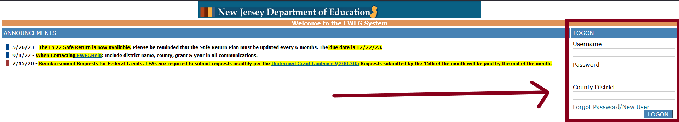
How to Log on to the NJDOE’s Grants Management System
First, you must access the Electronic Web-Enabled Grant (EWEG) system at: EWEG Logon Page.
On the right-hand side of the EWEG Logon Page, enter your EWEG user ID, password, and county district code and hit the “LOGON” button. User IDs are limited to eight characters. Each user must have their own unique ID and password. Passwords are case sensitive. Please allow 48 hours for your permissions to become active.

Slide 7
Accessing NJGMS
From the EWEG Dashboard, click on the NJGMS Link:

Slide 8
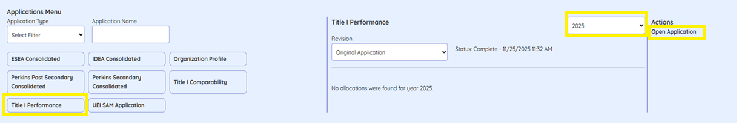
Accessing the Title I Performance Report
Click on “Applications” on the top Navigation bar, and then select “Title I Performance.” Next, select “2025” from the dropdown, and click “Open Application” under “Actions.”

Slide 9
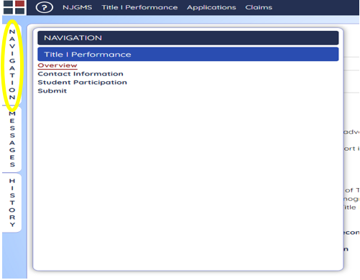
Navigating the Title I Performance Report
Clicking the stacked “Navigation” tab on the upper left-hand corner brings up the Navigation page. Move through the report’s various pages—Overview, Contact Information, Student Participation, and Submit—by clicking on their titles here.
Move any tab by dragging it to another location on the screen.

Slide 10
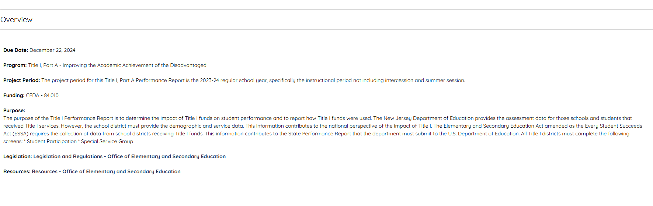
Overview
This page provides the purpose and other useful information to assist with the completion and submission of the Title I, Part A Performance Report. No data input is required.

Slide 11
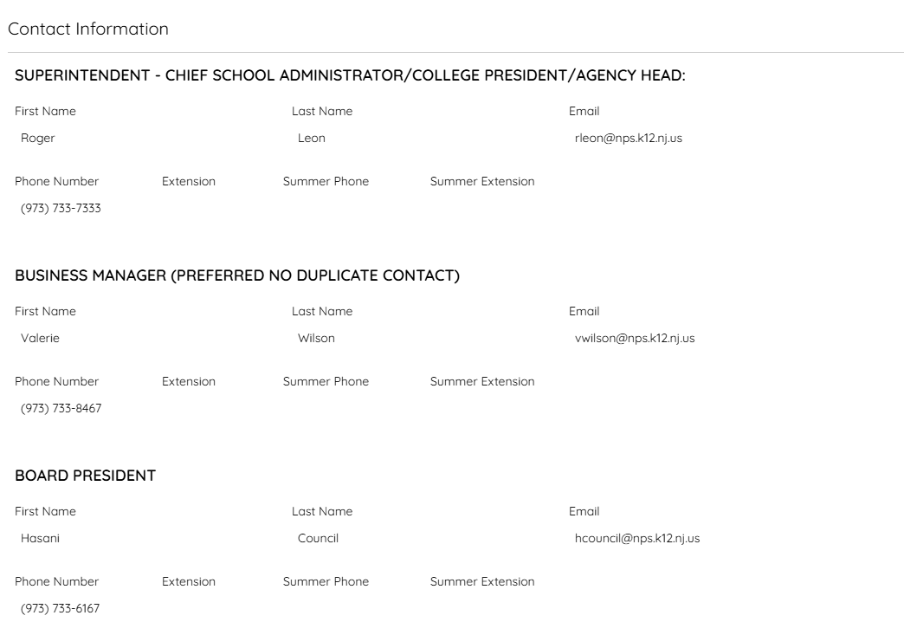
Contact Information
The Contact Information page displays the information provided in the Organization Profile and in the 2025-2026 ESEA Consolidated Application.
Be sure you have updated the Organization Profile to reflect LEA personnel currently responsible for the various programs and functions. Any changes to the LEA Contact information should be made in the Organizational Profile. NJDOE staff use this information to contact personnel.

Slide 12
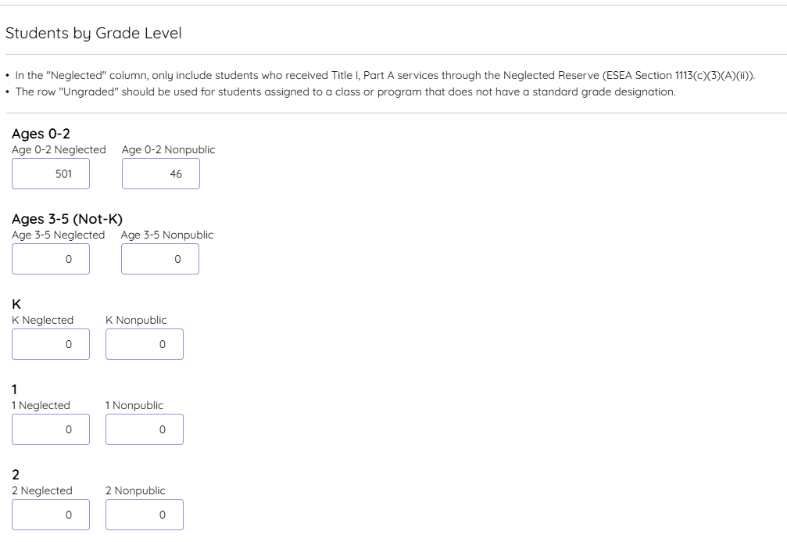
Student Participation
The Student Participation page is where you need to input, by age/grade level, the counts of neglected students and nonpublic students served in 2024-2025 using Title I, Part A funds.

Slide 13
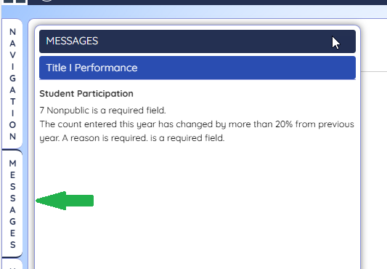
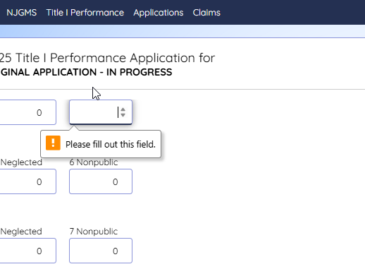
Messages in NJGMS
Navy borders appear around the Messages tab or Pop-up

Slide 14
Nonpublic and Local Neglected Students by Grade Level
The “Neglected” column is for LEAs with neglected institutions within their boundaries. Only students who received Title I, Part A services through the Neglected Reserve (ESEA Section 1113(c)(3)(A)(ii)) should be counted in this column. Do not include neglected students who received Title I, Part A services in TAS or SWP schools, as these students have already been identified in NJSMART. Students served under Title I, Part D should not be included in the “Neglected” column.
Students served with Title I, Part A funds who attend private schools within the LEA’s geographic catchment area need to be reflected by age/grade in the column labeled “Nonpublic.”
If your LEA did not serve any neglected or nonpublic students through Title I, Part A, please input zero (0) in each box.

Slide 15
Explanation Text Boxes (if required)
A brief explanation is required whenever the year-over-year percentage change for Neglected or Nonpublic is greater than or equal to 20 percent.
NJGMS sums the counts provided in each column, Neglected and Nonpublic, and shows the results from this year in the “Total*” row and the results from last year in the “Totals from Previous Year” row.
NJGMS also calculates the year-over-year percentage difference between the total counts for each column and displays the results in the “Percentage Change in Totals from This Year Compared to Last Year” row.
Additionally, an explanation is required when the non-zero count in the “Total*” row for either Neglected or Nonpublic equals the non-zero count in the “Total from Previous Year” row.

Slide 16
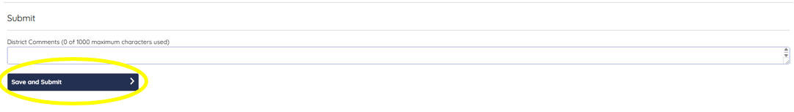
Submit
To complete the report, select the Submit tab on the Navigation screen, click the blue “Save and Submit” button, and refresh the page to confirm the report’s submission. Note: A successfully submitted report’s status will show as “complete.”
The system will let you know to check the Messages tab to find and resolve the errors preventing you from submitting the report.
You also have the option to add comments if there is any additional information you would like us to know or additional context you’d like to provide.

Slide 17
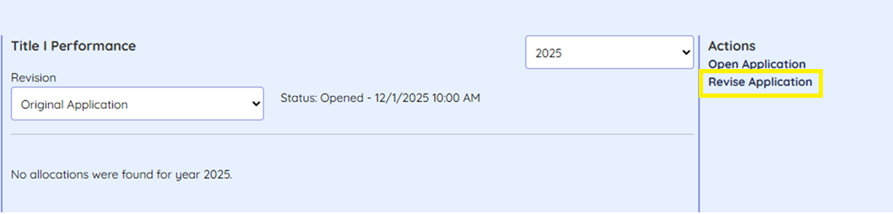
Revising the Report
Select “Applications” on the NJGMS landing page, then click on “Title I Performance,” and select “Revise Application” under Actions.
Update the report as needed, and save and submit when you are done.

Slide 18
Helpful Resources
For assistance with accessing the NJGMS system, please follow the instructions provided in NJGMS: How to Log In.
For technical issues, contact EWEG Help at eweghelp@doe.nj.gov.
For content questions, contact the Office of Fiscal and Data Services at OFDS@doe.nj.gov.

Slide 19
Follow Us
Facebook @njdeptofed
X @newjerseydoe
Instagram @newjerseydoe
LinkedIn New Jersey Department of Education
nj.gov/education
Threads @newjerseydoe
YouTube @newjerseydepartmentofeduca6565

Slide 20
Thank You
Office of Fiscal and Data Services
OFDS@doe.nj.gov

