Slide 1
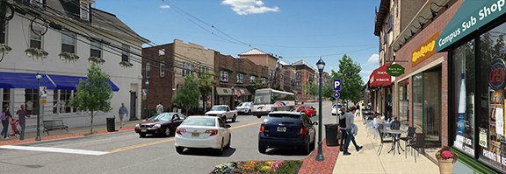
How to Measure and Monitor Outcomes in Opportunity Zones

Slide 2
Why track outcomes in Ozs?
  Track progress toward municipal development and redevelopment priorities
  Measure impacts on resident employment, incomes, and quality of life
  Hold developers and investors receiving public subsidies accountable
  Inform changes to local Opportunity Zone strategy
  Communicate progress to new potential investors, use as marketing tool

Slide 3
Key neighborhood Indicators
  Jobs
  Businesses
  Unemployment
  Poverty
  Household incomes
  Property values
  Housing vacancies
  Crime
  Neighborhood satisfaction

Slide 4
Methodology
  Opportunity Zones are defined based on census tract boundaries
  Collect quantitative data at the census tract level
    Select Opportunity Zones by their census tract numbers
  Measure trends relative to similar areas and past history
    Looking at 5 year trend before and after OZ would identify improvements attributable to zones
    Comparing trend to similar non-OZ neighborhoods within and outside the municipality
      Can choose a “control group” based on similarity on demographics, unemployment, poverty, property values, etc.

Slide 5
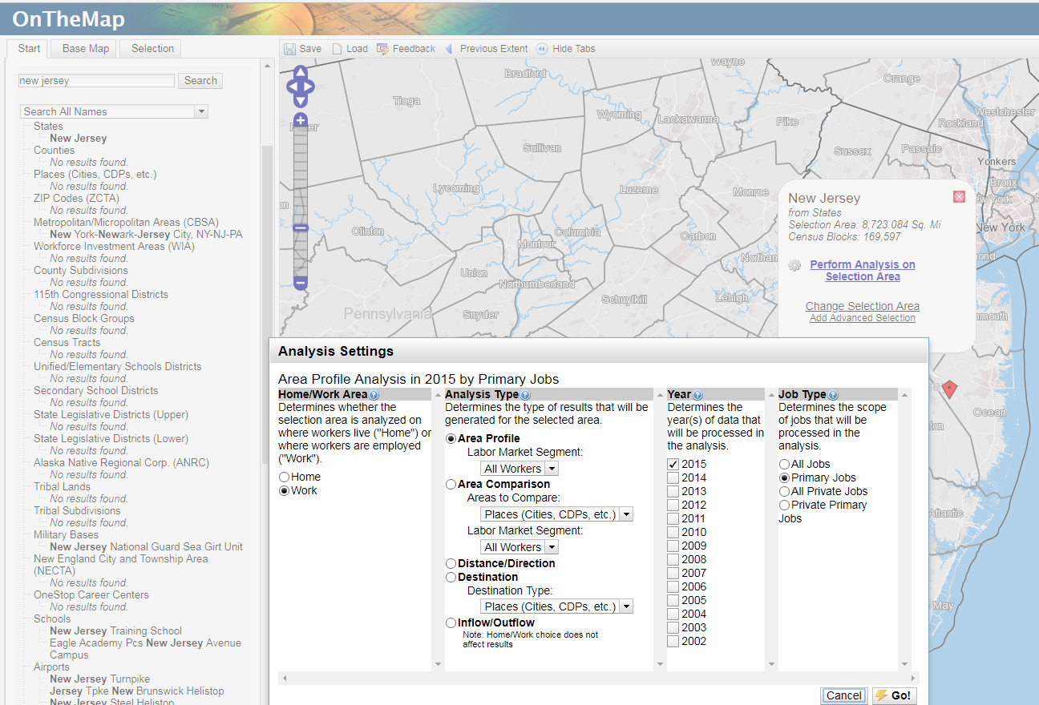
Jobs
  Jobs in neighborhood
  (not resident workers)
  Census Bureau Longitudinal
  Employer-Household Dynamics
  database
    Easily accessible from the
    On the Map application
    (https://onthemap.ces.census.gov/)
    More advanced users can use
    raw LODES data down to the
    block level
    (https://lehd.ces.census.gov/data/)
    Jobs data at municipality, census tract and block group level
    2002-2015
    Can break down by industry, education level, worker age, sex, earnings, industry, race, ethnicity, and worker place of residence
    Available for primary and all jobs (including 2nd jobs)

Slide 6
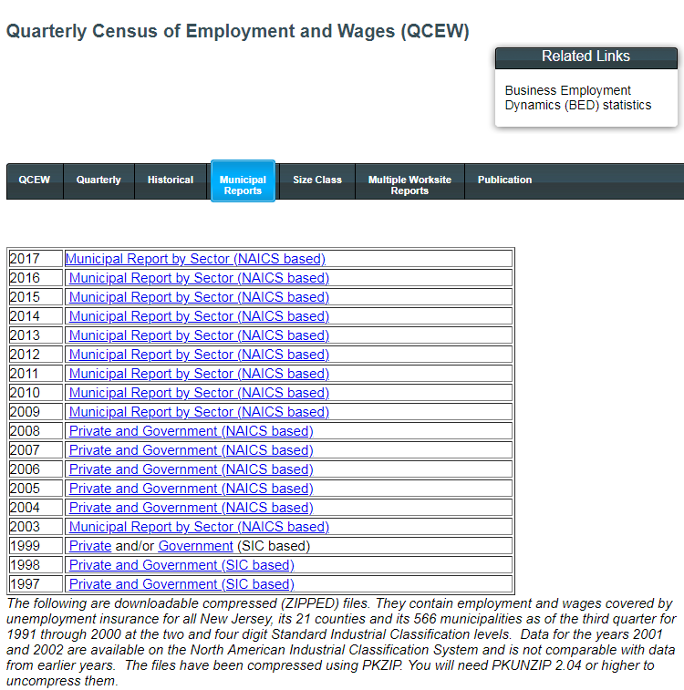
Businesses
  Businesses
    At municipal level available
    from NJ Department of Labor and
    Workforce Development’s
    Quarterly Census of Employment
    and Wages Municipal Reports by Sector
    (https://www.nj.gov/labor/lpa/employ/qcew/qcew_index.html)
    Business establishment estimates are found
    in the “Average Units” column
    Available for 1997-2017
    Can break down businesses by industry
    Census tract level data could be obtained from municipal business licensing records

Slide 7
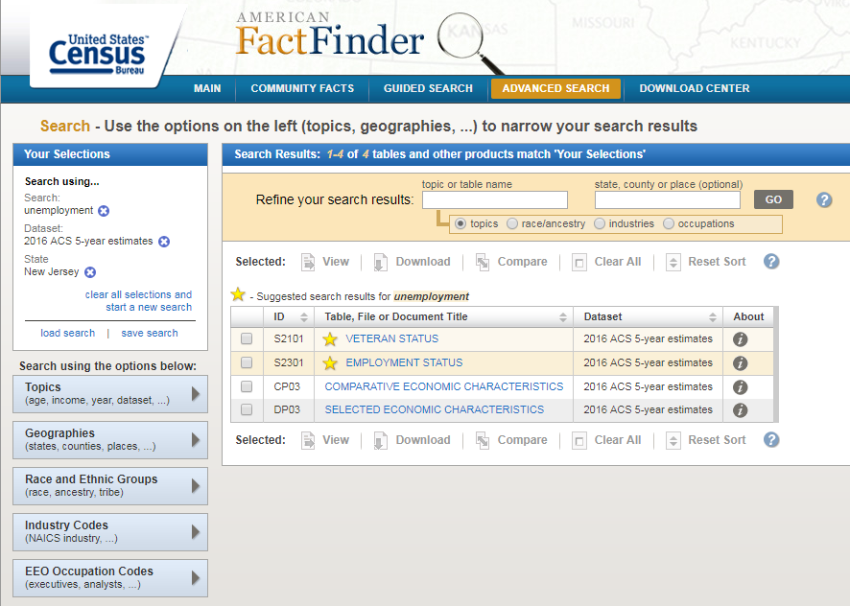
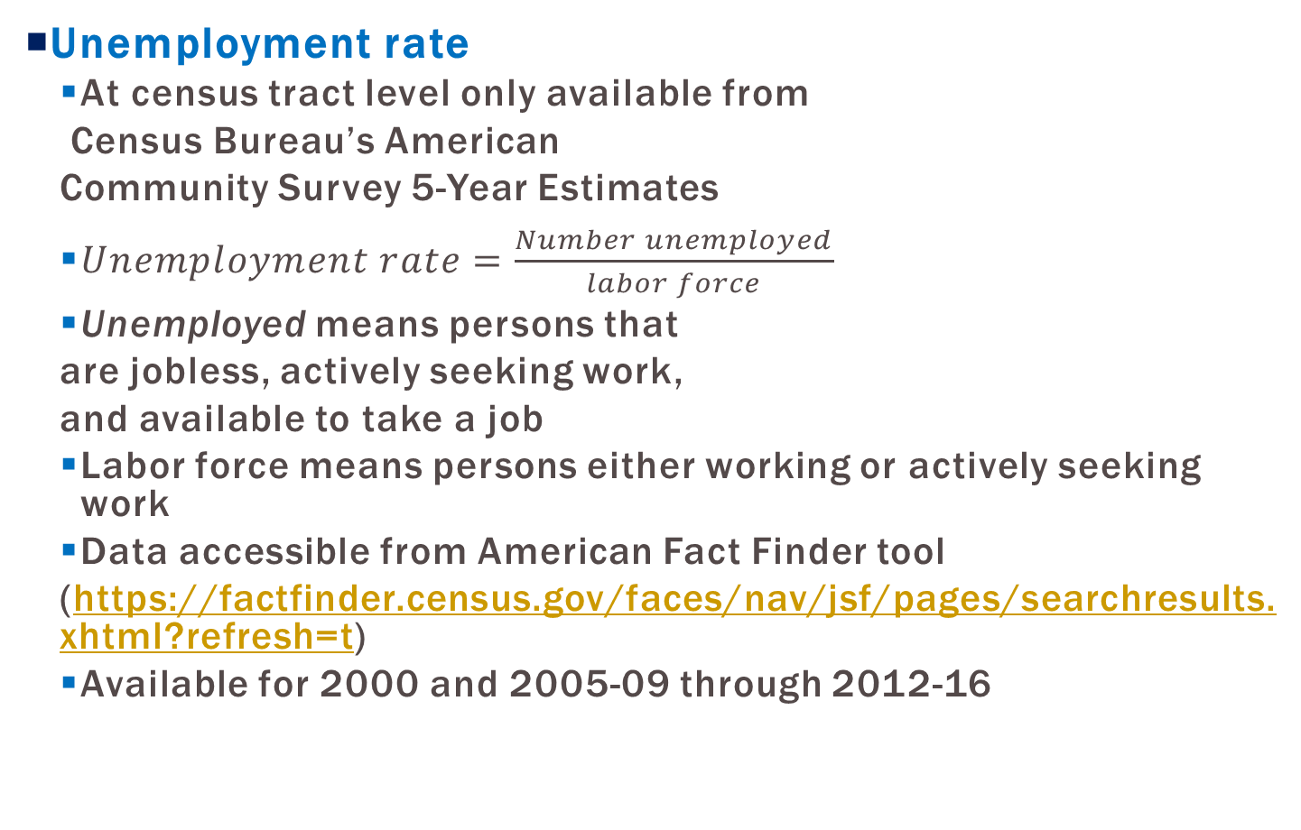
Unemployment Data
  Unemployment rate
  At census tract level only available from
  Census Bureau’s American
  Community Survey 5-Year Estimates
  $Unemployment rate=\frac{Number unemployed}{labor force}$
  Unemployed means persons that
  are jobless, actively seeking work,
  and available to take a job
  Labor force means persons either working or actively seeking work
  Data accessible from American Fact Finder tool
  (https://factfinder.census.gov/faces/nav/jsf/pages/searchresults.xhtml?refresh=t)
  Available for 2000 and 2005-09 through 2012-16

Slide 8
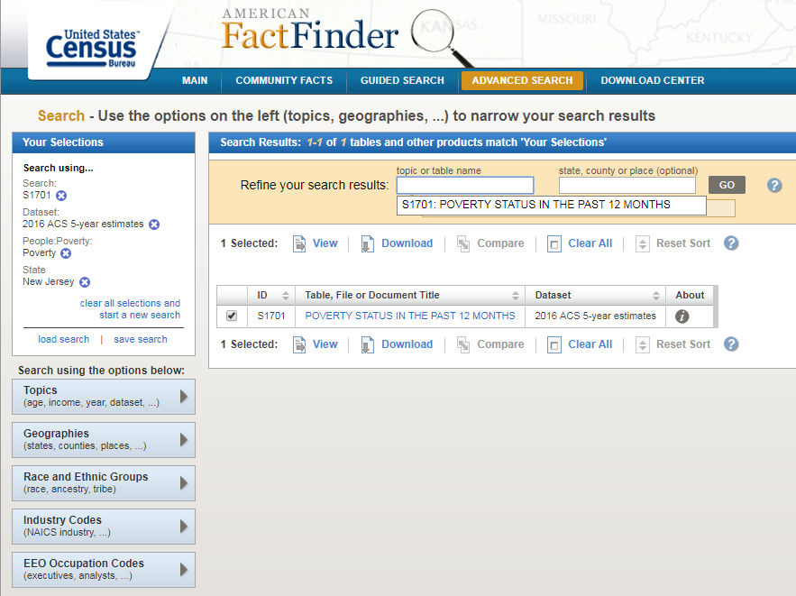
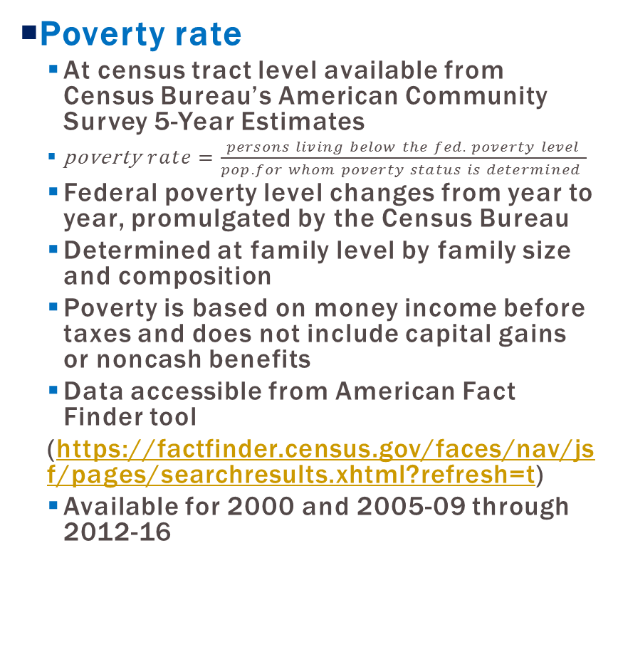
Poverty Data
  Poverty rate
  At census tract level available from Census Bureau’s American Community Survey 5-Year Estimates
  poverty$rate=\frac{persons living below the fed. poverty level}{pop. for whom poverty status is determined }$
  Federal poverty level changes from year to year, promulgated by the Census Bureau
  Determined at family level by family size and composition
  Poverty is based on money income before taxes and does not include capital gains or noncash benefits
  Data accessible from American Fact Finder tool
  (https://factfinder.census.gov/faces/nav/jsf/pages/searchresults.xhtml?refresh=t)
  Available for 2000 and 2005-09 through 2012-16

Slide 9
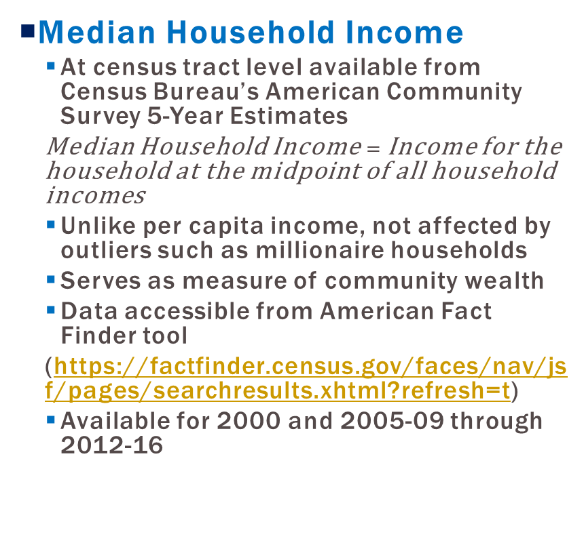
Household Incomes
  Median Household Income
  At census tract level available from Census Bureau’s American Community Survey 5-Year Estimates
  Median Household Income$=$ Income for the household at the midpoint of all household incomes
  Unlike per capita income, not affected by outliers such as millionaire households
  Serves as measure of community wealth
  Data accessible from American Fact Finder tool
  (https://factfinder.census.gov/faces/nav/jsf/pages/searchresults.xhtml?refresh=t)
  Available for 2000 and 2005-09 through 2012-16

Slide 10
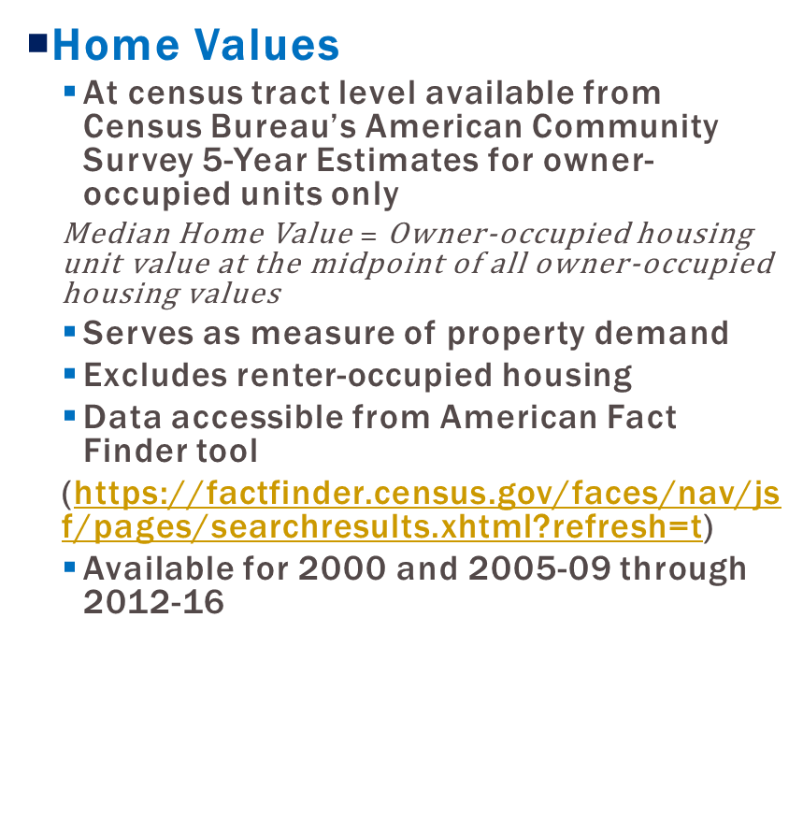
Property Values
  Home Values
  At census tract level available from Census Bureau’s American Community Survey 5-Year Estimates for owner-occupied units only
  Median Home Value $=$ Owner-occupied housing unit value at the midpoint of all owner-occupied housing values
  Serves as measure of property demand
  Excludes renter-occupied housing
  Data accessible from American Fact Finder tool
  (https://factfinder.census.gov/faces/nav/jsf/pages/searchresults.xhtml?refresh=t)
  Available for 2000 and 2005-09 through 2012-16

Slide 11
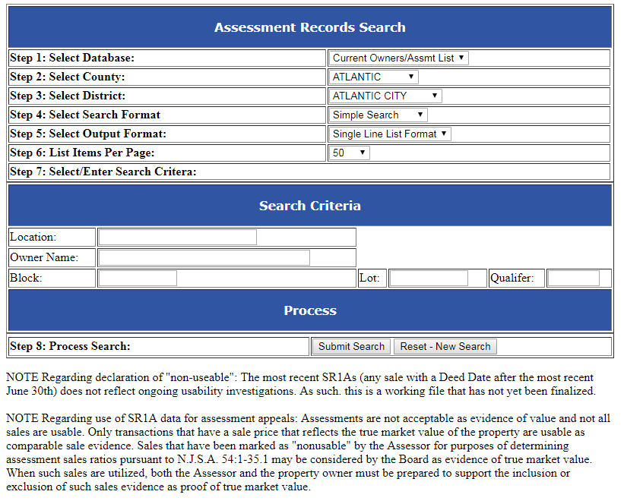
Property Values
  Other Property Values
  Available from municipal
  assessors or the
  Monmouth County
  Assessment Record database
  Single record for every parcel
  or taxable property
  Comprehensive – data on
  resid., apartment, commercial,
  industrial, publicly–owned and
  vacant properties
  Raw data also accessible from NJ Division of Taxation website
  (https://www.state.nj.us/treasury/taxation/lpt/TaxListSearchPublicWebpage.shtml)
    Available for 2009 through the current year

Slide 12
Property Values
  Other Property Values
  Assessed values – only current as of last
  reassessment or revaluation
    Could be a disparity with market value –
    may need to apply equalization ratio
    Can use to calculate tax ratables in the Opportunity Zones, estimate savings to taxpayers from tax base growth
  Can produce custom medians and averages by census tract
  Requires more intensive GIS and statistical analysis to tabulate and calculate for census tracts

Slide 13
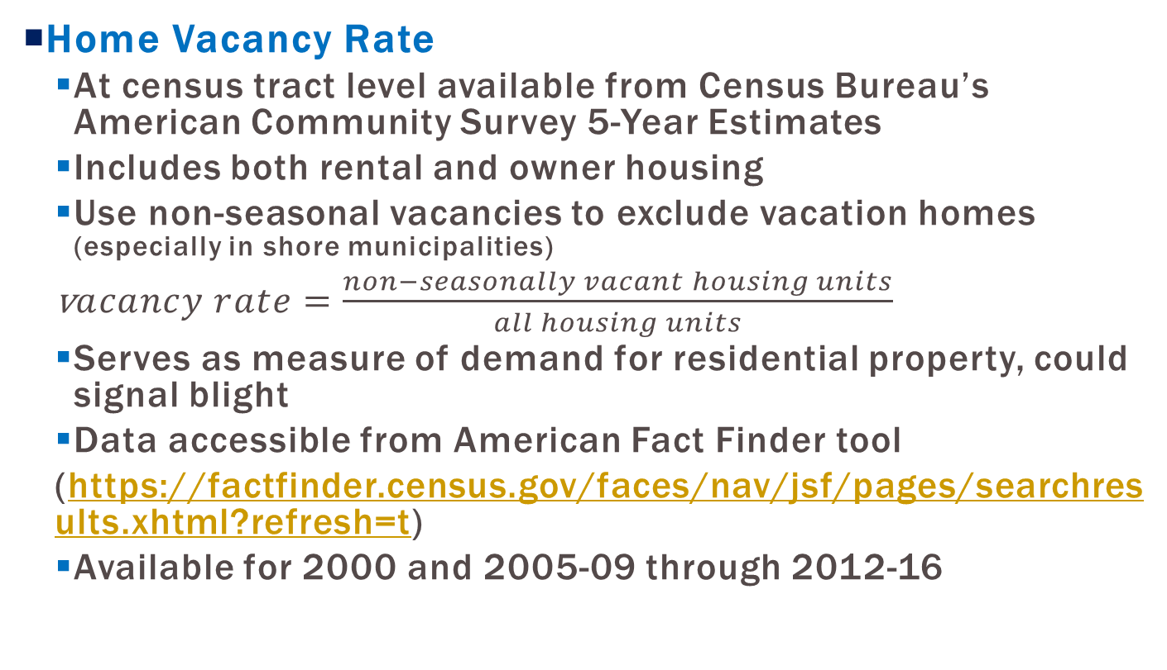
Home Vacancies
  Home Vacancy Rate
  At census tract level available from Census Bureau’s American Community Survey 5-Year Estimates
  Includes both rental and owner housing
  Use non-seasonal vacancies to exclude vacation homes (especially in shore municipalities)
  v$acancy rate=\frac{non−seasonally vacant housing units}{all housing units}$
  Serves as measure of demand for residential property, could signal blight
  Data accessible from American Fact Finder tool
  (https://factfinder.census.gov/faces/nav/jsf/pages/searchresults.xhtml?refresh=t)
  Available for 2000 and 2005-09 through 2012-16

Slide 14
Crime
  Crime
  Municipality-wide data available from local police departments, the New Jersey State Police Uniform Crime Reports (https://www.njsp.org/ucr/uniform-crime-reports.shtml), or FBI Uniform Crime Reports (https://ucr.fbi.gov/crime-in-the-u.s/2017/crime-in-the-u.s.-2017)
    Tabulation and tracking by census tract would require raw incident data from local police departments

Slide 15
Other indicators
  Some neighborhood improvements won’t show up in statistical data
  (i.e. resident neighborhood satisfaction, feelings of safety, aesthetics, streetscapes, infrastructure quality)
  Requires a neighborhood survey administered before and after Opportunity Zone investments and developments occur
    Can be conducted by local higher ed institution or non-profit with survey experience

Slide 16
Other indicators
  For projects that require a PILOT, Redevelopment Area Bond, tax abatement, or other local subsidy, require outcome reporting:
    Number of local residents hired
    Number of community information/input meetings held
    Number of local contractors/vendors used

Slide 17
Statistical Data Limitations
  Changes in census tract boundaries over time
    Census tract boundaries are updated with every decennial census to account for population growth and loss
    Need to use a longitudinal census tract database to track indicators for consistent geographies over time when that occurs
    Brown University database
    (https://s4.ad.brown.edu/projects/diversity/researcher/bridging.htm)
  High margins of error on census tract estimates

