Slide 1
“Turning ideas into plans and plans into actions”
State of New Jersey Department of Community Affairs Local Planning Services
League of Municipalities Conference
NJ Opportunity Zone Navigator
November 13-15, 2018

Slide 2
What should you know about your Opportunity Zone(s)
Do you know what the boundaries are for the Opportunity Zone(s) designated in your Municipality?
Are you aware of the assets located in and AROUND the Opportunity Zone?
Are you aware of other incentive areas available in the Opportunity Zone?

Slide 3
The NJ Opportunity Zone Navigator

Slide 4
Things to consider as you develop a plan or strategy
Use the NJ Opportunity Zone Navigator
To focus on areas ripe for development
Identify where there are incentive areas
Establish a Municipal Opportunity Zone Committee
Who should be involved in planning
Local businesses, potential investors/developers
Municipal officials
Public participation
Analyze zoning and land use regulations, policies, and impediments within the Opportunity Zone
Develop an inventory of shovel ready projects
Streamline development process for efficiency

Slide 5
Example 1- Salem Waterfront, City of Salem

Slide 6
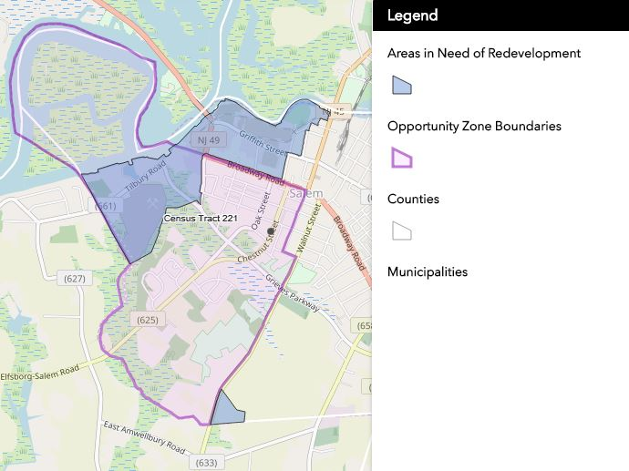
Example 1: Salem Waterfront, City of Salem
Review History, Background, Demographics/Market Analysis, Existing Conditions, and Redevelopment Plan Goals
A review of applicable State regulations and current zoning regulations in Redevelopment Area
Developed Redevelopment Area Land Use Concept Plan & Zoning Ordinance
Specific recommendations made by LPS:
Change permitted uses, bulk standards, and zoning districts
Market Salem and the Waterfront Zone
Continue to be proactive to keep county court facility in the City
Connect the waterfront to the downtown by providing waterfront access to the public

Slide 7
Salem

Slide 8
Example 2- Browns Mills, Pemberton Township

Slide 9
Example 2: Browns Mills, Pemberton Township
An analysis of the existing Browns Mills Town Center Redevelopment Area
An evaluation of current demographic and development conditions and trends
A review of applicable State regulations and local zoning and land use regulations
Specific recommendations made by LPS:
Change permitted uses, zoning districts
Redevelop Browns Mills Shopping Center
Identify vacant property for new hotel site
Redevelop property purchased by the Township using UEZ monies

Slide 10
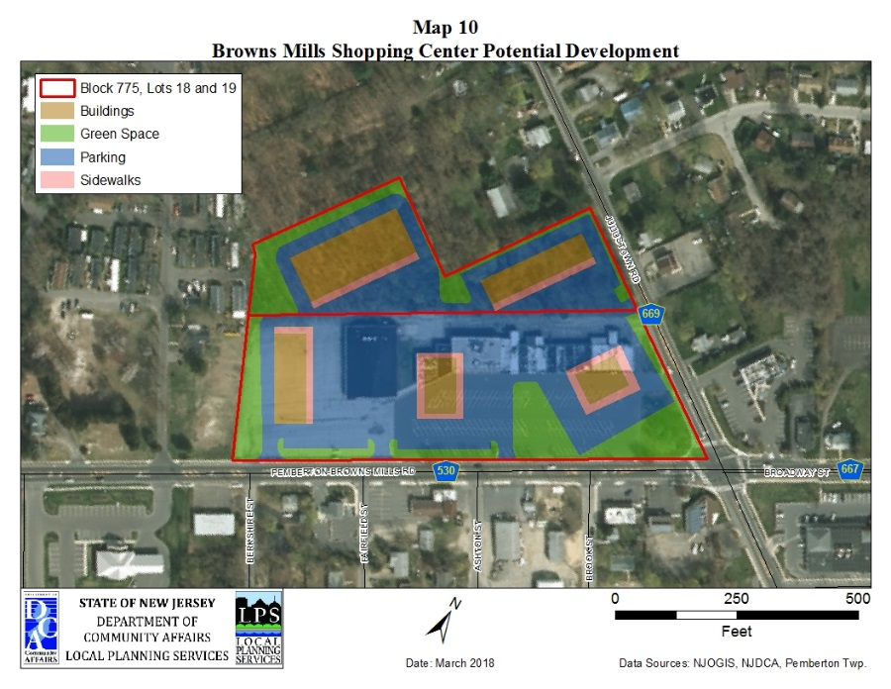
Browns Mills

Slide 11
Example 3- Central Business District, City of Millville

Slide 12
Example 3: Central Business District, City of Millville
An evaluation of current demographic and development conditions and trends.
A study of past variances, current zoning regulations and district boundaries.
An analysis of future land use needs based upon pending plans and land use issues.
A review of current Redevelopment Plans
Specific recommendations made by LPS:
Change permitted uses, zoning districts along High Street and Central Bus. District
Redevelop the Millville Airport District
Sunset outdated redevelopment plans
Target underutilized and vacant properties around the Community College

Slide 13
Millville

Slide 14
If you need assistance:
Local Planning Services (LPS), an office within DCA, works with communities to achieve local land use and planning goals. As part of DCA’s commitment to provide technical assistance to municipalities, our professional planning staff offers comprehensive planning services at no cost to local governments.

Slide 15
HOW TO GET STARTED
Please contact us or our Director to discuss your planning needs:
Sean Thompson
(609) 292-1716
Email: LPSmail@dca.nj.gov
Speak with a LPS Representative:
Maria Connolly, Geoffrey Gray-Cornelius,
Tom Stanuikynas, Robert Tessier
Application forms, resources and
additional information can be found on the LPS website: www.nj.gov/dca/services/lps

