Slide 1
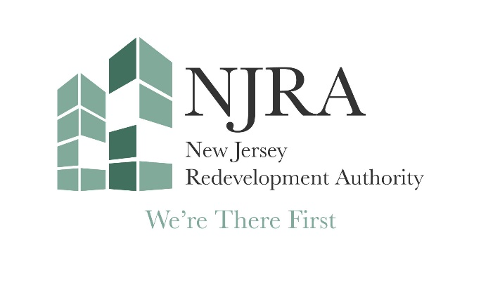
2018
NJ League of Municipalities
New Jersey Opportunity Zones
Strategies for Success

Slide 2
PRINCIPLES
Support Existing Communities
Balancing Equitable and Inclusive Development
Promote development to different investors and varying levels of investment type
Exploring Pathways to refocus non-state resources
We’re there first

Slide 3
PRINCIPLES
Exploring Pathways to refocus non-state resources
Engage Stakeholders
Focus on transit-oriented development
We’re there first

Slide 4
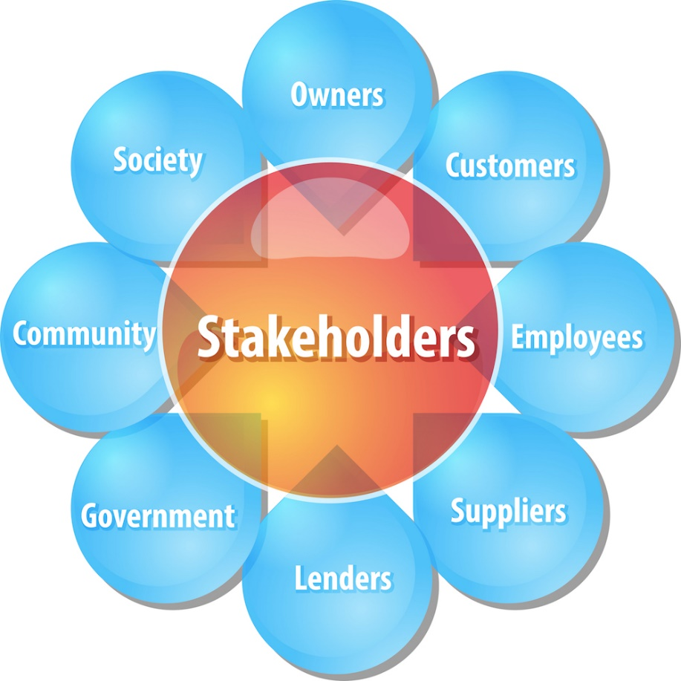
Opportunity Zone partnerships
Primary Groups
State of NJ
Municipalities
Developers
Investors
Business Owners
Community Residents
Non-Profit Organizations
We’re there First
Notes:
Flexible Financing Tool
$9 million appropriated by New Jersey Urban Redevelopment Act.
Interim, term and permanent loans, real estate equity, loan guarantees and other forms of credit enhancements.
Work in partnership with conventional lenders to provide them with the comfort to finance the deal
Gap financer
Securitization - Augmented original appropriation
Our dollars trigger prevailing wage

Slide 5
Who Is at the table
(Locally)
Mayor/Council
Planning Board
Zoning Board
Tax Assessor
Community Based Organization
Local Non-Profits
Local Small Business
Developers
We’re there First

Slide 6
Municipal role
(Hook, Hammer and Monitoring)
Stable development environment
Streamlined Permit Process
Clear policy for local tax incentives
Articulate the need for community benefits
Recognize Municipal Vulnerabilities and Strategies in Place to address identified issues
Efficient and Effective Municipal Approval Process
Project Impact
We’re there First

Slide 7
Ready to Go Projects
(Real Estate Development)
Municipal Approvals
Environmental Approvals
Signed Agreements
Approved Financing
We’re there First

Slide 8
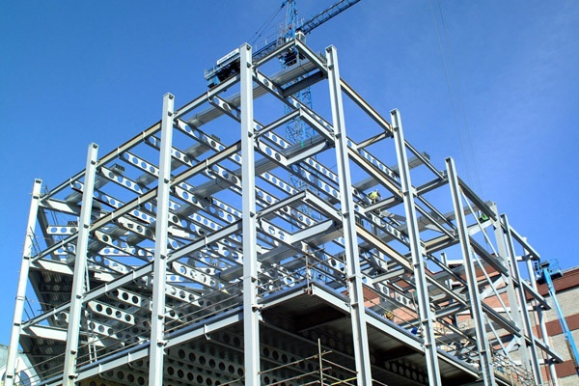
Project Investment
How will Opportunity Zone Investment Work
Functions as Equity
Serves as a part of the
Capital Stack
Business Investment
Real Estate Transactions
We’re there First

Slide 9
Project IMPACT
Steer development, businesses, and investment in distressed neighborhoods
Opportunity to connect community residents with jobs and economic opportunities incentivized by the program
Incentive to attract investment to vacant and blighted properties targeted for redevelopment
Financing for community development projects with both public and private benefit
Opportunity to strengthen and support small and locally-owned businesses, through an outside flow of capital
We’re there First

Slide 10
Contact us
Leslie A. Anderson Darryl Godfrey
President and CEO Chief Operating Officer
609.278.5171 609.278.5175
landerson@njra.us dgodfrey@njra.us
New Jersey Redevelopment Authority
www.njra.us
State of NJ Opportunity Zones
https://www.state.nj.us/dca/divisions/lps/opp_zones.html
We’re there First

