Slide 1
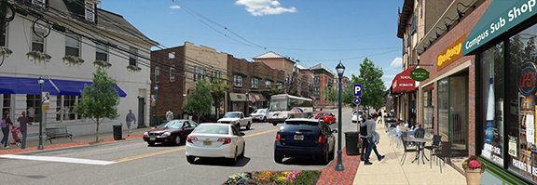
Opportunity Zone
Strategic Planning

Slide 2
Why Plan?
  Coordinates and facilitates municipality’s efforts to attract businesses, development, and investment
  Allows for municipality to align investment activity with local priorities
    Developing housing and employment opportunities for residents
  Helps connect local community, small and MWBE businesses with flows of outside capital
  Helps target appropriate development in the appropriate areas
    Leverages stakeholder partnerships to get the most local benefit out of the program

Slide 3
SETTING PRIORITIES
  Prioritizing OZ neighborhoods
    Increased code enforcement and law enforcement presence in targeted areas
Development and redevelopment priorities for Opportunity Zones
  Vacant sites, abandoned buildings targeted for redevelopment

Slide 4
Setting priorities
  Identifying key priority projects
  Shovel ready” but without a developer or sufficient capital to get off the ground
    Projects that are ready for investment
    Opportunity Zone investments generally must occur before the end of 2019
  Projects where there’s willingness to support with local tax incentives if necessary
  Projects that work well with Opportunity Zones (taxable capital gains involved)
  Work with county, local agencies, anchor institutions, and community development partners to identify these projects
  Examining Areas in Need of Redevelopment – removing old and obsolete ones
    Focusing on priority areas
    Creating new ones

Slide 5
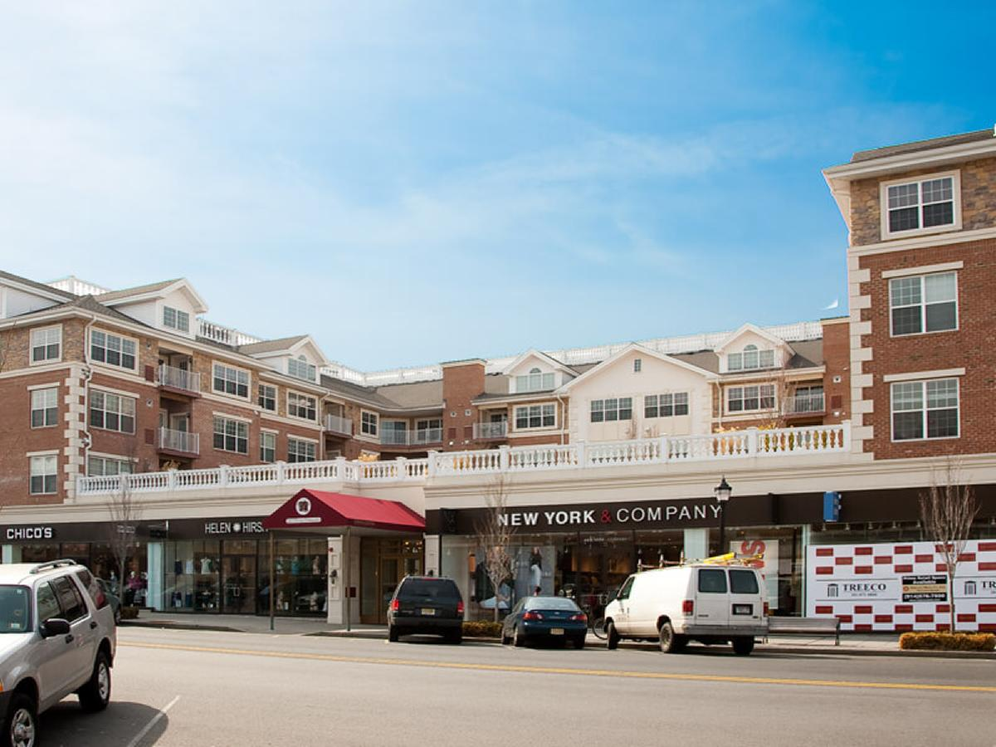
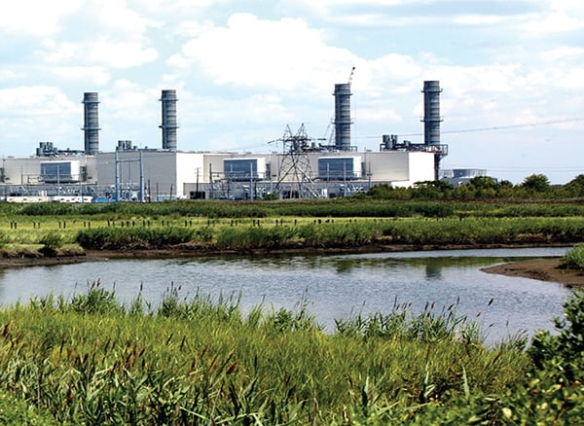
Building on neighborhood strengths
  Strategic focus on investments by neighborhood character
  Small businesses and mixed-use
  developments in commercial corridors,
  downtowns
  Affordable housing in residential
  neighborhoods
  Transportation, warehousing,
  and logistics in industrial area -
  areas close to highways, railyards airports,
  and other transportation links
  Neighborhoods with existing state and local
  development incentives
  Avoiding projects with negative
  neighborhood impacts in residential areas
    Waste management facilities
    Landfills
    Chemical manufacturing and processing

Slide 6
Development impacts
Develop strategies to deal with development impacts
  Infrastructure improvements from new development (i.e. roads, highways, streetscapes)
    Funding through impact fees and charges
  Impact on schools (new students from residential development)
    School improvements and expansion
  Impact fees
    Developers contribute to the additional cost of municipal services and infrastructure from development
  Preservation and expansion of affordable housing
    Inclusionary zoning – mitigate effects of gentrification
    Contributions to an Affordable Housing Trust Fund
  Parking
  Transit access
    Working with NJ Transit to improve and expand access

Slide 7
Promoting your community
  Develop a marketing strategy to sell your Opportunity Zones to businesses, investors, and developers
    Investment prospectuses that highlight community assets and economic strengths
  Promote projects with excellent potential for attracting investment
    Emphasize potential return on investment for investors, how Opportunity Zone projects could yield a better return than others
  Link marketing efforts to community development goals and strategies

Slide 8
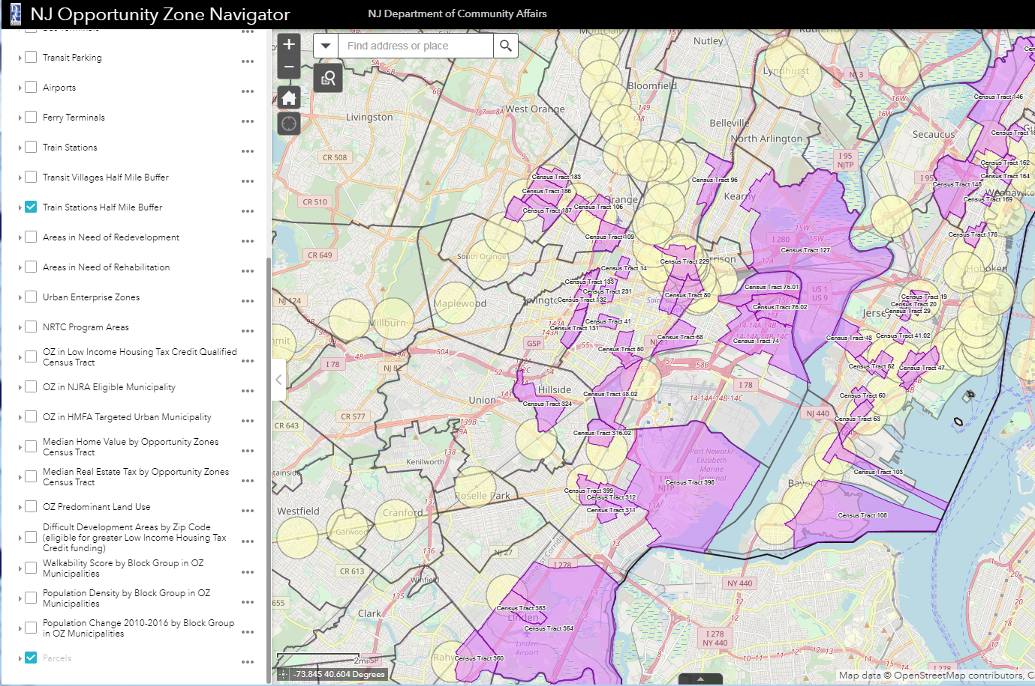
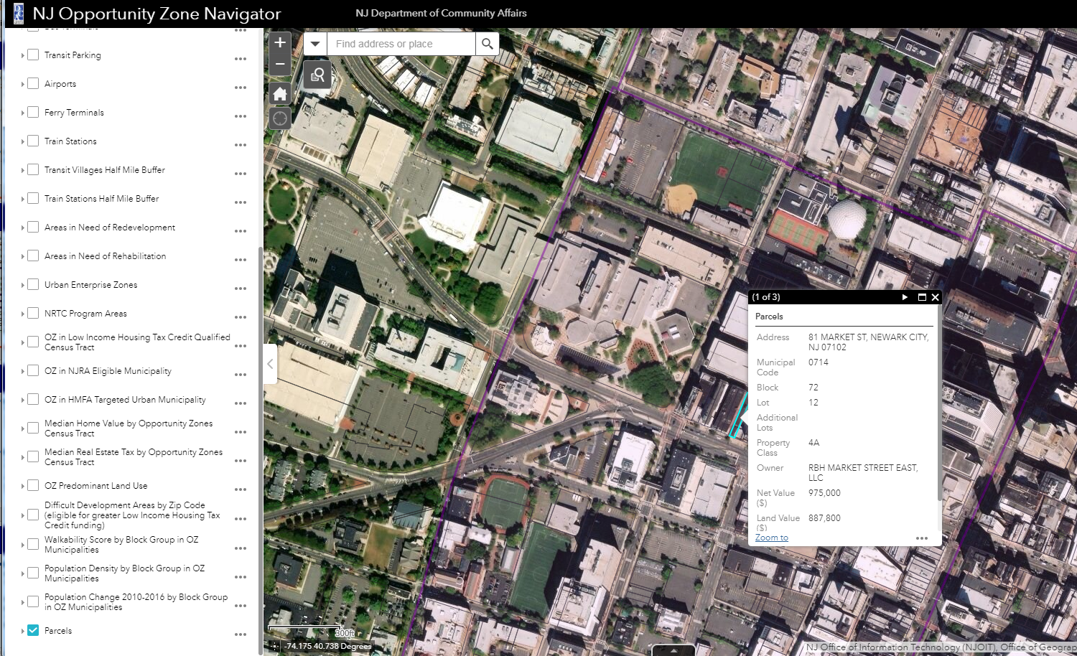
Promoting your communiTy
  Use the DCA community asset map to help promote your community
    Identify and highlight community assets
      Schools, colleges, hospitals, parks, transit access, walkability, etc.
    Identify special state development incentive areas that are attractive to investors
      Urban Enterprise Zones
      Neighborhood Revitalization Tax Credit
    Gather information on vacant parcels, property values, and ownership to pitch specific properties to investors
    Highlight local redevelopment areas

Slide 9
Planning and coordinating
  Interdepartmental planning and coordination
  Interdepartmental meetings to discuss and coordinate OZ priorities and strategy. Include all local departments and agencies that are involved in authorizing business and development activity
    For example, community development, economic development, planning and zoning, codes and construction departments
Designating Opportunity Zone coordinators
  Liaison to engage with businesses and developers
  Engage with local community members, community organizations and non-profits
  Provide local resources for Opportunity Zone development
  Answer questions about development opportunities and the approval process

Slide 10
Building partnerships
Build partnerships with local institutions
  Anchor institutions (i.e. colleges, universities, hospitals)
  Community and non-profit organizations (i.e. neighborhood associations, community development corporations, community development financial institutions, local foundations)
  Build partnerships with neighboring municipalities
  Develop regional investment prospectuses that communicate the region’s economic strengths and advantages
    Joint marketing efforts
  Advance large OZ projects that cross municipal boundaries
  Information and best practices sharing
  Coordinate engagement of investor and businesses communities

Slide 11
Regional cooperation
  Cooperating with other local governments
  For example, county government, surrounding municipalities
  Develop regional investment prospectuses that communicate the region’s economic strengths and advantages
  Advance large OZ projects that cross municipal boundaries
  Information and best practices sharing
  Coordinate engagement of investor and business communities

Slide 12
Creating a plan
Develop a local opportunity zones plan
  Roadmap for achieving positive outcomes in your Opportunity Zones
    Documents all planned activities with timelines
  Identifies local priorities for development in zones
  Outlines a detailed local strategy for attracting investment and community engagement
  Establishes framework for evaluation and review

Slide 13
State Assistance
  The State of New Jersey stands ready to support your efforts to promote equitable and inclusive development within your Opportunity Zones
  Feel free to reach out to the State if you need assistance:
  njopportunityzones@dca.nj.gov

