Slide 1
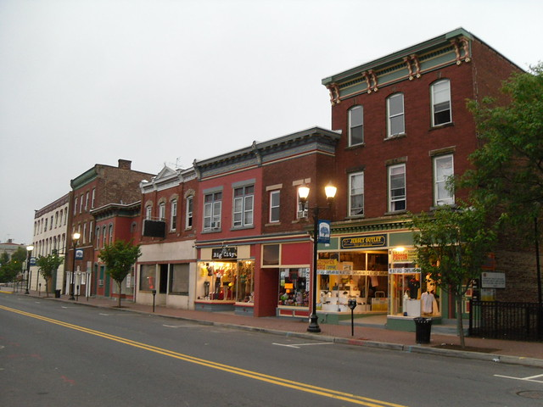
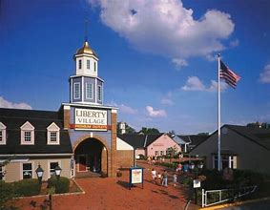
Opportunity Zone strategies For Non-Profits and Community Organizations

Slide 2
How can opportunity zones benefit my organization and community ?
Communicate and advance local development priorities
Ensure Opportunity Zone investment is equitable and inclusive
Connect community residents with jobs and economic opportunities incentivized by the Opportunity Zones
Attract financing for community development projects
Hold developers accountable for positive community outcomes

Slide 3
Community engagement

Slide 4

Education and awareness
  Promote education and awareness about OZs in local communities
    Flyers
    Social media outreach
    Website information
    Community meetings
    Forums
  Communicate what OZs are and how they can be leveraged to improve community quality of life
  Find out what kind of development the local community wants and does not want

Slide 5
Promoting inclusive development

Slide 6
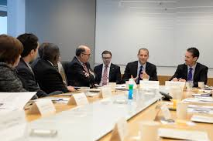

Having a seat at the table
  Actively engage with businesses, developers, and municipal officials on OZ developments in your community
    Highlight neighborhood assets
    Communicate neighborhood needs and priorities
    Communicate local concerns about incoming or planned development
    Speak against harmful development

Slide 7
Opportunities for community residents
  Facilitate connections of residents to jobs from OZ investments– i.e. construction, trades, etc.
    Partner with local workforce development and job training programs, community colleges
  Promote investment in locally-owned businesses and social enterprises
  Protect against gentrification pressures by promoting affordable housing development and set-asides

Slide 8
Advancing Community projects

Slide 9
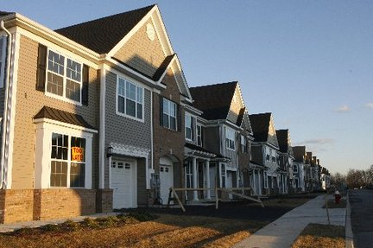
Potential community-based OZ projects
  Develop new businesses and projects of community-benefit that could be funded by OZ investment
    Early childhood development centers
    Charter schools
    Health centers
    Affordable housing
    Community-based social enterprises
      Food service
      Light manufacturing
      Cooperatives
  OZ must make sense for the business or project
  Projects must be pitched to investors

Slide 10

Role of Community development financial institutions
  Community Development Financial Institutions can play a leading role providing capital for important OZ projects
    Identify projects
    Raise investment capital
    Develop strategy
    Engage with key local players

Slide 11
Networking and partnerships
  Network with other community-based organizations, local non-profits, foundations, small businesses, and elected officials for maximum impact and influence
    Help to steer development toward better community outcomes
  Engage with legal, accounting, real estate, and investment banking professionals
    Engage network of experts to help get a community project off the ground
  Partner with Opportunity Funds focused on investments with a social impact
    Pitch priority projects in your local community

Slide 12
Leveraging state neighborhood programs

Slide 13
Neighborhood Revitalization tax Credit program
DCA’s Neighborhood Revitalization Tax Credit Program provides businesses a 80% tax credit for funds provided to community non-profits carrying out comprehensive revitalization plans
  At least 60% of the funds are for housing and economic development
  Remaining funds can be used for supportive services and other activities that promote neighborhood revitalization.
The NRTC program will be changing its focus in 2019
  Soliciting new neighborhood plans from local non-profits from an expanded list of eligible communities
  Funding will be available to develop such plans

Slide 14
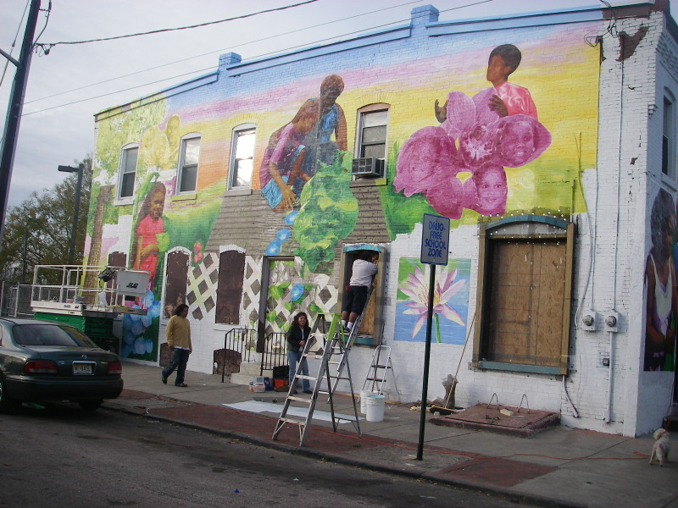
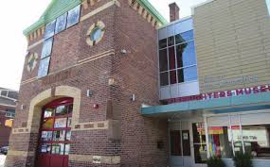
Neighborhood Revitalization tax Credit program
Today, 24 of the 29 NRTC neighborhoods have at least some part of an OZ
Consider developing and submitting an NRTC neighborhood plan to capitalize on your OZ
State tax credit funding may be available to subsidize Opportunity Zone projects

Slide 15
Resources and assistance

Slide 16
Take advantage of state resources
  One-Stop-Shop Opportunity Zones website
  (www.opportunityzones.nj.gov)
    Frequently asked questions
    Draft regulations from US Treasury
    State tax treatment of Opportunity Zone investments
    Opportunity Fund self-certification form
  Interactive community asset map
  (www.nj.gov/dca/communityassetmap)
    Opportunity Zone profiles
  EDA Opportunity Zone Marketplace
    Post projects and find investors
    (https://oppsites.com/newjerseymarketplace)

Slide 17
State Assistance
  The State of New Jersey stands ready to support your efforts to promote equitable and inclusive development within your Opportunity Zones
  Feel free to reach out to the State if you need assistance:
  njopportunityzones@dca.nj.gov

