Slide 1
ZIKA VIRUS: INFORMATION FOR CLINICIANS
Updated May 9, 2017

Slide 2
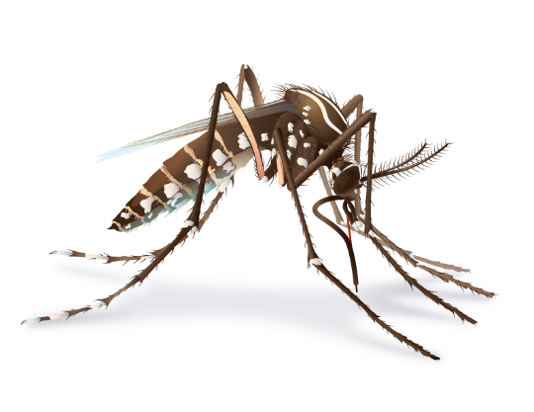
These slides provide clinicians with information about
Zika virus epidemiology
Diagnoses and testing
Case reporting
Zika and pregnancy
Clinical management of infants
Sexual transmission
Preconception guidance
Infection control
What to tell patients about Zika
What to tell patients about mosquito bite protection
Notes:
These are topics discussed in this training. Information comes from: http://www.cdc.gov/zika/index.html.
All clinical guidances can be found here: http://www.cdc.gov/zika/hc-providers/index.html

Slide 3
Zika Virus epidemiology

Slide 4
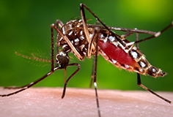
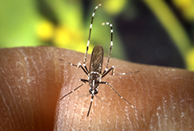
Zika Virus (Zika)
Single stranded RNA virus
Genus flavivirus, family Flaviviridae
Closely related to dengue, yellow fever, Japanese encephalitis, and West Nile viruses
Primarily transmitted through the bite of an infected Aedes species mosquito (Ae. aegypti and Ae. albopictus)
Aedes aegypti
Aedes albopictus
Notes:
Zika virus was first discovered in a monkey in the Zika Forest of Uganda in 1947.
Before 2007, at least 14 cases of Zika had been documented, although other cases were likely to have occurred and were not reported.
Before 2015, Zika virus disease (Zika) outbreaks occurred in areas of Africa, Southeast Asia, and the Pacific Islands. Because the symptoms of Zika are similar to those of many other diseases, many cases may not have been recognized.

Slide 5
Where has Zika virus been found?
Before 2015, Zika outbreaks occurred in Africa, Southeast Asia, and the Pacific Islands.
Currently is a risk in many countries and territories.
For the most recent case counts in the US visit CDC’s Zika website: cdc.gov/zika
http://www.cdc.gov/zika/geo/index.html
Notes:
On May 7, 2015, the Pan American Health Organization (PAHO) issued an alert regarding the first confirmed Zika virus infections in Brazil.
Since May 2015, CDC has been responding to increased reports of Zika and has assisted in investigations with PAHO and countries’ ministries of health. The first travel notice for Zika in Brazil was posted in June 2015.
On January 22, 2016, CDC activated its Emergency Operations Center (EOC) to respond to outbreaks of Zika occurring in the Americas and increased reports of birth defects and Guillain-Barré syndrome in areas affected by Zika. On February 8, 2016, CDC elevated its EOC activation to a Level 1, the highest level.
On February 1, 2016, the World Health Organization (WHO) declared a Public Health Emergency of International Concern (PHEIC) because of clusters of microcephaly and other neurological disorders in some areas affected by Zika.

Slide 6
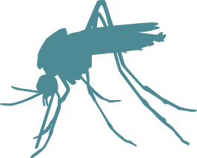
Transmission
Bite from an infected mosquito
Maternal-fetal
Periconceptional
Intrauterine
Perinatal
Sexual transmission from an infected person to his or her partners
Laboratory exposure
Notes:
There have been cases of male-to-male, male-to-female, and female-to-male sexual transmission reported.
There has been 1 reported case of laboratory exposure in the US.

Slide 7
Transmission
Zika may be spread through blood transfusion.
Zika virus has been detected in breast milk.
There are no reports of transmission of Zika virus infection through breastfeeding.
Based on available evidence, the benefits of breastfeeding outweigh any possible risk.
Notes:
To date, there have been no confirmed blood transfusion-transmission cases in the United States.
Zika virus currently poses a low risk to the blood supply in the continental United States, but this could change depending on how many people become infected with the virus.
In August 2016, FDA issued revised guidance calling for blood collection centers in the United States to screen all donated blood for Zika virus, beginning immediately in affected states, within 4 weeks in high-risk states, and within 12 weeks in all states. Currently, all blood collected in the United States and its territories should be screened for Zika virus.
There have been suspected cases of Zika transmission through blood transfusion in Brazil.
During the Zika virus outbreak in French Polynesia in 2013-2014, 2.8% of blood donors tested positive for Zika. In previous outbreaks elsewhere, the virus has also been found in blood donors.
It is possible that Zika can be spread through breastfeeding.
However, CDC and the World Health Organization recommend that infants born to women with suspected, probable, or confirmed Zika virus infection, or who live in or have traveled to areas with Zika, should be fed according to normal infant feeding guidelines.

Slide 8
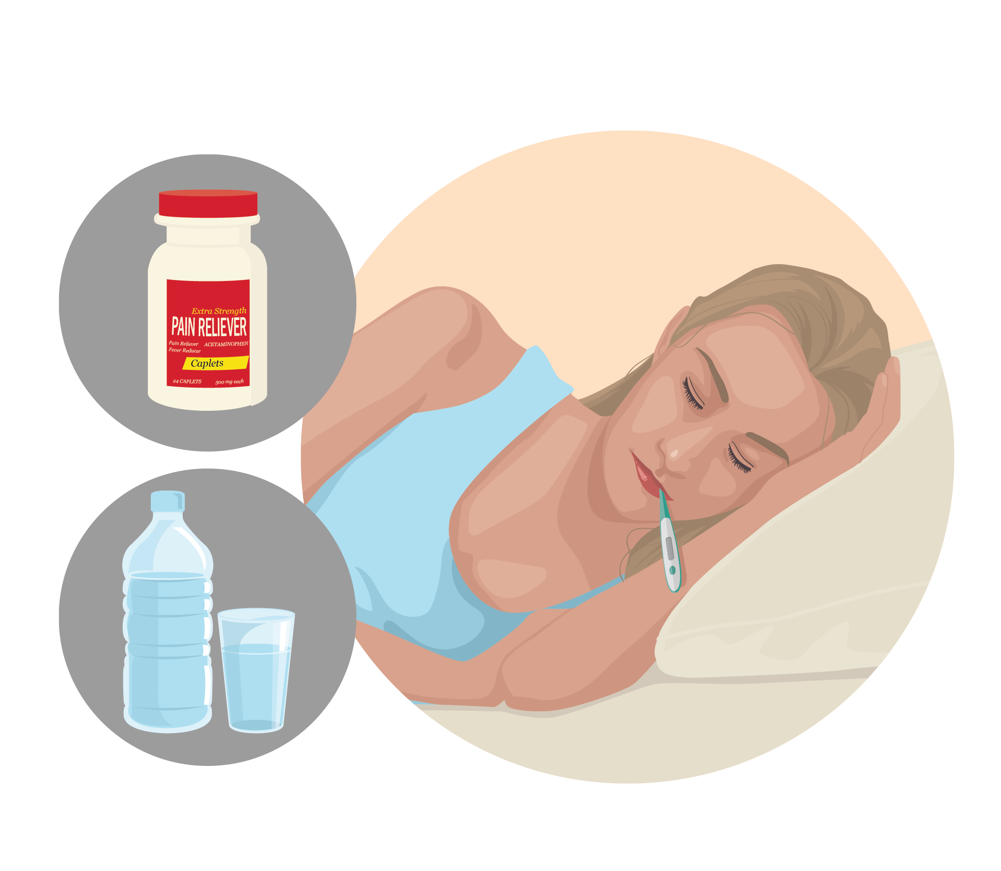
Zika virus incidence and attack rates, Yap 2007
Infection rate: 73% (95% CI 68–77)
Symptomatic attack rate among infected: 18% (95% CI 10–27)
All age groups affected
Adults more likely to present for medical care
No severe disease, hospitalizations, or deaths
Note: Rates based on serosurvey on Yap Island, 2007 (population 7,391)
Notes:
To read the complete study, visit: http://www.nejm.org/doi/full/10.1056/NEJMoa0805715

Slide 9
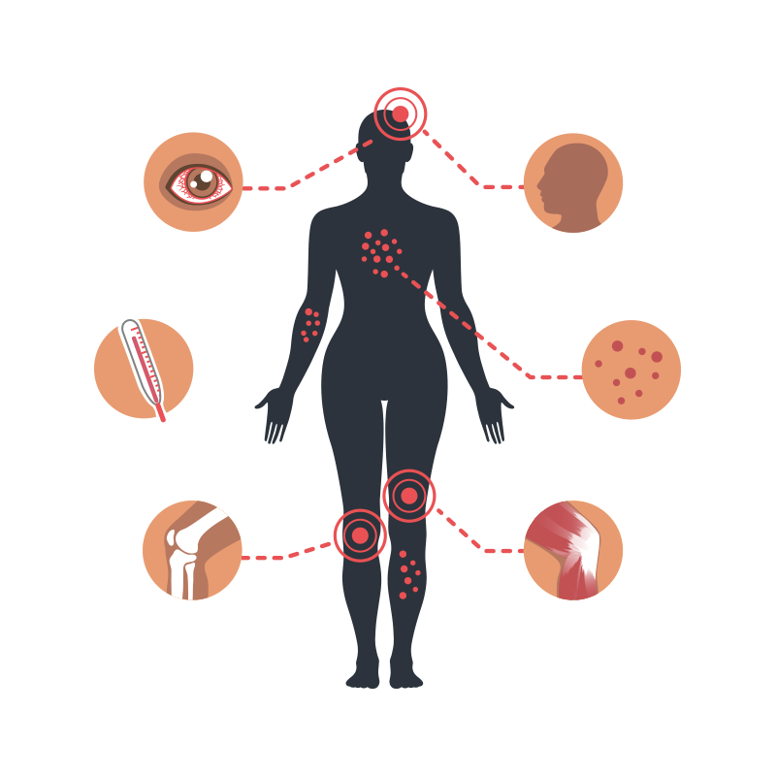
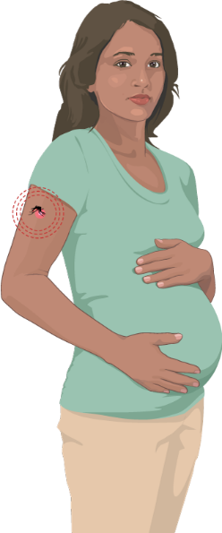
Incubation and viremia
Incubation period for Zika virus disease is 3–14 days.
Zika viremia ranges from a few days to 1 week.
Some infected pregnant women can have evidence of Zika virus in their blood longer than expected.
Virus remains in semen and urine longer than in blood.
3 – 14 days
Notes:
Zika has been found in genital fluids, including semen and vaginal fluids. Studies are underway to find out how long Zika stays in urine, semen, and vaginal fluids of people who have Zika and how long it can be passed to sex partners. Current research indicates that Zika can remain in semen longer than in other body fluids, including vaginal fluids, urine, and blood.
Among four published reports of Zika virus cultured from semen, virus was reported in semen up to 69 days after symptom onset.
Pieces of Zika virus (Zika RNA) have been found in semen as many as 188 days after symptoms began, and in vaginal and cervical fluids up to 3 and 11 days after symptoms began, respectively.

Slide 10
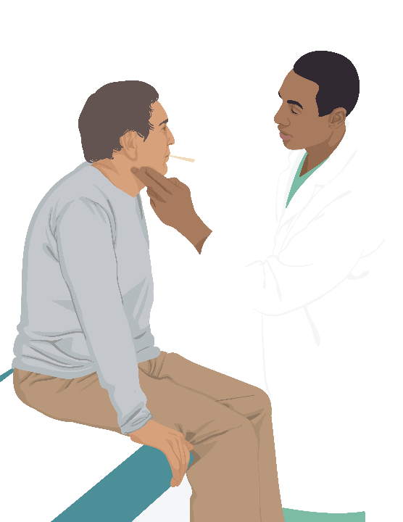
Zika virus clinical disease course and outcomes
Clinical illness is usually mild.
Symptoms last several days to a week.
Severe disease requiring hospitalization is uncommon.
Fatalities are rare.
Research suggests that Guillain-Barré syndrome (GBS) is strongly associated with Zika; however only a small proportion of people with recent Zika infection get GBS.
Notes:
Because the symptoms of Zika are similar to those of many other diseases, many cases may not have be recognized.

Slide 11
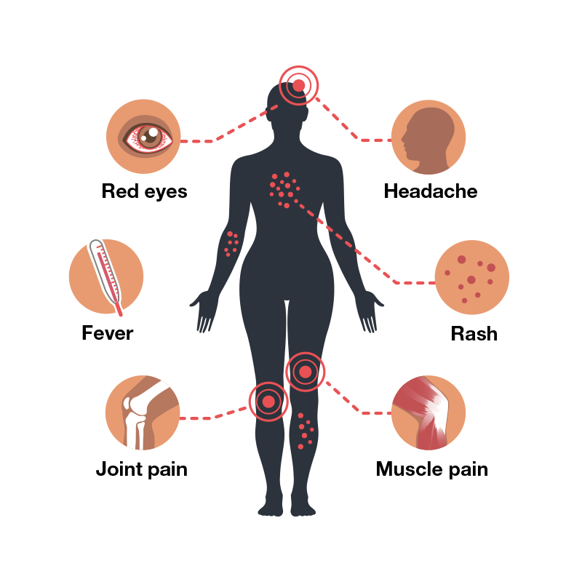
Symptoms
Many infections are asymptomatic
Acute onset of fever
Maculopapular rash
Headache
Joint pain
Conjunctivitis
Muscle pain
Notes:
People usually don’t get sick enough to go to the hospital, and they very rarely die of Zika.

Slide 12
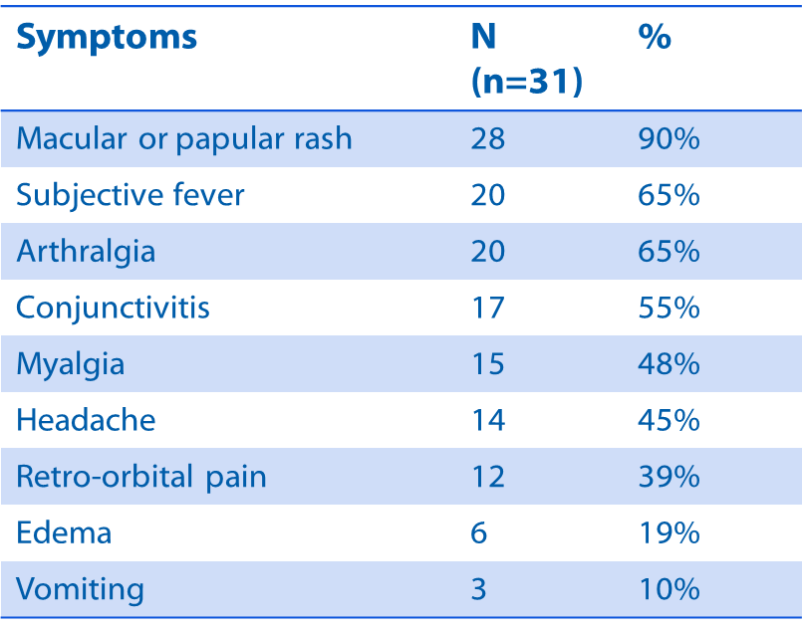
Reported clinical symptoms among confirmed Zika virus disease cases
Yap Island, 2007
Duffy M. N Engl J Med 2009
Notes:
This chart lists the symptoms of Zika virus infection and the number and percentage of cases reported with each symptom in a study conducted in Yap Island during the 2007 outbreak. The most common symptom is rash.
Symptoms include rash, fever, arthralgia, conjunctivitis, myalgia, headache, retro-orbital pain, edema, and vomiting.

Slide 13
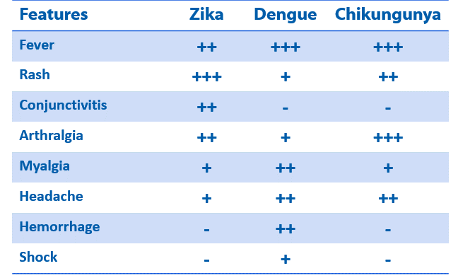
Clinical features: Zika virus compared to dengue and chikungunya
Rabe, Ingrid MBChB, MMed “Zika Virus- What Clinicians Need to Know?” (presentation, Clinician Outreach and Communication Activity (COCA) Call, Atlanta, GA, January 26 2016)
Notes:
This chart compares the symptoms of Zika to dengue virus and chikungunya virus.
All three viruses can cause fever, rash, arthralgia, headache, and myalgia.
Zika can cause conjunctivitis. Dengue can cause hemorrhage and shock.

Slide 14
Diagnoses and Testing for Zika

Slide 15
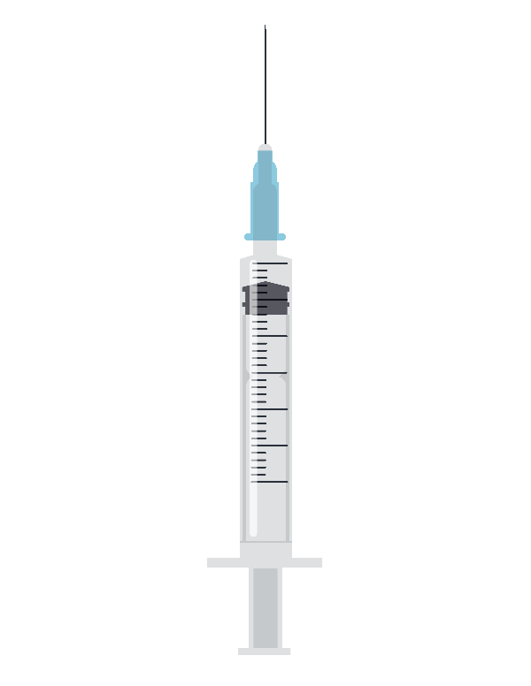
Assessing pregnant women
All pregnant women should be asked at each prenatal care visit if they
Traveled to or live in an area with risk of Zika during their pregnancy or periconceptional period (the 6 weeks before last menstrual period or 8 weeks before conception).
Had sex without a condom with a partner who has traveled to or lives in an area with risk of Zika.
Pregnant women who have a possible exposure to Zika virus are eligible for testing for Zika virus infection.
Notes:
Possible exposure to Zika virus that warrants testing include:
Travel to or residence in an area with risk of Zika, or
Sex (vaginal, anal, and oral sex) without a condom, or sharing sex toys with a person who traveled to, or lives in an area with risk of Zika.
Full laboratory guidance can be found here http://www.cdc.gov/zika/laboratories/lab-guidance.html

Slide 16
Who to test for Zika
Anyone who has or recently experienced symptoms of Zika and lives in or recently traveled to an area with risk of Zika
Anyone who has or recently experienced symptoms of Zika and had unprotected sex with a partner who lived in or traveled to an area with risk of Zika
Pregnant women who have possible exposure to
An area with risk of Zika with a CDC Zika travel notice, regardless of symptoms
An area with risk of Zika but without a CDC Zika travel notice if they develop symptoms of Zika or if their fetus has abnormalities on an ultrasound that may be related to Zika
Notes:
The type of testing recommended varies according to when a woman visits a provider relative to when her symptoms began or, if she is asymptomatic, the date of her last possible exposure to Zika virus.
Because the level of risk of Zika virus infection is unknown in areas with risk of Zika but without travel notices, routine testing is not recommended for pregnant women who have traveled to those areas but who do not have symptoms. However, testing may be offered on a case-by-case basis.

Slide 17
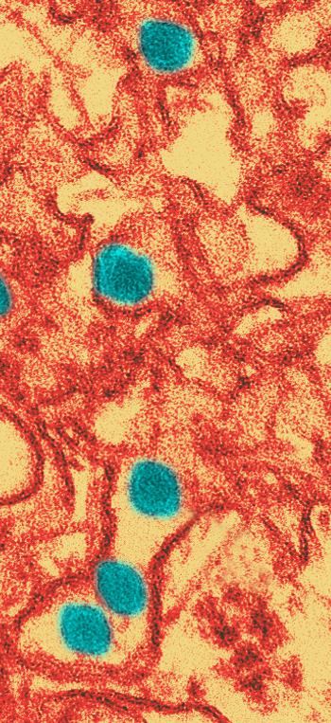
Diagnostic testing for Zika virus
During first 2 weeks after the start of illness (or exposure, in the case of asymptomatic pregnant women), Zika virus infection can often be diagnosed by performing RNA nucleic acid testing (NAT) on serum and urine, and possibly whole blood, cerebral spinal fluid, or amniotic fluid in accordance with EUA labeling.
Serology assays can also be used to detect Zika virus-specific IgM and neutralizing antibodies, which typically develop toward the end of the first week of illness.
Plaque reduction neutralization test (PRNT) for presence of virus-specific neutralizing antibodies in serum samples.
Notes:
Information on Zika testing can be found here: http://www.cdc.gov/zika/hc-providers/types-of-tests.html
During the first two weeks after the start of illness (or exposure, in the case of asymptomatic pregnant women), Zika virus disease can often be diagnosed by performing RNA nucleic acid testing (NAT) on serum and urine, and possibly whole blood, cerebral spinal fluid, or amniotic fluid in accordance with EUA labeling.
Zika virus RNA NAT should be performed on serum and urine collected <14 days after onset of symptoms in patients with suspected Zika virus disease.
A positive Zika virus RNA NAT confirms Zika virus infection. However, because Zika virus RNA in serum and urine decreases over time, a negative RNA NAT does not rule out Zika virus infection; in this case, serologic testing should be performed.

Slide 18
Differential diagnosis
Based on typical clinical features, the differential diagnosis for Zika virus infection is broad. Considerations include
Dengue
Chikungunya
Leptospirosis
Malaria
Riskettsia
Group A Streptococcus
Rubella
Measles
Parvovirus
Enterovirus
Adenovirus
Other alphaviruses (e.g., Mayaro, Ross River, Barmah Forest, o’nyong-nyong, and sindbis viruses)
Notes:
For more information see http://www.cdc.gov/zika/laboratories/index.html
Serology assays can also be used to detect Zika virus-specific IgM and neutralizing antibodies, which typically develop toward the end of the first week of illness.
o A positive IgM result does not always indicate Zika virus infection and can be difficult to interpret because cross-reactivity with related flaviviruses (e.g., dengue, Japanese encephalitis, West Nile, yellow fever) can occur.
o A positive Zika virus IgM result may reflect previous vaccination against a related flavivirus; previous infection with Zika or a related flavivirus; or current infection with a flavivirus, including Zika virus.

Slide 19
Serology cross-reactions with other flaviviruses
Zika virus serology (IgM) can be positive due to antibodies against related flaviviruses (e.g., dengue and yellow fever viruses).
If Zika virus RNA NAT results are negative for both specimens, serum should be tested by antibody detection methods.
Neutralizing antibody testing by PRNT may discriminate between cross-reacting antibodies in primary flavivirus infections.
Difficult to distinguish Zika virus in people previously infected with or vaccinated against a related flavivirus.
Notes:
Plaque-reduction neutralization testing (PRNT) can be performed to measure virus-specific neutralizing antibodies to confirm primary flavivirus infections and differentiate from other viral illnesses.
PRNT can be performed to measure virus-specific neutralizing antibodies to Zika virus, but neutralizing antibodies may still yield cross-reactive results in a person who was previously infected with another flavivirus, such as dengue, or has been vaccinated against yellow fever or Japanese encephalitis.

Slide 20
Testing for infants
CDC recommends laboratory testing for
All infants born to mothers with laboratory evidence of possible Zika virus infection during pregnancy.
Infants who have abnormal clinical or neuroimaging finds suggestive of congenital Zika syndrome and a mother with a possible exposure to Zika virus, regardless of maternal Zika virus testing results.
Infant samples for Zika virus testing should be collected ideally within the first 2 days of life; if testing is performed later, distinguishing between congenital, perinatal, and postnatal infection will be difficult.
Notes:
Infant samples for Zika virus testing should be collected ideally within the first 2 days of life; if testing is performed later, distinguishing between congenital, perinatal, and postnatal infection will be difficult.
Infants born to mothers with risk factors for maternal Zika virus infection for whom maternal testing was not performed before delivery, or was performed outside the recommended window, and the IgM result was negative, should receive a comprehensive assessment, including a physical exam, careful measurement of head circumference, head ultrasound to assess the brain’s structure, and standard newborn screening. If no infant abnormalities are detected, further evaluation should proceed based on the following scenarios:
If maternal testing was not performed during pregnancy, maternal diagnostic testing with Zika virus IgM antibody may be considered; however, a negative test > 12 weeks after symptom onset or possible exposure does not rule out recent maternal Zika virus infection because IgM antibody levels decline over time testing
If maternal testing is not performed before delivery, testing of infant samples collected within the first 2 days of birth should be considered.
If maternal samples are collected around the time of delivery and fall within 12 weeks of symptom onset or possible exposure, and maternal test results are negative, infant samples should not be tested for Zika.
If maternal samples are collected around the time of delivery, which is >12 weeks after symptom onset or exposure, infant samples should be collected. If maternal IgM is negative, infant testing should be considered because a negative IgM result does not rule out recent maternal Zika virus infection. If maternal IgM is positive or equivocal, infant testing should be based on maternal PRNT results (if neutralizing antibodies to Zika are detected, infant testing should be pursued).

Slide 21
Laboratories for diagnostic testing
Testing performed at CDC, select commercial labs, and a few state health departments.
CDC is working to expand diagnostic testing capacity with both public and commercial partners in the United States.
Healthcare providers should work with their state health department to facilitate diagnostic testing and report results.
Notes:
Laboratories processing clinical specimens for Zika virus diagnostic testing should, at a minimum, adhere to BSL2 (biosafety level 2) precautions. All laboratories should perform a risk assessment to determine if there are certain procedures or specimens that may require higher levels of biocontainment. Suspicion that the specimen may contain a pathogen that requires BSL3 precautions (e.g., chikungunya virus), should be considered a significant risk factor.
CDC is working to expand diagnostic testing capacity with both public and commercial partners in the United States.

Slide 22
Reporting zika cases

Slide 23
Reporting cases
Zika virus disease is a nationally notifiable condition. Report all confirmed cases to your state health department.
Notes:
Zika virus disease and Zika virus congenital infection are nationally notifiable conditions. State and territorial health departments are encouraged to report laboratory-confirmed cases to CDC through ArboNET, the national surveillance system for arboviral diseases. Healthcare providers should report cases to their local, state, or territorial health department according to the laws or regulations for reportable diseases in their jurisdiction.

Slide 24
Zika pregnancy registries
CDC is monitoring pregnancy and infant outcomes following Zika infection during pregnancy in US states and territories through the US Zika Pregnancy Registry (USZPR) and the Zika Active Pregnancy Surveillance System (ZAPSS) in Puerto Rico.
CDC maintains a 24/7 consultation service for health officials and healthcare providers caring for pregnant women. To contact the service, call 800-CDC-INFO (800-232-4636),or email ZIKAMCH@cdc.gov.
Decorative image
Notes:
Health departments are working with healthcare providers to collect information about exposure to Zika, the presence or absence of symptoms and pregnancy complications, prenatal Zika testing, pregnancy and birth outcomes, and infant health and development.
The data collected through these registries will provide additional, more comprehensive information to complement notifiable disease case reporting and will be used to update recommendations for clinical care, to plan for services for pregnant women and families affected by Zika virus, and to improve prevention of Zika virus infection during pregnancy.

Slide 25
Zika and pregnancy

Slide 26
Zika and pregnancy
Knowledge about Zika virus is increasing rapidly and researchers continue to work to better understand the extent of Zika virus’ impact on mothers, infants, and children.
No reports of infants getting Zika through breastfeeding
No evidence that previous infection will affect future pregnancies
Notes:
Recognizing that Zika is a cause of certain birth defects does not mean that every pregnant woman infected with Zika will have a baby with a birth defect. It means that infection with Zika during pregnancy increases the chances for these problems.
Scientists continue to study other potential health problems that Zika virus infection during pregnancy may cause.
Although studies to date have linked Zika with certain birth defects or other pregnancy problems, it’s important to remember that even in places with active Zika transmission, women are delivering infants that appear to be healthy.
Many questions remain about the timing, absolute risk, and the spectrum of outcomes associated with Zika virus infection during pregnancy.
More lab testing and other studies are planned to learn more about the risks of Zika virus infection during pregnancy.

Slide 27
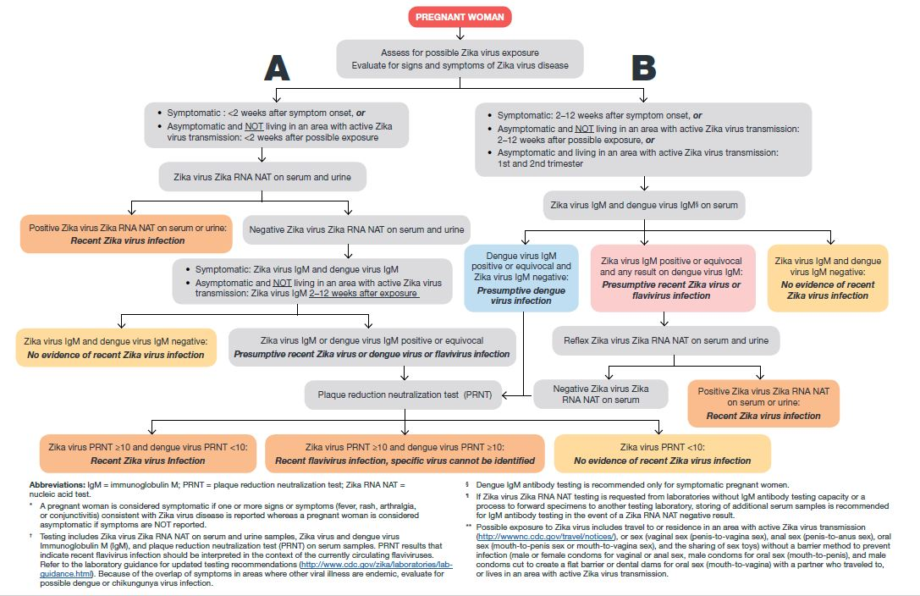
Testing guidance: Pregnant women with possible Zika exposure
Notes:
This is an algorithm for the processes of testing women who are possibly exposed to Zika virus during pregnancy. Possible exposure includes living in or traveling to an area where Zika is spreading or having sex without a condom with a person who has lived in or traveled to an area with Zika.

Slide 28
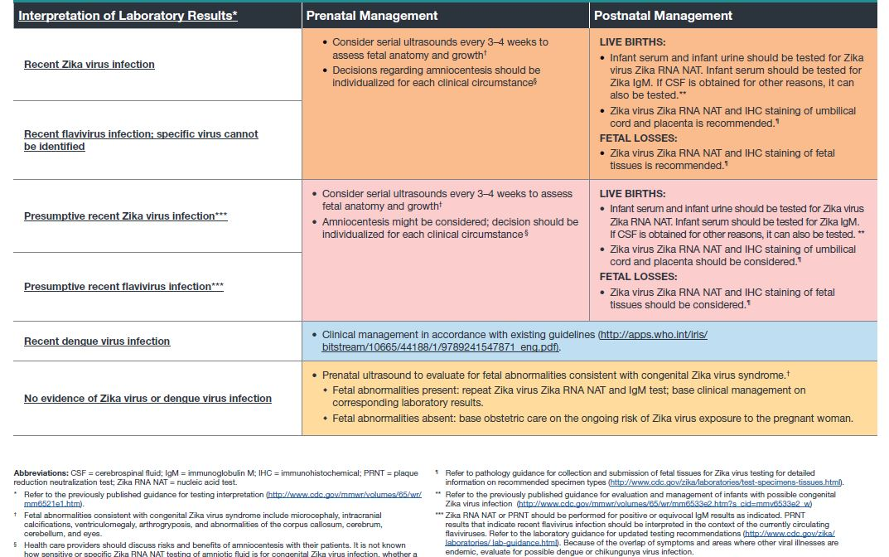
Clinical management of a pregnant woman with suspected Zika virus infection
Notes:
This chart provides guidance for clinical prenatal and postnatal management for pregnant women with suspected Zika infection based on their Zika laboratory testing results.

Slide 29
EVALUATION AND Follow up of infants with confirmed or possible zika infection

Slide 30
Zika and pregnancy outcomes
Zika virus infection during pregnancy is a cause of microcephaly and other severe birth defects.
All infants born to mothers with laboratory evidence of Zika infection during pregnancy should receive a comprehensive physical exam.
Congenital Zika syndrome is a distinct pattern of birth defects among fetuses and infants infected before birth.
Notes:
Based on rigorous peer-reviewed evaluation of the scientific evidence, CDC and international partners have concluded that Zika virus infection during pregnancy is a cause of microcephaly and other severe brain defects.
Microcephaly at birth is not a necessary feature of congenital Zika syndrome. Infants with a head circumference at birth in the normal range can have brain abnormalities consistent with congenital Zika syndrome. In addition, microcephaly from congenital infection can develop after birth.

Slide 31
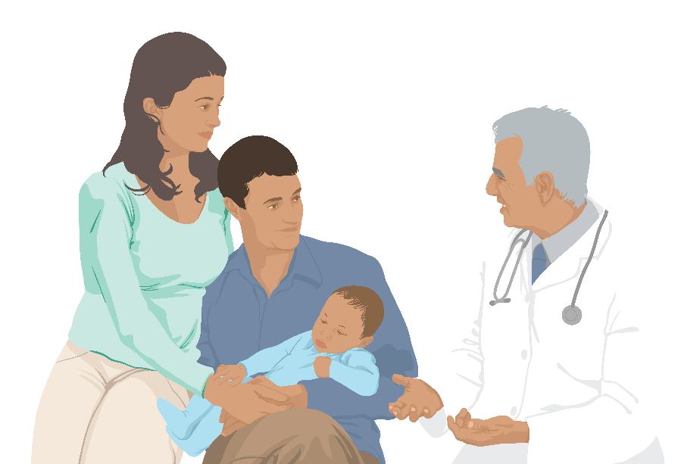
Congenital Zika syndrome
Congenital Zika syndrome is associated with five types of birth defects that are either not seen or occur rarely with other infections during pregnancy:
Severe microcephaly (small head size) resulting in a partially collapsed skull
Decreased brain tissue with brain damage (as indicated by a specific pattern of calcium deposits)
Damage to the back of the eye with a specific pattern of scarring and increased pigment
Limited range of joint motion, such as clubfoot
Too much muscle tone restricting body movement soon after birth
Notes:
A distinct pattern of birth defects, called congenital Zika syndrome, has emerged among fetuses and infants of women infected with Zika during pregnancy. In addition to cognitive, sensory, and motor disabilities that are shared with other birth defects, congenital Zika syndrome is associated with five types of birth defects that are either not seen or occur rarely with other infections during pregnancy:
Severe microcephaly (small head size) resulting in a partially collapsed skull
Decreased brain tissue with brain damage (as indicated by a specific pattern of calcium deposits)
Damage to the back of the eye with a specific pattern of scarring and increased pigment
Limited range of joint motion, such as clubfoot
Too much muscle tone restricting body movement soon after birth.
A recent report indicates that microcephaly at birth is not a necessary feature of congenital Zika syndrome. Infants with a head circumference at birth that is within the normal rance can still have brain abnormalities consistent with congenital Zika syndrome. In addition, microcephaly from congenital infection can develop after birth.

Slide 32
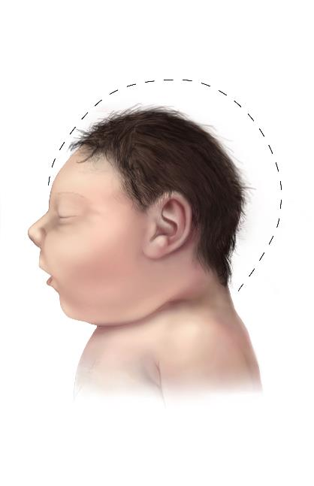
Case definition of microcephaly
Definite congenital microcephaly for live births
Head circumference (HC) at birth is less than the 3rd percentile for gestational age and sex.
If HC at birth is not available, HC less than the 3rd percentile for age and sex within the first 6 weeks of life.
Definite congenital microcephaly for still births and early termination
HC at delivery is less than the 3rd percentile for gestational age and sex.
Baby with microcephaly
Notes:
Microcephaly is diagnosed when an infant’s head is smaller than expected as compared to infants of the same age (or gestational age) and sex. Postnatal (after birth) head circumference that is less than the 3rd percentile based on standard growth charts is considered microcephaly.

Slide 33
Definitions for possible congenital microcephaly
Possible congenital microcephaly for live births
If earlier HC is not available, HC less than 3rd percentile for age and sex beyond 6 weeks of life.
Possible microcephaly for all birth outcomes
Microcephaly diagnosed or suspected on prenatal ultrasound in the absence of available HC measurements.
Baby with microcephaly
Notes:
Head circumference (HC) and occipitofrontal circumference (OFC) are the same. These terms can be used interchangeably. CDC has information regarding how to accurately measure head circumference.

Slide 34
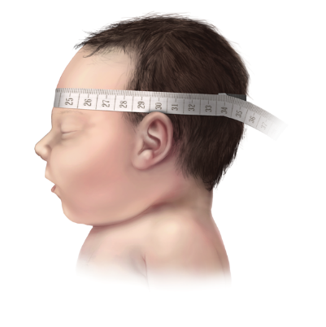
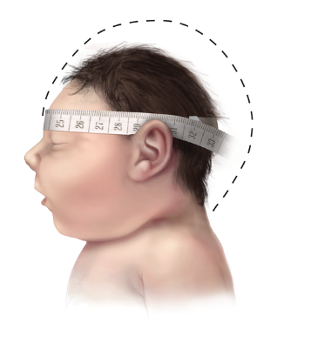
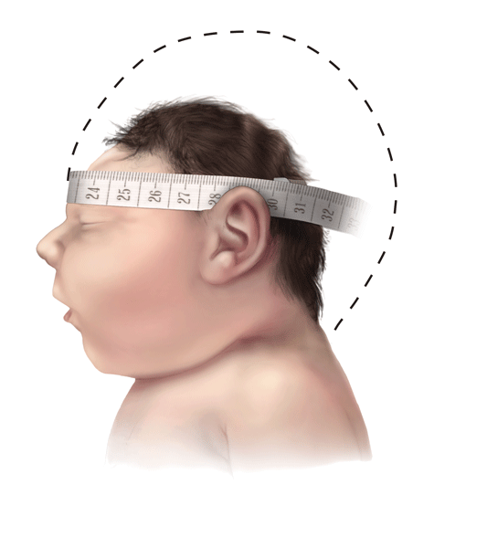
Measuring head circumference for microcephaly
Baby with typical head size
Baby with Microcephaly
Baby with Severe Microcephaly
Use a measuring tape that cannot be stretched
Securely wrap the tape around the widest possible circumference of the head
Broadest part of the forehead above eyebrow
Above the ears
Most prominent part of the back of the head
Take the measurement three times and select the largest measurement to the nearest 0.1 cm
Optimal measurement within 24 hours after birth.
Commonly-used birth head circumference reference charts by age and sex based on measurements taken before 24 hours of age
http://www.cdc.gov/zika/pdfs/microcephaly_measuring.pdf
Notes:
For infants diagnosed with microcephaly, head size correlates with underlying brain size. However, these measurements do not consistently predict long-term sequelae.
Neurologic sequelae may include seizures, vision or hearing problems, and developmental disabilities. Sequelae vary with the extent of brain disruption.
Causes of congenital microcephaly may include genetic conditions such as chromosomal abnormalities or maternal exposures (e.g., alcohol, mercury, or radiation) during pregnancy. In addition to Zika, other maternal infections that have been associated with microcephaly include cytomegalovirus (CMV), herpes simplex virus, rubella virus, lymphocytic choriomeningitis virus (LCMV), Treponema pallidum (i.e., syphilis), and Toxoplasma gondii.

Slide 35
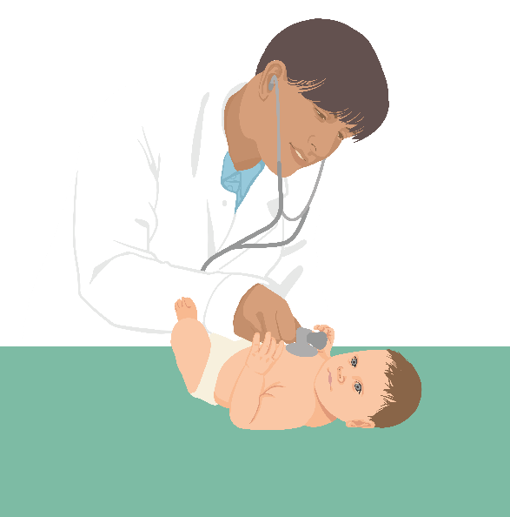
Not every infection will lead to birth defects
It’s important to remember that even in places with Zika, women are delivering infants that appear to be healthy.
Many questions remain about the timing, absolute risk, and the spectrum of outcomes associated with Zika virus infection during pregnancy.
More lab testing and other studies are planned to learn more about the risks of Zika virus infection during pregnancy.

Slide 36
Infants of mothers with potential maternal exposure to Zika
Infants born to potentially exposed mothers who were not tested before delivery, or who were tested outside of the recommended window, and the IgM result was negative, should receive
Comprehensive assessment including a physical exam
Careful measurement of head circumference
Head ultrasound to assess the brain’s structure
Standard newborn screening

Slide 37
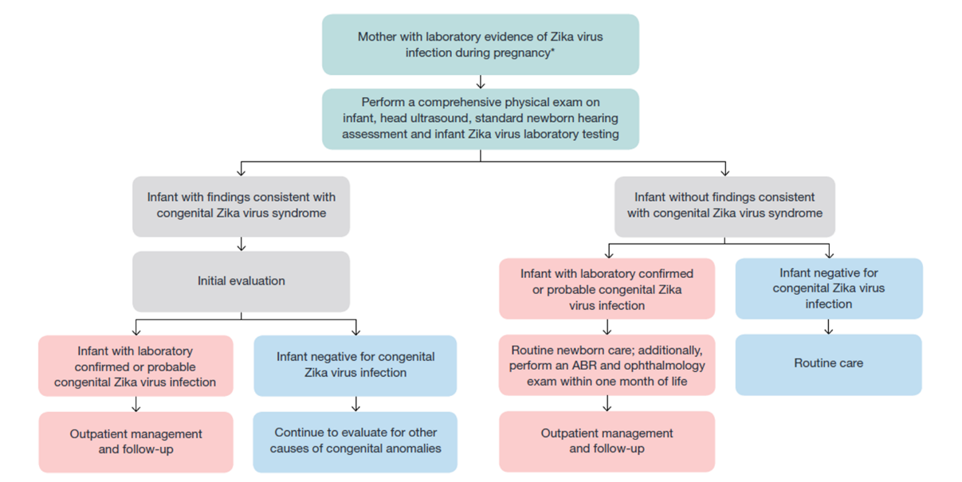
Interim Guidance: Evaluation and testing of infants with possible congenital Zika virus infection
Notes:
This algorithm shows the guidance for testing and evaluating infants with possible congenital Zika infection. Source: https://www.cdc.gov/zika/pdfs/zika_peds.pdf

Slide 38
Recommended consultation for initial evaluation and management of infants affected by Zika
Consultation with
Neurologist - determination of appropriate neuroimaging and evaluation
Infectious disease specialist - diagnostic evaluation of other congenital infections
Ophthalmologist - comprehensive eye exam and evaluation for possible cortical visual impairment prior to discharge from hospital or within 1 month of birth
Endocrinologist - evaluation for hypothalamic or pituitary dysfunction
Clinical geneticist- evaluate for other causes of microcephaly or other anomalies if present
Notes:
Families of affected infants will require support and referrals for information and services. There is likely to be a disproportionate burden on families with limited access to medical care and barriers to services.
Because the types of services needed to care for infants with congenital Zika syndrome are complex, CDC recommends coordinated care through a multidisciplinary team and established medical home.

Slide 39
Considerations for consultation
Consider consultation with
Orthopedist, physiatrist, and physical therapist for the management of hypertonia, club foot, or arthrogrypotic-like conditions
Pulmonologist or otolaryngologist for concerns about aspiration.
Lactation specialist, nutritionist, gastroenterologist, or speech or occupational therapist for the management of feeding issues.
Perform auditory brain response (ABR) to assess hearing.
Perform complete blood count and metabolic panel, including liver function tests.
Provide family and supportive services.
Notes:
As a critical component of patient care and early identification of any delays, families should be empowered to be active participants in their child’s monitoring and care. Resources for families can be found at CDC’s website.

Slide 40
Outpatient management and checklist
Outpatient management checklist
 | 2 weeks | 1 mo. | 2 mo. |  | 3 mo. | 4-6 mo. | 9 mo. | 12 mo.
Infant with abnormalities consistent with congenital Zika syndrome and laboratory evidence of Zika virus infection | Thyroid screen (TSH & free T4) | Neuro exam | Neuro exam |  | Thyroid screen (TSH & free T4) Ophthalmology exam | Repeat audiology evaluation (ABR) | Developmental screening
 | Routine preventive health care including monitoring of feeding, growth, and development Routine and congenital infection-specific anticipatory guidance Referral to specialists as needed Referral to early intervention services
Infant with abnormalities consistent with congenital Zika syndrome and negative for Zika virus infection | Evaluate for other causes of congenital anomalies Further management as clinically indicated
Infant with no abnormalities consistent with congenital Zika syndrome and laboratory evidence of Zika virus infection | Ophthalmology exam ABR |  |  |  |  | Consider repeat ABR | Developmental screening Behavioral audiology evaluation if ABR was not done at 4-6 mo
 | Monitoring of growth parameters (Head circumference, weight, and height), developmental monitoring by caregivers and health care providers, and age-appropriate developmental screening at well-child visits
Infant with no abnormalities consistent with congenital Zika syndrome and negative for Zika virus infection | Monitoring of growth parameters (Head circumference, weight, and height), developmental monitoring by caregivers and health care providers, and age-appropriate developmental screening at well-child visits
Notes:
This table can be found in the supplemental material on the CDC website for healthcare providers caring for infants and children with Zika virus infection. https://www.cdc.gov/zika/pdfs/pediatric-evaluation-follow-up-tool.pdf

Slide 41
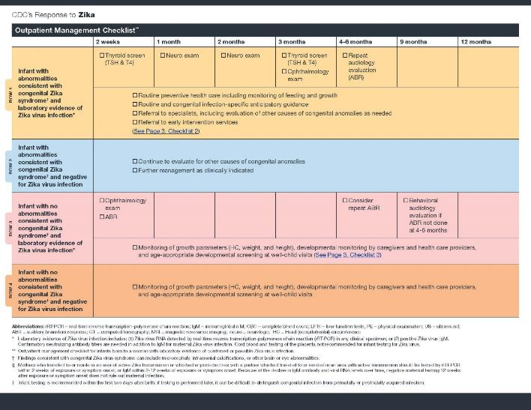
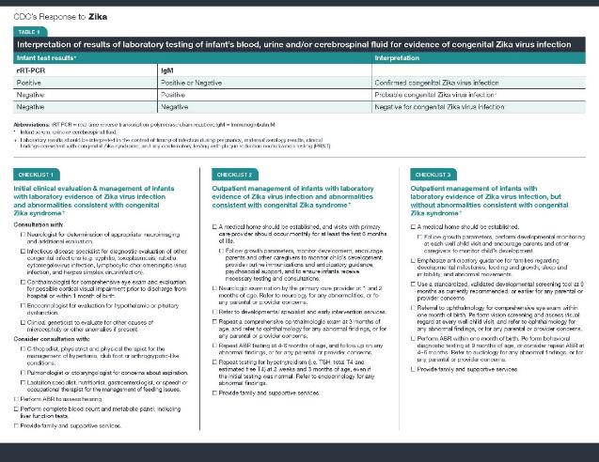
Pediatric evaluation and follow up tools
Download at: http://www.cdc.gov/zika/pdfs/pediatric-evaluation-follow-up-tool.pdf

Slide 42
Sexual Transmission

Slide 43
About sexual transmission
Zika can be passed through sex from a person who has Zika to his or her sex partners.
It can be passed from a person with Zika before their symptoms start, while they have symptoms, and after their symptoms end.
The virus may also be passed by a person who never has symptoms.
Sexual exposure includes sex without a condom with a person who traveled to or lives in an area with risk of Zika.
This includes vaginal, anal, and oral sex and the sharing of sex toys.
Notes:
Zika has been found in genital fluids, including semen and vaginal fluids. Studies are underway to find out how long Zika stays in the semen and vaginal fluids of people who have Zika and how long it can be passed to sex partners. Current research indicates that Zika can remain in semen longer than in other body fluids, including vaginal fluids, urine, and blood.

Slide 44
Zika in genital fluids
We know that Zika can remain in semen longer than in other body fluids, including vaginal fluids, urine, and blood.
Among four published reports of Zika virus cultured from semen, virus was reported in semen up to 69 days after symptom onset.
Zika RNA has been found in semen as many as 188 days after symptoms began, and in vaginal and cervical fluids up to 14 days after symptoms began.
Notes:
Studies are underway to find out how long Zika stays in the semen and vaginal fluids of people who have Zika and how long it can be passed to sex partners.

Slide 45
What we do not know about sexual transmission
CDC and other public health partners continue research that may help us find out
How long Zika can stay in genital fluids.
How common it is for Zika to be passed during sex.
If Zika passed to a pregnant woman during sex has a different risk for birth defects than Zika transmitted by a mosquito bite.
Notes:
For more information on sexual transmission see: http://www.cdc.gov/zika/transmission/sexual-transmission.html

Slide 46
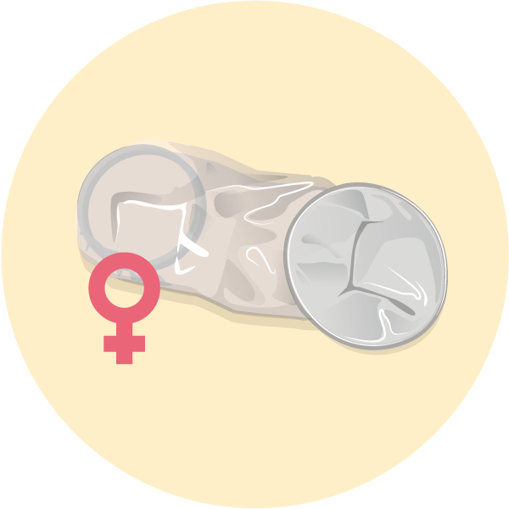
Preventing or reducing the chance of sexual transmission
Not having sex eliminates the risk of getting Zika from sex.
Condoms can reduce the chance of getting Zika from sex.
Dental dams (latex or polyurethane sheets) may also be used for certain types of oral sex (mouth to vagina or mouth to anus).
Not sharing sex toys can also reduce the risk of spreading Zika to sex partners
Pregnant couples with a partner who lives in or recently traveled to an area with risk of Zika should use condoms correctly every time they have sex or not have sex during pregnancy.
Notes:
For more information on sexual transmission see: http://www.cdc.gov/zika/transmission/sexual-transmission.html

Slide 47
Men and women with possible Zika exposure
People with a partner who traveled to an area with risk of Zika can use condoms or not have sex.
If traveler is female: For at least 8 weeks after travel or symptom onset.
If traveler is male: For at least 6 months after travel or symptom onset.
People living in an area with risk of Zika can use condoms or not have sex.
Decorative image
Notes:
Talk with your doctor or other healthcare provider
Women and their partners who are thinking about pregnancy should talk with their doctor or healthcare provider about
Their plans for having children
The potential risk of getting Zika during pregnancy
Their partner’s potential exposures to Zika
The full sexual transmission guidance can be found here: http://www.cdc.gov/mmwr/volumes/65/wr/pdfs/mm6529e2.pdf

Slide 48
Preconception guidance

Slide 49
Asymptomatic couples interested in conceiving
Testing is NOT recommended for asymptomatic couples in which one or both partners has had possible exposure to Zika virus:
A negative blood test or antibody test could be falsely reassuring.
No test is 100% accurate.
We have limited understanding of Zika virus shedding in genital secretions or of how to interpret test results of genital secretions.
Zika shedding may be intermittent, in which case a person could test negative at one point but still carry the virus and shed it again in the future.
Notes:
Zika virus testing is not recommended for asymptomatic couples interested in attempting conception in which one or both partner has had possible exposure to Zika virus for the following reasons:
A negative blood test or antibody test could be falsely reassuring. This can happen when:
The blood test is performed after the virus is no longer in the blood but could still be present in other bodily fluids (e.g., semen).
The antibody test is performed early after infection when the antibody levels are not yet high enough to be detected or later after infection when the antibody levels have fallen to undetectable levels.
No test is 100% accurate; a test result can sometimes be negative in the setting of true infection
We currently have limited understanding of Zika virus shedding in genital secretions or of how to interpret the results of tests of semen or vaginal fluids. Zika shedding in these secretions may be intermittent, in which case a person could test negative at one point but still carry the virus and shed it again in the future.

Slide 50
Couples interested in conceiving who live in or frequently travel to an area with risk of Zika
Women and men interested in conceiving should talk with their healthcare providers.
Factors that may aid in decision-making:
Reproductive life plan
Environmental risk of exposure
Personal measures to prevent mosquito bites
Personal measures to prevent sexual transmission
Education about Zika virus infection in pregnancy
Risks and benefits of pregnancy at this time
Long-lasting IgM may complicate interpretation of IgM results in asymptomatic pregnant women. Pre-conception IgM testing may be considered to help interpret any subsequent IgM results post-conception. Pre-conception results should not be used to determine whether it is safe for a woman to become pregnant nor her Zika infection risk.
Notes:
Men and women who live in areas with risk of Zika who are considering pregnancy in the near future should talk with their healthcare providers about their pregnancy plans during a Zika virus outbreak, the potential risks of Zika, and how they can prevent Zika virus infection during pregnancy. .
Counseling should also include an assessment of their risk of Zika virus exposure and a discussion about the prevention of both mosquito bites and sexual transmission of Zika virus.

Slide 51
Couples interested in conceiving who DO NOT live in an area with risk of Zika
For women with possible exposure to an area with a CDC Zika travel notice
Discuss signs and symptoms and potential adverse outcomes associated with Zika.
Wait at least 8 weeks after last possible exposure to Zika or symptom onset before trying to conceive.
If male partner was also exposed, wait at least 6 months after his last possible exposure or symptom onset before trying to conceive.
During that time, use condoms every time during sex or do not have sex.
Notes:
For more information on trying to conceive in the context of the Zika outbreak see: http://www.cdc.gov/zika/pregnancy/women-and-their-partners.html

Slide 52
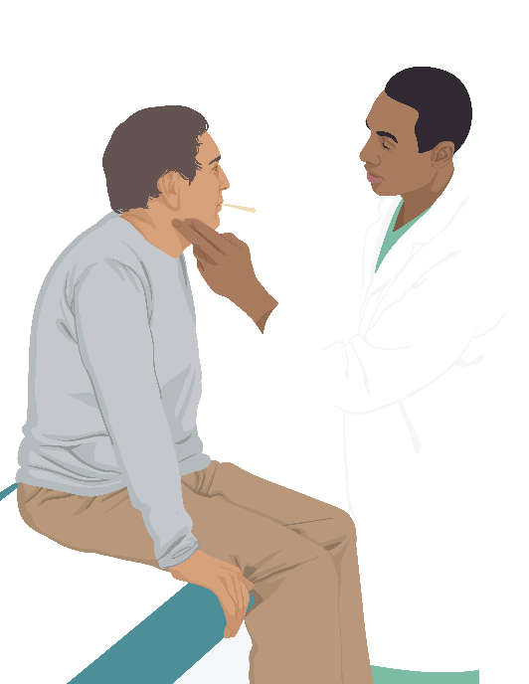
Couples interested in conceiving who DO NOT reside in an area with risk of Zika
For men with possible exposure to with a CDC Zika travel notice
Wait at least 6 months after last possible exposure to Zika or symptom onset before trying to conceive.
During that time, use condoms every time during sex or do not have sex.
Notes:
For more information on trying to conceive in the context of the Zika outbreak see: http://www.cdc.gov/zika/pregnancy/women-and-their-partners.html

Slide 53
Couples interested in conceiving who DO NOT reside in an area with risk of Zika
For couples with exposure to areas with risk of Zika but no CDC Zika travel notice
The level of risk for Zika in these areas is unknown
Healthcare providers should counsel couples about travel to these areas and risk, including potential consequences of becoming infected
Notes:
For more information on trying to conceive in the context of the Zika outbreak see: http://www.cdc.gov/zika/pregnancy/women-and-their-partners.html

Slide 54
Infection control in Healthcare settings

Slide 55
Infection control
Standard Precautions should be used to protect healthcare personnel from all infectious disease transmission, including Zika virus.
Body fluids, including blood, vaginal secretions, and semen, have been implicated in transmission of Zika virus.
Occupational exposure that requires evaluation includes percutaneous exposure or exposure of non-intact skin or mucous membranes to any of the following: blood, body fluids, secretions, and excretions.
Notes:
Pregnant healthcare personnel can care for patients with Zika virus infection. However, facility managers and supervisors should exercise judgement in accommodating personnel concerned about potential exposure, which includes percutaneous exposure (needle stick or cut with a sharp object), or exposure of non-intact skin (skin that is chapped or abraded) or mucous membranes to any of the following: blood, body fluids, secretions, and excretions.
For more information please see http://www.cdc.gov/zika/hc-providers/infection-control.html

Slide 56
Labor and delivery settings
Healthcare personnel should assess the likelihood of the presence of body fluids or other infectious material based on the condition of the patient, the type of anticipated contact, and the nature of the procedure or activity that is being performed.
Apply practices and personal protective equipment to prevent exposure as indicated.
Notes:
In the absence of an occupational exposure, healthcare personnel with potential Zika exposure should be evaluated for testing following the same guidance as for the general public.
Routine Zika testing is not indicated for asymptomatic healthcare personnel caring for patients with Zika virus infection.

Slide 57
What to tell patients about zika

Slide 58
Travel
Pregnant women should not travel to areas with risk of Zika.
If they must travel to areas with risk of Zika, they should protect themselves from mosquito bites and sexual transmission during and after travel.
Women planning pregnancy should consider avoiding nonessential travel to areas with CDC Zika travel notices.
Notes:
The risk of Zika is of greatest concern for pregnant women, who can pass Zika to their developing fetus if infected during pregnancy. Because Zika infection is a cause of microcephaly and severe brain abnormalities and has been linked to other birth defects, pregnant women should strictly follow steps to prevent mosquito bites and to protect themselves against sexual transmission throughout their entire pregnancy.

Slide 59
Treating patients who test positive
There is no vaccine or medicine for Zika.
Treat the symptoms of Zika
Rest
Drink fluids to prevent dehydration
Take acetaminophen (Tylenol®) to reduce fever and pain.
Notes:
Do not take aspirin or other non-steroidal anti-inflammatory drugs (NSAIDS) until dengue can be ruled out to reduce the risk of bleeding.

Slide 60
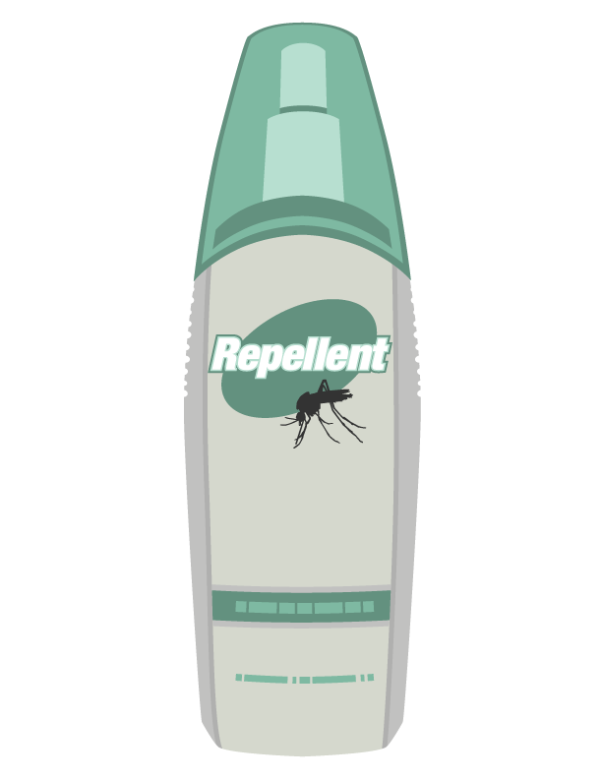
Patients who have Zika
Protect from mosquito bites during the first week of illness, when Zika virus can be found in blood.
The virus can be passed from an infected person to a mosquito through bites.
An infected mosquito can spread the virus to other people.
Notes:
During approximately the first week of infection, Zika virus can be found in a person’s blood and can pass from an infected person to a mosquito through mosquito bites. An infected mosquito can then spread the virus to other people.
To help prevent others from getting sick, strictly follow steps to prevent mosquito bites during the first week of illness.
Even if they do not feel sick, travelers returning to the United States from an area with Zika should take steps to prevent mosquito bites for 3 weeks. These steps will prevent them from passing Zika to mosquitoes that could spread the virus to other people.

Slide 61
Preventing Zika: Mosquito bite protection
Wear long-sleeved shirts and long pants.
Stay and sleep in places with air conditioning and window and door screens to keep mosquitoes outside.
Take steps to control mosquitoes inside and outside your home.
Sleep under a mosquito bed net if air conditioned or screened rooms are not available for if sleeping outdoors.
Notes:
The best way to prevent diseases spread by mosquitoes is to protect yourself and your family from mosquito bites.

Slide 62
Preventing Zika: Mosquito bite protection
Use Environmental Protection Agency (EPA)-registered insect repellents with one of the following active ingredients: DEET, picaridin, IR3535, oil of lemon eucalyptus, para-menthane-diol, or 2-undecanone.
Always follow the product label instructions.
Do not spray repellent on the skin under clothing.
If you are also using sunscreen, apply sunscreen before applying insect repellent.
Notes:
We do not know the effectiveness of non-EPA registered insect repellents, including some natural repellents.
Some natural insect repellents, often made with natural oils, have not been tested for effectiveness. Homemade insect repellents may not protect you from mosquito bites.
Some natural products are EPA-registered.
These natural products with EPA registration include para-menthane-diol, oil of lemon eucalyptus, and 2-undecanone.

Slide 63
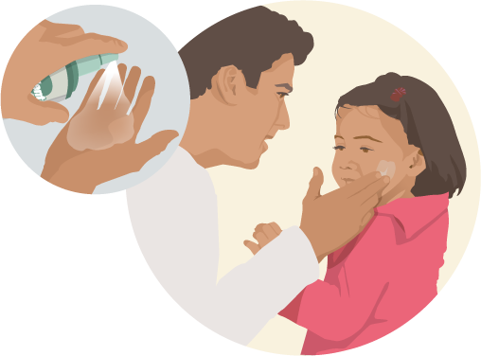
Preventing Zika: Mosquito bite protection
Do not use insect repellent on babies younger than 2 months old.
Do not use products containing oil of lemon eucalyptus or para-menthane-diol on children younger than 3 years old.
Dress children in clothing that covers arms and legs.
Do not apply insect repellent onto a child’s hands, eyes, mouth, and cut or irritated skin.
Notes:
Cover crib, stroller, and baby carrier with mosquito netting.
Adults: Spray insect repellent onto your hands and then apply to a child’s face.

Slide 64
Additional resources
http://www.cdc.gov/zika
http://www.cdc.gov/zika/hc-providers/index.html

