Slide 1
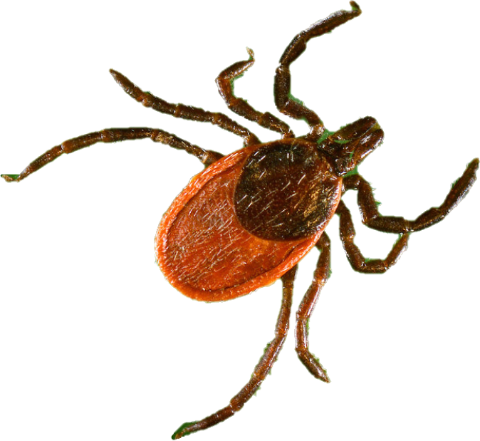
Don’t Let a Tick Make You Sick
How to Stay Safe in a Tick’s World
Notes:
Today we’re going to learn about ticks, the diseases they spread, and how to protect yourself.
[Instructor note: The last slide of this presentation includes a link to a pre-loaded Kahoot! tick quiz. The tick quiz questions, answers, and how to play the Kahoot! Game are included as separate materials in the New Jersey School-Based Tick-borne Disease Education toolkit.]
Image: CDC

Slide 2
Why should I care about ticks?
New Jersey consistently has one of the highest rates of tick-borne diseases in the US including:
Anaplasmosis
Babesiosis
Ehrlichiosis
Lyme disease
Rocky Mountain spotted fever
Ticks are tiny but dangerous
In 2018 NJ had over 4,200 cases of tick-borne diseases
Notes:
Why should you or I care about ticks? Even though they’re so tiny, they can be very dangerous if they bite you.
Here, you can see some of the different diseases that ticks transmit in New Jersey. They include Anaplasmosis, Babesiosis, Ehrlichiosis, Lyme disease, and spotted fever group rickettsiosis. However, ticks transmit different diseases across the country and often spread to new places.
In 2018, New Jersey reported 3700 cases of Lyme disease and over 500 cases of other tick-borne diseases. Actual numbers of Lyme disease are often estimated to be much larger because many cases may not be reported.
[Instructor note: Updated New Jersey reportable disease statistics by year are available at https://www.nj.gov/health/cd/statistics/reportable-disease-stats/index.shtml.]

Slide 3
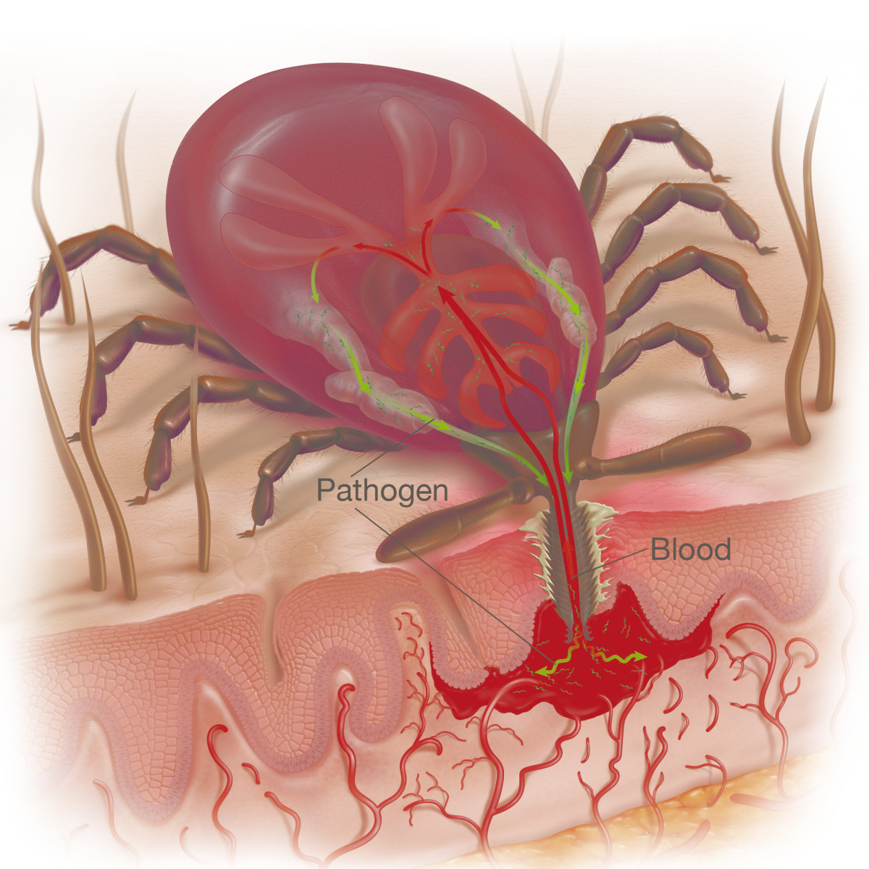
The Lowdown on Ticks
Ticks start out about the size of a poppy seed.
They feed on blood when transitioning from the nymph stage to the adult stage.
They live in long grass and brushy areas especially away from the sun.
Most diseases, including Lyme disease, can be spread 36-48 hours after being bitten by an infected tick.
Image: https://tickencounter.org/
Image: https://www.nobiteisright.ca
Notes:
Ticks begin life really tiny, about the size of a poppy seed. This is when they are in the nymph stage of their life cycle (notice the unfed tick all the way on the left of the slide). In order to continue to the adult stage, ticks must feed on blood.
Ticks live in long grass and brushy areas like in the woods. They latch on to humans and other animals as they walk by.
Once a tick finds a host (human or animal) to feed on, the tick punctures the skin. This causes blood to pool and the tick can suck it up. You can see the tick’s gut in the highlighted colors in the picture on the right. This is where the blood is filtered and excess water is returned to the host—this is also when germs are spread from the tick to the host its feeding on. Germs like bacteria or viruses cause disease.
You can see on the left photo what happens to an attached tick feeding on a host over time. Adult ticks will generally remain attached for about 7-10 days if not removed. As the tick feeds on blood it becomes engorged (swollen).
Most diseases, including Lyme disease, can be spread 36-48 hours after being bitten by an infected tick. This is why it’s important to perform tick checks regularly, especially after being outdoors. We will discuss how to properly perform a tick check later in this presentation.

Slide 4
Blacklegged (deer) ticks are the ticks that transmit Lyme disease in New Jersey… but there are others!
Notes:
As you can see, these three ticks are the common ticks that spread disease in New Jersey.
At the top is the blacklegged (deer) tick which spreads Lyme disease. They also spread anaplasmosis, babesiosis, and Powassan disease. Adult female deer ticks have a red semicircle around the outside of their body.
The photos in the middle show the Lone Star Tick. Lone Star ticks spread ehrlichiosis and tularemia.
At the bottom of the photo is the American dog tick, which spread Rocky Mountain spotted fever and tularemia.
Lone Star ticks and American dog ticks are a little bigger than deer ticks, but remember, they are all very tiny.
Knowing which ticks in New Jersey spread disease—and being able to recognize them—can help keep you safe.

Slide 5
Blacklegged (deer) ticks are the ticks can also transmit Powassan virus.
Notes:
We just learned that the deer tick can spread Lyme disease and Powassan disease.
[Suggested Instructor Note: Compare how many students are familiar with Lyme vs. Powassan]
Powassan is a rare, but often severe disease caused by a virus that is spread to people by infected ticks. Powassan virus belongs to a group of viruses that can cause infection of the brain or the membranes around the brain and spinal cord. The number of reported cases of people sick from Powassan virus has increased in recent years.

Slide 6
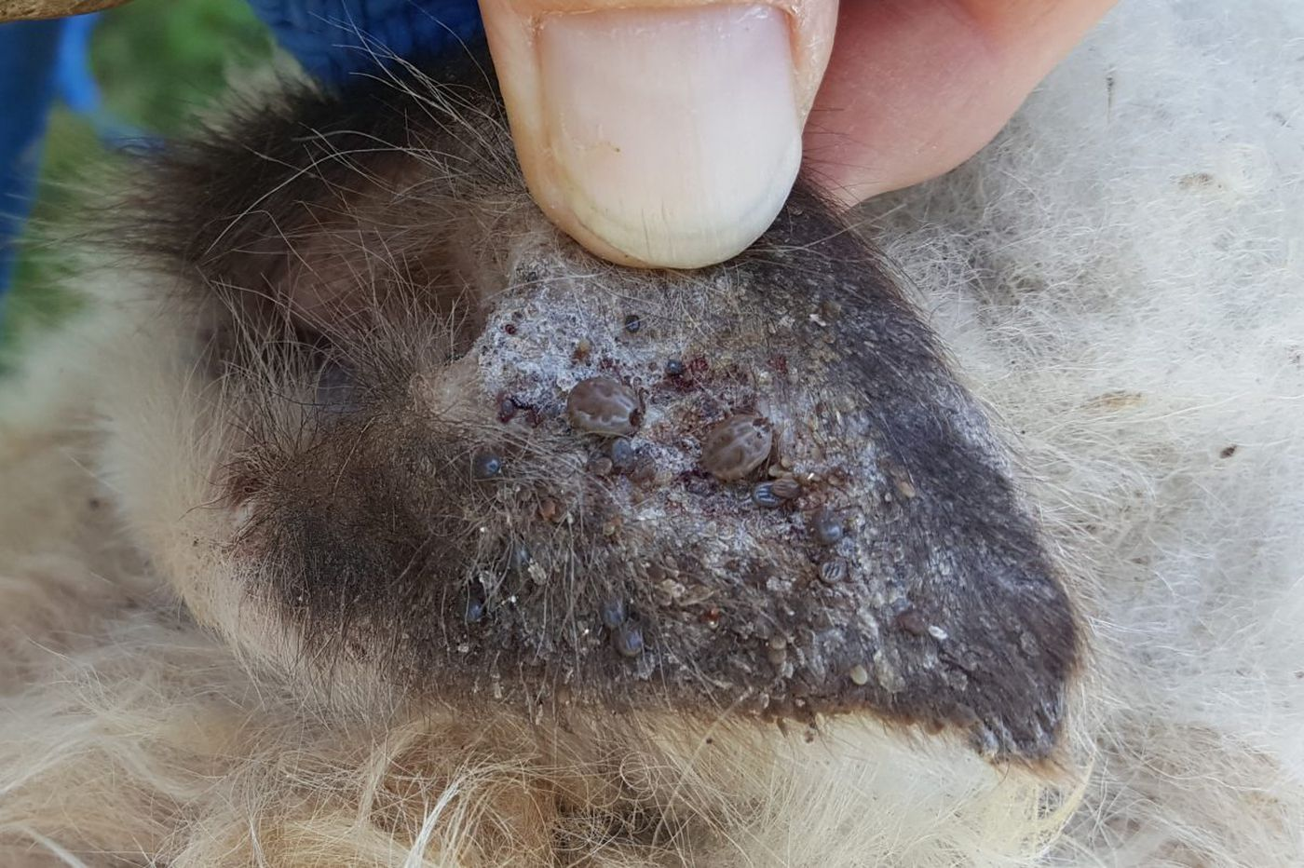
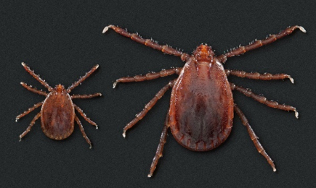
Asian longhorned tick
The Philadelphia Inquirer
The Washington Post
Patch.com
Image: Tadhgh Rainey
The Weather Channel
Image: CDC
Notes:
One new tick that has made its way to New Jersey is the Asian longhorned tick. As its name suggests, this tick that is native to east Asia. As mentioned earlier, ticks transmit different diseases across the country (and around the world) and ticks can spread to new places. In November 2017, Asian longhorned ticks were first reported in New Jersey.
Asian longhorned ticks are very invasive, meaning they spread quickly. The female tick can produce thousands of eggs on her own! This makes it very easy for a single tick to invade an area.
In other countries, bites from these ticks can make people and animals seriously ill. As of August 1, 2019, no harmful germs that can infect people have been found in the ticks collected in the United States. Research is ongoing.
Asian longhorned ticks are a serious threat to livestock. These ticks frequently form large infestations on warm-blooded host animals. This causes great stress on the animal, reducing its growth and production. A severe infestation can kill the animal due to blood loss.

Slide 7
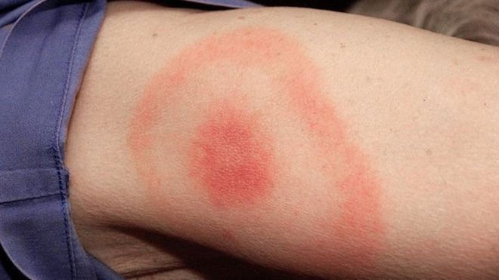
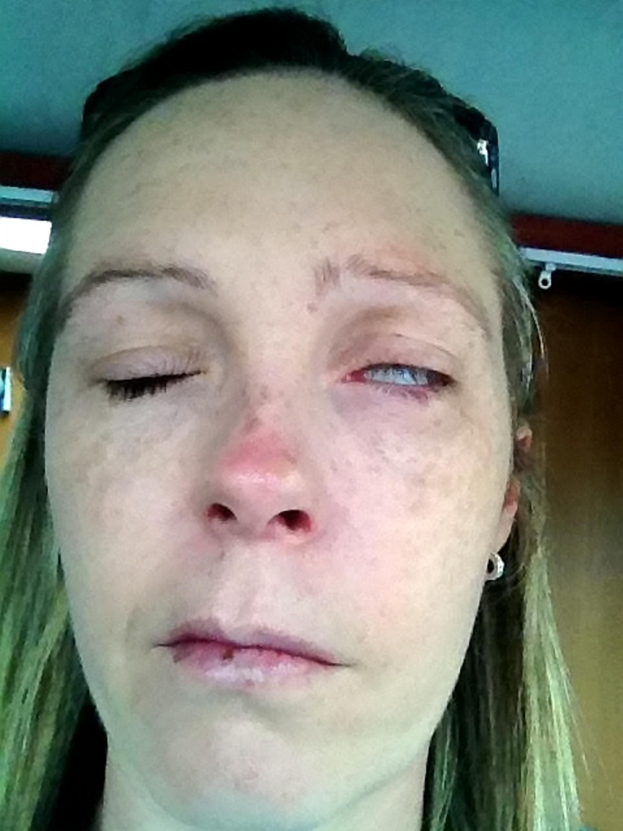
Symptoms of tick-borne diseases
Early signs (usually 2-30 days after infection) can include:
Skin rash
Flu-like symptoms
Fever
Fatigue
Headache
Muscle aches
Joint pain
Dizziness
Additional symptoms:
Facial weakness
Allergy to red meat?
Image: www.bbc.com
Image: www.independent.co.uk
Image: Sean Dreilinger via flickr.com
Notes:
Depending on the tick-borne disease, symptoms can start to show as early as 2 days after the tick bite, but may not show for as long as 30 days or more.
The bulls-eye rash you can see on the top right is an early sign of Lyme disease. Watch for a red circle about the size of a quarter that grows over time into a bulls-eye. Most people, but not everyone, infected with Lyme disease will develop a rash. About 80% of Lyme disease cases will show this symptom.
Other common symptoms of tick-borne diseases are “flu-like symptoms” such as fever, fatigue, headache, muscle aches, and joint pain.
Two other serious symptoms are facial weakness and red meat allergy. The woman in the photo to the right is suffering from facial weakness or facial paralysis due to a tick bite.
Red meat (alpha-gal) allergy may also be linked to tick bites. Alpha-gal allergies can be severe, and even life-threatening. Scientists don’t quite know how it happens, but alpha-gal is a sugar molecule found in most mammals (except in people, apes, and monkeys). Alpha-gal has also been found in some types of ticks. Data from the United States and other countries suggest that alpha-gal allergy may be associated with tick bites. More research is needed to determine if tick bites can cause alpha-gal allergy.

Slide 8
How can I prevent tick-borne disease?
Don’t let a tick bite you!
Some strategies to prevent bites:
Use an EPA-registered insect repellent according to product label instructions and permethrin on clothes.
Wear light-colored long pants and sleeves and tuck pants into socks.
Stay on paths and away from the woods when outside.
Shower as soon as you get inside and dry clothes on high heat for 10 minutes.
Notes:
Now that we know about the types of ticks that cause illness in New Jersey and the symptoms of tick-borne diseases, you’ll want to know how to protect yourself.
The best answer is…don’t let a tick bite you! There are a few ways you can prevent tick bites.
Before going outside, use repellent registered by the Environmental Protection Agency (EPA-registered) and follow the instructions on the product label. You can also use permethrin, and insecticide, on clothes or buy clothing pre-treated with permethrin. Permethrin should not be used on skin.
[Instructor note: The Environmental Protection Agency has a search tool to help find the repellent that works best for you: https://www.epa.gov/insect-repellents/find-repellent-right-you.]
Wearing long pants tucked into socks protects against tick bites because ticks like to crawl up the leg. Wearing light-colored clothing helps because the ticks can be seen easier.
While outside, stay on paths and open, sunny areas with short grass to avoid the ticks’ primary living space.
As soon as you get inside, shower to rinse off any ticks that may be on you, but not attached. Put your clothes in the dryer on high heat for 10 minutes to kill ticks. Washing your clothes alone will not kill the ticks.

Slide 9
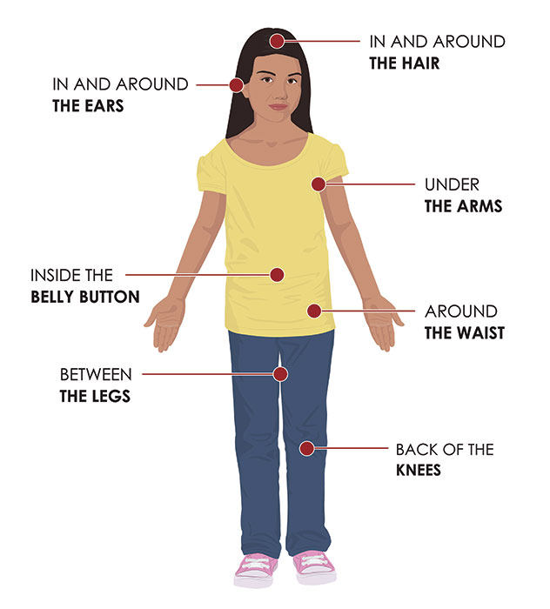
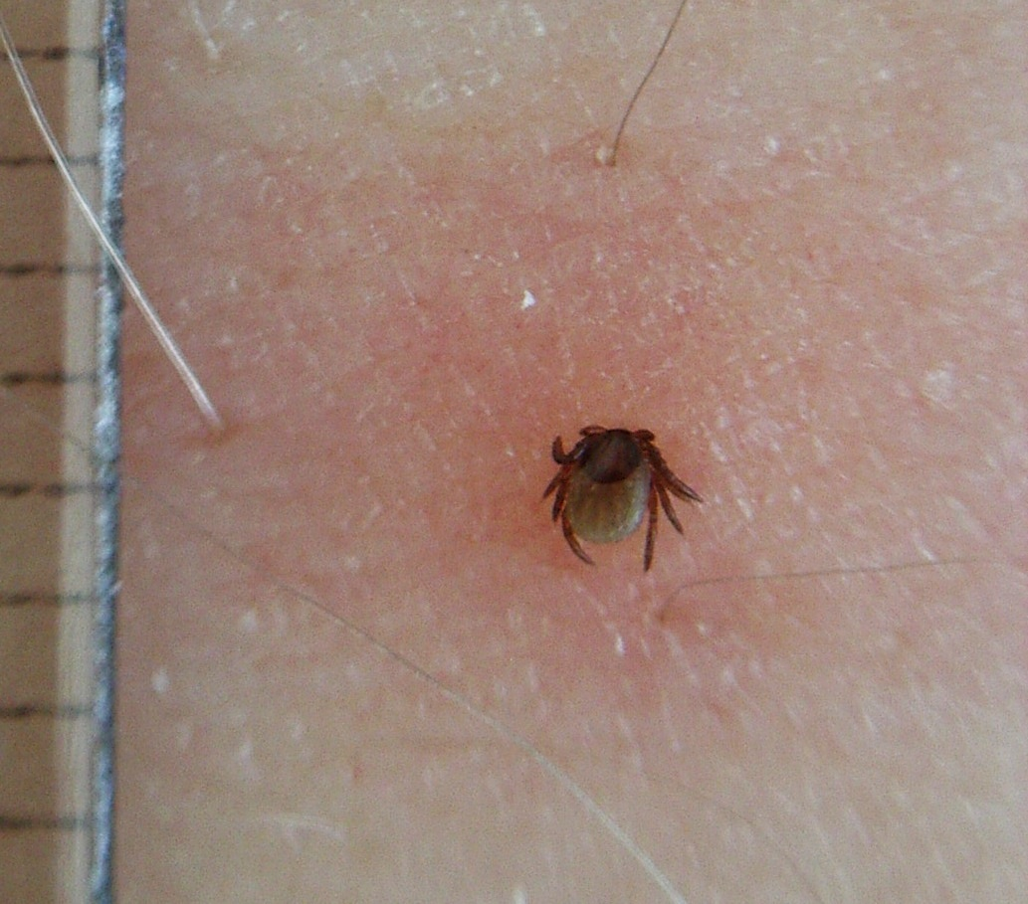
Tick Checks
Try to perform tick checks regularly, especially after you’ve been outside.
Ticks love to hide in hard-to-see areas so be sure to check the places shown in the photo.
Watch out: ticks can easily be mistaken for freckles, so look and feel for bumps!
Image: CDC
Image: Wikimedia
Notes:
Tick checks are another way to decrease the chances you’ll get a tick-borne disease. Try to perform tick checks regularly, particularly after being outside.
Remember how long most diseases—including Lyme disease—can be spread after being bitten by an infected tick? For most diseases, it’s 36-48 hours. That means the sooner you find and remove an attached tick, the better your chances of not getting sick. We’ll talk about removing attached ticks on the next slide.
When checking for ticks, look everywhere but special attention to hard-to-see areas—where ticks love to hide. You can see in the top photo that some of these hard-to-see places include in your hair, behind your ears, under your arms, in your belly button, between your legs, and the backs of your knees.
Be careful. Often, ticks are mistaken for freckles or birthmarks on your body. A good way to identify a tick is by looking and feeling for any new bumps or spots. It may be helpful to perform the tick check using a mirror or asking a parent or sibling to help with the hard-to-see areas.

Slide 10
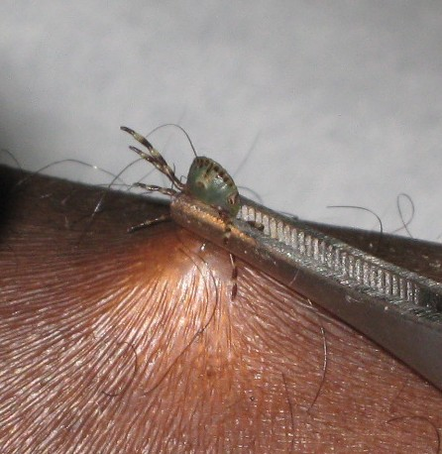
What if I find an attached tick?
You may want to find a trusted adult to help you remove the tick.
Your goal is to remove the whole tick (including its head) and avoid squishing the blood and germs into your skin.
Use fine-tipped tweezers to grip the tick as close to the skin as possible.
Pull straight upwards firmly.
Wash the bite area with warm water and soap.
For the next few weeks, pay close attention to any symptoms that may arise. Contact your healthcare provider if you notice any.
Image: Wikimedia
Notes:
If during a tick check or otherwise you find an attached tick, you may want to ask an adult for help.
It’s important that you don’t touch or play with the tick with your fingers. Doing so can squish the tick and force its blood and germs into your skin.
The only safe way to remove a tick is to use fine-tipped tweezers. Grab the tick as close to the skin as possible and pull straight upwards firmly. You can see in the photo an example of how the tick should be grasped.
After removing the tick, wash the bite area with warm water and soap.
Get rid of the live tick by putting it in rubbing alcohol, placing it in a sealed bag or container, wrapping it tightly in tape, or flushing it down the toilet.
For the next few weeks, pay close attention to any symptoms of tick-borne diseases that may show up. What are some of the early symptoms again? Skin rash, fever, fatigue, headache, muscle aches, joint pain, dizziness.
If you notice any symptoms, contact your healthcare provider to be evaluated. Don’t forget to mention you had a tick bite.

Slide 11
Don’t let a
TICK
Make you
SICK!
Thanks to Andrea M. Egizi from Monmouth County
Notes:
You just learned the absolute best ways to protect yourself from getting sick from a tick.

Slide 12
http://bit.ly/tickquiz
Time to test your knowledge!
Notes:
[Instructor note: Kahoot! is a free game-based learning platform that users can play on any mobile device or laptop with an internet connection: https://kahoot.com/. Alternatively, the New Jersey School-Based Tick-borne Disease Education Toolkit provides a page of questions and answers that may be used instead.]

