Slide 1
A Dose of Prevention
Vaccines to help you stay healthy during adolescence
Notes:
Today we will be talking about one important way that you can stay healthy as a preteen/teenager. Before we begin, who can tell me what they already know about vaccines. Why do we get vaccines? Why are they necessary?
[NOTE TO TEACHER: WE SUGGEST BEGINNING THE LESSON WITH THESE INTERACTIVE QUESTIONS TO HELP DETERMINE STUDENTS’ BASELINE KNOWLEDGE SO THAT YOU CAN ADAPT THE PRESENTATION TO ADDRESS COMMON QUESTIONS OR INFORMATION GAPS.]

Slide 2
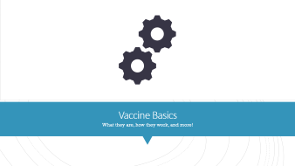


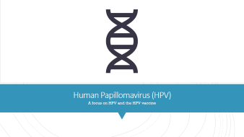
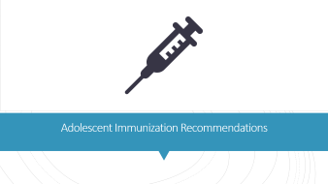
Outline
Notes:
This presentation covers the following topics:
Vaccine basics
The current adolescent immunization recommendations
A focus on HPV and the HPV vaccine
Frequently asked questions
Additional resources

Slide 3

Vaccine Basics
What they are, how they work, and more!
Notes:
Let’s get started with some information on vaccine basics from what they are to how they work and how they are developed.

Slide 4

When should you put your seatbelt on?
  Before turning on car
  When leaving driveway
  After a near accident
Source: Temte JL. Pediatrics 2014.
Notes:
When thinking about vaccination, let’s consider this scenario…you are about to hop in the car to head to the grocery store. When should you put your seatbelt on?
Before turning on the car
When leaving the driveway
After a near accident
The answer is of course A, before turning on the car. You want to take action to prevent something from happening before it could potentially happen. This is how vaccines work. You get vaccinated to prevent disease before you are potentially exposed to that disease.

Slide 5
Why are vaccines important?
Vaccine preventable diseases have not gone away!
Vaccines protect you from serious and life-threatening diseases.
As you get older, some of the vaccinations you got as a child begin to wear off so you need a booster to keep you protected.
Vaccines also protect the people around you who are not able to get vaccinated.
Notes:
Question: Why do you think vaccines are important?
[CLICK TO ADVANCE THE BULLETS FOLLOWING THE RESPONSES]
Before vaccines, many children suffered from debilitating — and killer — illnesses such as measles, polio, smallpox and diphtheria. A simple scratch could be deadly if it became infected with the bacteria responsible for tetanus (or “lockjaw”). Although you may not have heard much about these diseases, they have not gone away! From January 1 to December 31, 2019 in the United States, 1,282 individual cases of measles were confirmed in 31 states. This is the greatest number of cases reported in the U.S. since 1992. The majority of cases were among people who were not vaccinated against measles. Measles is more likely to spread and cause outbreaks in U.S. communities where groups of people are unvaccinated.
Vaccines are important in preventing you from catching a disease or starting an outbreak.
Most of you were likely vaccinated as a kid, but it’s important to know that some of those vaccines can start to wear off. To make sure you are adequately protected, some vaccines need a booster dose to bring your immunity back up to protective levels.
Another great thing about vaccines is that they can protect the people around you as well as yourself. Some people who are going through chemotherapy or have other medical conditions are not able to get vaccinated. By you being vaccinated, you are making sure that you don’t pass dangerous diseases to those who may not have strong immune systems.

Slide 6
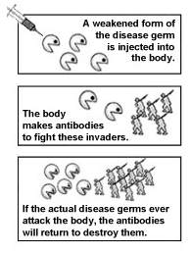
Vaccination in action
Source: www.cdc.gov/vaccines/vac-gen/howvpd.htm
Notes:
So how do these vaccines work? You get a shot and then what happens?
With vaccination, killed or weakened disease germs are introduced into the body, usually by injection. After vaccination, your immune system goes to work. It recognizes the vaccine germs as not belonging in your body – as being “foreign invaders.” It responds by producing antibodies. The germs in the vaccine are weakened or killed, so they won’t make you sick, however, you will still develop immunity, just as if you had gotten sick from the actual disease. So if germs from that disease ever do try to infect you, your immune system will come to your defense and stop them from making you sick.

Slide 7
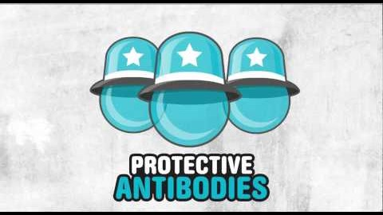
How do vaccines work?
Vaccines help develop immunity by imitating an infection. This type of infection, however, almost never causes illness, but it does cause the immune system to produce antibodies.
Once the imitation infection goes away, the body is left with a supply of antibodies that will remember how to fight that disease in the future.
It typically takes a few weeks for the body to produce antibodies after vaccination.
Source: www.cdc.gov/vaccines/hcp/conversations/downloads/vacsafe-understand-color-office.pdf
Notes:
This video shows you how that process takes place. Vaccines help your body develop protection by imitating an infection. The body then develops antibodies to fight that specific disease without you getting sick. If you are ever exposed to that disease in the future, your body will now remember how to fight it to prevent you from getting sick.
Vaccines can take a few weeks for the body to produce all its antibodies. This is why it’s important to get vaccinated before you are exposed to a disease.
[More detailed video on Ted Ed: How Vaccines Work: www.youtube.com/watch?v=rb7TVW77ZCs also available on the Protect Me with 3 website under the Schools Tab: www.protectmewith3.com/schools/]

Slide 8
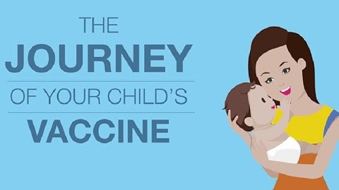
Are vaccines safe?
Vaccines are one of the most convenient and safest preventive care measures available.
Vaccines are monitored before and after licensure to ensure that they are safe and effective.
The potential risks associated with the diseases that vaccines prevent are much greater than the potential risks from the vaccines themselves.
Source: www.cdc.gov/vaccines/hcp/patient-ed/conversations/downloads/vacsafe-ensuring-bw-office.pdf
Notes:
The safety of vaccines is monitored at every step of the process to ensure that it will keep people healthy and protect them from disease. This video shows the whole process of how much work goes into developing and producing a vaccine.
Vaccines are one of the safest and most convenient preventive care measures available. The U.S. Food and Drug Administration (FDA) ensures the safety, effectiveness, and availability of vaccines for the United States. Before the FDA licenses (approves) a vaccine, the vaccine is tested extensively by its manufacturer. FDA scientists and medical professionals carefully evaluate all the available information about the vaccine to determine its safety and effectiveness.
After a vaccine is licensed, it is continuously monitored through the U.S. vaccine safety system for adverse events (possible side effects).

Slide 9
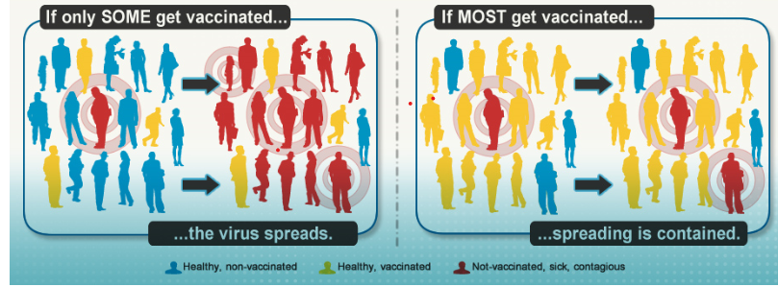
Herd Immunity
Notes:
Most vaccine-preventable diseases are spread from person to person. If one person in a community gets an infectious disease, it can spread to others who are not immune. A person who is immune to a disease because she has been vaccinated can’t get that disease and can’t spread it to others. The more people who are vaccinated, the fewer opportunities a disease has to spread.
When a large percentage of the population is immunized, the spread of disease is limited. This indirectly protects unimmunized individuals, including those who can’t be vaccinated and those for whom vaccination was not successful. This is the principle of herd immunity. As the number of those vaccinated increases, the protective effect of herd immunity increases.
For some diseases, herd immunity may begin to be induced with as little as 40% of the population vaccinated. More commonly, and depending on the contagiousness of the disease, vaccination rates may need to be as high as 80-95%. This percentage is called the herd immunity threshold.
[ANIMATION TO DEMONSTRATE HERD IMMUNITY: www.historyofvaccines.org/content/herd-immunity-0]

Slide 10

Adolescent Immunization Recommendations
Notes:
Vaccines are recommended throughout your lifespan. Preteens and teens need vaccines because the vaccines that you had as a child may begin to wear off or provide less protection. Changes in your behavior can also increase your exposure to certain diseases.

Slide 11
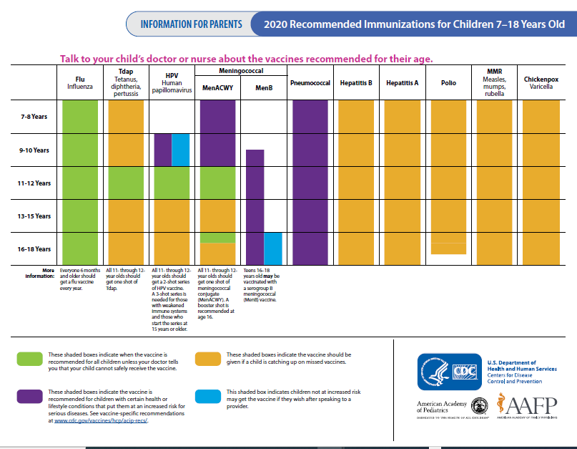
Source: www.cdc.gov/vaccines/schedules/easy-to-read/adolescent-easyread.html
Notes:
Shown here is the 2020 Centers for Disease Control and Prevention (CDC) recommended immunization schedule for those 7 through 18 years of age. The green boxes represent vaccines that are recommended. If we go to the age group of interest for today (in the red box), we can see the recommendations for a child who is 11-12 years. Going across the row, the green boxes indicate vaccines that are recommended for all children so we have flu vaccine, Tdap, HPV, and MenACWY.
There are also a few boxes in purple and some in yellow. The purple indicates a vaccine that may be recommended for youth with certain health conditions or high-risk groups. The yellow indicates recommendation for catch-up immunization if you didn’t get the vaccine at a younger age. The blue indicates children not at increased risk may get the vaccine if they wish after speaking to a provider.

Slide 12
Adolescent Immunization Schedule
Age: | Vaccines recommended:
11-12 years | Tdap* HPV Meningococcal conjugate*
16 years | Meningococcal conjugate (booster)
All ages | Flu (each year) Catch-up vaccines (as needed) Travel-specific vaccines (as needed)
* Indicates NJ school requirement
Source: www.cdc.gov/vaccines/schedules/downloads/child/0-18yrs-child-combined-schedule.pdf
Notes:
In summary, there are four routine adolescent immunizations. There is Tdap, the vaccine to protect against tetanus, diphtheria, and pertussis. HPV protects against human papillomavirus infection and HPV-associated cancers. Third is the meningococcal conjugate vaccine which protects against meningococcal strains A, C, W, and Y. Each of these three vaccines are recommended at 11-12 years. The fourth routine vaccine for this age group is the annual flu vaccine, which is recommended each year for everyone 6 months of age and older.
At 16 years of age, the meningococcal conjugate booster dose is recommended. Additionally, certain vaccines may be recommended for travel or as catch-up for any doses that were missed during childhood.
There are also two vaccines marked with an asterisk, these indicate that these vaccines are required for school attendance in New Jersey.
Some people may need additional vaccines based on their medical condition or other risk factors. For example: people with diseases that affect their immune system (like diabetes, HIV infection, or cancer) should get a pneumococcal vaccine.

Slide 13
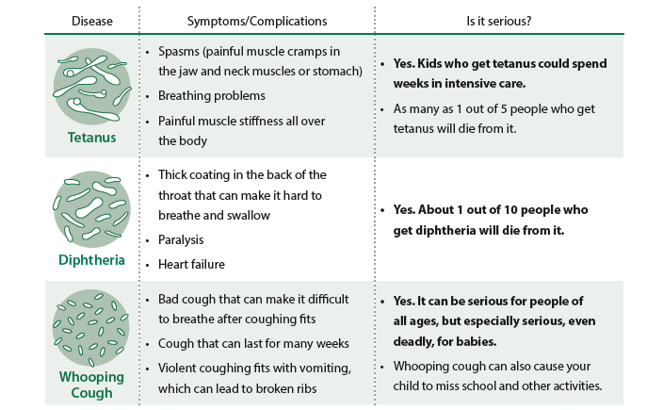
Tdap vaccine
Source:
Notes:
Let’s talk a little bit more about the Tdap vaccine. All preteens should get one Tdap shot when they are 11 or 12 years old to help protect against tetanus, diphtheria, and whooping cough. You probably received the DTaP vaccine when you were younger, but the protection from that vaccination wears off. You need a booster shot of Tdap vaccine to help maintain your protection. Some children who did not finish the DTaP vaccines when they were younger need to catch up with Tdap and/or Td vaccines. It can get very confusing, but your school nurse or your doctor can help you learn which vaccines you need.
TETANUS (tet-a-nus), also known as lockjaw, is caused by bacteria that enters your body through cuts, scratches, or wounds. It is not spread person-to-person. Tetanus causes painful muscle tightening and stiffness; you might not be able to open your mouth, swallow, or even breathe.
DIPHTHERIA (dif-THEER-ee-a) is caused by bacteria and is spread person-to-person when an infected person coughs and sneezes. It causes a thick coating to form in the back of your throat and can lead to breathing problems, paralysis, heart failure, and death.
PERTUSSIS (per-TUS-iss), also known as whooping cough, is caused by highly contagious bacteria that is easily spread from person-to-person when an infected person coughs or sneezes. It causes rapid, uncontrollable coughing fits that can cause you to vomit, break ribs or have difficulty breathing and sleeping.

Slide 14

Meningococcal Disease
Meningococcal Disease can result in inflammation of the brain and spinal cord (meningitis) and/or a serious blood infection (septicemia)
Spread through close, direct contact with an infected person’s spit or nasal secretions. (e.g. kissing, sharing items that come in contact with the mouth such as water bottles, etc.)
Symptoms can include confusion, fatigue, headache, sensitivity to light
Source: www.cdc.gov/vaccines/vpd/mening/index.html
Notes:
Meningococcal (muh-nin-jo-cok-ul) disease is a serious bacterial infection. The disease may result in inflammation of the lining of the brain and spinal cord (Meningococcal meningitis) and/or a serious blood infection (Meningococcal septicemia). Meningococcal disease can become deadly in 48 hours or less. Even with treatment, 10-15% of people die. Others have long-term complications such as brain damage, learning problems, skin scarring, hearing loss, and loss of arms and/or legs.
The bacteria are spread from person-to-person through the exchange of saliva (spit) or nasal secretions. One must be in direct (close) contact with an infected person’s secretions in order to be exposed. Close contact includes activities such as: living in the same household, kissing, sharing eating utensils, food, drinks, cigarettes.

Slide 15
Meningococcal vaccines
MenACWY
Recommended at ages 11-12 years
Booster dose recommended at 16 years
NJ requires a dose of MenACWY at age 11 in six grade or higher grade level.
Serogroup B meningococcal vaccination (MenB)
Recommended for people 10 years or older at increased risk for meningococcal disease
Teens and young adults (16-23 years) may choose to get a serogroup B meningococcal vaccine after speaking with their doctor.
Notes:
Meningococcal vaccines are the best way to prevent meningococcal disease. There are two types of meningococcal vaccines available: the MenACWY vaccine, known as the meningococcal conjugate vaccine, and the serogroup B meningococcal vaccine, known as the MenB vaccine.
The MenACWY vaccine protects against four of the five types of bacteria (A, C, W, Y) that cause almost all cases of meningococcal disease worldwide. The first dose is routinely administered when you are 11-12 years old. When you are 16 years old, you will need a booster shot.
There are two MenB vaccines available to choose from. These vaccines protect against the B strain. Currently, MenB vaccination is recommended for people 10 years or older who are at increased risk for meningococcal disease. The CDC also recommends that the MenB vaccine may be administered for those not at increased risk at ages 16–23 years (preferred age 16–18 years) after a discussion with your doctor.

Slide 16
Flu Vaccine
Influenza (“flu”) is a highly contagious (easily spread) respiratory illness
Symptoms include coughing, fever, body aches, headaches
Flu vaccine is recommended for those 6 months of age and older during each flu season
Notes:
You’ve probably heard a lot about the flu. Influenza or “flu” is a highly contagious (easily spread) respiratory disease caused by influenza viruses that infect the nose, throat, and lungs. The flu can be very serious, even for healthy youth, and especially for youth with certain health conditions like asthma or diabetes. If you get the flu, you could miss one to two weeks of school and activities. Some youth have painful complications like sinus infections, ear infections, or pneumonia (a serious lung infection).
An annual flu vaccination is recommended for everyone 6 months of age and older. Protection from last year’s flu vaccine wears off and the circulating strains may vary from year to year, so to be fully protected you need to be vaccinated for the current flu season. By getting a flu vaccination, you protect yourself and your friends, grandparents, parents, and siblings from potentially life-threatening diseases.

Slide 17

Human Papillomavirus (HPV)
A focus on HPV and the HPV vaccine
Notes:
The fourth and final routine vaccine is the human papillomavirus vaccine, or the HPV vaccine. I will go into a bit more depth on this since it is something a lot of you may not have heard of before.
How many of you have ever heard of HPV? If so, tell me some of things you have heard.

Slide 18
Human Papillomavirus (HPV)
HPV is a group of viruses that affects individuals of all genders, sexual orientation, and backgrounds
There are more than 150 types of HPV
Certain types can cause cancer. Other types can genital warts.
HPV infection is most common in people in their teens and early 20s
Source: www.cancer.gov/about-cancer/causes-prevention/risk/infectious-agents/hpv-and-cancer
Notes:
HPV is a group of viruses that commonly affects individuals of all genders, sexual orientations, and backgrounds. There are more than 150 types of human papillomavirus (HPV). About 40 kinds can infect your genital area as well as your mouth and throat. HPV can cause anal and mouth/throat cancers. It can also cause cancer in the cervix, vulva, and vagina in women; and cancer of the penis in men.
Infection with low-risk HPV types can cause external genital warts. Low-risk HPV strains (HPV 6 and HPV 11) cause approximately 90% of genital warts and are rarely associated with pre-cancer or cancer of the lower genital tract. An important distinction is that warts on other parts of the body, such as the hands, are caused by different types of HPV. Contact with these warts does not seem to cause genital HPV warts.
Of the over 150 types of HPV that live on the body, only a small number of types (ie. high-risk HPV) can cause problems by changing cells from normal to abnormal.
Infection with high-risk HPV types that are not cleared by the immune system can cause cervical cancers and a significant proportion of cancers of the anus, oropharynx, vagina, vulva and penis. HPV cancers take many years to develop. However, not all infections with HPV progress to cancer.
Though HPV infections can lead to cancer, most infections tend to go away on their own naturally before they cause any health problems.

Slide 19
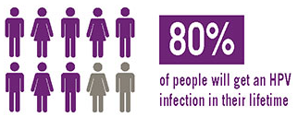
How do people get HPV?
HPV is spread through intimate skin-to-skin contact.
Transmission occurs most frequently with sexual intercourse, but can also occur with nonpenetrative sexual activity.
About 79 million Americans are currently infected with HPV.
About 14 million people become newly infected each year.
Notes:
HPV is spread through intimate skin-to-skin contact. Although transmission occurs most frequently with sexual intercourse, it can also occur with nonpenetrative sexual activity.
HPV infections are so common that nearly all men and women (80%) will get at least one type of HPV at some point in their lives.

Slide 20
HPV Infection
Most HPV infections do not have symptoms and will go away on their own.
People may never know that they were infected, but they can still spread HPV.
For some people, symptoms can develop years after being infected, making it hard to know when you first became infected.
When HPV does not go away on its own, it can cause health problems like genital warts and cancer
Sources:
www.cdc.gov/vaccines/pubs/pinkbook/hpv.html
www.cdc.gov/std/hpv/stdfact-hpv.htm
Notes:
HPV can be transmitted even when an infected person has no signs or symptoms. Most of the time, the body can fight off HPV, but sometimes HPV can cause serious infection. Symptoms can develop years after being infected, making it hard to know when a person first became infected.
When HPV does not go away on its own, it can cause health problems like genital warts and cancer. Cancer often takes years, even decades, to develop after a person gets HPV.
There is no cure for HPV, but there are ways to treat the health problems caused by HPV such as genital warts and certain cancers. There is no way to know which people will develop cancer or other health problems.
EXTRA INFORMATION:
Genital warts can be treated by your healthcare provider or with prescription medication. If left untreated, genital warts may go away, stay the same, or grow in size or number.
Cervical precancer can be treated. Women who get routine Pap tests and follow up as needed can identify problems before cancer develops. Prevention is always better than treatment. For more information visit www.cancer.org.
Other HPV-related cancers are also more treatable when diagnosed and treated early. For more information visit www.cancer.org.

Slide 21
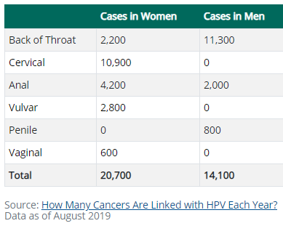
HPV-Associated Cancers
HPV can cause cancers of the:
  Cervix, vagina, and vulva in women
  Penis in men
  Anus and back of the throat, including the base of the tongue and tonsils (oropharynx), in both women and men
Source: www.cdc.gov/hpv/parents/cancer.html
Notes:
HPV infections can lead to six types of cancer: cervical, vaginal, and vulvar cancer in women. Penile cancer in men. For both men and women, HPV infections can lead to anal and throat cancers.
The table on the slide shows the total number of HPV-associate cancers in males and females for 2019. Cancer often takes years, even decades, to develop after a person gets HPV. CDC recommends HPV vaccination at ages 11–12 to protect against these cancers. Getting vaccinated can protect against 90% of HPV-associated cancers.

Slide 22
HPV Vaccine Schedule
Recommended at 11-12 years for best immune response and to provide protection prior to exposure, but can be given as early as 9 years.
2-dose schedule:
Catch-up vaccination for person through age 26:
Individuals 27 through 45 years may receive the HPV based on shared clinical decision making.
3-dose schedule:
Patients who initiate the series on or after age 15 years
Patients who initiate the series prior to age 15 years
Immunocompromised patients
Notes:
So now that we’ve learned more about HPV infections and their impact, how can you prevent getting infected? Fortunately, as I just mentioned, there is a vaccine available that can prevent over 90% of HPV-associated cancers.
The HPV vaccination series is routinely recommended for adolescents at age 11 or 12 years. For those who start the vaccination series before the 15th birthday, the recommended schedule is two doses of HPV vaccine. For those starting the series on or after their 15th birthday, they should get three doses. Those who have weakened immune systems should also get 3 doses.
If you weren’t vaccinated at 11-12 years or if you started the series but didn’t complete it, you are still recommended to get the vaccine through age 26 years. People ages 27-45 years, can choose to get vaccinated based on discussing the benefits with their doctor.

Slide 23

Frequently Asked Questions
Notes:
That was a lot of information about a very important topic! Let’s get to some of the common questions teens have about vaccination.

Slide 24
How do I know if I’ve gotten all my shots?
Ask a parent to contact your pediatrician or family doctor so he or she can check your health records.
Your vaccine history may be available through the New Jersey Immunization Information System (NJIIS). You can ask your doctor about this.
Notes:
If you are unsure whether you have received all of the recommended vaccines, talk with your parents and your doctor. Your doctor will likely have a copy of your immunization history and they can check your health record.
New Jersey also has a centralized immunization registry, which serves to help doctors know when patients are due for vaccines. Your immunization record may be available through the New Jersey Immunization Information System (NJIIS). You can ask your doctor about this as well.

Slide 25
What if I missed a shot?
If you've missed some shots in a series of vaccines, you don't need to get the whole series again — you can simply pick up where you left off.
Notes:
If you missed any shots, don’t worry! You can pick up where you left off to complete any vaccine series or to catch-up on any missed doses.

Slide 26
Where can I get vaccinated?
Healthcare provider
Federally qualified health centers (FQHCs)
https://web.doh.state.nj.us/apps2/fhs/cphc/cphcSearch.aspx
Local Health Departments
Localhealth.nj.gov
Some facilities may participate in the New Jersey Vaccines for Children Program (VFC), which allows children through 18 years of age to receive low-cost or no-cost vaccine for those who cannot otherwise afford it.
Notes:
Vaccines may be offered at multiple locations in your community. The best place to start is your primary doctor. If you don’t have a regular doctor, sometimes you can get vaccines at a local health department or a federally qualified health center.
Some facilities may participate in the NJ Vaccine for Children Program to make sure that the vaccine is affordable and available at no-cost or low-cost.

Slide 27
Can I get tested for HPV?
NO test available to determine a person’s HPV status
Cervical cancer is the only type of HPV cancer with a recommended screening test. The other types of HPV cancer may not be detected until they cause health problems.
Sources:
www.cdc.gov/std/hpv/pap/default.htm
www.cdc.gov/std/hpv/stdfact-hpv-and-men.htm
Notes:
You may be wondering if there is a way to test for HPV. There is no test to find out a person’s “HPV status.” There is currently no approved HPV test to find HPV in the mouth or throat.
Cervical cancer is the only type of HPV cancer with a recommended screening test. The other types of HPV cancer may not be detected until they cause health problems.
The HPV test is a screening test for cervical cancer, but the test doesn't tell you whether you have cancer. Instead, the test detects the presence of HPV, the virus that causes cervical cancer, in your system. These tests are only recommended for screening in women aged 30 years and older. HPV tests are not recommended to screen men, adolescents, or women under the age of 30 years.
If you have a positive HPV test, don’t panic. This doesn’t mean that you have cancer. It means that you have a type of HPV that can possibly lead to cancer in the future. This means your nurse or doctor will want to keep an eye on you to make sure you stay healthy. Most people never know that they have been infected.
Routine testing (also called ‘screening’) to check for HPV or HPV-related disease before there are signs or symptom, is not recommended by the CDC for anal, penile, or throat cancers in men in the United States. However, some healthcare providers do offer anal Pap tests to men who may be at increased risk for anal cancer, including men with HIV or men who receive anal sex. If you have symptoms and are concerned about cancer, please see a healthcare provider.
The best way to prevent HPV infections is through vaccination.

Slide 28
Tips for getting vaccinated
1
2
3
4
5
Distract yourself while you’re waiting
Concentrate on taking slow, deep breaths
Focus intently on something in the room
Cough – Some research has shown that coughing once before and once during the shot can help some people feel less pain.
Relax your arm
Source: https://kidshealth.org/en/teens/tips-shots.html
Notes:
Do shots make you nervous? You're not alone. Lots of people dread them because they have a very real fear of needles. So next time your doc asks you to roll up your sleeve, try these tips:
Try to distract yourself while you’re waiting. That may mean bringing a book, music, or something to take your mind off of the shot itself.
Concentrate on breathing – take slow, deep breaths.
Focus intently on something in the room – look at the details or count the number of letters or flowers in an image
Cough – some research has shown that coughing once before and once during the shot can help some people feel less pain.
Relax your arm – if you are tense, it can make the shot hurt more.
Don't hesitate to tell the doctor or nurse that you're nervous before getting the shot. Medical professionals are used to people who are afraid of shots and they'll be able to help you relax.

Slide 29

Resources
Notes:
To close, I want to leave you with some additional resources in case you have more questions.

Slide 30
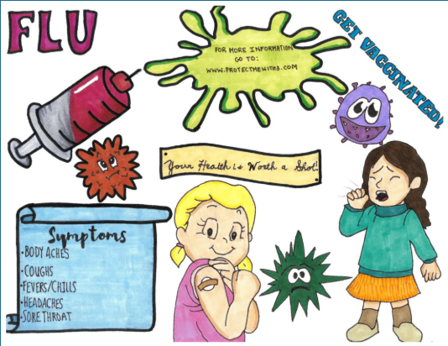
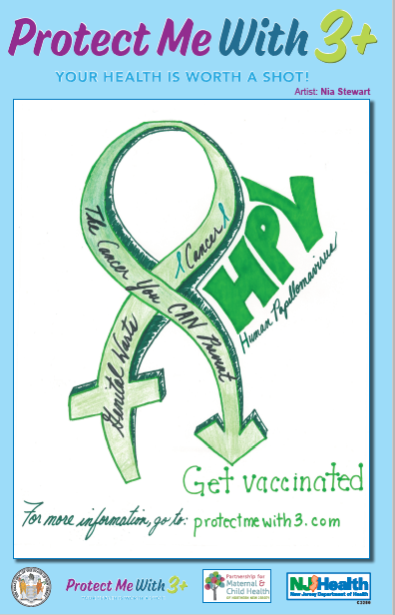

Protect Me With 3+ Campaign www.protectmewith3.com
Notes:
The Protect Me With 3+ campaign is a fun way to learn and share knowledge about teen vaccines. This initiative was started in 2012 in collaboration with the Partnership for Maternal & Child Health of Northern New Jersey and the New Jersey Department of Health. This campaign includes a poster/video contest and also features teen-focused social media and an educational website for youth, parents, and educators. Pictured here are some of the winning student submissions from previous years. This contest also offers prizes for winning submissions! The campaign kicks off in the Fall, be sure to check out the website for more information.
NOTE TO TEACHER: The Protect Me With 3+ website features a set of resources for educators including classroom activities, games, and lesson plans. Hard copies of posters from previous years are also available upon request at no cost. We strongly encourage you to use and to share these resources as widely as possible.
OTHER CLASSROOM ACTIVITY IDEAS:
Have students form groups and create a skit about one of the adolescent vaccines. Students would write the script and act it out in front of the classroom (similar to Protect Me With 3+ videos)
Have students pick a popular song and change the lyrics to include promotion of one of the adolescent vaccines.
Have individual students create a poster or video and submit to the Protect Me with 3+ contest.
For a project that is outside of the classroom, have students interview someone who was sick with one of these diseases (flu, meningococcal) to learn more about the disease and benefits of vaccination. If it is difficult to find someone to interview, perhaps have students view personal stories on the Vaccinate Your Family website (www.vaccinateyourfamily.org/why-vaccinate/personal-stories/) and write a few paragraphs about what they learned.

Slide 31
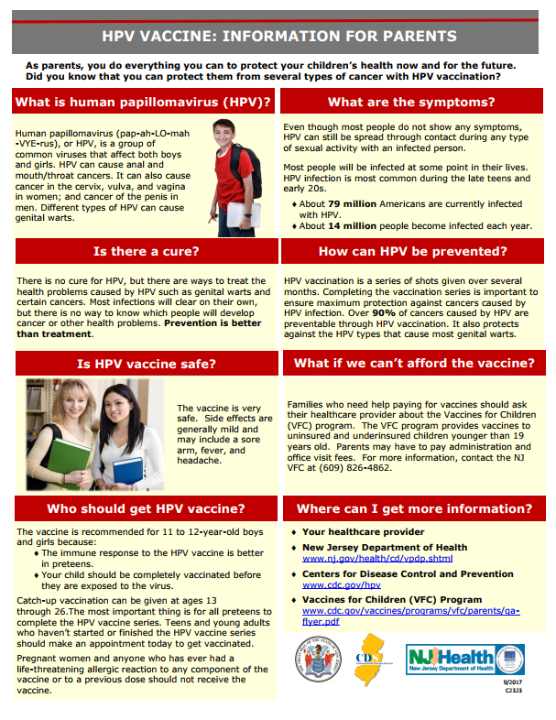
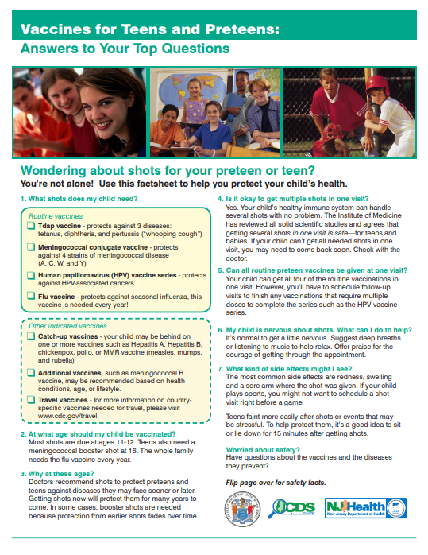
New Jersey Department of Health Educational Materials
https://nj.gov/health/cd/vpdp.shtml
http://nj.gov/health/cd/topics/hpv.shtml
Notes:
The New Jersey Department of Health has also developed some educational materials including flyers, posters, and brochures. These materials are available electronically at the links listed on the slide.

Slide 32
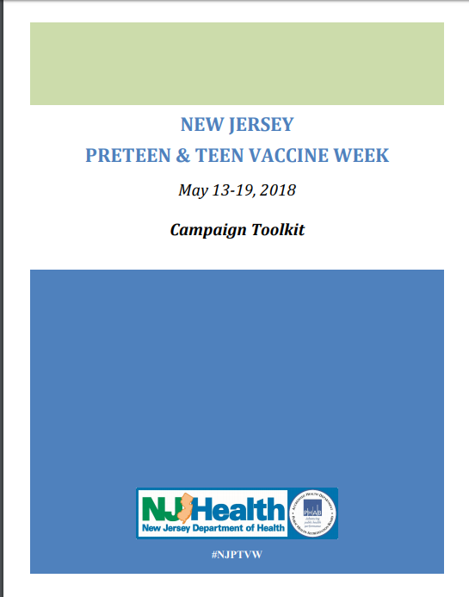
Spreading the Message
January = Cervical Cancer Awareness Month
March 4th = HPV Awareness Day
April = Oral Cancer Awareness Month
August = National Immunization Awareness Month
Source: https://nj.gov/health/cd/documents/vpdp/adolescent-immunization-toolkit.pdf
Notes:
You can play a role in helping to spread the message. Public health observations are a great opportunity to share important messages with friends, family, and followers. Listed here are a few vaccine-related public health observations.
The New Jersey Department of Health also developed a campaign toolkit to celebrate its 2018 preteen and teen vaccine week. You can use some of these messages to help spread the word and prevent disease!

Slide 33
Additional Resources
NJ Department of Health www.nj.gov/health/cd/vpdp.shtml
CDC vaccine information www.cdc.gov/vaccines
Immunization Action Coalition www.immunize.org/
Notes:
Lastly, here are some reliable resources where you can find more information on adolescent vaccines.

