Slide 1
State of New Jersey Department of Health Patient Safety Reporting System Module 3 – Root Cause Analysis

Slide 2
Patient Safety Reporting System Course Contents
Preparing to Enter Root Cause Analysis and Action Plan
Enter Root Cause Analysis and Action Plan
PSRS review of RCA
Other Communications about the RCA

Slide 3
Preparing to Enter Root Cause Analysis and Action Plan – continued
Log into the system
Access the “Resources” tab from the Main Menu
“Resources” Tab Menu
Information Consulted
Report Questions
User Guide
Select Event Type
View Initial RCA Questions
Information needed will be displayed

Slide 4
Preparing to Enter Root Cause Analysis and Action Plan – continued
Locate Comments from the Event Reviewer
Locate Event for which an RCA is required
Home Page: enter Event/RCA number
View Events: all Events and RCAs listed
Click on ‘Detail’
Comments from Event Reviewer can be accessed by:
A comment link in the Initial Event
Only visible in sections of the Event with PSRS comments
Click on ‘Comments’ link
A link to the comment through the Communication Log
‘View All Comments’

Slide 5
Preparing to Enter Root Cause Analysis and Action Plan
RCA Questions

Slide 6
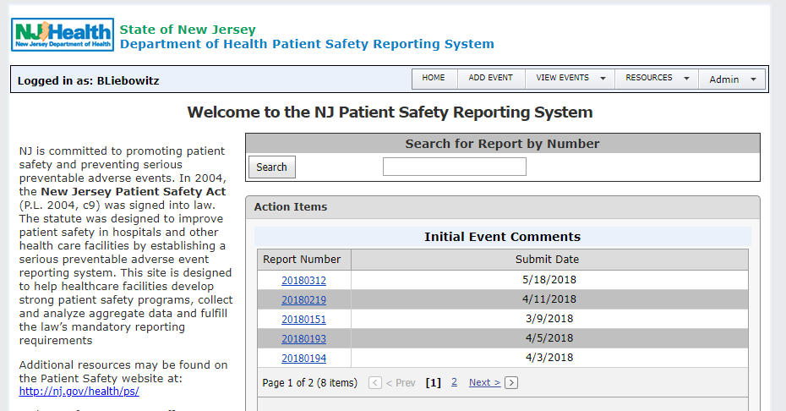
Preparing to Enter Root Cause Analysis and Action Plan – continued

Slide 7
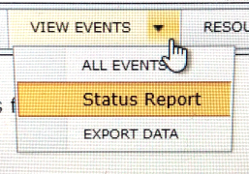
Preparing to Enter Root Cause Analysis and Action Plan – continued

Slide 8
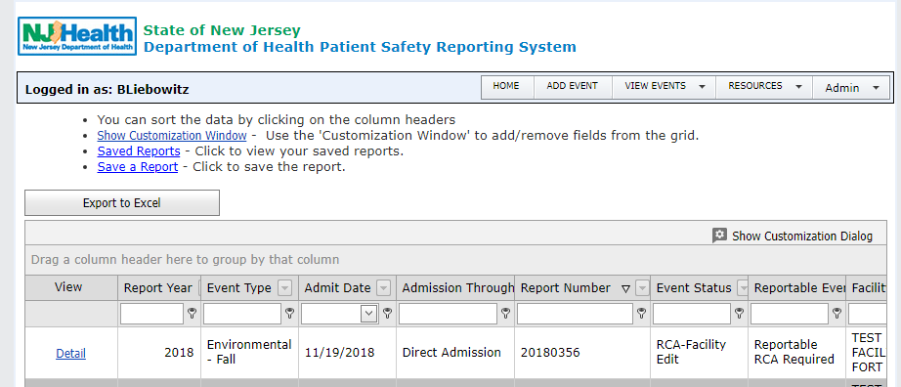
Preparing to Enter Root Cause Analysis and Action Plan – continued
View Events (includes RCAs)

Slide 9
Preparing to Enter Root Cause Analysis and Action Plan – continued
Locate Comments

Slide 10
Preparing to Enter Root Cause Analysis and Action Plan – continued
System Navigation - General
“Main Menu” Bar
View Events – Event/RCA listing, may create custom reports
“Report Menu” Bar
Moves you through each report section with an arrow to indicate next step
RCA Summary page builds as information is entered
“Save/Next” Button
Move to next screen

Slide 11
Enter Root Cause Analysis and Action Plan
The “Report Menu” will guide you through the RCA
A red arrow will indicate the next step in the process
Complete fields for:
RCA General information
RCA Facts of the Event
RCA Specific Questions
Create Documents to copy information into the RCA screens
All required fields must be completed to save screen
Two Hour Time Out Window

Slide 12
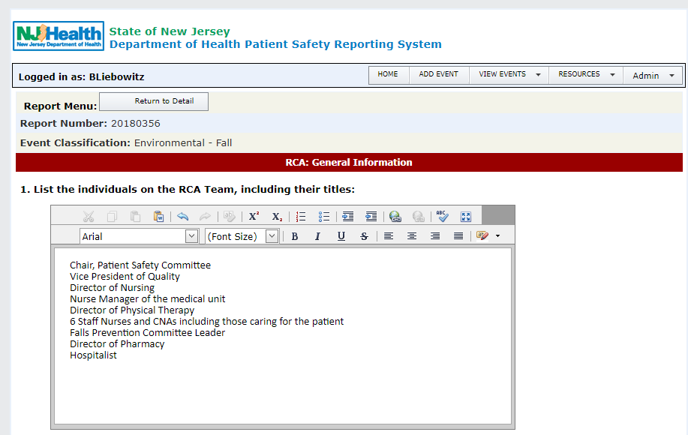
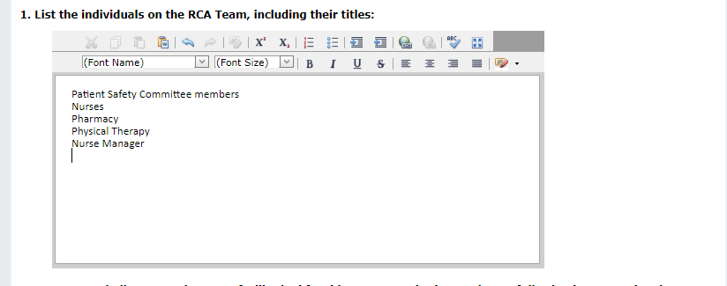
Enter Root Cause Analysis and Action Plan – continued
RCA: General Information
Note this example is an illustration of an insufficient description of the individuals on the RCA Team. In later slides, PSRS will show you how to modify this entry to reflect best practices.

Slide 13
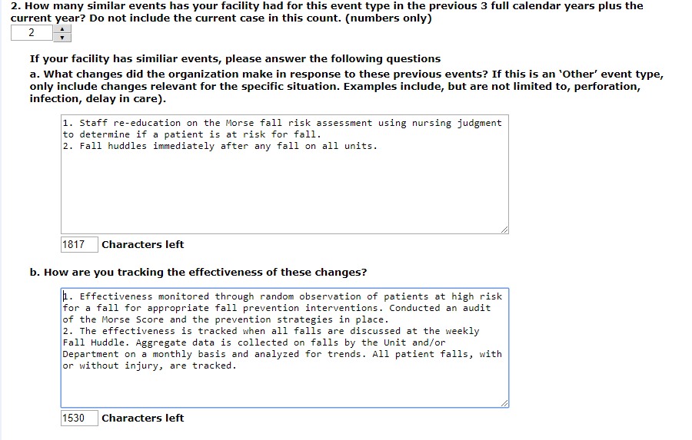
Enter Root Cause Analysis and Action Plan – continued
RCA: General Information

Slide 14
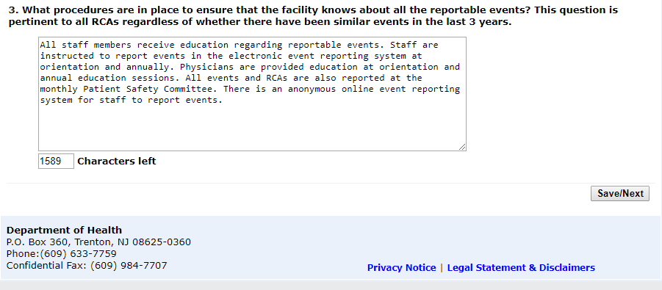
Enter Root Cause Analysis and Action Plan – continued
RCA: General Information

Slide 15
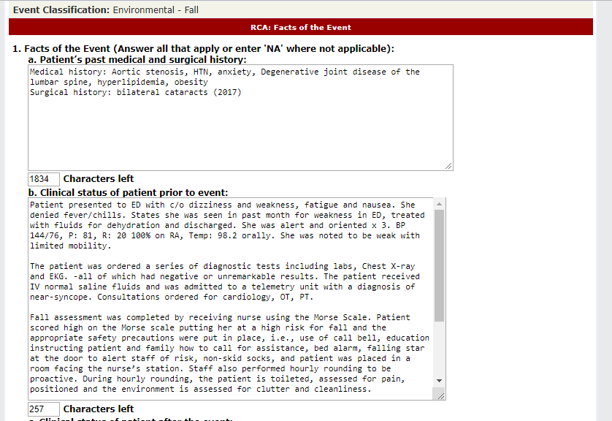
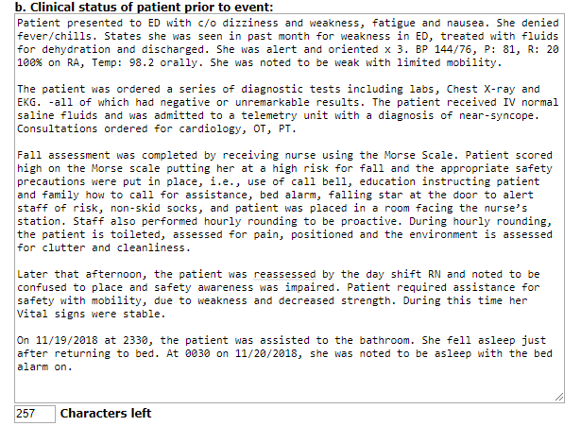
Enter Root Cause Analysis and Action Plan – continued
RCA: Facts of the Event

Slide 16
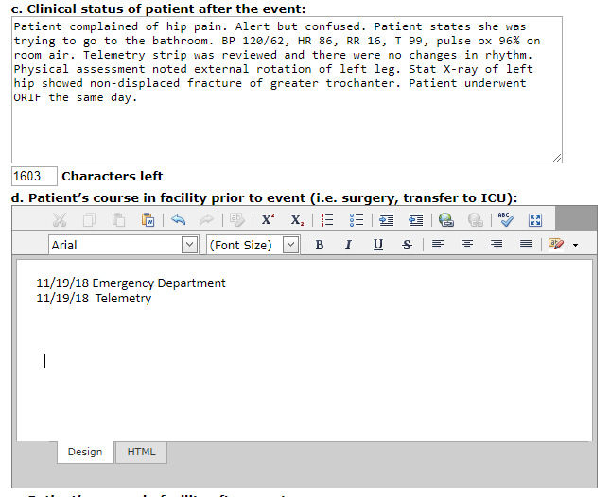
Enter Root Cause Analysis and Action Plan – continued
RCA: Facts of the Event

Slide 17
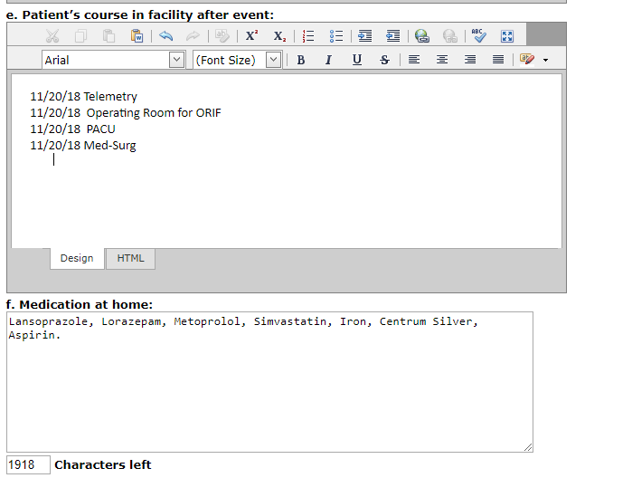
Enter Root Cause Analysis and Action Plan – continued
RCA: Facts of the Event

Slide 18
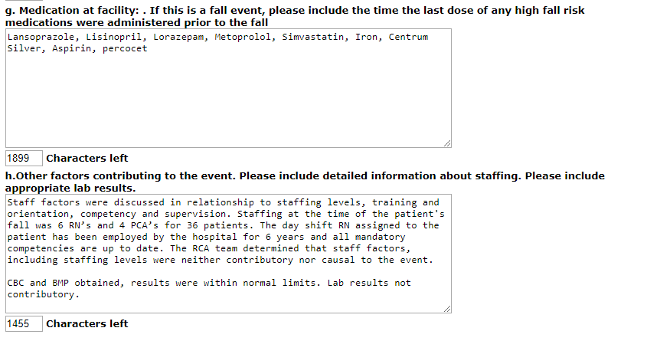
Enter Root Cause Analysis and Action Plan – continued
RCA: Facts of the Event

Slide 19
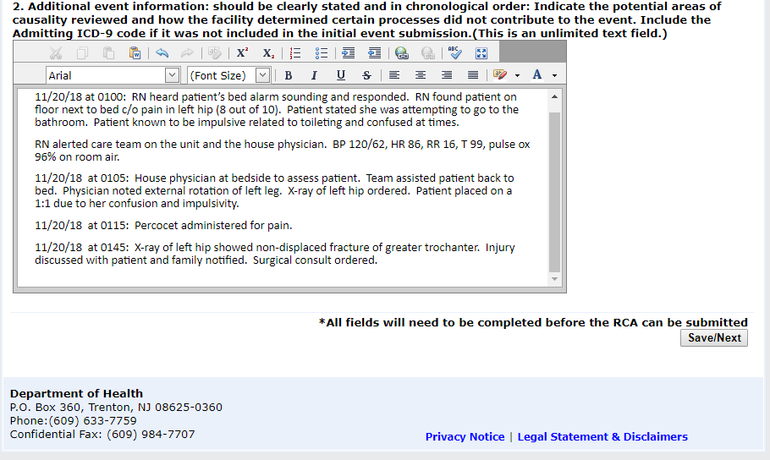
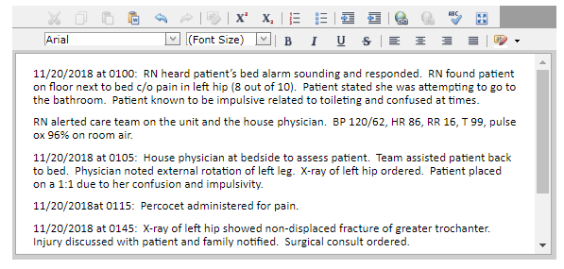
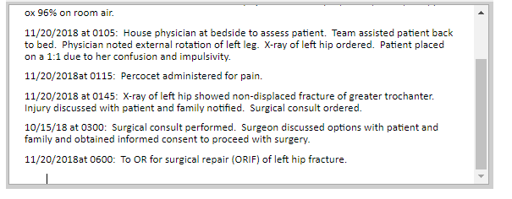
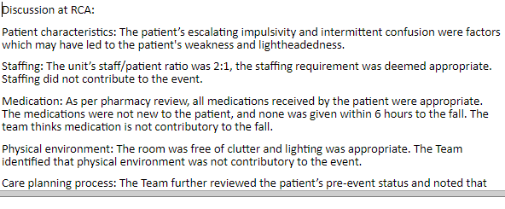
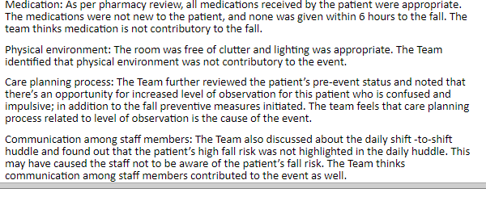
Enter Root Cause Analysis and Action Plan – continued
RCA: Facts of the Event

Slide 20
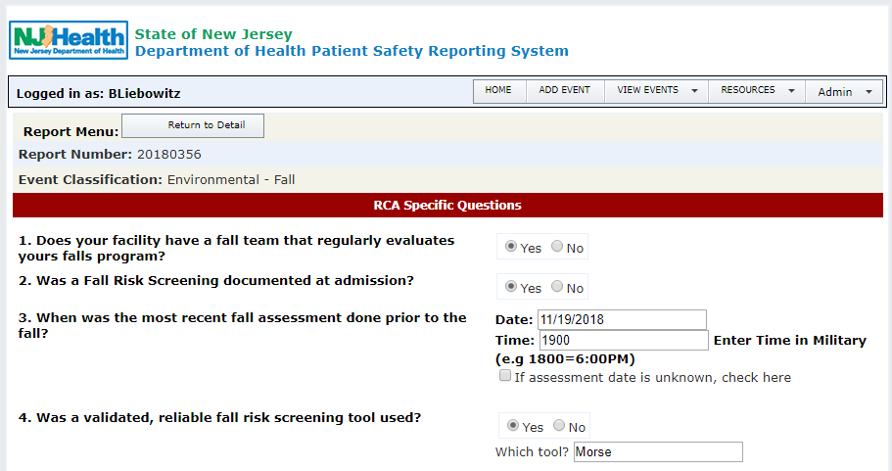
Enter Root Cause Analysis and Action Plan – continued
RCA Specific Questions

Slide 21
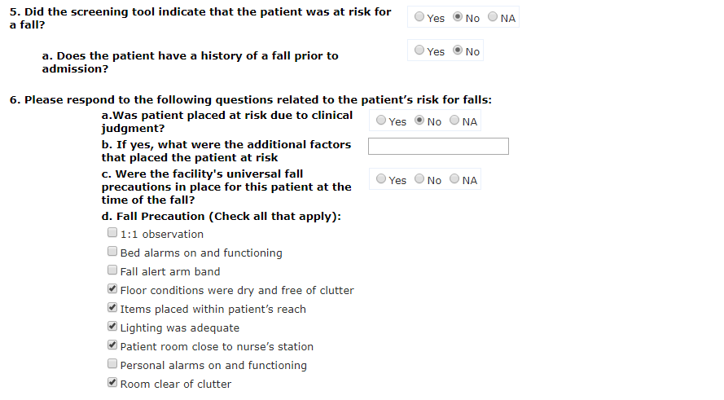
Enter Root Cause Analysis and Action Plan – continued
RCA Specific Questions

Slide 22
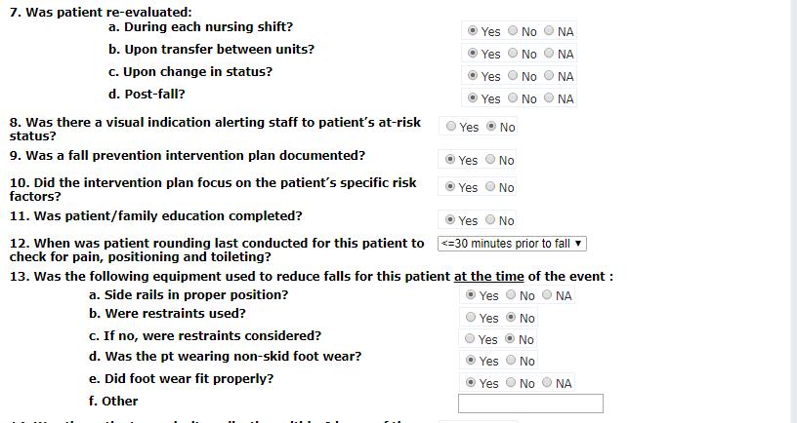
II. Enter Root Cause Analysis and Action Plan – continued
RCA Specific Questions

Slide 23
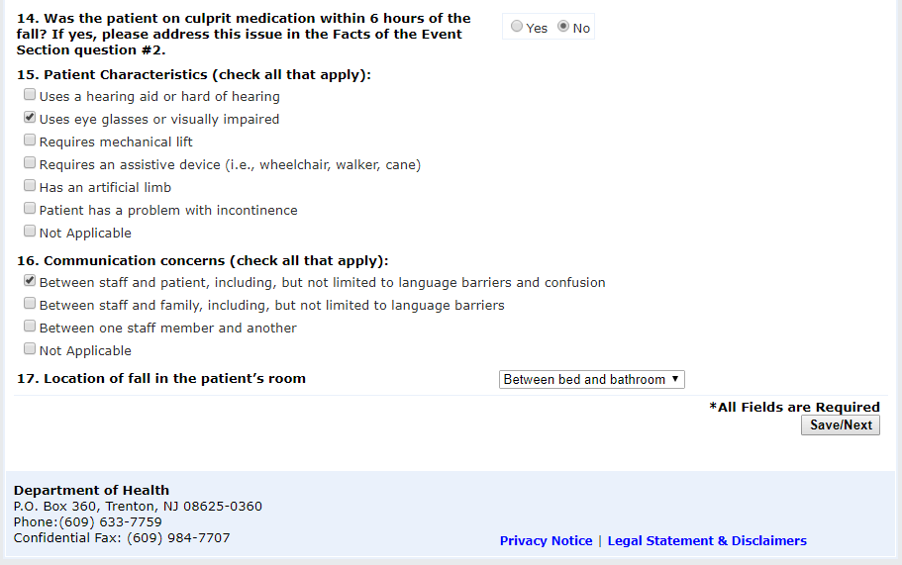
II. Enter Root Cause Analysis and Action Plan – continued
RCA Specific Questions

Slide 24
II. Enter Root Cause Analysis and Action Plan – continued
Root Cause/Causality Statement
For each RCA you may have:
More than one Root Cause
Each root cause will have a causality statement
More than one Action Plan per Root Cause
Each Action Plan will have one Methodology
Work through one Root Cause at a time with the corresponding Action Plan(s)

Slide 25
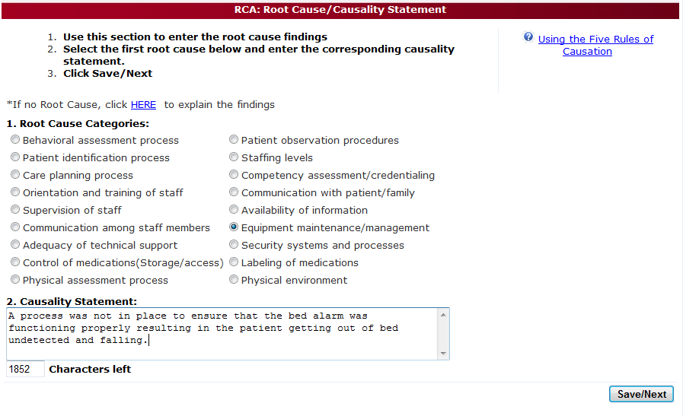
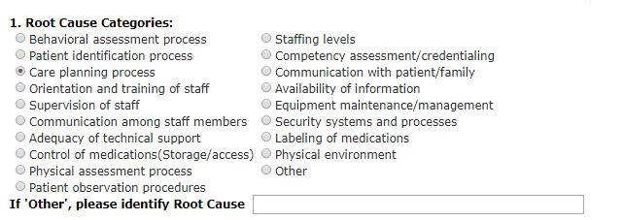
II. Enter Root Cause Analysis and Action Plan – continued
RCA: Root Cause/Causality Statement

Slide 26
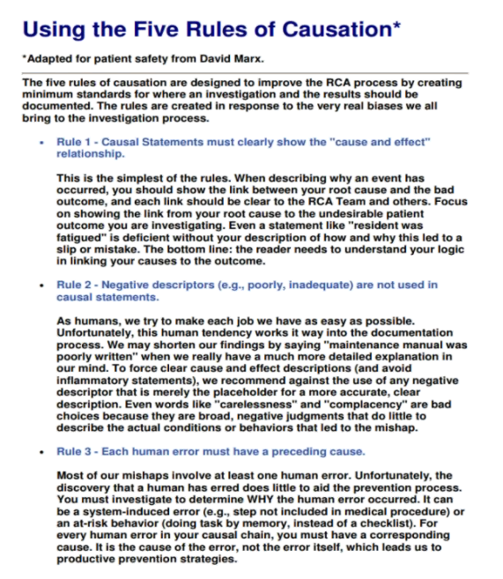
II. Enter Root Cause Analysis and Action Plan – continued
RCA: Five Rules of Causation

Slide 27
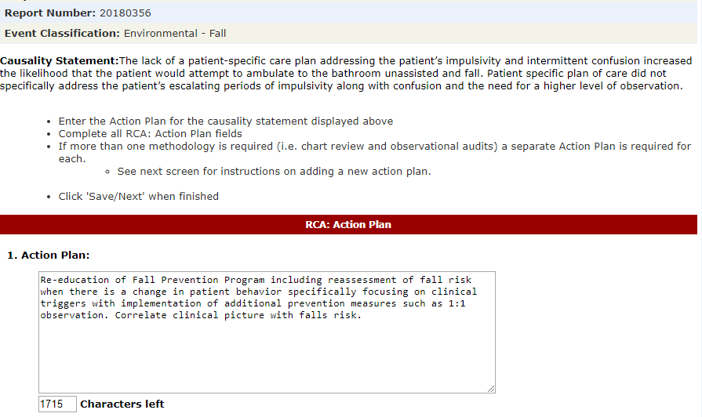
II. Enter Root Cause Analysis and Action Plan – continued
RCA: Action Plan

Slide 28
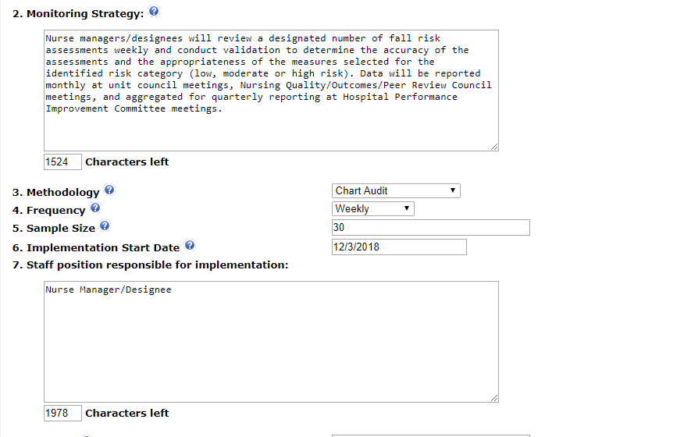
II. Enter Root Cause Analysis and Action Plan – continued
RCA: Action Plan

Slide 29
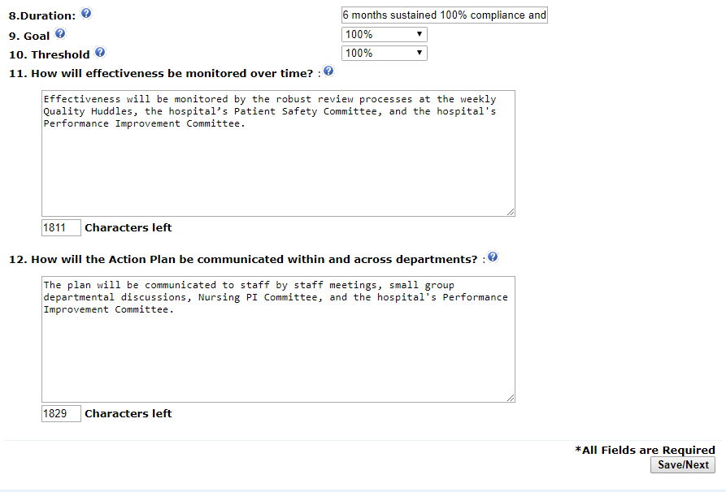
II. Enter Root Cause Analysis and Action Plan – continued
RCA: Action Plan

Slide 30
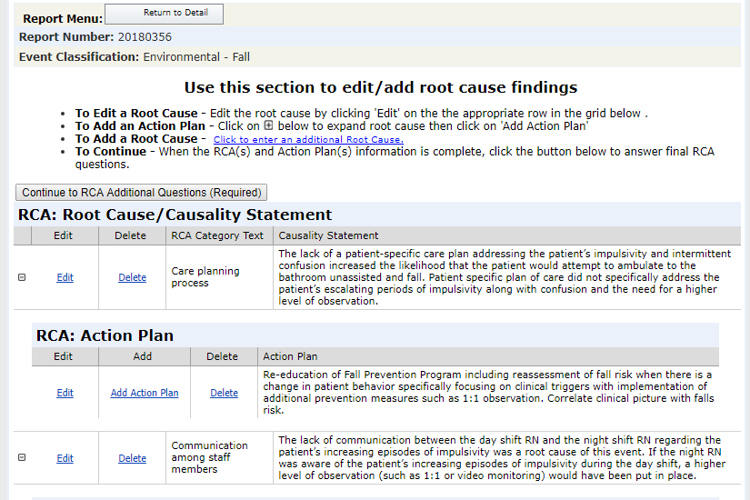
II. Enter Root Cause Analysis and Action Plan – continued
Edit/Add Root Cause Findings
When the first Root Cause and Action Plan are complete, you can add an additional Action Plan to the Root Cause or edit the first Root Cause.

Slide 31
II. Enter Root Cause Analysis and Action Plan – continued
Edit/Add Root Cause Findings

Slide 32
II. Enter Root Cause Analysis and Action Plan – continued
Add an Additional Root Cause

Slide 33
II. Enter Root Cause Analysis and Action Plan – continued
When all Root Causes and Action Plans are complete:
Complete RCA Additional Questions
Submit to PSRS for review
You will receive an error message if any required information is not completed

Slide 34
II. Enter Root Cause Analysis and Action Plan – continued
RCA Additional Questions

Slide 35
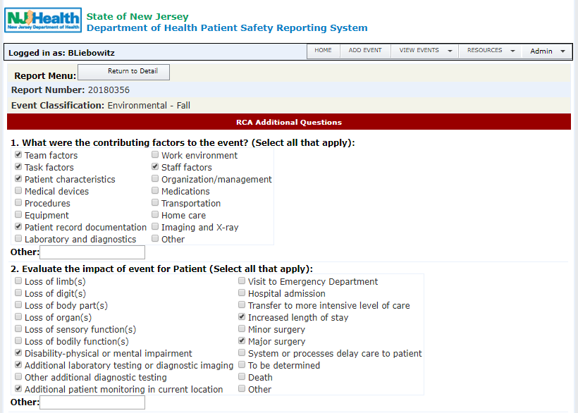
II. Enter Root Cause Analysis and Action Plan – continued
RCA Additional Questions

Slide 36
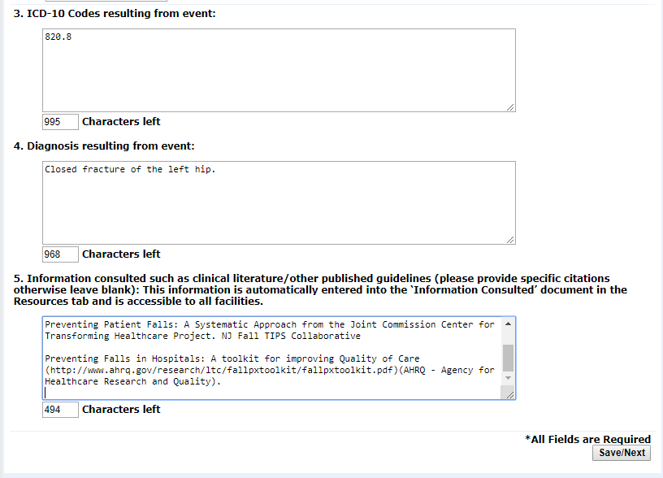
II. Enter Root Cause Analysis and Action Plan – continued
RCA Additional Questions

Slide 37
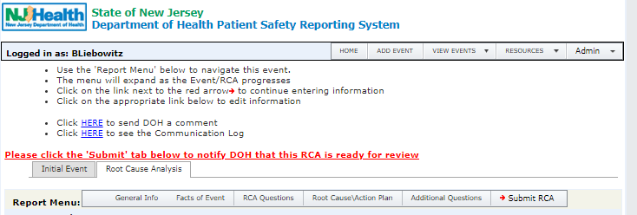
II. Enter Root Cause Analysis and Action Plan – continued
Submit RCA to PSRS

Slide 38
RCA Review by PSRS
Automated e-mail sent to PSRS when RCA is submitted
PSRS reviews the RCA
Possible Review Outcomes:
Email: RCA Comment Process
Email: RCA Complete

Slide 39
RCA Review by PSRS - continued
Email: RCA Comment process:
Additional information is needed
PSRS makes comments to determine if the RCA contains the required components of an RCA
An email is sent to the FacAdmins
Comments are available on this RCA. Please log into the Patient Safety Reporting System to view the details and respond accordingly.
Note: PSRS must be added as a safe sender so PSRS emails do not go to your spam folder
A Facility User must log into the PSRS and open the Communication log for that RCA to view the email and
read the comments

Slide 40
RCA Review by PSRS - continued
Email: RCA Comment Process continued
Comments can be accessed by:
A comment link in the RCA
Only visible in sections of the RCA with PSRS comments
Click on ‘Comments’ link
A link to the comment through the Communication Log
Click HERE to see the Communication Log
Click HERE to view all comments

Slide 41
RCA Review by PSRS - continued
Email: RCA Comment Process continued
Respond to all comments by editing the RCA
Click on ‘Edit’ in the section(s) with the Comments
Provide responses to the Comments/Questions
The RCA: Facts of the Event section question #2 is an unlimited text field
Resubmit the RCA to PSRS
Click on ‘Save’ to keep the changes
Click on the ‘Submit RCA’ tab to resend the RCA to PSRS
There may be more than 1 cycle of responding to comments

Slide 42
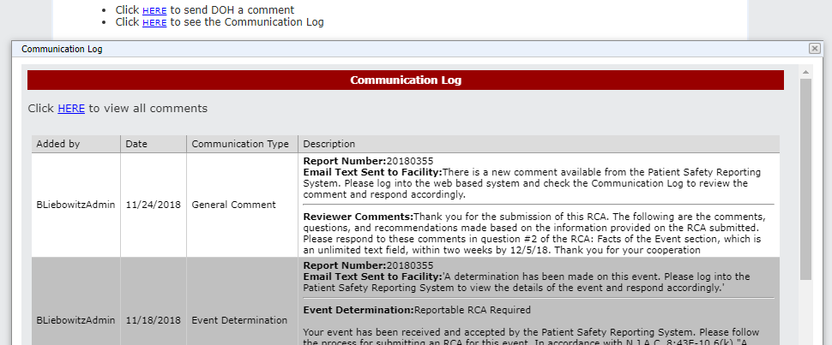
RCA Review by PSRS - continued
Email: RCA Comment Process continued

Slide 43
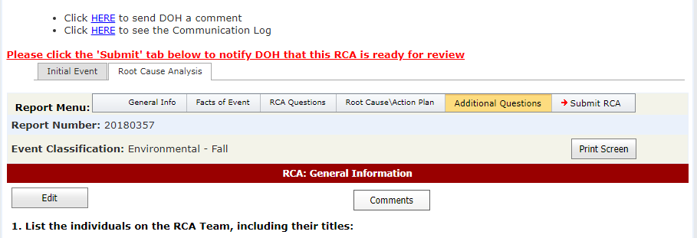
RCA Review by PSRS - continued
Email: RCA Comment Process continued

Slide 44
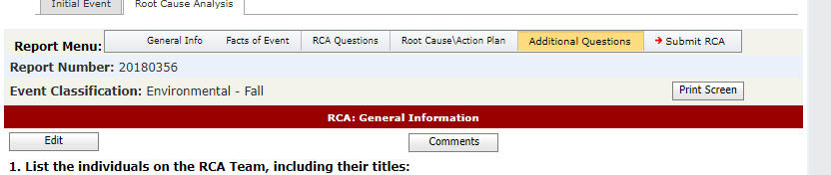
RCA Review by PSRS - continued
Email: RCA Comment Process continued

Slide 45
RCA Review by PSRS - continued
Email: RCA Comment Process continued

Slide 46
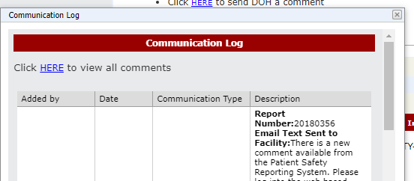
RCA Review by PSRS - continued
Email: RCA Comment Process continued

Slide 47
RCA Review by PSRS - continued
Review All Comments Link

Slide 48
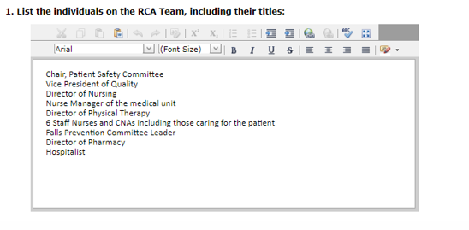
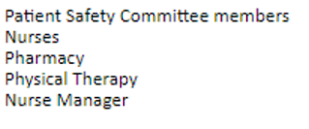
RCA Review by PSRS - continued
Edit RCA

Slide 49
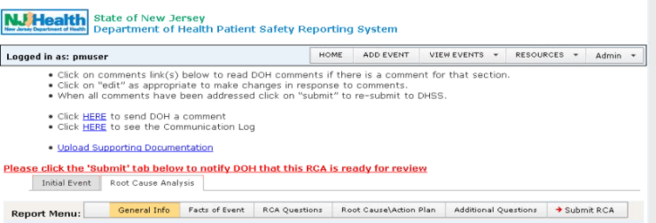
RCA Review by PSRS - continued
Re-Submit Edited RCA

Slide 50
III. RCA Review by PSRS - continued
Email: RCA Complete:
The RCA is closed
Additional information or clarification may be requested to complete the RCA Review
An email is sent to the FacAdmins
The status of this RCA has changed. Please log into the Patient Safety Reporting System to view the details and respond accordingly.
Note: PSRS must be added as a safe sender so PSRS emails do not go to your spam folder

Slide 51
III. RCA Review by PSRS - continued
Email: RCA Complete continued:
A Facility User must log into the PSRS to read the Status of the RCA, which will be located in the Communication log for that RCA, and respond accordingly.
If requested, additional information may be sent to PSRS by
General Comment
Attachment (Upload Documentation)
Covered in ‘Other Communications about the RCA’

Slide 52
III. RCA Review by PSRS - continue

Slide 53
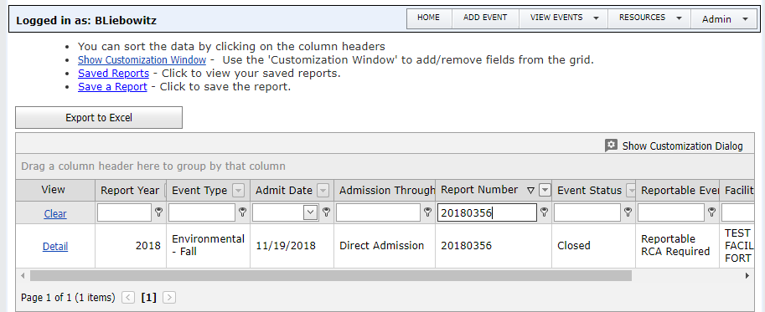
Other Communications About the RCA - continued
Email: RCA Complete

Slide 54
Patient Safety Reporting System
Other Communications About the RCA
Communication from PSRS
FacAdmins receive notification via email there is a communication from PSRS
General Comment or Email:Other
There is a new comment available from the Patient Safety Reporting System. Please log into the web based system and check the Communication Log to review the comment and respond accordingly
Access Communications using the Communication Log

Slide 55
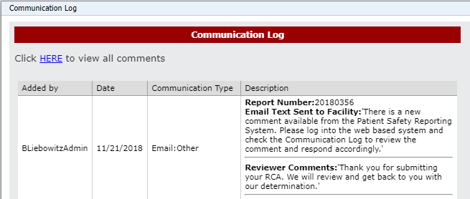
Other Communications About the RCA - continued
Email: Other

Slide 56
Other Communications About the RCA - continued
Email: General Comment

Slide 57
Other Communications About the RCA - continued
Communication to PSRS
PSRS will receive email notification that there is a communication from the facility about a specific Event
Be sure to send communication for the correct Event number
General Comment
Respond to PSRS Comment
Send Communication through the Communication Log

Slide 58
Other Communications About the RCA - continued

Slide 59
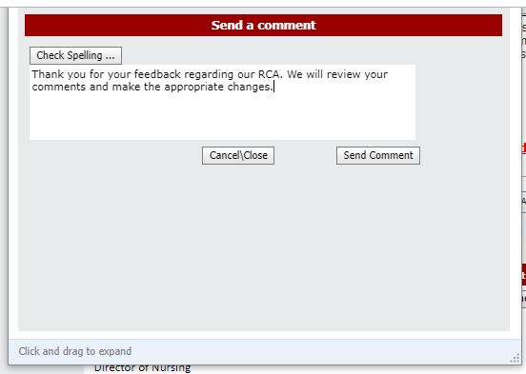
Other Communications About the RCA - continued

Slide 60
IV. Other Communications About the RCA – continued
Upload Supporting Documentation
Documents can be attached to the RCAs; contact PSRS through the PSRS Communication Log to enable the attachment function
Applies to a single Event or RCA
Do NOT attach medical records
Attachment titles cannot contain special characters, for example: @ ! ? *

Slide 61
IV. Other Communications About the RCA – continued
Upload Supporting Documentation

Slide 62
IV. Other Communications About the RCA – continued
Upload Supporting Documentation
Note: This link is not available unless the attachment function is enabled by PSRS.

Slide 63
REVIEW
Use “View Events” menu to find Event requiring RCA
Enter Root Cause and Action Plan
Multiple Root Causes and Action Plans can be entered
PSRS reviews RCA and responds with next step
Review PSRS comments and respond accordingly

Slide 64
Next Module
System Navigation
Reports
Resources and Support

