Slide 1
New Jersey Financial Aid Management System (NJFAMS)
Conducted by:
Office of the Secretary of Higher Education (OSHE)
Educational Opportunity Fund (EOF)

Slide 2
Purpose of the Training
Instructions on how to select, award, certify, and request payment for identified EOF eligible candidates during the academic year
EOF Undergraduate AY Processing Calendar
Clarification Regarding EOF & HESAA
Disbursement of Academic Year Funds
EOF Non-Funded and Discretionary Appeal Process
Submission of Pending Verification form

Slide 3
OSHE/EOF Central Office Staff
Dr. Hasani Carter
Hasani.Carter@oshe.nj.gov
(609) 341-3808
Peter Collazo
Peter.Collazo@oshe.nj.gov
(609) 273-9090
Hema Patel
Hema.Patel@oshe.nj.gov
(609) 984-3751
Catherine Sackey
Catherine.Sackey@oshe.nj.gov
(609) 633-6090
Dr. Stephanie Shanklin
Stephanie.Shanklin@oshe.nj.gov
(609) 984-3751
  Website: http://www.state.nj.us/highereducation/EOF/EOF_Program_Resources.shtml

Slide 4

Points of Emphasis
Awarding and roster management is the responsibility of each institution.
The EOF selection, awarding, certification and payment request process will require the involvement of both the EOF campus program and their institution’s financial aid office.
Student selection and the ability to place an EOF Article III undergraduate grant award on their account must occur within the EOF portal.
Student certification and payment requests must occur within the institution’s Financial Aid portal of NJFAMS.
The EOF portal is a separate part of NJFAMS.
Access to the EOF portal is facilitated by OSHE/EOF.

Slide 5
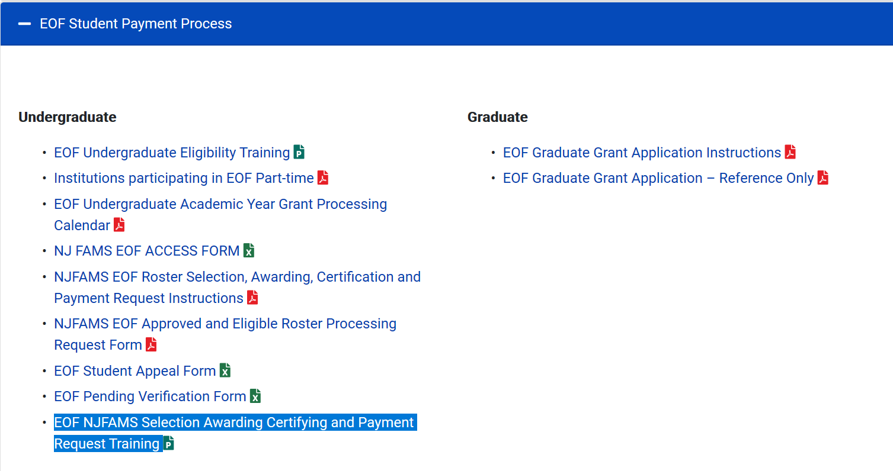
EOF Campus Program Resources Webpage
https://www.nj.gov/highereducation/EOF/EOF_Program_Resources.shtml

Slide 6
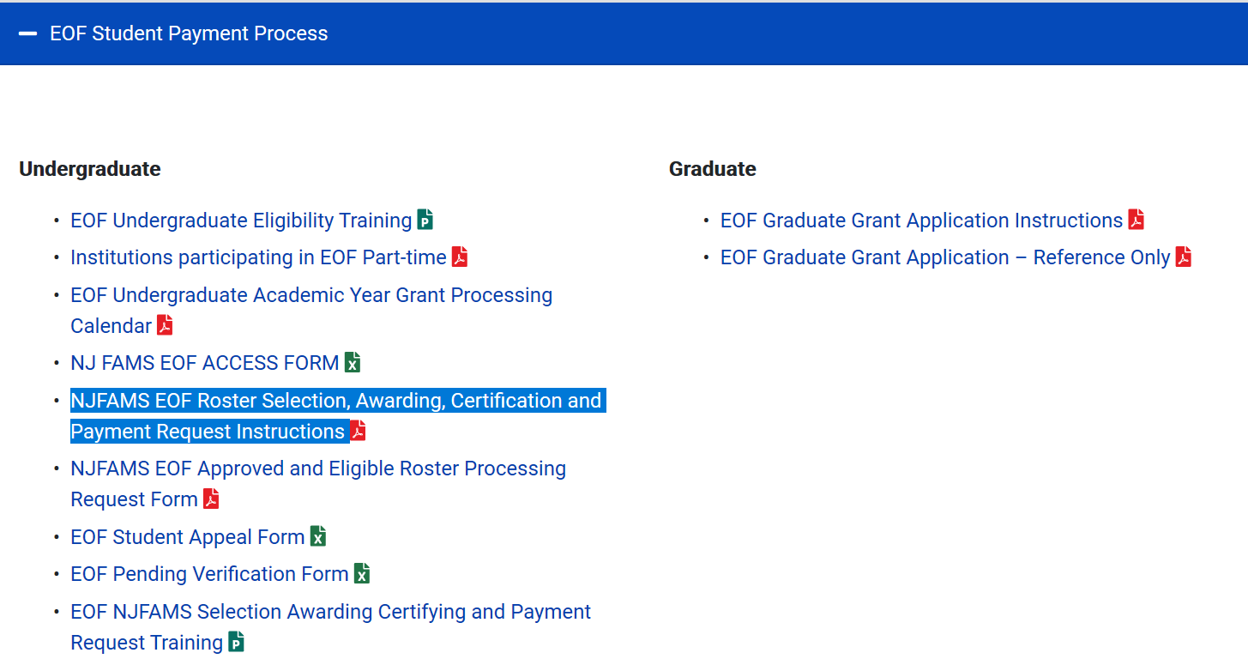
EOF Roster Selection, Awarding, Certification and Payment Request Instructions

Slide 7
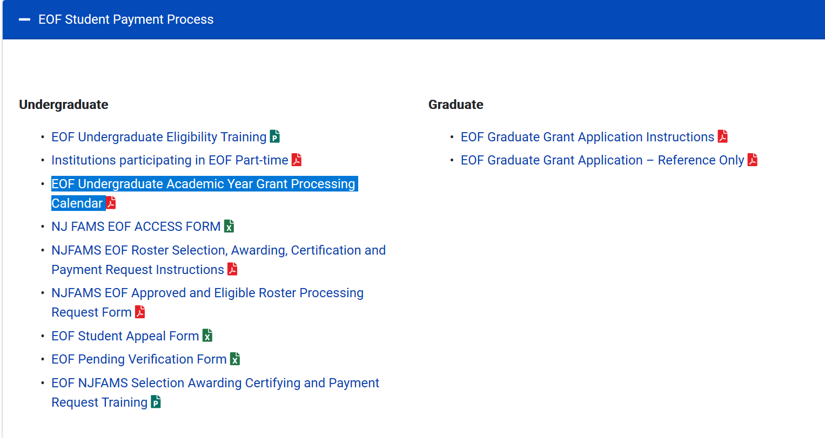
EOF Undergraduate AY Processing Calendar

Slide 8
The EOF Undergraduate
Article III Grant Award Process
EOF Campus Program(s)
Campus Financial Aid Office
ONLY has the ability to select and award an EOF Undergraduate Article III Grant to an eligible student.
Funding is limited
Programs are responsible for ensuring all candidates are reviewed and awarded properly and the appropriate documentation to determine eligibility is kept on file (See EOF regulations).
Must ensure EOF Enrollment matches institutional FA Enrollment Status
Must certify EOF students
Must request payment by the EOF Deadline
If a refund is due, funds must be sent to OSHE.
DO NOT SEND EOF FUNDS TO HESAA

Slide 9
Clarification Regarding EOF & HESAA
EOF does not operate under the authority of the Higher Education Student Assistance Authority (HESAA).
EOF is a part of the Office of the Secretary of Higher Education (OSHE) which is a separate agency.
EOF refunds must be sent to OSHE. Do not send them to HESAA.
Relationship Between
OSHE/EOF & HESAA
OSHE
EOF Portal
HESAA
NJFAMS
EOF
EOF Processing Calendar
HESAA Processing Calendar

Slide 10
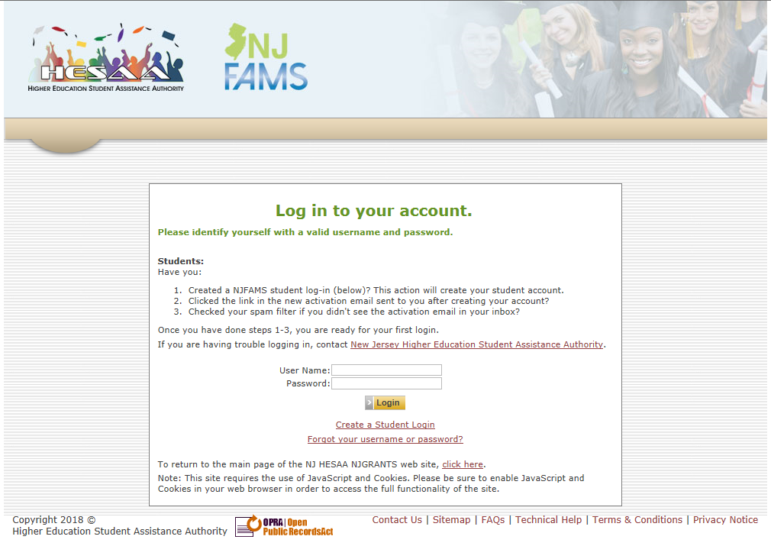
EOF Portal Access
EOF Campus Director must manage who is given EOF portal access

Slide 11
Main Menu – EOF Portal View
Program Undergraduate Art. III Allocation and Available Funds
Locate, award or un-award students via the rosters. Also, you can look up each student to see what is going on with them.

Slide 12
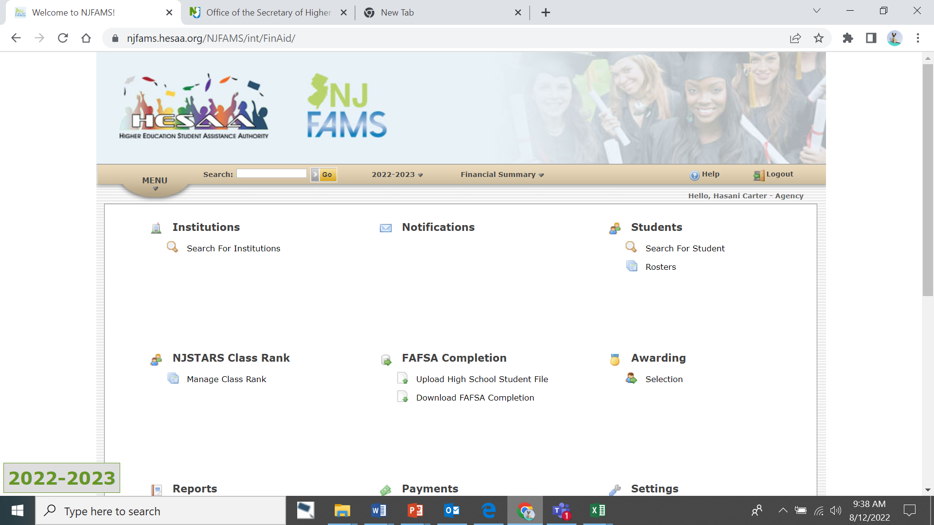
Main Menu Notables
Confirm Academic Year
The Main Menu provides access to all the options that are available to the user. Access is based on system permissions established for the user. If you have “READ ONLY” permission, you will only be able to view the data on the screen.
You can access all the regions via the “Menu” drop down option.
Confirm the Academic Year you need to work within.

Slide 13
EOF Allocation and Available Funds

Slide 14
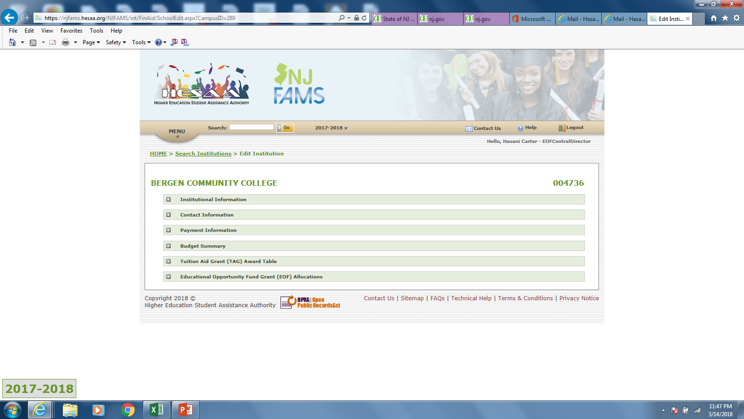
Institutional Information
View Program Allocation and Available funds here.

Slide 15
EOF Allocation
Available $ to award to students

Slide 16
Search for Students
Click on “Rosters”

Slide 17
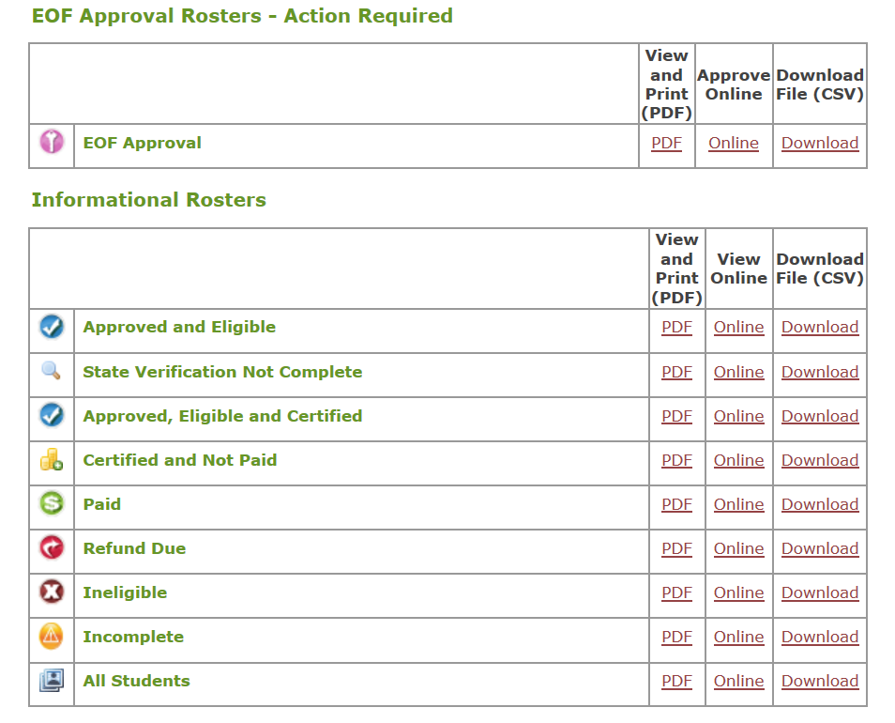
Additional Informational Rosters

Slide 18
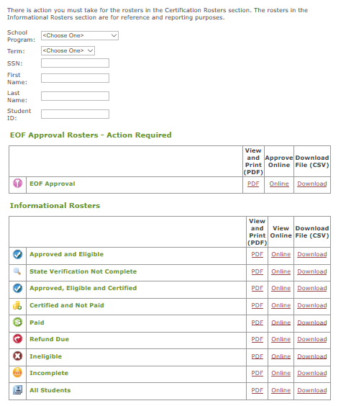
EOF Roster Management
Look for eligible Initials and Renewals who were not on the program’s roster as of the Fall term of the previous Academic Year. Also a source to find students who may already be enrolled at your school.
Renewal students who appeared on a program’s roster during the Fall term of the previous Academic Year & who remain eligible should appear here.
$ ineligible students BUT EOF discretionary eligible students will appear here.

Slide 19
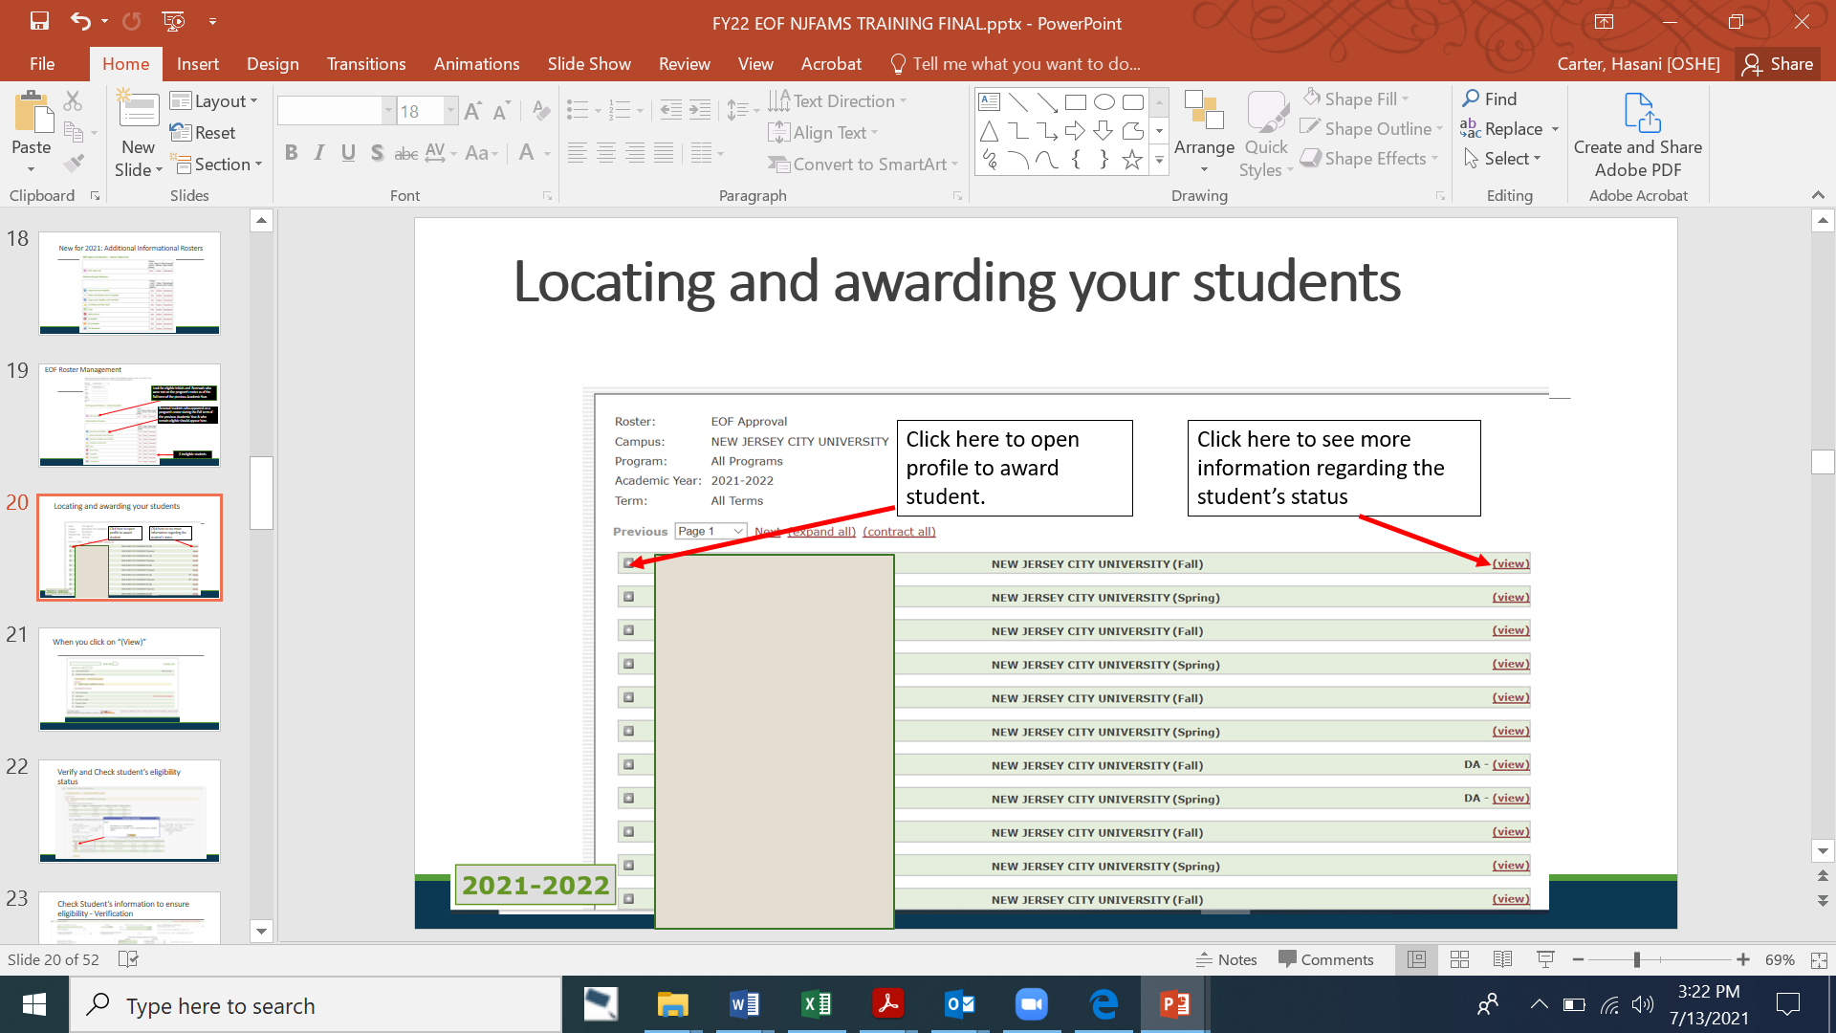
Awarding Students

Slide 20

When you click on “(View)”

Slide 21
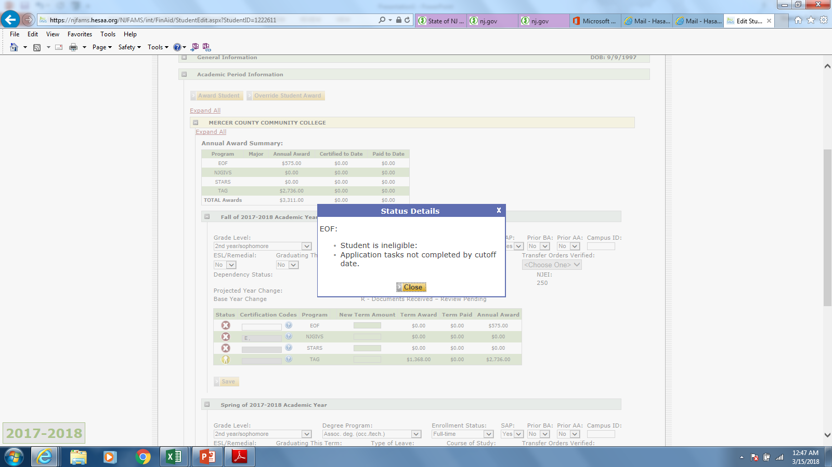
Verify and Check student’s eligibility status

Slide 22
Verification
Check Student’s information (i.e. Dependency status, Adjusted Gross Income, Untaxed Income & Assets to ensure eligibility.

Slide 23
Verification
(Continued)

Slide 24
EOF Financial Eligibility Notables:
A dependent student’s income and assets shall not be considered in the gross household income.
Ineligibility for TAG should not be automatically associated with ineligibility for EOF.
An applicant whose household receives Temporary Assistance for Needy Families (TANF) and/or Supplemental Social Security Income (SSI) as the sole means of support are eligible regardless of the amount of such support.
In determining financial eligibility for an Article III student grant, separation or divorce, or the disability or death of a wage earner for the academic year for which eligibility is being determined, with a concomitant decrease in household income below the EOF Income Eligibility Scale, does not automatically satisfy the financial eligibility requirement.
If an applicant believes that their reported household income and/or assets are not accurately reflective of their current financial profile, they will need to work with the institution’s financial aid office and HESAA to rectify this matter. OSHE/EOF does not make or review any adjustment appeals.

Slide 25
When you expand the “+” to award a student

Slide 26
When you expand the “+” to award a student

Slide 27
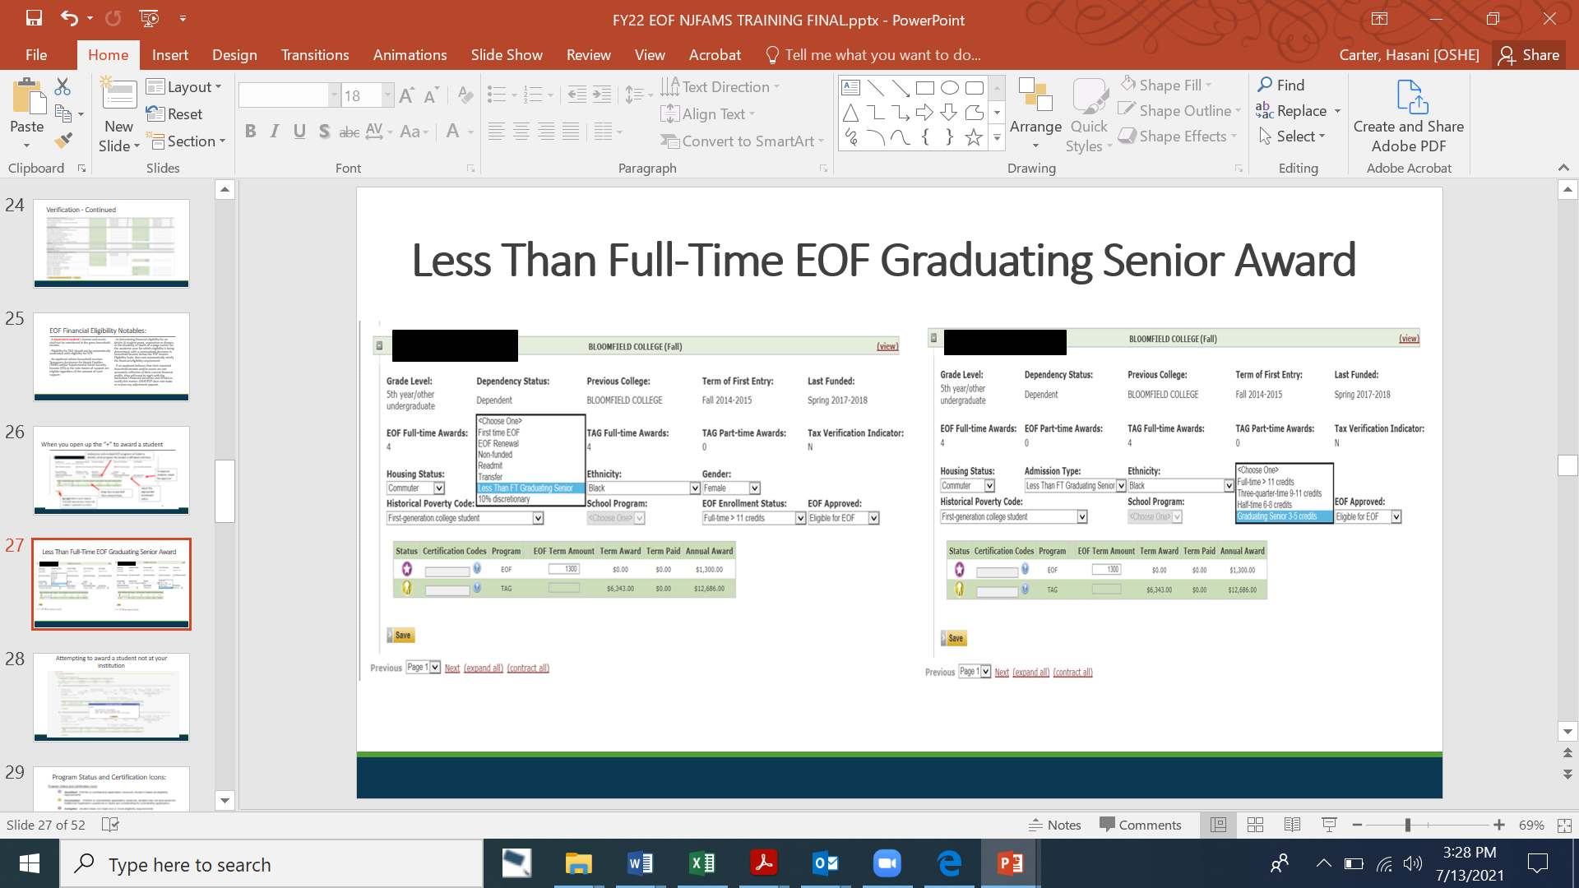
Less Than Full-Time EOF Graduating Senior Award

Slide 28
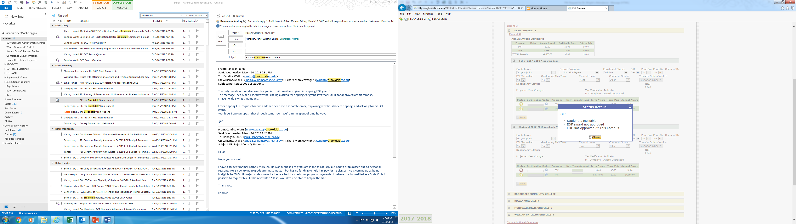
Attempting to award a student not at your institution

Slide 29
“EOF Award Not Approved”
Awarding a student with this as their ONLY ineligibility reason
If “EOF award not approved” is the only reason that a student appears as ineligible, you may be able to award this student.
There are several reasons that may cause for this status to appear. You will need to check the student’s profile to ensure that they meet all the eligibility requirements (e.g., financial eligibility, residency, completed application, etc.).
Once you have verified that the student appears to be eligible within the system and you have reviewed the appropriate financial documents submitted by the student, then change the status to EOF Approved and award the student.
Awarding of the student will force the system to re-screen the student. If everything is in proper order, then the student’s status should switch to “qualified”, and their award should appear on their account.
If it does not go through, then contact your EOF program liaison and we will investigate the matter further.

Slide 30
Program Status and Certification Icons

Slide 31
Roster Certification Submission Process
Ensure that all students have been awarded
Students must appear on your EOF Approved and Eligible Roster
Send this CSV file and your EOF Roster Certification form to EOF@oshe.nj.gov w/ a copy to your program liaison

Slide 32
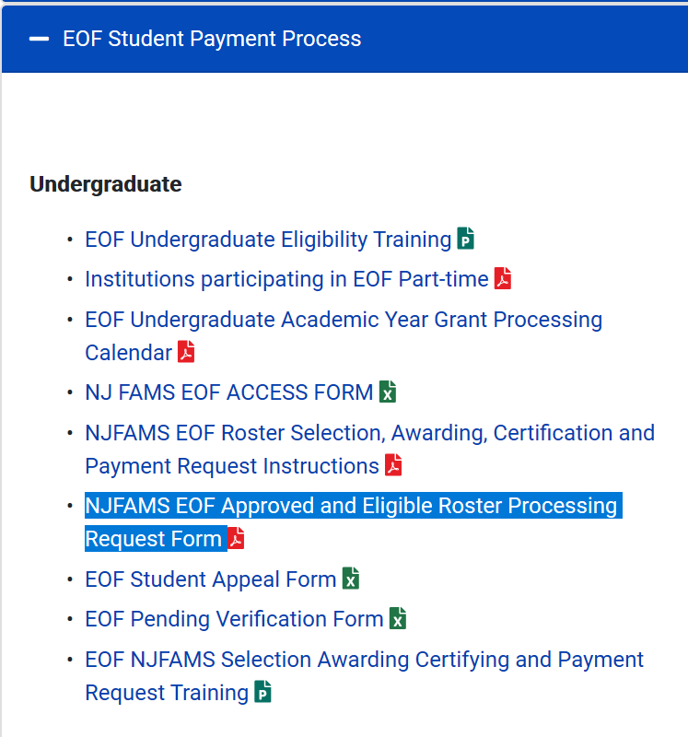

EOF Roster Processing Form
(Located on the EOF Campus Program Resources Webpage)

Slide 33
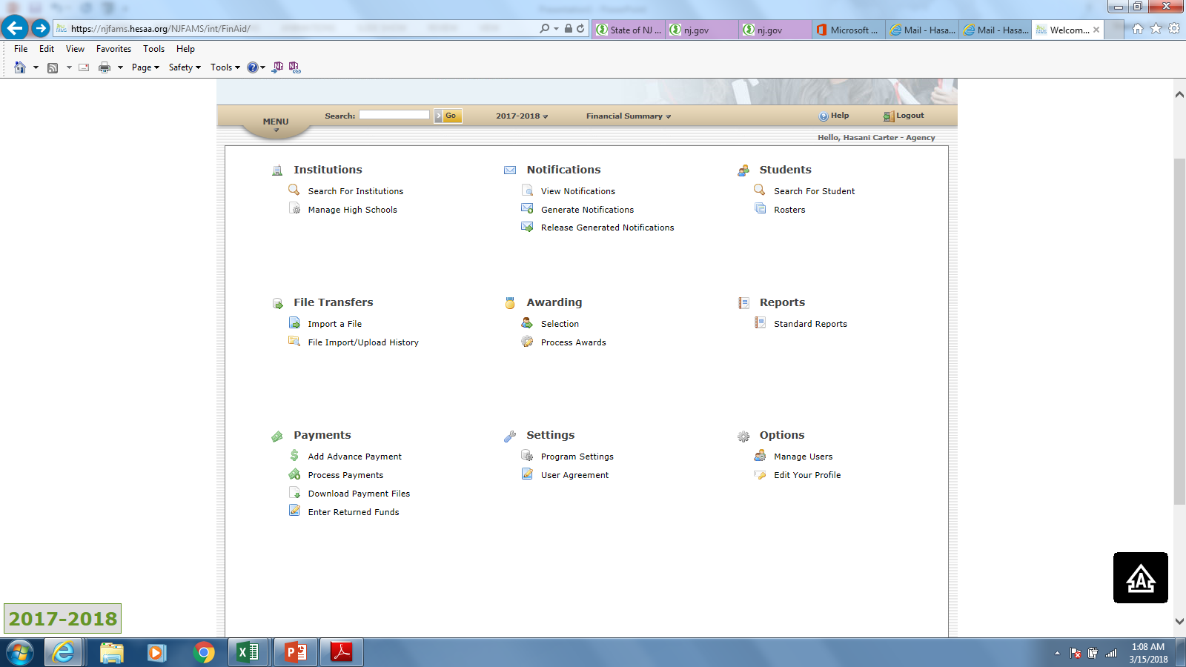
Institutional FAO have a region where they can certify and request payment for your students
FAO liaison must go here to locate the students that need to be certified.

Slide 34
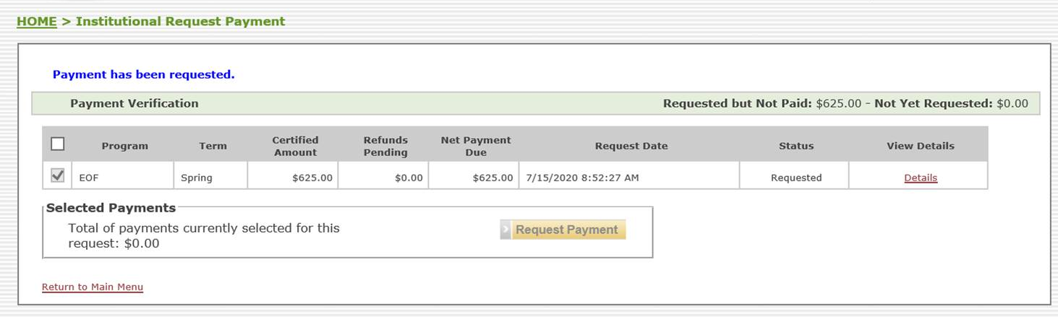
Institutional Financial Aid Office (FAO) Certification & Payment Request
Each participating institution’s Financial Aid Office (FAO) must certify all EOF students (including Non-Funded) before submitting a request for payment.

Slide 35
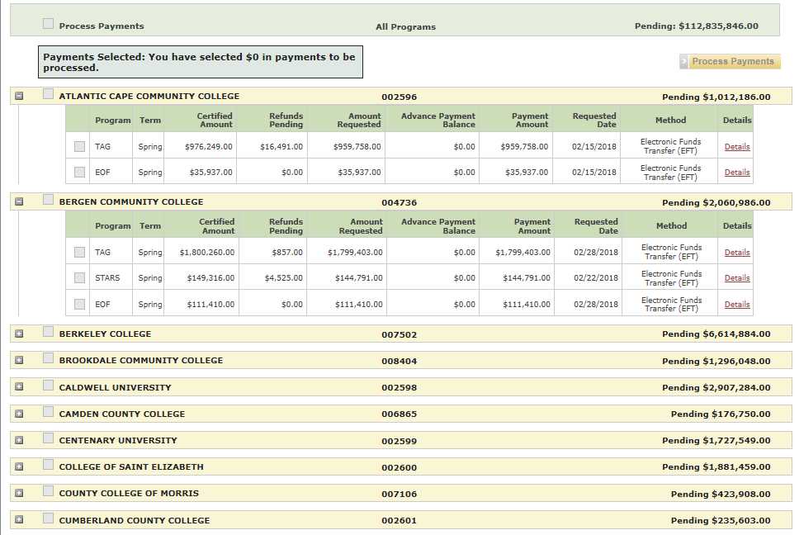
Once FAO has certified and requested payment – OSHE/EOF can move students to paid status.

Slide 36
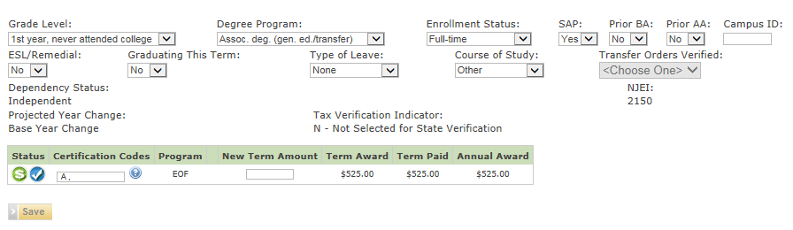
Students should now show up as “Paid”

Slide 37
Reminder: EOF AY UG Grant Award is a range
EOF Undergraduate Awards for Full-time and Part-time students (2023-2024 Academic Year) Minimum semester award = $100 * = award amount is based on whether the student is a residential or commuter student
 |  | Full-time Maximum Annual/Semester | Part-time (6-8 credits) Maximum Annual/Semester | Part-time (9-11 credits) Maximum Annual/Semester
Community Colleges |  | $1,600 annual max./ $800 semester max. | $1026 annual max./ $513 semester max. | $1,312 annual max./ $656 semester max.
Independent College and Universities |  | $3,050 annual max./ $1,525 semester max. | $1,750 annual max./ $875 semester max. | $2,400 annual max./ $1,200 semester max.
State & Research Colleges and Universities* | Commuter: | $1,950 annual max./ $975 semester max. | $1,350 annual max./ $675 semester max. | $1,650 annual max./ $825 semester max.
 | Residential: | $1,950 annual max./ $975 semester max. | $1,350 annual max./ $675 semester max. | $1,650 annual max./ $825 semester max.

Slide 38
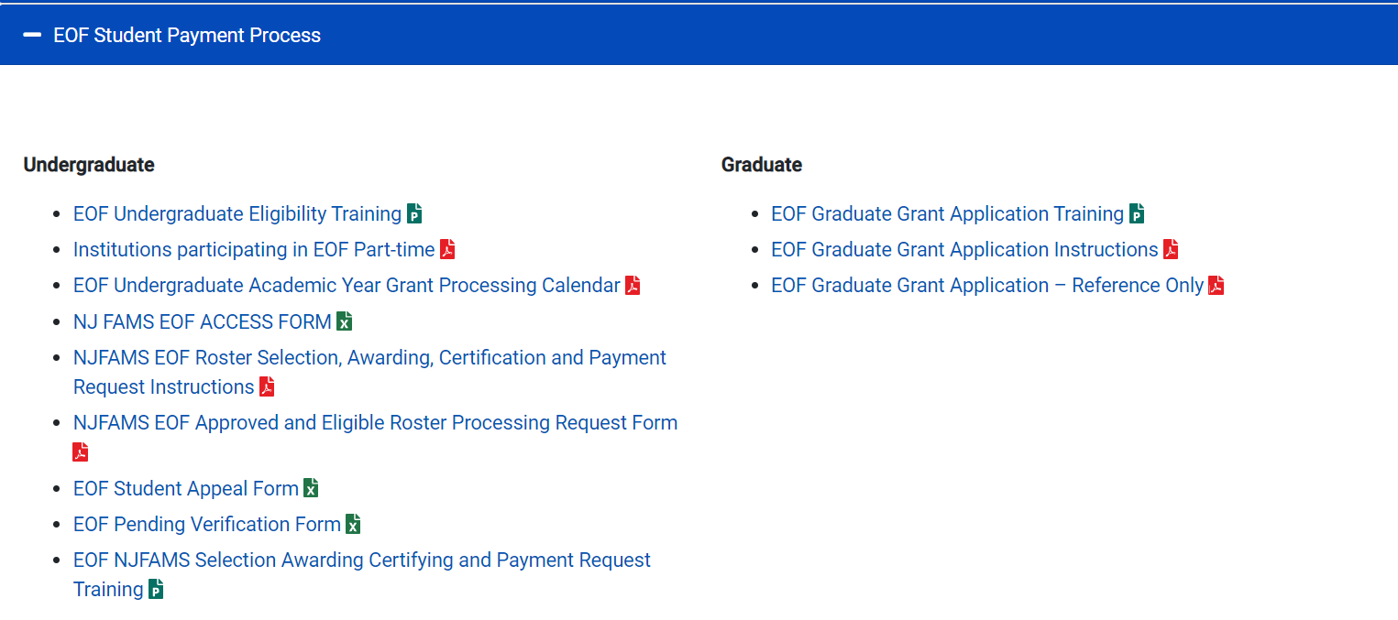
EOF Undergraduate AY Processing Calendar

Slide 39

Institutional Accountability
All participating institutions must adhere to the EOF statewide processing deadlines.
Institution’s that fail to properly adhere to the EOF processing calendar will:
Need to provide in writing why this error/oversight occurred.
How it plans to address and ensure that this error/oversight does not happen again.
Demonstrate how the institution will hold the students harmless (i.e., use institutional funds to cover the EOF grant amount that the institution failed to properly process and request in accordance with the EOF processing guidelines.)

Slide 40
Reminder: EOF Funded vs. Non-Funded
There are only two types of students who participate in the Fund, Funded or Non-Funded:
A student who receives Article III Academic Year grant funds is classified as a Funded student.
A student who has received an Academic Year Article III grant award during a previous academic year but was subsequently found to be financially ineligible can only be supported as a Non-Funded student.
NJ GEAR UP, NJ College Bound, and TRIO Students who do not meet the EOF financial criteria may also be classified and supported as a Non-Funded student.
All other students who do not meet the financial eligibility criteria to receive an initial EOF grant are deemed ineligible for EOF.
EOF Campus programs should consistently review NJFAMS to ensure that you are aware of any students under verification and continue to monitor their status.

Slide 41
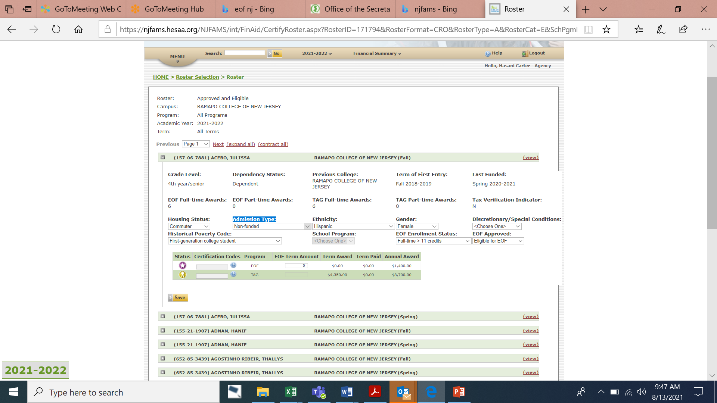
“Awarding” of Non-Funded Students
- Select “Non-funded” from the Admission Type.
EOF Term Amount must be Zero
Select Eligible for EOF under EOF Approved
Note: If the student is financially ineligible but is eligible for Non-funded consideration, an appeal must be sent to OSHE/EOF​

Slide 42
EOF Financial Eligibility Notables (Discretionary Students)
Per 9A:11-2.3(h) of the EOF regulations, the EOF campus administrator/director has the discretion to admit, up to a maximum of 10 percent of the annual class of initial students as discretionary admits. These admits can have family incomes as high as, but no more than, 281 percent of the Federal poverty guidelines and have assets that do not exceed 20 percent of the maximum income allowance as per the 281 percent of the Federal poverty guidelines per household size, as published annually by the Federal government.
Discretionary admit students shall also meet all eligibility provisions of N.J.A.C. 9A:11-2.2.
As noted within 9A:11-2.3 of the EOF regulations, if an applicant’s reported household income and assets exceeds the maximum allowable limit for EOF for discretionary consideration, then by regulation, the student is financially ineligible to receive an EOF grant award.

Slide 43
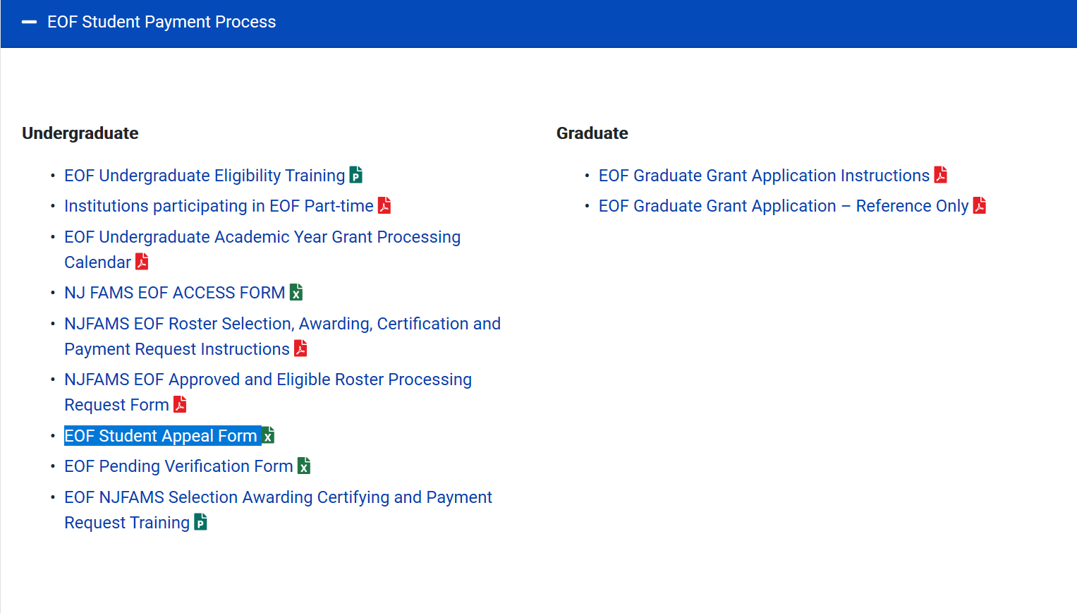
EOF Non-Funded and Discretionary Appeals

Slide 44
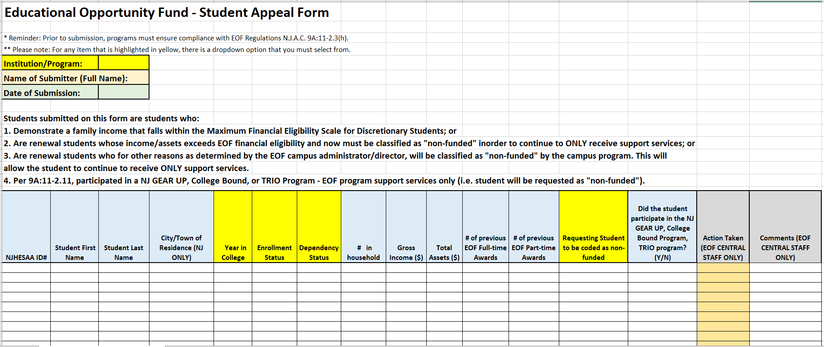
EOF Student Appeal Form
All appeals must be sent directly to your EOF program liaison once the OSHE/EOF office has re-opened the EOF portal for edit access.
Edit access will be restored once the OSHE/EOF office has completed its reconciliation of all AY UG Rosters and has provided each campus program with their appropriate desk audit (End of July/Early August.)
Only an EOF program liaison or the EOF Executive Director has the authority to approve an appeal.
Due to the number of appeals received, programs are limited to 25 students per appeal/per day.

Slide 45
EOF Pending Verification Form
At the conclusion of each semester, if there is a student who is pending verification (federal, state, institution) and has not cleared by the final deadline for EOF campus programs to award students on their roster, the EOF campus program must submit the name of the student and the appropriate information to OSHE/EOF on the Pending Verification Form. (Note: Do not send this form at the beginning of the semester)
This is especially important during the Spring term due to the Fund’s lack of carry forward ability and the need to sweep all accounts in March.
It is the responsibility of the EOF campus program to monitor and notify OSHE/EOF when a student successfully clears verification.
Programs that fail to properly submit the appropriate information are subject to covering the grant award for each student not properly accounted for.

Slide 46
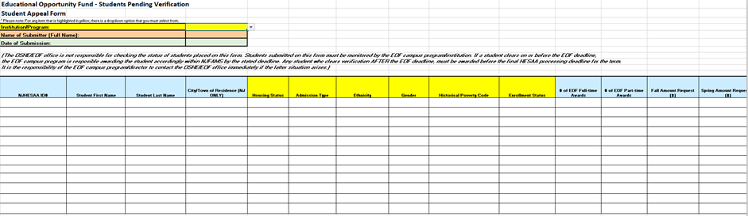
EOF Pending Verification Form

Slide 47
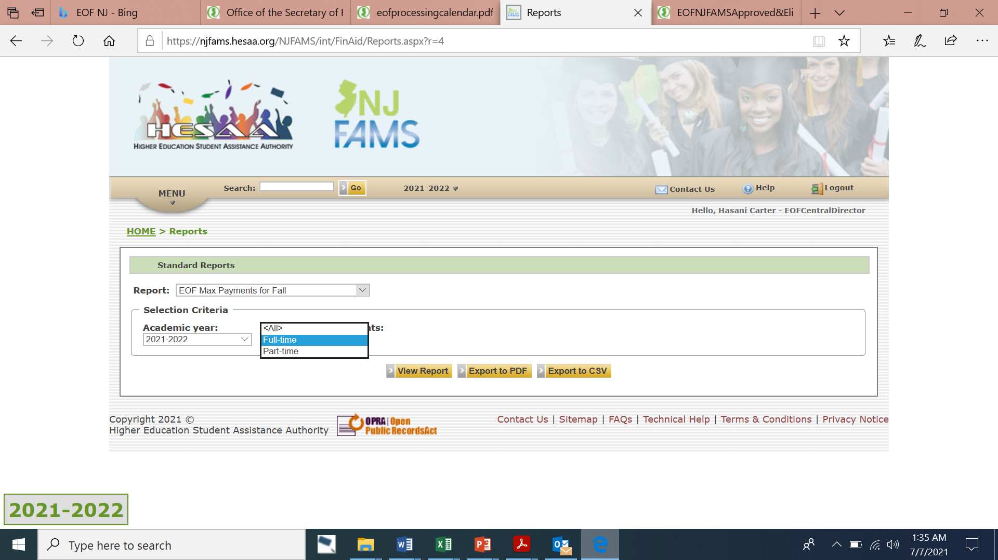
Max EOF Payment Report – FAO Portal

Slide 48
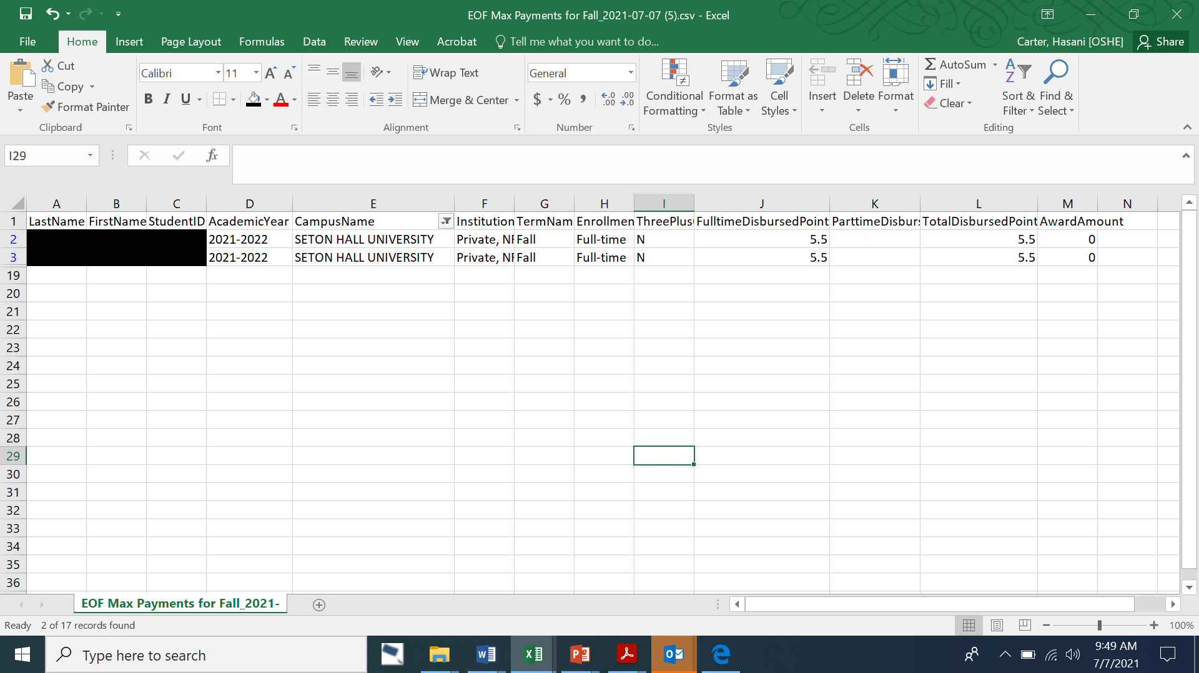
Max EOF Payment Report (Full-time)
– FAO Portal

Slide 49
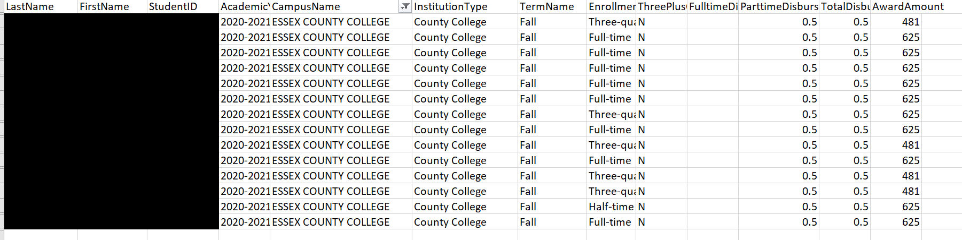
Max EOF Payment Report (Part-time)
– FAO Portal

Slide 50
Disbursement of Academic Year Funds

Slide 51
Disbursement of AY Art. III
Undergraduate Student Grant Funds
Institutions should divide their academic year Article III allocation in half (think Fall and Spring semester)
For the fall term, institutions will receive an advance payment = 75% of the first half of their allocation in the early portion of the Fall term. (Typically in September)
The Final Fall disbursement will be based on the campus program’s “Paid” roster after the Final Roster Certification period. (Typically in January)
Spring semester advance payment will = 75% of the total Article III funds paid to the institution for the fall semester. (Typically in January)

Slide 52
Roster Processing Reminders
Unlike HESAA, EOF does not have carry forward language. This is why there are differences in our roster processing deadlines.
The OSHE/EOF office must sweep all accounts during the Spring term (End of March/Early April) and use the remaining balance of EOF Art. III and IV funds to help front fund the EOF Summer Program.
If an institution submits a payment request after the EOF payment request deadline for students who do not appear on the pending verification form this payment may not be honored. The institution must provide in writing the justification for this late request. If funds are available, the OSHE/EOF office will consider this request. However, this is not guaranteed. An institution may be held accountable for covering this payment due to failure to properly account for your students and adhere to the EOF payment processing procedures.
It is very important for an institution to develop the appropriate internal process and procedures to help prevent any roster processing errors.

Slide 53
Other Notables and Reminders:
When contacting OSHE/EOF for assistance with a student, you must include:
  Student’s HESAA ID#
  Description of the issue
  Any appropriate demographic & enrollment information
  Amount ($) to be awarded (if no amount is given, OSHE/EOF will only award $100)
EOF vs. HESAA related issues that can be resolved by OSHE/EOF.
Financial Aid should not use the EOF refund roster to accurately know the total amount owed to OSHE/EOF. This is due to how we remit payment using the “Paid” roster. Do not send any refunds for a particular academic year until after you have received your Academic Year Desk Audit.
NJFAMS is a useful tool for recruitment purposes. It should not be used as the primary source for recruitment.
Participating institutions/EOF campus programs are responsible for accurate management of your program roster. This includes the accuracy of the roster and the personnel who should have access.
Submission of Pending Verification form is the responsibility of the EOF campus program Director.
Final Enrollment Reports are used for the completion of the EOF Annual Report

Slide 54


Slide 55


Thank You!
We look forward to working with you

