Slide 1
EOF Undergraduate Eligibility Training
Conducted by:
OFFICE OF THE SECRETARY OF HIGHER EDUCATION (OSHE)
Educational Opportunity Fund (EOF)

Slide 2
OSHE/EOF Central Office Staff
NJ OSHE EOF Central Office
Dr. Hasani Carter ​
Hasani.Carter@oshe.nj.gov ​
​
Peter Collazo ​
Peter.Collazo@oshe.nj.gov ​
​
Hema Patel​
Hema.Patel@oshe.nj.gov​
​
Dr. Stephanie Shanklin​
Stephanie.Shanklin@oshe.nj.gov
NJ OSHE Finance
​Tiffany Hazzard
Tiffany.Hazzard@oshe.nj.gov​
Kelechi Unegbu
Kelechi.Unegbu@oshe.nj.gov

Slide 3
Agenda
Overview of the Mission and Purpose of EOF
EOF Undergraduate (UG) Recruitment and Admission Process
EOF UG Eligibility Requirements
EOF Transfer Students and NJ Dreamers
NJFAMS Verification
Discretionary/Non-funded Appeals
EOF Summer/Winter Session, Part-time vs. Non-Funded, NJ GEAR UP, NJ College Bound and TRIO students

Slide 4
Overview:
Mission and
Purpose of EOF

Slide 5




NJ Educational Opportunity Fund
New Jersey Educational Opportunity Fund created by law in 1968
For students from educationally and economically disadvantaged backgrounds attending institutions of higher education in NJ
EOF Provides
Student support services
UG summer bridge program, advising/counseling, tutoring, developmental coursework, academic enrichment activities, student leadership development
Financial Assistance

Slide 6
Recruitment/Admission

Slide 7
General Overview: EOF Recruitment,
Eligibility and Admission
Conduct EOF recruitment and admission at the campus level.
  OSHE/EOF does not make any admission decisions but can help with verification questions.
Develop an action plan to recruit and admit eligible students, including transfers, for participation in EOF.
Develop year-round outreach and recruitment efforts.
Ensure that institutional requirements for admission into the EOF campus program are publicly available and shared with the external community.
Inform applicants that they have the right to appeal their admission decision if they believe there was a misapplication of the EOF regulations, as it pertains to their eligibility for the Fund.
Each participating institution shall provide for the campus EOF administrator/director to participate actively in all institutional policy making that affects the EOF program and its students, including academic standards, recruitment, and retention. - 9A:11-4.4(h)

Slide 8
EOF Admission, Eligibility, and Contact Information
Review the accuracy of online information and within any printed materials regularly.
Use accurate language to communicate with prospective students.
Assist the OSHE/EOF Central Office in maintaining accurate admission requirements and contact information on the OSHE website.
View the contact information for each of our Public Research Universities, State Colleges and Universities, Community Colleges, and Independent Colleges and Universities and campus programs.

Slide 9
Criteria for Admission
Each institution shall develop clearly defined criteria for the admission of students, consistent with the EOF mission, scope, purpose, student eligibility, and student transfer procedures
Such criteria shall be available to secondary schools and community organizations in the recruitment region.
EOF admissions criteria shall be derived from a combined assessment of qualitative and quantitative indices.
Qualitative indices: personal interviews, employment history, volunteer and student leadership experiences, and letters of recommendation from knowledgeable community leaders.
Quantitative indices: student aptitude test scores, high school transcripts, institutional entrance and placement tests, and writing samples.
Regulation: 9A:11-4.6

Slide 10

Student Eligibility-Broad Assessment
An eligible initial, first-time, full-time undergraduate shall exhibit evidence of the potential to succeed in college, but may need the following:
  Academic preparation to gain admission under an institution's regular admission standards (where applicable), such as standardized test scores that are below the institutional norms
  Improved basic skills, additional academic support, or additional preparation for a desired degree program
*Note: Students who typically meet regular admission standards and have excelled academically while in high school may fall into this category due to their need to receive additional academic support (i.e. advising, tutoring, etc.) while in pursuit of their degree.
Regulation: 9A:11-2.2

Slide 11
Historical Poverty
To be eligible, a student must demonstrate a history of poverty, which includes:
Documented, long-term economic hardship of the family, such as the accumulation of assets that do not exceed 20 percent of the EOF financial eligibility scale, per household size.
-N.J.A.C. 9A:11-2.3(a)
The inability to provide more than the basic needs of family members, as evidenced by at least one of the following:
Attended/graduated from a school district where 40% or more of enrolled students are eligible for free/reduced price lunch program
Resided in a municipality that is a high-distress/labor surplus area or an eligible urban aid municipality
Resided in area that has historically been populated by low-income families
Resided in areas called a “pocket of poverty,” with characteristics of a high-distress/labor surplus area, even if municipality is not formally identified
Qualified as a first-generation college student who is, or whose family is, eligible for government assistance and/or educational programs targeted toward low-income and disadvantaged populations (TRIO programs, free and reduced breakfast/lunch programs, Supplemental Nutrition Assistance Program (SNAP), formerly food stamps)
Completed a NJ GEAR UP, NJ College Bound, or TRIO grant program

Slide 12
EOF Eligibility, Admission, & Communications
Students should know the difference between an institutional requirement versus an EOF statewide requirement.
Institutions should inform students about their eligibility, especially their rank within funding priorities and the availability of EOF Art. III grant funds.
Institutions should provide applicants the specific reason for their ineligibility or denial into the program.
If a candidate is placed on a waitlist, they should be informed and offered a date regarding their acceptance status in the program.
Institutions/EOF campus programs should refrain from telling an applicant, “you are ineligible for EOF.”
Generalized statements can lead applicants to believe that they are ineligible for EOF (statewide), which may be inaccurate.
Encourage applicants to look at all NJ institutions that have an EOF program if they are not admitted into your campus program, especially if they are actively seeking admission into an EOF program (independent of institutional choice).

Slide 13
Allocation Based Enrollment Approach
EOF does not use a “slot” based enrollment approach.
Slot based enrollment reflects a program that supports a pre-determined number of students in a program.
EOF uses an “allocation” based enrollment approach.
Allocation based enrollment reflects a program that supports as many students as possible based on the program’s available resources.
The total number of students in the program can be impacted by the number of students who receive a maximum award.
The allocation model allows for enrollment to be driven via the exhaustion of the program's available allocation.

Slide 14
EOF Eligibility

Slide 15
Student Eligibility
To be initially eligible for an EOF undergraduate Article III grant, a student must demonstrate that they:
1. Have a high school diploma or GED.
2. Meets Tuition Aid Grant and Garden State Scholarship programs’ rules governing residency and noncitizens and resident aliens. -N.J.A.C. 9A:9-2.2 and 2.3
3. Meets the financial criteria established in N.J.A.C. 9A:11-2.3.
4. Is admitted to and intends full-time enrollment and matriculation in a curriculum leading to an undergraduate degree or certificate at an institution participating in the Fund.
The Fund is not intended for a student whose primary educational goal is to complete an adult basic education curriculum or attain language proficiency. | Degree and certificate programs shall require a minimum of 24 semester hours or the equivalent and be at least one academic year in duration.
Regulation: 9A:11-2.2

Slide 16
EOF Undergraduate Student Eligibility
Demonstrate an educationally and economically disadvantaged background
Be a New Jersey resident 12 consecutive months prior to receiving the award
Apply and be accepted to a participating New Jersey college or university
Meet the academic criteria as set by the institution of choice
File a Free Application for Federal Student Aid (FAFSA) or the New Jersey Alternative Financial Aid Application
Gross Income and Assets must fall within the EOF financial eligibility range Office of the Secretary of Higher Education- EOF Eligibility.

Slide 17
EOF Funding Priorities
Based on an institution’s annual academic year EOF Article III appropriation, student grant funds shall be awarded to eligible students in the following priority order:
Renewal students who were funded during the PREVIOUS academic year;
First-time, full-time freshmen;
Students that have earned 24 or more college credits while in high school or who participated in a dual enrollment program and have earned an associate’s degree as part of their high school graduation requirements and have no prior history of EOF funding support;
EOF transfer students who received an EOF student grant at their previous institution, in the preceding academic year;
Renewal students readmitted or returning who did not receive funding the prior academic year; and
Eligible students who do not fall into any of the other four categories listed above.
Note: These are not admission priorities. Beyond the financial and residential requirements outlined within the EOF regulations, all participating institutions must also make publicly available its institution-based admission requirements.

Slide 18
Initial Article III Student Grants
Use NJFAMS to verify student financial eligibility for any undergraduate student admitted into the EOF.
The institution must continue to have a copy of the appropriate financial documentation for 7 years
Retain tax transcripts/documentation for any student admitted for the Fall 2023 term and prior.
Any student who is a participant in the Fund shall provide the required documentation to verify their financial eligibility, if requested by the Office of the Secretary of Higher Education/EOF Central Office or the Higher Education Student Assistance Authority.
Regulation: 9A:11-2.3

Slide 19
Eligibility Limitations
Students shall not receive assistance under the programs administered by the Board if they owe a refund on a grant or scholarship previously received from a State or Federal program through any institution or are in default on any loan made under any State or Federal student financial assistance program at any institution.
  Students may receive State financial assistance if they make satisfactory repayment arrangements with the appropriate office. ​
Students attending out-of-State institutions are not eligible for Article III undergraduate grants. ​
Regulation: 9A:11-2.2

Slide 20
Automatically Eligible
The following students are automatically eligible for EOF eligibility consideration but must meet the financial guidelines to qualify to receive an EOF Article III grant:
NJ GEAR UP Participant
NJ College Bound Participant
NJ TRIO Program Participant
If a NJ GEAR UP, NJ College Bound or NJ TRIO student does not meet the EOF financial criteria, they are eligible to be admitted and participate in the EOF Pre-First year summer program.
During the academic year, they can only receive support services.
They cannot be given an Art. III UG grant.
This student would be considered “Non-Funded.”

Slide 21
Dual Enrollment or Advanced College Prep Programs
EOF program applicants who have earned 24 or more college credits while in high school or earned an associate’s degree as part of their high school graduation requirements are eligible for participation in the pre-first year summer program.
If a student has earned an Associate’s degree, they are ineligible to receive EOF funding to obtain another Associate’s degree or certificate.
- 9A:11.2.8
These students must be considered for the EOF program based on the EOF Article III, student grant funding priorities outlined at N.J.A.C. 9A:11-6.1(h), and if they meet the eligibility requirements set forth at N.J.A.C. 9A:11-2.2 and 2.3.
Regulation: 9A:11-5.4(c)

Slide 22
NJ Dreamers
State of NJ - Office of the Secretary of Higher Education
NJ Dreamer applicants must meet all the requirements of P.L. 2018, c. 12 to qualify for State aid:
Attended a New Jersey high school for at least three years
Graduated from a New Jersey high school or received the equivalent of a high school diploma in New Jersey
Prior to April 2022 only: registered for selective service, if required by federal law
Student must file an affidavit stating that they have filed an application to legalize their immigration status or will file an application as soon as they are eligible to do so
Students who hold a T or U visa who are not eligible non-citizens must meet the requirements of The Law P.L. 2018, c. 12. U and T Visa Certifications | U.S. Department of Labor

Slide 23
EOF Eligibility: Part-time
The number of part-time payments is cumulative.
Max # of part-time payments in pursuit of an associate degree = 3 payments
Max # of part-time payments in pursuit of a baccalaureate degree = 4 payments
Institutions may award Article III part-time grants to no more than 10% of their total EOF funded population in any given semester (9A:11-2.9(e)).

Slide 24
Duration of Eligibility
The number of semesters of Article III grant payment is cumulative.
EOF students shall be eligible for no more than 12 semesters of UG payment over the course of their entire undergraduate career.
Exception: Students enrolled in a five-year undergraduate course of study at a senior institution. These students are eligible for an additional 2 semesters upon written formal request and approval from the EOF Executive Director.
Under no circumstances shall a student receive more than 14 semesters of Article III Undergraduate payments to earn a baccalaureate degree).
Students enrolled in a county college who are in pursuit of an associate’s degree may receive a maximum of 8 semesters of Article III Undergraduate payments.
Students are ineligible to receive EOF funding support to earn a degree at a level they have already achieved.
An initial Article III undergraduate grant cannot be given to a student in the last two semester of baccalaureate study, nor shall a student receive an initial Article III grant during the winter.

Slide 25
EOF Eligibility: Non-Funded Students
A student who receives Article III academic year grant funds is classified as FUNDED student.
A student who received an academic year Article III Grant award during a previous academic year, but is now financially ineligible can only be supported as a NON-FUNDED student.
NJ GEAR UP, NJ College Bound, and TRIO students who are not financially eligible may also be classified as NON-FUNDED.
A student who has received an Academic Year Article III grant in a previous semester and remains financially eligible may be supported as a NON-FUNDED student (at the program’s discretion) due to not adhering to program requirements.
All other students who do not meet the financial criteria to receive an Initial grant are ineligible for EOF and may not be supported as a non-funded student.

Slide 26
EOF Financial Eligibility Notables
A dependent student’s income and assets shall not be considered in the gross household income.
Eligibility for TAG should not be automatically associated with eligibility for EOF.
An applicant whose household receives Temporary Assistance for Needy Families (TANF) and/or Supplemental Social Security Income (SSI) as the sole means of support are eligible regardless of the amount of such support.
In determining financial eligibility for an Article III student grant, separation or divorce, or the disability or death of a wage earner for the academic year for which eligibility is being determined, with a concomitant decrease in household income below the EOF Income Eligibility Scale, does not automatically satisfy the financial eligibility requirement.
If an applicant believes that their reported household income and/or assets are not accurately reflective of their current financial profile, they will need to work with the institution’s financial aid office and HESAA to rectify this matter. OSHE/EOF does not make or review any adjustment appeals.

Slide 27
NJFAMS Verification

Slide 28
Reminder - EOF New Jersey Financial Aid Management System (NJFAMS) Portal Access
The EOF NJFAMS Portal is the primary means for all EOF UG AY campus programs to manage your EOF UG AY program roster.
EOF campus program directors should be aware of who has access to the EOF NJFAMS portal for your institution.
Two kinds of access may be granted with the NJFAMS EOF ACCESS FORM:
View Only or Edit
When a staff member who has been granted access to the EOF NJFAMS portal leaves their position/institution, it is the responsibility of the EOF campus program director to inform the OSHE/EOF Central Office of the need to remove the staff member’s access. This is also the case even if the staff member does not work directly in your office.
EOF campus directors who need an up-to-date list of who has EOF NJFAMS portal access at your institution should contact either your EOF program liaison

Slide 29


NJFAMS Verification
When reviewing a student in NJFAMS, it is important to verify the student’s eligibility information and ineligibility reason(s).
Not all ineligibility reasons require an override by OSHE/EOF. Some may be managed by the campus program. (i.e. EOF Not Approved at this Campus).
There are some ineligibility reasons that OSHE/EOF can override and there are some that we cannot.
As the parameters for EOF eligibility continue to change, it is important to be aware of this information so that the student can be processed accordingly.
To properly complete the Discretionary/Non-Funded Appeal form, you must know how to properly navigate NJFAMS.

Slide 30
Verification of Financial Eligibility
As noted earlier, to be eligible for an undergraduate EOF grant, a student must demonstrate a history of poverty, which generally includes documented, long-term economic hardship of the family.
Students must be reviewed for eligibility. Institutions may use NJFAMS data for household size, annual income, untaxed income, and assets.
For dependent students – programs must only review the parent(s) or guardian(s) financial information. Do not include the student/student spouse's financial information.
For independent students – programs must only review the student and student spouse's financial information. Do not include the parent(s)/guardian(s).
Annually, programs are responsible for reviewing the continued eligibility of all awarded students (initials and renewals).
Regulation: 9A:11-2.5

Slide 31
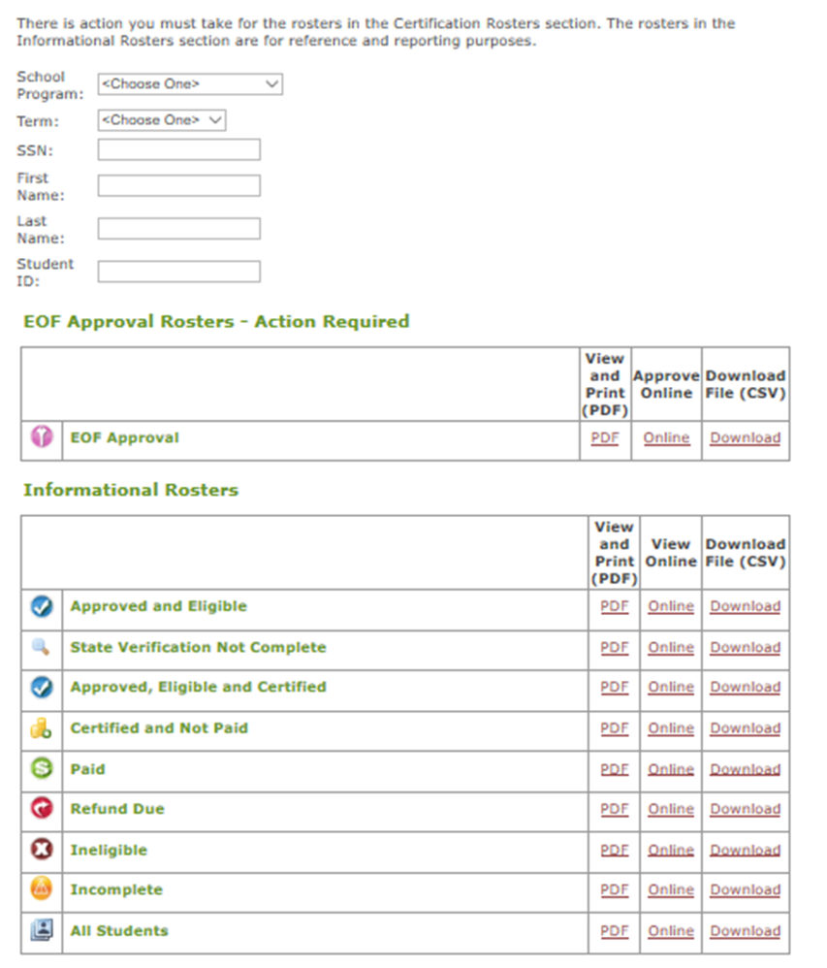
EOF Rosters
Look for eligible Initials and Renewals who were not on the program’s roster as of the Fall term of the previous Academic Year. Also a source to find financially eligible students who may already be enrolled at your school.
Click "Online" to see a list of students
Renewal students who appeared on a program’s roster during the Fall term of the previous Academic Year & who remain eligible should appear here. ​
Ineligible students BUT EOF discretionary & some Non-funded eligible students may appear here.
Recommended roster to use to locate any student.

Slide 32
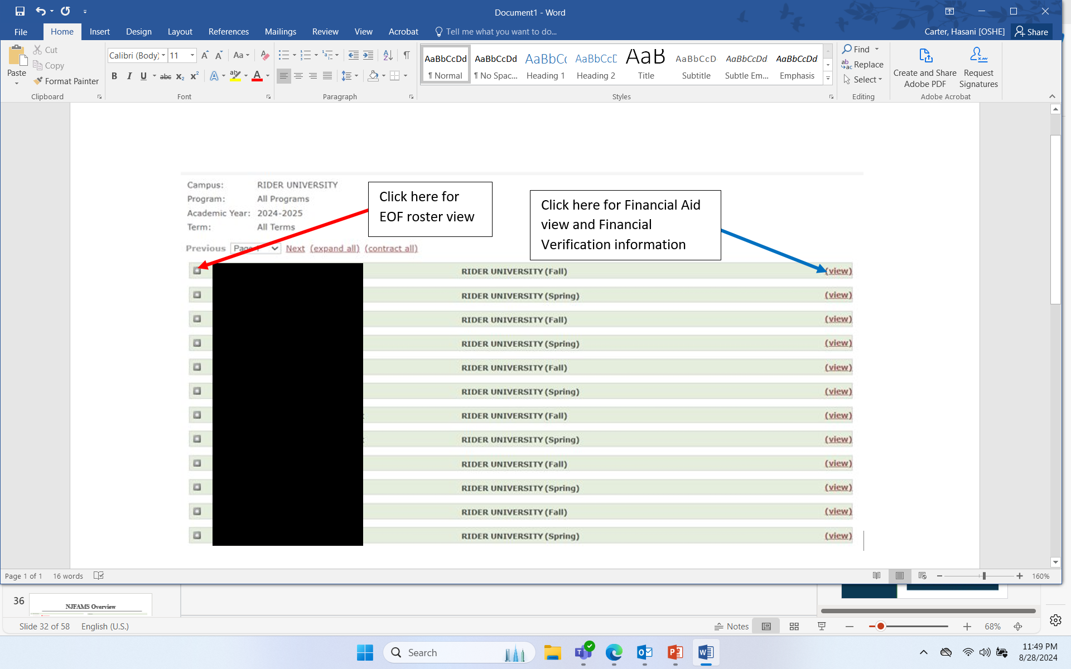
Rosters: Discovery & Troubleshooting

Slide 33
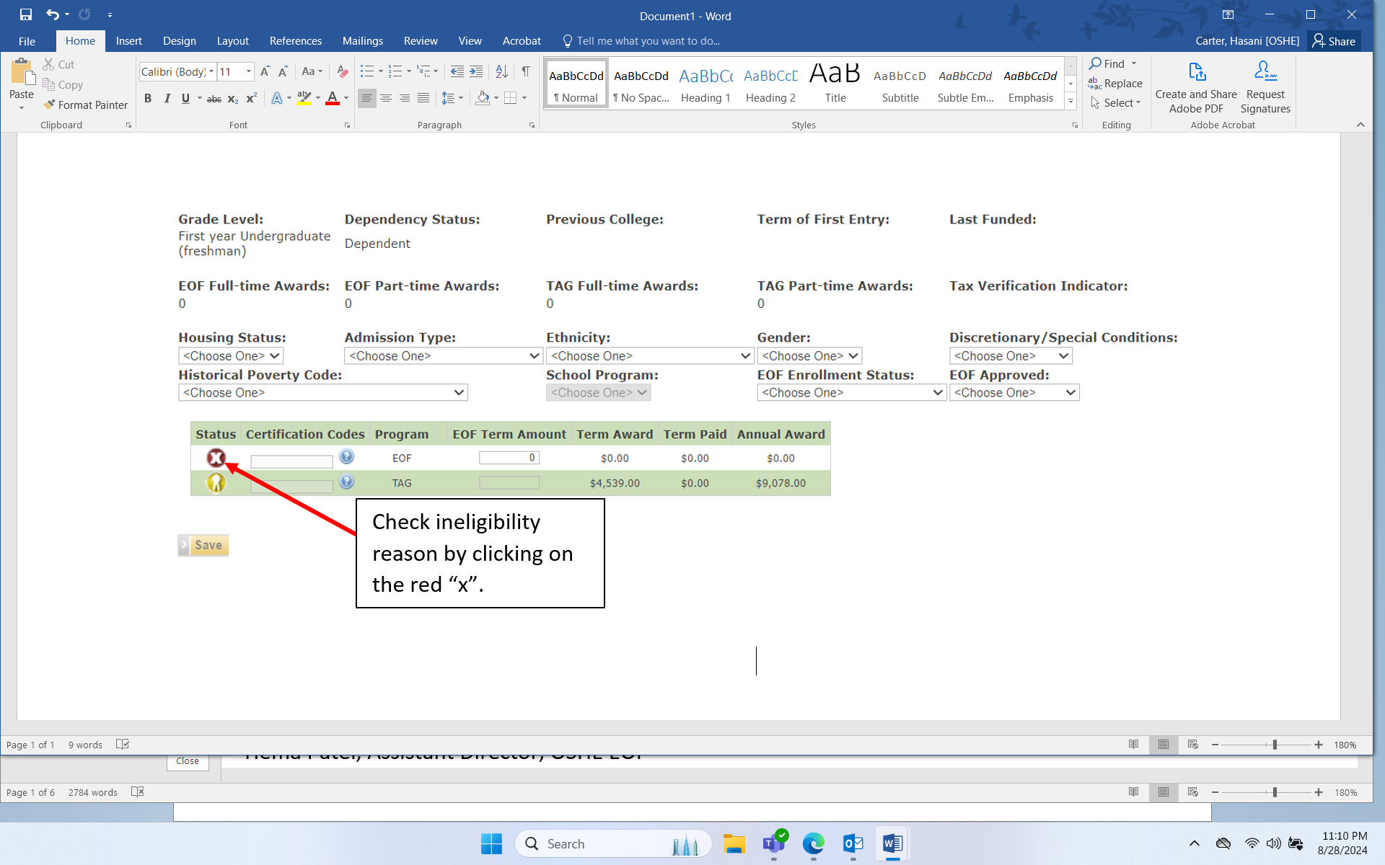
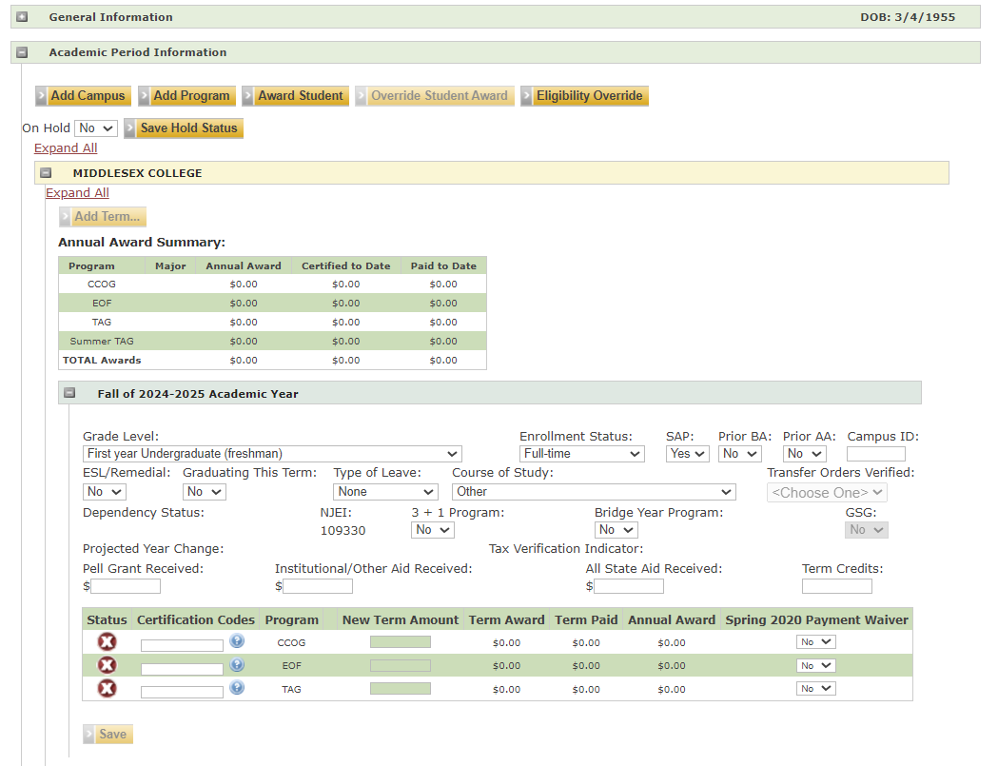
Verification of Ineligibility Reason(s)
EOF roster view:
Financial Aid side:

Slide 34
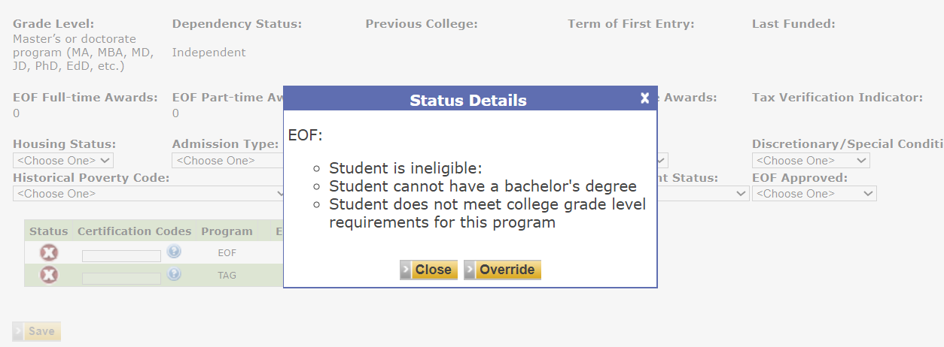
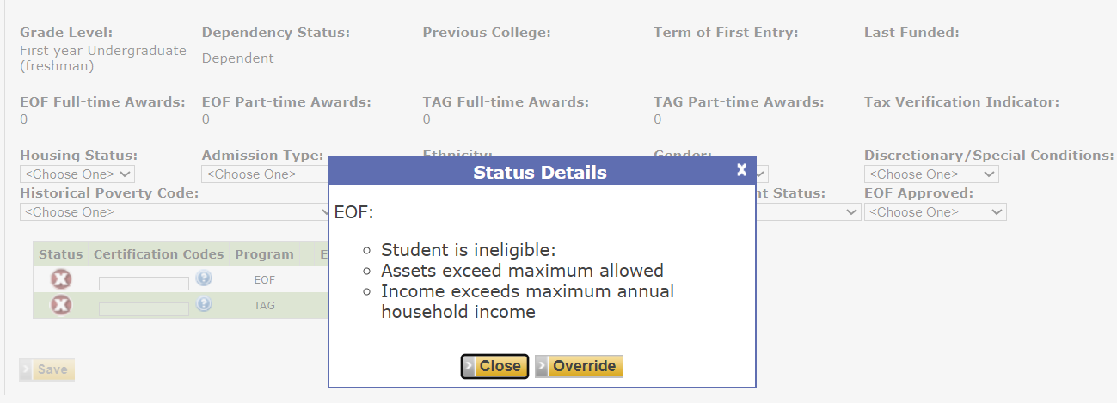
Verification of Ineligibility Reason(s)
Example 1
Example 2

Slide 35
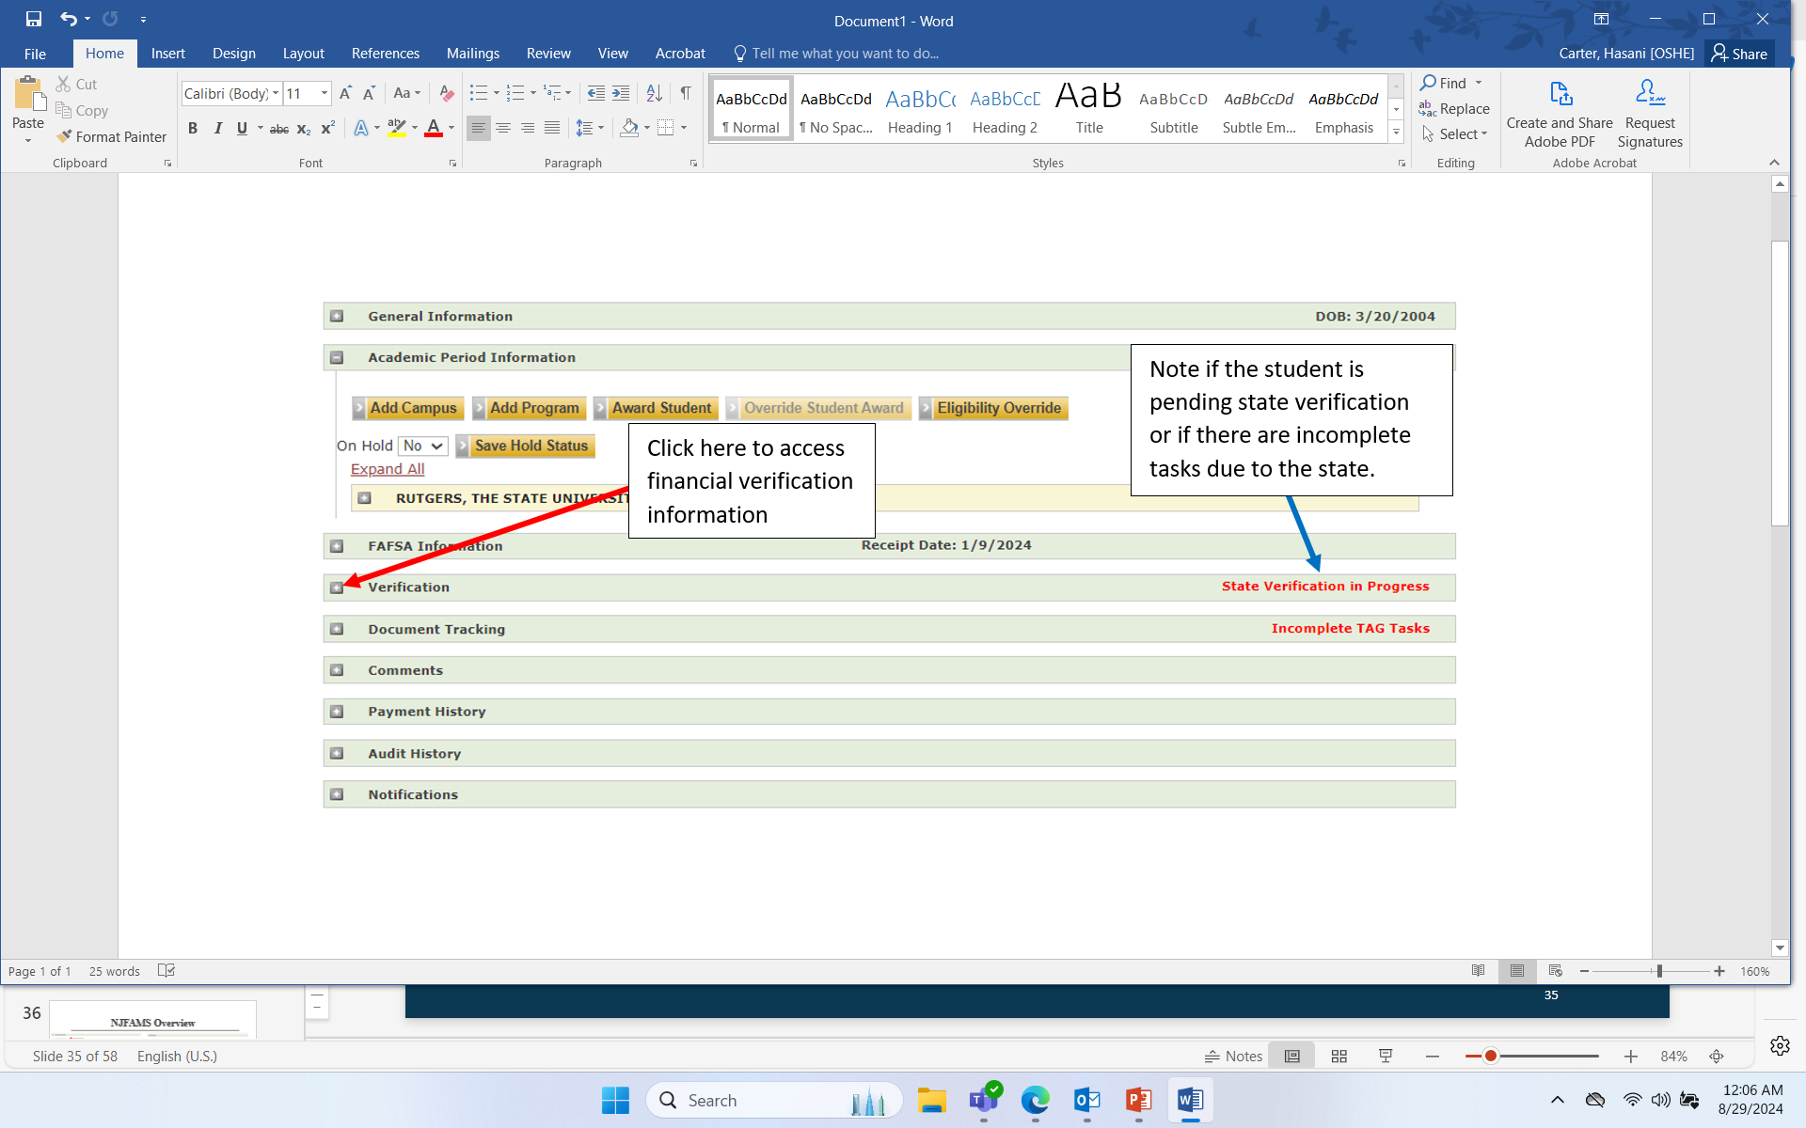
NJFAMS Financial Verification
(Only available via Financial Aid side)
General Information: provides basic student information (address, email)
Academic Period Information: section that allows the Financial Aid Office to code data such as enrollment (credits must match “EOF Enrollment Status” credits for certification), enter TAG/CCOG/GSG award amounts, etc.), certify your roster, etc.
FAFSA Information: Shows date of FAFSA submission. You can access ISIR for family size
Verification: THIS IS WHERE YOU CHECK EOF ELIGIBILITY. view the financial information needed to complete the Discretionary/Non-Funded appeal form
Document Tracking: Shows documents are that are missing or have been submitted to HESAA for verification
Payment History: Shows a history of EOF and TAG payments
Notifications: Allows you to view notifications sent to student from HESAA
If the student has been selected by the State for verification, you can not submit an appeal for them until this process has been completed.

Slide 36
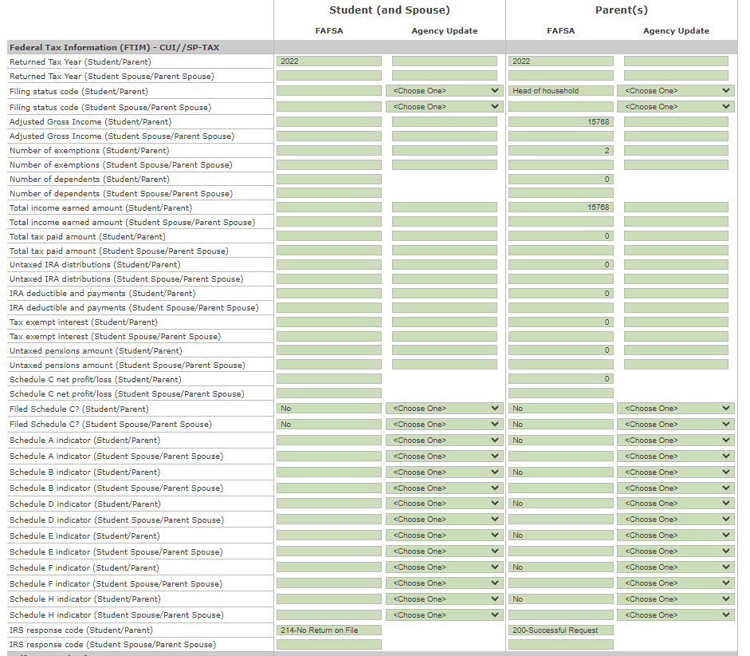
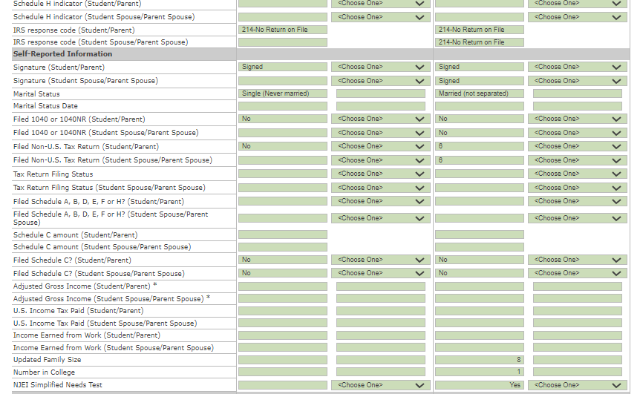
NJFAMS Overview: Verification Sections
Check Code
Student may have submitted FAFSA in 2 ways:
FTIM: Federal Tax Information pulled from IRS retrieval tool left image)
Self-Reported Information Student put in values on FAFSA manually, as done in the past (right image)
In FTIM section, IRS response code matters for income calculations
  200: Use FTIM data
  214/any non-200 number/or blank: Use Self-Reported Information
2 rows for data points
  “Student/Parent” and “Student Spouse/Parent Spouse” indicates which column is reference point, based on dependency status

Slide 37
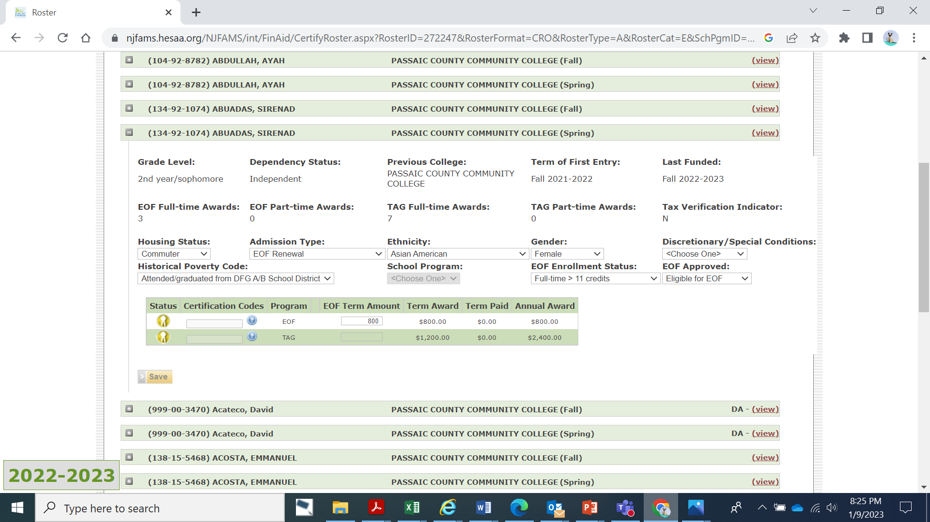
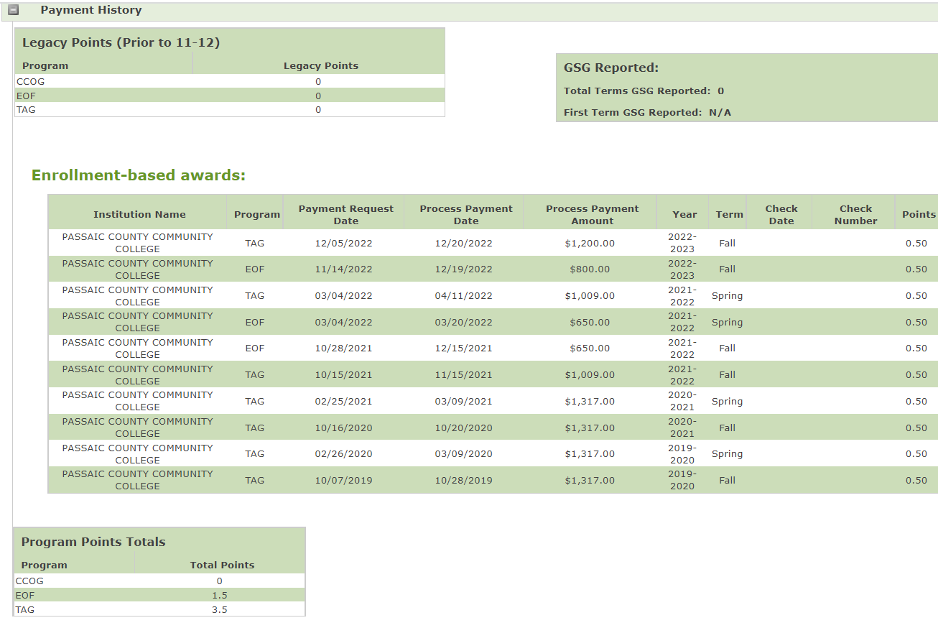
NJFAMS Payment History
To locate the number of EOF payments a student has received, you can either view this information from the EOF roster or from the “Payment History” tab from the financial aid view.
EOF Roster:
Financial Aid view:

Slide 38
Discretionary/
Non-funded Appeals

Slide 39
Discretionary Scale
The EOF campus administrator/director has the discretion to admit up to 10% of the annual class of initial students in the Discretionary Range
  These students may have a family income that is 281% above Federal poverty guidelines, and have assets that do not exceed 20% of the maximum income allowance per household size, as published annually by the Federal government.
  Discretionary admit students shall also meet all eligibility provisions of N.J.A.C. 9A:11-2.2
If an applicant’s reported household income and assets exceeds the maximum allowable limit for discretionary consideration, then by regulation, the student is financially ineligible to receive an EOF grant award.
Regulation: 9A:11-2.3​

Slide 40
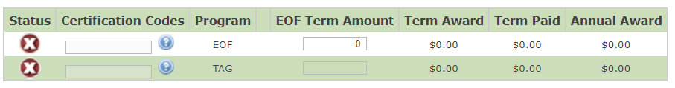
Non-Funded Appeals
Non-Funded appeals should only be submitted for students who appear as ineligible in NJFAMS. If the student appears in “Qualified” or “Awarded” status and has a history of receiving an EOF Article III undergraduate grant, then the program does not have to include this student on the Non-Funded appeal form.

Slide 41
APPEAL FORM
HESAA ID# | First Name | Last Name | Year in College | Enrollment Status | Dependency Status | # in household | Marital Status | Adjusted Gross Income Student/ Parent ($) | Adjusted Gross Income Student Spouse/ Parent Spouse ($) | FTIM Section: Untaxed Pension Only include this information if the IRS Response Code is 200 | FTIM Section: Untaxed IRA Distribution Only include this information if the IRS Response Code is 200 | FTIM Section: IRA Deductible and Payments Only include this information if the IRS Response Code is 200 | FTIM Section: Tax Exempt Interest Income Only include this information if the IRS Response Code is 200 | Untaxed Income Section ($) (Note: If IRS Code is 200, the amounts listed for the areas highlighted columns L-0 on this form may be excluded from this total.) | Child Support | Total Gross Income (Adjusted Gross Income + Untaxed Income) ($) | Total Assets ($) | # of previous EOF Full-time Awards | # of previous EOF Part-time Awards | Requesting student to be coded as non-funded (Y/N) | Did the student participate in the NJ GEAR UP, College Bound,TRIO program? (Y/N) | Action Taken (EOF CENTRAL STAFF ONLY) | Comments (EOF CENTRAL STAFF ONLY)
Additional columns have been added to help clarify how Total Gross Income is calculated.

Slide 42
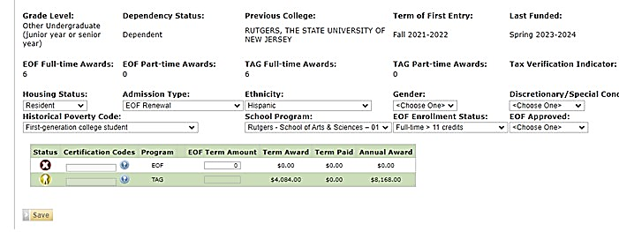
Example: Filling in the Appeal Form
Fill out all demographic data on the EOF Portal Screen before submitting your appeal.
Non-funded students must be coded as "Non-funded" in Admission Type
Use the portal to identify:
  Year in college
  Enrollment status (must match Financial Aid)
  Number of full-time/part-time payments

Slide 43
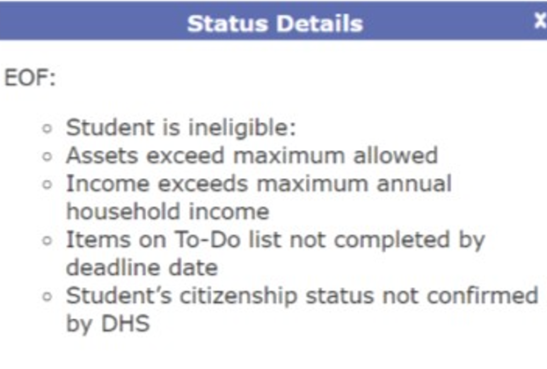
Common Ineligibility Codes that EOF Central Cannot Override
If the student fails to file their FAFSA (or NJ Alternative Financial Aid Application) by the State deadline or fails to submit the required verification documents as requested to the State by any identified deadlines, the student will be ineligible for EOF. (This also means that the student is ineligible to be considered as a Non-Funded student.)
If a student’s residency or citizenship status has not been properly confirmed, the EOF Central Office cannot override this.

Slide 44
Submission Requirements
Discretionary and Non-Funded appeals must be submitted using the updated form to your EOF program liaison with a CC to EOF Executive Director, Dr. Hasani Carter.
Submit your appeals throughout the semester and before the Fall/Spring deadlines. Submit your appeal forms smaller batches (i.e. <25 students per submission).
Programs must continue to monitor your compliance with the 10% discretionary rule for initials. (Please remember that an initial is any student who is receiving their 1st EOF academic year grant. This may include transfer students.)
Programs are responsible for managing the accuracy of their roster.
Due to staffing capacity, the OSHE/EOF Central Office is requesting for programs to be mindful of your roster appeal submission efforts.
Identify Discretionary, Non-funded, SAP students early.
Due to the volume of appeals received, please note that it may take a week or more for our office to review and process a program’s appeal.

Slide 45
Important Reminders
Read EOF Regulations and apply them correctly.
Review all of the information in NJFAMS (i.e. ineligibility reasons, verification information, payment history, etc.).
Read the information within NJFAMS carefully and put the correct information on the appeal form.
Provide the correct HESAA ID# and fill out the appeal form completely.
Stay on top of your program roster throughout the semester and submit your appeals early and regularly to avoid missing or forgetting a student or inaccurately awarding a student in NJFAMS.

Slide 46
Important Reminders (continued)
EOF is the “EDUCATIONAL” OPPORTUNITY FUND.
It is NOT the “equal” opportunity fund.
EOF operates under the Office of the Secretary of Higher Education (OSHE).
It does NOT operate under HESAA.
EOF is NOT an entitlement program.
NJ’s TAG award program is an example of an entitlement program.
EOF is a comprehensive support program. It provides both academic and non-academic support. EOF is NOT a financial aid program.
Institutions must actively recruit EOF students from all areas of the State, NOT just from urban and rural communities. The usage of NJFAMS as the primary means of recruitment is not appropriate.
Institutions are accountable for ensuring compliance with the EOF regulations & must have an up-to-date EOF policies and procedures manual.
$
?

Slide 47
Final Comments
It is important for EOF campus programs to continue to review the financial information provided by the student to ensure financial eligibility. Do not simply rely on NJFAMS.
NJFAMS is a great resource to assist programs with identifying potentially eligible students.
Students can inadvertently make an error when filing their FAFSA that can make them appear as either eligible or ineligible.
If a student is not accepted into your EOF campus program, they should be informed about the reason for their non-acceptance. If the student is ineligible due to institutional reasons, this should be clearly articulated and the student should be informed that this rejection is independent of their eligibility for another EOF campus programs.
The OSHE/EOF Central Office does not make admission decisions. Admission into an EOF campus program is conducted at the campus level.
The OSHE/EOF team is here to assist. If you have any questions, please do not hesitate to contact us.

Slide 48
Resources
OSHE/EOF Website: https://www.nj.gov/highereducation/EOF/index.shtml
EOF Regulations: http://www.state.nj.us/highereducation/EOF/EOF_Program_Resources.shtml
EOF Campus Program Resources Webpage: https://www.nj.gov/highereducation/EOF/EOF_Program_Resources.shtml

Slide 49
If you have any questions please reach out to your liaison.
EOFCampusProgramLiaisonAssignementsAY2022-23.pdf

Slide 50


Thank You!
We look forward to working with you

