Slide 1
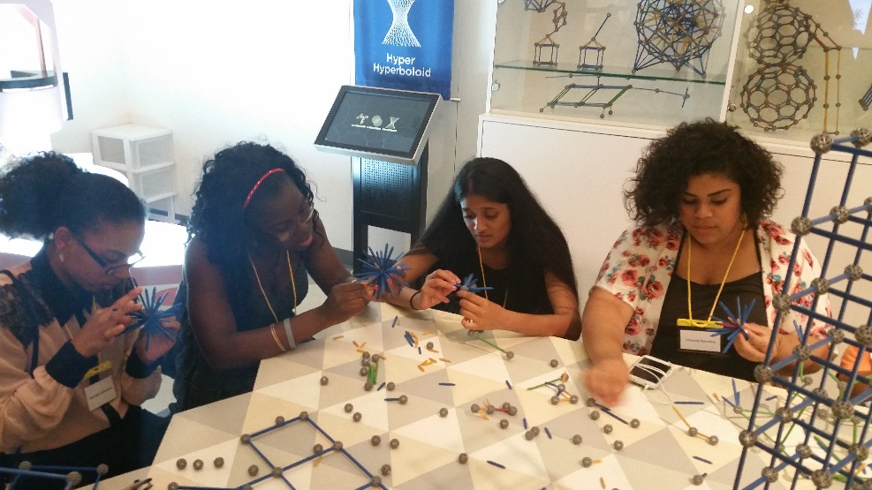
School of Environmental and Biological Sciences
Educational Opportunity Fund (EOF)
New Jersey Office of the Secretary of Higher Education
Educational Opportunity Fund
FY 2017 Article IV
Special Project Grant Report
Presented by:
Jenice Sabb, Ed.D.
Assistant Dean/Director

Slide 2
SEBS EOF
Vision
Promoting academic excellence by cultivating an appreciation for education that transcends the classroom into local and global communities.
Mission
Focused on access, academic excellence, and research, the SEBS Educational Opportunity Fund (EOF) cultivates student capacity to make adaptive changes in their educational development and overcome historic socioeconomic factors that challenge their potential for success. SEBS EOF seeks to provide services that assist students in navigating the complexities of an academic and social climate, within a global environment; and, facilitate an understanding of what is required to succeed in college as a science major at Rutgers. Seeking to produce researchers, scientists, and health professionals, SEBS EOF promotes learning outcomes that positions the program to become a leading producer of first-generation graduates and high achieving STEM professionals.

Slide 3
SEBS EOF Core Values
A.G.R.E.E.
EOF
Excellence
Graduation/Retention
Academic Research Training
EOF History
Notes:
Academic Research Training (A.R.T.) – We promote the enhancement of individual analytical reasoning skills to encourage inquiry designed to engage each student’s thoughtful approaches to addressing societal problems using scientific reasoning; with the expectation that students will enroll in graduate degree studies.
Graduation – We support each student’s desire for academic success creating an environment where educationally purposeful activities focus on removing distractions that hinder graduation.
Retention – We engender an office climate that provides or directs students to resources that will assist with addressing those academic, social, and personal concerns that contribute to student attrition.
EOF History – We promote student understanding of the founding principles and ideas of EOF, hoping to instill a feeling of confidence and sense of belonging for enrolled students.
Excellence – We exude and expect honest, responsible, and ethical behavior as we develop course curriculum that supports student academic success leading to enrollment in graduate school studies.

Slide 4


Slide 5
Building the Well Rounded Student
How the cycle of learning drive EOF academic support
STUDENTS
EOF
General Population
Solid GEMS Chemistry Program
S.T.A.R.T. U.P. Summer Institute
Student Assessment
Academic Courses
Introduction to Research
Residence Life
Academic Year
Counseling
Tutoring
Advising
Workshops
Critical Thinking
Research Opportunities
Biology House Summer
Program
Mapping Academic Thoughts: Quad
MATH QUAD
Knowledge/
Learning
Research
Technology
Research Presentations
Community Service Initiatives
Yale University SURF Program
Students Supporting Students Initiatives
C.O.S.I.N.E.
C.H.E.M.S.
W.I.S.E..
XAE
Administration
Data Collection
Report Generation
Program Evaluation
Alumni Connections

Slide 6

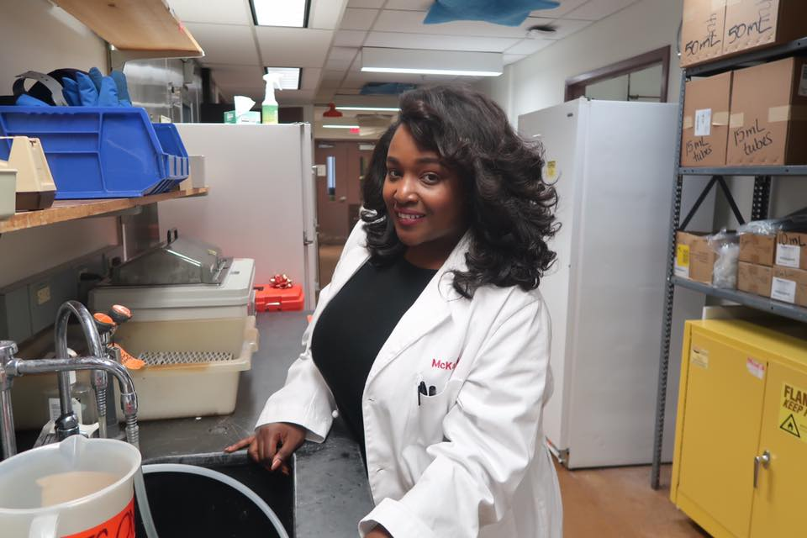
Special Project Request
General Chemistry I
Academic Supplemental Instruction Initiative
ALEKS for Chemistry
RU Researching
Laboratory Experiences

Slide 7

General Chemistry I Academic Supplemental Instruction Initiative
ALEKS for Chemistry

Slide 8

General Chemistry I Academic Supplemental Instruction Initiative
ALEKS for Chemistry
Placement test scores prevent first-year student enrollment in General Chemistry I
Students placed in General Chemistry I earned “DWF” grades and were given the opportunity to ‘drop-down’ to enroll in a more basic chemistry course
Students are unable to declare a science major prior to completing the General Chemistry I & II course sequence
Attempt to deliver chemistry content to meet the students where they are ready to learn to enhance transferrable understanding of chemistry topics
Enhance science enrollment, retention, persistence, and graduation
Why?

Slide 9

General Chemistry I Academic Supplemental Instruction Initiative
ALEKS for Chemistry
Eligible population – N = 32
  9 – Impact of Chemistry (134)
  23 – Drop-downs (161/165)
Participant Selection Method
  Participants opted-in
  Counselor Recommendation
  First-Come First-Served
Demographics
  n = 10
  First-Year Students (FTFT)
  8 Female & 2 Males
  3 (134) & 7 – (161/165)
Participants

Slide 10

General Chemistry I Academic Supplemental Instruction Initiative
ALEKS for Chemistry
Data Collected
ALEKS Assessments/Pie Charts
Course Grades
Evaluation and Survey
Assessment
Attend seven (7) weekly in-class supplemental instruction sessions for 2 hours each session (14 total hours)
Engage in two (2) weekly online sessions for 2 hours each session (28 hours)
Success is determined by students earning a “C” or better
Evaluation Survey (7 students completed the survey)
Data Collection & Assessment

Slide 11
General Chemistry I Academic Supplemental Instruction Initiative
ALEKS for Chemistry
Results
Of the 226 available topics, students progressed through an average of 60 topics (27%)
80% of students earned a “C” or better
Average TGPA = 2.39 (n=10)
  Average TGPA (“C” or better) = 2.71
  Average TGPA (< “C”) = 1.08
Average CGPA = 2.49 (n=10)
  Average CGPA (“C” or better) = 2.77
  Average CGPA (< “C”) = .992
Results & Discussion

Slide 12
General Chemistry I Academic Supplemental Instruction Initiative
ALEKS for Chemistry
Discussion
Overall, students:
  Completed an average of 32.3 hours online
  Attempted an average of 95.6 (42%) of the topics
  Learned an average of 86.0 (38.1%) of the topics
Students who earned a “C” or better completed an average of 37.8 online hours and learned an average of 72.4 topics
Students who did not earn a “C” or better completed an average of 10.3 online hours and learned an average of 48.0 topics
Of the students completing the survey:
  71% completed ALEKS assignments
  57% rarely used ALEKS to study for class assessments
  57% found ALEKS useful
  85% found the instructor knowledgeable and capable of relating chemistry to real world examples
Results & Discussion

Slide 13

General Chemistry I Academic Supplemental Instruction Initiative
ALEKS for Chemistry
Future Consideration
ALEKS must be linked to the actual class
There should be a central location and/or structured time for online assessments and practice
Additional use of online worksheets and quizzes
Compensation to support fiscal concerns given time commitment
Recommendations

Slide 14
RU Researching Laboratory Experiences

Slide 15
RU Researching Lab Experiences
Promote student (particularly first-year) involvement in research activities – to enhance retention and persistence in the sciences
Stimulate student understanding and interest in scientific research as an alternative to the medical profession – demystify research
Promote scientific discovery through the Introduction programs and institutes designed to connect students with faculty to engage in conversations about research
Illuminate and enhance the pathway for URM’s to pursue Ph.D. studies
Enhance opportunities for students to take on leadership roles in promoting scientific research as an option
Why?

Slide 16

Eligible Student Population – N = 168
Participant Selection Method
  Faculty
    Less Popular Majors
    Opted-In
  Student
    Major Declaration/Interest
    Counselor Recommendation
    Courses Taken
    Grades Received
    Opted-in
Demographics
  Faculty - 7
    Animal Science
    Biotechnology
    Biological Sciences
    Ecology, Evolution, and Natural Resources (EENR)
    Environmental Policy, Institute, and Behavior (EPIB)
    Genetics
    Nutritional Sciences (2)
    Public Health
  Students - 9
    2 - first-year, 4 second-year, and 3 third year students
    9 Female (100%)
RU Research
Laboratory
Experiences
Participants

Slide 17
RU Research Laboratory Experiences
Data Collected
Evaluation and Survey
Assessment
Greater understanding of what research entails
Confidence in potential for success in the sciences
Laboratory skills or techniques learned
Interest in research careers
Evaluation Survey
Student Narrative
Data Collection & Assessment

Slide 18
RU Research Laboratory Experiences
Results
Faculty
  57% met with students once per week
  71% were satisfied with the quality of students
  28% wanted more time for engagement
Student
  66% indicated confidence in STEM success
  78% see themselves pursuing research after graduation
  89% indicated success with faculty mentorship
  89% indicated that it was a valuable experience
  100% agree that they are now able to present research findings
Results & Discussion

Slide 19
RU Research Laboratory Experiences
Discussion
Two (2) students were offered research assistant work in the fall (1 paid by the department)
Faculty were engaged and requested more time with students (work throughout the year)
Students gained confidence in their research, communication, and academic skills
Enhanced student exposure to research practices and processes – helping to explore critical questions
Students were able to delve deeper into their major for greater understanding
Results & Discussion

Slide 20
RU Research Laboratory Experiences
Future Consideration
Screen for student personal time constraints (potential conflicts)
Extended time to see results of laboratory experimentation
Offer stipends for students/research competition
Create structured opportunities for researchers to check-in with administration
Create and maintain an online discussion thread for students and faculty to share experiences/concerns
Recommendations

Slide 21
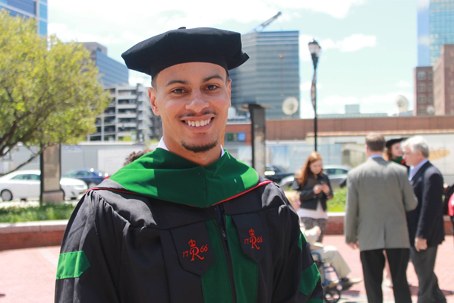
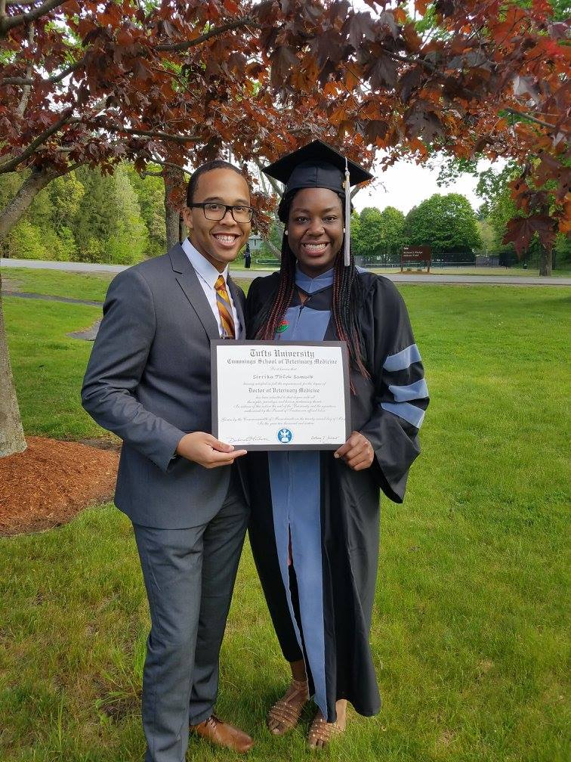
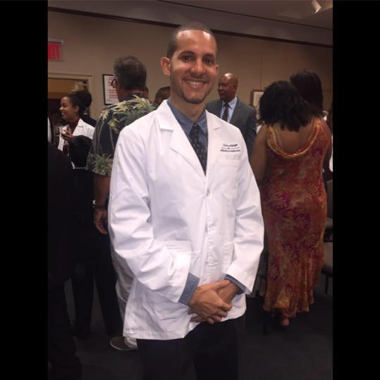
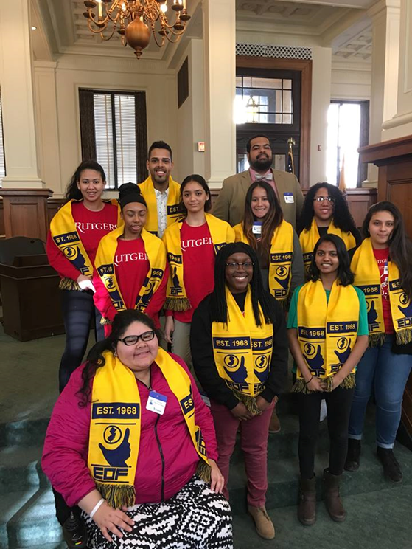
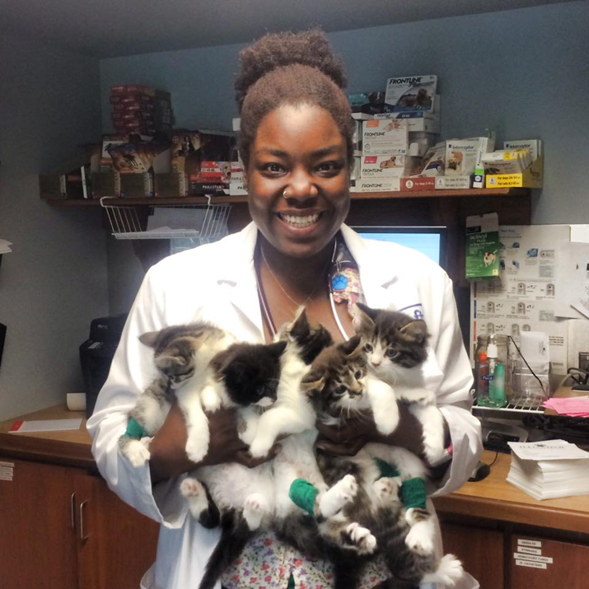


Slide 22
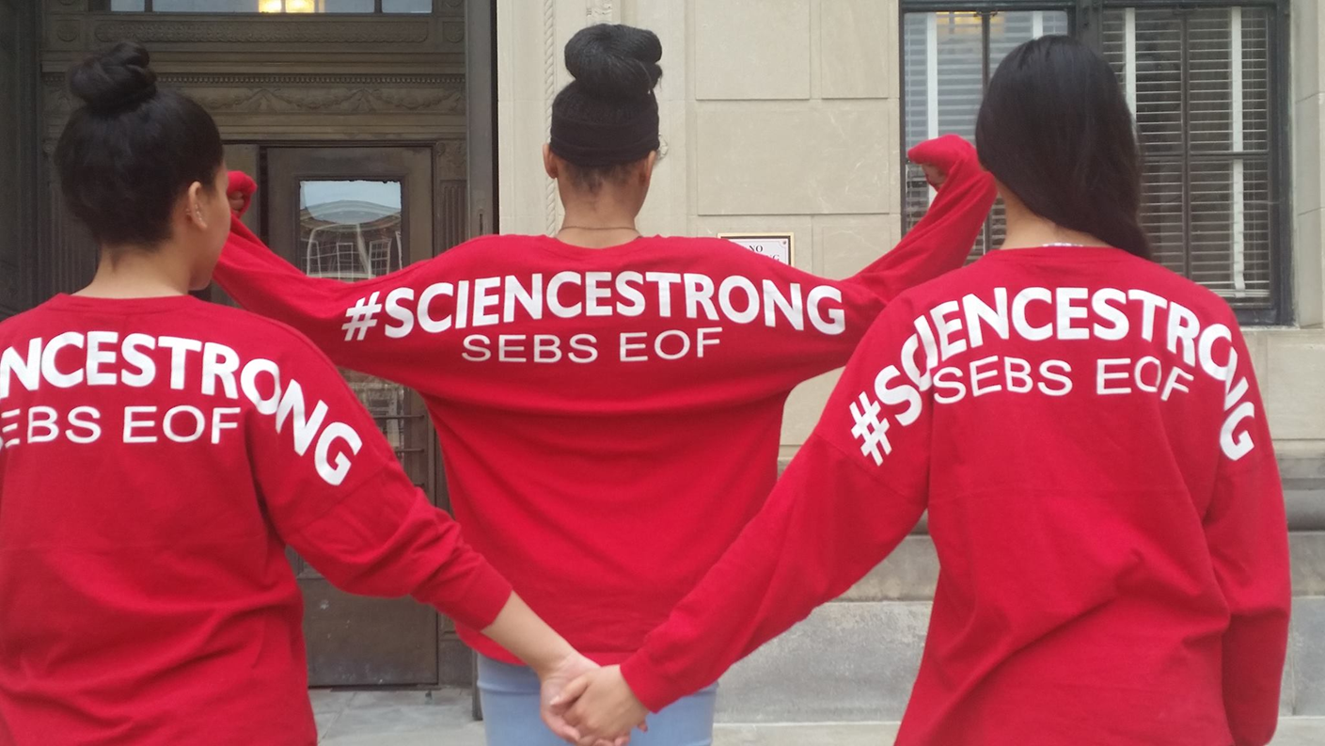
We are…

Slide 23
Thank You!
NJ Office of the Secretary of Higher Education
EOF Administration
EOF Board Members
SEBS Office of Academic Programs
Rutgers SEBS Academic Departments
Daphney Chery – Ph.D. Candidate Drexel Univ.
Kathleen Teichman, Rutgers Business Manager
Martha Estevez, SEBS EOF Admin. Assistant
SEBS EOF Professional Team

