Slide 1
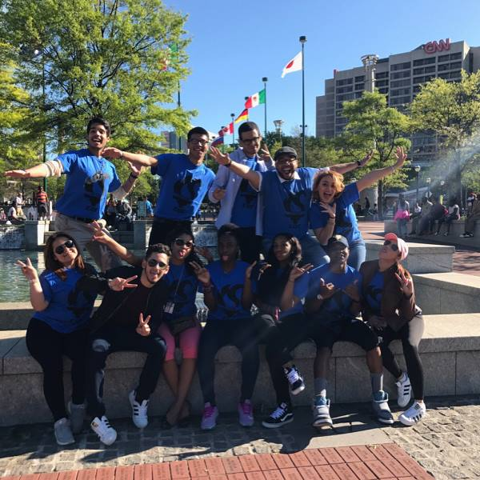
OSHE/EOF SUPPLEMENTAL FY 2017 ARTICLE IV Special Projects – Outcomes Report
Saint Peter’s University – Educational Opportunity Fund Program

Slide 2
TARGET AUDIENCE
7 - 1st Year EOF Scholars
2 - 2nd Year EOF Scholars
1 - 3rd Year EOF Scholar (Student Worker)

Slide 3
PROJECT GOAL & OBEJECTIVES
Build 1st & 2nd Year EOF Scholars Professional Skills
Develop and Strengthen skills
Usage of Skills within Student Organizational Involvement
Strengthen Collaboration
Strengthen Organizational/Presentational Skills

Slide 4
ASSESSMENT MEASURES
CAMPUS ACTION PLAN
Organize and Strategize on
how to best market and execute successful events
INVOLVEMENT & LEADERSHIP
100% of NSLDC participants in 2+ Student Orgs.
70% hold an executive board position
EOF Scholar testimonial – EOF SU17
2 EOF Peer Mentors
1 EOF Resident Assistant

Slide 5
ASSESSMENT MEASURES
LEADERSHIP SELF-ASSESSMENT QUESTIONNAIRE PRE/POST RESULTS
EOF Student Leader | Year | Pre Score | Post Score | Percentage Point > / <
Avosuahi Albert | 1st Year | 83% | 94% | +11
Christian Barthelemy | 2nd Year | 75% | 81% | +6
Christian Butts | 1st Year | 82% | 80% | -2
Nadiyah Chase | 2nd Year | 76% | 83% | +7
Jerry Guallpa | 1st Year | 81% | 87% | +6
Andrea Lopez | 1st Year | 91% | 91% | =
Adrian Reyes | 1st Year | 59% | 79% | +20
Ana Rodriguez | 1st Year | 69% | 73% | +4
Jonathan Rodriguez | 1st Year | 97% | 100% | +3
Leyla Salhuana | 3rd Year | 87% | 90% | +3

Slide 6
ASSESSMENT MEASURES
LEADERSHIP SELF-ASSESSMENT QUESTIONNAIRE PRE/POST RESULTS
80% increased in percentage points
3 Highest Scored Statements
1) I believe in diversity in the workplace
2) If I made a mistake, I would admit it and correct it
3) I thrive on change
Notes:
Highest Scored Questions – 1) I believe in diversity in the workplace 2) If I made a mistake, I would admit it and correct it 3) I thrive on change

Slide 7
IMPACT
Opportunity to acquire and strengthen skills outside NJ
Opportunity to reconnect with fellow EOF cohort members
National Convention offering networking with students nationwide
Effective Communication Skills
ATLANTA GEORGIA

Slide 8
ACADEMIC IMPACT
SPRING 2017
60% of NSLDC participants received a 3.0 or better semester GPA
1 EOF Scholar - 4.0 GPA
Average GPA = 3.23 among participants

Slide 9
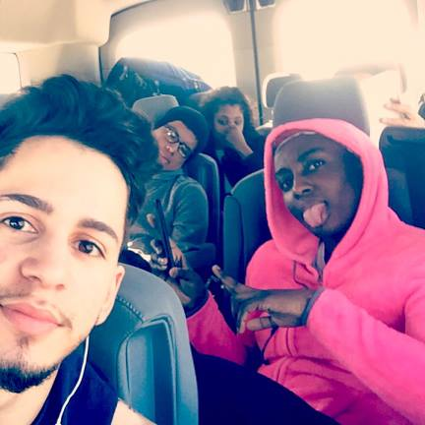
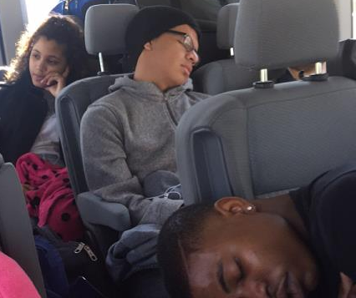
ROAD TRIP LIKE A PEACOCK!
14 Hours to Atlanta One Way
880 Miles One Way

Slide 10
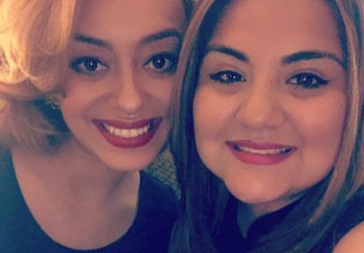
ROAD TRIP LIKE A PEACOCK!
Atlanta Olympic Park
Lots of Cups of Coffee
Dinner at Watershed Restaurant

