Slide 1

EOF B1 & B3 Contract Attachment Training
New Jersey Office of the Secretary of Higher Education (OSHE)
Educational Opportunity Fund (EOF) Program

Slide 2
OSHE/EOF Central Staff
NJ OSHE EOF Central Office
Dr. Hasani Carter
Hasani.Carter@oshe.nj.gov
Peter Collazo
Peter.Collazo@oshe.nj.gov
Hema Patel
Hema.Patel@oshe.nj.gov
Dr. Stephanie Shanklin
Stephanie.Shanklin@oshe.nj.gov
NJ OSHE Finance
Tiffany Hazzard
Tiffany.Hazzard@oshe.nj.gov
Kevin Kobylowski
Kevin.Kobylowski@oshe.nj.gov
Kelechi Unegbu
Kelechi.Unegbu@oshe.nj.gov

Slide 3
Purpose of this Training
To provide an overview of the EOF B1 Mission and Goals & B3 Program Support Contract Budget Attachments
To review the process of completing the EOF B1 and B3 Contract Attachments
To review the EOF B1 and B3 submission requirements and deadlines

Slide 4
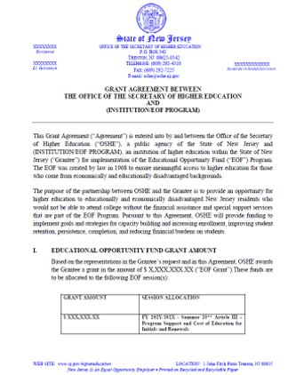
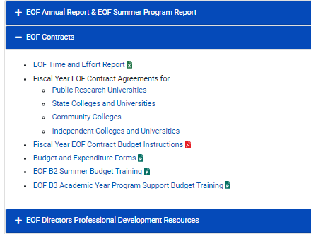
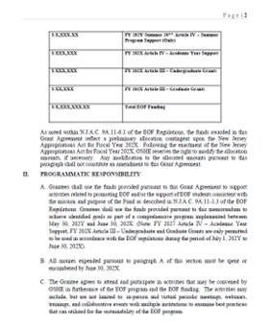
Fiscal Year EOF Program Contracts
FY EOF Program Contract
Where to Access
Click here to access the EOF Campus Resources webpage.
Notes:
FY24 contract includes 2023 Summer Program Allocations AND FY24 Academic Year Allocations
Please note that EOF summer payments cannot be executed until a signed contract has been received.
Programs should use this information to develop their respective budgets attachments.

Slide 5
Virtual Review of the B1 Contract Attachment
FYEOFB1ContractAttachment
Fiscal Year EOF B1 Contract Attachment
The Fiscal Year EOF B1 Contract Attachment submission deadline (please see your EOF contract).
New for FXX: Initial B1 Contract Attachment submissions must be completed via Qualtrics.
Notes:
Spend Down Calculator tool
“Annual Salary in Dollars” enter the annual total salary for each position listed in the personnel section of the budget.
Budget using whole dollars
Expenditure reports will include actual monies spent (show pennies)
“Professional Development & Student Leadership Development” itemize costs of staff and student registration fees for conferences, webinars, and leadership development activities. Include also professional membership fees and consultant presentation costs.
“Travel” itemize travel expenses for professional staff development, recruitment activities, student educational development and student travel for leadership activities. For all travel for professional development (i.e. attendance at conferences), programs must articulate how this information is beneficial for the program (do not simply state “will enhance staff knowledge of best practices”).
Narrative/Line Item Descriptions – for all student development and leadership activities, programs must document some form of pre- and post-activity assessment of what was learned. Additionally support to attend professional conferences must include some form of post-activity assessment of what was learned relative to the program’s current and future offerings. Documentation of this assessment must be kept (i.e. Discussion of what was learned at the conference at a staff meeting held on xx/xx/20xx and information based on what was learned, a validation or suggestion of change for current practice should be considered.)
Program Advisory Board (PAB) itemize expenses for PAB meetings & functions. Only programs that have a PAB (membership list, by-laws & minutes of meetings) should list expenses. Otherwise leave this category blank.
Within the Narrative Description section, provide a brief description of each item listed in each of the Art. IV budget categories.
Example: Educational Materials & Supplies
Acceptable: purchase of textbooks for tutors @ a total cost of $500.00
Not acceptable (too vague): purchase of textbooks
Not acceptable: purchase of books and supplies for student usage
Example: Student Leadership Activity
Acceptable: “XYZ” student leadership activity. Students will be provided a pre- and post-activity assessment to gauge their cultural and self-awareness regarding “XYZ”. The educational purpose of this activity is to provide students with instructions and tools to help identify and improve in the areas of “A, B, & C”.
Not acceptable: (too vague) Student event to help create student solidarity.

Slide 6
FY EOF B3 Contract Attachment
The FY EOF B3 Contract Attachment submission deadline (please see your EOF contract).
Initial B3 Contract Attachment submissions must be sent to EOF@oshe.nj.gov for approval.
The subject line must include your institution/program name, and the appropriate contract budget attachment included (i.e. XYZ University FYXX B3 Contract Budget Attachments).
Notes:
Spend Down Calculator tool
“Annual Salary in Dollars” enter the annual total salary for each position listed in the personnel section of the budget.
Budget using whole dollars
Expenditure reports will include actual monies spent (show pennies)
“Professional Development & Student Leadership Development” itemize costs of staff and student registration fees for conferences, webinars, and leadership development activities. Include also professional membership fees and consultant presentation costs.
“Travel” itemize travel expenses for professional staff development, recruitment activities, student educational development and student travel for leadership activities. For all travel for professional development (i.e. attendance at conferences), programs must articulate how this information is beneficial for the program (do not simply state “will enhance staff knowledge of best practices”).
Narrative/Line Item Descriptions – for all student development and leadership activities, programs must document some form of pre- and post-activity assessment of what was learned. Additionally support to attend professional conferences must include some form of post-activity assessment of what was learned relative to the program’s current and future offerings. Documentation of this assessment must be kept (i.e. Discussion of what was learned at the conference at a staff meeting held on xx/xx/20xx and information based on what was learned, a validation or suggestion of change for current practice should be considered.)
Program Advisory Board (PAB) itemize expenses for PAB meetings & functions. Only programs that have a PAB (membership list, by-laws & minutes of meetings) should list expenses. Otherwise leave this category blank.
Within the Narrative Description section, provide a brief description of each item listed in each of the Art. IV budget categories.
Example: Educational Materials & Supplies
Acceptable: purchase of textbooks for tutors @ a total cost of $500.00
Not acceptable (too vague): purchase of textbooks
Not acceptable: purchase of books and supplies for student usage
Example: Student Leadership Activity
Acceptable: “XYZ” student leadership activity. Students will be provided a pre- and post-activity assessment to gauge their cultural and self-awareness regarding “XYZ”. The educational purpose of this activity is to provide students with instructions and tools to help identify and improve in the areas of “A, B, & C”.
Not acceptable: (too vague) Student event to help create student solidarity.

Slide 7
Disbursement of Fiscal Year Art. IV
Academic Year Allocations
Programs will receive 75% of their academic year Art. IV allocation in July
Programs that owe a refund or report will not receive funding until all items are submitted and correct.
Note: FYXX Art. IV AY Program Support payee reference format
EOF AY4 FYXX (Inst./Program Name) ADV PMT
Balance (up to 25%) of the academic year Art. IV allocation will be sent in June.

Slide 8
Art. IV Academic Year Allowable Expenses
Funds used to assist with paying for EOF 12-month staff and student support activities that occur between July 1, 20XY – June 30, 20XX
      Salaries: 12-month salaries, wages and fringe benefits for permanent program positions for a specified period
        May not include those staff whose total percentage of commitment to the EOF program is less than 10%.
      Educational Materials & Supplies
      Consumable Materials & Supplies
      Professional Development & Student Leadership Development
      Program Advisory Board
      Other Services (communications, utilities, overhead)
Each budget item must have a narrative description
For additional details, please refer to EOF Regulations (N.J.A.C. 9A:11-6.10) (Pgs. 37-38).
Notes:
B3 contract attachments outlines the Art. IV budget for program support services
All program financial resources must be shown on the respective contract budget: EOF Art. IV, institutional funds and other sources.
Requires a dollar for dollar match against the EOF allocation from institutional and other funding resources. Reference - EOF regulation 9A:11-6.9 (c)
Compensation and payment for activities must have occurred within the identified time period associated with the respective contract budget from which the funds were paid from.
Must ensure that the appropriate documentation and accountability records (i.e. description of time and effort, timesheets, etc.) are kept for all individuals whose percentage of involvement with the EOF program is less than 100%

Slide 9
Art. IV Academic Year Funding Restrictions
The EOF campus program administrator’s salary and fringe benefits
Fringe benefits for 12-month EOF staff at public senior institutions
Fringe benefits in excess of 21 percent of the salaries and wages paid by EOF funds for 12-month EOF staff at community colleges and independent institutions
Employee benefits for academic year student assistants and part-time personnel
The purchase of office furniture and/or décor items
Transportation of students for normal commuting costs
The cost of instruction for which students are charged tuition
Other student costs that normally are covered by a student’s financial aid package, such as any fees, room and board, transportation, funds for printing, and childcare
Lobbying, partisan political contributions, and/or fund-raising activities
The purchase of medications, drugs, or alcoholic beverages
Indirect expenses (such as space, heat, lights, postage, and telephone) that exceed 10 percent of the total academic year Art. IV allocation.

Slide 10
Art. IV Institutional Match:
Allowable
Funds contributed or donated to the institution by public agencies, private organizations or individuals
Overhead (up to 20% of total program costs) such as the cost of building maintenance, security, insurance/liability, etc.
The provision and maintenance of state-of-the-art technological equipment (such as computer hardware, modems, fax machines)
Direct services rendered by other institutional staff solely to the EOF program, as long as those services constitute at least 10 percent or more of the institutional staff member’s time
Real or personal property contributed or donated to the institution by public agencies, private organizations, or individuals
All or a portion of any EOF staff member’s salary, wages, or fringe benefits

Slide 11
Art. IV Institutional Match:
Not Allowable
Program reporting supervisors and other high level institutional officers who are required to serve all students
Any Institutional Staff whose total contribution to the EOF program is less than 10%. (Note: If a staff member resigns or is removed from their position, an adjustment to your contract is required)
Items and services normally provided to students by the institution without charge
Items and services normally provided to the institution by other government agencies without charge
Charges incurred by the institution as program costs but require no cash outlay by the institution during the grant period
Any cost incurred or contribution of services made in a prior fiscal year

Slide 12
Time & Effort
Institutions must have an approved waiver from the OSHE/EOF Office if the Program Director is less than 100% time EOF.
MANDATORY FOR ALL EOF DIRECTORS WHO ARE LESS THAN 100% TIME EOF.
All monthly reports must be included with the Final Art. IV B3 Expenditure Report.
Failure to submit this information means we cannot accurately assess the institution’s financial and labor commitment, as outlined in the submitted budget and approved waiver.
Institutions must also properly document the time and effort for all staff included on the budget, including EOF staff who are less than 100% time EOF.
REMINDER – EOF TIME AND EFFORT REPORT
Therefore, the Director’s salary from the institutional match will be disallowed.
If the institution’s financial commitment falls below the required “Dollar-for-Dollar match” of Art. IV funds, the institution will not be permitted to adjust the contract and your program must return the disallowed amount.
Notes:
Directors role defined in Regulations (9A:11-4.4 Institutional administration, pg.24-26)
Mandatory - Program Directors who are less than 100% time EOF are required to keep a monthly time and effort report on file. A copy of the EOF Time & Effort report can be found on our website within the EOF campus program resources webpage: https://www.nj.gov/highereducation/EOF/EOF_Program_Resources.shtml
Waivers must be resubmitted if there is a change in title, personnel, responsibilities, or if any elements of the original approved waiver has been impacted.

Slide 13
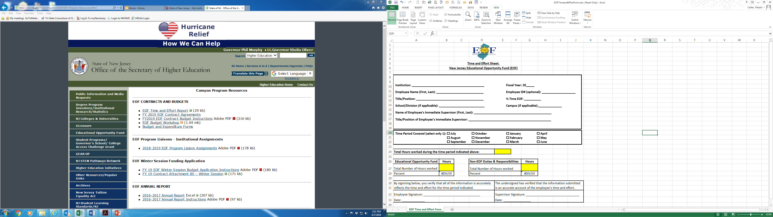
Time & Effort

Slide 14
Budget Submission: Final Checklist
PERSONNEL
Provide names & titles
Annual Salaries and % Time & Effort
Line item/Narrative descriptions
OTHER
Correct allocation/Institution name
Institutional match
Utilized full allocation
Naming convention and Email subject used
Ensure no restricted expenditures have been included
Round to the nearest dollar

Slide 15
See EOF FY Contract for Due Dates
  Email Subject Line:
    (Institution/Program Name) EOF FISCAL YEAR Art. IV B3 Contract Attachment
  Electronic File Submission:
  EOF B1 Program Mission, Goals & Objectives (Must be submitted via Qualtrics)
  EOF B3 Article IV Academic Year Program Support Budget
      Naming Convention:
        (Insert Institution/Program Name) EOF FY** B3 Contract Attachment
            - Example: New Jersey State College EOF FY** B3 Contract Attachment
Email B3 to: EOF@OSHE.NJ.GOV w/CC: Hasani.Carter@oshe.nj.gov
Do not:
Convert the budget documents to PDF
Save submissions as password protected documents
Provide a link to a file sharing portal (i.e., Google Docs, Microsoft Teams, SharePoint, One Drive, etc.)

Slide 16


Budget Modifications
Changes to your original, approved budget require prior written approval form OSHE/EOF Central Office Staff.
      This includes modifications between categories (i.e. moving money from the budgeted line for staff salaries to the line for Educational Materials and Supplies) as well as new items that were not part of the original fiscal year contract.
      Budget Modifications within the same category without requesting approval is allowed.
  Budget modifications must be submitted via email to your Program Liaison with the following information:
          Moving Funds from (identify category, row #, & item)
          Moving Funds to (identify category, row # & item)
          Amount/Change
          Rationale
Notes:
Required:
Email including rationale proposed modification narrative explaining both “why” and “where” you are looking to re-distribute your existing funds in Email body.

Slide 17

Budget Modifications
  Submit the approved EOF Art. IV FY B3 budget file (Excel) with proposed modifications listed in the appropriate column(s) on the B3 - Contract Budget Summary tab and highlighted in red on the line-item description tab.
  EOF FYXX B3 budget modification deadline (please see your EOF contract). Budget requests submitted after that date will be reviewed on a case by case for approval and must be in accordance with your institution’s internal budget modification deadline.

Slide 18
FY 2027 EOF B3 Annual Program Support Budget
Virtual Review of the B3 Contract Attachment
FYEOFB3ContractAttachment

Slide 19
Resources
OSHE/EOF Website:
http://www.state.nj.us/highereducation/EOF/EOF_Program_Resources.shtml

Slide 20

QUESTIONS?

Slide 21

Thank You!
We look forward to working with you

