Slide 1

EOF B2 Summer Budget Training
OFFICE OF THE SECRETARY OF HIGHER EDUCATION (OSHE)
Educational Opportunity Fund (EOF)
Notes:
Welcome and thank you for attending our Contract and Summer Budget Training.

Slide 2
Purpose of this Training
To provide an overview of the EOF Summer Contract and changes to the Budget Documents (Contract Attachment B2)
To review the allowable expenditures for the EOF Summer Program
To review the process of completing the EOF Summer Budget and submission deadlines

Slide 3
OSHE/EOF Central Staff
Dr. Hasani Carter
Hasani.Carter@oshe.nj.gov
Peter Collazo
Peter.Collazo@oshe.nj.gov
Hema Patel
Hema.Patel@oshe.nj.gov
Dr. Stephanie Shanklin
Stephanie.Shanklin@oshe.nj.gov
OSHE Finance
Tiffany Hazzard
Tiffany.Hazzard@oshe.nj.gov
Kevin Kobylowski
Kevin.Kobylowski@oshe.nj.gov
Kelechi Unegbu
Kelechi.Unegbu@oshe.nj.gov

Slide 4
Prior to Completing the EOF Summer Budget
Review the new Fiscal Year (FY) contract and EOF Summer allocations to ensure you are working with the correct figures.
Instructions for completing the budget template are in the template file – the tab is labeled “Directions to Complete”
Program Directors should work with your OSHE/EOF program liaison if you have any questions regarding the development of your budget and allowable expenses.

Slide 5
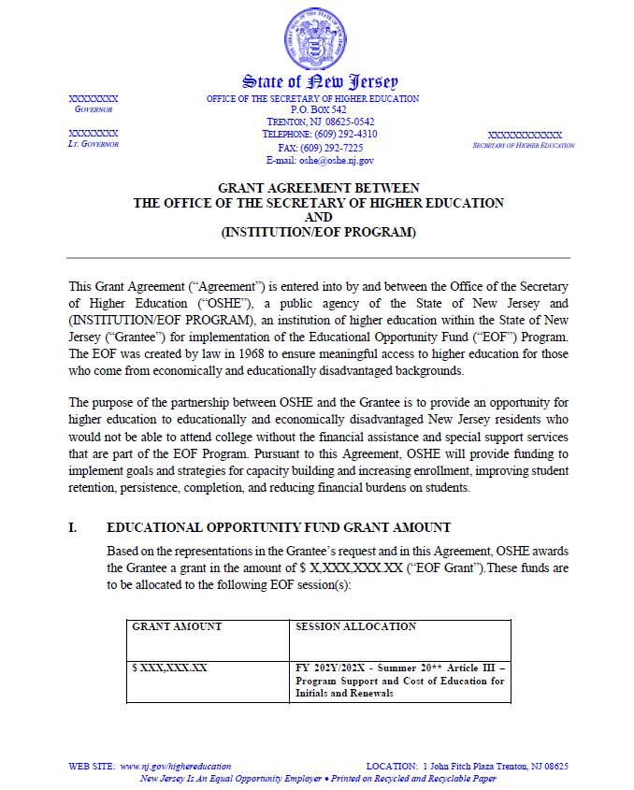
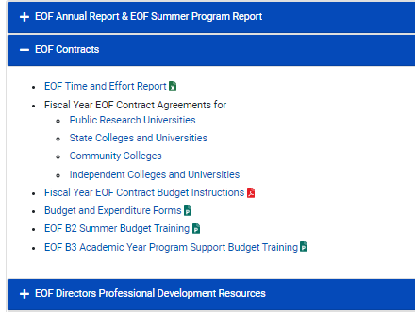
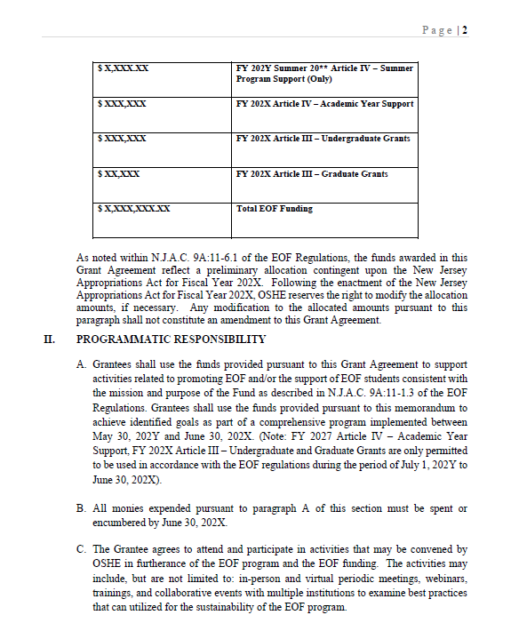
Fiscal Year EOF Program Contracts
FY EOF Program Contract
Where to Access
Click here to access the EOF Campus Resources webpage.

Slide 6
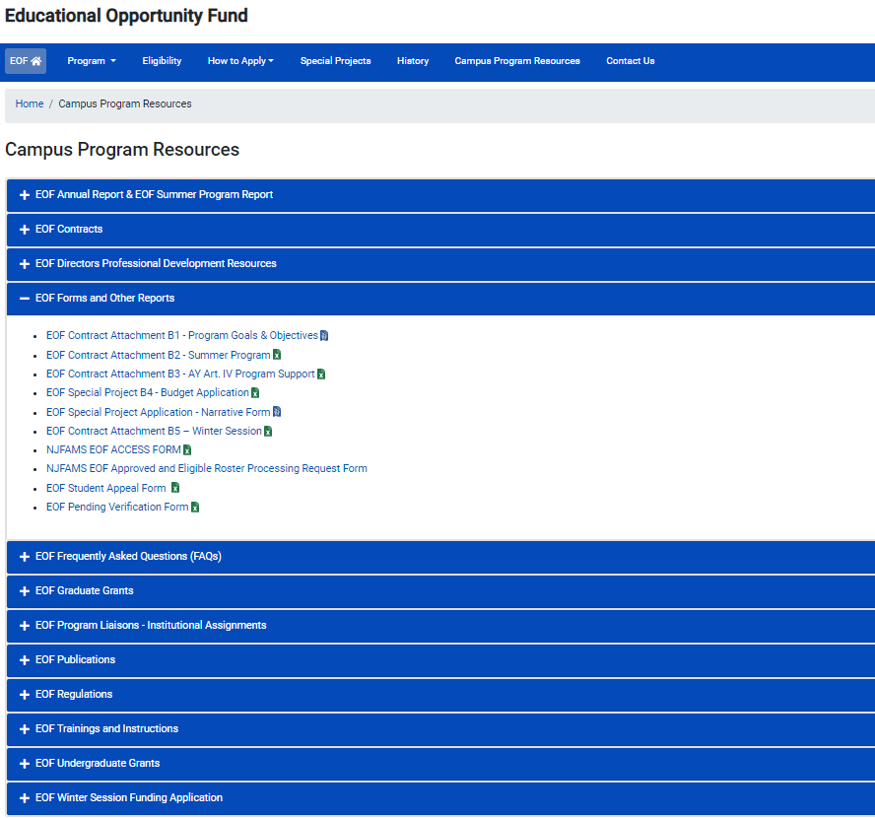
Fiscal Year EOF B2 Contract Attachment

Slide 7
Cells are locked. Only cells that require information to be inputted are accessible.
Programs can still, however, add tabs if needed.
All programs must start on the Initial tab. EOF special programs that only provide support to Renewals must start on the Initial tab and put your allocation at the top.
All line items require a “Narrative Description”. Items must include a clear educational purpose and where appropriate, any associated pre- and post-activity assessments that will be conducted.
Programs must report on all EOF students supported during the Summer (even if the EOF student only received program support and did not receive EOF funds).
Programs must report all forms of aid received by students (e.g., Summer TAG funds, institutional funds, and aid charged to other resources).
Things to Know When
Completing the B2 Summer
Budget

Slide 8
Disbursement of Summer Funds
Payment Distribution:
For the EOF Summer Program: Programs will receive 100% of their Article 3 and Article 4 funds.
  Note: As noted in the May EOF Board materials, the total amount of Summer Article 3 funds may be paid out via two fiscal sources (Prior year/available Article 3 resources (i.e. fiscal funds available prior to June 30th) and new fiscal year funds (i.e. funds available after July 1st).
  New fiscal year funds will not be remitted until OSHE has been able to verify that these funds are available in our account and the EOF program has successfully submitted a signed a new fiscal year contract and a copy of its Policy and Procedures manual.

Slide 9
Summer Article III - Allowable Expenditures
The EOF Article III summer program grant shall be applied to the student’s educational costs.
Such costs shall include the participating institution’s educational budget and/or instructional costs as follows:
Tuition charged per student or instructional costs (instructors’/teaching assistants’ salaries), but never both for any single course​
Fees, room & board, books, educational supplies, transportation, and childcare, as well as stipends and insurance​
Salaries and room and/or board for professional, graduate, and/or peer tutors
Educational materials used to support instruction

Slide 10
Tuition & Fees = Credits Attempted/Earned During Summer
If a student is charged for “X” credits, then this number of credits should appear on the student’s transcript for the Summer program.
For example:
    Student is registered for 9 credits during the summer.
    EOF funds are used to pay for those 9 credits.
    Student’s transcript must show that the student was enrolled for 9 credits during the Summer session.

Slide 11
Stipends: Article III Funds
Cost of education purposes only (supplies, commuter costs, textbooks, etc.)
Programs must have documentation to reflect how the amount was determined (ex: cost of actual textbooks, mileage reimbursement rate, on-campus meal plan price, etc.)
OSHE/EOF does not determine stipend award levels
Program should not wait until the end of the summer session to seek adjustments to stipends.
Institutions/EOF campus programs assume all liability associated with the distribution of stipends (i.e., future financial aid eligibility for independent students, etc.)
Stipends may not be used to reimburse or pay a student directly for taking a course at another institution

Slide 12
Special Circumstances:
Courses at Another Institution
    Should seek to establish a formal arrangement/agreement
    Must be at an institution that participates in EOF
    Allow for the institution to be billed directly for the student’s enrollment at another institution/program
    Ensure appropriate documentation between institutions for audit purposes

Slide 13
Summer Article IV - Allowable Expenditures
EOF Article IV Funds are to be used for EOF Program Support activities.
Article IV program support funds shall not be used for the following items:
Cost of Education Items (highlighted in green on Initials/Renewal Tabs). Student costs covered by a student’s financial aid package
Fringe benefits for AY student assistants, part-time personnel, campus EOF administrator/director, or 12-month EOF staff at public senior institutions; fringe benefits in excess of 21% of the salaries paid by EOF funds for 12-month EOF staff at community colleges and independent institutions
Transportation of students for normal commuting costs
The cost of instruction for which students are charged tuition
For additional details, please refer to EOF Regulations (N.J.A.C. 9A:11-6.10) (Pgs. 35-36)​

Slide 14
Completing the EOF Summer Budget:
Final Checklist for Submission
Provided Institution/EOF Program Name
Provided the total number of Initial and Renewal students on the respective tabs
Provided the appropriate Narrative Descriptions per budget category utilized, including a breakdown of the expenses summarized by the total
Utilized full allocation for the EOF Summer Program
When budgeting, use whole numbers whenever appropriate (i.e. round to the nearest dollar).
Notes:
Final checklist:
Make sure your institution is listed. If we were to print this budget, would we know it’s yours?
Provide the total Number of students. This may change with final expenditures, but we need estimated numbers to check math
Please make sure that each budgeted items have a Narrative description
Use your full allocation!

Slide 15
EOF File Naming Convention
All Documents must be submitted via email to EOF@OSHE.NJ.GOV. Institutions can include new tabs within this workbook to provide additional details.
  Email Subject Line: School/Program NAME 20** B2
    - Ex: New Jersey State College Health Careers Program 20** B2
  File Naming Convention: School/Program NAME 20** B2
    - Ex. New Jersey State College Health Careers Program 20** B2
Notes:
We ask that you use these naming conventions when you submit your Budget. We need it to identify items in the EOF mailbox.

Slide 16
Summer Program Budget Modification Deadline
Due to variable lengths of Summer Sessions, OSHE/EOF defines the last day of the EOF summer program as the day before your institution’s next immediate Fall term.
Remain aware of any anticipated under-expenditures/cost savings on a weekly basis.
Re-purpose any available funds immediately with a budget modification request to the OSHE/EOF office. Modifications received on or near the last day of the summer program cannot include purchases for items that have not been received. All expenses must be for services and items that occur during the identified summer session(s).
Notes:
Summer Budget Modifications are important because of the quick turn-around time.
We encourage you to monitor your budget for enrollment changes, staffing changes, and changes in programming to make sure you are working with your budget. As you know your allocation is based on expenditures, so we want to ensure that you are using your allocation fully, as well as working within your budget.
Again, let your liaison assist you.

Slide 17
Summer Budget Deadlines
Your initial EOF Summer Budget (Contract Attachment B2) must be e-mailed to EOF@OSHE.NJ.GOV and the EOF Executive Director by the identified date listed within your EOF Fiscal Year contract.
Budget Modification Deadline:
OSHE/EOF defines the last day of the EOF summer program as the day before your institution’s next immediate Fall term.
Modifications received after the last day of your institution's summer program will not be accepted.
E-mail Final Summer Expenditure Report (C1 attachment) to EOF@OSHE.NJ.GOV and the EOF Executive Director by the identified deadline listed within your EOF Fiscal Year contract.
Notes:
Important Deadlines:
Budgets are due on June 16
Modification are due on the last day of Summer Session
Final Expenditure are due by September 25.

Slide 18
Questions

Slide 19
Completing the EOF Summer Budget: Summer Budget Template
A walk-through of how to properly complete the EOF Summer Budget
(Contract Attachment B2)
EOFB2ContractAttachment.xlsx

Slide 20
OSHE/EOF Campus Resources Website
https://www.nj.gov/highereducation/EOF/EOF_Program_Resources.shtml

Slide 21

Thank You!
We look forward to working with you!

