Slide 1

EOF B3 Contract Budget Training Webinar
WEBINAR
New Jersey Office of the Secretary of Higher Education (OSHE)
Educational Opportunity Fund (EOF) Program

Slide 2
OSHE/EOF Central Office Staff
  Website: http://www.state.nj.us/highereducation/EOF/EOF_Program_Resources.shtml
EOF Central Office Staff:
Dr. Hasani Carter
Hasani.Carter@oshe.nj.gov
(609) 341-3808
Dr. Stephanie Shanklin
Stephanie.Shanklin@oshe.nj.gov
(609) 984-2821
Hema Patel
Hema.Patel@oshe.nj.gov
(609) 984-2800
Shakia Williams
Shakia.Williams@oshe.nj.gov
(609) 984-2631
EOF receives assistance from OSHE Department of Finance, Research, & Accountability
OSHE Staff:
Angela Bethea
Angela.Bethea@oshe.nj.gov
Maisha Howard
Maisha.howard@oshe.nj.gov
(609) 292-8916
Kelechi Unegbu
Kelechi.Unegbu@oshe.nj.gov
(609) 633-9528
Please note that due to the impact of COVID-19, all OSHE staff are working remotely. The best way to contact us is via email.

Slide 3
Purpose of Budget Workshop
To provide a general orientation to the EOF B3-(A) and B3-(B) contract budget attachments and expenditure report forms
For this year, there will be two separate B3 contract budget attachments: EOF FY20 5th Quarter (July 1, 2020 – September 30, 2020) & EOF FY21 AY program support (October 1, 2020 – June 30, 2021)
Discussion about the importance of submitting documents on time and review of submission deadlines
Training on how to properly complete the EOF B1 and B2 contract attachments were provided during the EOF Summer Budget Training. Questions regarding these two documents can be directed to your EOF program liaison.

Slide 4
During this workshop, we will focus on the following items:
- Fiscal Year Contract Summary and Signature Page
- Attachment B3-(A) - EOF FY20 5th Quarter Art. IV Program Support (July 1, 2020 – September 30, 2020)
- Attachment B3-(B) – EOF FY21 AY Art. IV Program Support (October 1, 2020 – June 30, 2021)
*** REMINDER – EOF TIME AND EFFORT REPORT *** - MANDATORY FOR ALL EOF
DIRECTORS WHO ARE LESS THAN 100% TIME EOF.
- Review of Deadlines and Submission Requirements
- Discussion on who you should direct your respective contracts, budget requests, and expenditure reports to

Slide 5
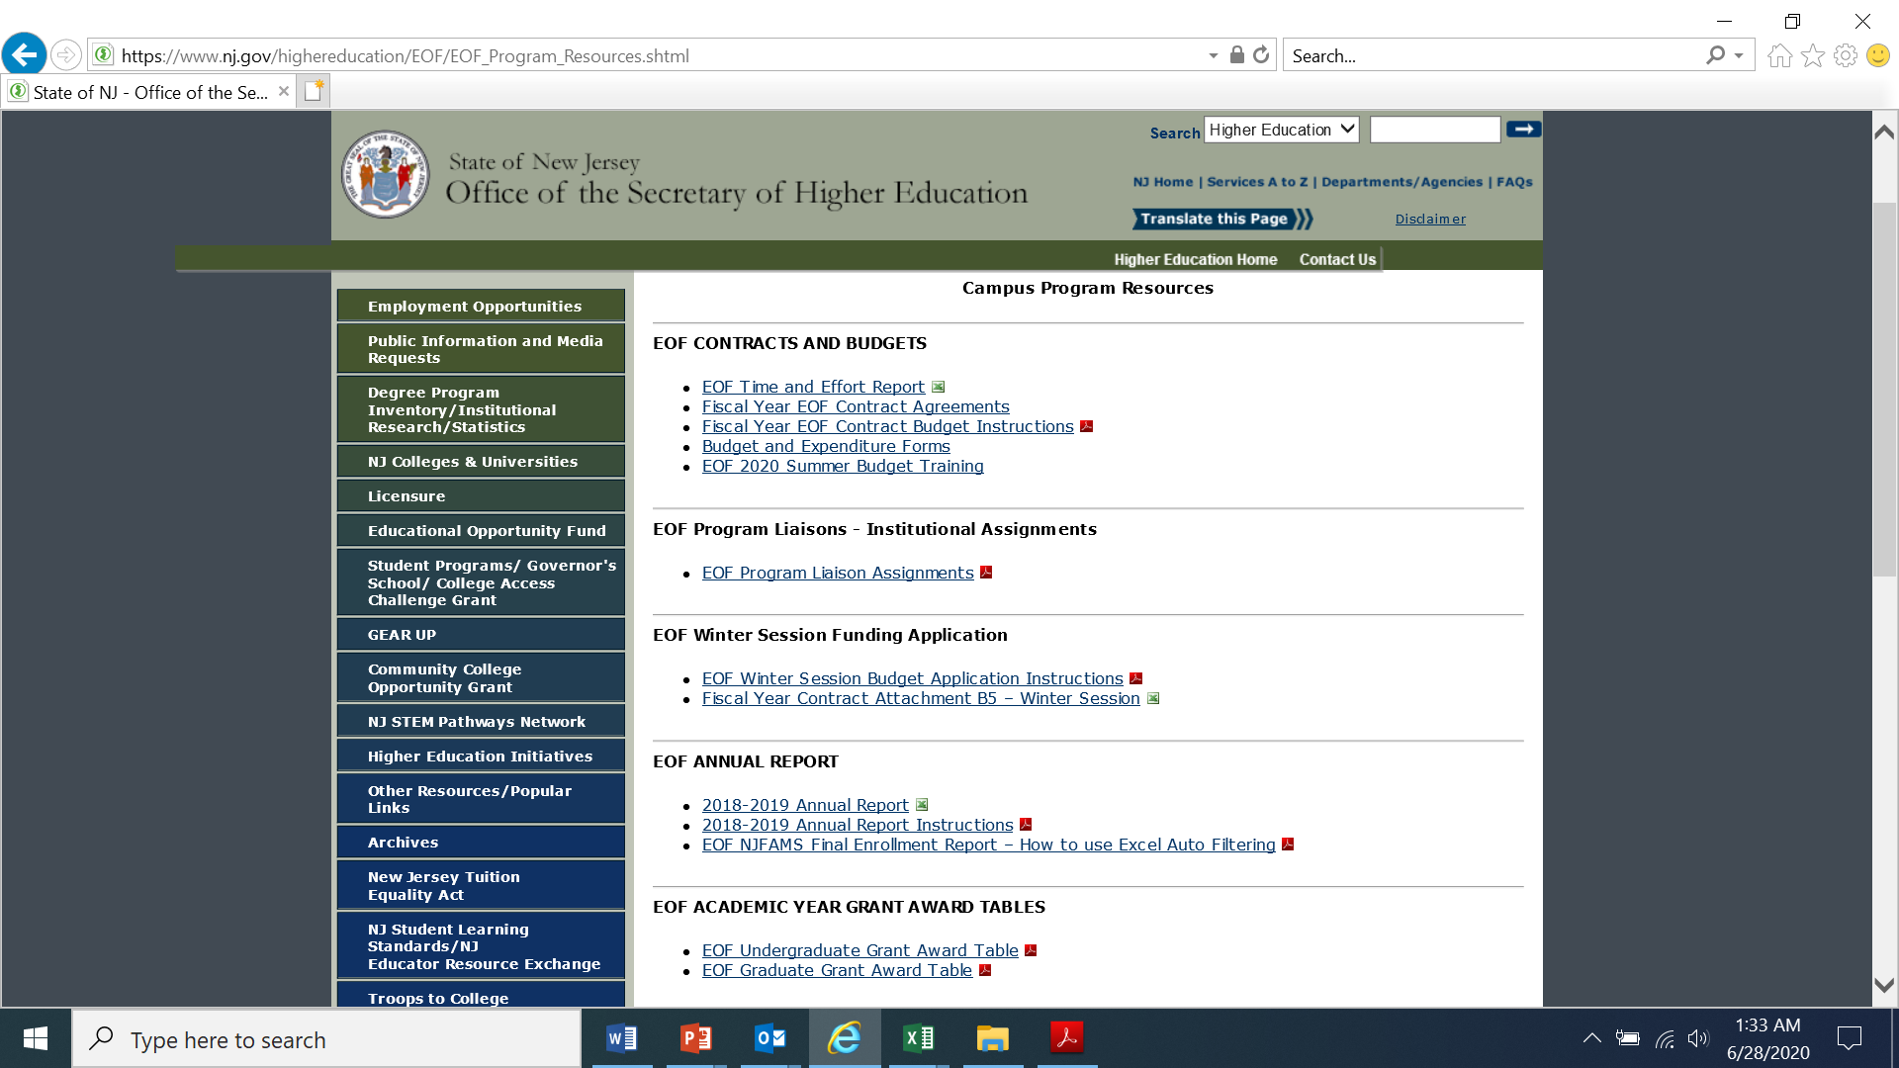
Check for re-assignments

Slide 6
EOF Fiscal Distribution Chart
Governor’s Final Fiscal Year (FY “xx”) Appropriation
Prior Year Refunds and Balances
Article III
Article IV
Article III
Article IV
EOF FY “xx” Academic Year Art. IV Allocations
(Program Support)
EOF FY “xx” Article IV Central Initiatives
EOF FY “xx”
Academic Year (AY) Art. III Undergraduate Allocations
EOF FY “xx” Academic Year (AY) Art. III GRADUATE Allocations
FY “xx” EOF Summer Program
EOF Special Projects
EOF Winter Session
EOF Board of Directors/EOF Central Office

Slide 7
EOF Summer and AY Contract
- All EOF contracts are posted online and should be downloaded and saved for record retention purposes.
- Please carefully review the contact allocations to ensure that they match your respective preliminary allocations as approved by the EOF Board on June 22, 2020.
- A copy of the June 22, 2020 EOF Board materials was sent to all college and university Presidents and EOF campus program Directors.

Slide 8
What are the components of the EOF Contract?
Attachment A Contract Provisions
Attachment A1 Contract Provisions (Rutgers University ONLY)
Attachment B1 EOF Program Mission Statement and Program Goals & Objectives
Attachment B2 EOF Summer Support and Cost of Education Budget
Attachment B3-(A) FY20 5th Quarter Art. IV Program Support (July 1, 2020 – September 30, 2020)
Attachment B3-(B) FY21 EOF Academic Year Program Support Budget (October 1, 2020 – June 30, 2021)
Attachment B4 EOF Special Project Budget* (if applicable)
Attachment B5 EOF Winter Session Support and Cost of Education Budget* (if applicable)
Attachments C1-5 Expenditure Reports sent under separate cover
Attachments C Annual and Summer Assessment Reports sent under separate cover
Attachment D Grant Deadlines and Project Specifications
Download the EOF contract documents and budget instructions from OSHE/EOF Website at:
http://www.nj.gov/highereducation/EOF/EOF_Program_Resources.shtml
* = Document not found on EOF website. Will be provided if applicable.

Slide 9
Completing Contract Signature Page
Due to the impact of COVID-19, this year the contract signature page will be completed via DocuSign. The contract signature page must be signed by the institution’s president or designee only.
(Due by October 22, 2020)
After the EOF Central Office staff completes the review of the fiscal year contract documents, the contract signature page will be signed by the EOF Executive Director and a final copy will be emailed to the EOF campus Program Director.
(Please note: Due to the signature page being completed via DocuSign, a copy of the signature page is included in the EOF contract for reference purposes only.)

Slide 10
EOF B3 Contract Attachments
- Due to the impact of COVID-19 and the State’s creation of a FY20 5th Quarter, there will be two (2) B3 contract attachments that must be administered this year.
- For audit and proper accountability purposes, institutions must develop a total of three Art. IV accounts this year:
* EOF Summer Art. IV (B2 contract funds – No Institutional match required)
* EOF FY20 5th Qtr. (B3-(A) contract funds – Institutional match required)
* EOF FY21 (B3-(B) contract funds – Institutional match required).
(Please remember that EOF regulations governing the restrictions and usage of Art. IV funds apply throughout the entire calendar year)

Slide 11
EOF B3 Contract Attachments
B3-(A) eof fy20 5TH Qtr. Art. Iv program support
B3-(B) EOF FY21 AY Program support
- Funds used to assist with paying for EOF 12-month staff and student support activities that occur between July 1, 2020 – September 30, 2020)
- Programs will receive their full allocation. Any unexpended funds resulting in a refund owed back to OSHE/EOF Central must be submitted with the final expenditure report. Over-expenditures may not be offset by EOF Summer Art. IV funds or EOF FY21 Art. IV funds.
- Institutional Match is required.
- Funds used to assist with paying for EOF 12-month staff and student support activities that occur between October 1, 2020 – June 30, 2021)
- Programs will 75% of allocation as advance funds. Balance of up to 25% will be provided based on the program’s 2nd interim expenditure report.
- Any unexpended funds that result in a refund owed back to OSHE/EOF Central must be submitted with the final expenditure report. Over-expenditures may not be offset by EOF Summer Art. IV funds or EOF FY20 5th Quarter Art. IV funds.
- Institutional Match is required.

Slide 12
Completing B3-(A) & B3-(B) contract attachments
- The process and requirements to complete both B3 contract attachments are very similar.
Notable differences:
B3-(A) - Due to the associated time period, there are no interim expenditure reports for the EOF B3-(A) contract attachment. Programs are only required to submit an initial budget and a final expenditure report.
B3-(B) – Similar to previous year(s) B3 contract attachments, the B3-(B) contract attachment requires the submission of an initial budget, 2-interim expenditure reports, and a final expenditure report.

Slide 13
Contract Attachments B3-(A) & B3-(B)
Article IV Program Support
Both B3 contract attachments outlines the Art. IV budget for program support services which includes the 12 month salaries, wages and fringe benefits for permanent program positions for a specified period of time. Compensation and payment for activities must have occurred within the identified time period associated with the respective contract budget from which the funds were paid from.
Both respective budgets also cover the costs of Educational Materials and Supplies, Consumable Supplies, Staff and Student Professional Development and Leadership activities, Travel, Program Advisory Board, and other related program services (communications, utilities, overhead) during the indicated respective time periods.
All program financial resources must be shown on the respective contract budget: EOF Article IV, institutional funds and Other sources.
For both B3-(A) and B3-(B), the Program Support budget requires at least a dollar for dollar match against the EOF allocation from institutional and other funding resources. Reference - EOF regulation 9A:11-6.9 (c)
Institutional match funds may not be double counted (i.e. institutional (or other resources) used to pay for a line item on B3-(A) can not be counted on B3-(B) (or vice versa).
Note: Programs may not include those individuals whose total percentage of commitment to the EOF program is less than 10%. Programs will need to ensure that the appropriate documentation and accountability records (i.e. description of time and effort, timesheets, etc.) are kept for all individuals whose percentage of involvement with the EOF program is less than 100%.

Slide 14
Program Directors who are less than 100% Time EOF
- Must have an approved waiver from the EOF Central Office.
- Mandatory - Program Directors who are less than 100% time EOF will also be required to keep on file a monthly time and effort report. A copy of the EOF Time & Effort report can be found on our website within the EOF campus program resources webpage:
https://www.nj.gov/highereducation/EOF/EOF_Program_Resources.shtml
A collection of all monthly reports must be included with the submission of the program’s respective final Article IV B3-(A) and B3-(B) expenditure report (i.e. July 2020 -September 2020 must be submitted with the program’s B3-(A) final expenditure report; October 2020 – June 2021 must be submitted with the program’s B3-(B) final expenditure report.)
Failure to submit this information will result in the Fund’s inability to accurately assess the institution’s financial and labor commitment as outlined in the submitted budget and approved waiver. Therefore a disallowance of the Director’s salary from the institutional match will be enacted. As a result of this action, if the institution’s financial commitment falls below the required “Dollar-for-Dollar match” of Article IV funds, the institution will not be permitted to adjust the contract and a refund will be due in the amount of the EOF Art. IV disallowance.

Slide 15
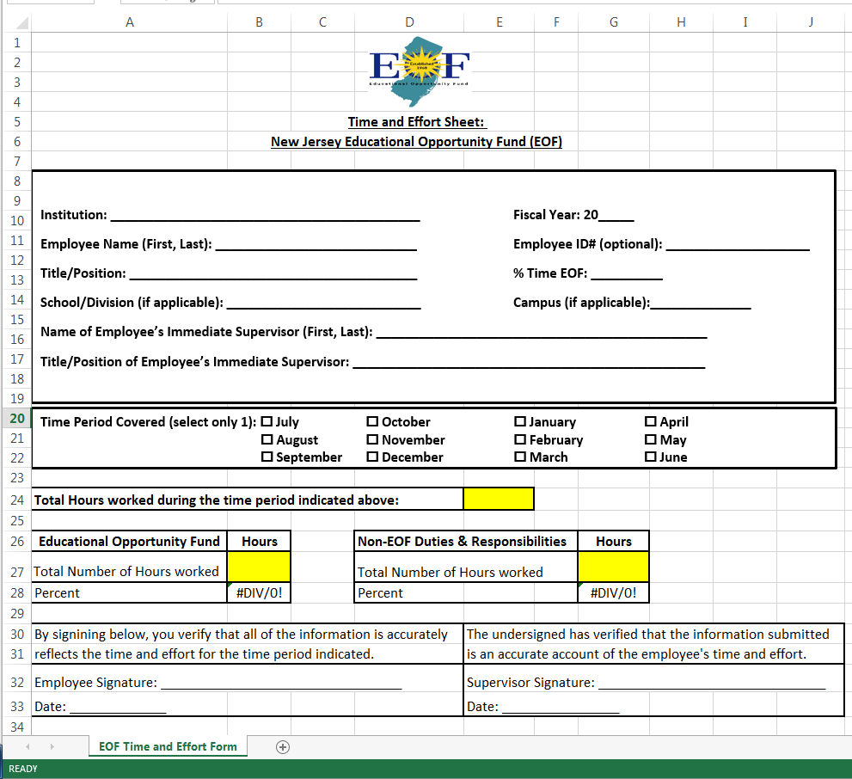
EOF TIME AND EFFORT REPORT

Slide 16
A visual representation of how things are different this year
FY20 (2019 Summer Program & FY20 AY Support)
FY21 (2020 Summer Program & FY20 5th Qtr. & FY21 AY Support
SUMMER PROGRAM FUNDING
(FYS19 &20)
B2 Contract Attachment
FY20 Academic Year Art. IV Program Support
(7/1/2019 – 6/30/20)
B3 Contract Attachment
SUMMER PROGRAM FUNDING
(FYS20 & FY20 5th Qtr. Art. III)
B2 Contract Attachment
FY20 5TH Qtr. Art. IV Program Support
(7/1/2020 – 9/30/202)
B3-(A) Contract Attachment
FY21 AY Art. IV Program Support (10/1/2020 – 6/30/2021)
B3-(B) Contract Attachment

Slide 17
Virtual review of B3-(A) and B3-(B) contract attachments

Slide 18
Summer funds to support EOF 12-month staff members
Example:
- John Doe is a EOF 12-month counselor. John is 100% time EOF.
- John Doe’s annual salary is $60,000. ($60,000/12 months = $5,000/month)
- 50% of John’s salary ($30,000) is covered by EOF funds; the other 50% of John’s salary ($30,000) is covered by the institution. Monthly = $2,500 (EOF) & $2,500 (Institution).
- Instead of using FY20 5th Quarter funds to cover the EOF portion of John’s salary for the months of July and August, the institution elects to use a portion of the EOF program’s summer funds to help cover the EOF portion of John’s salary. ( $2,500 for July) & ($2,500 for August) = $5,000 in EOF summer funds. The institution will continue to cover it’s portion of John’s salary during this time (i.e. $2,500 for July and $2,500 for August = $5,000).
- The next three slides will show how John should appear on the program’s B2, B3-(A), & B3-(B) contract attachments.

Slide 19
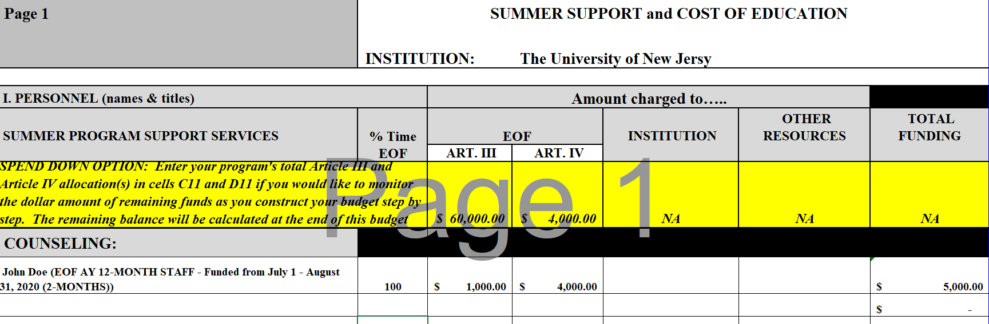
Example of John Doe – EOF 12 Month Employee supported by 2020 Summer funds (B2 budget accountability)
Note: Since John is a 12-month EOF staff member, the institution’s contribution to John’s salary should not appear on the program’s B2 Summer budget. It should be listed on the B3-(A) contract attachment for the indicated time period of July 1 – August 31, 2020.
For EOF 12-Month staff --- Programs must indicate the exact dates of summer fund coverage.
%Time and salary should reflect how the person appears on the B3 contract attachments

Slide 20
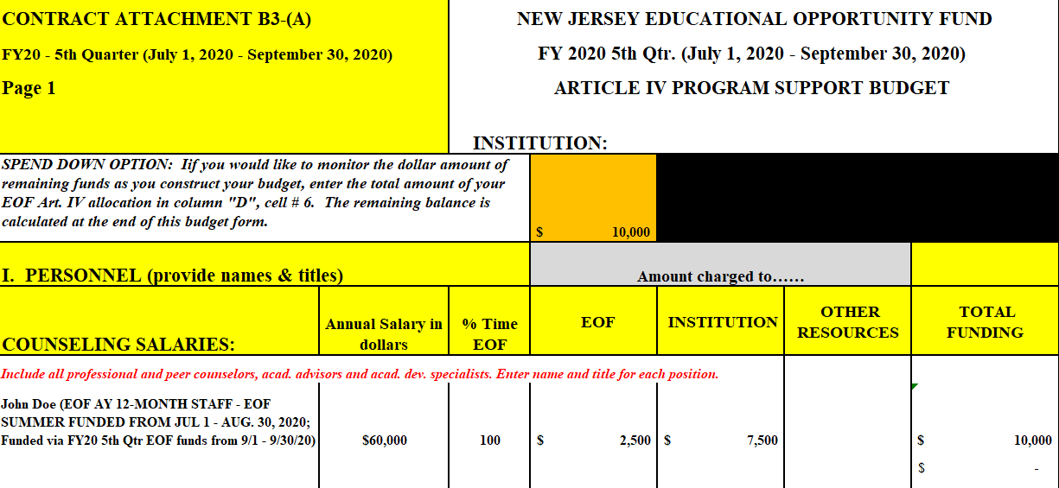
Example of John Doe – EOF 12 Month Employee supported by 2020 Summer funds (B3-(A) FY20 5th Qtr. budget accountability)
Important to remember that although this budget reflects a total of $10K, John earned $15k in total because $5k was covered via Summer Funds (B2)
John’s Annual Salary equates to ($60K/12mo.) = $5,000 monthly. FY20 5th Quarter covers 3 months (July-September). John should receive a total of $15k for three months.
John’s salary is distributed: 50% EOF and 50% institution; Since EOF summer funds were used, only 1 month of FY20 5th Qtr. Art. IV funds is needed.
For EOF 12-Month staff --- Programs must indicate the exact dates of summer fund coverage vs. EOF FY20 5th Qtr.
Institution’s 50% contribution for 7/1/20 – 9/30/20 appears here.

Slide 21
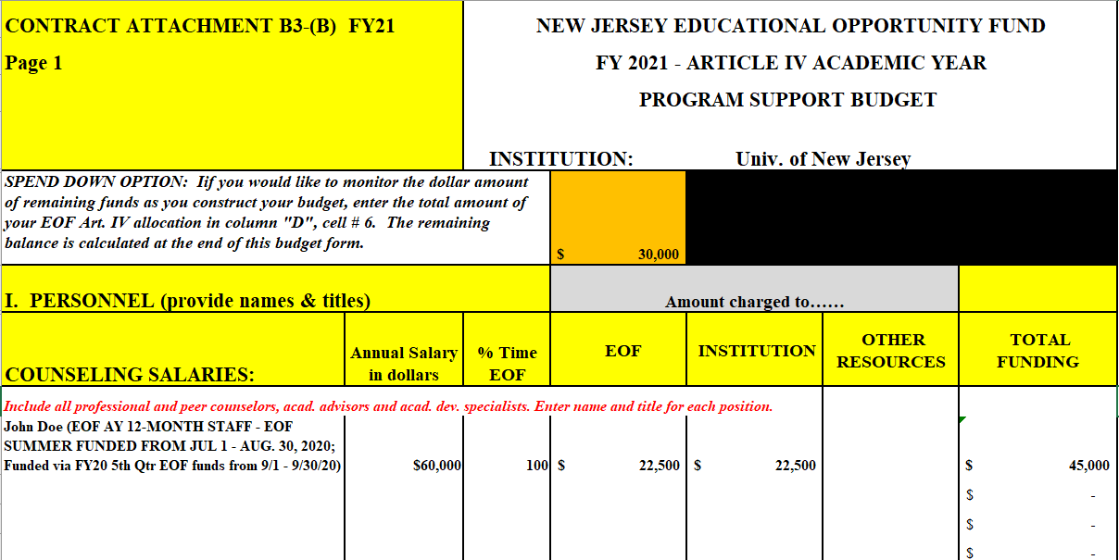
Example of John Doe – EOF 12 Month Employee supported by 2020 Summer funds (B3-(B) FY21 budget accountability)
Important to remember that although this budget reflects a total of $45K, John earned $15k in total because $5k was covered via Summer Funds (B2); and $10k was covered via the FY20 5th Qtr. budget (B3-(A))
John’s Annual Salary equates to ($60K/12mo.) = $5,000 monthly. FY21 covers 9 months (10/1/20–6/30/21). John should receive a total of $45k over 9 months.
John’s salary is distributed: 50% EOF and 50% institution; Since EOF summer and FY20 5th Qtr. funds were used, only 9 months of FY21 Art. IV funds is needed.
For EOF 12-Month staff --- Programs must indicate the exact dates of fund coverages.
Institution’s 50% contribution for 10/1/20 – 6/30/21 appears here.

Slide 22
IMPORTANT FEATURES
OF BOTH B3 CONTRACT BUDGET ATTACHMENTS
Emphasis on the following budget categories
Spend Down Calculator tool
“Annual Salary in Dollars” enter the annual total salary for each position listed in the personnel section of the budget.
“Professional Development & Student Leadership Development” itemize costs of staff and student registration fees for conferences, webinars, and leadership development activities. Include also professional membership fees and consultant presentation costs.
“Travel” itemize travel expenses for professional staff development, recruitment activities, student educational development and student travel for leadership activities. For all travel for professional development (i.e. attendance at conferences), programs must articulate how this information is beneficial for the program (do not simply state “will enhance staff knowledge of best practices”). Must document some form of post-conference assessment of what was learned relative to the program’s current and future offerings. Documentation of this assessment must be kept (i.e. Discussion of what was learned at the conference at a staff meeting held on xx/xx/20xx and information based on what was learned, a validation or suggestion of change for current practice should be considered.) It is also important to remember that FY20 5th Qtr. funds can only be used to pay for EOF 12-month staff salaries and support activities that occur from July 1, 2020 to September 30, 2020. FY21 funds can only be used to pay for EOF 12-month staff salaries and support activities that occur from October 1, 2020 to June 30, 2021.
Program Advisory Board (PAB)” itemize expenses for PAB meetings & functions. Only programs that have a PAB (membership list, by-laws & minutes of meetings) should list expenses. Otherwise leave this category blank.

Slide 23
B3-(A) & B3-(B) Art. IV Program Support Contract Budget Attachments
Line Item Description
Use the new worksheet tab labeled “line item description” on both respective contracts to provide a brief description of each item listed in each of the Article IV budget categories
e.g. - Educational Materials & Supplies:
Acceptable: purchase of textbooks for tutors @ a total cost of $500.00
Not acceptable (too vague): purchase of textbooks
Not acceptable: purchase of books and supplies for student usage

Slide 24
Article IV Institutional Match
May Include
May Not Include
The EOF campus program administrator’s salary and fringe benefits;
Funds contributed or donated to the institution by public agencies, private organizations or individuals;
Real or personal property contributed or donated to the institution by public agencies, private organizations, or individuals;
The provision and maintenance of state of the art technological equipment (such as computer hardware, modems, fax machines);
Direct services rendered by other institutional staff to the EOF program (Services to EOF students should be above and beyond what all students would normally receive and for audit purposes is defined part of the individual’s job responsibilities); and
All or a portion of any EOF staff member’s salary, wages, or fringe benefits (certain restrictions do apply).
Program reporting supervisors and other high level institutional officers who are required to serve all students;
Any Institutional Staff whose total contribution to the EOF program is less than 10%. (Note: If a staff member resigns or is removed from their position, an adjustment to your contract is required).
Items and services normally provided to students by the institution without charge;
Items and services normally provided to the institution by other government agencies without charge;
Charges incurred by the institution as program costs but require no cash outlay by the institution during the grant period;
Any cost incurred or contribution of services made in a prior fiscal year;
Double count any item covered by institutional or other resources on B3-(A) on B3-(B) or vice a versa.

Slide 25
Article IV Funds Cannot Be Used to Pay For:
The EOF campus program administrator’s salary and fringe benefits;
Fringe benefits for 12-month EOF staff at public senior institutions;
Fringe benefits in excess of 21 percent of the salaries and wages paid by
EOF funds for 12-month EOF staff at community colleges and
independent institutions;
Employee benefits for academic year student assistants and part-time
personnel;
The purchase of equipment/hardware
Transportation of students for normal commuting costs;
The cost of instruction for which students are charged tuition;
Other student costs that normally are covered by a student’s financial aid
package, such as: any fees, room and board, books, educational supplies,
transportation, funds for printing, and child care;
Lobbying, partisan political contributions, and/or fund raising activities;
The purchase of alcoholic beverages; and
Indirect expenses (such as space, heat, lights, postage, and telephone) that
exceed 10 percent of the total academic year Article IV allocation.

Slide 26
B3-(A) & B3-(B) Article IV Budget Transfers/Modifications/Adjustments
Campus programs may make budget transfers/modifications/adjustments for
current personnel budget items within the personnel lines, and current “other than
personnel" budget items within the other than personnel line without written approval
Budget transfers between personnel budget items and other than personnel budget items must be submitted in writing with a narrative explaining both “why” and “where” you are looking to re-distribute your existing funds & an updated Excel Budget document reflecting the requested change. All requested changes require the written approval of the EOF Central Office.
Budget modifications for items that were not part of the original fiscal year contract
must be submitted in writing with a narrative explaining both “why” and “where” you are looking to re-distribute your existing funds and an updated Excel budget document reflecting the requested change. All requested changes require the written approval of the EOF Central Office.
All requests for budget modifications should be sent to the EOF Central Office liaison assigned to your program.

Slide 27
B3-(A) & B3-(B) Article IV Budget Transfers/Modifications/Adjustments
B3-(a) fy20 5TH quarter art. Iv Program support
b3-(b) fy21 ay art. Iv program support
- Due by September 4, 2020
- Must provide written justification for the proposed modification.
- Must include original EOF budget document (via excel format) with proposed budget modifications displaying the total amounts being reallocated.
- Due by April 1, 2021
- Must provide written justification for the proposed modification.
- Must include original EOF budget document (via excel format) with proposed budget modifications displaying the total amounts being reallocated.

Slide 28
B3-(A) EOF FY20 5th Qtr. Article IV Program Support Draft & Final Expenditure Reports
Comprehensive Draft of B3-(A) EOF FY20 5th Quarter Art. IV Program Support due by: July 27, 2020
Final Expenditure Report submission deadline: November 2, 2021
- Report expenditures from July 1, 2020 through September 30, 2020
- Refund checks for total under expenditures of Article IV funds are payable to the Treasurer, State of New Jersey and should accompany the expenditure report.

Slide 29
B3-(B) EOF FY21 Article IV Program Support
Interim & Final Expenditure Reports
Finalized B3-(B) Contract Attachment submission deadline: October 22, 2020
1st Interim Expenditure Report submission deadline: January 18, 2021
- Report expenditures from Oct. 1, 2020 through Dec. 31, 2020.
- Project expenditures from Oct. 1, 2020 through Mar. 31, 2021.
2ND Interim Expenditure Report submission deadline: April 15, 2021
- Report expenditures from Oct. 1, 2020 through Mar. 31, 2021.
- Project expenditures from Oct. 1, 2020 through June 30, 2021.
Final FY 2021 Article IV payment based 2ND Interim Expenditure Report:
- Based on program’s total projected expenditures through June 30, 2021.
Final Expenditure Report submission deadline: August 31, 2021
Report expenditures from Oct. 1, 2020 through June 30, 2021.
Refund checks for total under expenditures of Article IV funds are payable to the Treasurer, State of New Jersey and should accompany the expenditure report.

Slide 30
Submission of Completed Contract Documents to EOF Central Office
Send contract document attachments via email to the EOF program liaison assigned to your campus
This includes:
Contract budget attachment B1 EOF Program Mission Statement and Program Goals & Objectives - send as an unprotected word document
Contract budget attachment B2 Summer Program – send as an unprotected excel document
Contract budget attachment B3-(A) FY20 5TH Quarter & B3-(B) FY 21 Academic Year Article IV program support funds - send as an unprotected excel document
THESE FORMS MUST BE KEPT IN THEIR ORIGINAL WORD OR EXCEL FORMAT. DO NOT CONVERT TO PDF FORMAT OR REMIT AS PASSWORD PROTECTED DOCUMENTS OR VIA A FILE SHARE PORTAL (I.E. GOOGLE DOCS, MICROSOFT TEAMS, ETC.)

Slide 31
Contract Attachment B4 - EOF Special Projects (if applicable)
EOF Special Projects Budget Forms will only be made available if Special Project funds are made available.

Slide 32
Contract Attachment B5 - EOF Winter Session (if applicable)
EOF Winter Session Budget Forms will only be made available if Winter Session funds are made available.

Slide 33
EOF Winter Session (if applicable)
* Only for EOF Renewals (i.e. student may not receive an initial EOF grant during the Winter Session).
* Funding may not be used to support housing for staff.
* Only for undergraduate EOF students.
* Funding is intended for academic enrichment or academic advancement.
* Only can be used for courses that count toward degree progress.
* Funding may not be used for Professional Development or Student Leadership activities.

Slide 34
Disbursement of B3-(A) FY20 5th Quarter and B3-(B) FY21 Article IV Academic Year Program Support Funds
FY20 5th Quarter Art. IV Program Support Funds:
Campus programs will receive 100% of their FY20 5th Quarter Article IV allocation in July.
FY21 AY Art. IV Program Support Funds:
Campus programs will receive 75% of their academic year Article IV allocation in October pending the final approved FY21 Appropriations Act.
* = Programs that owe a refund or an outstanding report will not receive their funding until all past-due items are remitted.
Campus programs will receive the balance of their academic year Article IV allocation during either Mid-May to early June. The balance (up to 25%) will be based on the campus program’s projected expenditures on the 2nd interim expenditure report.

Slide 35
Submission Deadlines
Per the revised EOF Regulations, the EOF campus program director is responsible for ensuring that all documents are submitted by the identified deadlines.
        Comprehensive Draft of B2 – (Previously - July 1, 2020; Extended due to June 22nd EOF Board approved updated preliminary allocations) - Received by July 15, 2020
        Comprehensive Draft of B3-(A) – Received by July 27, 2020
        Contract signature page (via DocuSign) – Received by October 22, 2020
        Finalized Contract Attachments B1, B2, and B3-(A)&(B) (Emailed in original format to Program Liaison) – Received by October 22, 2020
Reminder - Late documents may result in suspension of payments.

Slide 36
Distribution of EOF Document Submissions
Attachment B1 – Mission, Goals and Objectives: EOF Program Liaison
Attachment B2/C1 - Summer Program Final Expenditure Report: Maisha Howard w/CC to Program Liaison
Attachment B3-(A)&(B)/C2-4 – AY Art. IV Expenditure Reports: Kelechi Unegbu w/CC to Program Liaison
Attachment B4/C5 – Special Projects (if applicable): Dr. Stephanie Shanklin w/CC to Program Liaison
Attachment B5/C6 – Winter Session (if applicable): Dr. Hasani Carter w/CC to Program Liaison
Attachment C7 – EOF Annual Report: Shakia Williams w/CC to Program Liaison

Slide 37
Resources
OSHE/EOF Website
http://www.state.nj.us/highereducation/EOF/EOF_Program_Resources.shtml

