Slide 1
New Jersey Financial Aid Management System (NJFAMS)
EOF Selection, Awarding, Certification and Payment Process

Slide 2
OSHE/EOF Staff
Dr. Hasani Carter
hasani.carter@oshe.nj.gov
Hema Patel
Hema.Patel@oshe.nj.gov
Dr. Stephanie Shanklin
Stephanie.Shanklin@oshe.nj.gov
Shakia Williams
Shakia.Williams@oshe.nj.gov

Slide 3

Points of Emphasis
Awarding and roster management is the responsibility of each institution.
Provide EOF campus programs and their respective Financial Aid office with instructions on how to select, award, certify, and request payment for identified EOF eligible candidates during the academic year.
The EOF selection, awarding, certification and payment request process will require the involvement of both the EOF campus program and their institution’s financial aid office.
Student selection and the ability to place an EOF Article III undergraduate grant award on their account must occur within the EOF portal.
Student certification and payment requests must occur within the institution’s Financial Aid portal of NJFAMS.
The EOF portal is a separate part of NJFAMS.
Access to the EOF portal is facilitated by OSHE/EOF.

Slide 4
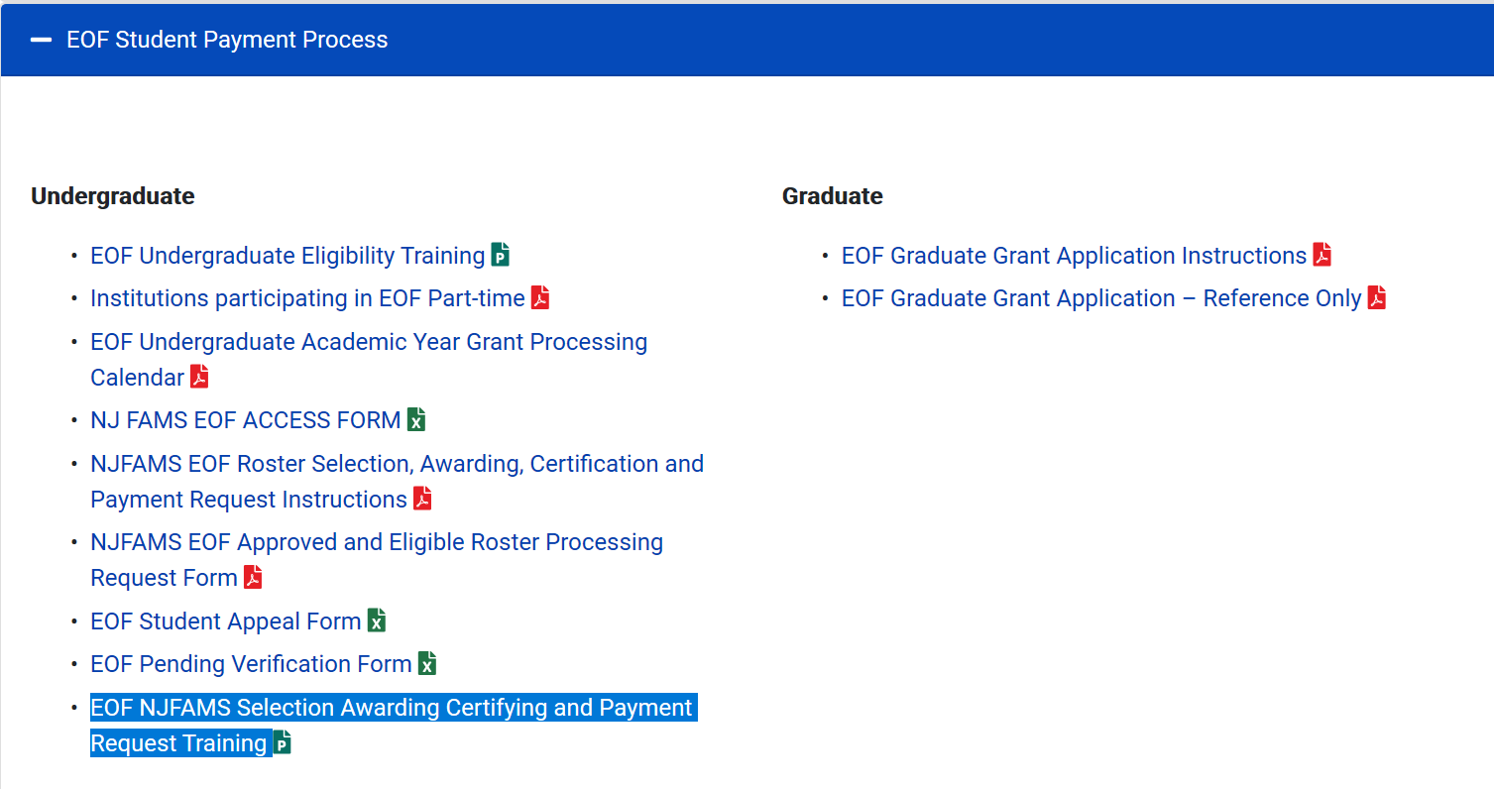
EOF Campus Program Resources Webpage
https://www.nj.gov/highereducation/EOF/EOF_Program_Resources.shtml

Slide 5
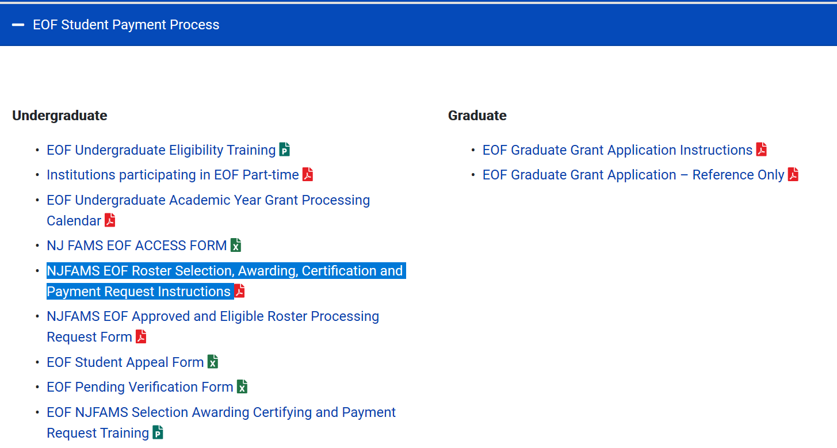
EOF Roster Selection, Awarding, Certification and Payment Request Instructions

Slide 6
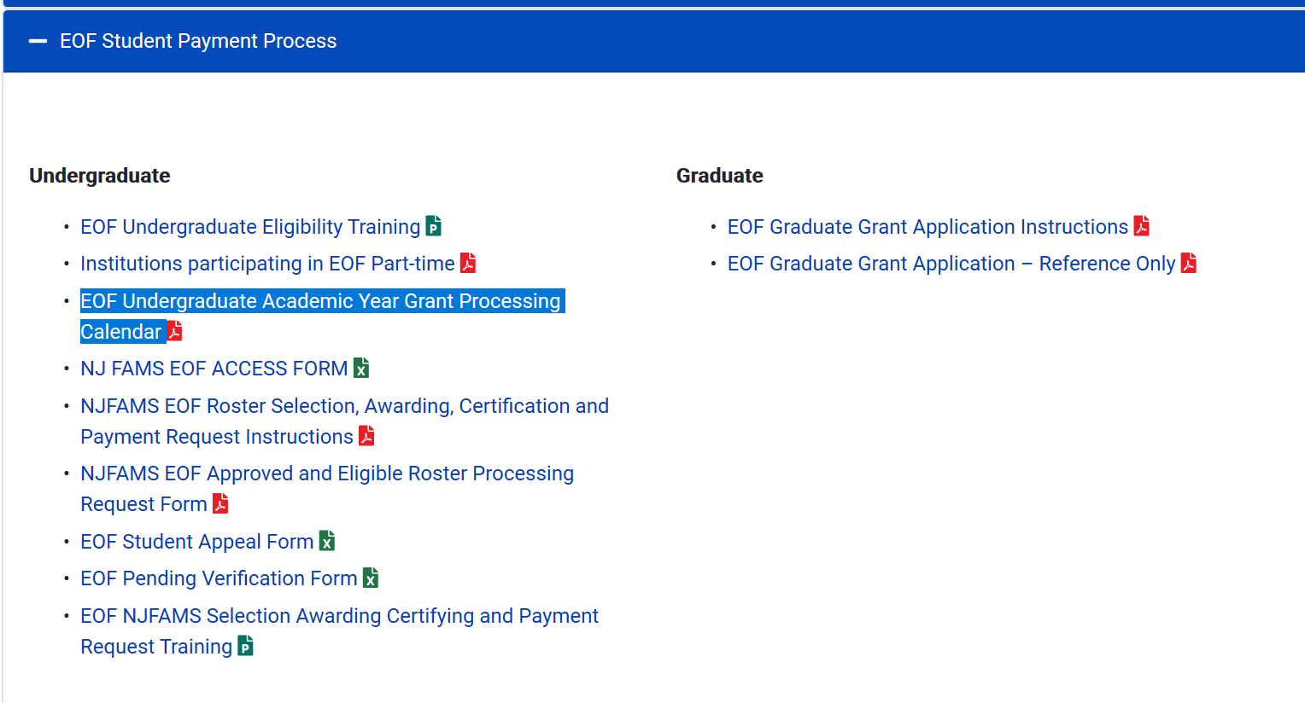
EOF Undergraduate AY Processing Calendar

Slide 7
The Process
EOF Campus Program(s)
Campus Financial Aid Office
ONLY has the ability to select and award an EOF Undergraduate Article III Grant to an eligible student.
Funding is limited
Programs are responsible for ensuring all candidates are reviewed and awarded properly and the appropriate documentation to determine eligibility is kept on file (See EOF regulations).
Must ensure EOF Enrollment matches institutional FA Enrollment Status
Must certify EOF students
Must request payment by the EOF Deadline
If a refund is due, funds must be sent to OSHE.
DO NOT SEND EOF FUNDS TO HESAA

Slide 8
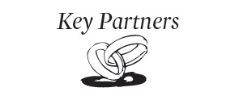
Clarification Regarding EOF & HESAA
EOF does not operate under the authority of the Higher Education Student Assistance Authority (HESAA).
EOF is a part of the Office of the Secretary of Higher Education (OSHE) which is a separate agency.
EOF refunds must be sent to OSHE. Do not send them to HESAA.
OSHE
EOF Portal
HESAA
NJFAMS
EOF
EOF Processing Calendar
HESAA Processing Calendar

Slide 9
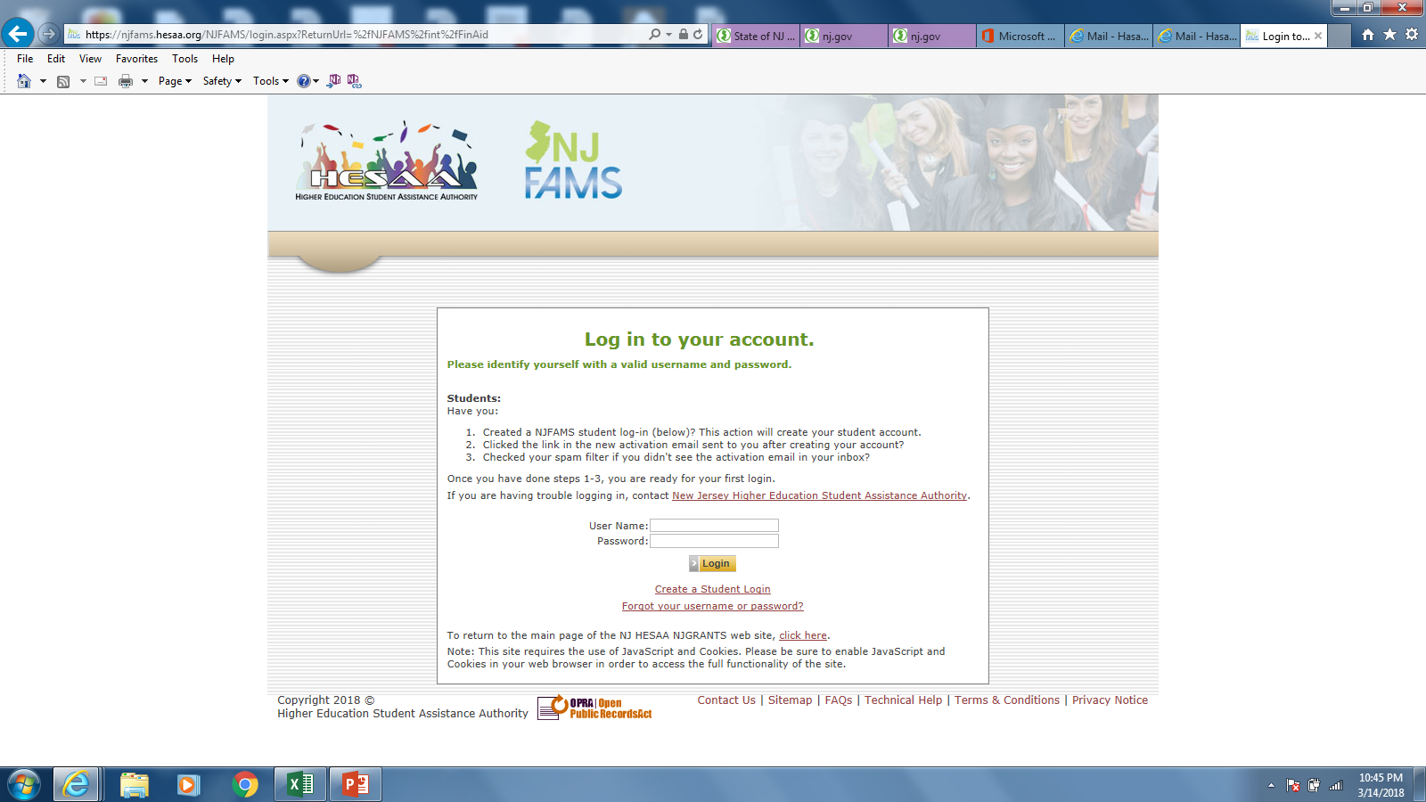
EOF Campus Director must manage who is given EOF portal access

Slide 10
Main Menu – EOF Portal View
Program Undergraduate Art. III Allocation and Available Funds
Locate, award or un-award students via the rosters. Also, you can look up each student to see what is going on with them.

Slide 11
Other Main Menu Notables
The Main Menu provides access to all of the options that are available to the user. Access is based on system permissions established for the user. If you have “READ ONLY” permission, you will only be able to view the data on the screen.
You can access all of the regions via the “Menu” drop down option.
Confirm the Academic Year you need to work within.
Confirm Academic Year

Slide 12
Quick Search
Use Quick Search to search for a student record by last name, first name, first and last name, Social Security Number, or NJHESAA ID.
If searching by name, enter the first initial of the student’s first and/or last name at a minimum. If entering last name before the first name, the names, or any portion of the names, must be separated by a comma.
If you are searching by last name only, enter a comma after your entry. The comma limits the search to last names, so search results will be returned to you more quickly.
If searching by SSN or ID, you must enter the complete number.

Slide 13

Quick Search - Continued
If only one student meets the Quick Search criteria, clicking Go opens Edit Student for that student. If the student does not have a record in the selected academic year but does have a record in another year, a screen will alert you to the year(s) for which the student has a record.

Slide 14
EOF Allocation and Available Funds

Slide 15
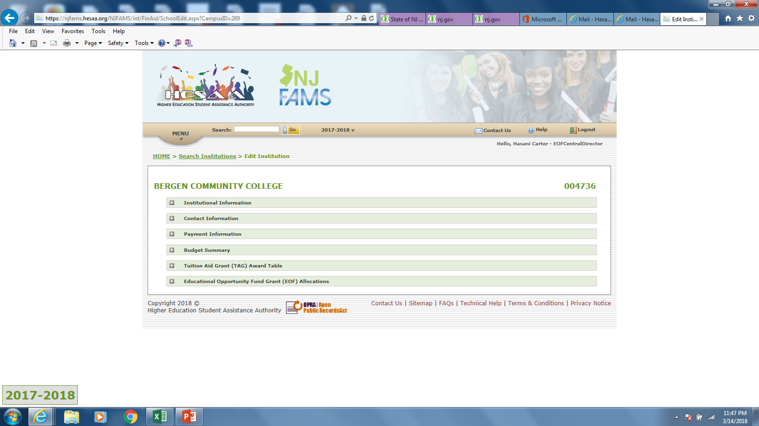
Institutional Information
View Program Allocation and Available funds here.

Slide 16
EOF Allocation
Available $ to award to students

Slide 17
Locating your students
Click on “Rosters”

Slide 18
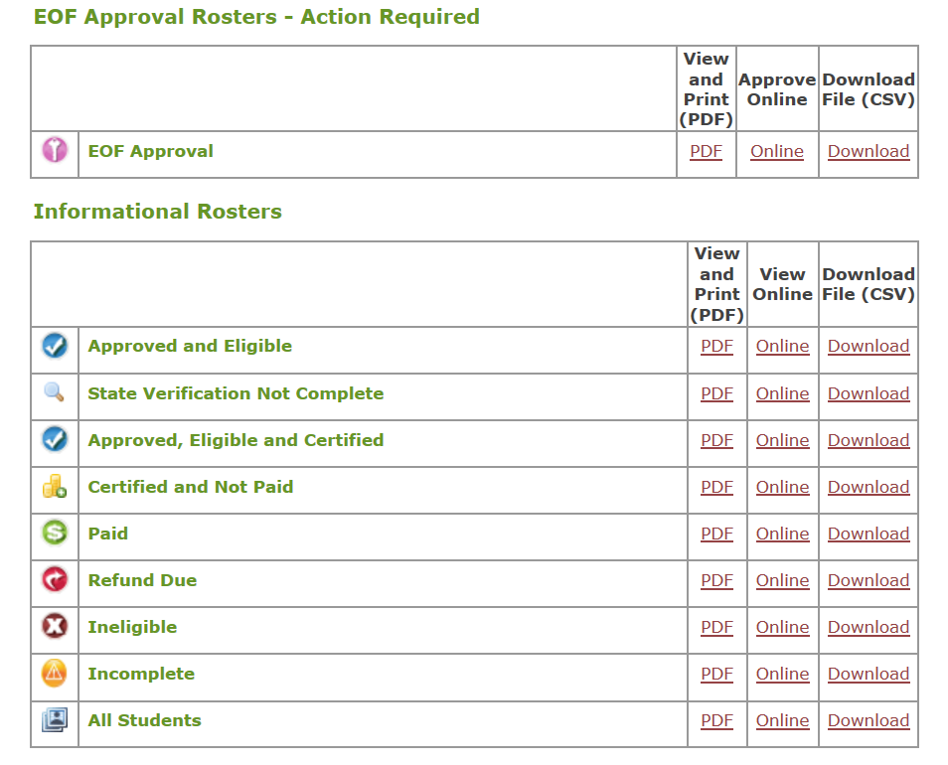
New for 2021: Additional Informational Rosters

Slide 19
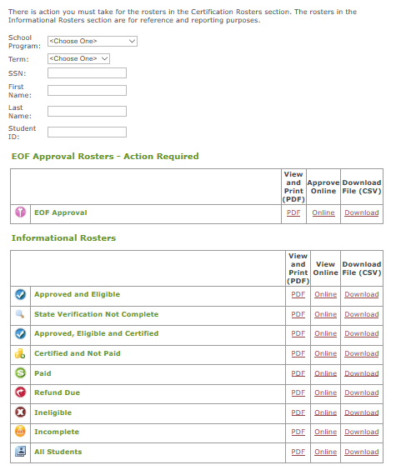
EOF Roster Management
Look for eligible Initials and Renewals who were not on the program’s roster as of the Fall term of the previous Academic Year.
Renewal students who appeared on a program’s roster during the Fall term of the previous Academic Year & who remain eligible should appear here.
$ ineligible students

Slide 20
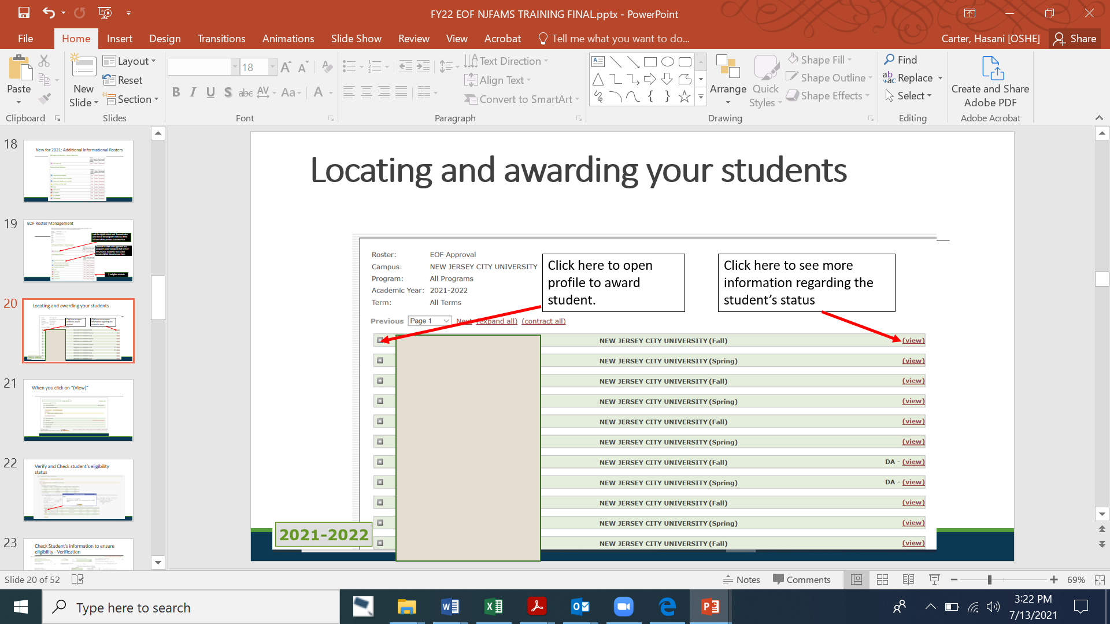
Locating and awarding your students

Slide 21

When you click on “(View)”

Slide 22
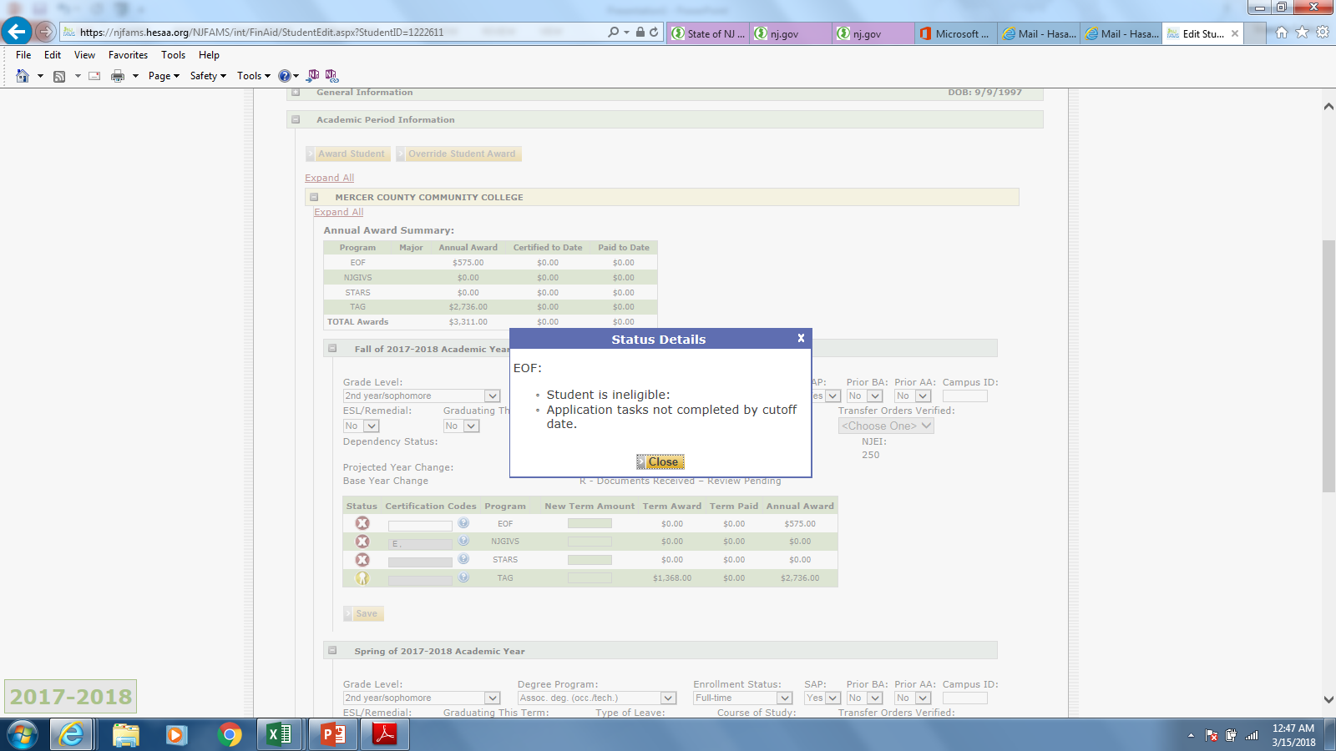
Verify and Check student’s eligibility status

Slide 23
Check Student’s information to ensure eligibility - Verification

Slide 24
Verification - Continued

Slide 25
EOF Financial Eligibility Notables:
- A dependent student’s income and assets shall not be considered in the gross household income.
- Eligibility for TAG should not be automatically associated with eligibility for EOF.
- An applicant whose household receives Temporary Assistance for Needy Families (TANF) and/or Supplemental Social Security Income (SSI) as the sole means of support are eligible regardless of the amount of such support.
- In determining financial eligibility for an Article III student grant, separation or divorce, or the disability or death of a wage earner for the academic year for which eligibility is being determined, with a concomitant decrease in household income below the EOF Income Eligibility Scale, does not automatically satisfy the financial eligibility requirement.
- If an applicant believes that their reported household income and/or assets are not accurately reflective of their current financial profile, they will need to work with the institution’s financial aid office and HESAA to rectify this matter. OSHE/EOF does not make or review any adjustment appeals.

Slide 26
When you open up the “+” to award a student

Slide 27
When you open up the “+” to award a student

Slide 28
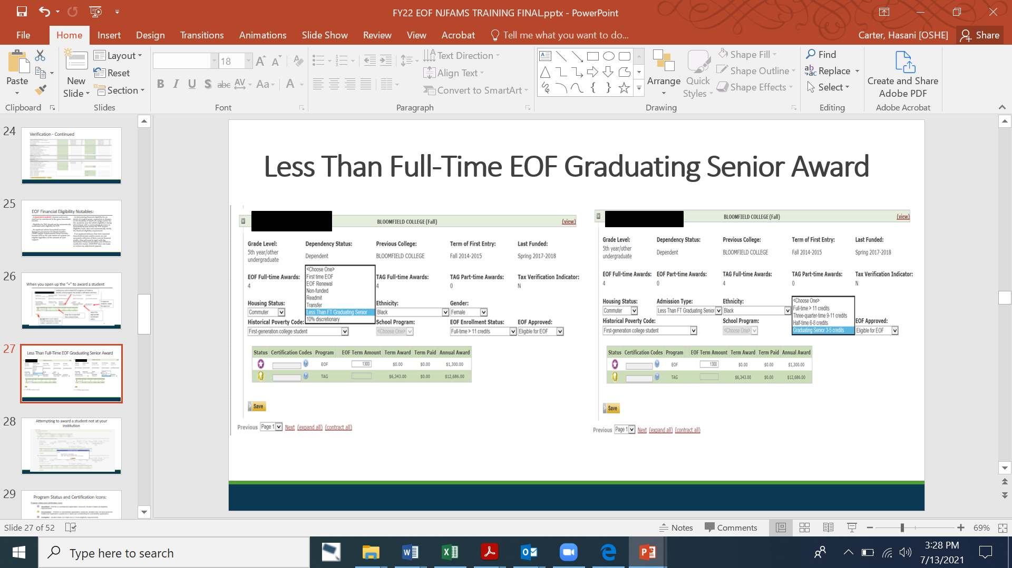
Less Than Full-Time EOF Graduating Senior Award

Slide 29
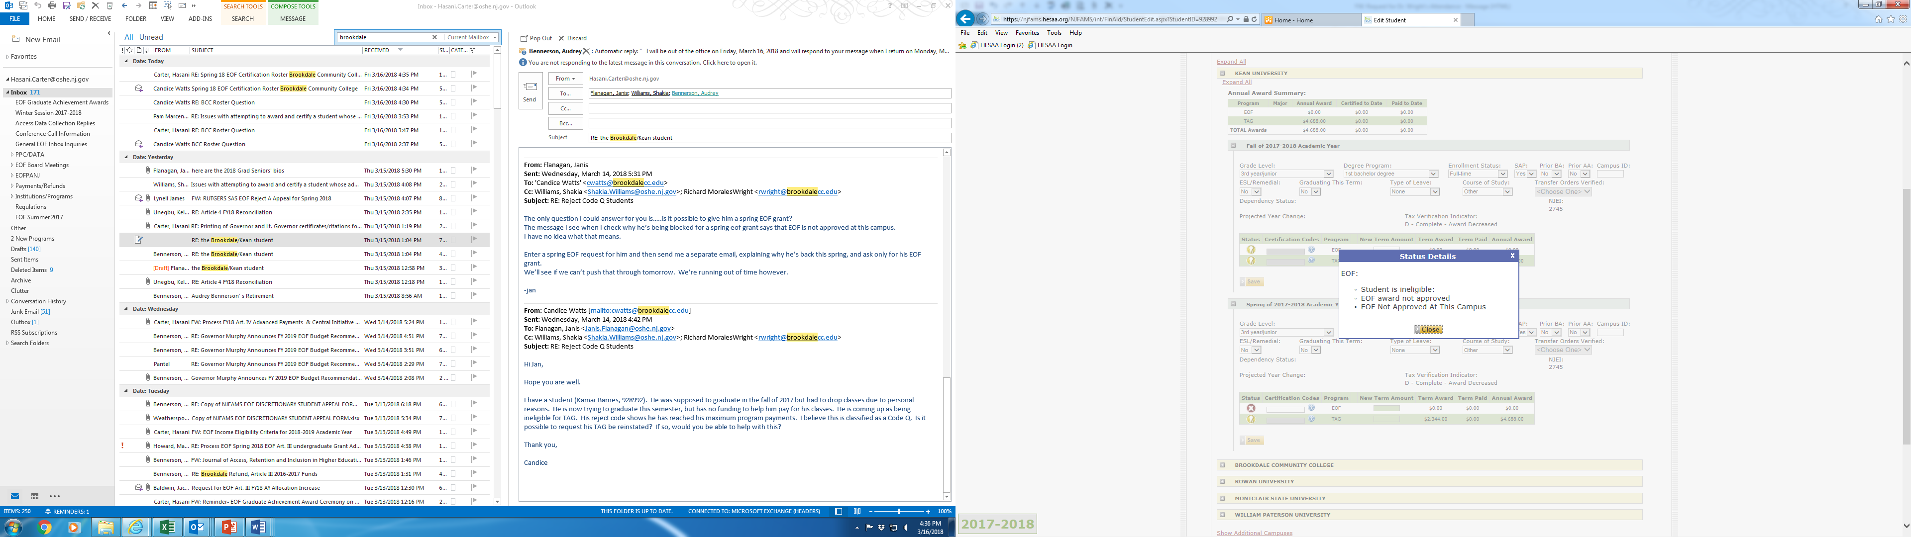
Attempting to award a student not at your institution

Slide 30
Awarding a student whose ineligibility reason only shows “EOF Award Not Approved”
* If “EOF award not approved” is the only reason that a student appears as ineligible, you may be able to award this student.
* There are a number of reasons that may cause for this status to appear. So you will need to check the student’s profile to ensure that they meet all of the eligibility requirements (i.e. financial eligibility, residency, completed application, etc.).
* Once you have verified that the student appears to be eligible within the system and you have reviewed the appropriate financial documents submitted by the student, then you can attempt to award the student within NJFAMS.
* Awarding of the student will force the system to re-screen the student. If everything is in proper order, then the student’s status should switch to “qualified” and their award should appear on their account.
* If it does not go through, then contact your EOF program liaison and we will investigate the matter further.

Slide 31
Program Status and Certification Icons:

Slide 32
EOF Campus Programs: After you have awarded all of your students, they must appear on your EOF Approved and Eligible Roster – Send this CSV file and your EOF Roster Certification form to OSHE/EOF (to Ms. Shakia Williams (shakia.williams@oshe.nj.gov) w/copy to program Liaison.

Slide 33
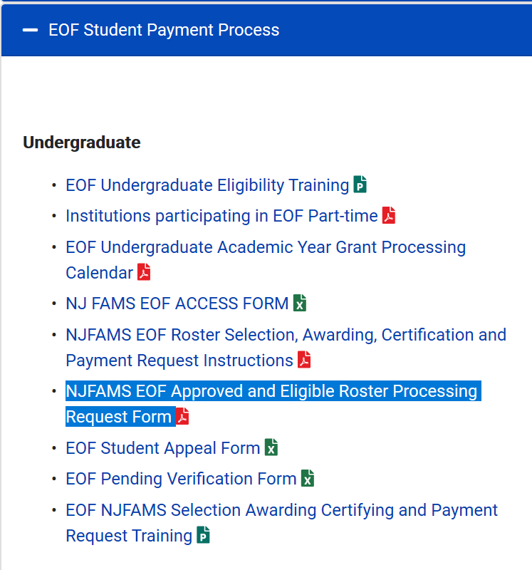
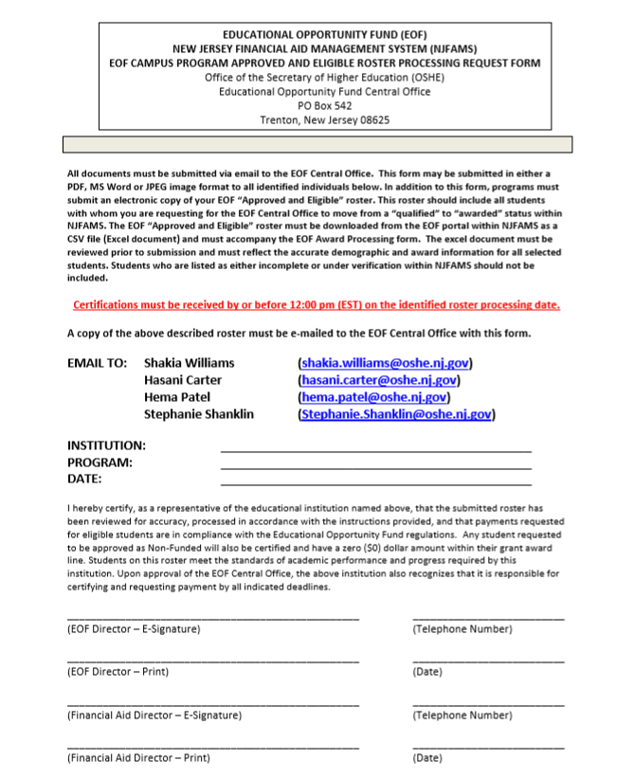
EOF Roster Processing Form – Located on the EOF Campus Program Resources Webpage

Slide 34
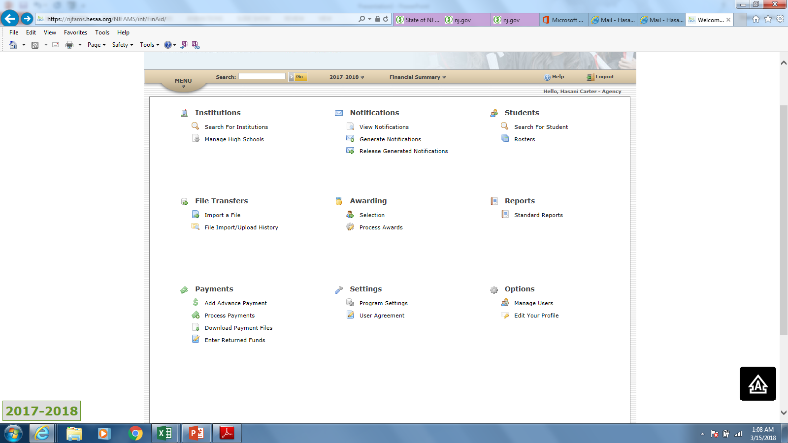
Although slightly different, Institutional FAO have a region where they are able to certify and request payment for your students.
FAO liaison must go here to locate the students that need to be certified.

Slide 35
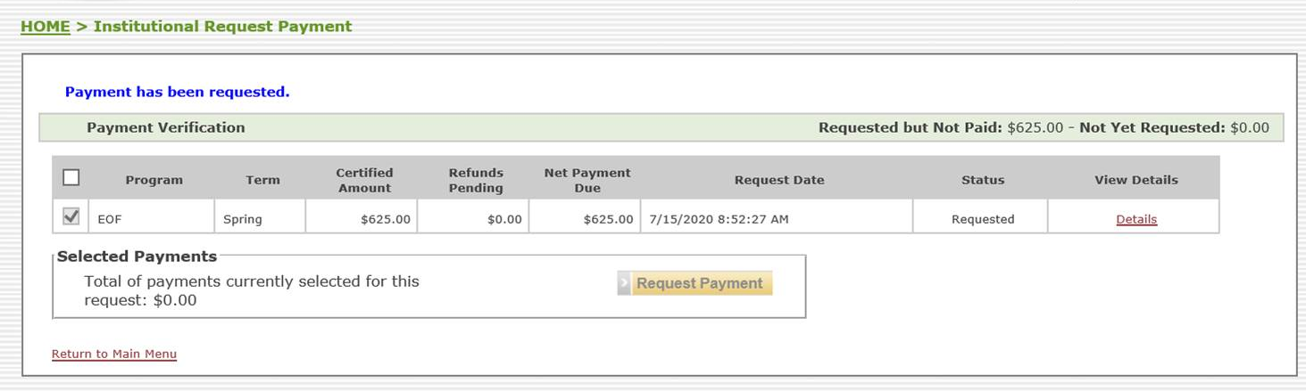
Institutional Financial Aid Office (FAO) – Certification & Payment Request
Each participating institution’s Financial Aid Office (FAO) must certify all EOF students (including Non-Funded) before submitting a request for payment.

Slide 36
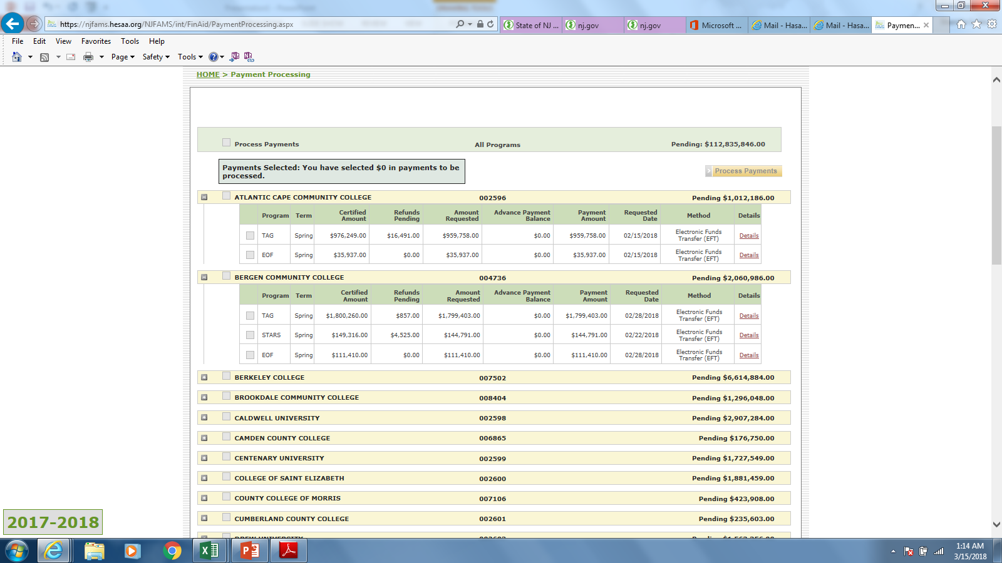
Once FAO has certified and requested payment – OSHE/EOF can move students to paid status.

Slide 37
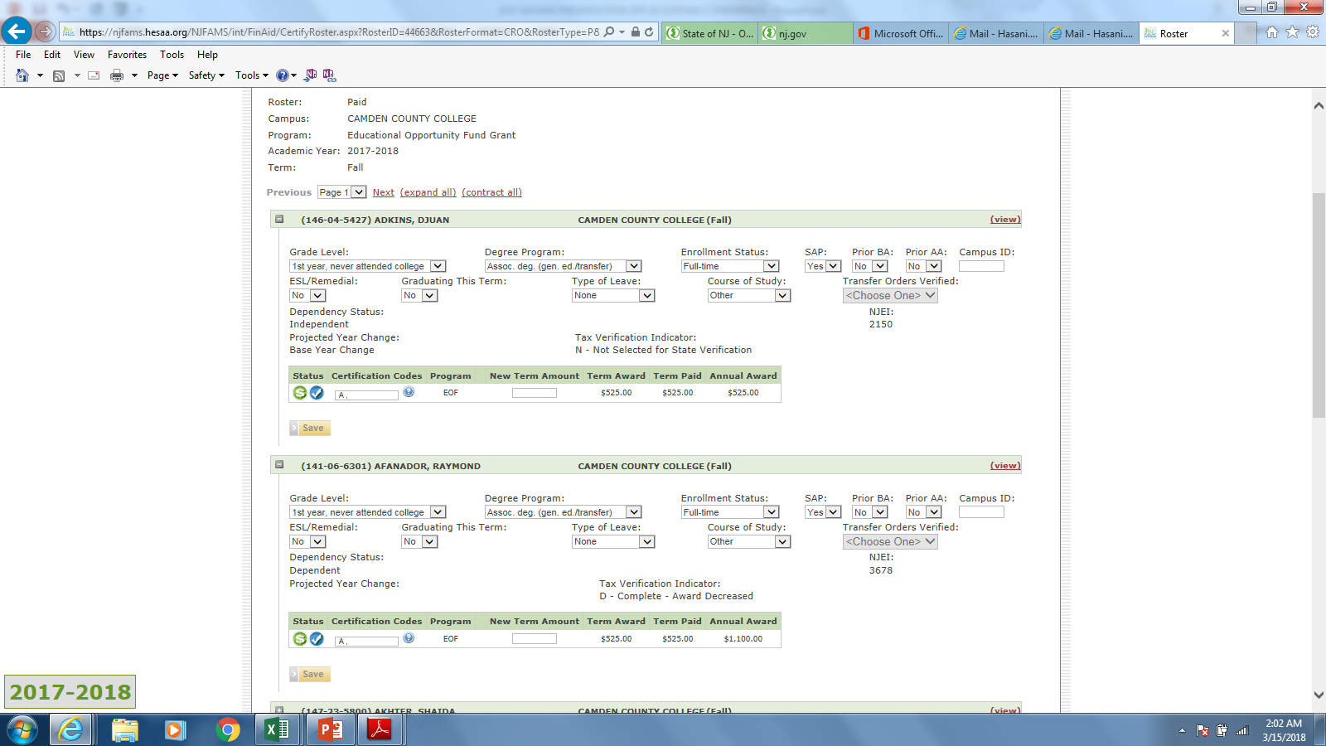
Students should now show up as “Paid”

Slide 38
Reminder: EOF AY UG Grant Award is a range
EOF Undergraduate Awards for Full-time and Part-time students (Minimum semester award = $100) * = award amount is based on whether or not the student is a residential or commuter student 2021-2022 Academic Year
 | Full-time Maximum Annual/Semester | (6-8 credits) Part-time Maximum Annual/Semester | (9-11 credits) Part-time Maximum Annual/Semester
Community Colleges | $1,300 annual max. / $650 semester max. | $726 annual max. / $363 semester max. | $1,012 annual max. / $506 semester max.
Independent College and Universities | $2,750 annual max. / $1,375 semester max. | $1,450 annual max. / $725 semester max. | $2,100 annual max. / $1,050 semester max.
State & Research Colleges and Universities* | Full-time Maximum Annual/Semester | (6-8 credits) Part-time Maximum Annual/Semester | (9-11 credits) Part-time Maximum Annual/Semester
Commuter: | $1,400 annual max. / $700 semester max. | $776 annual max. / $388 semester max. | $1,088 annual max. / $544 semester max.
Residential: | $1,650 annual max. / $825 semester max. | $1,050 annual max. / $525 semester max. | $1,350 annual max. / $675 semester max.

Slide 39
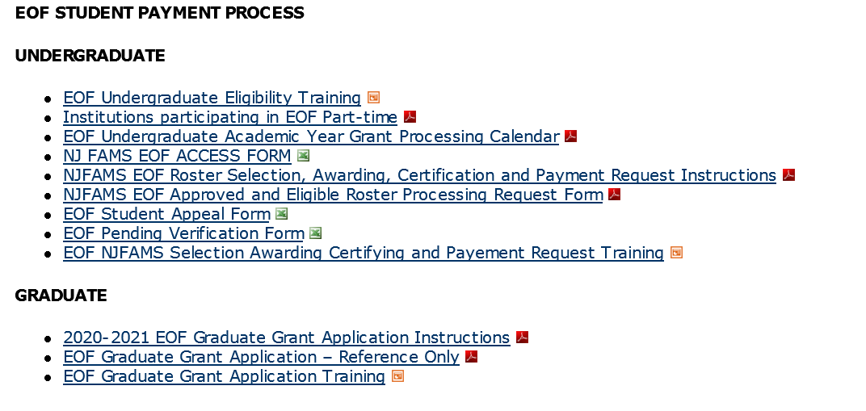
Review of EOF Undergraduate AY Processing Calendar

Slide 40
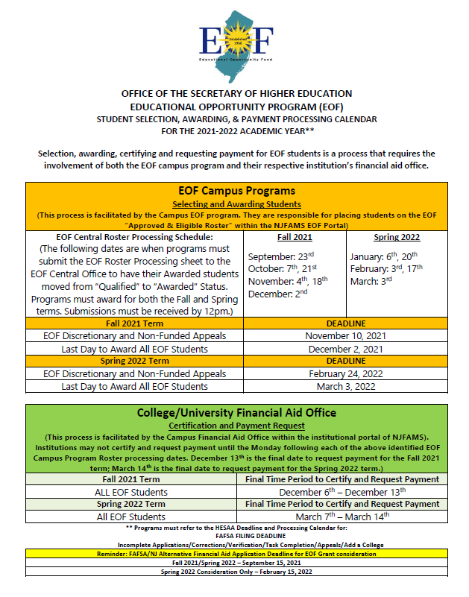
Institutional Accountability
All participating institutions must adhere to the EOF statewide processing deadlines.
Institution’s that fail to properly adhere to the EOF processing calendar will:
Need to provide in writing why this error/oversight occurred.
How it plans to address and ensure that this error/oversight does not happen again.
Demonstrate how the institution will hold the students harmless (i.e. use institutional funds to cover the EOF grant amount that the institution failed to properly process and request in accordance with the EOF processing guidelines.)

Slide 41
Reminder: EOF Funded vs. Non-Funded
There are only two types of students who participate in the Fund, Funded or Non-Funded:
- A student who receives Article III Academic Year grant funds is classified as a Funded student.
- A student who has received an Academic Year Article III grant award during a previous academic year, but was subsequently found to be financially ineligible can only be supported as a Non-Funded student.
- NJ GEAR UP, NJ College Bound, and TRIO Students who do not meet the EOF financial criteria may also be classified and supported as a Non-Funded student.
All other students who do not meet the financial eligibility criteria to receive an initial EOF grant are deemed ineligible for EOF.
EOF Campus programs should consistently review NJFAMS to ensure that you are aware of any students under verification and continue to monitor their status.

Slide 42
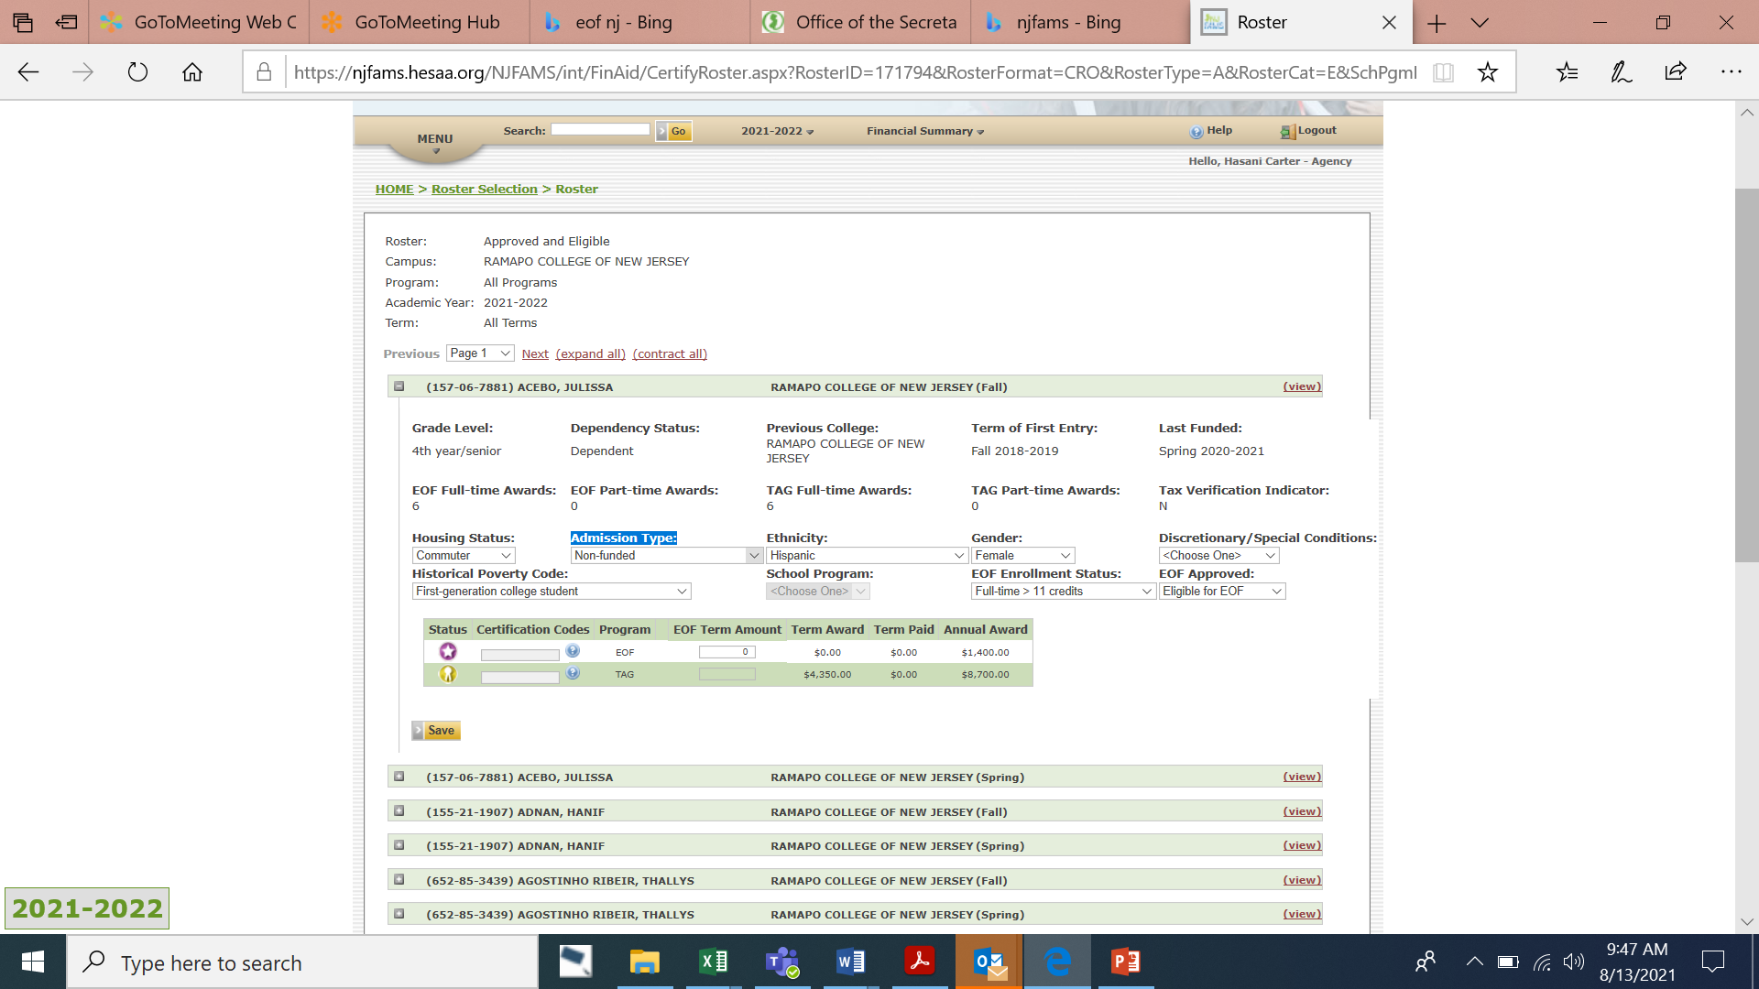
“Awarding” of Non-Funded Students
- Select “Non-funded” from the Admission Type.
EOF Term Amount must be Zero
Select Eligible for EOF
If the student is financially ineligible but is eligible for Non-funded consideration, an appeal must be sent to OSHE/EOF

Slide 43
EOF Financial Eligibility Notables (Discretionary Students)
- Per 9A:11-2.3(h) of the EOF regulations, the EOF campus administrator/director has the discretion to admit, up to a maximum of 10 percent of the annual class of initial students as discretionary admits. These admits can have family incomes as high as, but no more than, 281 percent of the Federal poverty guidelines and have assets that do not exceed 20 percent of the maximum income allowance as per the 281 percent of the Federal poverty guidelines per household size, as published annually by the Federal government.
- Discretionary admit students shall also meet all eligibility provisions of N.J.A.C. 9A:11-2.2.
- As noted within 9A:11-2.3 of the EOF regulations, if an applicant’s reported household income and assets exceeds the maximum allowable limit for EOF for discretionary consideration, then by regulation, the student is financially ineligible to receive an EOF grant award.

Slide 44
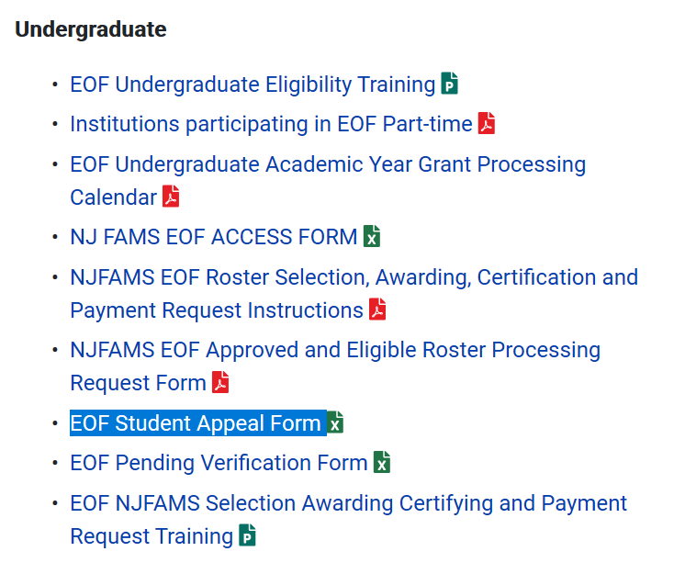
EOF Non-Funded and Discretionary Appeals via the EOF Student Appeal Form

Slide 45
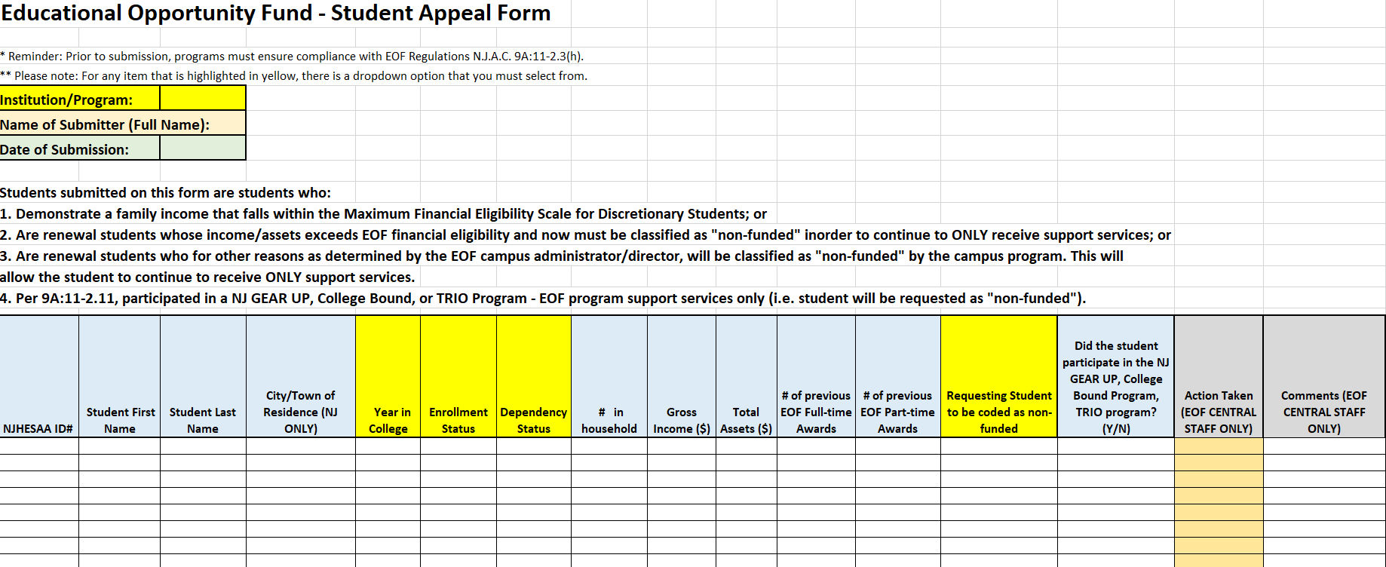
EOF Student Appeal Form
All appeals must be sent directly to your EOF program liaison once the OSHE/EOF office has re-opened the EOF portal for edit access.
Edit access will be restored once the OSHE/EOF office has completed its reconciliation of all AY UG Rosters and has provided each campus program with their appropriate desk audit (End of July/Early August.)
Only an EOF program liaison or the EOF Executive Director has the authority to approve an appeal.

Slide 46
EOF Pending Verification Form
At the conclusion of each semester, if there is a student who is pending verification (federal, state, institution) and has not cleared by the final deadline for EOF campus programs to award students on their roster, the EOF campus program must submit the name of the student and the appropriate information to OSHE/EOF on the Pending Verification Form.
This is especially important during the Spring term due to the Fund’s lack of carry forward ability and the need to sweep all accounts in March.
Institutions/Programs that fail to properly submit the appropriate information are subject to covering the grant award for each student it failed to properly account for.

Slide 47
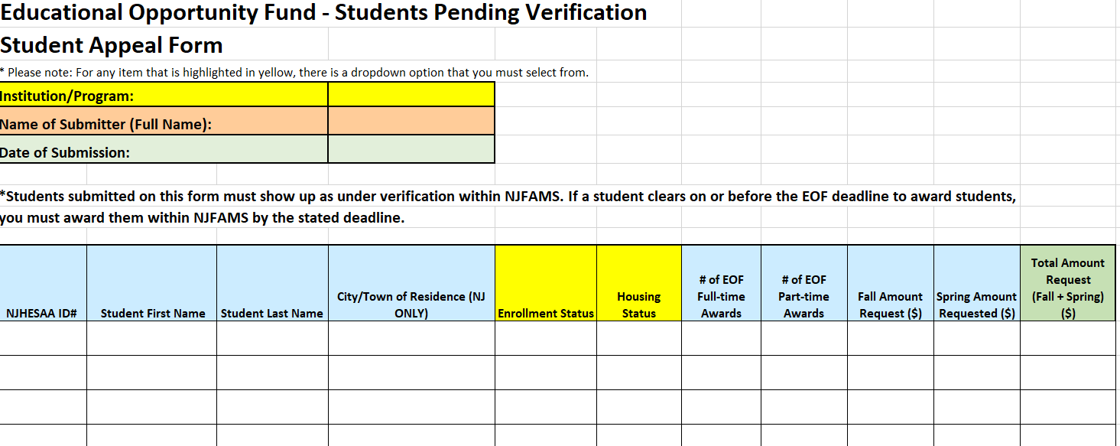
EOF Pending Verification Form

Slide 48
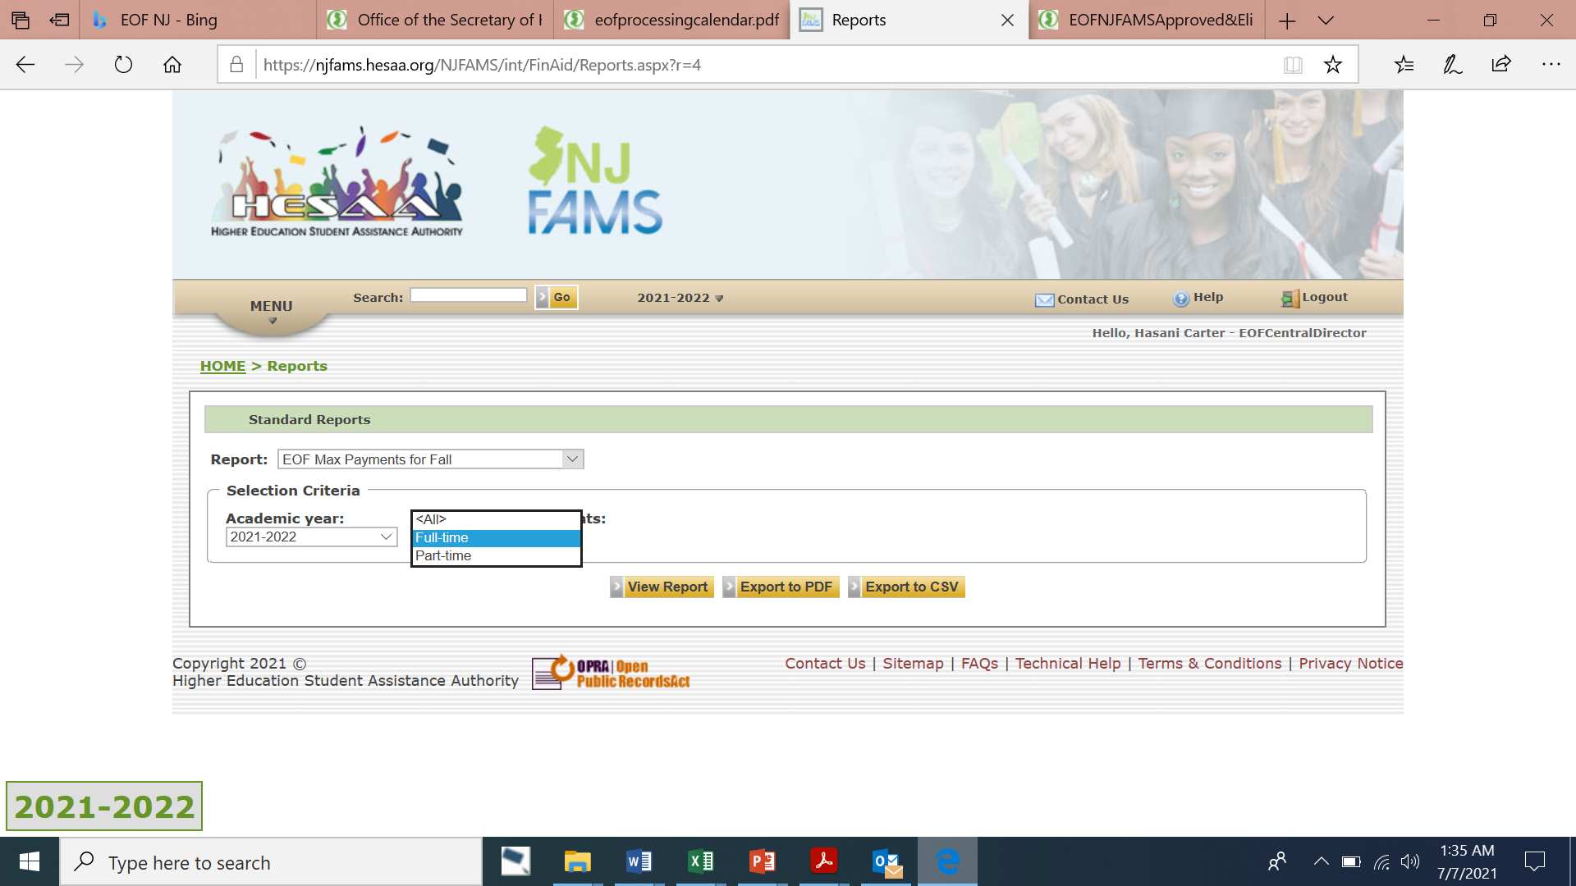
New for 2021: Max EOF Payment Report – FAO Portal

Slide 49
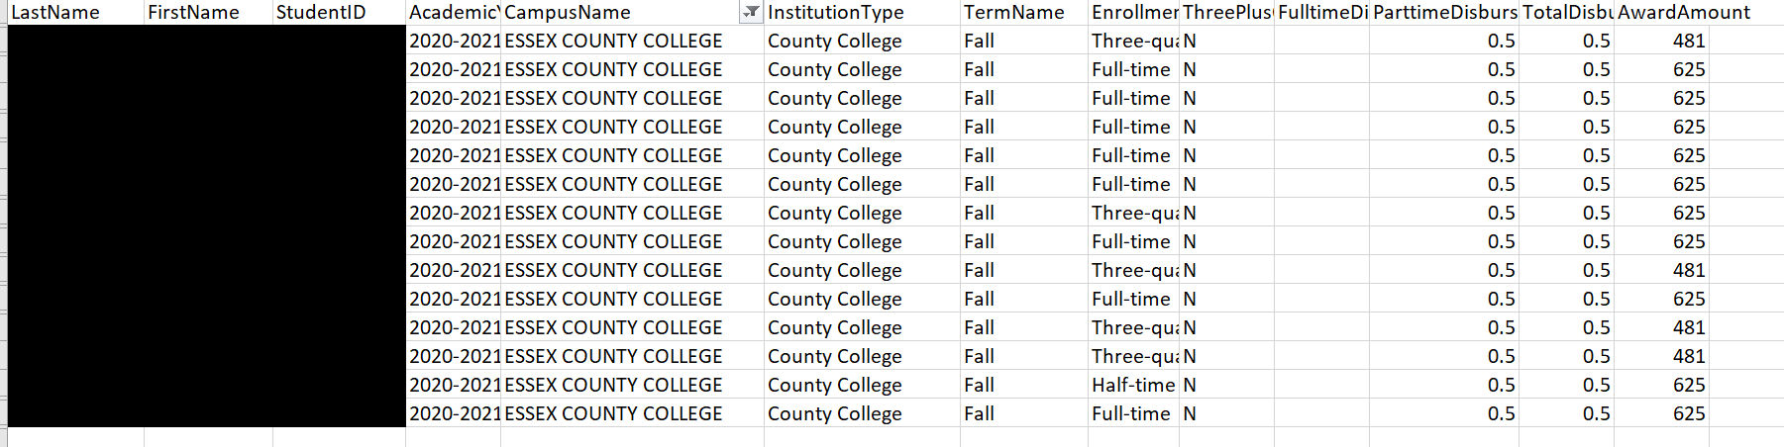
Max EOF Payment Report (Part-time) – FAO Portal

Slide 50
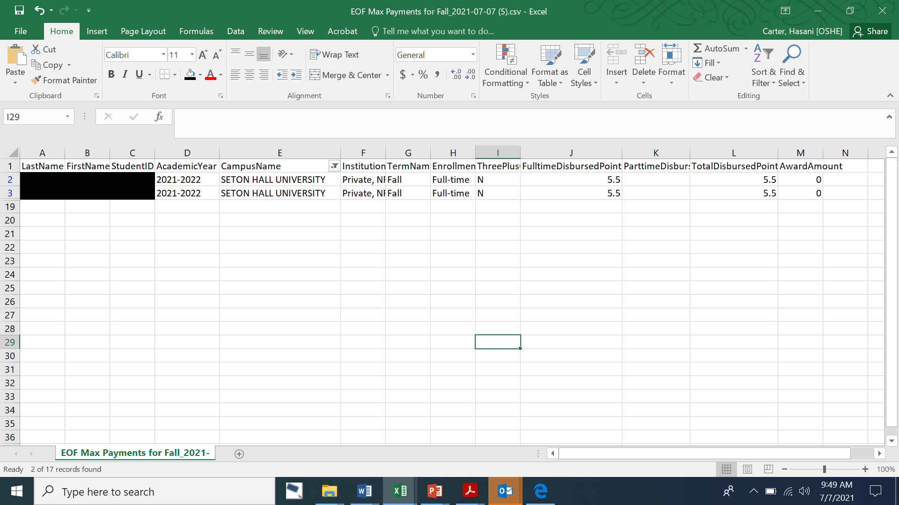
Max EOF Payment Report (Full-time) – FAO Portal

Slide 51
Disbursement of Academic Year Funds

Slide 52
Disbursement of AY Art. III Undergraduate Student Grant Funds
Institutions should divide their academic year Article III allocation in half (think Fall and Spring semester)
For the fall term, institutions will receive an advance payment = 75% of the first half of their allocation in the early portion of the Fall term.
The Final Fall disbursement will be based on the campus program’s “Paid” roster after the Final Roster Certification period.
Spring semester advance payment will = 75% of the total Article III funds paid to the institution for the fall semester.

Slide 53
NO CARRY FORWARD = SWEEP OF ACCOUNTS IN MID-SPRING – MAKE SURE ALL OF YOUR STUDENTS ARE ACCOUNTED FOR
Unlike HESAA, EOF does not have carry forward language.
As a result, the OSHE/EOF office must sweep all accounts during the Spring term (End of March/Early April) and uses the remaining balance of EOF Art. III and IV funds to help front fund the EOF Summer Program.
If an institution submits a payment request after the EOF payment request deadline (for students who do not appear on the pending verification form) this payment may not be honored. The institution must provide in writing the justification for this late request. If funds are available, the OSHE/EOF office will attempt to consider this request. However, it should be noted that an institution may be held accountable for covering this payment due to an institution’s failure to properly account for your students and adhere to the EOF payment processing procedures.
It is very important for an institution to develop the appropriate internal process and procedures to help minimize any roster processing errors.

Slide 54
Other Notables and Reminders:
When submitting a request for assistance with a student, the request must include the student’s HESAA ID#.
OSHE/EOF will not update any student’s award without the specific amount indicated by the institution/EOF campus program.
EOF vs. HESAA related issues that can be resolved by OSHE/EOF.
EOF Refund roster may not accurately reflect the total amount owed to OSHE/EOF. This is due to how we remit payment using the “Paid” roster. Do not send any refunds for a particular academic year until after you have received your Academic Year Desk Audit (forthcoming).
Programs should refrain from using NJFAMS as a primary recruitment tool. Students may accidently process their FAFSA incorrectly, which could result in an inaccurate assessment.
Participating institutions/EOF campus programs are responsible for accurate management of your program roster. This includes the accuracy of the roster and the personnel who should have access.
Submission of Pending Verification form by the Spring deadline is the responsibility of the EOF campus program Director. Students who do not appear on this roster but subsequently clear verification will need to have their EOF award covered by the institution due to institutional oversight.
Final Enrollment Reports are used for the completion of the EOF Annual Report

Slide 55

Questions?

