Slide 1

Conducted by:
New Jersey Office of the Secretary of Higher Education (OSHE)
Educational Opportunity Fund (EOF)
EOF Graduate Grant
Application Training

Slide 2
OSHE/EOF Central Office Staff
Dr. Hasani Carter ​
Hasani.Carter@oshe.nj.gov ​
​
Peter Collazo ​
Peter.Collazo@oshe.nj.gov ​
​
Hema Patel​
Hema.Patel@oshe.nj.gov​
​
Catherine Sackey​
Catherine.Sackey@oshe.nj.gov​
​
Dr. Stephanie Shanklin​
Stephanie.Shanklin@oshe.nj.gov
OSHE Finance
​Tiffany Hazzard
Tiffany.Hazzard@oshe.nj.gov​
​
Kevin Kobylowski​
Kevin.Kobylowski@oshe.nj.gov

Slide 3
Overview
EOF Mission and Purpose
EOF Graduate Student Eligibility (9A:11-3.2, p.20)
Verification of Financial Eligibility (9A:11-3.3, p.21)
Duration of Student Eligibility (9A:11-3.5, p.21-p.22)
Graduate Grant Award Amounts
EOF Graduate Grant Application and Awarding Process

Slide 4
EOF Mission and Purpose

Slide 5




NJ Educational Opportunity Fund
New Jersey Educational Opportunity Fund created by law in 1968
For students from educationally and economically disadvantaged backgrounds attending institutions of higher education in NJ
EOF Provides
Student support services
UG summer bridge program, advising/counseling, tutoring, developmental coursework, academic enrichment activities, student leadership development
Financial Assistance

Slide 6
EOF By The Numbers
13,200+
Undergraduate Student Enrollment
297+
Graduate Student Enrollment
41
Participating Institutions
70
EOF Campus Programs
1,700+
EOF Campus Staff Members

Slide 7
HASANI CARTER​ | PETER COLLAZO​ | HEMA PATEL​ | STEPHANIE SHANKLIN​
Email: hasani.carter@oshe.nj.gov​ | Email: peter.collazo@oshe.nj.gov​ | Email: hema.patel@oshe.nj.gov​ | Email: stephanie.shanklin@oshe.nj.gov​
Rutgers University - Camden​ | County College of Morris​ | Bergen Community College​ | Atlantic Cape Community College​
Rutgers University - College of Nursing​ | Felician University​ | Brookdale Community College​ | Caldwell University​
Rutgers University - Graduate Bio-medical​ | Middlesex College​ | Essex County College​ | Camden County College​
Rutgers University - Graduate Education Prep​ | Monmouth University​ | Fairleigh Dickinson University - Florham​ | Centenary University​
Rutgers University - Graduate Studies (except Bio-medical)​ | Ramapo College of New Jersey​ | Fairleigh Dickinson University - Metropolitan​ | Drew University​
Rutgers University - New Jersey Medical School ​ | Rowan School of Osteopathic Medicine (SOM) - Graduate (Only) ​ | Hudson County Community College​ | Georgian Court University​
Rutgers University - Newark​ | Rowan School of Osteopathic Medicine (SOM) - Pre-Matric​ | Kean University​ | Montclair State University​
Rutgers University - ODASIS​ | Rowan School of Osteopathic Medicine (SOM) - Summer Prep​ | Mercer County Community College​ | Montclair State University - Bloomfield​
Rutgers University - Office of EOF Administration​ | Rowan University - Camden​ | New Jersey City University​ | Montclair State University - Health Careers Program​
Rutgers University - Robert Wood Johnson Medical School​ | Rowan University - Cooper Medical School - Graduate (Only)​ | New Jersey Institute of Technology​ | Rider University​
Rutgers University - School of Arts and Sciences (New Brunswick)​ | Rowan University - Cooper Medical School - PULSE Program​ | Ocean County College​ | Rowan College at Burlington County​
Rutgers University - School of Engineering​ | Rowan University - Glassboro​ | Passaic County Community College​ | Rowan College of South Jersey - Cumberland ​
Rutgers University - School of Environmental and Biological Sciences ​ | Rowan University - Graduate Bio-medical​ | Raritan Valley Community College​ | Rowan College of South Jersey - Gloucester ​
Rutgers University - School of Health Professions​ | Saint Peter's University​ | Sussex County Community College​ | Seton Hall - Law​
Rutgers University - School of Pharmacy​ | Salem Community College​ | The College of New Jersey​ | Seton Hall University - Main​
Rutgers University - Summer Grads​ | St. Elizabeth University​ | Union College of Union County, NJ​ | Seton Hall University - Pre-Legal​
​ | Stevens Institute of Technology​ | Warren County Community College​ | Seton Hall University - Pre-Med/Pre-Dent Plus​
​ | William Paterson University​ | ​ | Stockton University - Atlantic City​
​ | ​ | ​ | Stockton University - Galloway​
Participating Institutions & Campus Programs

Slide 8
EOF Graduate Student Eligibility
(9A:11-3.2, p.20)

Slide 9
EOF & Graduate Students
“The overall objective of the graduate EOF program is to increase the participation of New Jersey residents from backgrounds of historical poverty in graduate and professional study. Priority in granting EOF graduate grants shall be given to students who received EOF undergraduate grants.” (9A:11-3.1, p.20)
  EOF is not an entitlement grant
  Admission into EOF is facilitated by the EOF campus program

Slide 10
Student Eligibility (9A:11-3.2) (Part 1)
(a) Eligible students shall have economic backgrounds that reflect a history of poverty as described in N.J.A.C. 9A:11-2.2(b)1 through 5.
(b) Students who received Article III EOF grants as undergraduates shall be given priority consideration for Article III graduate grants. These students are presumed to have met the financial eligibility criteria (as outlined in N.J.A.C. 9A:11-2.3) for graduate EOF as long as they continue to demonstrate financial need.

Slide 11
Student Eligibility (9A:11-3.2) (Part 2)
(c) To be initially eligible for an EOF Article III graduate student grant, a student must demonstrate that they:
    1. Meet N.J.A.C. 9A:9-2.2 and 2.3, which are the Tuition Aid Grant and Garden State Scholarship programs’ rules governing residency, and noncitizens and resident aliens, respectively;
    2. Meet the financial criteria established in N.J.A.C. 9A:11-2.3, “Financial eligibility for initial Article III student grants”;
    3. Is or will be a full-time graduate student as defined by the institution offering the graduate program of study; and
    4. Is admitted to and enrolled full-time as defined by the participating institution in a curriculum leading to a graduate degree or certificate at an institution participating in the Fund, provided that the student has not already received a graduate or professional degree at the same level of study for which he or she is applying. Graduate degree and certificate programs must have a minimum requirement equivalent to 24 semester hours and be at least one academic year in duration.

Slide 12
Student Eligibility (9A:11-3.2) (Part 3)
(d) Students shall not receive assistance under the programs administered by the Board if they owe a refund on a grant or scholarship previously received from a State or Federal program through any institution or are in default on any loan made under any State or Federal student financial assistance program at any institution. However, such students may receive State financial assistance if they make satisfactory repayment arrangements with the appropriate office.
(e) Students attending out-of-State institutions are not eligible for Article III graduate grants.
(f) Students shall not receive an initial graduate grant in their last semester of enrollment.
  Dependent students who failed to meet the financial criteria while in undergrad do not automatically gain the ability to become financially eligible for EOF once they have graduated with their bachelor’s degree. Since most graduate students have the ability to be classified as an independent student, the applicant must demonstrate a family history of historical poverty.

Slide 13
Student Eligibility (9A:11-3.2) (Summary)
Students must be legal residents of New Jersey for a period of not less than 12 consecutive months immediately prior to the academic period for which aid is being requested. The residence of a student is defined in terms of domicile. (9A:2.2: Residency)
Domicile is defined as the place where a person has his or her true, fixed, permanent home and principal establishment, and to which, whenever her or she is absent, he or she has the intention of returning
A student may not establish State residence solely for the purposes of attending a particular college and will not be considered as fulfilling the definition of domicile for the purposes of State student financial aid
Institutions that certify a student’s state of legal residence shall maintain documentation concerning the student’s New Jersey residency and shall provide this certified documentation, if requested by the EOF Central Office

Slide 14
Verification of Financial Eligibility (9A:11-3.3, p.21)

Slide 15
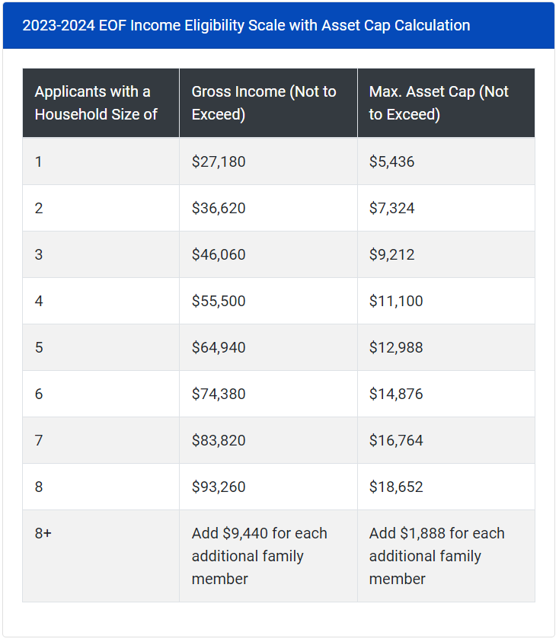
EOF
Student Eligibility
Must demonstrate an economically disadvantaged background
Must be a New Jersey resident 12 consecutive months prior to receiving the award
Must apply and be accepted to a participating New Jersey college or university
Must meet the academic criteria as set by the institution of choice
Must file a Free Application for Federal Student Aid (FAFSA) or the New Jersey Alternative Financial Aid Application
Gross Income and Assets must fall within the EOF financial eligibility range

Slide 16
Verification of Financial Eligibility
When a student receives an EOF graduate grant, the institution shall verify the income and assets of all applicants.
If earnings are not the source of an initial awardee’s income as described above, the file shall contain appropriate verified documentation on which to base the award (for example, statements form the public assistance agency, Social Security Administration, Division of Child Protection and Permanency, Veterans Administration, or other appropriate administrative agency), regardless of the awardee’s dependency status.
    In all cases, files must contain completed forms indicating the relevant data for determining initial eligibility, such as household size, annual income, and sources of income and assets
    Dependent students: parent(s) or guardian(s)
                Independent students: student and/or spouse
                Institutions may not solely use the student’s FAFSA to determine and document financial eligibility

Slide 17
Duration of Student Eligibility (9A:11-3.5, p.21-p.22)

Slide 18
Duration of
EOF Graduate Grant Eligibility (Part 1)
(a) To retain eligibility for an Article III graduate grant, students shall comply with the Tuition Aid Grant and Garden State Scholarship programs’ rule at N.J.A.C. 9A:9-2.4, Eligibility and repayments, in accordance with the Board’s annually established deadline dates.
(b) No student shall be eligible for an Article III graduate grant for more than 10 semesters; however:
    Duration of eligibility shall be extended to one semester beyond the normal number of semesters usually required for a full-time student to complete the degree requirements.
Degree Requirement | Credits for Full-time Status | Length of Eligibility
36 credits | 9 credits | (36 cr/9 cr) = 4 +1 = 5 semesters
84 credits | 12 credits | (84 cr/12 cr) = 7+1 = 8 semesters
    Students pursuing a medical or dental degree shall be extended to one year beyond the normal number of years usually required for a full-time student to complete the degree requirements.

Slide 19
Duration of
EOF Graduate Grant Eligibility (Part 2)
(c) Graduate grant recipients may pursue more than one advanced degree; however:
          Each degree must be a higher level than the previous one unless the grant recipient is enrolled in a dual degree program; and
          In no case shall the combined eligibility exceed the equivalent of 10 semesters.
(d) An Article III graduate grant shall not be awarded for summer program study except in those programs that, by their nature, require specific course(s) to be taken during the summer.
          Exceptions are possible in cases where the program of study requires a mandatory sequence of courses for more than two terms in an academic year.
          To qualify for an exception, the institution shall submit a written request to the EOF Executive Director.
(e) Students in their last semester of study to complete degree requirements may enroll for less than full-time status and still receive the maximum Article III graduate grant for which they would be eligible as a full-time student.

Slide 20
Graduate Grant
Award Amounts

Slide 21
Grant Amounts (9A:11-3.4)
The dollar amount of each Article III graduate grant shall be based on three factors
1
2
3
Full-time enrollment (as defined by the institution offering the graduate program of study)
The financial need of the student as determined by a needs analysis
The type of institution the student attends
An EOF graduate grant awardee shall receive not less than the minimum ($100) nor more than the maximum semester award for the academic year
Per 9A:11-3.4(c): “Under no circumstances shall the grant when combined with other aid exceed the cost of attendance as determined by the institution.”

Slide 22
EOF Graduate Grant Award Table
The academic year award ranges for EOF Article III graduate grants are as follows:
 | Semester Minimum | Semester Maximum | Academic Year Maximum
State Colleges & Universities | $100 | $1,425 | $2,850
Independent | $100 | $1,700 | $3,400
Public Research Universities | $100 | $1,700 | $3,400
Biomedical & Health Science Schools | $100 | $2,450 | $4,900
Approved by the EOF Board of Directors per Resolution 4:23 on 5/4/23.

Slide 23
EOF Graduate Grant Application & Awarding Process

Slide 24
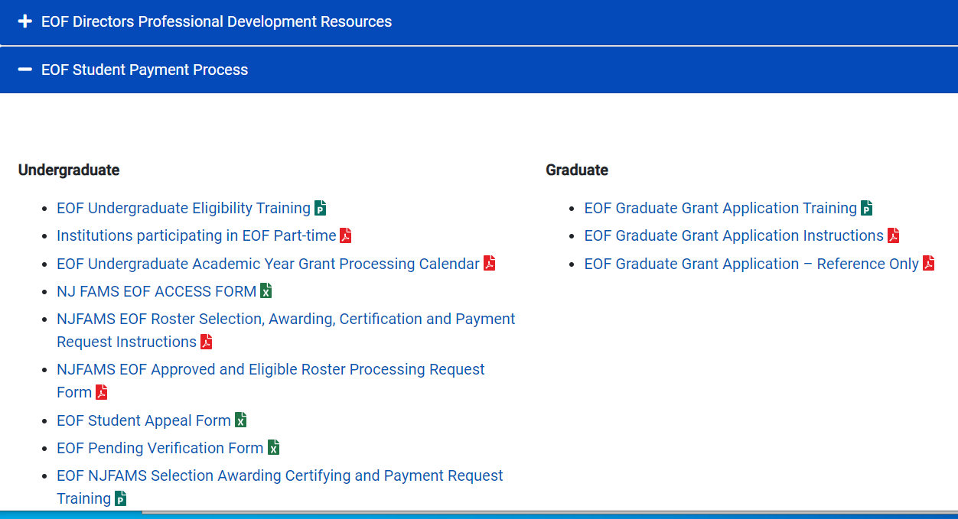
EOF Graduate Grant Application
A copy of the Graduate Grant Application and instructions can be found on the EOF website at:
https://www.nj.gov/highereducation/EOF/EOF_Program_Resources.shtml
Please note: The link to the online application will be emailed to all EOF campus program Directors.

Slide 25



Graduate Grant Application
Step-by-Step Walkthrough
Access the EOF Graduate Grant Application
Complete ALL Questions on the Application
Submit the Application and Save for your Records

Slide 26
Deadlines & Things-to-Know
Deadlines
  AY
  (Fall 2023 & Spring 2024 Semesters)
  September 29, 2023
  Spring Only
  February 2, 2024
Things-to-Know
Late & Incomplete Applications will not be accepted
Applications must be submitted by the EOF campus program graduate grant administrator/coordinator
The EOF Graduate Grant application must be submitted electronically via Qualtrics

Slide 27
Good Practices for Submitting
You cannot save the EOF Graduate Grant application while filling it out.
A copy of the EOF Graduate Grant Application is available online for reference purposes:
https://www.nj.gov/highereducation/EOF/EOF_Program_Resources.shtml
Programs should share a copy of the application with applicants to ensure that they are aware of all of the information that is needed to complete the form

Slide 28
Common Application Mistakes
EOF Graduate Programs allowing the EOF applicant to complete the application
The application is expected to be completed by the EOF Graduate Grant Administrator
Miss or skip a question
All questions must be completed before the application will be considered complete
Using non-numerical values for questions that require numerical values or not responding at all
If a question requires a financial indicator and the value is zero, please indicate $0. Do not leave it blank or put “N/A”, “Not applicable” or any other non-numerical indicator in the space
Missing the submission deadline
Institution/EOF campus programs must ensure that the EOF Graduate Application is submitted to OSHE by the deadline

Slide 29
EOF Graduate Grant Allocation
Institutions that have been approved to receive a FY24 EOF Graduate Grant allocation have their allocations listed on their institutional EOF contract
Institutions that did not receive an allocation for FY24 can still submit a EOF graduate grant application for your students.
Please reach out to the EOF mailbox at EOF@oshe.nj.gov and CC Peter Collazo at peter.collazo@oshe.nj.gov
Funding will be based on available resources

Slide 30
Resources
All OSHE/EOF Program Resources, Including EOF Regulations and EOF Campus Program Liaison Assignments, Can Be Accessed on the OSHE/EOF Website
OSHE/EOF Website
http://www.state.nj.us/highereducation/EOF/EOF_Program_Resources.shtml

Slide 31

Questions?

Slide 32
Thank You For Joining Us!

