Slide 1
Identifying Life-Threatening Emergencies
Danielle’s Law Training
Notes:
Tashay start the training: SLOW DOWN, RELAX, AND SMILE.
Welcome to Identifying Life Threatening Emergencies and Danielle's Law training.
Introductions: Name and title and the office you work for
Don’t read:
For Live Trainings:
I want to first thank you for the opportunity to give this Danielle’s Law training refresher. I really hope this training gives you the tools you need to feel confident to take appropriate actions if faced with a life threatening situation while working with individuals under services or even outside of work.
My name is Tashay Tolbert and I am one of the presenters for today’s training. Presenting with me today is Quality Assurance Specialist Melissa Henderson. Who has been with the state for 13 years.
Throughout my 18 year career, I’ve worked in group homes, day programs, and in developmental centers as well.
Currently I am the supervisor of the Risk Mitigation Team. Our team’s responsibilities include: managing provider agency plans of correction statewide and
analyzing New Jerseys DL cases to determine whether staff failed or delayed in calling 911 for someone experiencing a life threatening situation or condition.
I am very passionate about ensuring the health, safety, and wellbeing of individuals under the division’s services. Though I am fully committed to my career and the divisions goals, my first job is being a mom to my 6 children.
I would like to share a quick personal experience of mine before we get started. My youngest is 4 years old and our oldest that lives at home is 18. In 2023 while at home, my son was eating grapes that my mother was carefully feeding him as my son was walking around the house. My eldest daughter happened to look up and notice my son was choking.
His face was red and mouth open indicating his airway was completely blocked. In a panic, she picked him up and took him to my husband who immediately gave my son a few back blows which expelled half chewed grapes. We monitored him for a few hours following this traumatic event and thankfully he was fine. That same week, I signed up my entire family for first aid and CPR training.
Now because this incident, which is a true story, occurred in my home with my child whom I’m not paid to provide care to, I opted not to call 911 or take him to the ER to be cleared which I admit now was risky because with choking, which we’ll be covering more in this training, food could be lodged in the throat causing a life threatening situation.
Now for families who are self directed employees or community providers like yourselves who are paid to provide care, habilitation, and shelter to individuals, you don’t have the option to wait and observe and not call 911 immediately. You are mandated under Danielle’s Law to call 911, provide life saving care, and seek immediate treatment for someone in a life threatening situation.
My team and I review all of the DL cases statewide and come across scenarios like mine where paid caregivers made the decision to not call 911 because the individual “appeared fine.”
But understand that by not calling 911 there is a potential to violate Danielle’s Law. Most importantly that decision can cost someone their life.
So with that, on the next slide, we’ll get into the topic’s we will be covering today

Slide 2
Training Overview
Who is Danielle?
Danielle’s Law & Staff Responsibility
Health-threatening conditions
Life-threatening emergencies
End of Life and Hospice
How to Respond to Life threatening emergencies: When to call 911
Penalties for Non-compliance of Danielle’s Law
Scenarios
Interactive Quiz
Notes:
Today, we will cover
Who is Danielle
Danielle’s Law and all of our responsibilities to uphold the law
Distinguishing between health threatening conditions and life-threatening emergencies
We will discuss Danielle’s Law in relation to end of life plans and hospice
Responding to life threatening emergencies and when 911 should be called
We’ll go over all of our responsibilities to uphold Danielle’s Law and penalties for non-compliance
Lastly we will have scenarios throughout the training and an interactive quiz to test your Danielle’s Law knowledge.

Slide 3

Who is Danielle?
32 year old Danielle Gruskowski lived a full and active life as a member of her family and of the Carteret, NJ community
She founded the “Carteret Specials” group dedicated to enriching the lives of local children with developmental disabilities
Notes:
Who is Danielle?
Danielle's Law was formed for 32 year old, Danielle Gruskowski (Gru cow ski) who lived a full and active life as a member of her family and community.
She founded the Carteret (Car te ret) Specials group dedicated to enriching the lives of local children with developmental disabilities.
Danielle was an individual who lived in a group home, and she died at the young age of 32 after developing a very high fever and having difficulty breathing. No one at her facility called 911 to get her help and by the time Danielle was driven to the doctor’s office, it was too late to save her.

Slide 4

Danielle’s Law
Danielle’s Law was named in her memory to require 911 to be called for life-threatening emergencies
The law emphasizes the importance of staff calling 911 in life-threatening emergencies for people with intellectual and developmental disabilities or traumatic brain injuries
Notes:
Danielle's Law was named in her memory to mandate calling 911 for life-threatening emergencies.
The law emphasizes the importance of staff calling 911 in life-threatening situations for people with intellectual and developmental disabilities or traumatic brain injuries.

Slide 5
It’s the Law: Responsibilities
Staff
Employer/Provider
Department of
Human Services
Anyone who works with individuals with intellectual and developmental disabilities or traumatic brain injury must call 911 in the event of a life- threatening emergency
Not calling 911 or delaying the call in a life- threatening emergency is a violation of the law
Ensure staff are trained to identify life- threatening emergencies and know when to call 911
File an incident report according to Division procedures
Maintain a record of all 911 calls
Ensure training is provided to service providers
Maintain records of provider calls to 911
Review potential violations of Danielle’s Law
  Situations where a reasonably prudent person
  did not act in a life- threatening emergency
Maintain records of violations
Notes:
The law requires that anyone who works with individuals with intellectual developmental disabilities, or traumatic brain injury, must call 911 in the event of a life-threatening emergency. Not calling 911 or delaying the call in a life-threatening emergency, is a violation of the law.
Your provider or employer must ensure that staff are trained to identify life-threatening emergencies and know when to call 911.
They must also file an incident report according to division procedures, and maintain a record of all 911 calls made.
The Department of Human Services must ensure training is provided to all service providers.
As a Department, we are required to maintain records of provider calls to 911, review potential violations of Danielle's Law, which are situations where a reasonably prudent person did not call 911 in a life-threatening emergency. The department maintains records of violations of Danielle’s Law.

Slide 6


Responsibilities & Quality of Care
You have an important role in caring for individuals with intellectual and developmental disabilities
Recognizing medical issues and obtaining appropriate care is vital
Good communication and monitoring of individuals you are assisting provides quality of care
Your actions can save a life
6
Notes:
Direct support professionals, support coordinators, families who are paid caregivers, all play an important role in providing quality care to individuals with intellectual and developmental disabilities. This includes recognizing medical issues that may arise and obtaining appropriate medical care.
Anyone who assumes the caregiver role must communicate with their supervisor, their co-workers across shifts, or medical providers, and others to ensure quality care is obtained, and information is shared with those who need to know in order to provide good care.
For example, a direct support professional who knows the person well may relay information directly to a doctor, which results in proper medical care.
Whatever your role, and in whatever capacity you provide support, the key is when you recognize emergencies and respond appropriately, it can save someone’s life.

Slide 7
Identifying Life-Threatening Emergencies
Life-threatening Emergencies are potentially fatal
Need to identify those situations that are life- threatening emergencies
Not all medical situations are life- threatening emergencies
Notes:
Not all medical situations or health-threatening conditions are life-threatening; however, true life-threatening emergencies have the potential to be fatal if not addressed immediately.
It is crucial to distinguish between general health concerns and those that require urgent, life-saving intervention.

Slide 8
Scenario One
You provide individual supports to Suzie in her own home. One afternoon, as she is walking down the driveway to get her mail, you witness Suzie trip over an uneven patch on the sidewalk and fall to her knees. She cries out in pain and does not immediately stand up. When you reach her to offer assistance, you notice that both her knees are skinned and bleeding. You help her to her feet.
Notes:
We’ve come to our first scenario. Throughout the training, we will review different scenarios to help you determine whether the situation is a life-threatening emergency requiring a 911 call.
As we go through each scenario, please reflect on how YOU would handle the situation.
In this scenario, you are providing individual supports to Suzie in her own home. One afternoon, as she is walking down the driveway to get her mail, you witness Suzie trip over an uneven patch on the sidewalk and fall to her knees. She cries out in pain and does not immediately stand up. When you reach her to offer assistance, you notice that both her knees are skinned and bleeding. You help her to her feet.
Is this a life threatening emergency?
___: This is not a life-threatening emergency. Administering basic first aid would be appropriate in this situation.
We will be reviewing health threatening conditions that are non life threatening, like in this scenario, but may require medical intervention.

Slide 9
Health-Threatening Conditions
Some medical situations may be health threatening, but not life threatening
Obtain appropriate medical care for health-threatening conditions, such as calling a doctor
Always follow established medical protocols for any individual you support, such as checking blood sugar or providing physician prescribed asthma medication
Report all health conditions to your supervisor and monitor the condition
Notes:
Some medical situations may be health threatening, but not life-threatening.
For health threatening conditions, you must obtain appropriate medical care such as calling a doctor or scheduling an appointment.
You always want to follow established medical protocols for any individual you support, such as checking blood sugar for someone who has diabetes or providing an as needed asthma medication.
It is recommended that you report all health conditions to a supervisor or a nurse on shift or physician, and monitor the person’s condition.

Slide 10
Scenario Two
Ilene is volunteering at a food bank, where she helps to stack and sort the canned goods into different bins. She does not realize one of the metal bins has a jagged edge, and when she reaches past it, she slices her forearm and it begins to bleed. The cut is long and painful but not deep. You help her to clean the wound and stop the bleeding.
Notes:
In this next scenario, Ilene is volunteering at a food bank, where she helps to stack and sort the canned goods into different bins. She does not realize one of the metal bins has a jagged edge, and when she reaches past it, she slices her forearm and it begins to bleed. The cut is long and painful but not deep. You help her to clean the wound and stop the bleeding.
Is Ilene’s condition life threatening?
___: This is not a life-threatening emergency; however, medical attention would be necessary to assess the need for stitches as well as a possible tetanus shot to prevent a serious infection due to sustaining a cut from a metal bin.
So this would be considered a health threatening situation, not life-threatening.

Slide 11

Health-Threatening Conditions
Examples of Health-Threatening Conditions:
  Sprained ankle
  Bleeding controlled with pressure
  Seizures typical to the person that last under 5 minutes
  Minor burns/cuts
  Flu symptoms
If the health-threatening condition worsens or becomes life threatening, call 911 immediately
11
Notes:
Here are some examples of health threatening conditions:
A sprained ankle
bleeding controlled with pressure.
Seizures typical to the person that lasts under five minutes.
Minor burns and cuts, or
Cold and flu symptoms.
In non-life-threatening emergencies, you would call your supervisor and then take appropriate action. As a support coordinator, if you receive a call from an individual living on their own and reporting a health threatening condition to you, offer assistance in getting the individual medical care.
Appropriate actions could include:
driving the person to the emergency room;
calling a doctor or making an appointment to see a doctor,
getting an emergency appointment at the primary care physician’s office the same day or next day;
calling a pharmacist, or
having a nurse evaluate the person.
There are many different actions that could be taken when a person’s condition is not a life-threatening, but consult with your supervisor first.
It is important to remember to call 911 immediately if the health threatening condition worsens or becomes life threatening, for example the person‘s flu symptoms move to serious symptoms of dehydration or cold symptoms are accompanied with a very high fever that's not responding to medications.
At that point, you would need to call 911 to get the person help.

Slide 12
Scenario Three
Will calls you to say he cannot go to work today because he has a sore throat, runny nose, and a cough. He says he did not sleep well last night and is very tired. He is sniffling the whole time you are on the phone and his voice sounds very scratchy. He says he is starting to get the chills and is going back to bed.
Notes:
In this scenario, Will calls you to say he cannot go to work today because he has a sore throat, runny nose, and a cough. He says he did not sleep well last night and is very tired.
He is sniffling the whole time you are on the phone and his voice sounds very scratchy. He says he is starting to get the chills and is going back to bed.
Is Will’s condition life threatening?
____: This is not a life-threatening condition.
Monitoring Will and completing frequent checks would be appropriate to ensure his condition does not worsen over the next few days and to determine whether a doctor's visit may be needed.

Slide 13

Identifying Life-Threatening Emergencies
Life-threatening emergencies are those situations when immediate intervention is necessary to protect a person’s life or if serious impairment or dysfunction of a person’s body functions or organs/parts may occur
Notes:
With the previous scenario in mind, let’s review how Life-threatening emergencies are defined.
They are situations when immediate intervention is necessary to protect a person's life,
or a person is at risk of serious impairment or dysfunction of a body part or organ.

Slide 14
Scenario Four
You are assisting Carmen during her shower. She is seated in a shower chair as you help her dry off. You hear a wheezing sound when she breathes. You lean closer and hear a whistling noise every time she breathes in. You know Carmen has a history of asthma and has asthma medications. After Carmen takes her asthma medications, she is still wheezing strongly.
Notes:
Let’s take a look at this next scenario: You are assisting Carmen during her shower. She is seated in a shower chair as you help her dry off. You hear a wheezing sound when she breathes. You lean closer and hear a whistling noise every time she breathes in. You know Carmen has a history of asthma and has asthma medications. After Carmen takes her asthma medications, she is still wheezing strongly.
Is this a life threatening emergency?
___: This is a life-threatening emergency.
Trouble breathing, following medical protocols for asthma such as the person using their inhaler or taking their prescribed asthma medications or prescribed nebulizer treatment, should be considered life-threatening.
For an individual in Carmen’s situation, we advise against staff driving the person to the hospital as they could stop breathing during transport, so calling 911 is the best option.

Slide 15
Identifying Life-Threatening Emergencies
Examples of life-threatening emergencies include, but are not limited to:
  Unconsciousness
  Persistent chest pain or discomfort
  Not breathing or trouble breathing
  Severe bleeding
  Choking
  Severe, persistent abdominal pain with or without vomiting
  Serious head injury
  Shock
  Some seizures
  Confusion or disorientation
  Stroke symptoms
Notes:
Okay so we learned that respiratory distress or trouble breathing are examples of life threatening emergencies. Let review more examples. Please note this is not an all accompanying list
In our examples we have
Unconsciousness and unresponsiveness,
Persistent chest pain or discomfort,
Not breathing or difficulty breathing that may be accompanied by wheezing not typical to the person’s preexisting condition;
Bleeding profusely,
Choking, even if resolved, you still need to call 911
Severe persistent abdominal pain,
and symptoms of a stroke.
I just want to quickly note that for some of the symptoms on this list, such as chest pains for example, the individual would essentially need to self report that he/she is experiencing persistent pain in their chest or pain radiating down their arms. For our folks that don’t use words to communicate or who have limited verbal communication, this may be difficult, therefore we really have to pay attention to how a the person presents and how people communicate pain.
This may be through gestures such as clutching their chest or pointing to where it hurts
or you may observe that a person is sweating or grimacing
So we need to look at non verbal cues which may indicate that a person is in distress and in need of emergency care.

Slide 16
Scenario Five
Frank is finishing his breakfast. He has not shown much appetite this morning, and has only picked at his food, which is unusual for him. Throughout the meal, he has rubbed his left shoulder and arm and made grimacing faces. He nods every time you ask if he feels okay. As he passes you his dishes to put in the sink, you notice he is sweating and pale. He starts to rub his chest and says it feels like someone is standing on his chest.
Notes:
Okay so in this scenario, Frank is finishing his breakfast. He has not shown much appetite this morning, and has only picked at his food, which is unusual for him. Throughout the meal, he has rubbed his left shoulder and arm and made grimacing faces. He nods every time you ask if he feels okay. As he passes you his dishes to put in the sink, you notice he is sweating and pale. He starts to rub his chest and says it feels like someone is standing on his chest.
Do you consider this a life threatening situation?
____: Frank’s symptoms are life-threatening.
Signs of a heart attack always warrant an immediate call to 911.
Frank could go into cardiac arrest before or during transport to the hospital, therefore 911 must be called.
Next we will take a closer look at the symptoms of a stroke which like symptoms of a heart attack, proper identification of stroke symptoms is imperative as the person requires immediate life saving treatment.

Slide 17
Recognizing Signs and Symptoms of a Stroke “FAST”
To identify stroke symptoms, use the acronym “FAST”:
  F = Face: Ask the person to smile
  Does one side of their face droop?
  A = Arms: Ask the person to extend both arms out
  Does one arm drift downward?
  S = Speech: Ask the person to repeat a simple sentence
  Are the words slurred? Can the person repeat the sentence correctly?
  T = Time: Notate the time signs/symptoms of the stroke first began
        Call 911 immediately
Notes:
To recognize Symptoms of Stroke, use the acronym “FAST”:
F = FACE – ask the person to smile. Observe whether on side of their face droops
A = ARMS – have the person to extend both arms out. Does one arm drift downward?
S = SPEECH – ask the person to repeat a simple sentence. Note whether their words are slurred and if they were able to repeat the sentence correctly
T = TIME – You want to take note of the time when the individual’s symptoms first began and be sure to call 911 right away as every second counts in getting the person life saving treatment. Don’t delay in calling 911.
If you support an individual that does not communicate verbally, err on the side of caution and call 911 if the first two symptoms are noted

Slide 18
Scenario Six
One night Ida gets up to use the bathroom and trips over the outstretched legs of her roommate sitting next to her. She falls and doesn't quite catch her fall with her hands. You witnessed her head hit the carpet. She gets up right away, rubbing her head. She is crying a little bit and says that it hurts. When you check her head, she has very faint redness and a little swelling on the left side of her forehead.
Notes:
In this next scenario: One night Ida gets up to use the bathroom and trips over the outstretched legs of her roommate sitting next to her. She falls and doesn't quite catch her fall with her hands. You witnessed her head hit the carpet. She gets up right away, rubbing her head. She is crying a little bit and says that it hurts. When you check her head, she has very faint redness and a little swelling on the left side of her forehead.
Do you consider her injuries to be life threatening?
____: This is not a life-threatening injury, however, Medical attention would be appropriate if the swelling worsens or if Ida has persistent pain.
If a person in Ida’s situation experiences worsening of the condition or serious head injury symptoms, this would rise to a life-threatening emergency and 911 would need to be called.
Next we’ll review symptoms of a serious head injury to determine when 911 should be called

Slide 19
Symptoms of a Serious Head Injury
Examples of serious head injuries include, but are not limited to:
  Dizziness
  Headache
  Blurred vision
  Nausea/vomiting
  Confusion or disorientation, slurred speech
  Lethargy, irritability or excessive sleepiness
  Bleeding from one or more orifices
  Numbness or tingling
  Force of injury caused damage to wall or dents sturdy object
  Seizure
Notes:
Following an injury to a person’s head, monitor for the following symptoms which are indicators that the person may have sustained a serious head injury. Again, please keep in mind, this is not an all encompassing list
Consider the following when determining whether the person may have a serious head injury:
Is the person reporting Dizziness, headache, or blurred vision?
Are they Nauseous or vomiting following the injury to the head?
Are they presenting with Confusion, disorientation, or do they have slurred speech?
Is the person suddenly Lethargic, irritable, or excessively sleepy or was there a change in level of consciousness or
Do they have a dazed or vacant expression on their face?
Is clear fluid or blood coming from the ears, nose or mouth?
Any reports of Numbness or tingling?
Observe if the force of injury damages a wall, dents a vehicle or sturdy object, or breaks glass due to a fall or from banging their head
Or Maybe the person has a seizure or multiple seizures following the head injury.
So, please Call 911 immediately if you observe any of these symptoms following a head injury.

Slide 20
Scenario Seven
You are assisting several people from the van to their day program to start the day when Carlos slips on some ice and falls backwards, hitting his head on the pavement. He doesn't move right away and seems stunned by the fall. You asked him if he is okay and attempt to sit him up, but he doesn't really respond, although his eyes are open.
Notes:
In this scenario, You are assisting several people from the van to their day program to start the day when Carlos slips on some ice and falls backwards, hitting his head on the pavement. He doesn't move right away and seems stunned by the fall. You ask him if he is okay and attempt to sit him up, but he doesn't really respond, although his eyes are open.
Would you consider this a life threatening situation?
____: This is a potential life-threatening emergency as Carlos could have a concussion.
As we reviewed in the previous slide, head injuries resulting in confusion, disorientation, dizziness, delayed response, excessive sleepiness immediately following the injury,
severe pain, vomiting, or blurred vision Should be considered symptoms of a serious head injury.
Serious head injuries can result in Death, therefore 911 must be called.

Slide 21

When Seizures Are Considered Life-Threatening Emergencies
Seizures that may be life threatening:
  First time seizure
  Lasting longer than 5 minutes
  Back-to-back (3 or more in a row)
  Result in serious injury
  Person is not breathing once seizure stops
  Occur in someone who is pregnant
  Occur in someone who has diabetes
21
Notes:
Let’s take a look as seizures that are considered life threatening.
A first time seizure is always considered life-threatening and warrants an immediate call to 911.
You must call 911 if the seizure lasts longer than five minutes regardless of the individual’s seizure protocol.
Call 911 immediately If a person has back to back seizures, like three or more in a row; and
if the seizure results in a serious injury;
Or perhaps the person is not breathing once the seizure stops;
Call 911 if the seizure occurs in someone who is pregnant or someone who has diabetes.
You can refer to the Identifying Life-Threatening Emergencies Bulletin located on the Danielle’s Law website, which references all of this information and more.

Slide 22
Scenario Eight
Jerome is sitting in his chair, working on a puzzle, when his body stiffens, then he begins to breathe deeply before he slumps back in the chair and begins to have jerky movements. You loosen the shirt around his neck and ensure he is breathing. Jerome has a known seizure disorder, so you know to time the seizure as he typically has a seizure that lasts about 2-3 minutes a few times a week. After 3 minutes have passed, his jerky movements stop and he opens his eyes and starts to sit up. He is breathing fine now, but appears tired.
Notes:
In this scenario, Jerome is sitting in his chair, working on a puzzle, when his body stiffens, then he begins to breathe deeply before he slumps back in the chair and begins to have jerky movements. You loosen the shirt around his neck and ensure he is breathing. Jerome has a known seizure disorder, so you know to time the seizure as he typically has a seizure that lasts about 2-3 minutes a few times a week. After 3 minutes have passed, his jerky movements stop and he opens his eyes and starts to sit up. He is breathing fine now, but appears tired.
Is this a life threatening emergency?
______: This is not a life-threatening emergency.
Typically, seizures lasting less than five minutes do not require a 911 call. However, you should always consider the person’s seizure protocol which may instruct staff to call 911 prior to 5 minutes.
For scenario sake, Jerome does not have a physician’s order advising staff to call 911 at 3 minutes, therefore, staff should follow all medical protocols in place for Jerome and document the seizure according to your agency policy.

Slide 23
Signs that a Choking Event May be a Life-threatening Emergency
The person:
Has an airway obstruction
Has a blue or purplish tint to their face or lips
Requires back blows and/or abdominal thrusts
Loses of consciousness-CPR initiated
Coughing and finger sweeps are ineffective at dislodging the airway blockage
Presents with respiratory distress or a change of demeanor following the choking event
Notes:
To prevent possible neglect of an individual you support, 911 should be called for all choking episodes due to the risk of aspiration and the potential for food to be lodged in the throat or esophagus. Even if choking appears to be resolved for example you observe that food is expelled and the person appears to be breathing, staff should still call 911.
Additionally, Medical follow up is required within 48 hours of all choking events to rule out swallowing disorders, changes in mastication, and the need for a possible food texture change or downgrade.
Here are some examples of choking incidents that may be considered life threatening. Please note this is not an all encompassing list:
The person’s
Airway is completely blocked, preventing any airflow.
The person’s face or lips show a blue or purplish tint indicating they are experiencing hypoxia (which is life-threatening condition that occurs when the body's tissues do not receive enough oxygen)
Intervention is required to dislodge the obstruction (such as back blows or abdominal thrusts). Despite these interventions appearing successful at dislodging the blockage, food coming up, does not mean the airway is fully cleared. Although food may be expelled and it may appear the airway is cleared, best practice is to call 911 to have the individual medically evaluated. It can potentially save someone’s life.
When attempts to dislodge the blockage are unsuccessful and the person loses consciousness. Call 911, and initiate CPR

Slide 24
Scenario Nine
Molly is out to eat with her peers and staff at the mall, when she begins to make gurgling sounds while swallowing. She is coughing and some food comes out of her mouth. She continues to sound like she is gagging and her eyes are watering. She appears to stop breathing and you jump up to use back blows and abdominal thrusts to assist her. It works right away and a piece of food comes out.
Notes:
____: In this next scenario, Molly is out to eat with her peers and staff at the mall, when she begins to make gurgling sounds while swallowing. She begins to cough and some food comes out of her mouth. She continues to sound like she is gagging and her eyes are watering. She appears to stop breathing and you jump up to use back blows and abdominal thrusts to assist her. It works right away and a piece of food comes out.
Is this a life threatening emergency?
_____: This is a potentially life-threatening emergency.
Calling 911 is warranted here due to the use of back blows and abdominal thrusts.
This type of manual removal of the airway obstruction can cause internal damage, such as swelling of the airway, which can occur within minutes to hours following a serious choking incident
The Office of Risk Management participated in its 2nd annual Choking Prevention Awareness Month in February. During our Danielle’s Law Training refreshers we included some best practice choking prevention tips which I think is worth sharing for this training as well:
During meals:
Encourage individual’s to chew food slowly and thoroughly and
to avoid laughing and talking while chewing and swallowing
Follow prescribed food textures,
Be sure to utilize prescribed adaptive utensils and dinnerware for safety and independence during meals
For people who eat rapidly or overstuff their mouth, encourage them to
slow their rate of eating
Monitor individuals who have food stealing behaviors and consider placing food they may be tempted to grab out of reach
Consider cutting food that is especially tough or fibrous like steak or raw veggies and
Be mindful of high risk foods and snacks for example like popcorn, grapes, etc.
Generally, monitoring individuals during meals is important to be able to react immediately if someone does happen to choke

Slide 25

Identifying Life-Threatening Emergencies
Some questions to determine if 911 should be called:
  Could this condition be potentially fatal?
  Could the condition get worse and become life threatening if you drove the person to the hospital?
  Could moving the person on your own cause further injury?
  Does the person require the skills/equipment of emergency medical personnel?
Notes:
Some of the questions to determine whether 911 should be called:
Could this condition be potentially fatal? Could the person die from this situation?
Could the condition get worse and become life threatening if you drove the person to the hospital?
Could moving the person on your own cause further injury?
Does the person require the skills or equipment of emergency medical personnel?
If you answer yes to any of these questions, it is imperative that you call 911 immediately.

Slide 26

Danielle’s Law and End of Life Orders
Danielle’s Law requires that 911 is called in the event of a life-threatening emergency, even if the individual has a DNR
Orders such as a DNR should be clearly posted in the home so that all staff and caregivers are aware
When calling 911:
    Inform the operator of any end of life orders, such as a DNR, DNI, DNH, or POLST
    Follow the recommendations of the 911 operator
    Responding emergency personnel will assess and determine appropriate actions
26
Notes:
At times, life-threatening emergencies occur to individuals who have end of life orders, such as a Do Not Resuscitate order (DNR).
Danielle’s Law requires that 911 is called in the event of a life-threatening emergency even if the individual has a DNR. Not calling 911, may result in a violation of Danielle's Law.
All end of life orders should be clearly posted in a person’s home so that all staff and caregivers are aware of the order. The refrigerator or a visible spot near the entrance of a home is a common place for a DNR to be posted. This includes DNR orders, but also DNI (Do not intubate), DNH (Do not hospitalize) and also POLST (Physician Orders for Life-Sustaining Treatment).
If someone experiences a life threatening emergency with an end of life order, when calling 911, inform emergency personnel of the order. Follow the instructions the 911 operator provides, ensure emergency personnel receive a copy of the order when they arrive. Emergency responders will assess and determine what action should be taken next.

Slide 27
Danielle’s Law and Hospice
For individuals at the end of life receiving hospice care, regardless of the presence of an end of life order such as a DNR:
  When issues arise related to the terminal condition, or if it appears the person has passed away, staff should call the hospice provider
  Staff are required to call 911 immediately for life-threatening emergencies unrelated to the terminal condition
    For example, if someone had a terminal cancer diagnosis, but experienced emergencies including but not limited to: a choking episode, first time seizure or prolonged seizure of over 5 minutes, or for a serious injury such as a broken bone, injury from a fall, profuse bleeding, etc.
    In those cases, staff should alert the 911 operator and emergency responders that the individual is on hospice, inform them of any end of life orders, and provide related contact information as needed
27
Notes:
Individuals at the end of life and their guardians, have a right to choose hospice if the individual has a terminal illness and meets the eligibility criteria.
Staff and caregivers should be made aware if an individual is on hospice, and have the hospice staff’s contact information, in the event the individual passes away. Most hospice programs will provide training to families and staff who are working with someone receiving in-home hospice care. This includes educating caregivers about phases of death, including how the individual will present in the active dying phase.
When an individual is receiving end of life care on hospice and issues arise related to the terminal condition, or if it appears the person has passed away, staff should call the hospice provider. This may be an assigned nurse or an on call service, who will provide additional instructions. This will not be a Danielle’s Law violation.
However, staff still must call 911 for life threatening emergencies unrelated to the terminal condition, including but not limited to, a choking episode, first time seizure or prolonged seizure of over 5 minutes, or for a serious injury such as a broken bone, injury from a fall, profuse bleeding, etc. In those cases, staff should alert the 911 operator and emergency responders that the individual is on hospice, and provide related contact information as needed.

Slide 28
Scenario Ten
June has stage 4 cancer and is receiving hospice care and has a DNR. As per a recent planning meeting, June must be repositioned by staff every three hours as she is no longer able to move on her own. While being repositioned, staff were unaware the bed rail was in the down position, and June fell out of bed, hitting her head on the night stand before landing on the floor. She was bleeding profusely from a deep laceration to her head. June immediately complained of a severe headache. Moments later, she reported changes to her vision and began to have difficulty speaking.
Notes:
June has stage 4 cancer and is receiving hospice care. As per a recent planning meeting, June must be repositioned by staff every three hours as she is no longer able to move on her own. While being repositioned, staff were unaware the bed rail was in the down position, and June fell out of bed, hitting her head on the night stand before landing on the floor. She was bleeding profusely from a deep laceration to her head. June immediately complained of a severe headache. Moments later, she reported changes to her vision and began to have difficulty speaking.
Tashay: This is a life-threatening emergency.
Calling 911 is required here as the injury is not related to her terminal illness. June appears to be experiencing symptoms of a serious head injury such as a brain hemorrhage. Although June is on Hospice and has a do not resuscitate order, she is in excruciating pain and requires treatment therefore staff should call 911 and advise the responding medical personnel of hospice status and DNR order and follow recommendations.

Slide 29

Responding to Life-Threatening Emergencies
CHECK the person to determine if he/she is experiencing a life- threatening emergency
CALL 911 If the condition is life threatening
CARE for the person until help arrives
You are not required to call 911 in non-life-threatening situations, but appropriate medical care is always required
Notes:
Melissa take over:
When responding to life-threatening emergencies, first you must check the person to determine if they are experiencing a life-threatening emergency.
If you determine the condition to be life threatening, call 911 and provide care to the person until help arrives.
You are not required to call 911 in non-life-threatening situations, but appropriate medical care is always required.

Slide 30
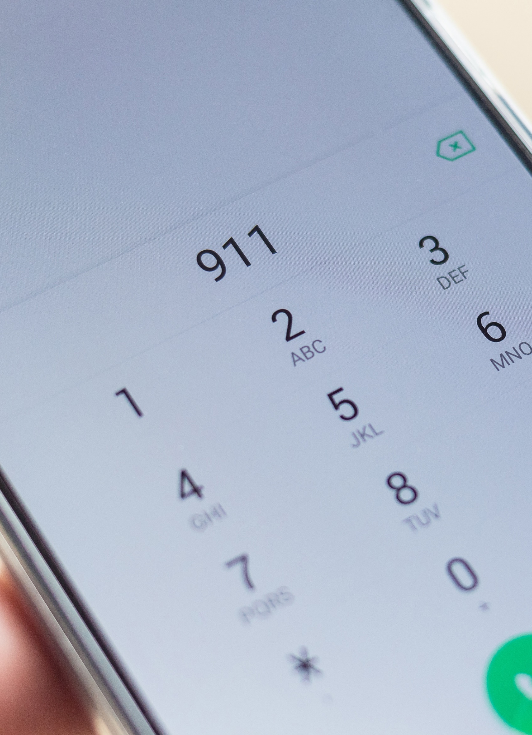
Life-Threatening Emergencies: Staff Responsibility
If you identify a life-threatening emergency, CALL 911 immediately
Don’t call a supervisor or co-worker first when a life-threatening emergency exists
If you are not sure if the situation is life threatening, call 911
30
Notes:
Remember, in life-threatening emergencies, you want to call 911 first, provide care, and when possible, call your supervisor.
Now this order of actions may contradict your agency directives, but delaying the call to 911 waste critical time needed for life saving treatment and may result in liability for violating Danielle’s Law which carries stiff penalties, which we will cover later in the training.
Our recommendation is, if you're unsure whether the situation is life-threatening versus health threatening, go ahead and call 911 to err on the side of caution.

Slide 31
Scenario Eleven
You are a job coach assisting Harry at his new job in the kitchen at the local restaurant. Harry is in charge of food preparation today, and is chopping salad items at the counter with a sharp knife. Just as you turn to leave, since he is doing well on his own, you hear him cry out in pain. The palm of his hand has a long gaping cut across the whole width of his hand. It is bleeding profusely. You grab a clean towel; wrap it around his hand, and apply pressure. The blood continues to soak right through the thick towel.
Notes:
In this last scenario, You are a job coach assisting Harry at his new job in the kitchen at the local restaurant. Harry is in charge of food preparation today, and is chopping salad items at the counter with a sharp knife. Just as you turn to leave, since he is doing well on his own, you hear him cry out in pain. The palm of his hand has a long gaping cut across the whole width of his hand. It is bleeding profusely. You grab a clean towel; wrap it around his hand, and apply pressure. The blood continues to soak right through the thick towel.
Do you consider his injury to be a life threatening emergency?
Tashay: This is a life-threatening emergency. Serious and severe bleeding that does not stop with basic first aid, could lead to impairment or dysfunction of the body part, if not immediately addressed.
Serious or severe bleeding, can also progress to shock, which is a life threatening condition that can result in organ failure, therefore 911 must be called in this scenario.

Slide 32
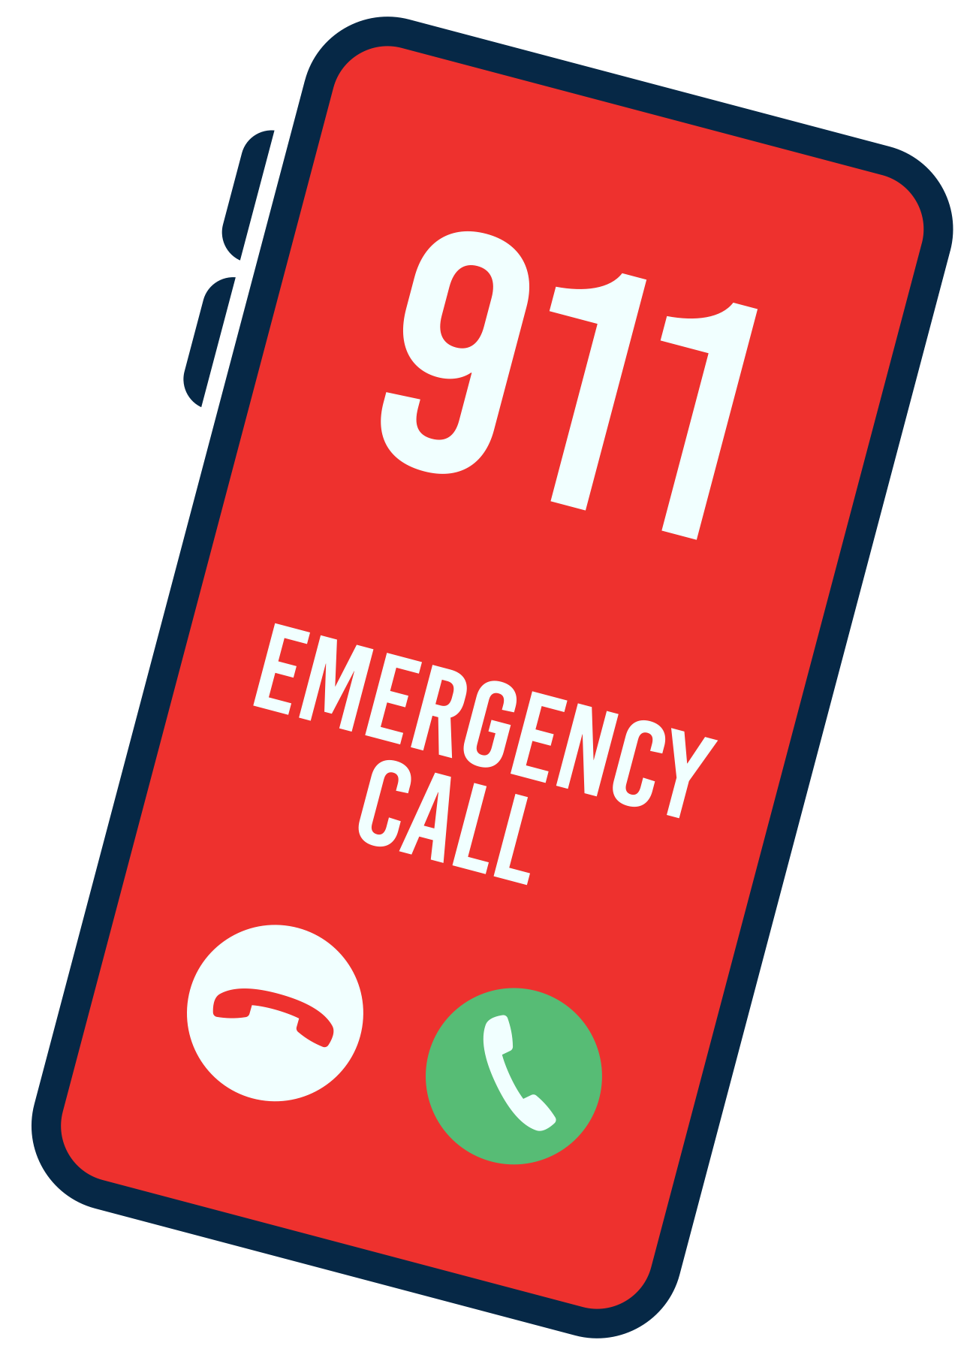
Calling 911
Tell the 911 Operator:
  Your name and number
  Location of incident
  What happened
  Condition of person including any special conditions
  Care being provided
Don’t hang up until the dispatcher instructs you to do so
Notes:
When you call 911, you want to tell the operator the following:
Your name and phone number;
The location of the incident;
Tell the operator what happened?
The condition of the person, including any special circumstances and the care being provided.
And Don't hang up until you are instructed to.

Slide 33

Penalties for Non-Compliance with Law
If you do not call 911 in a life-threatening emergency, penalties may include:
  Termination from employment
  Fines up to $25,000
  Loss of license (for healthcare professionals)
33
Notes:
Failure to call 911 in a life threatening emergency includes monetary fines:
$5,000 for the first offense,
$10,000 for the second offense,
and $25,000 for the third and each subsequent offense.
A health care professional, or licensed provider authorized to provide services, may be subject to revocation of their professional license and no longer be authorized to practice as a health care professional.

Slide 34
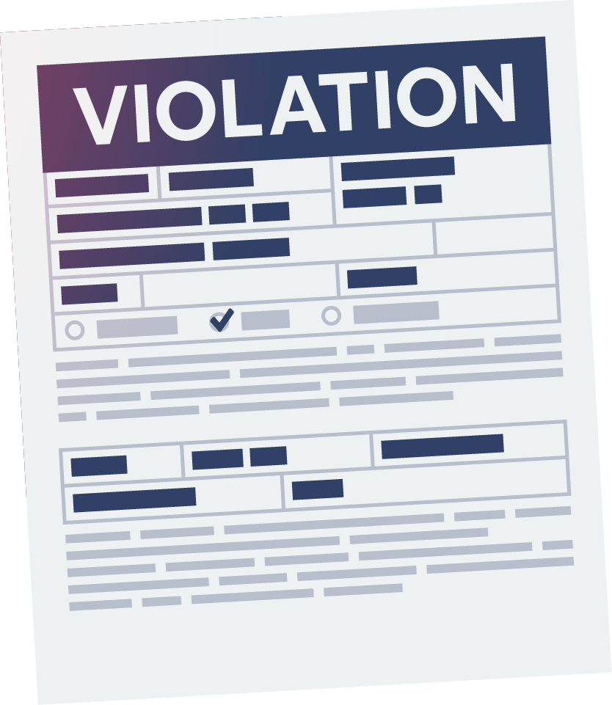
How are Danielle’s Law Incidents Reviewed?
Following OI’s Investigation, DDD Risk Management Staff reviews the case
Criteria:
  Was the condition a life-threatening emergency?
  Would a reasonably prudent person have known at the time of the incident that the condition was life threatening?
  Recommendations are not outcome based
Recommendation made to Assistant Commissioner for final decision
Notes:
Danielle's Law potential violations are investigated by the Office of Investigations (OI for short)
The case is then analyzed by the DDD Office of Risk Management, Risk Mitigation Team, which is my team.
The criteria considered to determine whether staff are in violation of the law is:
Was the condition a life-threatening emergency?
Would a reasonably prudent person have known at the time of the incident, that the condition was life-threatening?
The decision to violate is not based on the outcome of the incident.
The Risk Mitigation Team makes a recommendation to the Assistant Commissioner for Final Decision. If determined to have failed to call 911 for a life threatening emergency, Violators have the opportunity to appeal.
Note that even if a person has not violated Danielle's Law, not intervening in a health threatening situation, or not obtaining medical care for an individual, could be neglect.
I’m going to now turn this training over to Tashay for a quick review and interactive quiz

Slide 35

Review & Quiz
Review of health-threatening conditions
Review of life-threatening emergencies
Frequently Asked Questions Quiz
Notes:
Tashay take over:
Thank you Melissa. Now before we have our quiz, we will do a quick review.
We discussed that some examples of health threatening conditions could be say a minor injury, early onset of cold or flu symptoms, or other minor concerns.
Examples of life-threatening conditions include, but are not limited to, difficulty breathing, severe bleeding, serious injuries, unresponsiveness, or a dramatic and sometimes sudden change in a person’s health.
Please refer to the “Identified Life-Threatening Emergencies” bulletin on the Danielle’s Law website for more information. You can also refer to the “Frequently Asked Questions handout” and review additional information there.
It is important to understand Danielle’s Law requires you to call 911 immediately for life-threatening conditions even if a doctor or nurse is onsite.
Don't assume that someone else has called 911 and don’t delay in calling 911 for example, to call your supervisor first.
Call 911 immediately and provide life saving care to the person. You can apprise (aprize) your supervisor when emergency services arrive and take over care.
If the person has a DNR order and they experience a life-threatening emergency, you still need to call 911.
If the person is receiving end of life care on Hospice and issues arise related to the terminal condition or if it appears the person has passed away, staff should call the hospice provider. If the person receiving Hospice care experiences a life-threatening emergency unrelated to the terminal condition such as a choking episode, staff are required to call 911.”
For situations that are not life-threatening, but the individual may require medical care, at the advisement of your supervisor, get care for the person.
If you are unsure whether a person is experiencing a health threatening emergency versus a life-threatening emergency, err on the side of caution. Call 911 ,
Now, we invite you to participate in a brief quiz to review the information covered in this webinar.
Melissa will read the quiz questions. We will give you a few moments to submit your responses and then we will discuss whether your answer was correct
For in-person trainings:
Ask class for examples of health threatening conditions
Ask class for examples of life threatening conditions
Distribute FAQ handout and review
Start group quiz on next slide

Slide 36

Quiz Question: True or False?
Direct care staff often know the person best, so their input into medical conditions is important.
Notes:
Melissa: True or False?
Direct care staff often know the person best, so their input into medical conditions is important.
Tashay:
(Pause for poll results Most of you selected, most of you recognized this as, most of you correctly answered, the majority of you correctly answered or
looks like this was a tricky one or This question was a bit challenging, …)
This is true. Direct care staff may be the first to notice a change in a person's condition.
Staff should have good communication between shifts and programs, for example between the group home and day program, to promote continuity of care. It is vital to monitor an individual’s health condition and determine whether they need medical attention because a condition can worsen over the span of a few hours to a few days.
Some things that start out as a health-threatening situation can progress to a life-threatening emergency

Slide 37
Quiz Question: True or False?
All medical situations and conditions are life-threatening emergencies.
Notes:
Melissa: True or false?
All medical situations and conditions are life-threatening emergencies.
Tashay:
(Pause for poll results Most of you selected, most of you recognized this as, most of you correctly answered, the majority of you correctly answered or
looks like this was a tricky one or This question was a bit challenging, …)
You should recognize this as false.
Some situations, such as controlled bleeding, minor injuries, a cold or onset of the flu, are not life-threatening, and a call to
911 is not warranted.
However, Appropriate medical care such as providing basic first aid and/or a follow up with the individual’s doctor, is necessary.

Slide 38
Quiz Question: True or False?
All 911 calls must be for life-threatening emergencies.
Notes:
Melissa: True or false?
All 911 calls must be for life-threatening emergencies.
Tashay:
(Pause for poll results Most of you selected, most of you recognized this as, most of you correctly answered, the majority of you correctly answered or
looks like this was a tricky one or This question was a bit challenging, …)
This is false. Consider a scenario where someone falls and though they are not at risk for a fatal injury, they are too large to move by a staff member working alone; and they may have sprained their ankle or have a broken bone. In this situation emergency rescue worker’s assistance is needed even though the person's life is not at risk.
But ideally, calls made to 911 emergency response services should be reserved for life-threatening or potentially life-threatening situations.
That was a good one

Slide 39
Quiz Question: True or False?
A health-threatening condition may need immediate medical care such as driving someone to the doctor’s office or an emergency room.
Notes:
Melissa: True or false?
A health threatening condition may need immediate medical care, such as driving someone to the doctor's office or an emergency room.
Tashay:
(Pause for poll results Most of you selected, most of you recognized this as, most of you correctly answered, the majority of you correctly answered or
looks like this was a tricky one or This question was a bit challenging, …)
True. There are many situations in which a doctor may want to see the person in his or her office right away, or will advise staff to drive the person to the emergency room for an evaluation, for example, to have an x-ray taken.

Slide 40
Quiz Question: True or False?
Examples of life-threatening emergencies would be a heart attack or stroke.
Notes:
Melissa: True or false?
Examples of life-threatening emergencies would be a heart attack or stroke.
Tashay:
(Pause for poll results Most of you selected, most of you recognized this as, most of you correctly answered, the majority of you correctly answered or
looks like this was a tricky one or This question was a bit challenging, …)
True, these are potentially fatal or damaging conditions, which need fast response and access to emergency medical care right away

Slide 41
Quiz Question: True or False?
An example of a health-threatening condition would be seizures typical for the person lasting less than 5 minutes.
Notes:
Melissa: True or false?
An example of a health threatening condition would be seizures typical for the person, lasting less than five minutes.
Tashay:
(Pause for poll results Most of you selected, most of you recognized this as, most of you correctly answered, the majority of you correctly answered or
looks like this was a tricky one or This question was a bit challenging, …)
This is true. A person with a known seizure diagnosis experiencing their normal seizure activity would be considered health threatening situation but not life-threatening.
Many people with known seizure disorders have typical patterns of seizure activity and though these seizures must be monitored and documented, a call to 911 would not be appropriate unless the seizure lasted longer than five minutes, became atypical, resulted in a serious injury,
or the person did not resume breathing once the seizure ended.
Other seizures that would warrant a call to 911 include
a first time seizure,
back-to-back seizures, like three or more in a row, or
seizures occurring in someone who is pregnant or someone who is diabetic and whose blood sugar above the normal range.
Also, in some cases, a physician may order staff to call 911 for seizure activity under 5 minutes per the seizure protocol.

Slide 42
Quiz Question: True or False?
If someone is having trouble breathing, but is conscious and able to talk to you, it would be safe to drive them to the hospital yourself.
Notes:
Melissa: True or false?
If someone is having trouble breathing, but is conscious and able to talk to you, it would be safe to drive them to the hospital yourself.
Tashay:
(Pause for poll results Most of you selected, most of you recognized this as, most of you correctly answered, the majority of you correctly answered or
looks like this was a tricky one or This question was a bit challenging, …)
This is False.
While there are non- life-threatening conditions that would not pose a risk by driving the person to the emergency room yourself,
trouble breathing can worsen to no breathing in a matter of minutes.
If you are driving someone to an ER and they stop breathing or their condition worsens, you are delaying vital medical care so call 911 and have the EMTs or Paramedics transport them to the hospital by ambulance.

Slide 43
Quiz Question: True or False?
When you identify a life-threatening emergency, you should call 911, provide care and then call your supervisor to report the situation.
Notes:
Melissa: True or false?
When you identify a life-threatening emergency, you should call 911, provide care, and then call your supervisor to report the situation.
Tashay:
(Pause for poll results Most of you selected, most of you recognized this as, most of you correctly answered, the majority of you correctly answered or
looks like this was a tricky one or This question was a bit challenging, …)
True.
In life-threatening emergencies, it would be neglectful and dangerous to delay the call to wait for a supervisor's direction.

Slide 44
Quiz Question: True or False?
Health-threatening conditions are not emergencies, however appropriate and prompt medical care is always required, such as calling a doctor.
Notes:
Melissa: Last question, True or false?
Health threatening conditions are not emergencies, however, appropriate and prompt medical care is always required, such as calling a doctor.
Tashay:
(Pause for poll results Most of you selected, most of you recognized this as, most of you correctly answered, the majority of you correctly answered or
looks like this was a tricky one or This question was a bit challenging, …)
This is true.
Appropriate medical care and follow-up is always required.
Even with non- life-threatening conditions, if the situation worsens or it becomes life threatening,
then 911 should be called.

Slide 45

Wrap Up
For more information,
training materials,
and to view this
Danielle’s Law slide deck,
please visit the Division’s
Danielle’s Law Website:
www.nj.gov/humanservices/ddd/providers/staterequirements/danielle/
Notes:
Tashay
Thank you for attending this Danielle’s Law Training Refresher.
Please refer to the Department of Human Services, Division of Developmental Disabilities Danielle’s Law Website for Division Circular 20A, Frequently Asked Questions, and other relevant training materials, bulletins, and flyers. The slide deck from this training is on this website as well.
I will turn it over to Melissa prior to before get into the Q&A portion of our training:
Melissa:
I wanted to take this opportunity to share that giving this training is a great honor because the Office of Risk Management typically does not have the opportunity to be involved in Danielle's Law on the proactive side because we complete the analysis of all the Danielle's Law violation allegations statewide so we see the missed opportunities where staff should have called 911 or delayed in calling 911 and unfortunately some of our individuals were in life threatening emergencies and did not receive immediate care so this is our opportunity as state employees, providers, direct care staff, support coordinators and supervisors to ensure that we familiarize ourselves with the signs and symptoms of life threatening emergencies and don't fail to or delay in calling 911.
Before we take questions, I just want to note that this training does not replace the Danielle's Law Training offered on the College of Direct Supports platform which some of you may be required or assigned to take. This training is not a substitute for the DL Training on CDS. I just wanted to make sure I clarified that.
Lastly, the slide deck, flyers, and bulletins pertaining to today's training on Danielle's Law are on the Division website in both English and Spanish.
I encourage you to hang some of these bulletins in your offices, throughout high traffic areas in the group homes and day programs for continued awareness of situations that are potentially life threatening. Also if you or someone you know could benefit from the Danielle's Law Training in Spanish, it is now available on the CDS platform. It you would like to request a private Danielle's Law training for an agency or unit, please request it in the chat and include the agency or unit name and contact name and email and we will be in contact. Okay thanks again!
We will open up our Q&A portion of the training.
If you have any questions, you can either post them in the question box or you can click the react, raised hand icon and you will be unmuted so you can ask your question

