Slide 1
Work Experience – WIOA Youth
Wioa Title 1 training video series – April 2021
Notes:
Welcome back to the WIOA Title I Training Video Series

Slide 2
WIOA Title I Training Series
Clarifying Expectations and Key Takeaways
Individual Employment Plan
Measurable Skill Gains
Work Experience
Exit
Individual Service Strategies
Credential Attainment
Follow-up Services (Youth)
Notes:
This training series focuses on seven specific topics that are key to successful implementation of WIOA programs. This training focuses specifically on the provision of Work Experience in youth programs.

Slide 3
https://www.nj.gov/labor/wioa/resources/
Notes:
You can find New Jersey’s Work Experience policy in the Workforce Professional Resources section of the NJ WIOA website.

Slide 4
https://www.nj.gov/labor/wioa/resources/
Notes:
All policies that have been issued by NJDOL are available in the NJ Workforce Innovation Notices section.

Slide 5
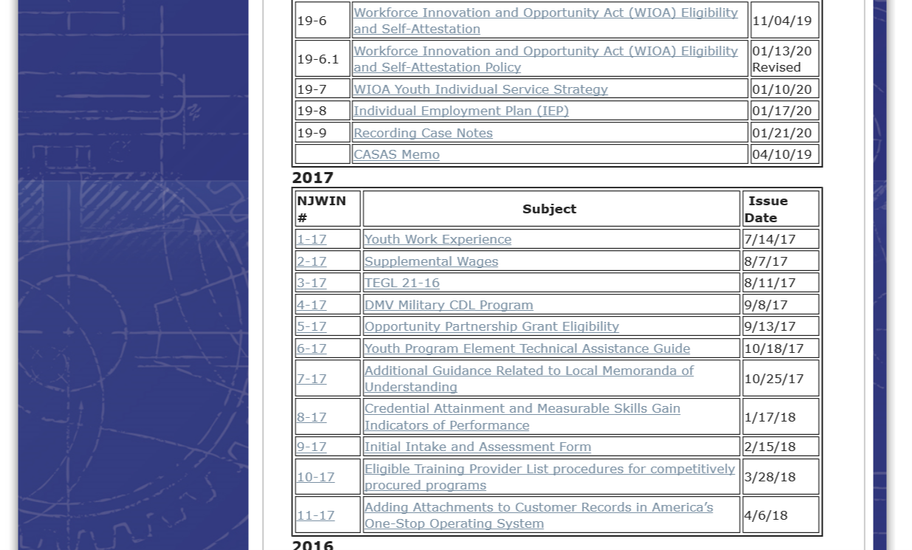
https://www.nj.gov/labor/wioa/resources/
Notes:
Including specifically the Work Experience policy, NJWIN 1-17.

Slide 6
Work Experience
Work Experience: Work-Based Career Exploration and Preparation Opportunities
A work experience is a planned, structured learning activity that takes place in a workplace setting for limited period of time and should include opportunities for acquiring job experience.
Work experiences should be offered to all youth:
In-School Youth
Out-of-School Youth without a Credential
Out-of-School Youth with a Credential
Notes:
Work experiences offer opportunities for work-based career exploration and preparation. They are planned, structured learning activities that take place in a workplace setting and offer youth opportunities for acquiring job experience.
Work experiences should be offered to all youth and can provide unique value to in-school youth, out-of-school youth without a secondary credential, and out-of-school youth with a secondary credential.

Slide 7
Types of Work Experience
Summer/Year-Round Employment Opportunities
Participants receive hands-on experience and activities during summer months as well as other employment opportunities available throughout the school year
Pre-apprenticeship Programs
A program or set of services designed to prepare participants to enter and succeed in a Registered Apprenticeship (RA) program
Internships and Job Shadowing
Participants learn about a job through first-hand observation of a professional or competent worker, including the work environment, occupational, and technical skills necessary to perform the job
On-the-Job Training
A paid employer-led training experience
Notes:
A variety of work experience types are available to support the unique interests and meet the needs of youth coming in with different experiences.
These include, summer and year-round opportunities which young people can receive hands-on employment experience.
Pre-apprenticeship programs that prepare participants to enter and succeed in a Registered Apprenticeship program. Pre-apprenticeship programs should include facilitated Entry/and/or Articulation with Registered Apprenticeship programs.
In addition, work experience includes internships and job shadowing where participants can learn about a job through first-hand observation of a professional.
Finally, a work experience, may also include on-the-job training, defined as a paid employer-led training experience.

Slide 8
Key Work Experience Characteristics
Compensation Potential
May be a paid or unpaid opportunity
Employer Base Diversity
May occur in a variety of employer settings
Career Exploration and Development
Includes opportunities for career exploration and skill development
Academic and Occupational Skill Development
Includes academic and occupational components
Career Readiness
Prepares individual for workplace readiness
Notes:
In addition to considering the variety of work experiences in which youth can engage, there are also five key work experience characteristics that you should consider when developing work experience opportunities in your local area.
Compensation potential
Diversity of your employer base
Integration of career exploration and development
Inclusion of academic and occupational components
As well as ensuring that work experiences strengthen the career and workplace readiness of youth.
We’ll spend the next part of this training discussing each of these areas in more detail.

Slide 9
Compensation Potential
A payment for services rendered where an employer/employee relationship exists
Wages
Payment Types
An allowable payment for participation in work experience activities
Stipends
Payments allowable to youth participants for recognition and achievements directly tied to work experience, such as a successful completion
Incentives
Notes:
Compensation potential includes payments to youth through wages, stipends, and incentives, as part of a work experience. Overall, while some work experiences may be unpaid, we encourage local areas to consider compensation strategies for all work experiences.
Wages are payment for services rendered where an employer/employee relationship exists
Stipends are allowable payments for participation in work experience activities
Incentives are payments allowable to youth participants for recognition and achievements directly tied to work experience, such as a successful completion

Slide 10
Compensation Potential
Notes about Payment:
Wages and stipends are subject to IRS rules and guidelines
Wages should be compliant with policies under the Fair Labor Standards Act (FLSA)
Local policies should be in place governing award of incentive payments
A payment for services rendered where an employer/employee relationship exists
Wages
Payment Types
An allowable payment for participation in work experience activities
Stipends
Payments allowable to youth participants for recognition and achievements directly tied to work experience, such as a successful completion
Incentives
Notes:
In addition, it is important to note the following specifics:
Wages and stipends are subject to IRS rules and guidelines
Wages should be compliant with policies under the Fair Labor Standards Act (FLSA)
Local policies should be in place governing award of Incentive payment specifics.
In addition to this video, more details about wages, stipends, and incentives are offered in NJWIN 1-17.

Slide 11
Employer Base Diversity
Diversity Characteristics
Location
Sector
Industry
Size
Notes:
The second characteristic to consider in developing work experiences in your local area, is the diversity of employers that you are working with to offer work experience.
Are you working with employers from different locations within your local area?
Are you working with employers that cross over for-profit/non-profit and private/public sectors?
Are you working with employers from different industries and occupations?
Are you working with employers of different sizes – small business, and large organizations?

Slide 12
Career Exploration and Development
Exploration
Skills Development
Career Observation/ Exposure
Examples: Job Shadowing, Company Tours
Career Exploration
Examples: Career Fairs, Career Mentors
Direct Employment Experience
Examples: Authentic Work Tasks and Projects
Industry Engagement
Examples: Pre-Apprenticeship and Internship
Notes:
In addition to employer diversity, the work experiences you offer to youth should include opportunities for career exploration and skill development.
Specific career exploration activities include opportunities for observing careers, for example through job shadowing, as well as company tours.
And additional career exploration opportunities such as through career fairs or engagement with career mentors.
Skills development opportunities should be available through direct employment experiences that includes authentic work tasks and projects
As well as specific industry engagement opportunities, for example through pre-apprenticeship and internship opportunities.

Slide 13
Academic + Occupational Skill Development
The academic and occupational education component of work experience must include information needed to understand and work in a specific industry or occupation.
Occupational Component
Academic Component
Employer-Based Experience
Contextualized Learning
Notes:
A fourth area to consider across your work experience programs are the inclusion of both academic and occupational skill development. Local programs have the flexibility to determine the appropriate type of academic and occupational education necessary for a specific work experience.
Every work experience should include both an occupational component and an academic component. And core to a work experience is engagement in an employer-based experience. This employer-based experience offers opportunities for contextualizing learning about an occupation, and connects the development of academic and occupational skills to an authentic professional environment.

Slide 14
Academic + Occupational Skill Development
Flexibility exists in how these components may be offered:
By the employer and/or another provider
At the worksite and/or in a classroom
Concurrently and/or sequentially
Occupational Component
Academic Component
Employer-Based Experience
Contextualized Learning
Notes:
Ultimately work experiences can be implemented in a number of ways, components may be offered by the employer and/or a provider, in a worksite and/or in a classroom, or concurrently and/or sequentially. The key is that there should be intentional integration of occupational and academic components through an employer-based experience and real world engagement.

Slide 15
Academic + Occupational Skill Development
Components should build academic knowledge and skills related to the specific occupation or occupational cluster of the work experience.
Work experiences should include opportunities to learn about:
The tools and mechanisms that are inherent to a particular occupation
Fundamental occupational concepts and techniques
Industry-based language
Occupational Component
Academic Component
Employer-Based Experience
Contextualized Learning
Notes:
It’s critical that youth not only gain real world exposure but also should build specific academic knowledge and skills related to a specific occupation or occupational cluster, including learning about fundamental occupational concepts and techniques, and the tools, mechanisms, and industry-based language that are inherent to a particular occupation.

Slide 16
Career Readiness
Academic and technical skills
Health and financial well-being
Citizenship
Environmental, social and economic awareness
Creativity and innovation
Communication
Critical thinking
Ethical leadership/ Effective management
Research strategies
Working in teams/
Cultural competence
Career pathways and goals
Technology
https://www.state.nj.us/education/cccs/2014/career/CareerReadyPractices.pdf
Notes:
Last but not least is the critical importance of considering and thinking about how work experiences can be designed to strengthen career and workplace readiness. The New Jersey Department of Education has developed a set of Career Ready practices that offers a full range of career readiness areas to consider in your work experience programming, including communication, critical thinking, creativity and innovations, working in teams/cultural competence, and health and financial well-being.
For more information, you can google NJ career ready practices for the full framework.

Slide 17
ISS Roadmap
Work Experience
Notes:
Now we’re going to shift gears to talk more about how to engage in identifying and documenting work experience with individual youth. The ISS is a critical tool in helping to identify an appropriate work experience for a youth, as well as documenting engagement in work experience.

Slide 18
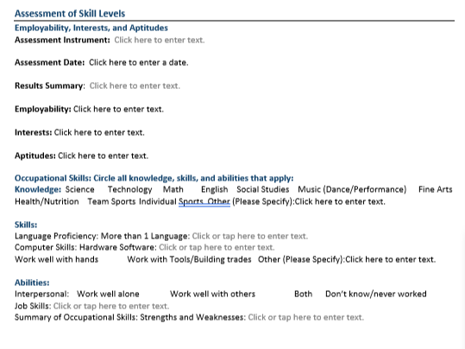
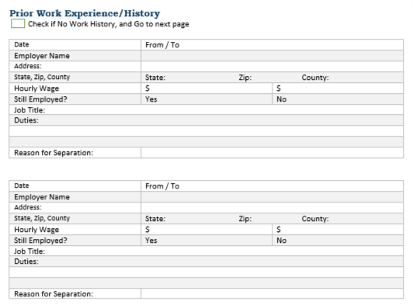
ISS Roadmap
Assessment of Need → Part I of ISS
Notes:
Identifying whether a youth can benefit from work experience, starts with assessment of a young person’s occupational interests, skills and employability, as well as a review of prior work experience and history.

Slide 19
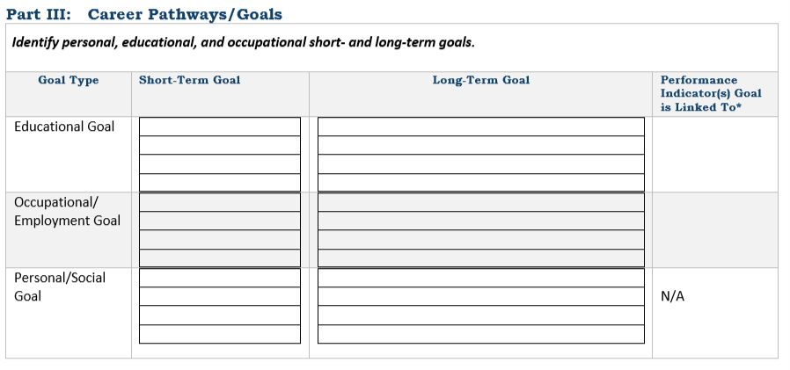
ISS Roadmap
Career Pathways and Performance Indicators→ Part III of ISS
Notes:
As well as a review of their career pathways and goals. How might a work experience offer them opportunities to build knowledge and skills and experience that aligns with their career pathway and goals?

Slide 20
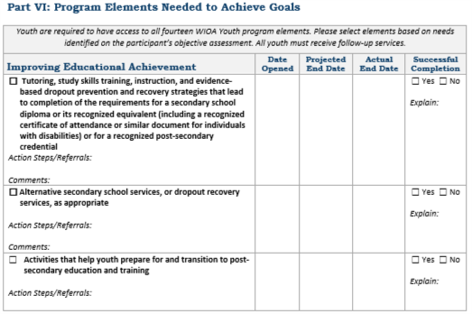
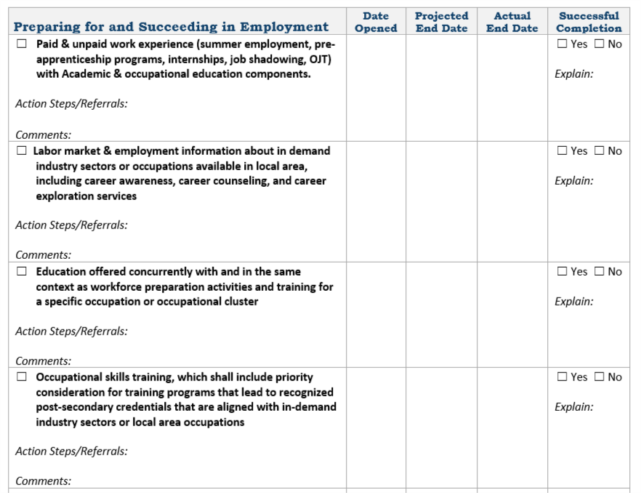
ISS Roadmap
Planned and Actual WIOA Services→ Part VI of ISS
Notes:
If based on assessment and identification of goals and career goals, a young person could benefit from a work experience, this should be documented in the program elements section of the ISS.

Slide 21
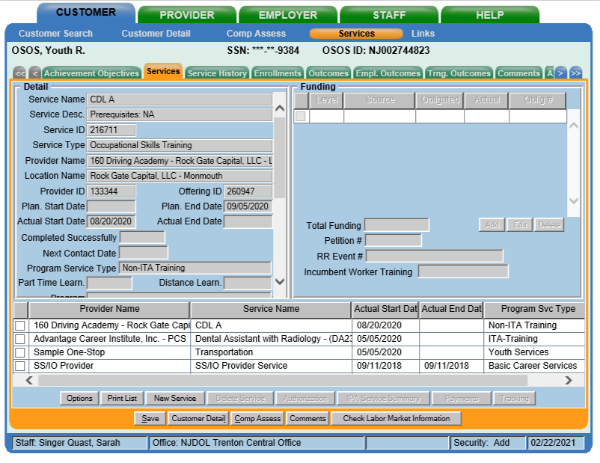
AOSOS Roadmap
Work Experience Services
Step 1: Designate and fund specific work experience services in the Services tab in Services.
Notes:
Work experience planning and participation should also be documented in AOSOS. Specifically, any work experiences should be designated and funded as services in the services tab.

Slide 22
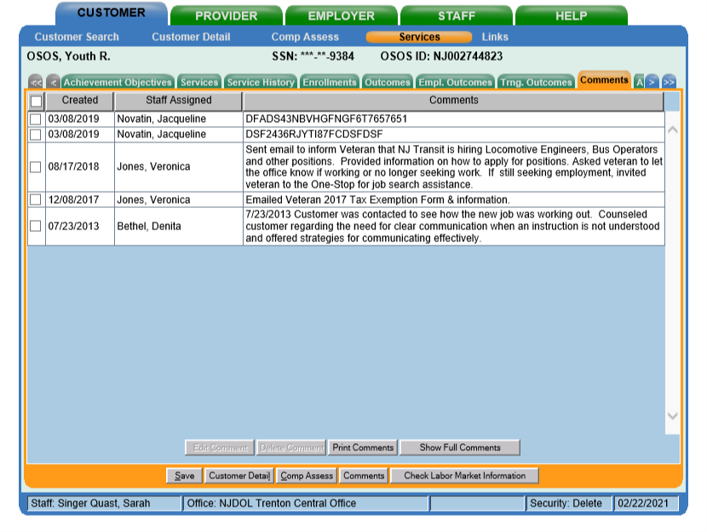
AOSOS Roadmap
Work Experience Services
Step 2: Document specific details related to work experience in the Comments tab in Services.
Notes:
Additional notes and details should be highlighted in the Comments tab in Services.

Slide 23
AOSOS Roadmap
Work Experience Details
Step 3: Document specific details related to work experience in the Comments tab in Services.
What is the type of work experience?
Where is the placement?
What is the duration of the work experience?
What are the educational components, both academic and occupational?
How is it aligned to the career pathway?
Notes:
Including specific information about the work experience in which the youth participated:
What type of work experience?
Where is the youth placed?
How long is the work experience?
What are the specific educational components?
And how is it aligned to the career pathway?

Slide 24
AOSOS Roadmap
Work Experience Details
Comments should also include information when a work experience is not part of a youth’s work experience.
When was a work experience offered?
Why wasn’t a work experience part of the youth’s service strategy?
Notes:
In addition to documenting when work experience is part of a youth’s service strategy, Comments should also include information when a work experience is not part of a youth’s service strategy, documenting when a work experience was offered and declined and/or why a work experience wasn’t part of the youth’s service strategy.

Slide 25
File Roadmap
Work Experience – Local Documentation
Additional Documentation
ISS
Worksite Agreement
Training Plan
Timesheets, Attendance sheets
Performance documentation
Proof of wage, incentive, or stipend payment
If incentives, documentation of benchmarks achieved
Justification for incentives/ stipends, if applicable
Notes:
In addition to documentation in AOSOS, there are also specific documents associated with work experiences that should be captured in the paper or electronic files based in your local areas, these include documents such as worksite agreements, training plans, timesheets and attendance sheets, and proof of wage, incentive, and/or stipend payments.

Slide 26
Additional Resources
NJDOL Policy
NJ Workforce Innovation notices including NJWIN 1-17 that outlines specific Work Experience policy can be found here:
https://www.nj.gov/labor/wioa/resources/
AOSOS Training Videos
Specific tutorials about entering Activities and Comments, the tabs in Customer Detail, and the tabs in Comp Assess can be found here: https://towork.dol.state.nj.us/aosostrainingmaterials/_layouts/15/start.aspx#/
Workforce GPS
Additional resources about paid and unpaid work experiences can be found on DOLETA’s Workforce GPS website:
https://youth.workforcegps.org/resources/2017/01/19/14/27/Paid-and-Unpaid-Work-Experience?_sm_au_=iVVZH6s45tRHqsSM
Contact us at Career Services with any questions at WIOApolicy@dol.nj.gov
Notes:
This concludes our summary of Work experience. Additional resources including NJDOL’s policies, a series of training tutorials on AOSOS, as well as work experience materials on Workforce GPS are available. If you don’t have access to these materials or have any additional questions, don’t hesitate to reach out to us at WIOApolicy@dol.nj.gov. And don’t forget to subscribe to this YouTube channel by clicking the subscribe button to get updates about future videos. Thank you.

