Slide 1
Lisa Moore Assistant Regional Census Manager New York Regional Census Center

Slide 2
U.S. Census Bureau
Largest statistical agency in the U.S.
Leading source of quality data about the nation’s people, places and economy conducting more than 130 Census Bureau Surveys and Programs
Demographic Programs
Decennial Census
American Community Survey
Current Population Survey
American Housing Survey
Economic Programs
Economic Census (Years ending in 2 & 7)
Census of Governments (Years ending in 2 & 7)

Slide 3
The 2020 Census
Mission
To serve as the nation’s leading provider of quality data about its people and economy.
Purpose
To conduct a census of population and housing and disseminate the results to the President, the States, and the American People.
Count everyone once, only once and in the right place.

Slide 4
What is the Census?
Count of every resident living in the United States
Increasingly diverse and growing population
330 million people
Over 140 million housing units
Mandated by Article 1, Section 2 of the U.S. Constitution
Conducted every 10 years ending in zero since 1790
Representation and Funding
Notes:
Let’s get started with the 2020 Census….
As I mentioned , the Census is mandated by the United States Constitution and has been around since 1790.
In 1790, Thomas Jefferson was director of the first census. Then In 1790, they only needed 650 enumerators to count 3.9 million residents in 13 states. At the time New York City was the largest urban place with 33 thousand people. In 2010, the Census Bureau needed about 635 thousand enumerators to count a population of about 308 million people
To give you an idea of the magnitude of conducting a Census, A Census is the largest U.S. peacetime mobilization and operation conducted.
In 2020 we will be attempting to count over an estimated 330 million people in 140 million households.
The law requires the Census Bureau to keep your information confidential. Your responses are only used to produce statistics
All Census Bureau workers take a legally binding, lifetime oath to protect your information. Anyone who violates that oath could face jail time, a $250,000 fine, or both.

Slide 5
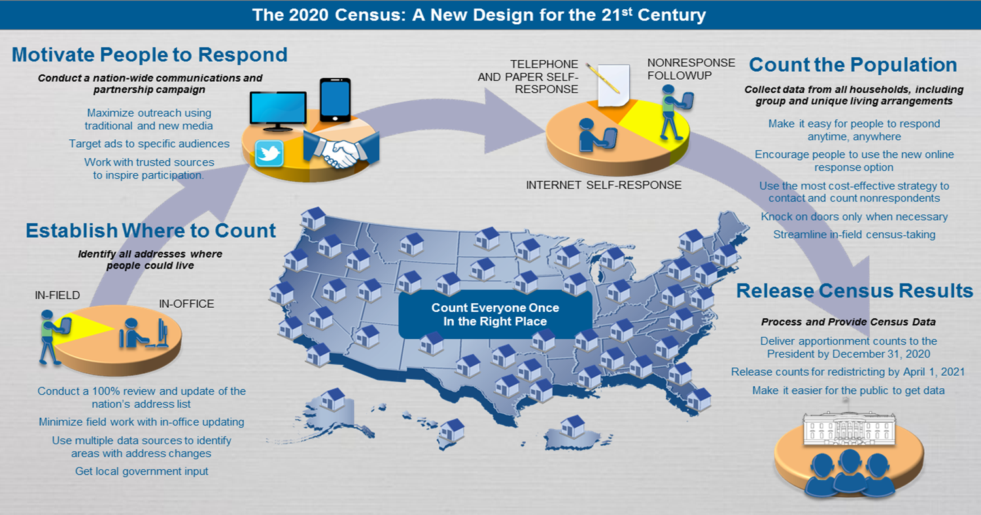
Design for 2020 Census

Slide 6
2020 Office & Field Staffing Hiring Now through Spring of 2020
Field Positions
Recruiting Assistants*
Census Field Supervisors*
Enumerators*
Office Positions
Area Census Office Manager
Census Field Manager
Administrative Manager
Information Technology Manager
Recruiting Manager
Office Operations Supervisor*
2020 NJ Recruiting Goal: 50,000
June 19,2019
20%
* Indicates apply now at the below link for our Field Operations https://2020census.gov/jobs
All other positions must apply on www.USAJobs.gov

Slide 7
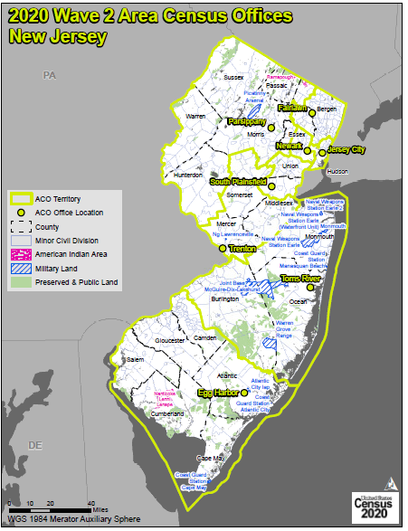

Slide 8
2020 Census – It Is Safe
Private information is never published, including names, addresses (including GPS coordinates), Social Security Numbers, and telephone numbers.
The Census Bureau collects information to produce statistics. Personal information collected by the Census Bureau cannot be used against respondents by any government agency or court.
Census Bureau employees are sworn to protect confidentiality for life.
Violating Title 13 is a serious federal crime. Violators are subject to severe penalties, including a federal prison sentence of up to five years, a fine of up to $250,000, or both.

Slide 9
2020 Census – It Is Easy
Four ways to respond in 2020
Online
Phone
Paper
Personal Visit by Census Employee
Name, age, DOB, race and origin, Hispanic origin, citizenship, relationship, gender, tenure, operational questions (pop count, name, phone number, overcount, undercount)
12 Non-English Languages for Online and Phone
59 Non-English Language Guides (Video and Print)
Includes American Sign Language, braille, and large print

Slide 10
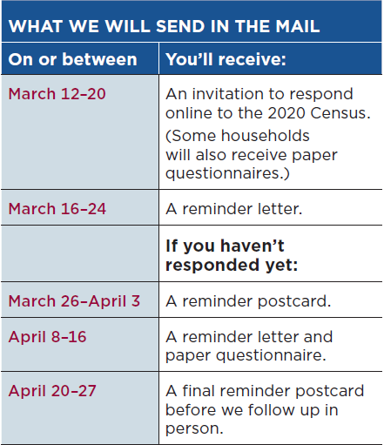
The Census Bureau will mail (or hand deliver) invitations to complete the 2020 Census in March 2020.
The majority of the country will receive a letter during the first mailing requesting the housing unit complete the census online, using the Internet Self-Response method (called “Internet First”).
The remainder of the country will receive a letter and paper form during the first mailing (called “Internet Choice”).
All non-responding housing units will receive a letter and paper form during the fourth mailing

Slide 12
2020 Census – It Is Important
Determines the number of seats each state has in the U.S. House of Representatives
Defines congressional and state legislative districts, school districts and voting precincts
Determines the annual allocation of $675 billion dollars in federal funding
Medicaid, SNAP, Hwy Planning, Section 8 Housing, Special Education Grants, S-CHIP, Title I Grants, National School Lunch Program, WIC, Head Start, Foster Care, Health Center Programs
Provides insight to governments, business and community planning groups for planning purposes
Provides population benchmarks for nearly every other United States survey

Slide 13
Key Milestones for the 2020 Census
August 2019 – New Statistics in Schools classroom activities available online www.census.gov/schools
January 2020 – Advertising campaign begins
March 2020 – Group Quarters (GQ) Enumeration begins
Includes college dormitories, prisons, nursing homes, service-based locations (homeless shelters, soup kitchens, mobile food vans) and homeless count
Mid-March 2020 – Public can begin responding online at www.2020census.gov
Replying by mail or phone will also be an option
April 1, 2020 – Census Day
Mid-May 2020 – July 2020 – Census takers go door to door
2021 – Initial 2020 Census results to be released on www.census.gov

Slide 14
The 2020 Census Phases
Education
Awareness
Motivation
Reminder
Thank You
Local governments and community leaders throughout the nation participate in activities highlighting the message that the 2020 Census is imminent and that it is easy, important and safe to participate.
Education Phase – 2018 - 2019
Awareness Phase – January – February 2020
Motivation Phase – March – May 2020
Reminder Phase – May – July 2020
Thank You Phase – Starts July 2020
Notes:
Chapter 4: Timeline Key Communications Phases (page 11)

Slide 15
What You Can Do Now!
Share job recruitment information
Start the Census conversation
Safe, Easy & Important
Become a partner
Start or join a Complete Count Committee (CCC)
Ask your local leadership to form a CCC
Identify opportunities to include Census messaging, materials, or invite Census staff to your event

Slide 16
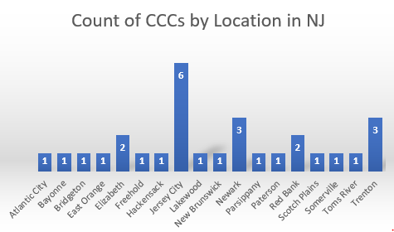

Slide 17
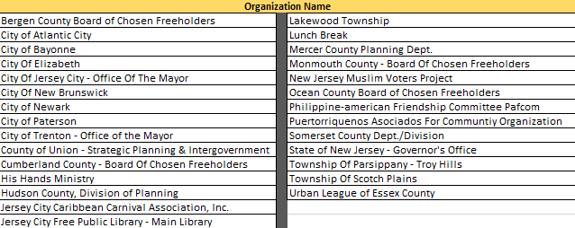
NJ: Complete Count Committees

Slide 18
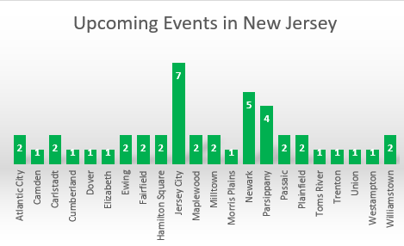

Slide 19
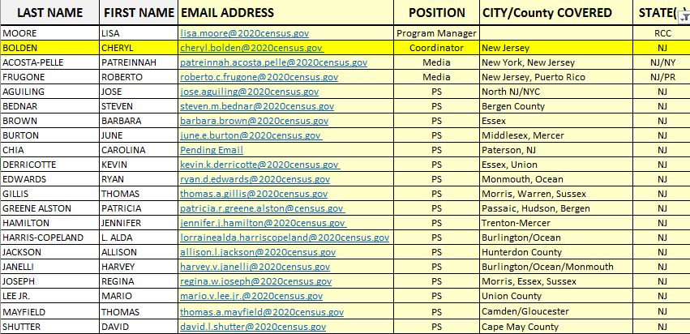
NJ Partnership Staff

Slide 20
CCC Tools
Center for Urban Research/CUNY Graduate Center
https://www.censushardtocountmaps2020.us/
US Census Bureau – Response Outreach Area Mapper
https://www.census.gov/roam
Local Knowledge!

Slide 21
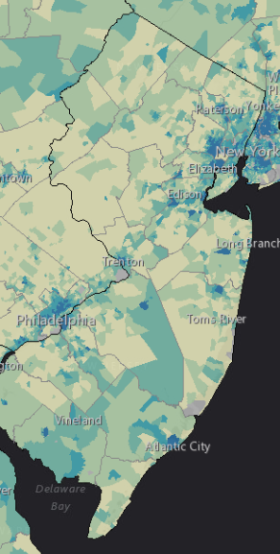
Response Outreach Area Mapper (ROAM)
www.census.gov/roam
Developed to identify hard-to-survey areas
Provides a demographic and socioeconomic characteristic profile using American Community Survey (ACS) estimates
Low Response Score (LRS) is a metric to predict the percentage of households who will not self-respond to the Decennial Census
Darker census tracts are harder to survey than lighter census tracts

Slide 22
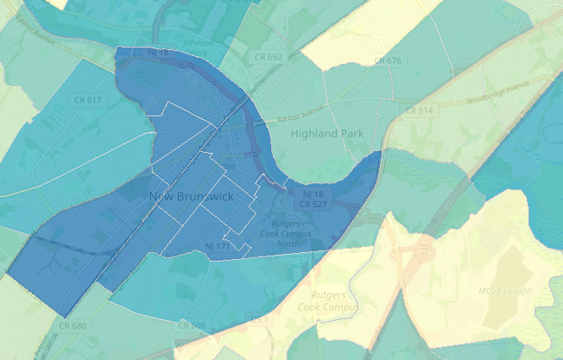
Response Outreach Area Mapper (ROAM)
census.gov/roam
Census Tract 58 Low Response Score (%): 37.0
Total Population: 5,480 Median Household Income ($): 31,458 Population Under 5 (%): 11.90 Population 18-24 (%): 15.07 Population 65 and Over (%): 4.45 Below Poverty Level (%): 49.87 Not High School Graduate (%): 53.17 Non-Hispanic, Black (%): 9.73 Non-Hispanic, White (%): 10.57 Hispanic (%): 77.15 Asian (%): 2.55 Foreign Born (%): 44.16 No One in Household Age 14+ Speaks English "Very Well" (%): 40.73 Population 5+ Who Speak English Less Than "Very Well" and Speak Spanish (%): 54.45 Total Housing Units: 1,441 Total Occupied Housing Units: 1,279 Renter Occupied Housing Units (%): 83.42 Family Occupied Housing Units with Related Children Under 6 (%): 39.42 Population 1+ Who Moved From Another Residence Within the Last Year (%): 16.58 Vacant Housing Units (%): 11.24 Multi-Unit (10+) Housing (%): 6.80
Notes:
As the Census Bureau anticipates national level issues, we have developed tools that can assist Partnership specialists and you to plan at the local level in anticipation of areas of low response.
You are looking at a screenshot from the Respondent Outreach Area Mapper also known as ROAM for the Brooklyn area. This tool is an interactive web mapping application that allows users to visualize predicted areas that are considered hard to survey down to the census tract. Hard-to-survey areas—the darker shaded areas represent the Hard to Survey areas. Be mindful that areas can be hard-to-survey for different reasons. Learning about each hard-to-survey area allows the Census Bureau to create a tailored communication and partnership campaign, and to plan for field resources including hiring staff with language skills.
As you can see, you can highlight a census tract and view the characteristics of the census tract.
This tool is available for public use and is available at www.census.gov/roam.
(if needed)
RAOM utilizes a metric called the Low Response Score (LRS)—or more simply, predicted mail nonresponse rate from the Census Bureau’s Planning Database. The Low Response score is calculated by 2010 Census response rates and other characteristics within the Census Bureau’s Planning Database.

Slide 23
Data Dissemination Program
Free Resource to YOU
Opportunities to teach the public how to access our data
Data Presentations
Data Access Workshops and Training Sessions
Webinars
Data and Survey Inquiries
All tools and data available at www.census.gov
American FactFinder
Census Business Builder
My Congressional District
OnTheMap
Subscribe and learn more:
www.census.gov/academy
Notes:
I don’t want to leave here today without mentioning the Census Bureau’s Data Dissemination Program. This program was developed to help you understand and utilize the vast array of data we have available on our website. This is a FREE program, a service we provide to give back to our partners and communities. Our expert staff can customize a training workshop for you or your constituents. Trainings can be done in person or via webinar. Our staff are well-versed in the data tools available on our website, including American FactFinder, Census Business Builder, My Congressional District and others.
The Data Dissemination staff are available to our partners for events to help educate people on the uses of the data.

Slide 24
https://www.youtube.com/watch?v=LXJz7ZfzAuM

Slide 25
Connect With Us
www.2020census.gov
facebook.com/uscensusbureau
twitter.com/uscensusbureau
youtube.com/user/uscensusbureau
instagram.com/uscensusbureau
Notes:
We are very active on social media, so add us!

Slide 26
Contact Us
Partnership Program
Phone: (212) 882-2130
Email: new.york.rcc.partnership@2020census.gov
Website: https://www.census.gov/partners/2020.html
Census Jobs
Field & Office Job Opportunities
Website: www.2020census.gov/jobs
Office Managerial Job Opportunities
Website: www.usajobs.gov
Website: www.census.gov/about/regions/new-york/jobs.html
Data Dissemination Program
Email: census.askdata@census.gov
Phone: 1-844-ASK-DATA
Website: www.census.gov/data/training-workshops.html

