Slide 1
The History Behind Census Geography
Michael Ratcliffe
Geography Division
New Jersey State Data Center Affiliates’ Meeting
New Brunswick, NJ
June 19, 2019

Slide 2
Today’s Presentation…
A brief look at the history behind some of the Census Bureau’s geographic areas.
Focus on:
History behind census geographic areas.
Changes to census geographic area concepts and criteria in response to changing settlement patterns and data user needs.

Slide 3
Census Geography: The Long View
The Census Bureau’s geographic areas reflect the variety of ways in which Americans have organized the settlement landscape.
1790-1890, census geography was largely limited to a small number of types of legal areas.
The history of changing census geography has largely been one of increasing types and numbers of statistical geographic areas.

Slide 4
Changes to Census Geography
Over the past century, the number and types of census geographic areas, and the criteria used to define areas, have changed in response to:
Changes in technology (i.e., GIS, databases) providing for more efficient exchange, collection, management, and dissemination of data.
Changes in user needs and expectations.
Improvements in spatial resolution of data.
Changes in theoretical approaches to interpreting and understanding geographic concepts.

Slide 5
Census Geography: Key Dates
Late-19th Century: introduction of small statistical areas, such as enumeration districts, sanitary districts. Tabulation of data by city ward.
1910: Introduction of census tracts (8 cities).
1910 – 1940: Industrial districts, metropolitan districts.
1930: Census tract coverage expanded to 10 additional large cities.
1940: block-level data for cities of 50,000 or more population. Unincorporated communities supplementary report.
1950: Introduction of standard metropolitan areas, urbanized areas, census designated places (CDPs), census county divisions (CCDs).
1990: Nationwide coverage for blocks; census tracts/block numbering areas.
2000: ZIP Code Tabulation Areas (ZCTAs), urban clusters, micropolitan statistical areas. Census tracts nationwide.

Slide 6
Westward migration of American political geography: Counties and County Subdivisions

Slide 7
Chesapeake Counties and New England Towns… and a Middle Path in the Mid-Atlantic
Our basic units of local political geography largely stem from three colonial hearths:
The Chesapeake Region of Maryland and Virginia
New England
Pennsylvania
The political landscape in the Chesapeake formed around counties.
In New England, the basic unit of local government was the town/township.
In Pennsylvania, we see a mix of counties, cities, and townships.
Notes:
Much of our political geography stems from patterns found in three colonial culture hearths: New England, Pennsylvania, and the Chesapeake Region. The political landscape of the Chesapeake Region formed around counties, and today we see “strong counties” in Maryland and Virginia, and less emphasis on municipal incorporation. In New England, the basic unit of local government was the town or township. In Pennsylvania, we see a blending of the two approaches to local government– cities, townships, and counties.
Migrants carried these local political geography preferences with them as they moved west of the Appalachians, across the old Northwest and Southwest.

Slide 8
As Americans moved west, they tended to take their political geography preferences with them.
Source: Donald W. Meinig. 1993. The Shaping of America: Continental America, 1800-1865. Yale University Press.
Notes:
The map on the left shows generalized patterns of migration from the Northeast and Middle Atlantic regions. In general, New Englanders moved westward through the Great Lakes region; Pennsylvanians and others from the Middle Atlantic region moved across the center of the old Northwest Territory. Southerners (Chesapeake region and Carolinas) moved west along the Ohio valley and then northward into Northwest Territory.
As we’ll see in the map of county subdivisions on slide 10, there are 12 states that we typically refer to as “strong-Minor Civil Division (MCD)” states. These are states in which the MCDs– generally towns/townships– are primary units of local government. These are the New England states, New York (which had a strong influence from New England, particularly in Upstate New York and Long Island), Pennsylvania, and New Jersey, as well as Michigan, Minnesota, and Wisconsin, also influenced by New England migrants.
States in which counties are primary units of local government have non-governmental MCDs or have shifted to statistical census county divisions.
The map on the right shows generalized patterns of migration across the South out of the Carolinas.

Slide 9
9
Notes:
Minor Civil Divisions (MCDs)
Legal entity in 29 states, DC, and Puerto Rico, and the Island Areas
May have a formal government with elected officials
Over 30,000 MCDs for the 2010 Census
A minor civil division (MCD) is the the primary governmental or administrative division of a county or statistically equivalent entity in many states and statistically equivalent entities. An MCD is created to govern or administer an area rather than a specific population.(e.g. Town, Township, District) The Census Bureau recognizes MCDs in 29 states, the District of Columbia, Puerto Rico, and the Island Areas.
Census County Divisions (CCDs)
Statistical entity in 21 states
Stable boundaries, recognizable names
Over 5,200 CCDs for the 2010 Census
A census county division (CCD) is a statistical subdivision of a county, delineated by the Census Bureau in cooperation with state and local government officials for data presentation purposes. A CCD usually represents one or more communities, trading centers or, in some instances, major land uses. CCDs are designed to be stable from census to census, and correspond to more obvious physical boundaries.

Slide 10
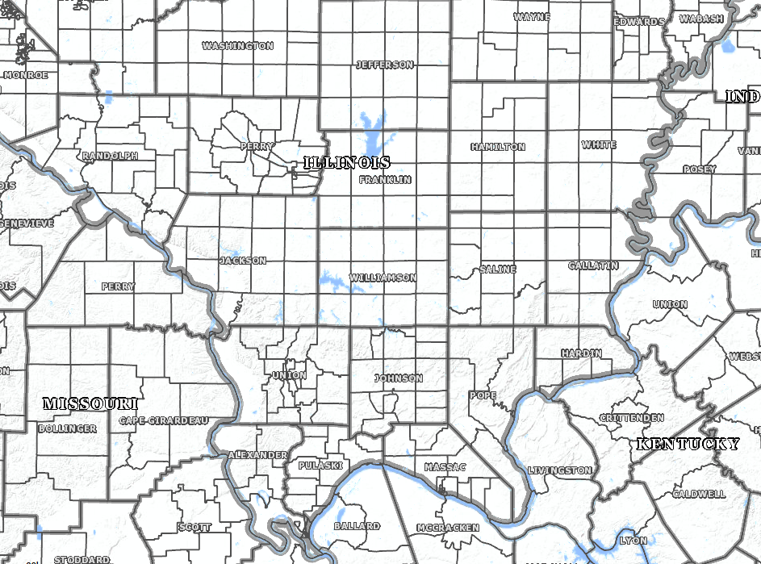
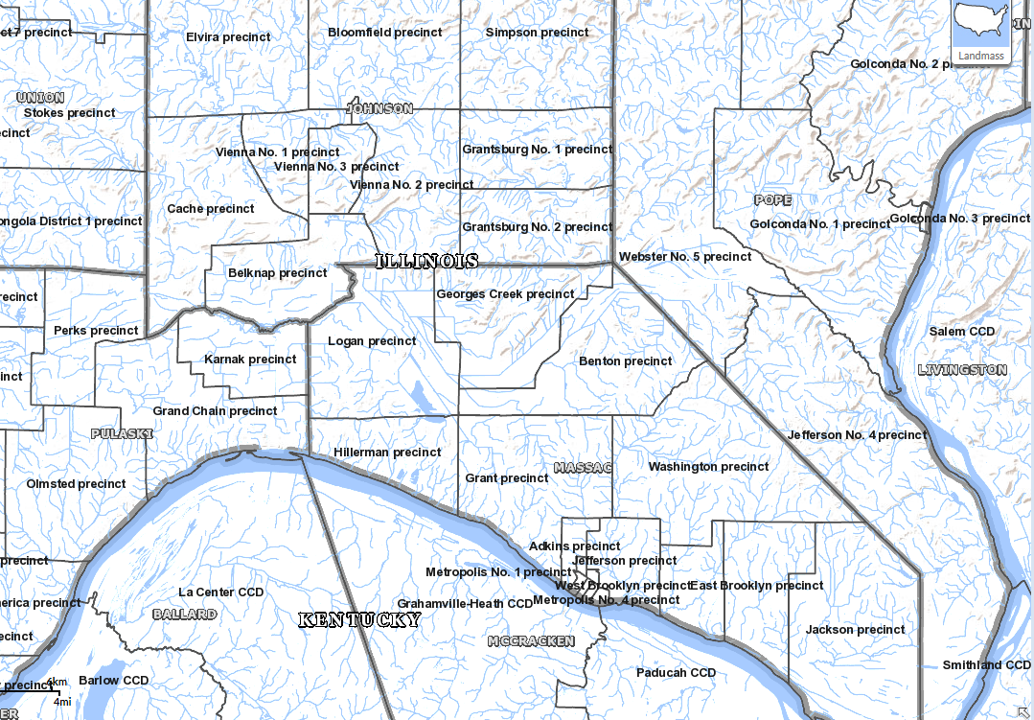
Illinois County Subdivisions
Non-governmental precincts in 17 counties, mostly in the southern half of the state, areas settled historically by migrants from the South.
Notes:
Illinois provides a good contemporary example of these historical preferences and patterns. There are two kinds of MCDs recognized in Illinois– active townships which provide some services and functions at the local level, reflecting the New England and Pennsylvania culture hearth influences; and non-governmental election precincts, located in the southern half of the state in which migrants from the Chesapeake and Carolina hearths tended to settle.

Slide 11
Filling in the gaps: Census Designated Places

Slide 12
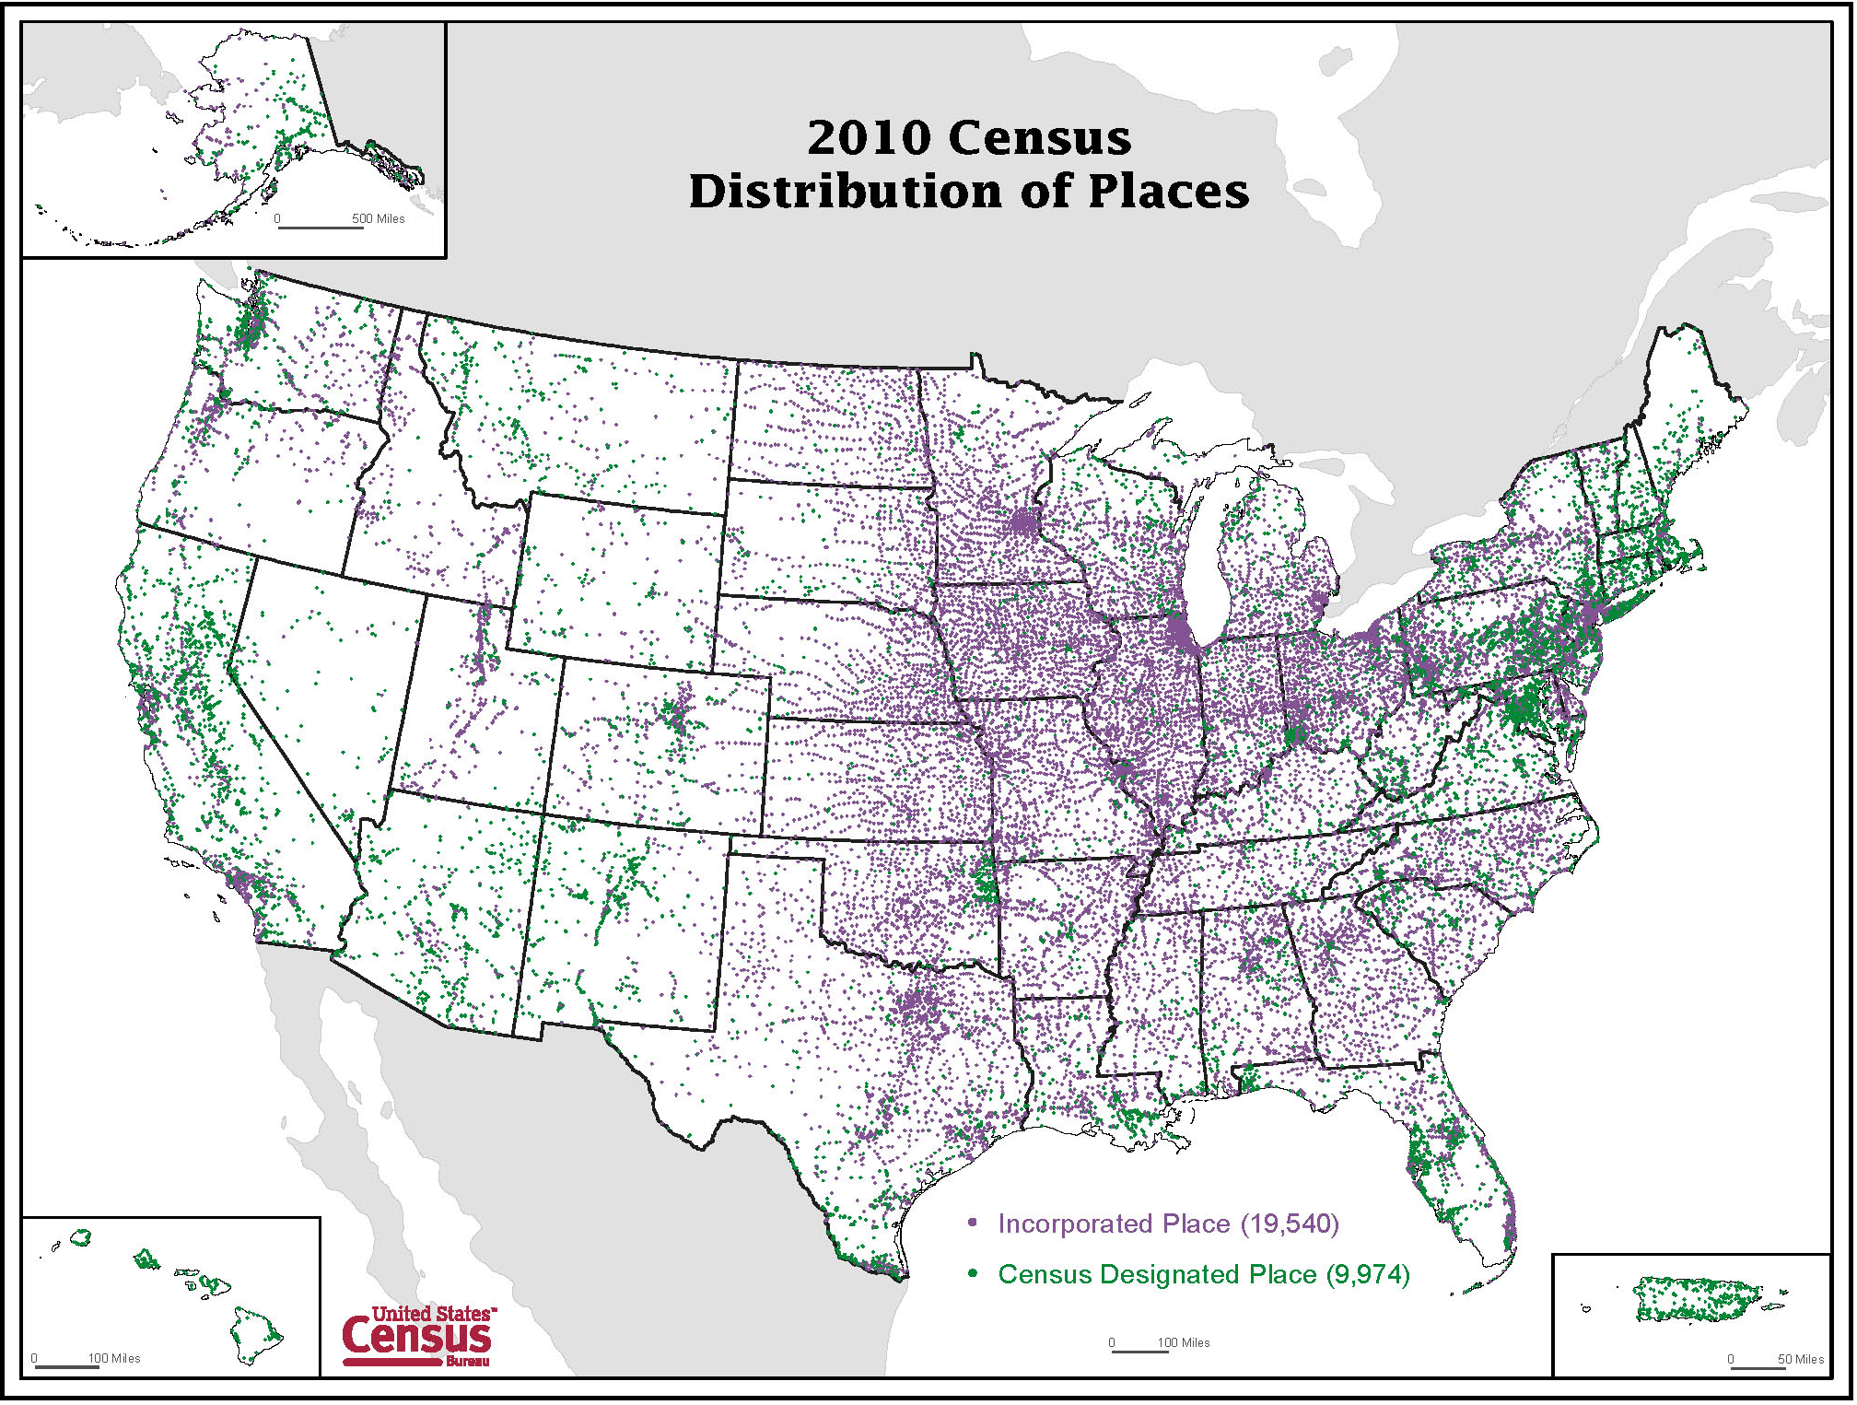
Notes:
Incorporated Places
Legally bounded entity
Cities, boroughs, towns, or villages, depending on the state
Over 19,000 incorporated places
Census Designated Places (CDPs)
Statistical entity
Unincorporated community, concentration of population, housing, and commercial structures, identifiable by name, but not within an incorporated place
Nearly10,000 CDPs for 2010 Census
Boundaries of incorporated places and CDPs do NOT necessarily correspond to census tracts, block groups or MCDs.
For Census 2000, for the first time, CDPs did not need to meet a minimum population threshold to qualify for tabulation of census data.
CDP boundaries, which usually coincide with visible features or the boundary of an adjacent incorporated place or other legal entity boundary, have no legal status, nor do these places have officials elected to serve traditional municipal functions. CDPs usually are delineated in cooperation with county, state, and tribal officials based on Census Bureau guidelines.
Hawaii has only CDPs and no incorporated places.

Slide 13
Unincorporated/Census Designated Places
1940: Supplementary report for unincorporated places. Must have population of at least 500.
1950: unincorporated places defined only outside urbanized areas. Must have a population of at least 1,000.
1960 through 1990: defined inside urbanized areas, with the minimum population threshold declining from 10,000 to 5,000, then to 2,500 during this period. Outside urbanized areas, population of at least 1,000.
2000 to present: no minimum population threshold.
Improve access to data for small, unincorporated communities.

Slide 14
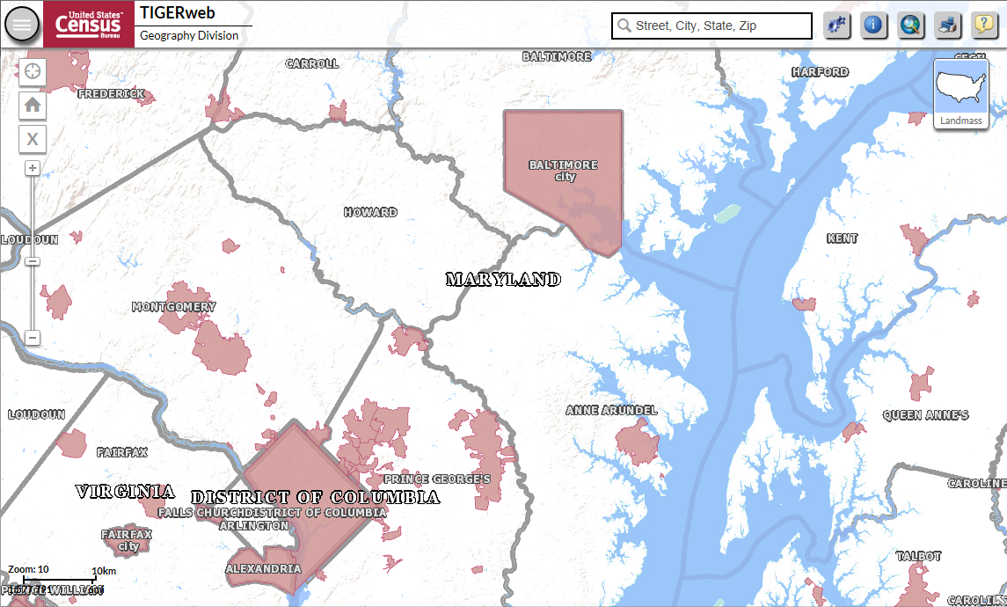
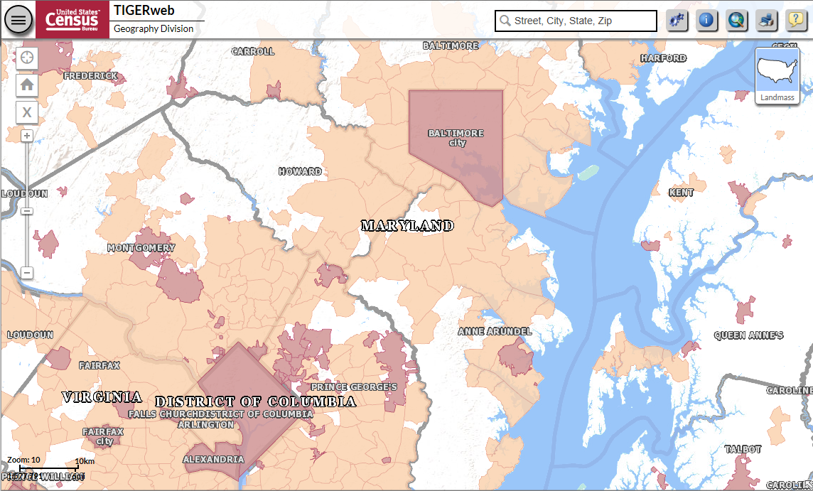
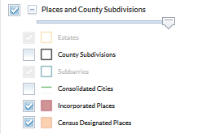
Census Designated Places
In states in which communities tend not to incorporate as cities, towns, or villages, CDPs are critical for providing place-level data.
Notes:
In states in which communities tend not to incorporated as cities, towns, or villages, CDPs are critical for providing place-level data. Maryland has “strong counties” providing the range of services that we typically associate with municipalities. As such, there is little value or need for communities to incorporate. As a result, many of the most important places economically and demographically are unincorporated. Without data for CDPs, there would be considerable gaps in the place level data for states like Maryland.

Slide 15
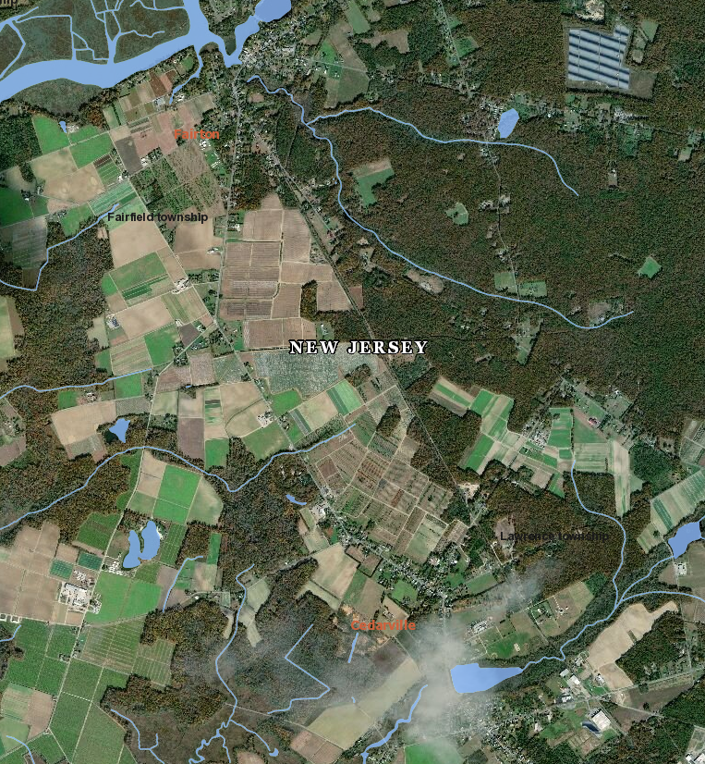
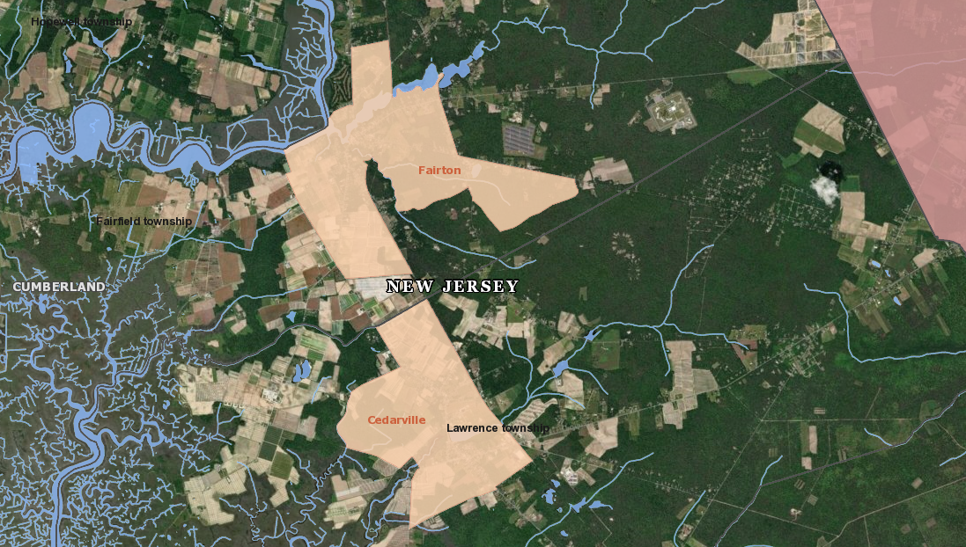
Providing data for small unincorporated communities: Cedarville CDP (population, 776) and Fairton CDP (population, 1,264)

Slide 16
Incorporated Places, Townships, and Census Designated Places
Notes:
New Jersey offers great examples of the difference between local and regional perceptions of “place” compared the Census Bureau’s definition of “place.” Are townships “places?” According to New Jersey municipal code, the answer is yes. According to the Census Bureau’s definition, which takes a nationwide view, the answer is no.
If we were to treat townships as places and still maintain the rule that places cannot overlap, what would we do with the CDPs that are defined for smaller communities within New Jersey’s townships?

Slide 17
Urban and Metropolitan Areas: Defining the structural and functional landscape

Slide 18
Urban/Rural and Metropolitan
The history of the urban/rural and metropolitan classifications has been one of response to:
Changes to settlement patterns in and around cities; i.e., increasing suburbanization.
Changes in theoretical approaches to interpreting and understanding the growth of urban areas.
Improved technology (i.e., GIS, digital databases) making it easier to manage large amounts of data.
Increased spatial resolution of statistical and geospatial data.
Notes:
We’ll start this portion of the presentation with two observations:
The history of urban and rural classifications since the late-19th century has been one of response to improvements in spatial resolution of data, increased amounts and variety of data, and improved technology. We’ll provide a few examples in this presentation.
Applying more data at lower levels of geography more frequently does not necessarily produce a better definition of rural or urban. We can now measure and define the urban landscape with greater precision than ever before. But, to what avail? We now quibble over small differences in measurements, or over whether the boundary line runs down the middle of a road or along one side or the other. We can now calculate block-level densities and measure changing commuting patterns at the tract-level on an annual basis, but we would ask: does that give us a better definition? Do we really need to do so?

Slide 19
1910: 2,500 threshold adopted.
1950: urbanized areas of 50,000+ adopted.
2000: urban clusters of 2,500-49,999 adopted.
Notes:
Over the course of over 200 years, the United States has changed from a predominantly rural to a predominantly urban nation (recognizing, of course, that the way in which one defines urban and rural affects the speed and magnitude of the shift).
As we look at the changing percentage of population that is urban over time, we can see three distinct eras: 1) a period (1790 to 1840) in which the population was predominantly rural and the percentage that was urban increased slowly; 2) a period (1840 to 1970) in which the percentage that is urban increased steadily as the nation industrialized, the nature of our economy changed, agriculture mechanized, and cities and suburbs grew; and 3) a period (1970 to present) in which the population is predominantly urban, with the percentage urban continuing to increase, but at a slower rate.
In the first era, when rural was the norm, cities– or perhaps more appropriately, densely settled populations– were more closely interconnected with the surrounding rural areas, and “urban” was perhaps more difficult to define. In the second era, as the industrial economy grows and cities expand both out and up, “urban” and “rural” became very distinct and easier to separate. We defined “urban” because it occupied the smaller footprint and required less time, but there was a clear distinction between urban and rural. In the third era, urban is the norm, less densely settled areas are closely connected to urban life, with the result that rural is now harder to define.

Slide 20
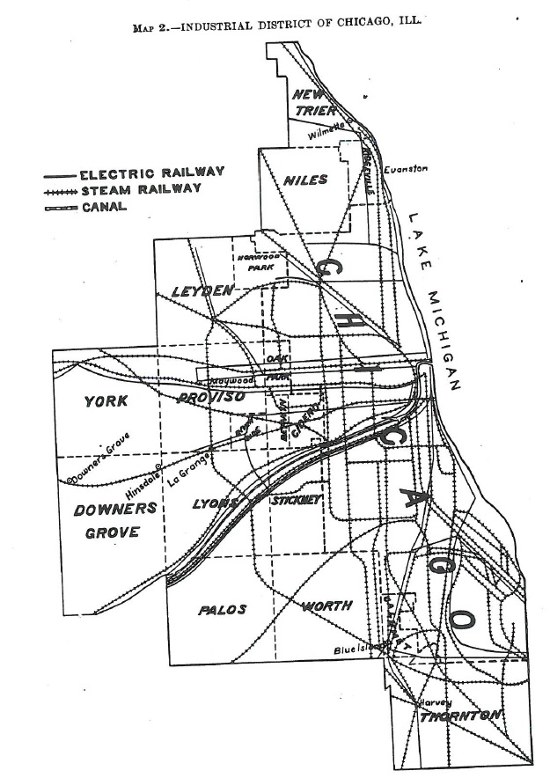
Industrial Districts (1905) and Metropolitan Districts (1910-1940)
Notes:
Industrial Districts and Metropolitan Districts were predecessors of the urbanized area and metropolitan area concepts. Each attempted to define and represent the built up area around a large city as well as the region socially and economically integrated with the city.

Slide 21
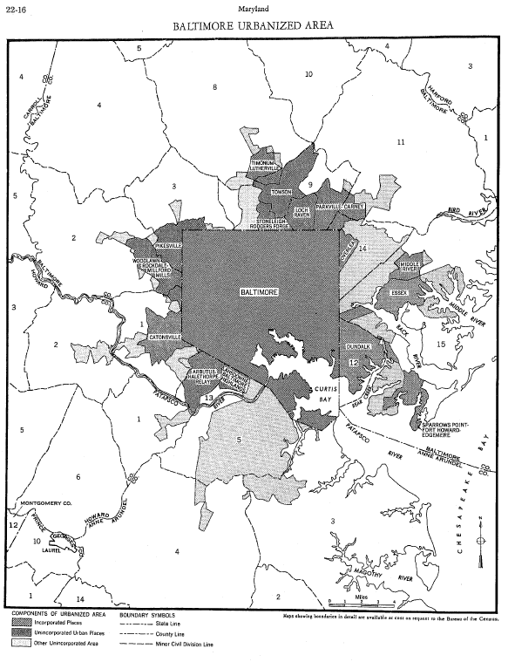
Urbanized Areas, 1950-1990
Adoption of concept to account for increased suburban growth around large cities.
Adherence to place boundaries.
Delineated manually/interactively.
Delineation built from previous decade’s boundary.
21
Notes:
Suburbs had existed outside major cities prior to the 1940s, but they were relatively limited in scope and extent. Increased suburbanization post-World War 2 led to the need for a urban area definition that better reflected the expansion of urban development beyond the boundaries of central cities. The definition needed to recognize that densely settled populations no longer necessarily resided within incorporated places and had moved into unincorporated territory, which may or may not also be defined as a CDP.
The result was adoption of the urbanized area concept which represented a city and its densely settled surrounding territory, together having a population of at least 50,000. The “starting points” for the 1950 Census urbanized areas were cities of 50,000 or more people.

Slide 22
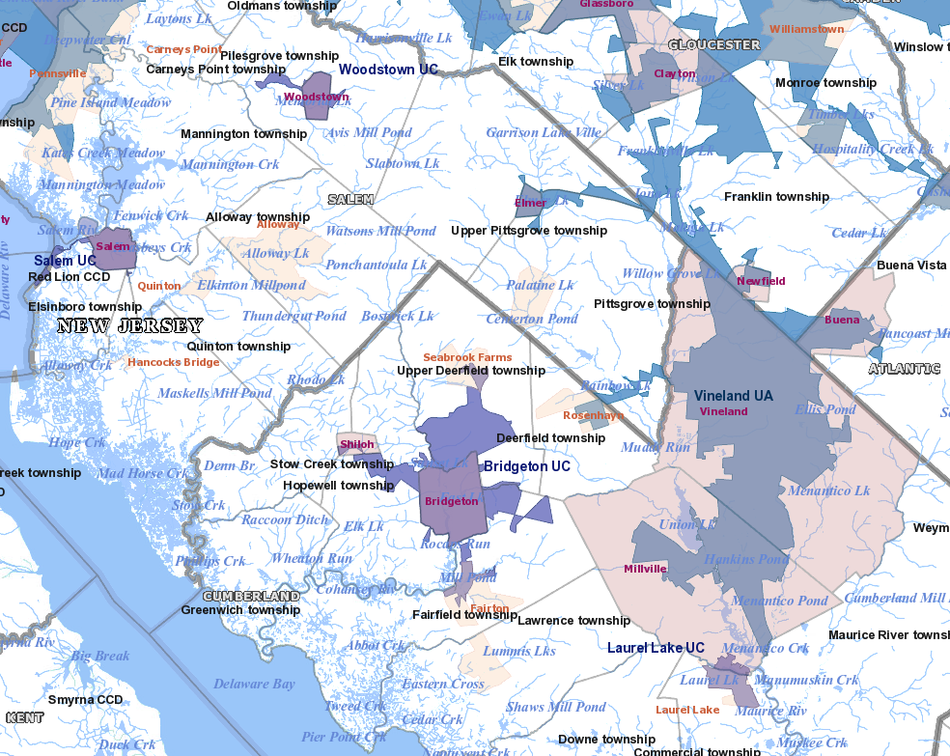
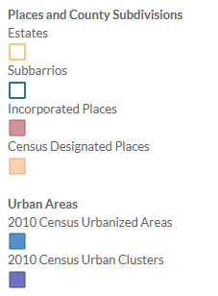
Changes to the Urban Area Concept and Criteria for Census 2000
Urban clusters adopted, extending the urbanized area concept to smaller places.
Place boundaries not considered when delineating areas.
Automated delineation to improve efficiency and consistency.
22
Notes:
The urban cluster concept was adopted to provide a nationally consistent and seamless urban area classification. Urban areas of less than 50,000 people are now defined using the same criteria as urbanized areas of 50,000 or more. Thus, data users can now work with a continuum of urban areas.
Place boundaries are no longer taken into consideration when delineating urban areas. As a result, any place can be split between urban and rural territory and population, rather than only in extreme circumstances as in the previous decades.
For the 2000 census, we adopted an automated delineation process. To more easily operationalize this, we used blocks and block groups as geographic units for delineating areas and lowered the minimum population density to 500 ppsm in some circumstances to account for the potential presence of non-residential urban land uses that would lower the overall population density of blocks and block groups.
We changed the criteria pertaining to the inclusion of densely settled, but discontiguous, territory. One change—the rules pertaining to “hops”—permits the inclusion of densely settled area separated by short gaps. There can be multiple hops in any given direction; the effect of this new criterion on the delineation of individual areas depends largely on the nature of planning and development within any given area. We also increased the “jump” distance from 1.5 to 2.5 miles, recognizing the increase presence of green space within suburban development and the greater propensity for separation of different types of land uses.

Slide 23
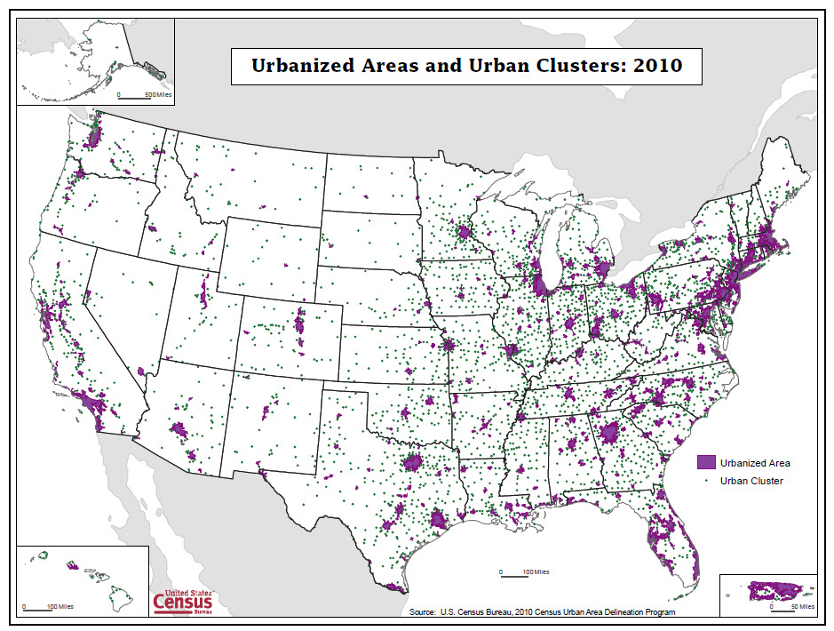
Notes:
Map depicting distribution of urbanized areas and urban clusters.

Slide 24
Metropolitan Areas: 1950-2013
Though the names have changed, the concept remained (essentially) the same:
Standard Metropolitan Areas
Standard Metropolitan Statistical Areas, Standard Consolidated Statistical Areas
Metropolitan Statistical Areas, Consolidated Metropolitan Statistical Areas, Primary Metropolitan Statistical Areas
Metropolitan and Micropolitan Statistical Areas, Combined Statistical Areas, Metropolitan Divisions

Slide 25
Standard Metropolitan Areas: 1950
Notes:
As we can see in this map, metropolitan areas in 1950 represented a relatively small proportion of the nation’s land area.
The “white space” on this map, the area outside metro areas, was classified as nonmetropolitan. Over the decades leading up to 2000, data users, analysts, and decision-makers, were recognizing the need for data about smaller centers that were important within the rural economy– too small to be metropolitan, but still the focal points around which social and economic interactions were organized.

Slide 26
Metropolitan and Micropolitan Statistical Areas: 2017
Notes:
Since 1950, not only has the number and extent of metropolitan areas increased, but the adoption of micropolitan statistical areas– pushing the metro area concept “down” to areas based around urban clusters of 10,000 or more people– helped fill in the “white spaces” on the map.
The nation’s map was now filled in with areas that were socially and economically focused on urbanized areas of 50,000 or more– metropolitan areas– and areas focused on urban clusters of 10,000 up to 50,000 people– micropolitan areas, or smaller towns. The remaining white space corresponded to the most rural parts of the nation, often beyond the daily “reach” of larger urban centers.

Slide 27
Defining Rural and Rurality Conceptual and Definitional Issues to Consider
What is “rural?” What characterizes “rurality?”
Low population density.
Small numbers of people.
Low levels of urbanization/urban population.
Distance from/proximity to [larger] urban centers.
Isolation and remoteness.
Is 2,500 still an appropriate minimum population for urban areas?
Notes:
Defining rural and rurality: conceptual and definitional issues to consider
What is “rural?” What characterizes “rurality?”
Is 2,500 still an appropriate minimum population for urban areas?
27

Slide 28
Concluding Thoughts
Census Bureau geography reflects the variety of geographic areas that exist and vary across the nation.
This variety has some basis in historical settlement patterns, but also reflects changing perceptions and data user needs.
Understanding the history behind Census Bureau geography helps us to understand the reasons for the variety, and adds richness to statistical data.
Notes:
Over the past century, the number and types of census geographic areas, and the criteria used to define areas, have changed in response to:
Changes in technology (i.e., GIS, databases) providing for more efficient exchange, collection, management, and dissemination of data.
Changes in user needs and expectations.
Improvements in spatial resolution of data.
Changes in theoretical approaches to interpreting and understanding geographic concepts.

Slide 29
Questions? Comments?
Contact information:
Michael Ratcliffe
Geography Division
U.S. Census Bureau
301-763-8977
michael.r.ratcliffe@census.gov
29

