Slide 1
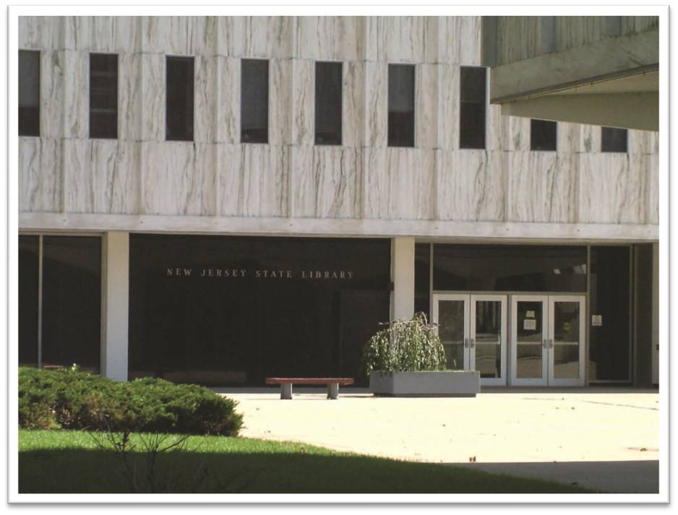
New Jersey State Library
Historical Census Resources
New Jersey State Data Center
Annual Network Meeting, June 17, 2010
Teri Taylor, ttaylor@njstatelib.org

Slide 2
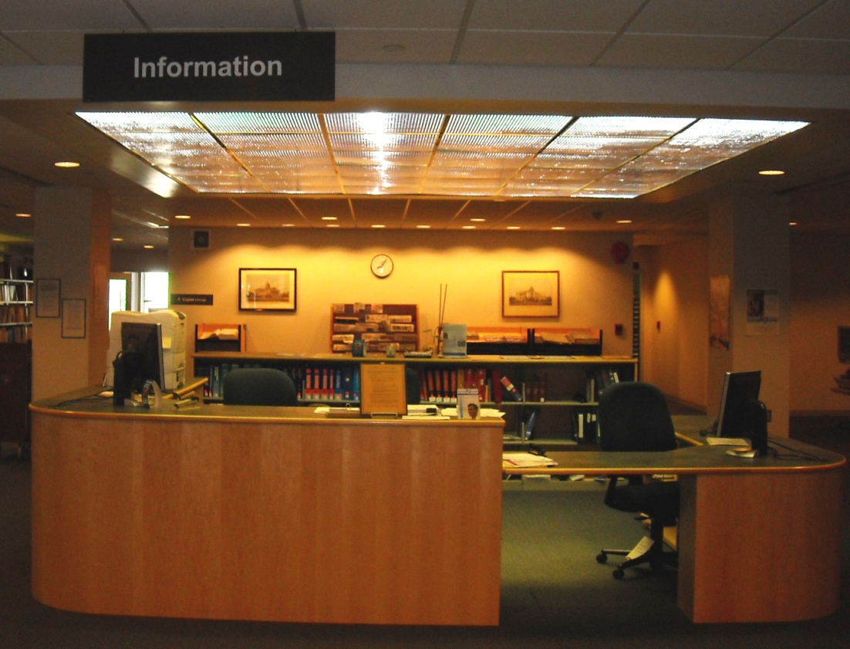
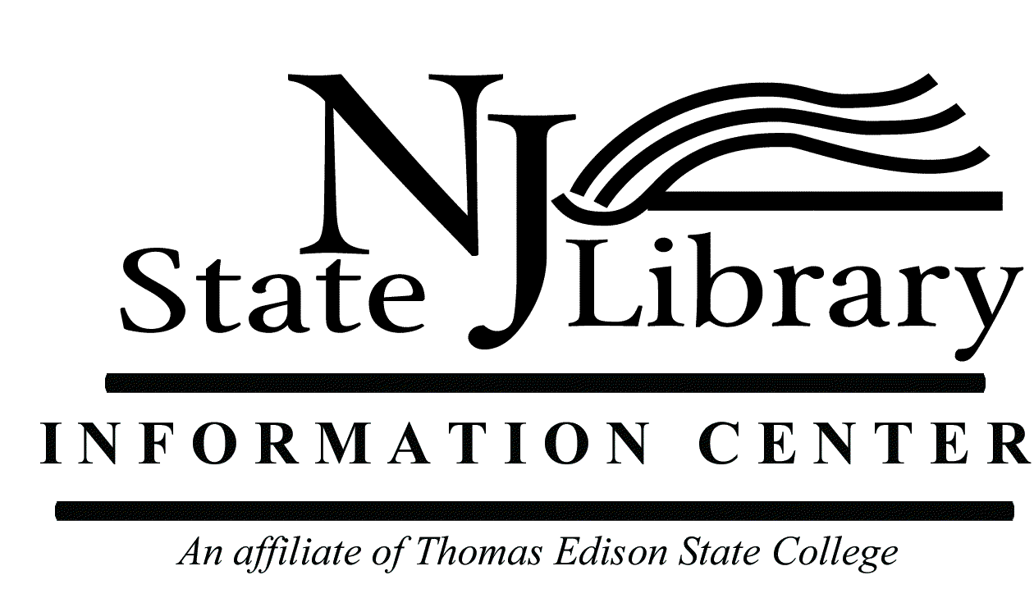
State Library Information Center
Provides library services to:
State government
Thomas Edison State College
State residents
Libraries
General public

Slide 3
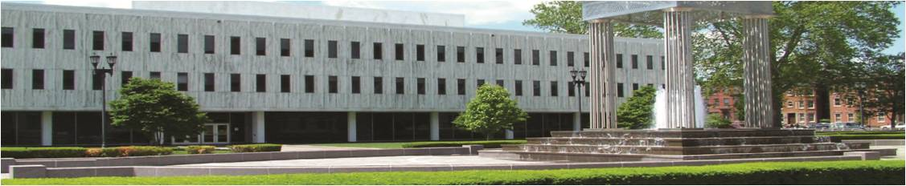
Research Collections
U.S. Government Documents
Law Library
New Jersey Government Publications
Funding Information Center
Jerseyanna
Genealogy

Slide 4
U.S. Government Documents
Selective
55%
Federal Depository since 1895
Emphasis
Social Sciences
Legal
Major Holdings
Commerce
Education
Congressional materials
Environmental Protection
Health & Human Services
Justice
Labor

Slide 5
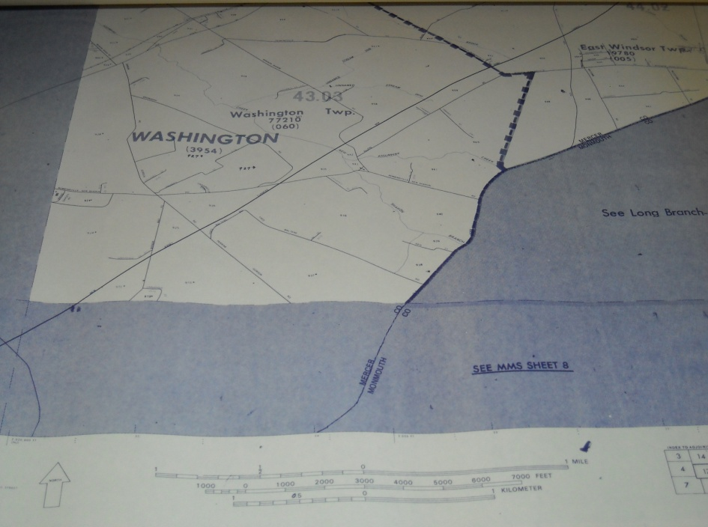
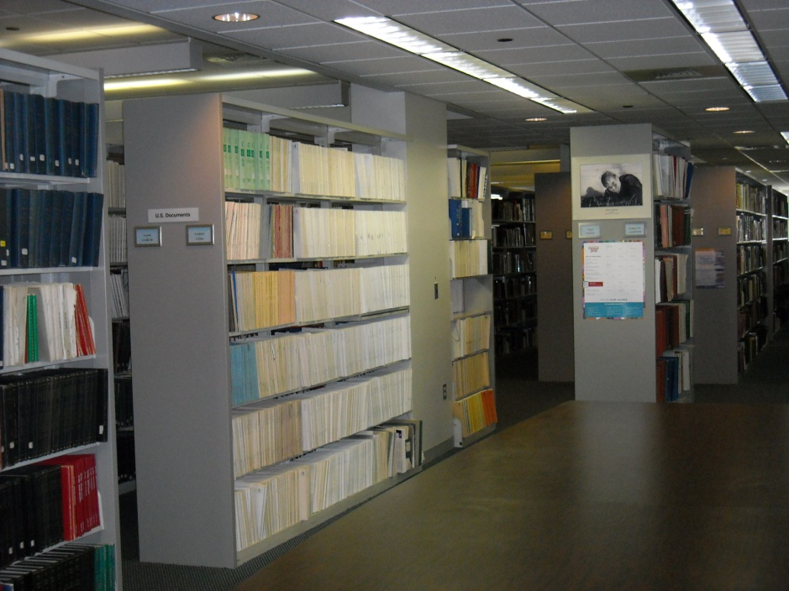
U.S. Census Collection
  Census reports dating back to the 1st Census (1790)
  New Jersey maps for the 1970-2000 Censuses
  Various formats: paper, microfiche, CDs, DVDs

Slide 6
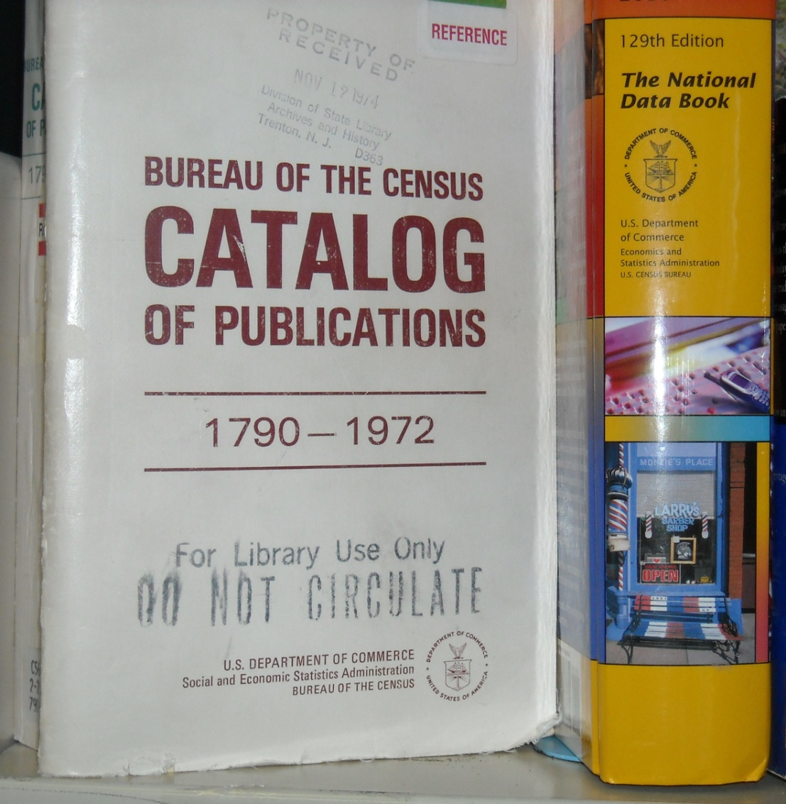
Who Uses the Collection?
Government agencies
Students
Libraries
Businesses
General public

Slide 7
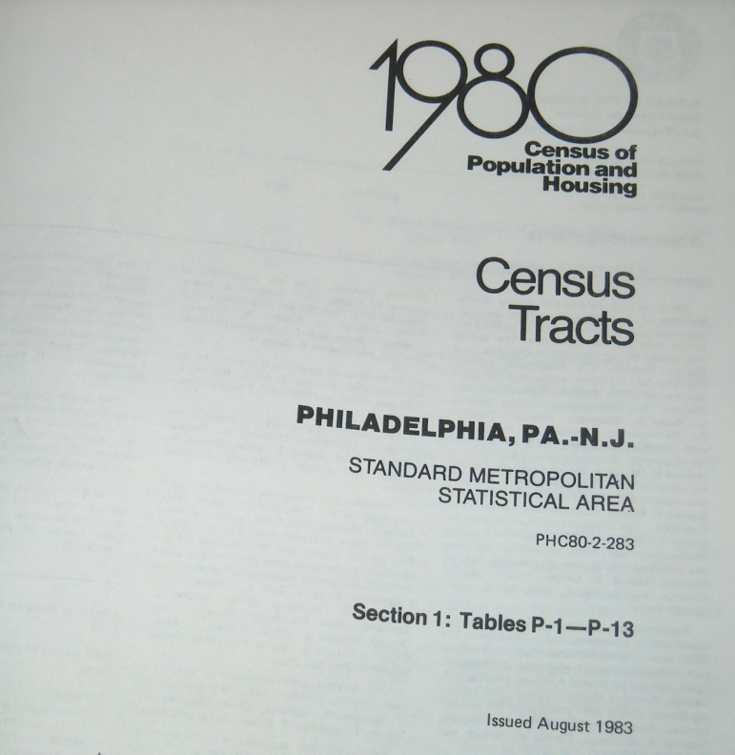
Example Census Question
Tracking Population Trends Using Census Tract Data

Slide 8
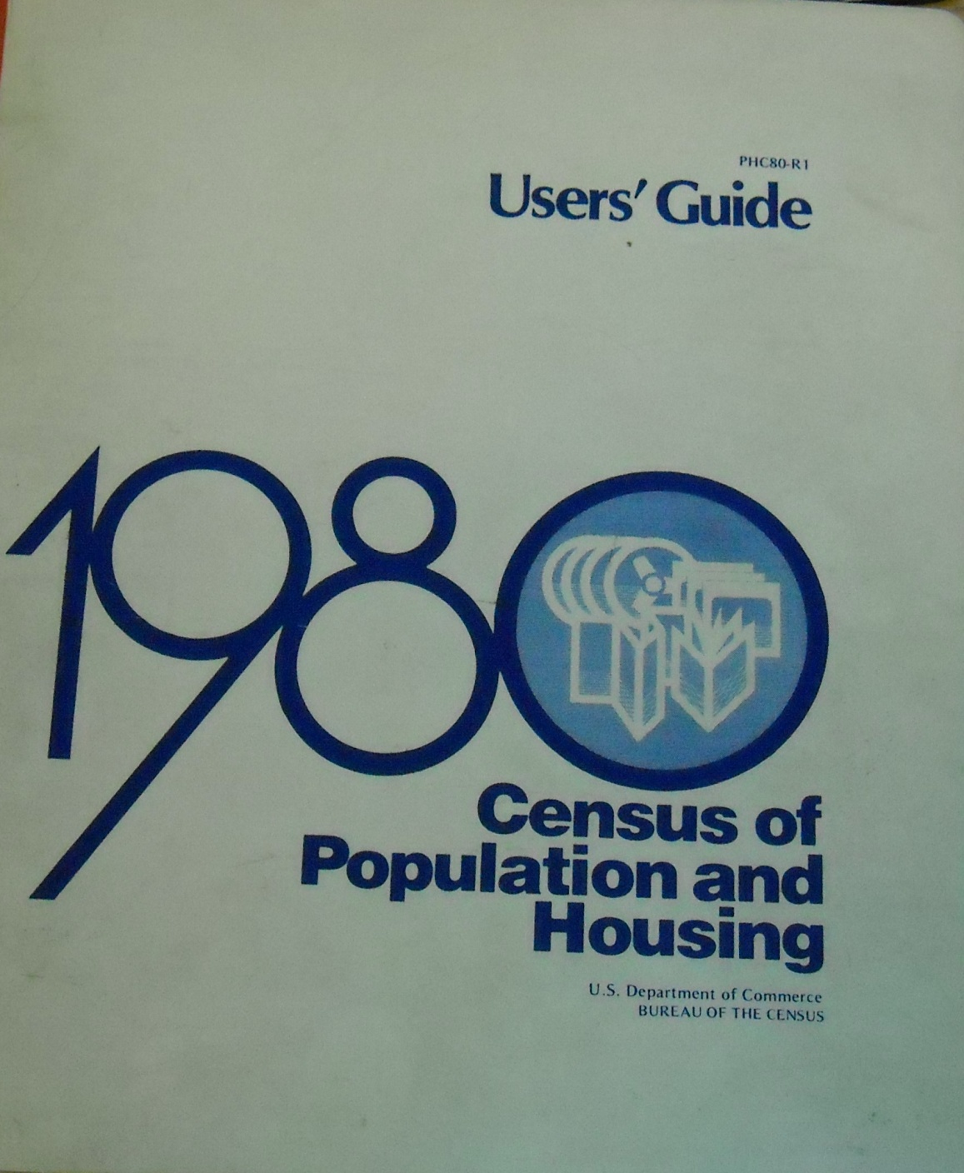
NJ Planning & Development firm needed:
1980 Census population data
Wrightstown, NJ Tract 7020
BNA 104

Slide 9
Tracking Population Trends
Wrightstown, NJ – Tract 7020
1980
1970
1960
1950

Slide 10
Challenges
Tract Numbers Change
Different number
Two Military Bases
Wanted to focus on Civilian Housing Population data
Different boundaries

Slide 11
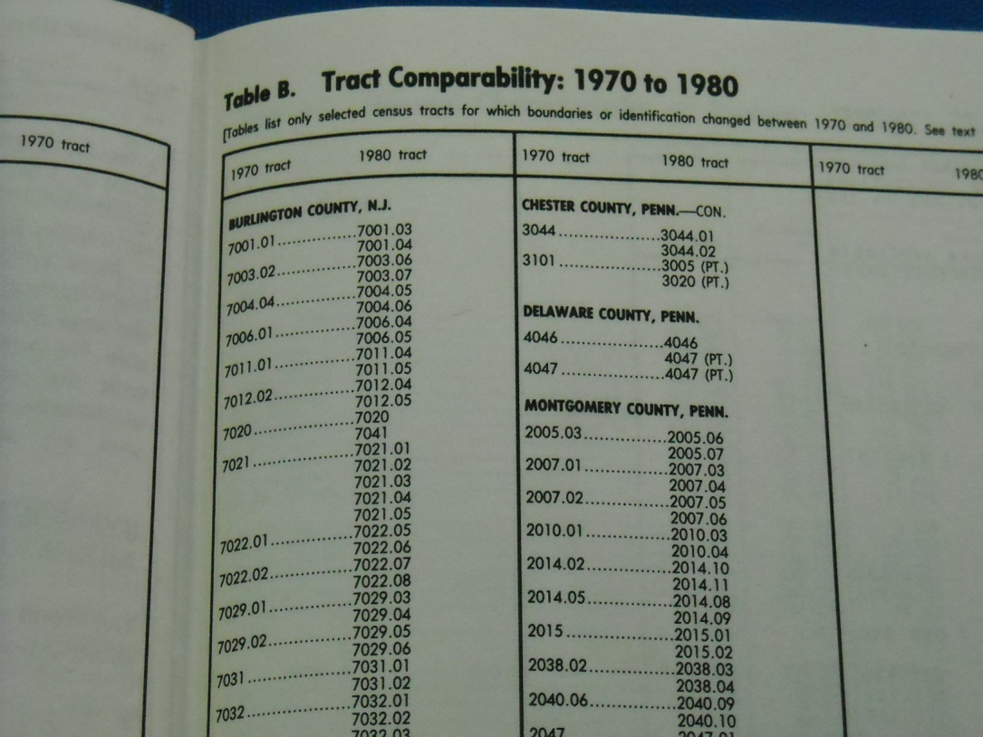

Challenges
Available Tools
Tract Comparability Indexing
2. Census Tract maps

Slide 12
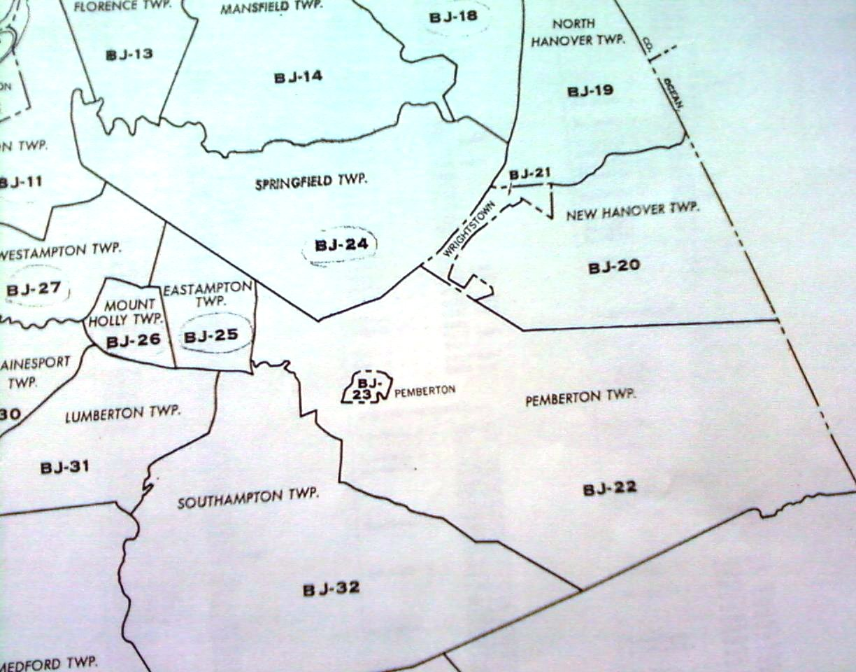
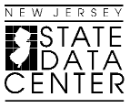
Collaboration
State Data Center
Len Preston
Helped track changes in census tract areas
Rutgers University Libraries
Ryan Womack
Provided scanned Census tract maps

Slide 13
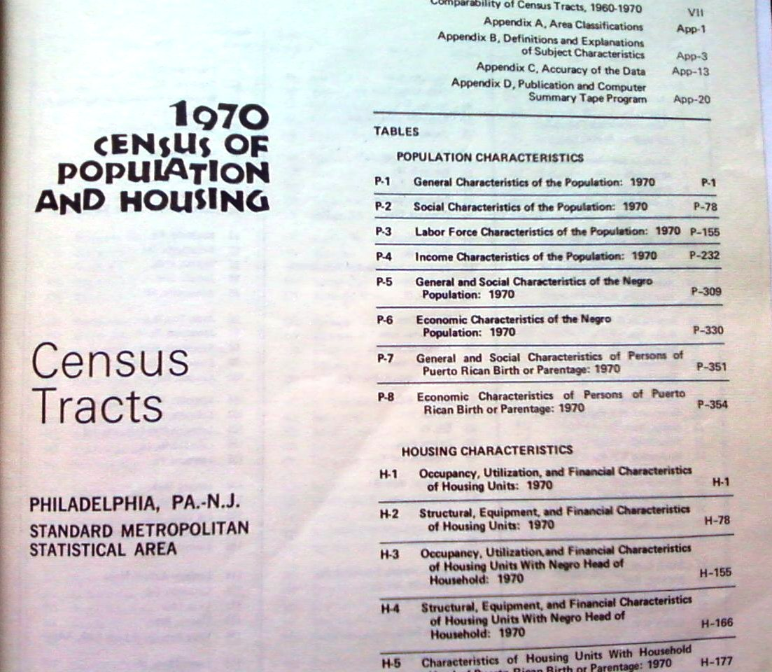
1970 Census
Wrightstown

Slide 14
CONTACT INFORMATION:
Librarian: Teri Taylor
Phone: (609) 278-2640 ext. 166
Fax: (609) 278-2647
Email: ttaylor@njstatelib.org
New Jersey State Library
State Library Information Center
185 W. State Street, PO Box 520
Trenton, NJ 08625
www.njstatelib.org

