Slide 1

Population and Labor Force Projections for New Jersey: 2014 to 2034

Slide 2
New Jersey’s Population is Projected to Reach 9,733,400 by 2034 (2016=8,944,469)

Slide 3
New Jersey’s 2014-2034 population growth will continue to lag behind the nation as a whole but with the similar trends.

Slide 4
Population Projections by County: 2014 to 2034
Population is projected to increase in all counties except 5: Salem, Cape May, Warren, Hunterdon and Sussex between 2014 and 2034.

Slide 5
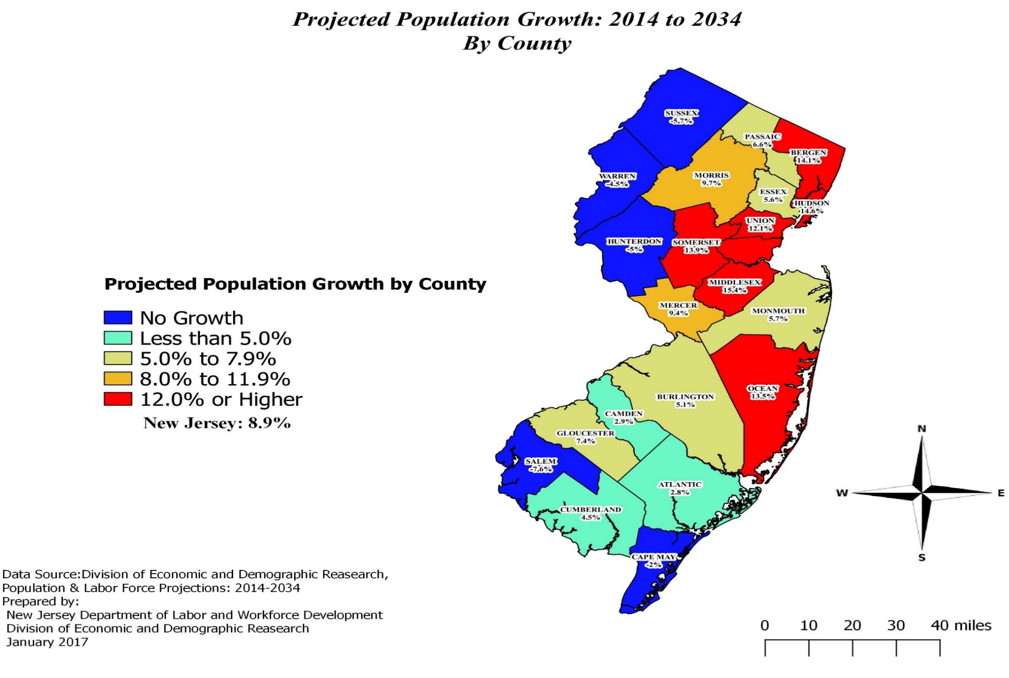

Slide 6

Projected New Jersey Population Trends
New Jersey’s population trend is going to become older and racially and ethnically more diverse from 2014 to 2034.
That is, the state’s residents will comprise of more elderly and more Hispanics and Asian, while women’s share of the state’s population will abate somewhat.

Slide 7
New Jersey Population by Age: 2014 and 2034
As “Baby Boomers (1946~1964)” continue to enter their “retirement age”, these major “working age” population (18 to 64 years old) will only grow by 1.3%, and their shares is projected to shrink from 62.9% to 58.5% during 2014 to 2034
The elderly population (65 & over) is projected to grow by 48.0%. They will account for 20.0% of the state’s total population in 2034, up from 14.7% in 2014.
With a moderate growth of 4.6%, children’s (under 18 years old) share in New Jersey is projected to decline somewhat from 22.4% in 2014 to 21.5% in 2034.
Inner circle = 2014, Outer circle = 2034

Slide 8
Projections of County Population by Age,
Elderly 65 +: 2014 to 2034
Cape May will be the “most elderly county” by 2034 with 28.0% seniors compared to 23.9% in 2014. Cape May will have the slowest increasing of 14.7%, for elderly.
4 Counties will have elderly population more than ¼ of their residents : Ocean (25.1%), Sussex (25.6%), Hunterdon (26.4%) and Cape May (28.0%) by 2034
9 counties will have more than 100,000 elderly population: Bergen, Ocean, Middlesex, Monmouth, Essex, Morris, Union, Hudson and Camden. There were only 3 counties like this in 2014.
8 counties will have less than 20% senior population in 2034: Hudson (13.4%, youngest), Essex (16.7%), Cumberland (17.1%), Union (17.6%), Passaic (18.3%), Camden (19.5%) Mercer (19.8%) and Middlesex (19.9%)

Slide 9
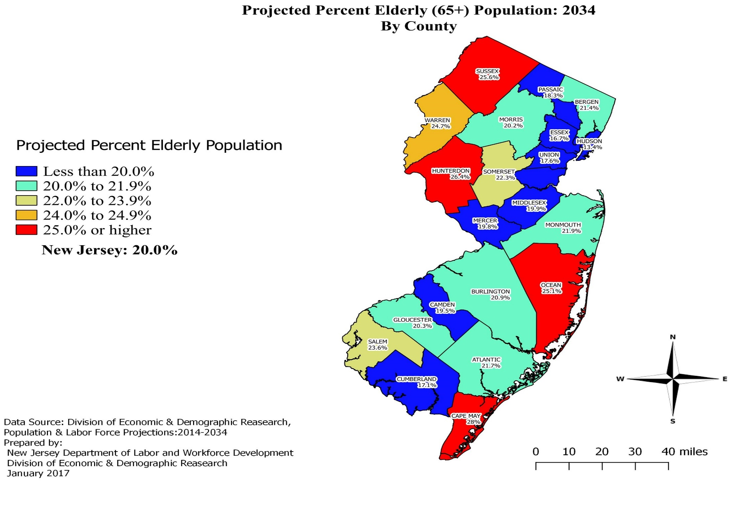

Slide 10
Projections of Population by Race: 2014 to 2034
Total population is projected to be 9,733,418 by 2034.
Inner circle = 2014, outer circle = 2034

Slide 11
Projections of Population by Race: 2014 to 2034
Multiracial, Asians, Hispanics and Other Races are projected to grow fast.

Slide 12
Projections of Population by Race: 2014 to 2034
Races | 2014 | 2034 | Growth Rate
White | 73.0% | 69.3% | 3.3%
Black | 14.8% | 15.4% | 13.3%
Asian | 9.4% | 11.6% | 34.2%
Other Races | 0.7% | 0.8% | 20.7%
2+ Races | 2.1% | 3.0% | 55.3%
Hispanic | 19.3% | 23.3% | 31.2%
Non-Hispanic White | 56.9% | 50.1% | -4.0%
With high rate of growth, Hispanics and Asians will expand their shares in New Jersey’s population.

Slide 13
Projections of Population by Race,
non-Hispanic White: 2014 to 2034
New Jersey’s non-Hispanic White population is projected to decline gradually from 56.9% in 2014 to 50.1% by 2034.
7 counties will have less than 50% non-Hispanic White by 2034: Hudson, Essex (32.2%), Union, Passaic, Middlesex, Cumberland and Mercer – the new county.
The non-Hispanic White newborns had lost their majority status in New Jersey since 2004. Consequently, the “minority” children (population under 18) will outnumber the “majority” children before 2024 when they reach 20 years old.
Age 65 and over non-Hispanic White population will maintain “majority” unchallenged throughout the projection period, although their shares of the total elderly persons will diminish from 74.2% in 2014 to 65.0% in 2034.

Slide 14
Projections of Population by Race:
non-Hispanic Whites: 2014 to 2034
Percent of non-Hispanic Whites in County Population: 2014 and 2034 |  |  | Growth Rate
County | 2014 | 2034
Sussex | 87.5 | 86.0 | -7.4%
Hunterdon | 86.5 | 80.5 | -11.5%
Cape May | 85.7 | 77.4 | -11.6%
Hudson | 29.3 | 25.5 | -0.5%
Essex | 32.2 | 27.9 | -8.6%
Union | 42.3 | 36.0 | -4.4%
Middlesex | 45.4 | 36.9 | -6.2%
New Jersey | 56.9 | 50.1 | -4.0%

Slide 15
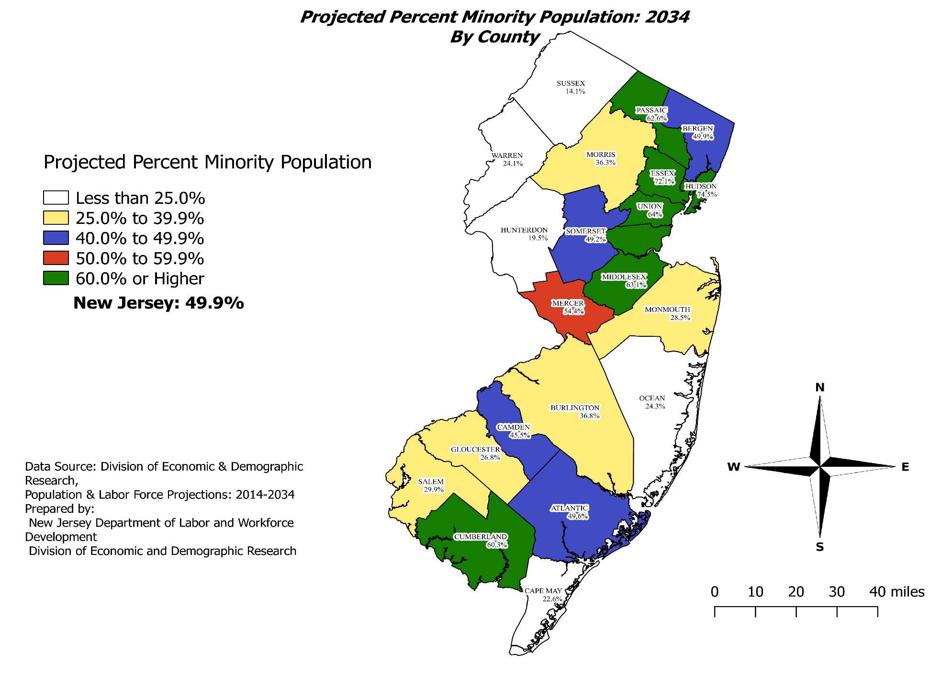
7 counties will be “Majority-Minority” counties by 2034 in New Jersey.

Slide 16
Projections of Population by Race,
African American: 2014 to 2034
African American population is projected to grow in every county except Salem, with growth rate by 13.3% in New Jersey between 2014 and 2034. Their rates of growth range from -6.9% in Salem County to 132.2% in Hunterdon County.
Middlesex, Bergen and Hudson will lead the state’s black population growth; Sussex and Warren are projected to have the smallest numerical gains of African Americans residents; while Salem (-654) will have decreased African Americans.
5 counties will have more than 100,000 African Americans: Essex, Union, Camden, Hudson and Middlesex by 2034. Together, they will account for 56.7% of the state’s black population.

Slide 17
Projections of Population by Race,
African American: 2014 to 2034
Percentages of African Americans are projected to range from 2.4% in Sussex County to 41.8% in Essex County, in 2034. But growth rates in the 20 years are different depend on their original base size.
Percent of African Americans in County Population: 2014 and 2034 |  |  | Growth Rate
County | 2014 | 2034
Essex | 41.9 | 41.8 | 5.3%
Cumberland | 21.9 | 24.0 | 14.6%
Union | 23.5 | 23.3 | 11.3%
Sussex | 2.2 | 2.4 | 3.5%
Morris | 3.6 | 4.2 | 29.3%
Ocean | 3.5 | 5.4 | 76.7%
NJ State | 14.8 | 15.4 | 13.3%

Slide 18
Projections of Population by Race,
Asian: 2014 to 2034
Asian population is projected to grow in every county except Hunterdon, with a growth rate of 34.2% in New Jersey, from 844,324 in 2014 to 1,133,050 in 2014~2034.
Middlesex, Bergen and Hudson counties had the largest number of Asian population in New Jersey; Bergen, Middlesex and Morris are projected to have the largest numeric increases of Asians between 2014 and 2034.
Asian population will be more than doubled in Salem, Ocean and Cape May counties from a small basis. Cumberland County’s 4.4% growth will be the slowest among 21 counties besides Hunterdon’s negative growth (-1.9%).

Slide 19

Projections of Population by Race,
Asian: 2014 to 2034
Counties | % Asian |  | Growth
County | 2014 | 2034 | Rate
Middlesex | 24.0 | 28.3 | 36.0%
Bergen | 16.3 | 21.1 | 47.9%
Somerset | 16.6 | 20.7 | 42.3%
Hudson | 15.2 | 15.0 | 12.6%
Cumberland | 1.4 | 1.4 | 4.4%
Cape May | 1.0 | 2.2 | 109.6%
Sussex | 2.0 | 2.2 | 5.1%
NJ | 9.5 | 11.6 | 34.2%
Middlesex, Bergen and Hudson counties will continue to have most of the state’s Asians. Together, these 3 counties will account for 50.9% of New Jersey’s Asian population in 2034.
Asian’s share will range from 1.4% in Cumberland County to 28.3% in Middlesex County, as of 2034.

Slide 20
Projections of Population by Ethnicity,
Hispanic: 2014 to 2034
Hispanic population is projected to increase in every single county with a growth rate of 31.2% in New Jersey between 2014 and 2034. The projected rates of growth range from 17.6% in Sussex County to 82.4% in Gloucester County.
Hudson, Bergen, Middlesex and Union counties are projected to have the largest numeric gains in Hispanic population. About 539,435 Latinos will be added to the state’s population in the 2014-2034 period.
6 counties will have more than 200,000 Hispanic as of 2034: Hudson, Passaic, Bergen, Essex, Middlesex and Union. Together, they account for two-third (65.2%) of New Jersey’s total Latinos population.

Slide 21
Projections of Population by Ethnicity,
Hispanic: 2014 to 2034
Almost one-half (46.1%) of Hudson County’s residents will be Latinos in 2034.
Percentage of Hispanic Population |  |  | Growth Rate
County | 2014 | 2034
New Jersey | 19.4 | 23.3 | 31.2%
Hudson | 43.1 | 46.2 | 22.6%
Passaic | 39.6 | 44.5 | 19.8%
Cumberland | 29.3 | 36.0 | 28.7%
Union | 30.0 | 35.0 | 30.9%
Hunterdon | 6.2 | 9.0 | 38.8%
Sussex | 7.3 | 9.1 | 17.6%
Gloucester | 5.7 | 9.6 | 82.4%
Cape May | 7.3 | 12.8 | 72.2%
Hunterdon will have the lowest percentage of Hispanic in 2034 (9.0%).
Gloucester County was the lowest in 2014 (5.7%).

Slide 22

Projections of Population by Sex: 2014 to 2034
New Jersey’s male to female sex ratio by all ages is projected to increase gradually as male population grow slightly faster than their female counterpart.

Slide 23
Projections of Population by Sex: 2014 to 2034
Cumberland will continue to be the only county in New Jersey where men outnumber women, throughout the projection period. But Hunterdon and Salem will also have more men than women by 2034.
The projected 93.1 sex ratio for Atlantic County will be the lowest among New Jersey’s 21 counties in 2034.
Sex ratios are projected to decline somewhat between 2014 and 2034 in 5 counties: Sussex, Middlesex, Atlantic, Bergen and Morris.

Slide 24
Projections of Population by Sex: 2014 to 2034

Slide 25
Civilian Labor Force Projections: 2014 ~ 2034
New Jersey’s civilian labor force is projected to grow faster than its population from 2014 to 2034.

Slide 26
Labor Force Projections by County: 2014 to 2034
Labor Force is projected to grow in most counties except the bottom 5 counties: Salem, Cape May, Warren, Hunterdon and Sussex between 2014 and 2034.

Slide 27
Projections of Labor Force by Age: 2014 to 2034
The “older workers” (labor force aged 55 and older) will continue to grow faster than their younger counterparts until 2024.

Slide 28
Projections of Labor Force by Age (55+): 2014 to 2034
Hudson (44.6%) and Union (33.3%) counties will have the fastest growth of “older workers(55+)” between 2014 and 2034.
Percentage of Older Workers(55+): 2014 and 2034 |  |  | Growth Rate
County | 2014 | 2034
Hunterdon | 31.2 | 30.2 | -6.8%
Sussex | 26.5 | 28.5 | 1.1%
Bergen | 25.9 | 27.9 | 22.7%
Cape May | 30.8 | 27.7 | -18.1%
Hudson | 15.5 | 18.7 | 44.6%
Cumberland | 19.9 | 22.6 | 17.1%
New Jersey | 23.0 | 24.5 | 17.9%
Hunterdon, Sussex, and Bergen counties are projected to have higher percentages of “older Workers” by 2034.

Slide 29
Projections of Labor Force by Race: 2014 to 2034
Labor Force Growth Rate by Race: 2014~2034

Slide 30
Projections of Labor Force by Race: 2014 to 2034
The shares of Asians and Hispanics in New Jersey’s civilian labor force will continue to increase. NJ State labor force growth 11.1% by 2034
Percentage Shares | 2010 | 2014 | 2034 | Growth Rate
Non-Hispanic White | 60.8% | 59.0% | 51.9% | -2.2%
Black | 13.5% | 13.7% | 14.4% | 16.6%
Asian | 8.5% | 9.6% | 11.8% | 36.8%
Others | 0.6% | 0.7% | 0.7% | 25.9%
2+ Races | 1.2% | 1.5% | 2.4% | 79.6%
Hispanic | 17.6% | 18.4% | 22.5% | 36.0%

Slide 31
Projections of Labor Force by Race,
Non-Hispanic White: 2014 to 2034
Non-Hispanic White labor force continue to decline, 16 counties decline, 5 increases.
By 2034, 14 counties will still be majority, 7 counties will be “minority-majority”
Shares of Non-Hispanic White in County Labor Force: 2014 and 2034 |  |  | Growth Rate
County | 2014 | 2034
Sussex | 89.3% | 88.2% | -7.4%
Hunterdon | 89.5% | 82.5% | -11.1%
Cape May | 87.7% | 78.8% | -18.0%
Hudson | 31.9% | 29.1% | 9.0%
Essex | 33.8% | 29.9% | 0.0%
Union | 43.1% | 36.4% | 2.1%
NJ State | 59.0% | 51.9% | -2.2%

Slide 32
Projections of Labor Force by Race,
African Americans: 2014 to 2034
Shares of Blacks in County Labor Force: 2014 and 2034 |  |  | Growth Rate
County | 2014 | 2034
Essex | 40.8% | 40.1% | 11.0%
Union | 22.7% | 22.7% | 20.5%
Cumberland | 19.0% | 21.7% | 17.6%
Sussex | 1.9% | 1.7% | -14.2%
Warren | 4.1% | 5.0% | 13.9%
Morris | 3.5% | 3.9% | 26.0%
NJ State | 13.6% | 14.4% | 16.6%
African Americans labor force are projected to grow in all counties, except Sussex (-14.2%), during 2014 ~ 2034, with growth rates range from 0.2% in Salem to 303.0% in Hunterdon County.

Slide 33
Projections of Labor Force by Race,
Asian: 2014 to 2034
Asian labor force are projected to grow in all counties, except Cumberland (-1.0%), with growth rates range from 4.6% in Sussex County to 139.8% in Salem County.
Asian labor force growth account for 31.9% of the state’s 11.1% total labor force growth between 2014 and 2034
Shares of Asians in County Labor Force: 2014 and 2034 |  |  | Growth Rate
County | 2014 | 2034
Middlesex | 23.4% | 28.3% | 42.8%
Bergen | 16.3% | 19.8% | 44.6%
Somerset | 15.8% | 19.4% | 46.5%
Hudson | 16.1% | 15.6% | 12.6%
Sussex | 1.9% | 2.0% | 4.6%
Cape May | 0.9% | 1.4% | 77.9%
Cumberland | 1.5% | 1.4% | -1.0%
NJ State | 9.6% | 11.3% | 36.8%

Slide 34
Projections of Labor Force by Hispanic Origin: 2014 to 2034
Shares of Hispanics in County Labor Force: 2014 and 2034 |  |  | Growth Rate
County | 2014 | 2034
Hudson | 40.7% | 43.4% | 27.3%
Passaic | 36.9% | 43.2% | 26.6%
Cumberland | 27.0% | 35.7% | 36.1%
Union | 30.0% | 35.5% | 42.7%
Sussex | 6.2% | 7.5% | 13.3%
Hunterdon | 5.0% | 7.9% | 50.3%
Gloucester | 4.7% | 8.5% | 100.5%
New Jersey | 18.4% | 22.5% | 36.0%
Hispanics are projected to account for more than one-third of four counties’ labor force by 2034.
Sussex County will have the lowest percentage of Hispanics (7.5%) in its labor force by 2034.

Slide 35

Comments Welcomed
Contact: DaQing Song
E-Mail: daqing.song@dol.nj.gov
Tel. (609) 292-0077

