Slide 1

WIOA Title I Program Oversight and Development Update
OCTOBER 7, 2021

Slide 2
Please sign in!
Welcome!
Please share your name, organization, and email address in the chat
We’ll send slides and a recording out after the session.

Slide 3




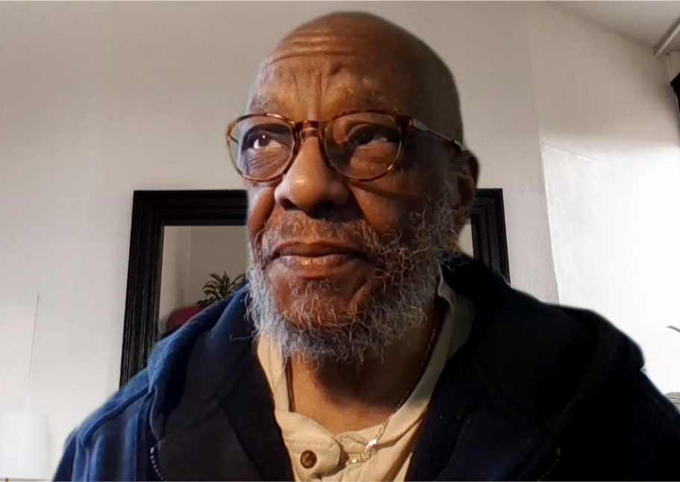

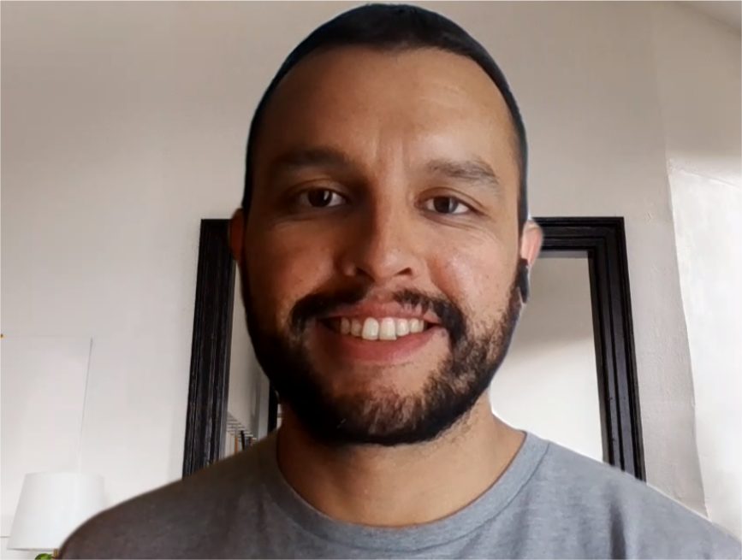



WIOA Program Oversight and Development
Monitoring
Technical Assistance
Raji
Patricia
Sabrina
Pat
Jean
Raul
Ozzy
Policy Team
Data Validation Support
Sancia
Sarah
Tom

Slide 4
Local Area | Monitor | Regional TA Liaison
Atlantic | Raji | Raul
Bergen | Jean | Raul
Burlington | Raji | Sabrina
Camden | Raji | Raul
Cumberland/Cape May/Salem | Raji | Raul
Essex | Jean | Sabrina
Gloucester | Raji | Raul
Greater Raritan | Pat | Oswaldo
Hudson/Jersey City | Jean | Oswaldo
Morris/Sussex/Warren | Pat | Oswaldo
Mercer | Pat | Sabrina
Middlesex | Pat | Sabrina
Monmouth | Pat | Oswaldo
Newark | Jean | Sabrina
Ocean | Raji | Sabrina
Passaic | Jean | Oswaldo
Union | Jean | Oswaldo

Slide 5
WIOA POD Team Focus this Fall
Fall Monitoring
Procurement
Partnership
Regional TA Labs
November
January
USDOL Required Actions
Hudson/Jersey City
Passaic
December
All LWDBs
Policy Resources
Technical Assistance Guides
Policy Updates and Refreshers
Manuals
New Policies

Slide 6
Policy Resources
Monitoring
Policy
TA/Training

Slide 7
Release of New Policy Resources
Resource | Description | Release Date Target
SkillUp Data Entry – Training Video Part I | This training video provides an overview of the SkillUp Data Entry policy released in July 2021. | October 4, 2021
AOSOS Technical Guide for Title I Service Delivery | This document provides a comprehensive overview of how to enter various elements of WIOA Title I Service Delivery into AOSOS. | October 4, 2021
Assessment Technical Assistance Guide (TAG) | This resource provides an overview of requirements and considerations for local WDBs in developing assessment strategies and identifying specific assessment tools. | October 4, 2021
Procurement Monitoring Tool | This resource provides an overview of the process and tools used for monitoring Title I Youth program procurement. | September 30, 2021
Partnership Monitoring Tool | This resources provides an overview of the process and tools used for monitoring WIOA required and optional partnerships. | September 30, 2021
Migrant Seasonal Farmworker Policy Refresher | This refresher provides an overview of Migrant Seasonal Farmworker programs and expectations. | October 2021
Title I Exit and Follow-up Policy | This policy provides an update to existing Title I Exit and Youth Follow-up policies, offering a clear standard across all Title I programs. | October 2021
On-the-Job Training (OJT) policy | This policy provides an overview of eligibility, program expectations, and operational guidance related to local area provision of OJT opportunities. | October 2021
Updated Incumbent Worker Training (IWT) policy | This policy provides an update to the current IWT policy, including more detailed information about AOSOS entry expectations. | October 2021
Supportive Services Technical Assistance Guide | This resource provides an overview of requirements and considerations for local WDBs in providing and working with partners to provide supportive services. | October 2021
Youth Policy Manual | This manual provides a comprehensive overview of existing policies related to Title I Youth programs. | November 2021
Adult/DW Policy Manual | This manual provides a comprehensive overview of existing policies related to Title I Adult and Dislocated Worker programs. | November 2021

Slide 8
Resource Review and Feedback
Resource Release
New resource released to NJDOL and local area staff.
Local Area Comment Period
Comment period open to local areas for two weeks.
Resource Finalization
Within a month, final version of resource released.
https://forms.office.com/g/Wem6cptsER

Slide 9
NJDOL Monitoring
Monitoring
Policy
TA/Training

Slide 10
Fall 2021 Monitoring: Partnership and Procurement
Procurement | Partnership
Vendor recruitment and engagement Quality of Request for Proposal (RFP) Public dissemination of and equal access to procurement information Fairness and rigor of proposal evaluation process Selection and award of contracts – including appropriate approval and dissemination procedures Alignment of proposal and contract content | Inclusion of required and optional partner services at One Stop locations Execution of MOU across partners Appropriate cost-sharing outlined in IFAs Clear roles and responsibilities of required and optional partners Strategic provision of all 14 youth program elements Engagement of partners to provide supportive services

Slide 11
Fall Monitoring Timeline Targets
Launch survey and document sharing tools
October 15, 2021
Entrance interviews to discuss monitoring process
Week of October 18, 2021
Survey and document sharing tools close
November 15,
2021
NJDOL engages in review of materials
November 2021
Exit interviews to discuss results and questions
December 2021
Finalization of reports
January 2022

Slide 12
Regional TA Labs
Monitoring
Policy
TA/Training

Slide 13
Targeted Training and TA
Monitoring Results
  Based on NJDOL and USDOL monitoring results, specific areas where additional policy resources and tools are needed are identified
Policy Resources
  New policy resources and tools that draw on existing state policy, federal policies, and research developed to support policy and practice
Regional TA Labs
Interactive Training
  TA team provides opportunities for interactive engagement around new policy resources

Slide 14
Regional TA Labs
November
AOSOS Technical Guide: Title I Service Delivery
Assessment Technical Assistance Guide
December
Placement, Exit, and Follow-up Policy
On-the-Job Training (OJT) Policy
January
Adult/DW Manual
Youth Manual

Slide 15
Targeted Training and TA
Policy Resources
New policy resources and tools that draw on existing state policy, federal policies, and research developed to support policy and practice
Interactive Training
TA team provides opportunities for interactive engagement around new policy resources
Virtual Training
Permanent training created and posted on Learning Management System (LMS)
Monitoring Results
Based on NJDOL and USDOL monitoring results, specific areas where additional policy resources and tools are needed are identified
LMS

Slide 16
Learning Management System (LMS)
We are working with MIS and DIT to develop a Learning Management System (LMS)
Will include training videos relevant to NJDOL workforce programs
NJDOL employees, staff working within local areas, and vendors – including youth providers will be able to access the LMS
We are working on compiling lists of individuals that will need access to the LMS from each local area
Your local technical assistance liaison will be in touch with you to finalize a list of folks that should be set up in the system

Slide 17
USDOL Monitoring
Monitoring
Policy
TA/Training

Slide 18
Key Program Areas
Workforce Development Board Functions
Required One-Stop Partner Engagement
Uniform Service Delivery
Local Oversight and Monitoring Functions
Grievance and Complaint Procedures
Youth Connection to One-Stop
Career and Youth Services Procurement
PII Policies
Placement, Exit, and Follow-up Procedures

Slide 19
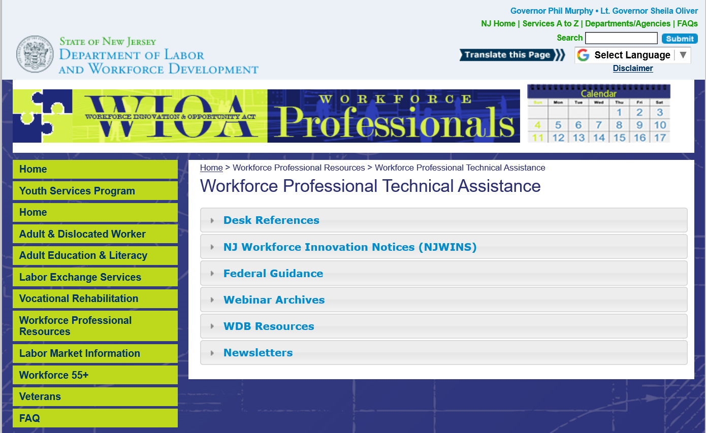
https://www.nj.gov/labor/wioa/resources/
Notes:
You can find a number of policies that relate to exit and follow-up the Workforce Professional Resources section of the NJ WIOA website.

Slide 20
https://www.nj.gov/labor/wioa/resources/
Notes:
All policies that have been issued by NJDOL are available in the NJ Workforce Innovation Notices section.

Slide 21
Resource Links:
AOSOS Technical Guide: Title I Service Delivery: https://www.nj.gov/labor/wioa/forms_pdfs/AOSOS%20Technical%20Guide%20for%20Title%20I%20Service%20Delivery%20(Final).pdf
WIOA Title I Assessment: Technical Assistance Guide: https://www.nj.gov/labor/wioa/forms_pdfs/WIOA%20Title%20I%20Assessment%20Technical%20Assistance%20Guide.pdf
WIOA Title I Partnership Monitoring Tool: https://www.nj.gov/labor/wioa/forms_pdfs/WIOA%20Title%20I%20Monitoring%20-%20Partnership.pdf
WIOA Title I Youth Procurement Monitoring Tool: https://www.nj.gov/labor/wioa/forms_pdfs/WIOA%20Title%20I%20Monitoring%20-%20Youth%20Services%20Procurement.pdf

Slide 22
https://www.nj.gov/labor/wioa/resources/
Notes:
All policies that have been issued by NJDOL are available in the NJ Workforce Innovation Notices section.

Slide 23


Slide 24
https://www.nj.gov/labor/wioa/resources/
Notes:
All policies that have been issued by NJDOL are available in the NJ Workforce Innovation Notices section.

Slide 25
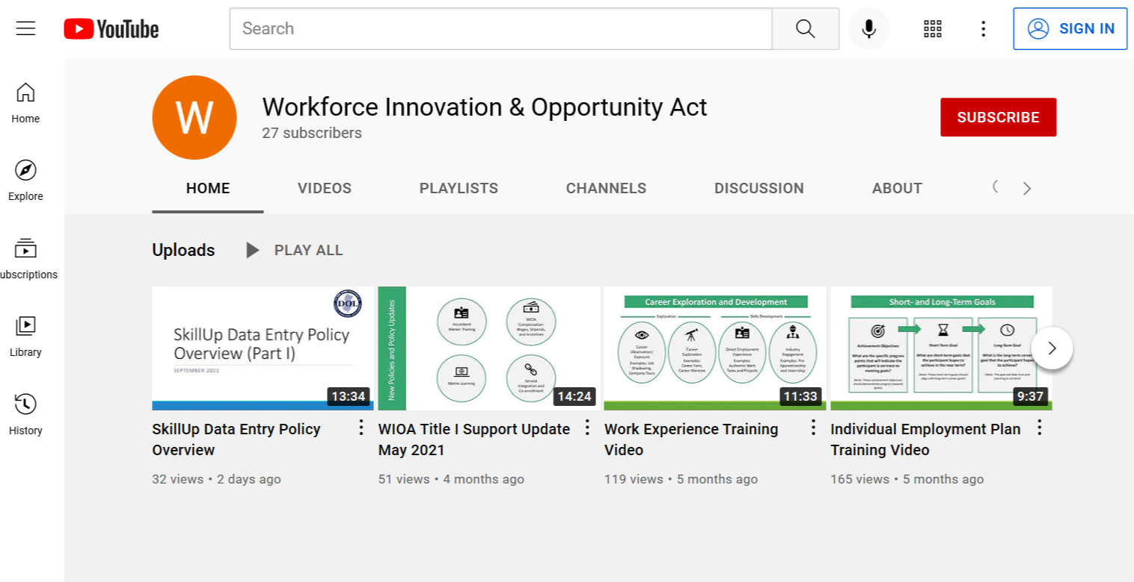
https://www.youtube.com/channel/UCPoTaed_Iei21g4xqgLaMFw

Slide 26
SkillUp Data Entry Policy Training Video: https://youtu.be/y2cTZ220RPc

Slide 27
Q & A
?

