Slide 1

NJMVC E‑Bike Information Presentation

Slide 2

NJMVC E‑Bike Overview

Slide 3
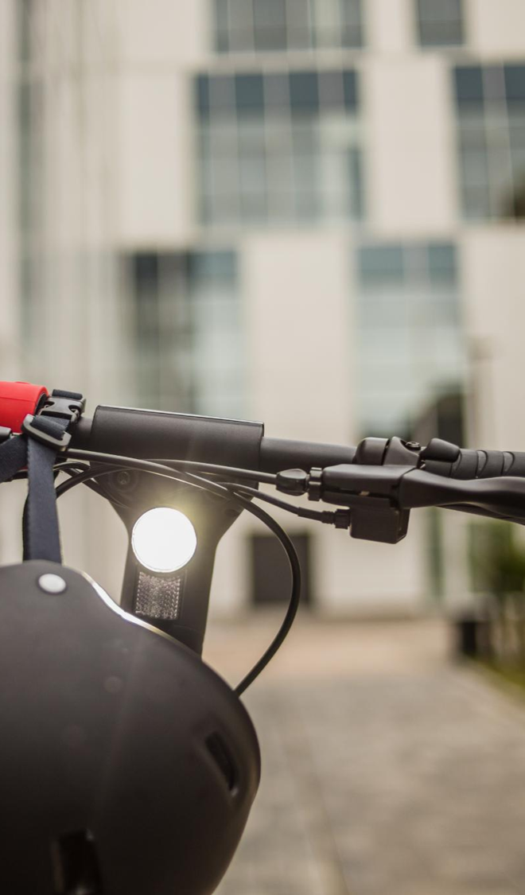
What is an E‑Bike
The term "e-bike" commonly refers to both low-speed electric bicycles and motorized bicycles, as defined by N.J.S.A. 39:1-1.
Low-Speed Electric Bicycles – These are pedal assisted bicycles with a helper motor that only provides assistance while pedaling up to 20 mph.
Motorized Bicycle-- Is a pedal assisted bicycle with either:
  An engine under 50 cubic centimeters, or
  An electric motor that assists while pedaling between 21 and 28 mph, or
  An electric motor that assists with using a throttle up to 15 mph.

Slide 4
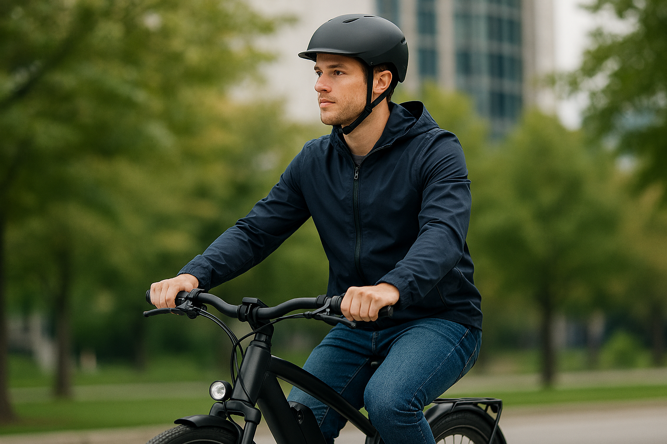
E‑Bike Usage Requirements
Age and License
To operate an e-bike, you must be at least 15 years old and have (1) an e-bike license or (2) a valid driver’s license.
An individual may neither apply for nor receive an E-Bike license during a period of suspension or revocation of any of their driving privileges.
Registration & Insurance:
E-bikes must be registered with the New Jersey Motor Vehicle Commission. Only motorized bicycles are required to have insurance coverage. Low-Speed Electric Bicycles do not require insurance but must be registered with MVC.

Slide 5
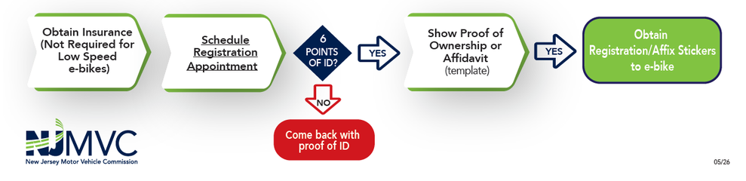
E-Bike Registration Process

Slide 6
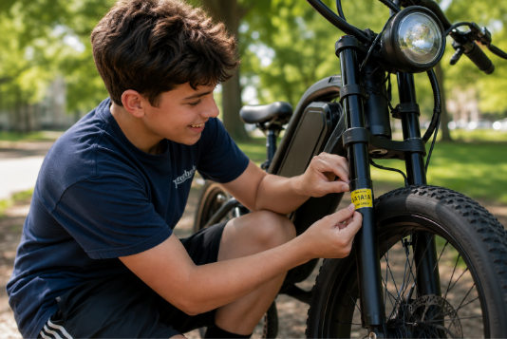
E-Bike Registration Process
Step 1:
  To register your e-bike, please make an E-Bike: Initial Registration appointment at a Vehicle Center
Step2:
  Complete the Registration Form - Low Speed electric Bike and Motorized Bike Ownership and Registration form, (Form number BA-49EB).
  Present either 6 points of ID, your valid NJ Driver License or Non-driver Photo Identification (ID)
  Complete the parent consent form, if your parent or guardian are not with you and you are under the age of 18
  Show proof of E-bike insurance if applicable. All motorized bicycles are required to have insurance coverage. Only Low-Speed electric bicycles are not required to have insurance
  Proof of ownership
    Manufacturer's Certificate of Origin (MCO);
    Purchase receipt;
    Notarized bill of sale; or
    An affidavit from the current owner documented on Form BA-49EB
Step 3:
  Place your e-bike license plate stickers on both sides of your front fork as shown:

Slide 7
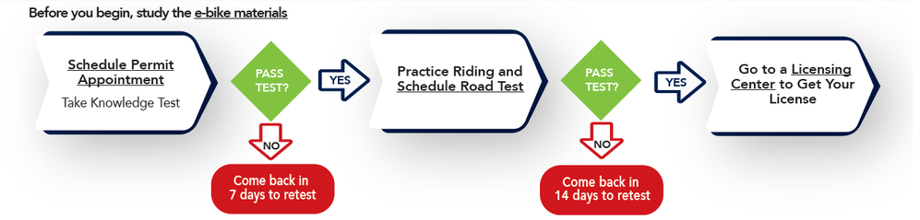
E-Bike License Process

Slide 8
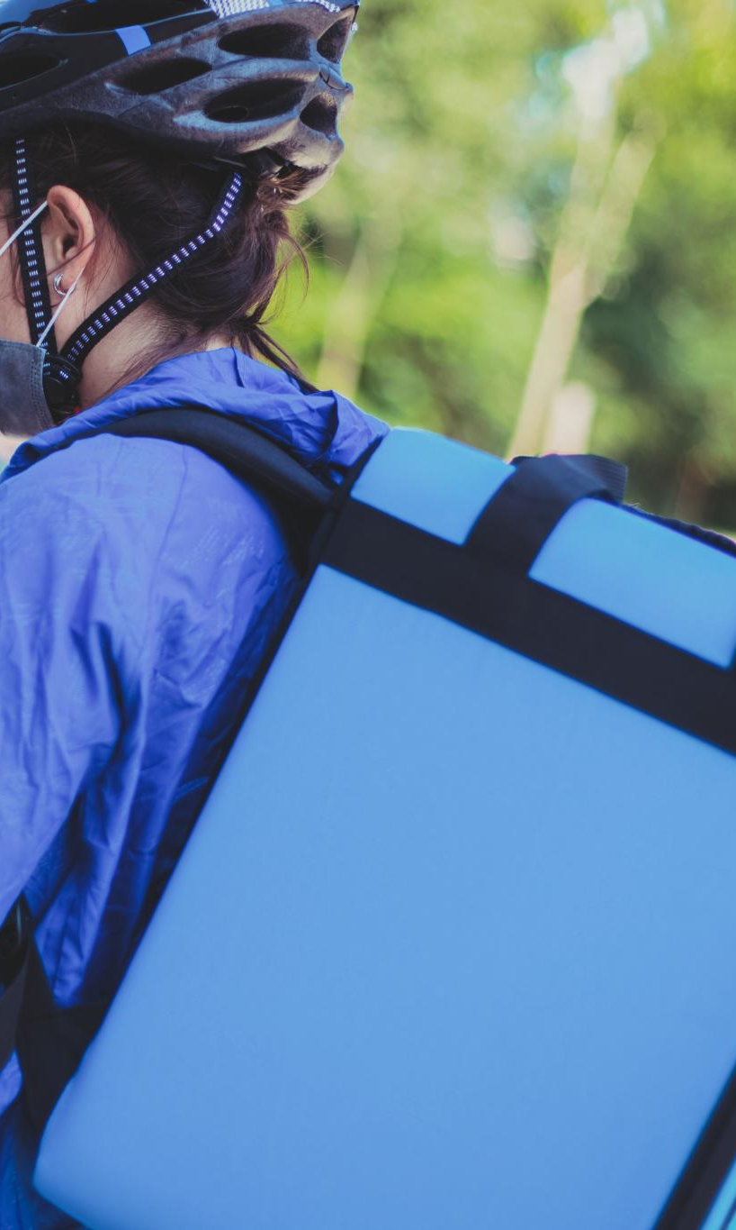
E-Bike License Process
Step 1:
  Study by reading the Driver Manuals,- the New Jersey Driver Manual and Motorcycle Manual (Section 10 of the New Jersey Driver Manual), along with the separate E-bike and Motorized Bicycle/Moped Manual.
  Make an appointment for an initial e-bike permit and complete an application (BA-208 form) for an e-bike permit.
Step 2:
  Bring your 6 Points of ID scheduled appointment as well as your parent consent form if your parent or guardian are not with you.
  Pay the examination fee for the e-bike permit. (Fee of $5 will be waived until January of 2027)
  Pass the knowledge and vision tests to validate your e-bike permit. If you fail the knowledge test, you can retest in 7 days.
Step 3:
  Practice operating the e-bike, unsupervised during daylight hours.
  Make an appointment for a road test dated at least 20 days, and up to 45 days, from the date of your validated e-bike permit.
Step 4:
  Bring to your road test:
    A registered e-bike with plate sticker affixed to the front fork,
    A helmet
    Your validated permit
    Your 6 points of ID.
    Insurance proof, if you will be using a motorized bicycle for the test
If you pass the road test, take your validated permit, your 6 Points of ID, proof of address, and your test results score sheet to a licensing center to receive your e-bike license (no appointment required). If you fail the road test, you can retest in 14 days.

Slide 9
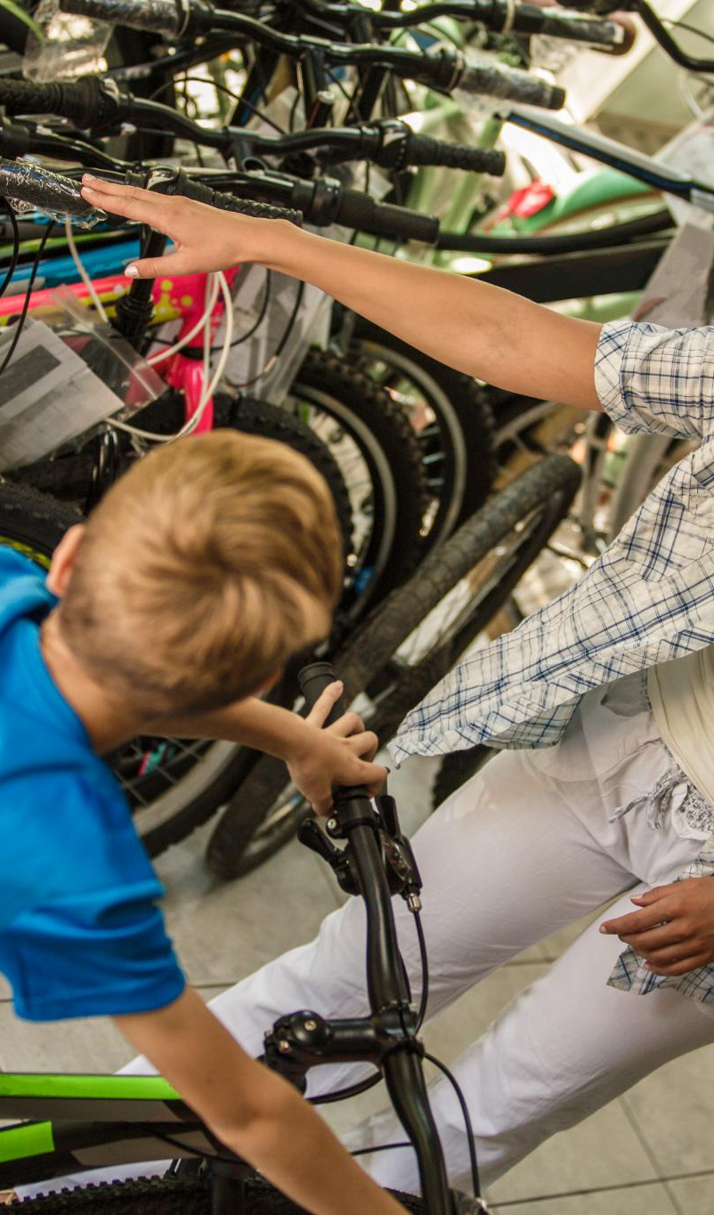
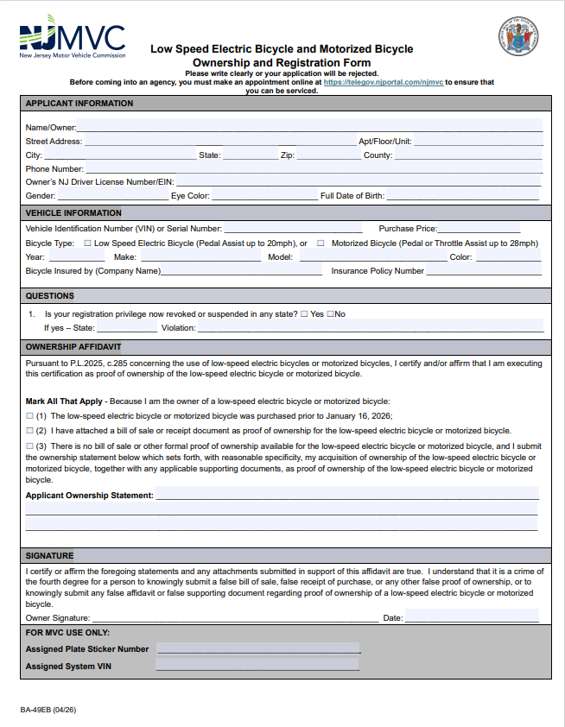
Retailers
Pursuant to state law, all sellers of e-bikes shall make the applicable registration forms available to individuals purchasing such bicycles. You can download and print out the registration forms for e-bikes and mopeds. Form BA-49EB

Slide 10
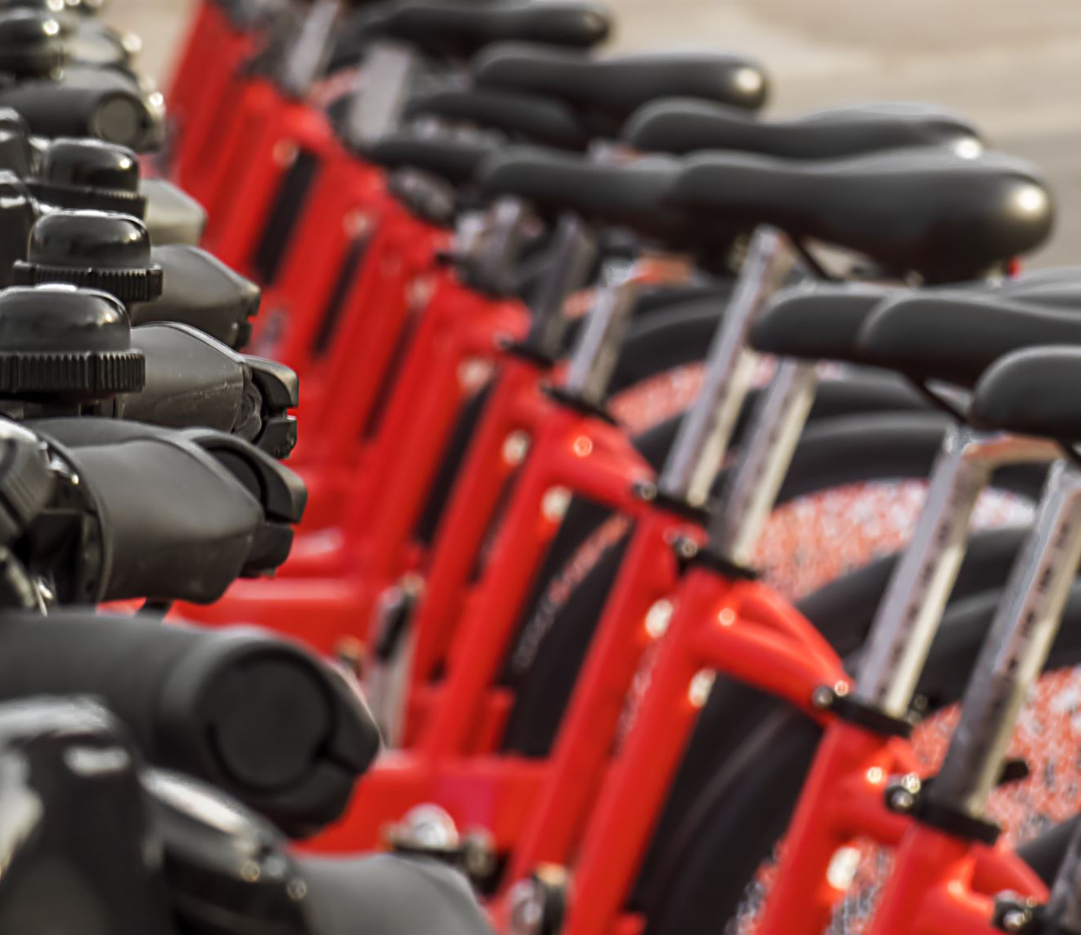
E-Bike Commercial Renters
The operator of a rented low-speed (under 21 MPH) electric bike must be 16 years old and is not required to be in possession of a driver license or an e-bike license.

Slide 11
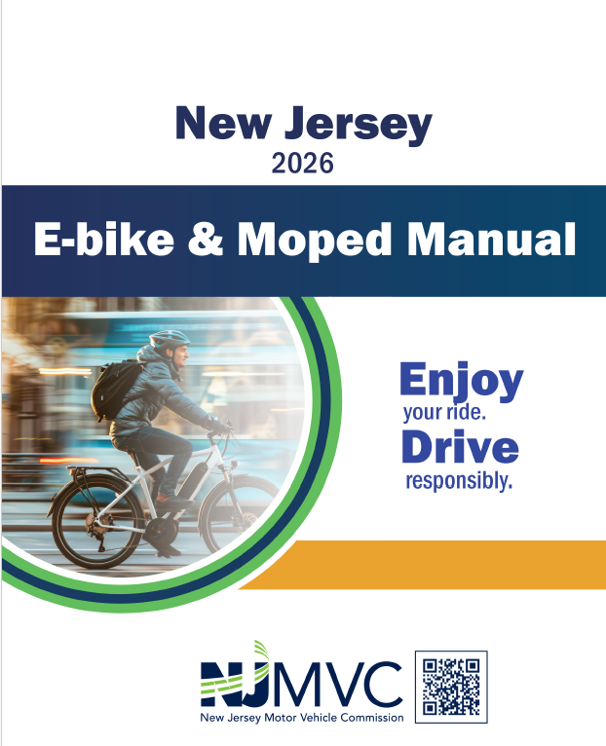
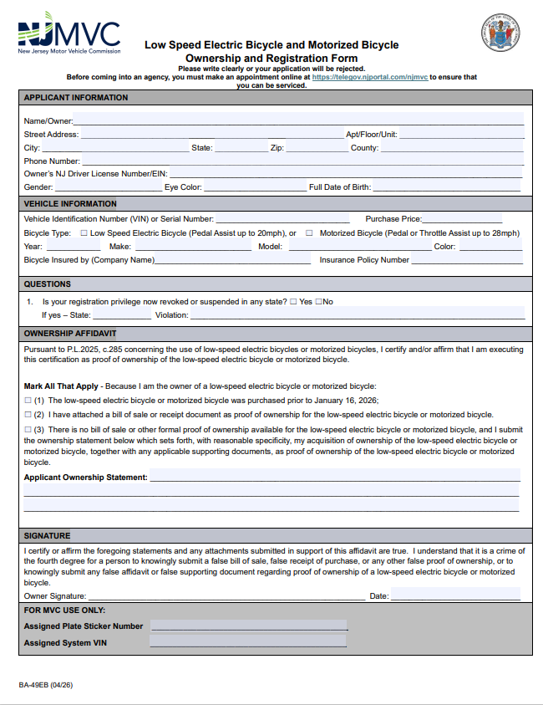
Forms and Resources
Moped Manual
E-Bike Registration Form

Slide 12
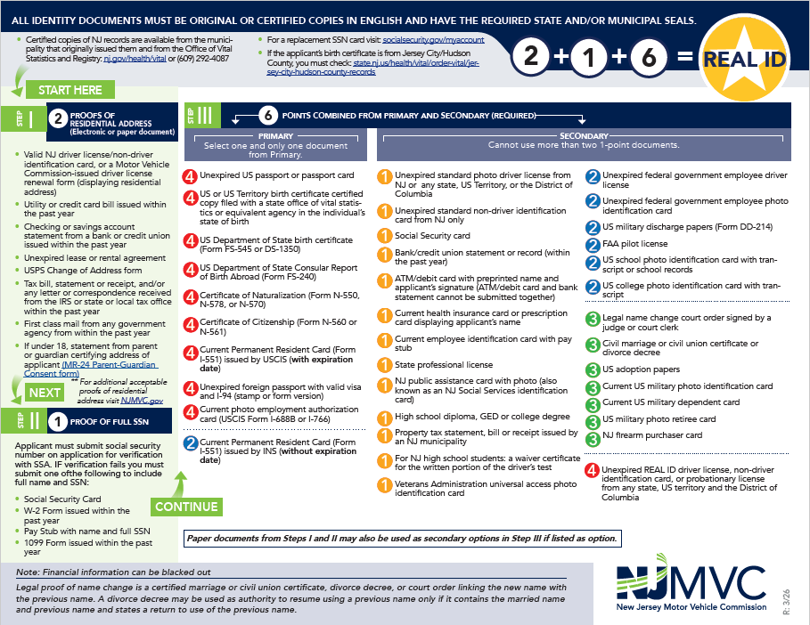
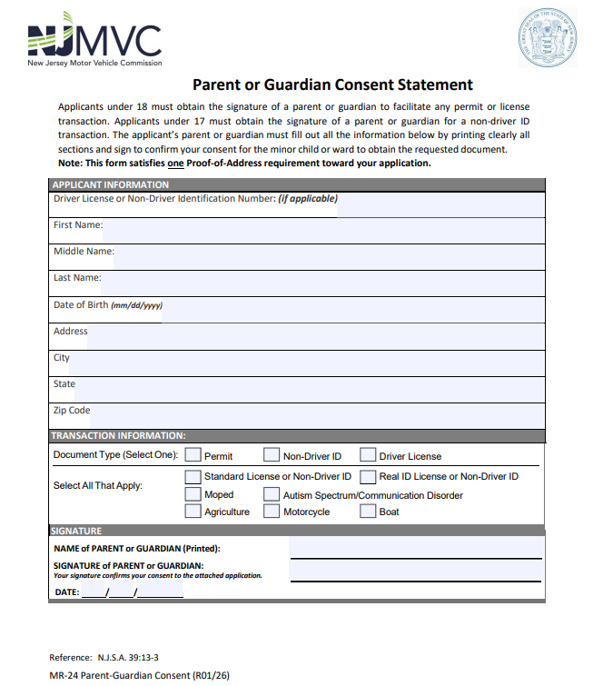
Forms and Resources
6 points of ID Form
Parent/Guardian Consent form

