Slide 1
New Jersey State Police
Firearms Identification Card
Safety & Awareness
Interim Training

Slide 2
Important Notes
The NJSP, in conjunction with the Office of the Attorney General, is working to establish a new comprehensive training program for applicants who are applying for, or renewing, a permit to carry a handgun, pursuant to N.J.S.A. 58-4(g)(1) and (g)(2). See also N.J.S.A. 2C:58-4(d)(3). In addition to online materials and firing range requirements, the newly developed training will include an in-person classroom component, where applicants will learn first-hand from authorized certified instructors the principles of lawful and safe handling and safe storage of firearms. The live component will be standardized across the state to ensure all applicants are provided the same meaningful opportunity to receive a permit to carry. Until such time that the new training is implemented, and in order to comply with the law, this document on safe handling and use, as well as the training materials on use of deadly force shall be taught by a certified firearms instructor to all applicants. Certified firearms instructors remain responsible for ensuring that applicants for permits to carry handguns are properly trained and proficient before attesting to the applicant’s competence on the prescribed certification form.
The material and content being presented to the viewer is intended to provide general safety awareness guidelines regarding the safe care and handling of firearms. It is not intended to supersede or be in lieu of any manufacturer guidelines, recommendations or instruction provided by a competent certified Firearms Instructor. Please refer to the NJ Criminal Code 2C to ensure compliance with all matters related to the care, handling, and transportation of firearms.

Slide 3
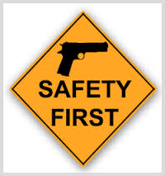
Safety
International Rules of Firearms Safety
“These rules are in place to lessen the possibility of accidental injury.”

Slide 4
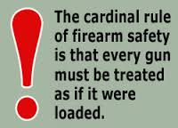
International Rules of Firearms Safety
Treat every firearm as if it were loaded until positively ascertained otherwise by you.
Ensure to visually and physically inspect the chamber of the weapon to establish that it is clear and safe from any live rounds or debris.

Slide 5
International Rules of Firearms Safety (continued)
  2. Never point a firearm at anything or anybody that you do not intend to shoot, or in a direction where an unintentional discharge may do harm.

Slide 6
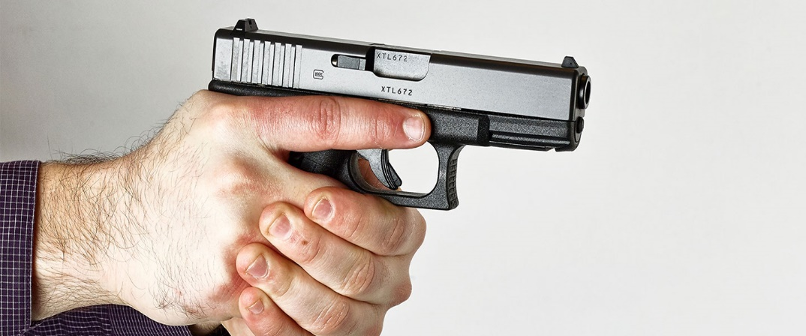
International Rules of Firearms Safety (continued)
  3. Never place your finger on the trigger until ready and justified to fire.
  Trigger Finger Discipline: Build tactile sensation. Keep your trigger finger oriented high on the frame of the weapon at all times, unless you are ready and justified to fire.

Slide 7
International Rules of Firearms Safety
4. Be sure of your threat, surroundings and beyond.
You are responsible for all of your rounds
including those that miss your intended
target.

Slide 8
“Everyone is part of the safety paradigm.”
Safety Acknowledgement

Slide 9
Additional Rules of Firearms Safety
Muzzle Discipline (Laser Rule): Be cognizant and aware of where your muzzle is always oriented. Treat the end of the barrel as if it had a laser through it and you do not want the laser to make contact with an unintended target
Never hand a loaded weapon to someone in a non-combat situation

Slide 10
“The world is 360°. There is no down range.”

Slide 11

Safety
The best safety device is between your ears – think safety first at all times!

Slide 12
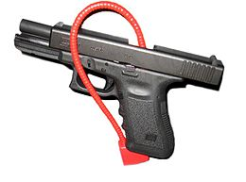
Home Safety Guidelines
All firearms should be unloaded and made safe prior to storage in a household
Secure the firearm in a safe place (locked and unloaded), follow manufacturer guidelines on how to properly utilize the trigger lock device to render the weapon inoperable
Ensure that the ammunition and magazines are locked and secured in a separate location from the firearm
Educate your family as to its dangers
Do Not show children how to load the weapon
Do Not store firearm in an easy access area (under pillow, under mattress, in nightstand. Should be kept in a locked container, drawer, or other location as far out of a child’s reach as possible)

Slide 13
Home Safety Guidelines (continued)
  General guidelines are to render the weapon inoperable and inaccessible when storing them
  Children: (Have a plan on how to educate them and properly store the firearm and follow it)
N.J.S.A. 2C:58-15 “A person who knows or reasonably should know that a minor is likely to gain access to a loaded firearm at a premises under the person’s control commits a disorderly persons offense if a minor gains access to the firearm…”

Slide 14
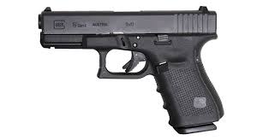
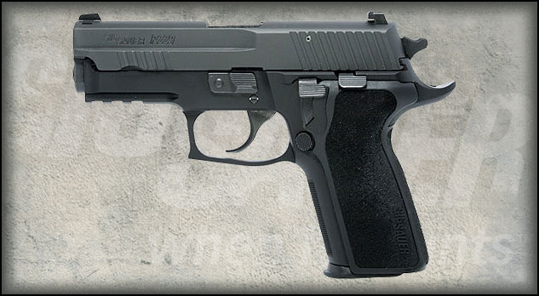
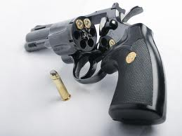
Semiautomatic Handgun and Revolver Nomenclature

Slide 15
Purpose
To provide general knowledge of different types weapons
Please refer to the respective firearm manufacturer for specific nomenclature and operating procedures. In addition, refer to a certified firearms instructor for instruction on how to operate a firearm

Slide 16
Semiautomatic
Handheld firearm in which depressing the trigger, when the magazine and chamber are loaded, will:
  Fire the chambered round
  Extract and eject the spent shell casing
  Cock the weapon
  Load and chamber a round from the magazine

Slide 17
Semiautomatic (continued)
Trigger must be pressed for each round to be fired
All semiautomatic handguns are similar by design, however most disassemble differently

Slide 18
Semiautomatic Handgun Nomenclature
Receiver
Magazine
Magazine Release
Barrel
Slide
Slide Stop Lever
Firing Pin
Safety(s)
Hammer or Striker
Trigger Guard
Trigger
Sights
Grip
Ejection Port
Recoil Spring
Bore, Lands, Grooves
Extractor
Ejector

Slide 19
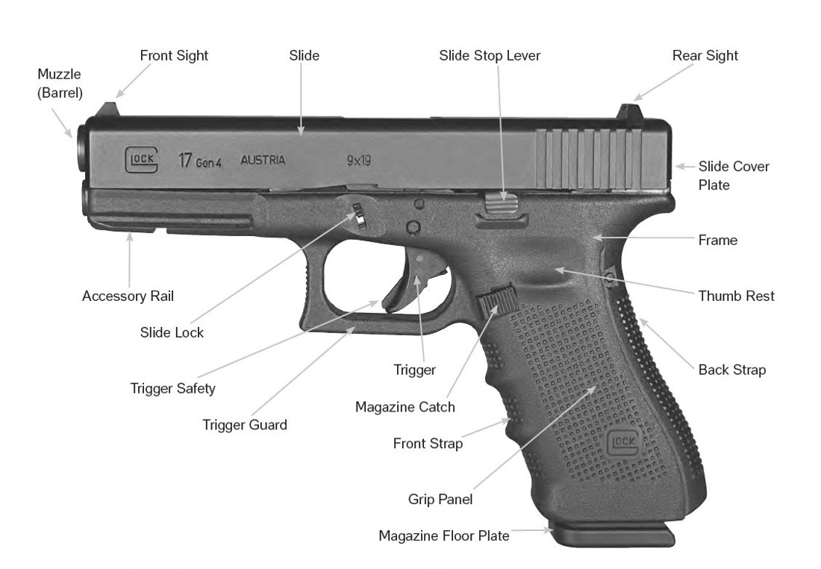

Slide 20
Making a Semiautomatic Safe
Safety (if applicable)
Point the weapon in safe direction
Remove the source of ammunition (magazine)
Lock the slide to the rear
Visually and Physically check the chamber

Slide 21
Safety
Rendering a semiautomatic handgun safe
DO NOT TRAP ROUND
Safely allow for the round to eject onto the floor, do not attempt to catch

Slide 22
Revolver
Handheld firearm in which the cartridges are inserted in individual chambers in a cylinder, which is mounted behind the barrel.
The cylinder revolves to bring the chamber and cartridge in line with the firing pin.

Slide 23
Revolver
Cylinders generally swing out to the left
May have an exposed or hidden hammer
Double action
Colt cylinders rotate clockwise
Ruger and Smith & Wesson cylinders rotate counterclockwise

Slide 24
Revolver Nomenclature
Muzzle
Front Sight
Barrel
Frame
Rear Sight
Top Strap
Crane
Ejection Rod
Cylinder
Trigger Guard
Trigger
Grip Panel
Back Strap
Cylinder Release
Chambers
Extractor
Rachet

Slide 25
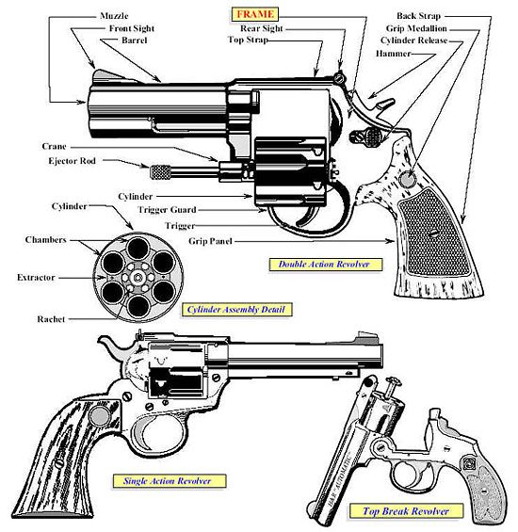

Slide 26
Making a Cocked Revolver Safe
Non-shooting hand thumb is placed between hammer and frame (weapon pointed in safe direction)
Press trigger and release hammer onto thumb
Remove finger from trigger
Remove thumb from between hammer and frame
Gently lower the hammer

Slide 27
Notable NJ Criminal Statutes related to Firearms
2C:24-4 (Endangering the Welfare of a Child)
2C: 39-6g (Transporting a Firearm within NJ)
2C:58-15 (Loaded Firearm easily accessible to minor)

Slide 28
Notable NJ Criminal Statutes related to
Firearms
2C:58-4.6 – Prohibited Places (3rd degree crime to enter a prohibited place with a firearm). See Koons/Siegel v. AG/NJSP case for current status of the prohibited places law. As of July 1, 2023, the following are included in the prohibited places under N.J.S.A. 2C:58-4.6:
government buildings
courthouses/buildings used for court administrative proceedings
state, county, municipal jails/prisons, juvenile detention centers
state-contracted half-way houses
poling locations during election
w/in 100 ft of public gatherings/demonstrations
schools, colleges, universities, other education institutions, and school buses
child care/daycares
nursery schools, pre-schools, zoos, summer camps
parks, beaches, recreation facilities, and playgrounds owned by the state, county, or local gov’t
youth sports events
libraries and museums
homeless shelters/children’s shelters
community residences for people w/developmental disabilities, head injuries, or terminal illness, and other DHS licensed residential settings
places that serve alcohol
cannabis retailers
entertainment facilities (theaters, museums, racetracks, concert venues)
casinos
energy plants
airport or public transportation hubs
healthcare facilities and addiction/mental health treatment centers
DHS, DCF, or DOH regulated addiction or mental health facilities (non-healthcare)

Slide 29
Notable NJ Criminal Statutes related to
Firearms
N.J.S.A. 2C:58-4.5 – Restrictions on Lawful Carrying
It is a 4th degree crime to openly carry, regardless of liability insurance. See Koons/Siegel v. AG/NJSP case for applicability of the liability insurance provisions. As of July 1, 2023, the liability provision is enjoined.
N.J.S.A. 2C:58-4.4 – Safe Carry Requirements:
Lawful holders of a permit to carry a handgun cannot:
  use or consume alcohol, cannabis, or CDS while carrying a handgun;
  be under the influence of alcohol, cannabis, or CDS while carrying a handgun;
  carry outside of the holster or carry in public in a holster that does not meet the carry permi requirements (2C:58-4); (4) carry more than 2 firearms at one time; or
  engage in unjustified display of a handgun.
Violation of the above is a 4th degree and constitute sufficient grounds for permit revocation.
(b) If an individual is stopped or detained by LE while lawfully carrying a handgun in public or in a vehicle, the individual must:
  immediately disclose they are carrying a handgun or that it is stored in the vehicle (violation is a 4th degree); and
  display the lawful carry permit (violation is a DP for first offense and $100 fine (4th degree for subsequent offenses).
  An individual who has a permit to carry and is carrying at the time they are detained as part of a criminal investigation, the individual must provide their handgun to the officer upon the officer’s request (violation is a 4th degree).**

