Slide 1
New Jersey Resilience Accelerator NJ State Planning Commission, 6.7.23

Slide 2
Why Develop the Accelerator? What Problem Are We Addressing?
Communities get stuck here
Communities planning resilience
Communities “doing” resilience
Notes:
Developed after extensive discussion and groundwork including research on what other states were doing to support local resilience work; review of Nj specific policies, tools and supports; and conducting focus groups. We were interested in increasing awareness and planning for resilience, but also and especially helping communities implement holistic resilience actions.

Slide 3
What is the Accelerator?
Technical Assistance Program to Help NJ Municipalities:
Identify and communicate their resilience goals
Develop strategies and critical projects
Find pathways for funding
Integrate resilience into daily operations
Notes:
In the Accelerator, NJ State partners and FEMA coordinate and work collaboratively with local communities, along with partners from academic and non-profit organizations, to jumpstart community resilience initiatives, which includes everything from communication campaigns to cost of inaction analysis, to project scoping and grant application.
Cohorts of municipalities cultivate cross-jurisdictional cooperation and break down barriers to resilience with ongoing technical assistance and support from FEMA and the state partners.

Slide 4
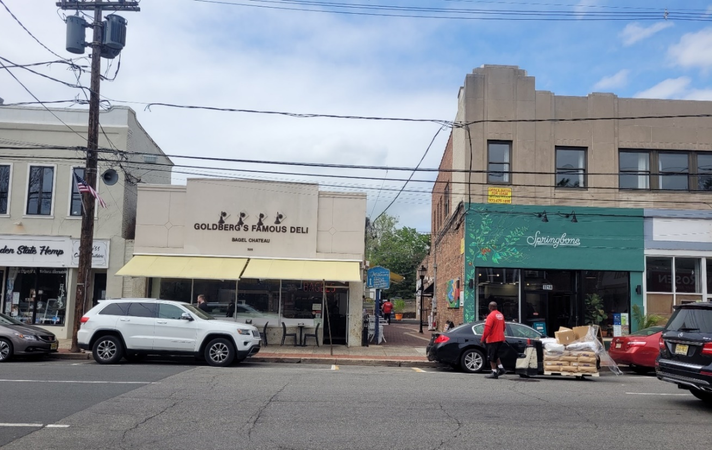
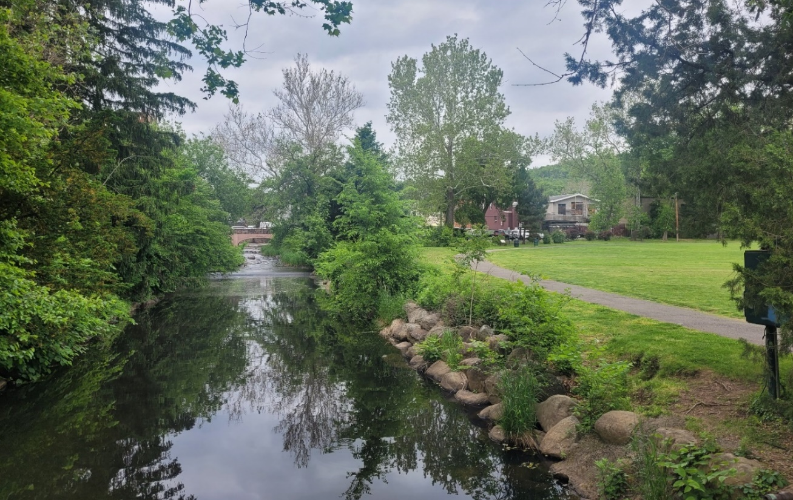
Who is leading?
The Rahway River in Millburn, NJ is channelized behind Goldberg’s Deli (top). During Hurricane Ida, the channel flooded right through deli, across the street, and into the park (below).
Millburn joined the Resilience Accelerator to build on their recovery efforts to reduce their risks of it happening again.
Photos by Gabriella Spitzer
FEMA Region 2 & contract support
New Jersey State Agencies
Dept. of Environmental Protection
Office of Planning Advocacy
Office of Emergency Management
Dept. of Community Affairs
Other partners
Rutgers
NJ Future
Experts from Wharton School of Risk Management, NJ Infrastructure Bank, state climatology office, other federal agencies, etc.
Notes:
The Accelerator evolved from a small working group of FEMA and the first 3 state agencies here, to a well-established committee to integrate different programs and support actions. Along the way we’ve talked to dozens of supporting agencies and brough in many different experts to speak to local communities. But I should really call out that initial team of Donna, Nick Angarone and Chris Testa for putting in hundreds of hours of work to make this program succeed.

Slide 5
Participating Communities
Communities nominated by state agencies
Riverine communities moved up after Ida.
Communities shared their gaps with DCA during the development of the CDBG-DR Action Plan for Ida, influencing the programming of funds.
Riverine cohort (spring 2022)
Bound Brook, Denville, Lambertville, Manville, Millburn, Millstone
Coastal cohort (winter 2022)
Commercial, Little Egg Harbor, Maurice River, Ocean City, Pennsville
Notes:
Communities nominated by the state agencies from a list of those meeting certain criteria (lower capacity/smaller, facing significant challenges, in good standing, primed for resilience action.).
Moved the riverine cohort to the front of the line after Ida hit NJ in September 2021, which was a good call. The communities were able to bring a larger resilience lens into their recovery considerations. The coordinated also provided benefits like providing a forum for impacted communities to communicate their needs to DCA as it was developing its Action Plan for Ida CDBG-DR funding. So that was our initial group and now we’re underway with the intensive phase of work with the coastal cohort.

Slide 6
Accelerator Structure
One-on-one calls to get to know communities and assist with preparation and homework
Two in-person workshops after initial virtual Partnering Session
Follow-up session 3-4 months after second workshop
Periodic check-ins with steering committee member agencies
Introductory calls and intake conversation
Workshop 1: Understanding Vulnerabilities and Resilience Options
Workshop 2: Developing an Action Plan
Partnering Session: Cohort Building
Notes:
Accelerator structure is built around 2 in person ¾ day workshops, with virtual meetings several months before and after those sessions.
The first meeting frames resilience and the work of the group and helps establish cohort camaraderie
Workshop 1: Understanding Vulnerabilities and Resilience Options
Workshop 2: Communities Developing a Specific Action Plan
Follow up to learn from each other, troubleshoot problem areas, provide support and learn about areas where they may need additional guidance or training.

Slide 7
Outcomes for Communities
Assessment of Long-range Flooding Vulnerabilities (coastal)
Identification of Resilience Solutions
Action Plan to Advance Resilience Solutions
Connections Across the Cohort
Access to a Network of Experts
Notes:
While it’s labor intensive and it takes time to really take root, we’ve seen a lot of good outcomes for the communities, not least by simply developing a cross-unit resiliency team and queuing up hard conversations about the future. With the coastal group, we’ve prioritized asking them to think seriously about how to respond to and mitigate the challenges ahead: what does 2050 look like for you, what about 2100?

Slide 8
Impacts: Riverine Cohort
Lambertville
Monthly Resilience Committee meeting.
Grant applications:
$450k from Congressman Malinowski for green infrastructure
Immersive Art Project
Stormwater utility feasibility study
Amendments to flood damage prevention ordinance: 1 foot freeboard, floodplain administrator to manage variances.
Plan to work with Blue Acres on abandoned properties.
The city offered to host ongoing peer-learning meetings with the accelerator cohort.
Millburn
Backyard drainage project to support 50-60 homes.
Application for three home elevations—first time ever!
Enhanced partnership with the City of Orange.
Notes:
First a general impact: Having discussions with the communities over many months as they begin work on priorities opens channels between the state officials and the communities. They hear about successes and barriers. That’s been helpful for building a collective approach to resilience that takes account of the different programs, tools and expertise the state brings.
Those of you who know Andrew Nowick, the relatively new mayor of Lambertville, will not be surprised to hear that they have been especially active and energetic, and seeing good success in securing money for projects. While Mayor Nowick has a lot of support, in Millburn it’s been the town administrator Alexander McDonald inspiring colleagues to tackle their challenges collectively and in a more regional manner.

Slide 9
Impacts: Riverine Cohort, cont.
Bound Brook
Planning nature-based solutions wherever possible.
Building traffic-calming, flood-resilient green space.
Somerset County
Working group on countywide stormwater management options.
Exploring a stormwater utility.
The county received expert advice on policy alternatives.
Manville
Progress with buyouts and plans for more
Four feet elevation now required.
Data sharing agreement with FEMA enables planning related to repetitive loss properties.
Millstone
Planning Board asked for a Resiliency Plan.
Working on two sewer plans: one for the historic district, one for the entire borough.
Working on internal communications between the borough departments and the council.
Notes:
Other communities are making progress with policy improvements, securing and applying better data, bringing ecosystem services benefits into mitigation discussions, and developoing new plans and partnerships. Somerset County was inspired by the Accelerator to begin a county-wide stormwater management working group which is meeting regularly to consider collective solutions.

Slide 10
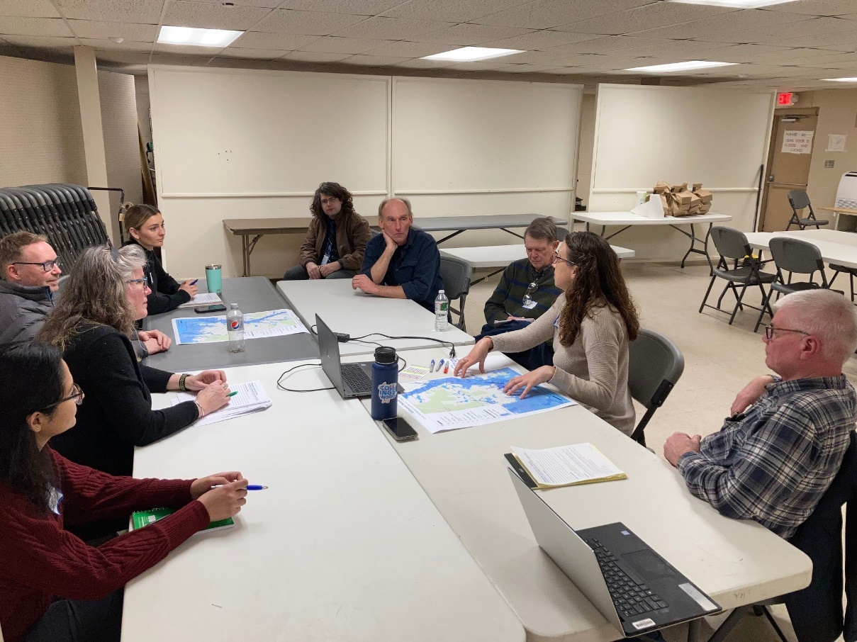
Impacts: Coastal Cohort
Maurice River and Commercial
Secured FEMA BRIC Direct Technical Assistance award, which provides expertise tailored to needs (engineering, planning, project mgmt).
Built trust and respect with state agencies.
Began to discuss managed retreat and creative ways to maintain the community, despite increasing vulnerabilities.
Pennsville
All areas of local government working together on their mitigation goals
Completing application for major OEM grant.
“We have a seat at the table now. There’s a lot to work through, but we are at the table—and we weren’t before.” – Bill Ashton, Deputy Mayor, Maurice River
Notes:
The coastal work is still gearing up, but we’re already seeing achievements, especially in the arena of forming strong resilience teams and developing good grant applications. Maurice River and Commercial came together over their common challenges in our first workshop, which lead them to apply for a FEMA BRIC grant, which they were awarded just 2 weeks ago. This will bring them several years of access to experts from across a wide range of contractors, so they can really target their biggest gaps.

Slide 11
2022 FEMA Administrator’s Award for Climate Resilience
Notes:
We’re pleased to note that we’ve also won some national plaudits with the awarding this spring of a FEMA Administrator’s Award, a recognition of good works around the country from a field of hundreds of submissions.

Slide 12
Questions and Discussion
For more information
Shannon McLachlan
Regional Coordinator, Community Assistance
FEMA Region 2
shannon.mclachlan@fema.dhs.gov
(347) 551-3818

Slide 13
Challenges
Breadth of officials and groups with resilience roles
Community Capacity
Customizing to the Needs of Each Community
Notes:
Working with the Steering Committee Agencies to ensure everyone is rowing in the same direction
State agencies each have their unique mission areas and priorities
Working together includes hashing out what’s possible
New Jersey’s climate policies are still in development & there’s no one formula for helping communities
Community capacity to participate
Many NJ communities hire contract planners
Resilience functions live in different departments across local government
Making time and traveling to workshops can be challenging
Customizing to the needs of each community
Some communities have just started their resilience journeys, while others have been successfully applying for grants for a decade or more. How do we meet the needs of both types of communities?
There may be pre-existing tensions in the relationships between communities and the state agencies

