Slide 1
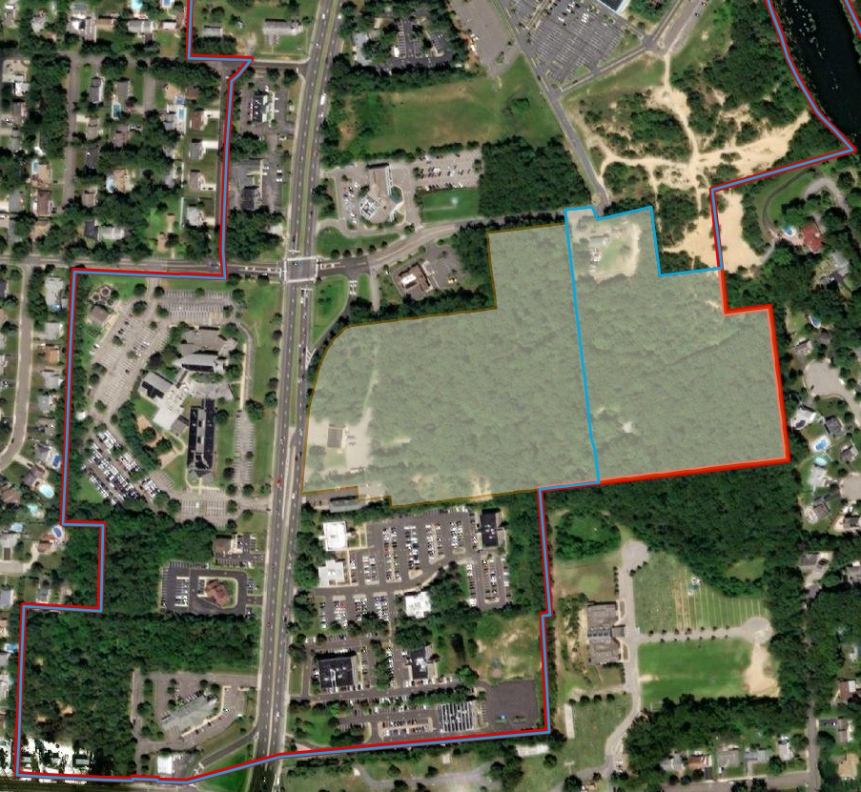
Township of Toms River State Plan Policy
Map Amendment
Presented to the
New Jersey State Planning Commission
September 7, 2022
NJ Office of Planning Advocacy
Notes:
Good morning everyone. I will be presenting on the Township of Toms River’s Map amendment that was petitioned in the township’s latest biennial review.

Slide 2
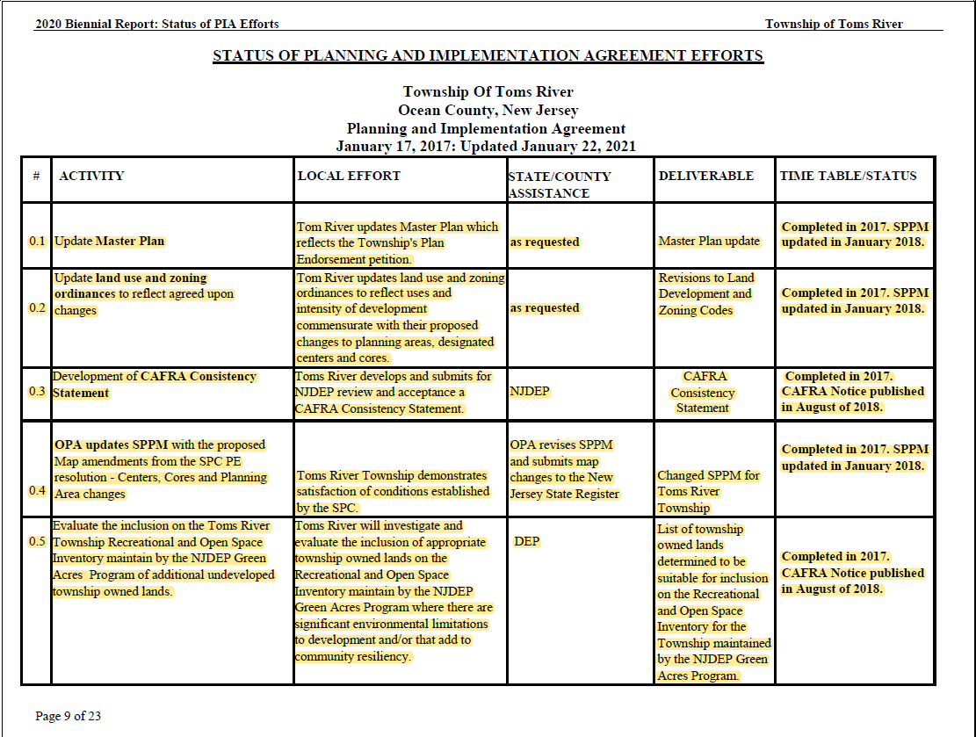
Biennial Review
Toms River Township was Plan Endorsed on July 2, 2018.
The Township submitted their first biennial report on July 7, 2021.
  PIA lists 34 items to be completed during the 10 year endorsement period
  24 items have been completed
  Remaining 10 items have a timetable listed as either ongoing or due by July 2, 2023.
As part of the biennial report, the Township of Toms River submitted a petition to amend the State Plan Policy Map.
Notes:
Toms River Township was Plan Endorsed by the State Planning Commission on July of 2018. and the Township submitted their first biennial report on July of 2021.
The Plan & Implementation Agreement lists 34 items that need be completed during the 10 year endorsement period and as part of the biennial review we ask municipalities for an update on their PIA.
The Township has completed 24 items and the Remaining 10 items have a timetable listed as either ongoing or due by July 2, 2023.
I have highlighted their PIA to show their completed items: Items worth noting include: that they completed updating their land use and zoning ordinance, they added appropriate township owned lands on their ROSI,

Slide 3
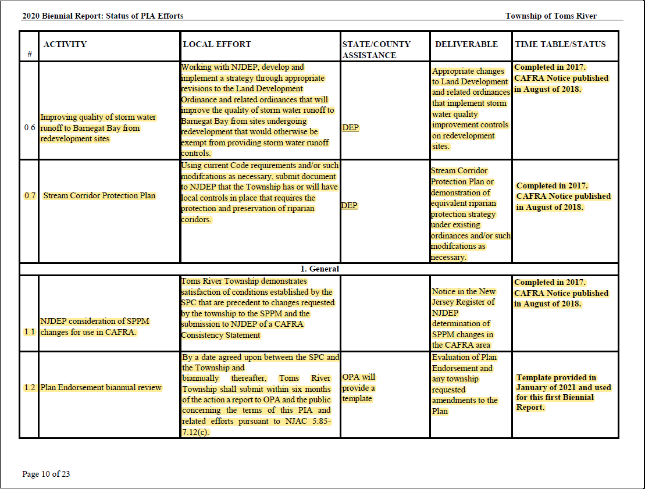
Biennial Review
Toms River Township was Plan Endorsed on July 2, 2018.
The Township submitted their first biennial report on July 7, 2021.
  PIA lists 34 items to be completed during the 10 year endorsement period
  24 items have been completed
  Remaining 10 items have a timetable listed as either ongoing or due by July 2, 2023.
As part of the biennial report, the Township of Toms River submitted a petition to amend the State Plan Policy Map.
Notes:
They made changes to their Land Development Ordinance in order to improve quality of storm water runoff to Barnegat Bay from redevelopment sites. They adopted a stream corridor protection plan

Slide 4
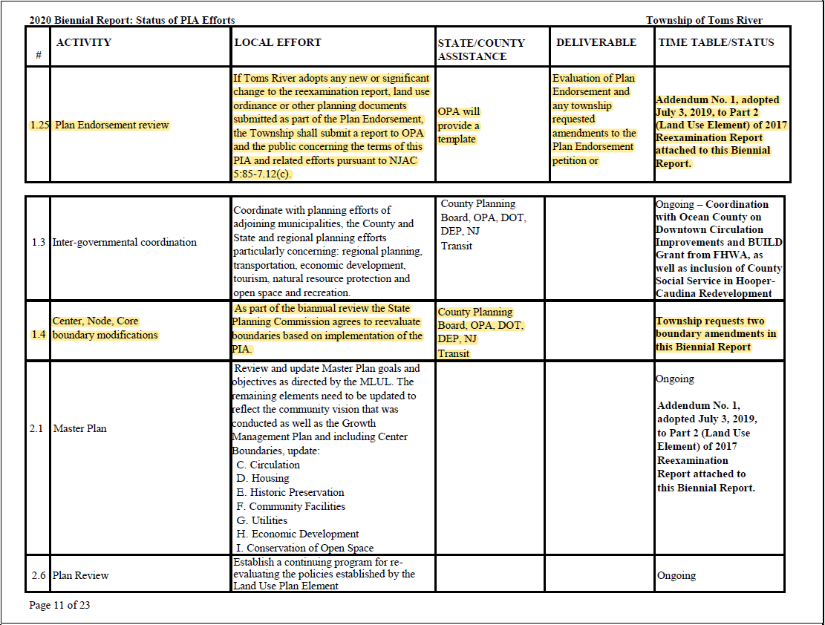
Biennial Review
Toms River Township was Plan Endorsed on July 2, 2018.
The Township submitted their first biennial report on July 7, 2021.
  PIA lists 34 items to be completed during the 10 year endorsement period
  24 items have been completed
  Remaining 10 items have a timetable listed as either ongoing or due by July 2, 2023.
As part of the biennial report, the Township of Toms River submitted a petition to amend the State Plan Policy Map.
Notes:
Here you can see that their update to their master plan is currently ongoing.

Slide 5
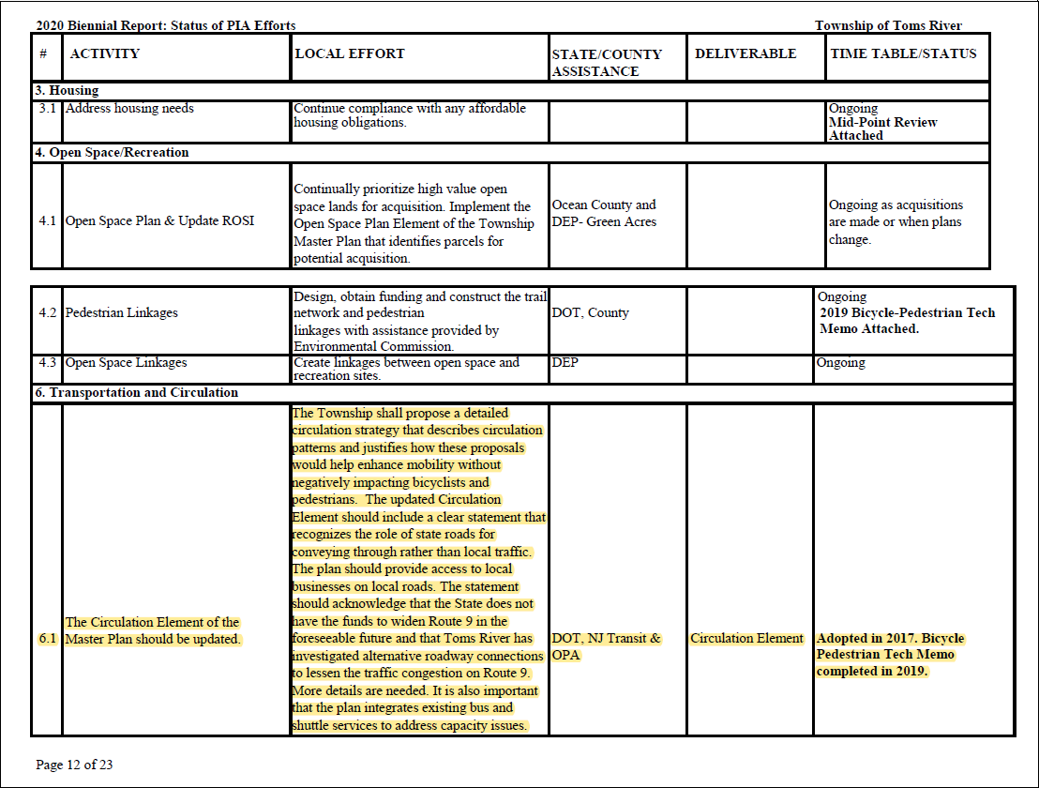
Biennial Review
Toms River Township was Plan Endorsed on July 2, 2018.
The Township submitted their first biennial report on July 7, 2021.
  PIA lists 34 items to be completed during the 10 year endorsement period
  24 items have been completed
  Remaining 10 items have a timetable listed as either ongoing or due by July 2, 2023.
As part of the biennial report, the Township of Toms River submitted a petition to amend the State Plan Policy Map.
Notes:
They updated and adopted a circulation element with a bicycle pedestrian memo completed in 2019

Slide 6
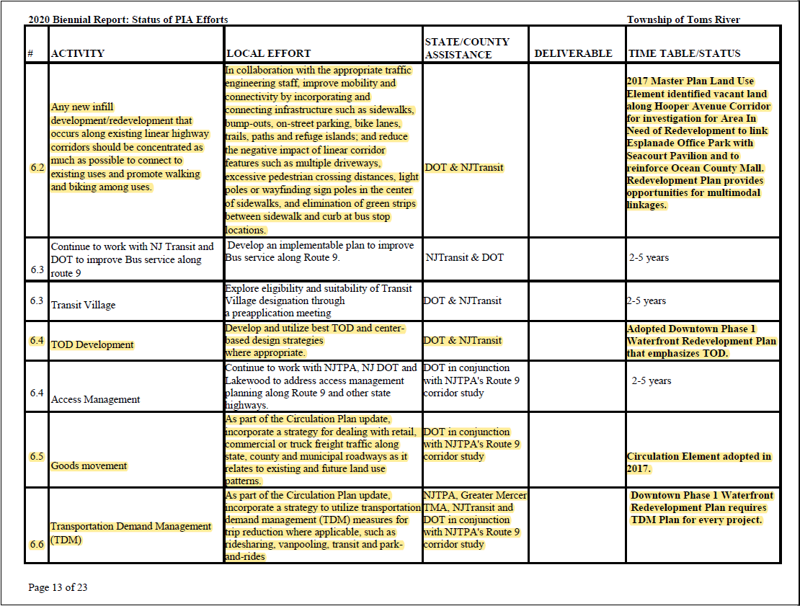
Biennial Review
Toms River Township was Plan Endorsed on July 2, 2018.
The Township submitted their first biennial report on July 7, 2021.
  PIA lists 34 items to be completed during the 10 year endorsement period
  24 items have been completed
  Remaining 10 items have a timetable listed as either ongoing or due by July 2, 2023.
As part of the biennial report, the Township of Toms River submitted a petition to amend the State Plan Policy Map.
Notes:
And as part of their circulation element they incorporated Goods movement and transportation demand management.

Slide 7
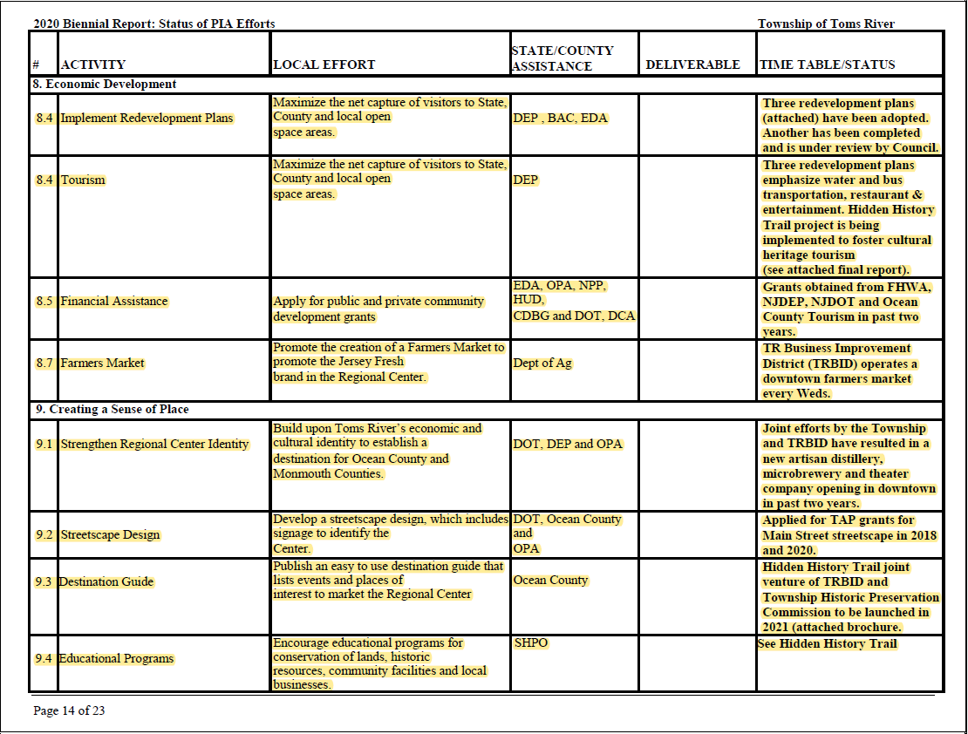
Biennial Review
Toms River Township was Plan Endorsed on July 2, 2018.
The Township submitted their first biennial report on July 7, 2021.
  PIA lists 34 items to be completed during the 10 year endorsement period
  24 items have been completed
  Remaining 10 items have a timetable listed as either ongoing or due by July 2, 2023.
As part of the biennial report, the Township of Toms River submitted a petition to amend the State Plan Policy Map.
Notes:
They have applied for public and private community development grants which they obtained grants from DEP, DOT, and from County Tourism in the past 2 years.
And as part of the biennial report, the Township of Toms River submitted a petition to amend the State Plan Policy Map.

Slide 8
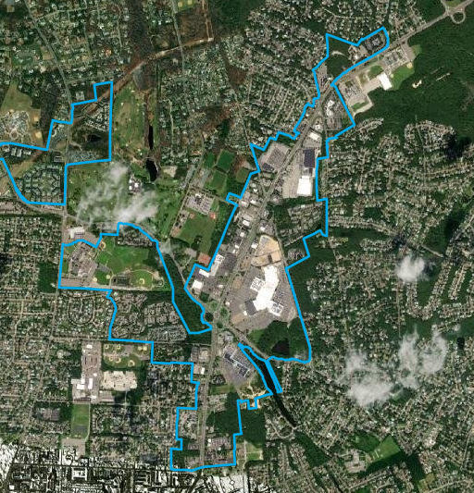
State Plan Policy Map Amendment
Toms River Township is petitioning for the Toms River Hooper Avenue Core South to align with their DCA approved Hooper-Caudina Redevelopment Area.
The Township is petitioning for the following Block and Lots to be included into the Toms River Hooper Avenue Core South.
  Block 592, Lots 72-95
  Block 594, Lots 139-158
  Block 595, Lots 159, 162, 163, 188, 198-202
  Block 596, Lot 203-246
  Block 597, Lots 49-71
  Unimproved ROW of Castlebuono Ave., Cirpiano Ave., and Sarno Ave, east of centerline of Salerno Ave, inclusive of Salerno Ave., and the ROW of Reggio Ave., and Nocero Place in their entirety.
Notes:
Toms River Township is petitioning for the Toms River Hooper Avenue Core South to align with their DCA approved Hooper-Caudina Redevelopment Area.
And here you can see that this is what the current Core south looks like today.
I have also listed here the specific blocks and lots that are being petitioned to be included in this Core South/

Slide 9
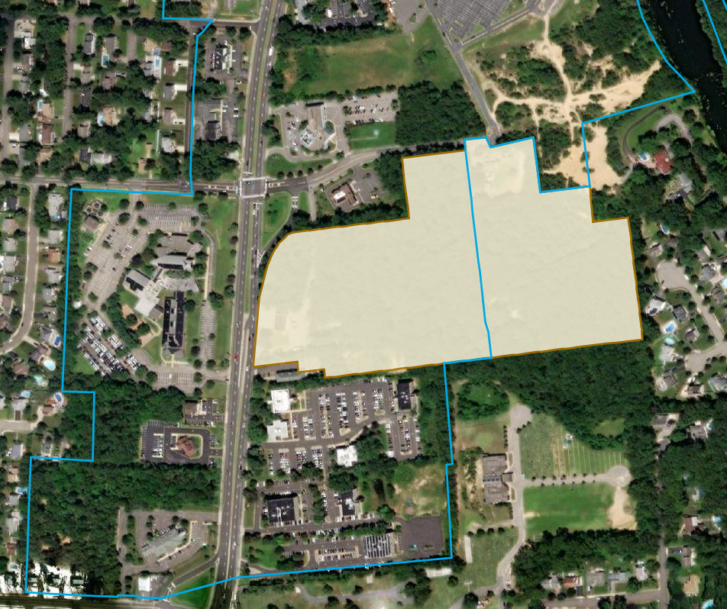
State Plan Policy Map Amendment
Toms River Township is petitioning for the Toms River Hooper Avenue Core South to align with their DCA approved Hooper-Caudina Redevelopment Area.
The Township is petitioning for the following Block and Lots to be included into the Toms River Hooper Avenue Core South.
  Block 592, Lots 72-95
  Block 594, Lots 139-158
  Block 595, Lots 159, 162, 163, 188, 198-202
  Block 596, Lot 203-246
  Block 597, Lots 49-71
  Unimproved ROW of Castlebuono Ave., Cirpiano Ave., and Sarno Ave, east of centerline of Salerno Ave, inclusive of Salerno Ave., and the ROW of Reggio Ave., and Nocero Place in their entirety.
Notes:
Here we overlayed the Hooper-Caudina Redevelopment Area to show the area that is currently not in the center.

Slide 10
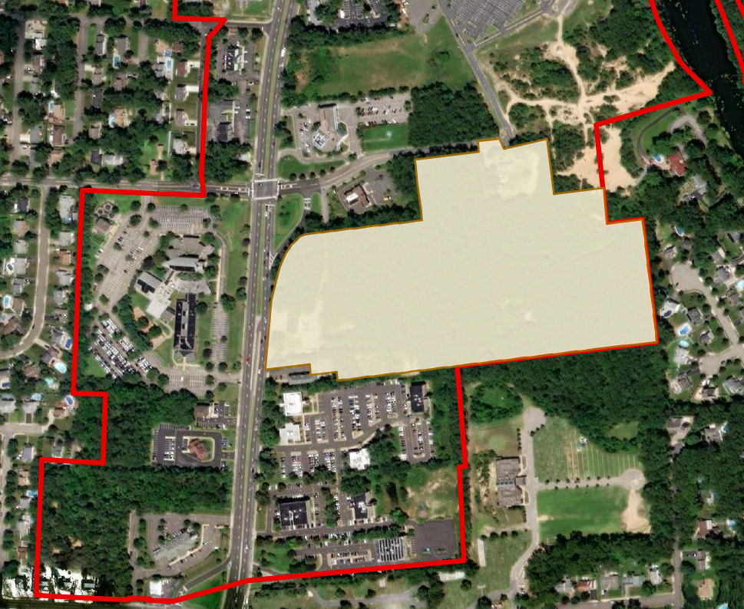
State Plan Policy Map Amendment
Toms River Township is petitioning for the Toms River Hooper Avenue Core South to align with their DCA approved Hooper-Caudina Redevelopment Area.
The Township is petitioning for the following Block and Lots to be included into the Toms River Hooper Avenue Core South.
  Block 592, Lots 72-95
  Block 594, Lots 139-158
  Block 595, Lots 159, 162, 163, 188, 198-202
  Block 596, Lot 203-246
  Block 597, Lots 49-71
  Unimproved ROW of Castlebuono Ave., Cirpiano Ave., and Sarno Ave, east of centerline of Salerno Ave, inclusive of Salerno Ave., and the ROW of Reggio Ave., and Nocero Place in their entirety.
Notes:
And here you see that this red line is the proposed center boundary

Slide 11
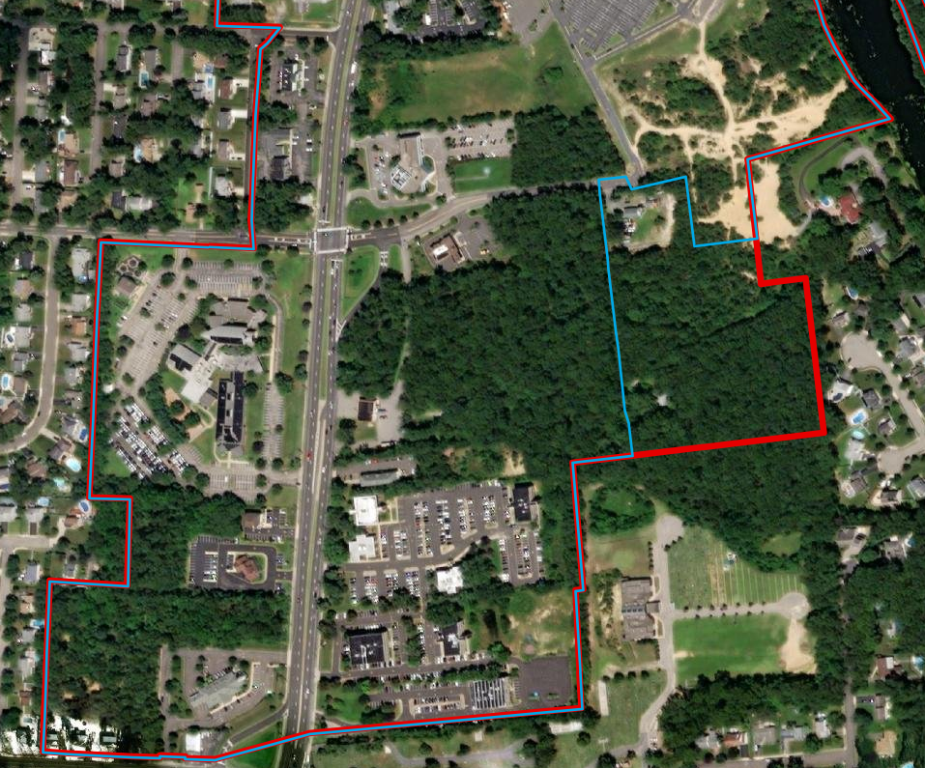
State Plan Policy Map Amendment
Toms River Township is petitioning for the Toms River Hooper Avenue Core South to align with their DCA approved Hooper-Caudina Redevelopment Area.
The Township is petitioning for the following Block and Lots to be included into the Toms River Hooper Avenue Core South.
  Block 592, Lots 72-95
  Block 594, Lots 139-158
  Block 595, Lots 159, 162, 163, 188, 198-202
  Block 596, Lot 203-246
  Block 597, Lots 49-71
  Unimproved ROW of Castlebuono Ave., Cirpiano Ave., and Sarno Ave, east of centerline of Salerno Ave, inclusive of Salerno Ave., and the ROW of Reggio Ave., and Nocero Place in their entirety.
Notes:
Here you can use the underlying land cover.

Slide 12
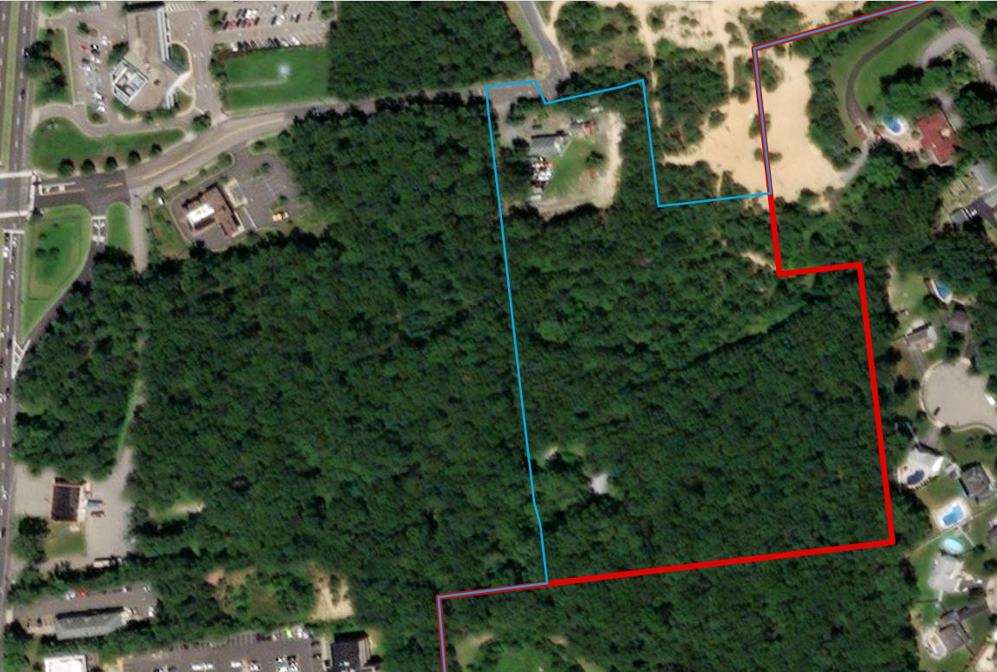
State Plan Policy Map Amendment
The petitioned 9 acre area is a Suburban Planning Area (PA2) and primarily wooded.
Notes:
The petitioned 9 acre area is a Suburban Planning Area (PA2) and primarily wooded.

Slide 13
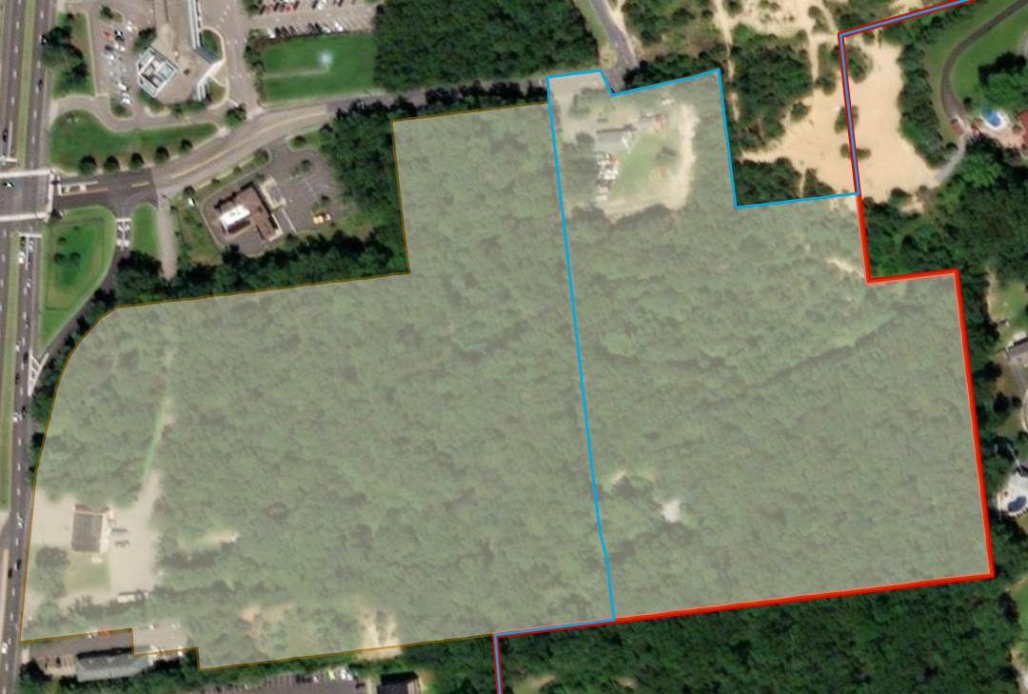
State Plan Policy Map Amendment
The petitioned 9 acre area is a Suburban Planning Area (PA2) and primarily wooded.
The goal of the Hooper-Caudina Redevelopment Plan is to promote the development of a campus for a new Veterans Affairs (VA) clinic for Ocean County.
This extension to the Core South will also enable flexibility in organizing the more appropriate areas of the Redevelopment Area for residential development.
Notes:
The goal of the Hooper-Caudina Redevelopment Plan (see attached for more detail) is to promote the development of a campus for a new Veterans Affairs (VA) clinic for Ocean County, situated with convenient access to related services for veterans and the public at large. One of the objectives of the Land Use Plan Element of the Master Plan adopted in 2017 was to investigate the area of approximately 21 acres The redevelopment investigation was conducted in 2018 and was promoted by inquiries by the developers searching for a site for a new medical clinic for VA and the need to encourage the USPS to relocate its post office from the Waterfront Redevelopment Area to a more central location. The relocation of the post office to the same campus and the connection of the campus with the adjacent office park where the County is in the process of building new office facilities to house several County departments, including the Office of Veterans Affairs, will address multiple needs for veterans in a single destination.

Slide 14
State Plan Policy Map Amendment
The petitioned 9 acre area is a Suburban Planning Area (PA2) and primarily wooded.
The goal of the Hooper-Caudina Redevelopment Plan is to promote the development of a campus for a new Veterans Affairs (VA) clinic for Ocean County.
This extension to the Core South will also enable flexibility in organizing the more appropriate areas of the Redevelopment Area for residential development.
Notes:
The Map Amendment will also enable flexibility in organizing the more appropriate areas of the Redevelopment Area for residential development. The Redevelopment Plan proposed a 50 unit multifamily residential development (inclusive of 10 affordable units) in the residentially zoned portioned of the Redevelopment Area, but the topographic challenge to developing a significant portion of the commercially zoned portion of the Redevelopment Area limits opportunity to create parcels for both the VA clinic and the proposed post office. The Map Amendment will enable preservation of the sloped ad wooded portion of the Redevelopment Area currently within the Core by allowing redevelopment to be shifted to the portion that is being petitioned.
DEP and OPA reviewed and evaluated the petitioned 9 acres and it does not have any Threatened and Endangered issues and is also not in the FEMA Special flood hazard area.

Slide 15
Recommendation
It is recommended that the Township of Toms River’s State Plan Policy Map Amendment be granted by State Planning Commission.

