Slide 1
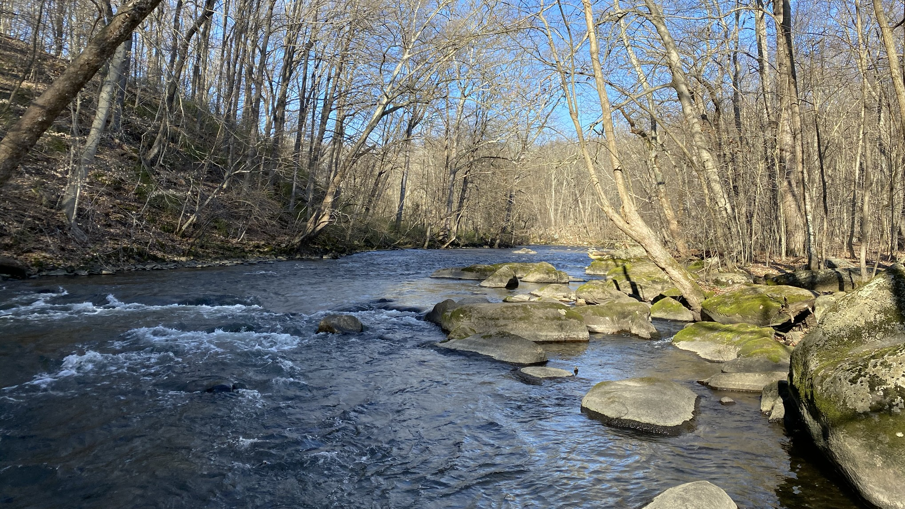
Musconetcong River, Point Mountain Reservation Lebanon Township, Hunterdon County
State Planning Commission
Wednesday, September 6, 2023
Notes:
Mikalea helped over the summer.
Photo library is ancient.
Photos very overused
Need more current stuff; more diverse stuff.
Need photos for insta, ppts, monthly report, etc.
Enlisting the help of staff.

Slide 2
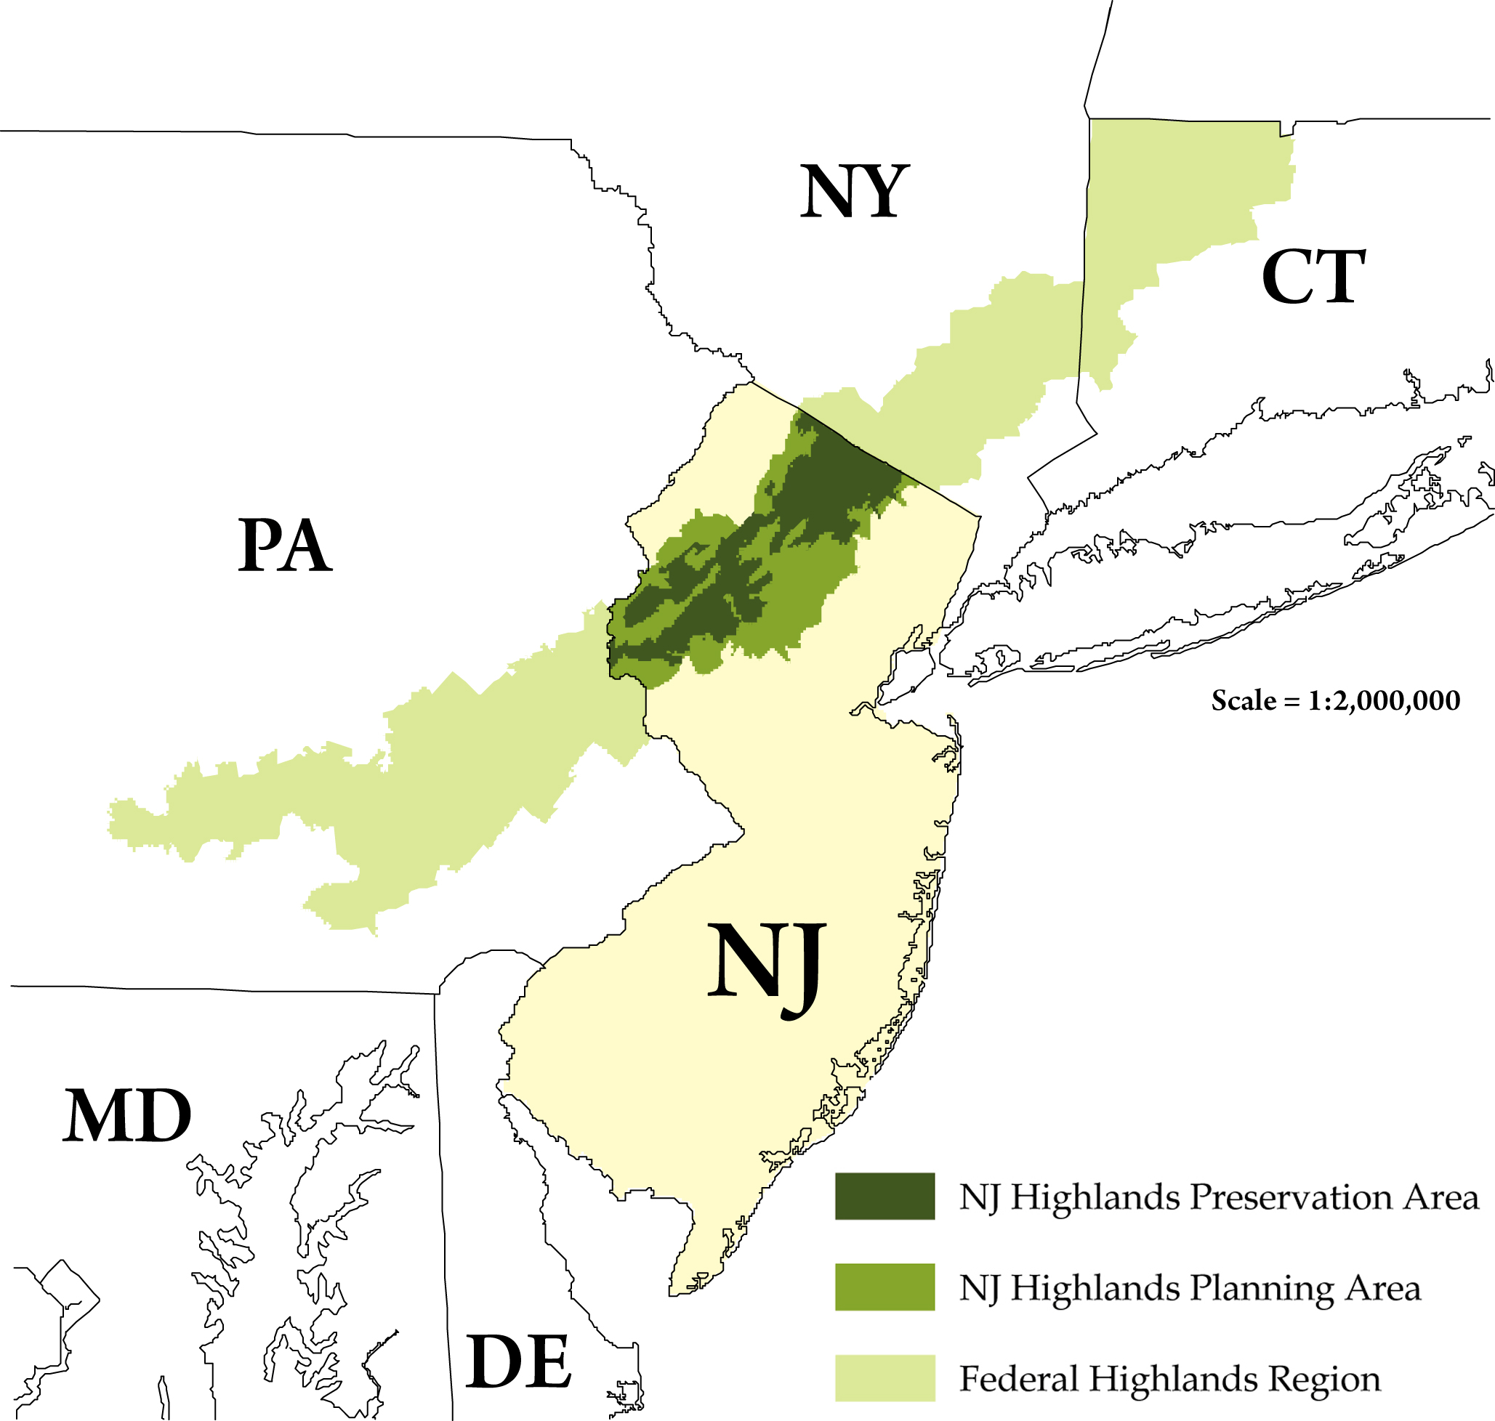
Federal Highlands Region
Pennsylvania, New Jersey, New York and Connecticut
Federal Highlands Conservation Act (2004)
“Preserve and protect” water, forest, agricultural, wildlife, recreational, and cultural resources

Slide 3
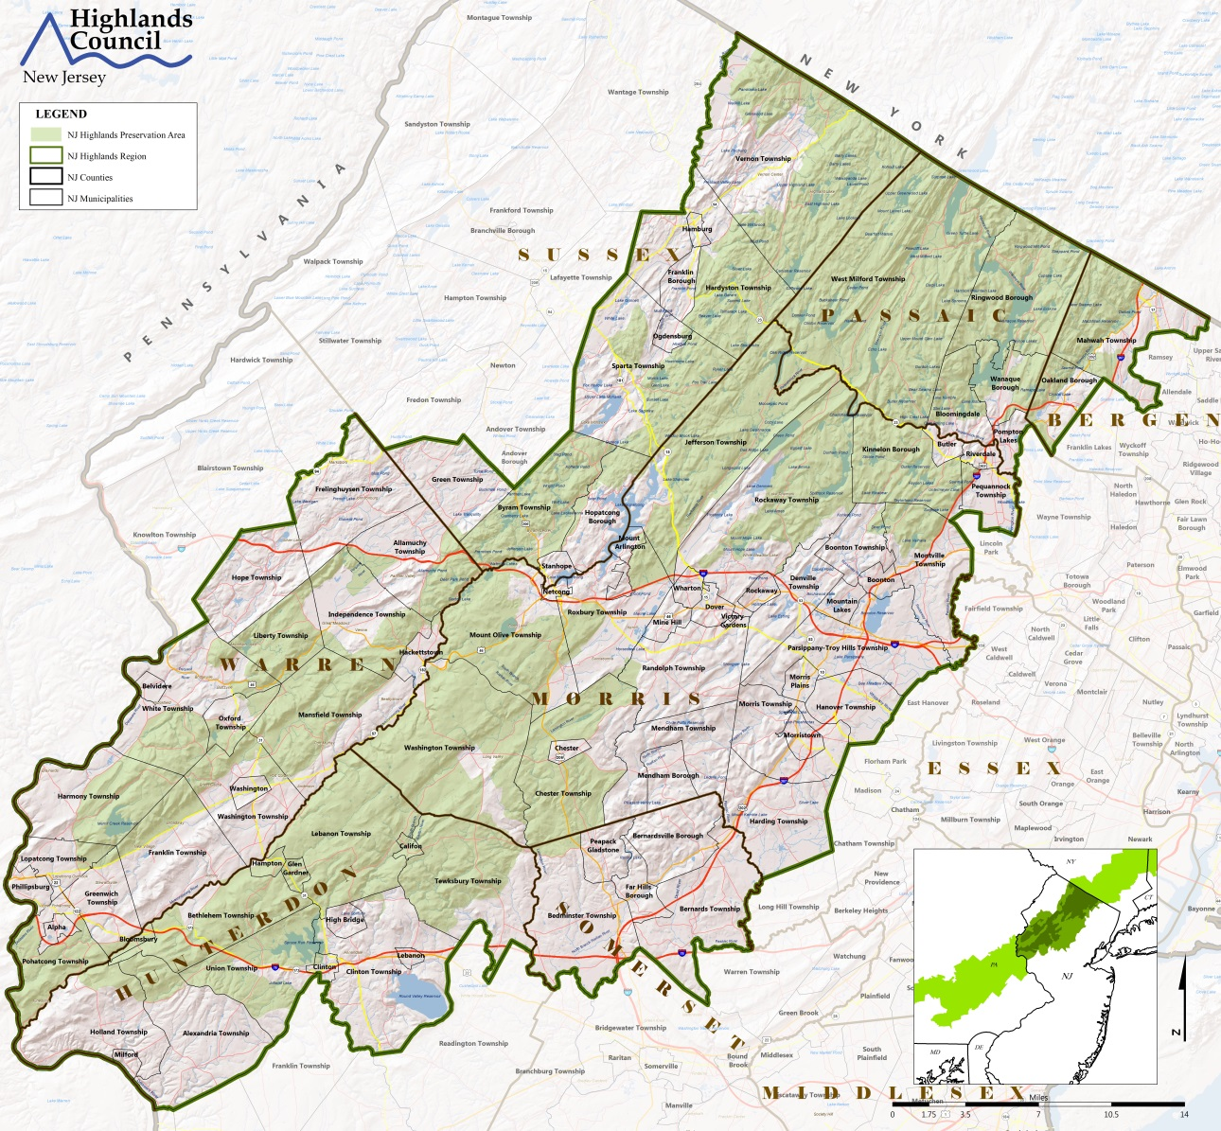
New Jersey Highlands Region
88 municipalities
7 counties
Divided into Preservation Area and Planning Area in the Highlands Act.

Slide 4
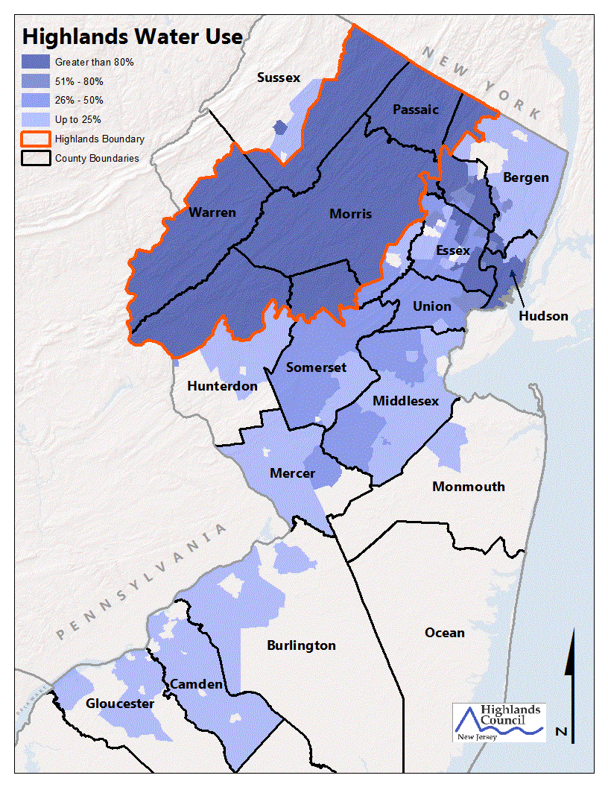
What are we protecting?
Drinking Water Supply for 70%+of NJ residents
Important Environmental Resources
Forests
Rivers, Streams & Wetlands
Natural Communities
Agricultural Lands
Rural Landscapes
Great Small Towns

Slide 5
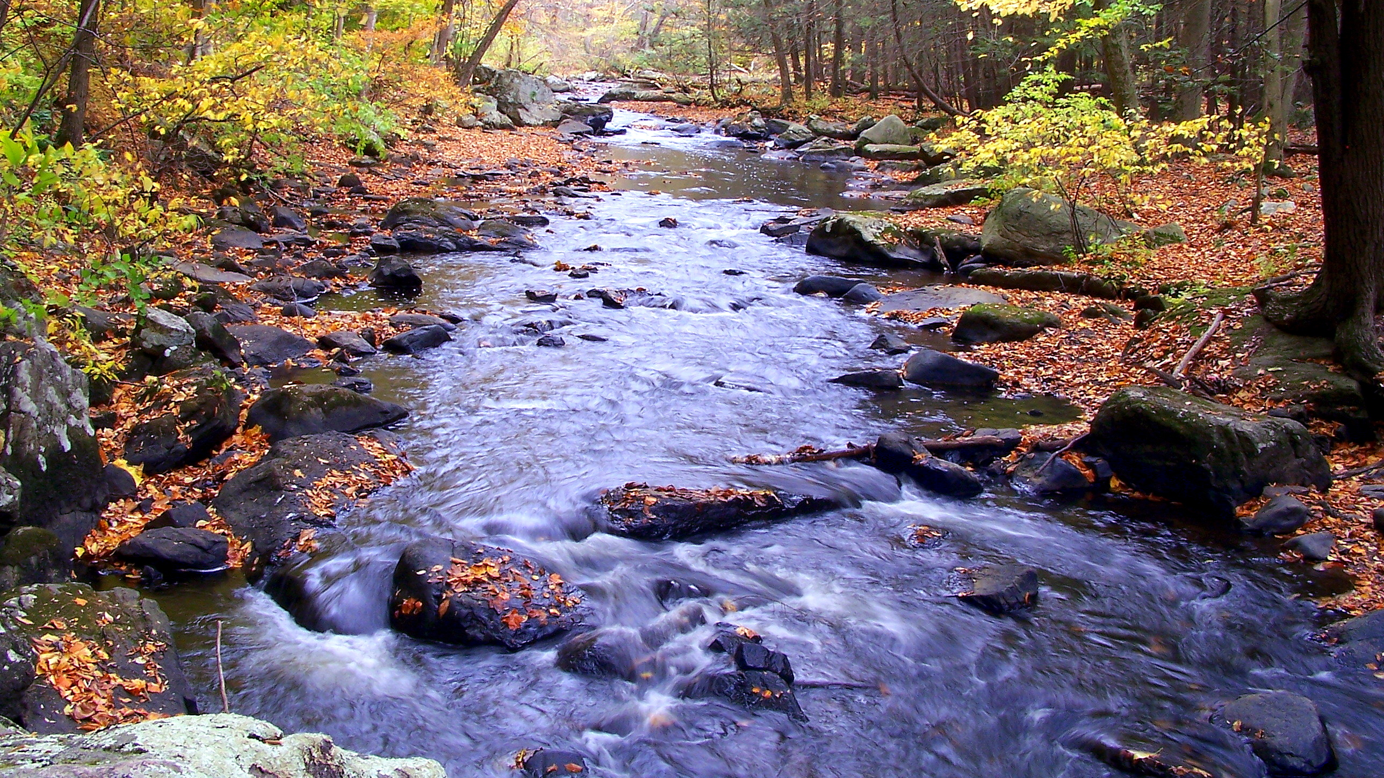
Foundations of the Highlands Act
The Legislature finds and declares…
That the New Jersey Highlands is an essential source of drinking water and contains other exceptional natural resources such as clean air, contiguous forest lands, wetlands, pristine watersheds, and habitat for fauna and flora, includes many sites of historic significance, and provides abundant recreational opportunities for the citizens of the State.

Slide 6
Lest we forget…
Overdevelopment was threatening:
Water supply
Natural habitats
Historic and cultural resources
…in 2000.

Slide 7
Highlands & The State Planning Commission
Highlands Region declared a Special Resource Area in the State Plan
Highlands Regional Master Plan (RMP) was endorsed by the State Planning Commission (SPC)
Highlands Centers are recognized by the SPC as “designated centers”
Municipalities with approved petition for RMP Conformance have the same status as municipalities achieving SPC endorsement.
Recent SPC Warehouse Guidelines refer to the Highlands RMP
Highlands Warehouse Guidelines build upon SPC Guidance

Slide 8
What does SPC Guidance say about the Highlands
The Highlands Region is at a critical crossroads for the location of warehousing, as three major interstate highways cross it: I-80, I-287, and I-78.
There likely are appropriate locations for warehousing in the Region
There are large areas of prime farmland at risk in the face of the demand for warehousing.
The RMP should guide any consideration of warehousing in the Highlands.

Slide 9
What is Protected
Water supply – primary objective
Important environmental resources
Prime agricultural soils
Outdoor recreational opportunities
Unique flora & fauna of the greater 4-state Highlands Region
Rivers, lakes & wetlands of the region
Economic, social and environmental future of the state
Assessment on a region-wide basis. Planning Area is NOT a growth area.

Slide 10
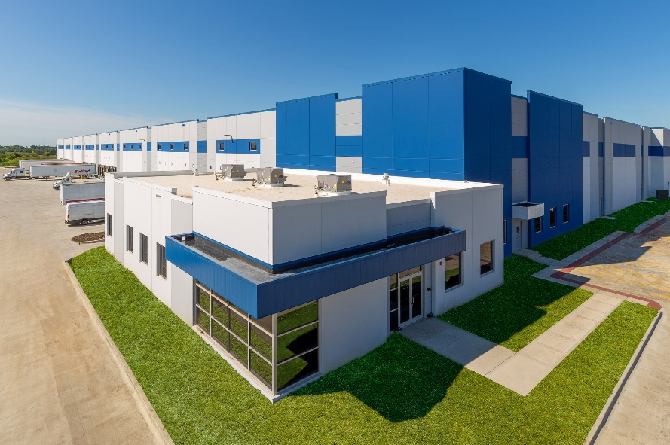
Region Remains Under Threat
Primarily farmland at risk
Large tracts of open space remain
Not all Highlands municipalities are planning appropriately
New & old threats to region
Warehousing
Solar projects
Climate change
Housing driven by pandemic demand

Slide 11
Long-Term Considerations
Highlands Act is a Forever measure
Not an unlimited growth area
Region has a finite capacity
Regional approach; not municipality-by-municipality
Warehouse siting and development must reflect protection of the region’s resources and sound planning
We cannot afford to get this wrong.

Slide 12
Highlands Guidance Policy Standards for Warehousing in the New Jersey Highlands Region
Interpretation of the RMP as it applies to warehouse siting and development
Designed to provide municipalities with appropriate standards for both land use planning and evaluation of applications
Guided by Highlands Act
Land Use Capability mapping and the goals and policies of the RMP
Straight-Forward Application of the basic planning principals required by the Highlands Act

Slide 13
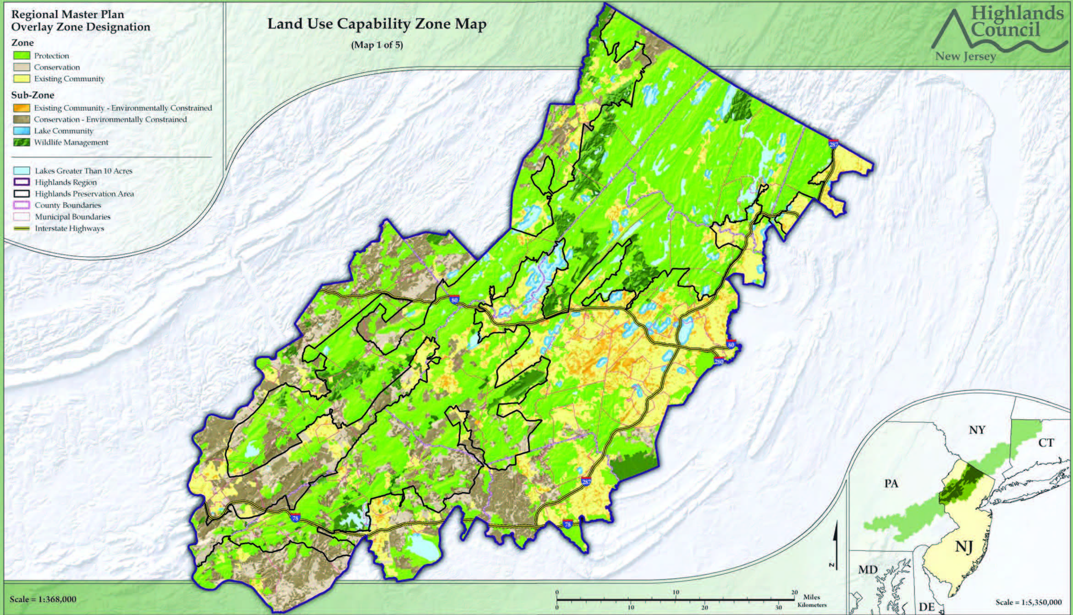

Slide 14
What does Highlands Guidance say?
The Highlands region is different from the rest of the state
Where warehouses should not go
Avoid the Conservation Zone and the Protection Zone
Minimize loss of farmland
Avoid environmental features/avoid Impact to Features
Do not go where infrastructure is limited or non-existent
Where warehouses should go
Approved Centers
Existing Community Zone
Geographic proximity to interstate highway interchanges
Access to other forms of goods movement (e.g. railroads)
Locations with adequate existing infrastructure

Slide 15
Important Considerations
Overall Impervious Coverage
Sub-Watershed Basis
Protect Integrity of Region’s Waterways
Traffic Analysis
Site Coverage/Clustering of Development
Utility Capacity
Carbonate Rock & Karst Topography
Landscaping & Buffers
Access to Site
Lighting
Stormwater Management
Air, Heat & Noise Impacts
Energy
Loading Requirements
Green Infrastructure
Building Standards
What Can be Stored (Hazardous Materials)
Truck Routing Plan
Decommissioning Plan

Slide 16
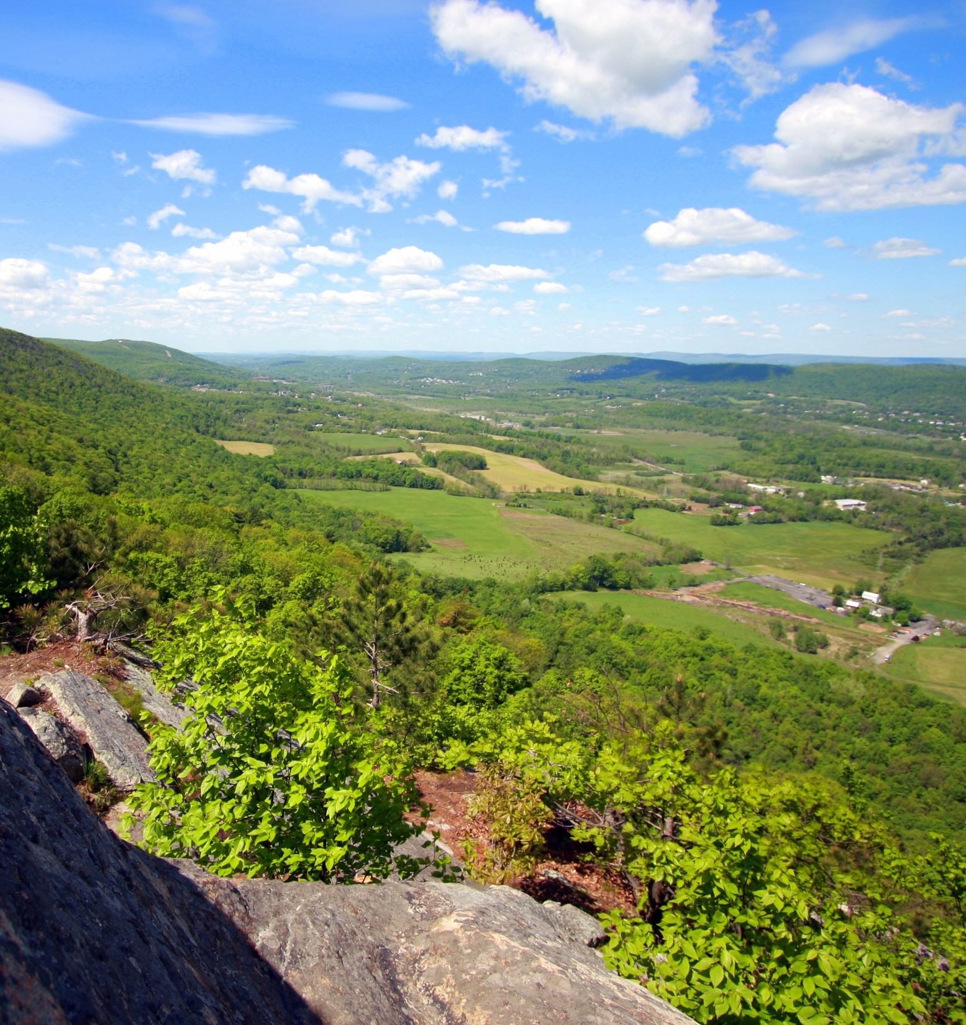
What else is on the horizon
Affordable Housing
Agricultural sustainability grants
Forestry standards for the Highlands
RMP update/ 20th Anniversary

Slide 17
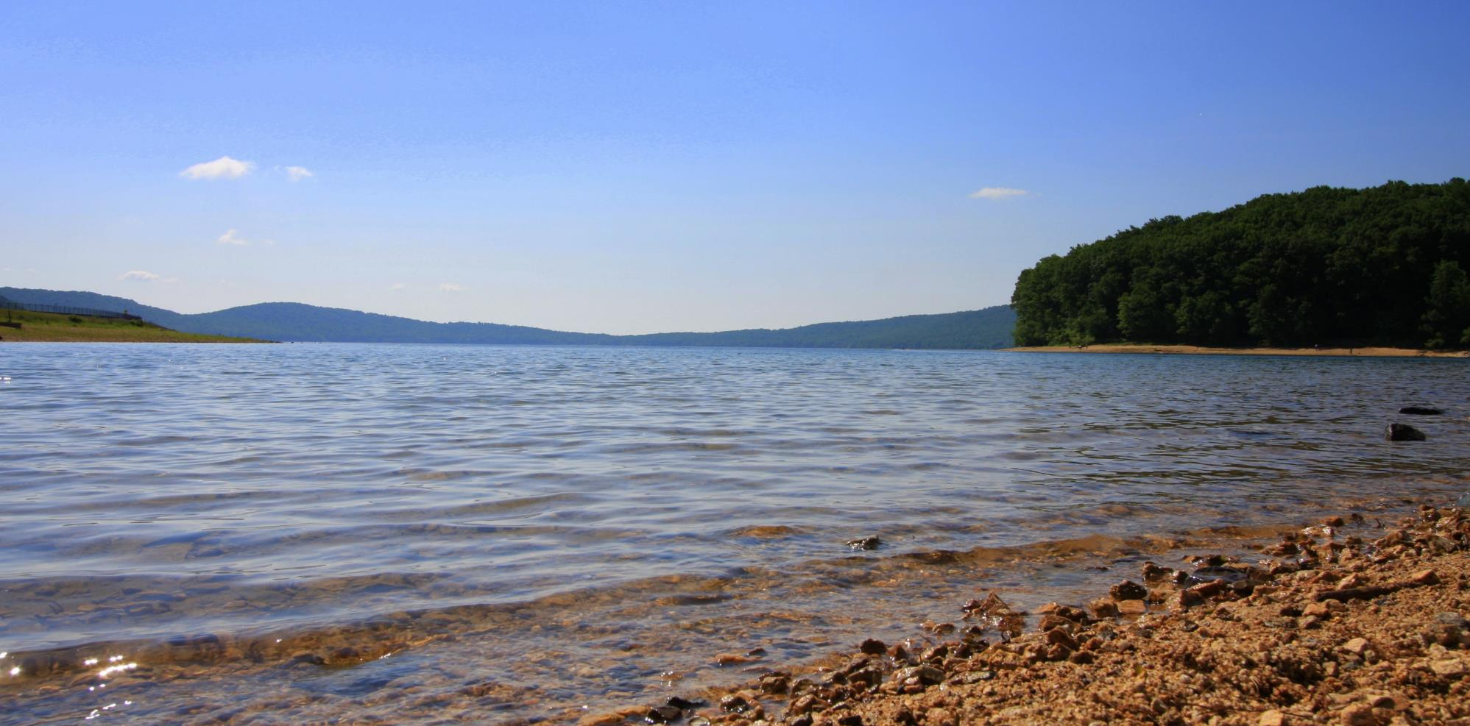
Questions?
Ben Spinelli Executive Director
ben.spinelli@highlands.nj.gov
www.nj.gov/njhighlands | 908.879.6737

