Slide 1


New Jersey Department of Transportation
TITLE VI NONDISCRIMINATION Requirements
County Engineers
Division Of Civil Rights& Affirmative Action
Anthony Davis, Manager, ADA & Title VI Nondiscrimination Program
2017
January 2016

Slide 2
Presentation Objectives
To Provide County Agencies a Short Background and History of Title VI/Nondiscrimination and Environmental Justice
To Assist County Agencies in developing Affirmative Action and Disadvantage Business Enterprise Plans to ensure nondiscrimination in their programs and activities.
Define County Agencies role in implementing Title VI Nondiscrimination within their Agencies
Provide Guidance to County Agencies on developing their Title VI Assurances Letters
Provide Guidance to County Agencies on developing ADA Self-Evaluations/Transition Plans
To advise you that we are in the process of developing a more comprehensive training for LPA’s at a later date.

Slide 3

What is Title VI?
Essence of the Federal Law:
Protections afforded under Title VI apply to anyone regardless of whether the individual is lawfully present in the United States, or a citizen of a state within the United States.
Includes all programs and activities of Federal-aid recipients and contractors.
“No person in the United States shall on the grounds of race, color, or national origin be excluded from participation in, be denied the benefits of, or be subjected to discrimination under any program or activity receiving Federal financial assistance.”

Slide 4
Definitions–Program, Activity & Financial Assistance
“Program or activity” is defined as:
A department, agency, special purpose district, or other instrumentality of a state or local government, or;
The entity of such state or local government that distributes such assistance and each department or agency (and each other state or local government entity) to which the assistance is extended…
“Financial assistance” means more than just money. It is also aid that enhances the ability to improve or expand allocation of a recipient’s own resources:
Use or rent of federal land or property
Training of employees
Loan of personnel
Tax incentives and tax exempt-status
Subsidies
Technical assistance
Other arrangements with the intention of providing assistance

Slide 5

Types of Discrimination
Intentional Discrimination/
Disparate Treatment
Unintentional Discrimination/
Disparate Impact
  Engaging in treating persons differently because of their race, color, national origin, sex, disability, or another protected basis.
  Does not require evidence of “bad faith, ill will or any evil motive.”
  Where direct evidence is unavailable, may be shown with demonstration that similarly situated persons received benefit or more favorable treatment.
  Use of neutral procedure/practice having a disproportionate impact on individuals of a particular race, color, national origin, sex, disability, or another protected class.

Slide 6
Title VI Prohibits
Denying an individual any service, financial aid, or other benefit because of race, color or national origin.
Providing a different service or benefit, or providing these in a different manner from those provided to others under the program.
Segregation or separate treatment in any manner related to receiving program services or benefits.
Requiring different standards or conditions as prerequisites for serving individuals.
Discriminatory activity in a facility built in whole or part with Federal funds.
Locating facilities in any way that would limit or impede access to a Federally funded service or benefit.

Slide 7
Title VI Requires
Notifying the respective population about applicable programs.
Information and services to be provided in languages other than English when significant numbers of beneficiaries are of limited English speaking ability.
Assurance of nondiscrimination in purchasing of services.
Title VI encourages
Participation of minorities as members of planning or advisory bodies for programs receiving federal funds.

Slide 8

Responsibilities at the County
Agency Level
  Maintain a signed Title VI Nondiscrimination Policy Statement
  Submit signed Standard Title VI Assurance that programs, activities, and facilities will be operated in a nondiscriminatory manner.
Develop EEO/Affirmative Action Program – how the LPA addresses recruiting, hiring and promoting females, minorities, disabled and veterans.
Develop DBE/Affirmative Action Program – how the LPA addresses recruiting Disadvantaged Business Enterprises for work as consultants, contractors, etc.
Extend subcontracting opportunities to Disadvantaged Business Enterprises (DBEs)
Disseminate Title VI information to your beneficiaries and stakeholders, including employees, subcontractors and the General public.
Ensure Title VI provisions are included in all contracts and subcontracts
Develop Title VI procedures to ensure nondiscrimination in all services, programs and activities, including involving persons of LEP, the public and other protected groups.

Slide 9

Title VI Nondiscrimination
Policy Statement
&
Standard Title VI Assurances

Slide 10
Title VI Nondiscrimination Policy Statement
  Title VI Nondiscrimination Policy Statement must:
    Indicate commitment to nondiscrimination in the LPA’s programs and activities administered by LPA, or your contractors, whether it is federally funded or not that:
    Be printed on Local Public Agency letterhead
    Signed by the appropriate authority
        “No person shall on the grounds of race, creed, color, national origin, age, ancestry, nationality, gender, disability, religion, affectional or sexual orientation, gender identity or expression, income level or ability to read, write or speak English be excluded from participation in, be denied the benefits of, or otherwise subjected to discrimination or retaliation under any program or activity… “

Slide 11

Example - NJDOT’s Title VI Nondiscrimination Policy Statement
Example
It is the policy of the New Jersey Department of Transportation to abide by Title VI of the Civil Rights Act of 1964, Executive Order 12898 for Environmental Justice, Executive Order 13166 for Limited English Proficiency, 23 U.S.C. Section 324, related statutes or Executive Orders, and N.J.A.C. 10:5-31 et seq., all together which provide in part, that:
No person in the United States shall, on the grounds of race, creed, color, national origin, age, ancestry, nationality, gender, disability, religion, affectional or sexual orientation, gender identity or expression, income level or ability to read, write or speak English, be excluded from participation in, be denied the benefits of, or otherwise subjected to discrimination in any program or activity which is administered by the Department, regardless of funding source (i.e. State, Federal Highway Administration, Federal Transit Administration, Federal Railroad Administration or Federal Aviation Administration).

Slide 12
Standard Title VI Assurance
Print on Local Public Agency letterhead
Page 1 of 4

Slide 13
Standard Title VI Assurance
Page 4 of 4

Slide 14
Standard Title VI Assurance -Appendix A
Applies to all federal aid contracts contracts)
    Prime contracts & subcontracts
    Vendor/supply agreements
    Consultant agreements for performance of work in connection with Federal-Aid contracts
    Research agreements with colleges, universities & other institutions
    Fee appraiser and fee attorney contracts in connection with federally-aided ROW work
    Contracts between NJDOT and a contractor for relocation of utilities, unless the utility company itself, or its contractor relocates utilities.

Slide 15
Standard Title VI Assurance – Appendix B
  Applies to conveyances of land or property to the State by the Federal government.
  Conditions the conveyance to require nondiscrimination in connection with the State’s use of the property

Slide 16
Standard Title VI Assurance – Appendix C
CLAUSES FOR TRANSFER OF REAL PROPERTY ACQUIRED OR IMPROVED UNDER THE ACTIVITY, FACILITY, OR PROGRAM

Slide 17
Standard Title VI Assurance – Appendix D
CLAUSES FOR CONSTRUCTION/USE/ACCESS TO REAL PROPERTY ACQUIRED UNDER THE ACTIVITY, FACILITY OR PROGRAM

Slide 18
Standard Title VI Assurance – Appendix E
(Must be physically included in all contracts)

Slide 19

Equal Employment Opportunity Program
EEO (AGENCY Internal)
EEO (AGENCY External)
CONSULTANT/CONTRACTOR
EXTERNAL EEO & Contractor DBE compliance
Deals with nondiscrimination in the hiring of internal employees
Title VII of Civil Rights Act
Deals with nondiscrimination in the procurement of contracts - the recruitment and hiring of female and minority contractors, consultants, etc.
Deals with nondiscrimination in the consultant/contractor’s internal workforce.
Deals with monitoring the contractor’s recruitment and hiring of females and minorities for work on construction contracts

Slide 20

EEO Program Components
Designation of Personnel Responsibility
Statement of Policy
Dissemination of Policy
Assessment of Employment Practices
Utilization Analysis
Goals and Timetables
Monitoring and Reporting

Slide 21
Statement of Policy
In writing, and must include:
A statement issued by the CEO regarding the Agency’s EEO policy affecting all employment practices, including recruitment, selection, promotions, terminations, transfers, layoffs, compensation, training, benefits, and other terms and conditions of employment;
Commitment to EEO for all persons regardless of race, color, creed, national origin, sex , age and disability;
Commitment to undertake an affirmative action program, including goals and timetables to overcome effects of past discrimination on minorities and women;
Responsibility for implementation is assigned to an agency executive, and include the name and contact of such person;
All management personnel share in the responsibility and will be assigned specific tasks to ensure compliance is achieved;

Slide 22
Statement of Policy
In writing, and must include:
Applicants and employees have the right to file complaints alleging discrimination with the appropriate official;
Performance by managers, supervisors, etc. will be evaluated on the success of the EEO program the same way as their performance on other agency’s goals;
Successful achievement of EEO goals will provide benefits to the recipient/sub-recipient/contractor through fuller utilization and development of previously underutilized human resources

Slide 23

Dissemination of Policy - Internally
How does the agency publicize and distribute the policy?
Managers and Supervisors
Non-supervisory staff
Informed via:
  Written communication from CEO
  Inclusion of the policy in the personnel and operations manual
  Meetings held with managers and supervisors to discuss EEO Program and its implementation
Informed via:
  Post EEO policy posters and statement on bulletin boards, near time clocks, cafeteria, employment/personnel office
  Include policy in employee handbooks, reports, manuals, union contracts
  Meet with minority and female employees for suggestions about the program
  Present EEO program during employee orientation and training programs

Slide 24

Dissemination of Policy - Externally
Distribute to regular recruitment sources:
  Employment agencies; unions, hiring halls, educational institutions, minority, disabled and women’s organizations, civil rights organizations, trade unions, training organizations, and others who refers applicants.
  Public Media sources; radio, television stations, newspapers, magazines, journals.
  All advertisements and vacancy announcements should include a statement that the sub-recipient is an “Equal Employment Opportunity Employer”

Slide 25

Employment Practices
Identify the practices that may operate as employment barriers
Detailed narrative and statistical data and analysis reviews on:
  Application procedures
  Types of Disciplinary Actions
  Promotion procedures
  Training opportunities
  Testing programs
Include Statistical Data on:
  Number of individuals by race and sex who:
    Applied for employment
    Actually hired
    applied for promotion or transfer
    actually promoted or transferred
    Number and types of disciplinary actions, resignations, suspensions, grade changes, reassignments and terminations

Slide 26

Employment Practices
    Additional areas to discuss:
Recruitment process | Positions descriptions
Selection standards & procedures | Interview procedures
Wage & salary structure | Seniority practices
Layoff, termination, disciplinary actions, transfers | Assess if there are external factors like potential applicants not knowing where to apply for jobs.

Slide 27
Workforce Analysis
Statistical breakdown of workforce by each department, job category, grade/rank of employee and job title.
Cross reference each by race/national origin and gender
Include principal rates of pay for each category, grade/rank of employee, and job title for each employee

Slide 28
Workforce Analysis Worksheet
A. SPONSOR INFORMATION B. OCCUPATIONAL INFORMATION
C. LABOR MARKET AREA & OCCUPATIONAL PARTICIPATION DATA:
Program Number:
Name of Sponsor:
Address:
City/State/Zip Code:
Contact Person:
Phone Numer: FAX Number:
Email Address:
Occupational Title:
RAPIDS Code: O*NET/SOC Code:
Type of selection method used:
Labor Market Area description:
C.1 Total Labor Force in Labor Market Area
Number of Women: | % of labor force
Number of Minorities: | % of labor force
C.2 Working Age Population in Labor Market Area
Number of Women: | % of labor force
Number of Minorities: | % of labor force
C.3 Apprentice Participation in Craft/Occupation in National Apprenticeship System
Number of Women: | % of labor force
Number of Minorities: | % of labor force
C.4 The General Availability of Minorities and Women with the Present or Potential Capacity for Apprenticeship in Program Sponsor’s Labor Market Area
Number of Women:
Number of Minorities:

Slide 29
Availability Analysis
Availability of minorities and women in the relevant labor market broken down by job category.

Slide 30
EEO-ALL01R-Geography-United StatesEstimate-Estimate: EEO 1r. Detailed Census Occupation by Sex and Race/Ethnicity for Residence Geography - Universe: Civilian labor force 16 years and over
EEO Tabulation 2006-2010 (5-year ACS data)
Occupation Code |  | Subject |  | Total, race and ethnicity |  | Hispanic or Latino |  | Not Hispanic or Latino, one race |  |  |  |  | Not Hispanic or Latino, two or more races |  |  |  |  |  |  | Balance of not Hispanic or Latino
 |  |  |  |  |  | White alone Hispanic or Latino | All other Hispanic or Latino | White alone | Black or African American alone | American Indian and Alaska Native alone | Asian alone | Native Hawaiian and Other Pacific Islander alone | White and Black | White and AIAN | White and Asian | Black and AIAN | NHPI and White (Hawaii only) | NHPI and Asian (Hawaii only) | NHPI and Asian and White (Hawaii only)
Total, all occupations |  | Total, both sexes
Total, all occupations |  | Number |  | 154,037,475 |  | 13,249,225 | 9,207,885 | 103,278,405 | 17,469,155 | 894,065 | 7,426,010 | 234,435 | 330,745 | 633,080 | 416,890 | 116,805 | (X) | (X) | (X) | 780,775
Total, all occupations |  | Percent |  | 100.0% |  | 8.6% | 6.0% | 67.0% | 11.3% | 0.6% | 4.8% | 0.2% | 0.2% | 0.4% | 0.3% | 0.1% | (X) | (X) | (X) | 0.5%
Total, all occupations |  | Male
Total, all occupations |  | Number |  | 81,323,085 |  | 7,569,470 | 5,308,805 | 54,794,265 | 8,050,065 | 448,660 | 3,877,925 | 123,255 | 157,770 | 328,910 | 209,525 | 51,985 | (X) | (X) | (X) | 402,450
Total, all occupations |  | Percent |  | 52.8% |  | 4.9% | 3.4% | 35.6% | 5.2% | 0.3% | 2.5% | 0.1% | 0.1% | 0.2% | 0.1% | 0.0% | (X) | (X) | (X) | 0.3%
Total, all occupations |  | Female
Total, all occupations |  | Number |  | 72,714,390 |  | 5,679,755 | 3,899,080 | 48,484,140 | 9,419,090 | 445,405 | 3,548,085 | 111,180 | 172,975 | 304,170 | 207,365 | 64,820 | (X) | (X) | (X) | 378,320
Total, all occupations |  | Percent |  | 47.2% |  | 3.7% | 2.5% | 31.5% | 6.1% | 0.3% | 2.3% | 0.1% | 0.1% | 0.2% | 0.1% | 0.0% | (X) | (X) | (X) | 0.2%
Chief executives and legislators 0010 (SOC 11-10XX) |  | Total, both sexes
Chief executives and legislators 0010 (SOC 11-10XX) |  | Number |  | 1,158,885 |  | 39,090 | 13,230 | 1,001,235 | 38,695 | 4,825 | 50,490 | 465 | 1,020 | 3,740 | 2,265 | 330 | (X) | (X) | (X) | 3,510
Chief executives and legislators 0010 (SOC 11-10XX) |  | Percent |  | 100.0% |  | 3.4% | 1.1% | 86.4% | 3.3% | 0.4% | 4.4% | 0.0% | 0.1% | 0.3% | 0.2% | 0.0% | (X) | (X) | (X) | 0.3%
Chief executives and legislators 0010 (SOC 11-10XX) |  | Male
Chief executives and legislators 0010 (SOC 11-10XX) |  | Number |  | 901,735 |  | 28,800 | 10,060 | 787,200 | 24,900 | 3,135 | 39,390 | 275 | 785 | 2,745 | 1,570 | 190 | (X) | (X) | (X) | 2,685
Chief executives and legislators 0010 (SOC 11-10XX) |  | Percent |  | 77.8% |  | 2.5% | 0.9% | 67.9% | 2.1% | 0.3% | 3.4% | 0.0% | 0.1% | 0.2% | 0.1% | 0.0% | (X) | (X) | (X) | 0.2%
Chief executives and legislators 0010 (SOC 11-10XX) |  | Female
Chief executives and legislators 0010 (SOC 11-10XX) |  | Number |  | 257,150 |  | 10,290 | 3,170 | 214,035 | 13,790 | 1,690 | 11,100 | 185 | 235 | 995 | 695 | 140 | (X) | (X) | (X) | 825
Chief executives and legislators 0010 (SOC 11-10XX) |  | Percent |  | 22.2% |  | 0.9% | 0.3% | 18.5% | 1.2% | 0.1% | 1.0% | 0.0% | 0.0% | 0.1% | 0.1% | 0.0% | (X) | (X) | (X) | 0.1%

Slide 31

Utilization Analysis
Comparison of the participation rate of minorities and women by job category (Workforce Analysis) with their availability in the relevant labor market (Utilization Analysis).
For each job category, the Utilization Analysis will indicate whether minorities and women are fully utilized or underutilized.

Slide 32
Step 1
Enter organization information.
Enter a title for your report:
Enter the job group being analyzed:
Step 2
Total number of employees in this job group:
Total number of Female employees in this job group:
Enter Number of Employees.
Total number of Minority employees in this job group:
Total number of Older employees in this job group: Total number of Disabled employees in this job group:
Step 3
Enter Number of People in the Civilian Labor Foce
and/or their Availability.
Number
Availability
Total
Female
%
Minority
%
Older
%
Disabled
%
Step 4
Select reporting options and press 'Compute' button.
Display: Description of Statistic Interpretation of Results

Slide 33

Goals and Timetables
Goals and Timetables must be established for any job category for which the Utilization Analysis indicated that minorities or women are underutilized.
The Plan must set specific, measurable, attainable hiring and promotion goals with target dates for each job category in which women or minorities were found to be underutilized. Each goal should be realistic and attainable.
Develop and execute action-oriented programs designed to attain goals and to eliminate any systemic barriers to maintaining a diverse and inclusive workforce.
Design and implement a means for monitoring progress toward attaining goals, such as an internal audit and reporting systems to measure the effectiveness of the total program.
If you are updating a prior affirmative action plan, and previously established goals and timetables were not met, you are to provide a justification (for instance, anticipated job openings may not have materialized or the applicant pool may not have yielded qualified female or minority candidates for positions that were open

Slide 34

Monitoring and Reporting
Purpose
  Provide feedback on program progress
  Identify problems that call for corrective action on your part
  How are you monitoring your program
Keep cumulative records on hiring, training, transfer and promotions in areas of under participation and prepare quarterly summaries.
Formal periodic reports are collected from supervisory personnel.
Discuss your mechanisms for tracking EEO complaints.
How are you monitoring your subs’ compliance?
    Who is reporting to you; how often; what are they reporting.
    Who are you reporting to; what are you reporting; how often.

Slide 35
DBE Affirmative Action Program
Deals with nondiscrimination in the procurement of contracts - the recruitment and hiring of female and minority contractors, consultants, etc.
DBE Affirmative Action Plan should include:
Designation of Personnel Responsibility
Statement of Policy on how LPA will seek out and utilize DBEs as consultants, prime contractors, suppliers, etc. in the procurement of contracts
Dissemination of Policy
Implementation of the DBE Program
Monitoring & Reporting
  DBE Consultants, Prime Contractors, Subcontractors, Suppliers, etc.

Slide 36
EEO & DBE Affirmative Action Submission Requirements
For all Local Public Agencies:
Local Public agencies (LPAs), grantees, etc. are required to annually submit the following for review and approval to the Division of Civil Rights – Title VI Unit:
Equal Employment Opportunity (EEO) /Affirmative Action Plan
EEO Policy Statement
Sexual Harassment Policy
Document designating LPAs EEO Officer, including name, address & telephone number of the Officer)
D/E/SBE Affirmative Action Plan (explanation of affirmative action methods used in seeking out DBE’s/ESBEs/SBEs during procurement process, ie: as consultants, etc.)
LPA’s Agency EEO/AA plan packages should be submitted directly to:
  New Jersey Department of Transportation
  Division of Civil Rights & Affirmative Action – Title VI Unit
  P.O. Box 600
  Trenton, New Jersey 08625-0600
  The Division of Civil Rights & Affirmative Action has sole authority to review and approve all EEO/AA Plans. Once a plan is approved, the DCR will issue an approval letter.
Notes:
Professional service firms, construction contractors, subcontractors with subcontracts over $10,000 on Federal projects & 2,500 on State projects, truckers/haulers and ?? Research institutions?? doing business with the NJDOT are required on an annual basis to submit a copy of their company’s EEO Affirmative Action Plan Package to NJDOT’s Division of Civil Rights & Affirmative Action – Contractor Compliance Unit for review and approval.
The EEO/AA Plan package submission should include:
EEO/AA Plan
EEO Policy Statement
Sexual Harassment Policy
Document designating EEO Officer, including contact information
D/ESBE AA

Slide 37
EEO & DBE Affirmative Action Submission Requirements
For all CONSTRUCTION CONTRACTS:
Sub-recipients (Contractors, subcontractors and professional service firms) working on NJDOT construction contracts are required to annually submit the following for review and approval to the Division of Civil Rights – Contract Compliance Unit:
Equal Employment Opportunity (EEO) /Affirmative Action Plan
EEO Policy Statement
Sexual Harassment Policy
Document designating company’s Corporate EEO Officer, including name, address & telephone number of the Officer)
D/E/SBE Affirmative Action Plan (explanation of affirmative action methods used in seeking out DBEs/ESBEs/SBEs as subcontractors, material suppliers or equipment-lessors for construction contracts.)
EEO/AA plan packages ONLY related to construction contracts should be submitted to:
  New Jersey Department of Transportation
  Division of Civil Rights & Affirmative Action - Contract Compliance Unit
  P.O. Box 600
  Trenton, New Jersey 08625-0600
Notes:
Professional service firms, construction contractors, subcontractors with subcontracts over $10,000 on Federal projects & 2,500 on State projects, truckers/haulers and ?? Research institutions?? doing business with the NJDOT are required on an annual basis to submit a copy of their company’s EEO Affirmative Action Plan Package to NJDOT’s Division of Civil Rights & Affirmative Action – Contractor Compliance Unit for review and approval.
The EEO/AA Plan package submission should include:
EEO/AA Plan
EEO Policy Statement
Sexual Harassment Policy
Document designating EEO Officer, including contact information
D/ESBE AA

Slide 38
How to Develop an ADA Self-Evaluation & Transition Plan
Chrystal Section
NJDOT
ADA Coordinator

Slide 39
Title II- State and Local Governments
Basic Requirements:
Must ensure that individuals with disabilities are not excluded from programs, services and activities (pedestrian facilities are an example of a program)

Slide 40
Title II- State and Local Governments
Basic Requirements:
Designate an ADA Coordinator
Development & postings of an ADA Policy Statement
Development & postings of Grievance/Complaint Procedures
Complete a Self-Evaluation
Development of a Transition Plan

Slide 41
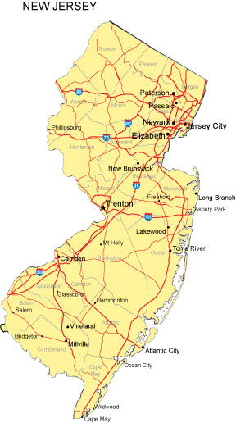
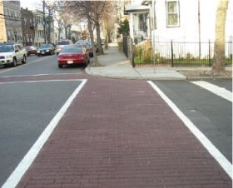

Court Cases
ADA has impacted case law that significantly shapes budgets, alterations and how improvement contracts are structured.

Slide 42
Court Cases
Major cases to be aware of
  Kinney v. Yerusalim (1993)
  Barden v. Sacramento (2004)
  CDR v. Chicago (2007)
  CDR v. Caltrans (2008)
  CDR v. Caltrans (2009 settlement agreement
  Bottom Line: This could cost your county real money if you get hit with one of these lawsuits!

Slide 43


Self-Evaluation
Required of all entities
  Rehabilitation Act of 1973
    USDOT Implementing Regulations (49 CFR 27)
  Americans w/Disabilities Act of 1990
    DOJ Implementing Regulations (28 CFR 35)

Slide 44
Self-Evaluation
Purpose & Scope
  Identify barriers in programs & activities that prevents persons with disabilities from access (includes evaluation of policies/practices)
  Key – provide equivalent access to the maximum extent feasible

Slide 45
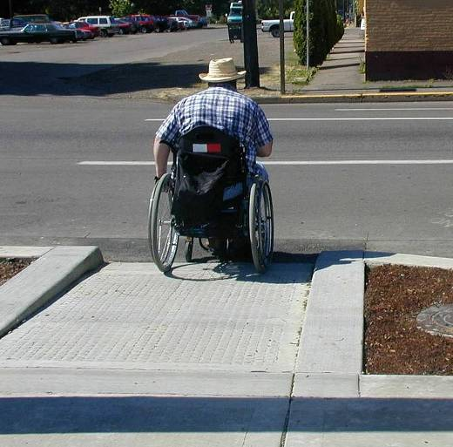
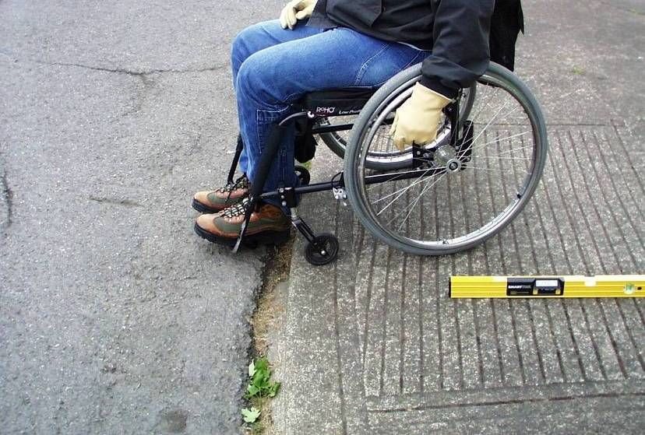
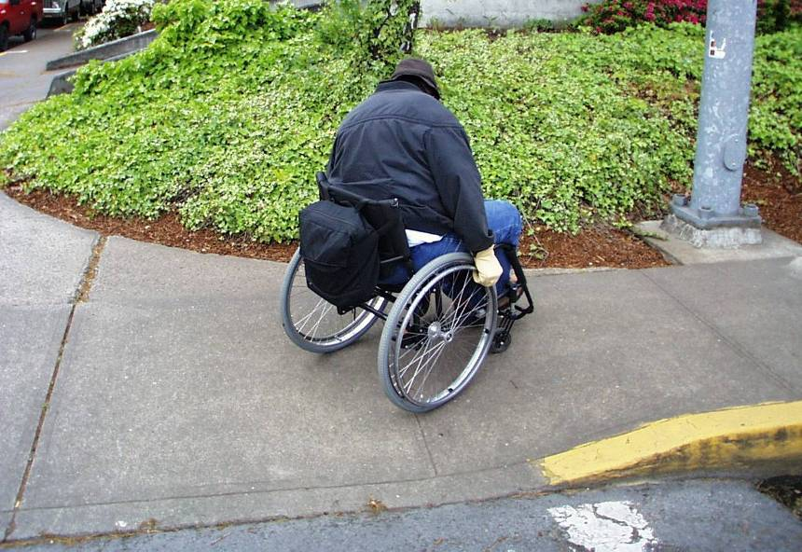
Self-Evaluation Barriers
Curbs/Slopes

Slide 46
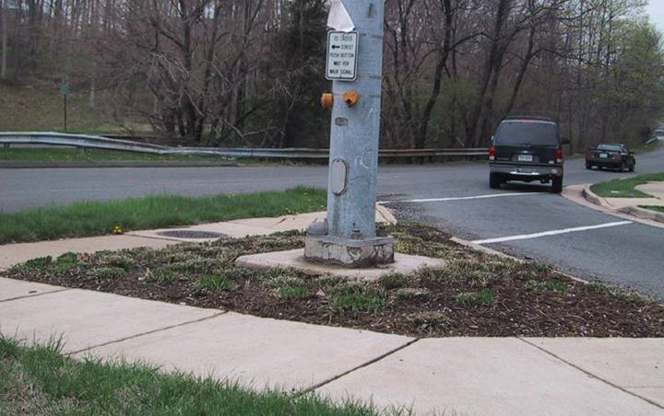

Self-Evaluation Barriers
Communication Devices

Slide 47
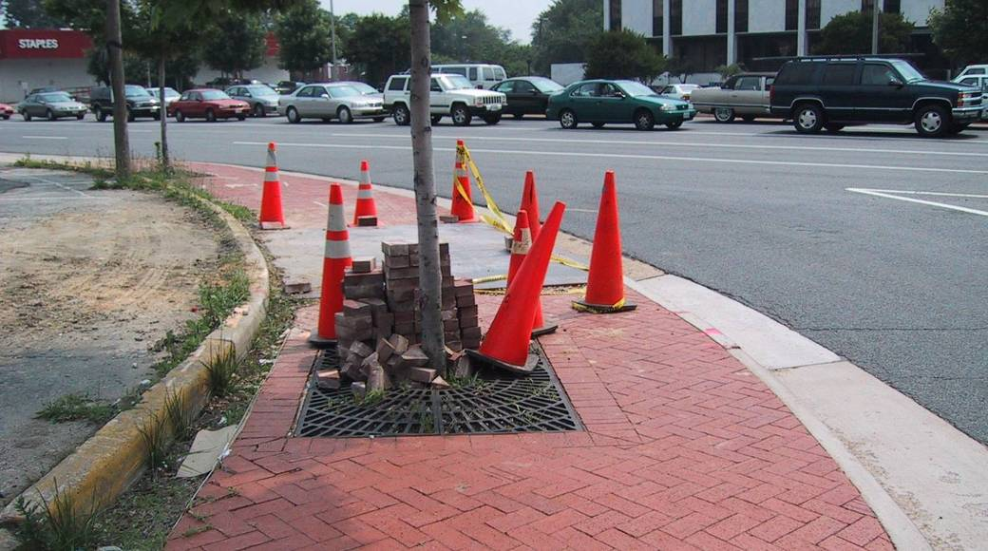
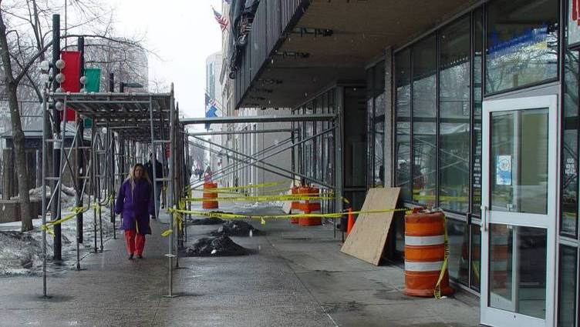
Self-Evaluation Barriers
Construction Work Zones

Slide 48
Self-Evaluation
Identifying Barriers within public right-of-way
  Curbs
  Sidewalks
  Pedestrian Crossings
  Pedestrian Signals
  Shared Use Trails
  Parking Lots
  Bus Stops

Slide 49
Self-Evaluation
Developing the Evaluation
  Agency commitment
    Funding
    Staff resources (i.e., survey/maintenance staff, interns) or contract with knowledgeable consultants

Slide 50
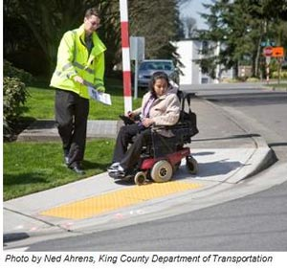

Self-Evaluation
Methods
  Field inspections/surveys (form/checklist)
  GIS (recording locations/measurements)

Slide 51
Self-Evaluation
Critical Areas to Evaluate
  Public right-of-way accessing government offices, medical facilities, downtown core areas, school zones, residential areas, et al
  Rest Areas, parks, shared use trails
  Access to public buildings (permit/licensing offices, public meeting rooms, etc.)

Slide 52
Self-Evaluation
End Result
  Inventory (and details) of facilities where structural modifications are needed to make facilities accessible to persons with disabilities
  Foundation for Transition Plan
  Maintain in file/available for public inspection for 3 yrs from date of completion

Slide 53

Transition Plan
Required by Rehabilitation Act and the ADA
  50 plus employees (entire agency)
  Public input

Slide 54
Transition Plan
Purpose & Scope
  Set forth steps necessary to complete modifications identified through self-evaluation (those areas not covered in a previously developed plan)
  Provide a schedule for completing modifications

Slide 55
Transition Plan
Content (at a minimum)
  Identify physical obstacles and location
  Describe the methods to make facilities accessible
  Specify the schedule for achieving completion (if longer than 1 year, identify steps to be taken each year but as expeditiously as possible)

Slide 56
Transition Plan
Content (cont.)
  Identify official responsible for implementation of plan
  Estimated Cost of each modification
  Status column to record completion date

Slide 57
Transition Plan
Important things to remember
  Prioritize modifications (using same criteria as self-evaluation)
  Coordinate/integrate schedule of modifications with planned alterations (paving, building, utility work)
  Inform/educate persons with authority over budget/prioritizing projects

Slide 58
Transition Plan
Important things to remember
  Transition Plan is a living document – evolving planning & monitoring tool
  As boundaries grow, so does the need to incorporate acquired facilities into Self-Evaluation/Transition Plan process
  Special Requests/Complaints & Transition Plan schedule

Slide 59
ADA Links
NJDOT Americans with Disabilities/Section 504 Overview – Self Evaluation and Transition Plans http://www.state.nj.us/transportation/business/ada/
FHWA Questions and Answers about ADA/Section 504
http://www.fhwa.dot.gov/civilrights/programs/ada.cfm
US Access Board-
http://www.access-board.gov/guidelines-and-standards/streets-sidewalks
http://www.access-board.gov/guidelines-and-standards/streets-sidewalks/public-rights-of-way/guidance-and-research
USDOJ/USDOT ADA Standards -
http://www.access-board.gov/guidelines-and-standards/buildings-and-sites/about-the-ada-standards/ada-standards

Slide 60

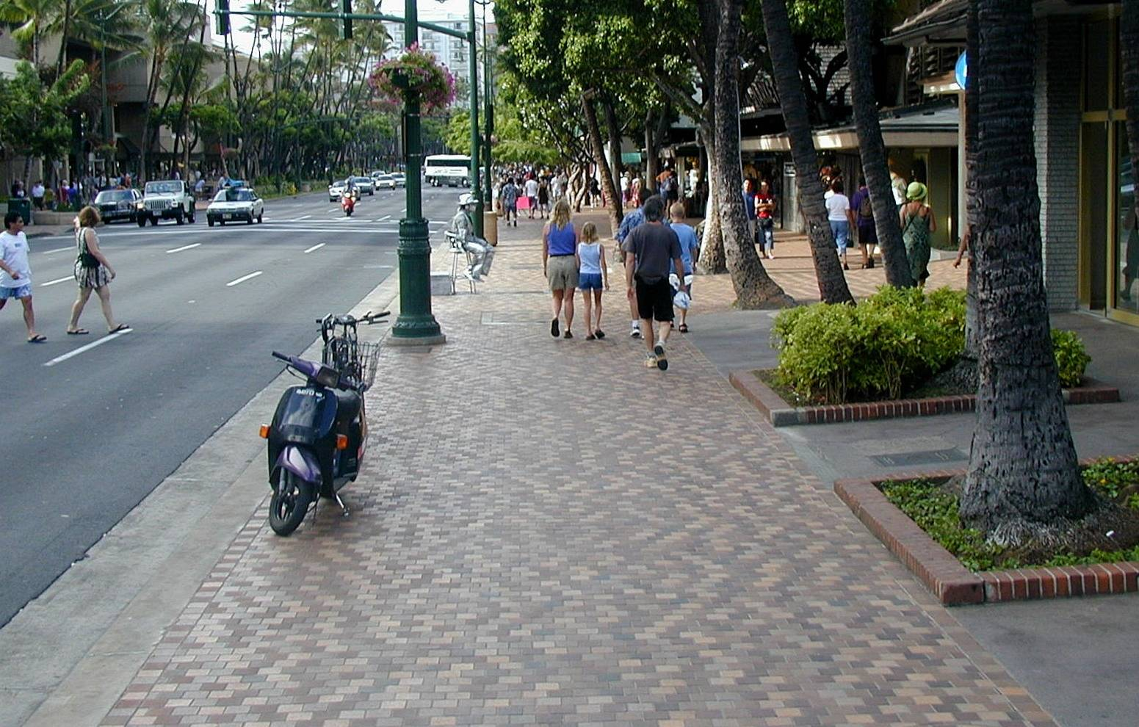
Questions?

Slide 61
Title VI Contact Information
New Jersey Department of Transportation
Division of Civil Rights and Affirmative Action - Title VI Unit
PO Box 600
Trenton, NJ -08625-0600
TitleVI@dot.nj.gov
Tony Davis
Manager, Title VI and ADA Unit
(609)530-2893
Anthony.Davis@dot.nj.gov
Chrystal Section
External ADA Coordinator
(609)530-2893
Chrystal.Section@dot.nj.gov
Shivani Patel
Affirmative Action Specialist
(609)530-2336
Shivani.Patel@dot.nj.gov

