Slide 1
What is the Status of my Action?
The Certification of Funds (COF) Log, located on the NJDOT Intranet, will provide you with information on the status of your action.

Slide 2
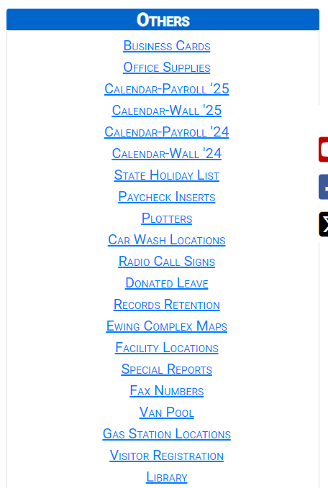
How to Access the COF Log
Access the NJDOT Intranet via http://njdotintranet.njdot.lan/
On the right-hand side, scroll down and locate the Others category and click Special Reports.

Slide 3
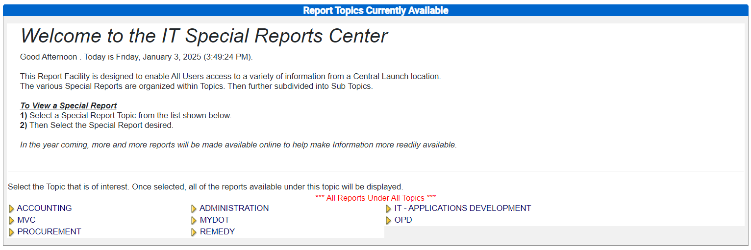
How to Access the COF Log (cont’d)
Under the IT Special Reports Center, select Accounting:

Slide 4
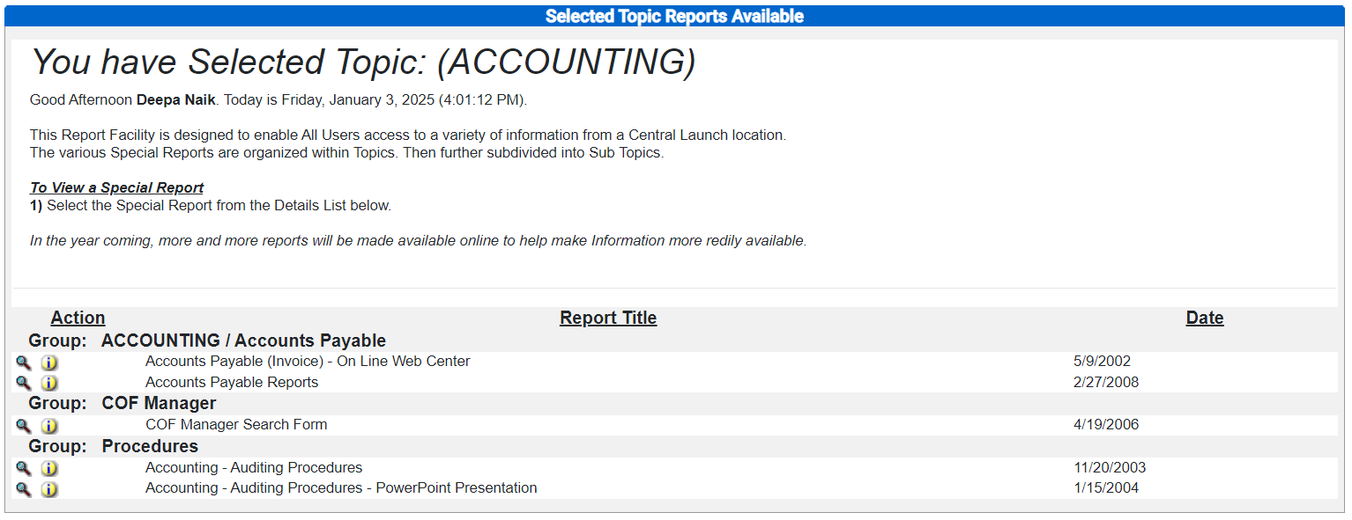
How to Access the COF Log (cont’d)
Click on the magnifying glass next to COF Manager Search Form:

Slide 5
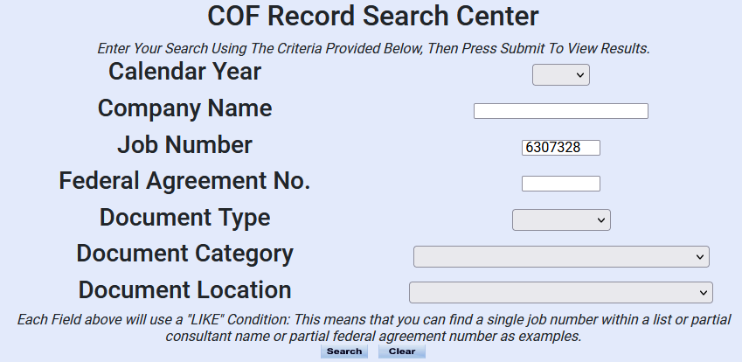
How to Look Up an Action in the COF Log
Select the blank space under Calendar Year.
Enter the Job Number.
Click Search.

Slide 6
How to Look Up an Action in the COF Log (cont’d)
Click on the magnifying glass next to the record of interest:

Slide 7
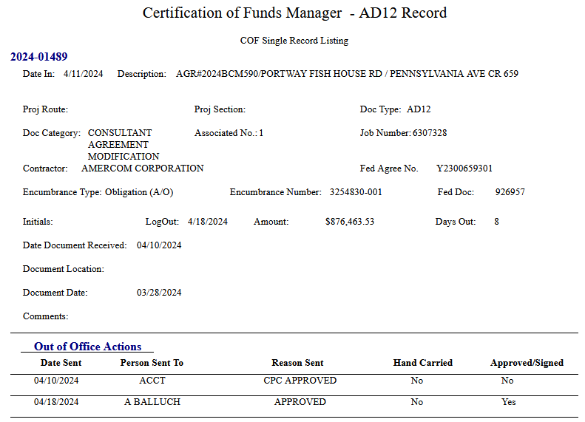
How to Interpret the Record
2024-01489 represents the Control Number.
If the “Date In” is blank, then Accounting has not received the action.
Associated Number is the Change Order # or CAA/CAM #.
This CAM was originally keyed and approved by CPC on 4/10/2024. It was then sent to Agreement Accounting the same day. Accounting processed and approved the CAM, sending it to Al Balluch on 4/18/2024.

