Slide 1
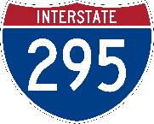
Redesignation of I-95 and I-295

Slide 2
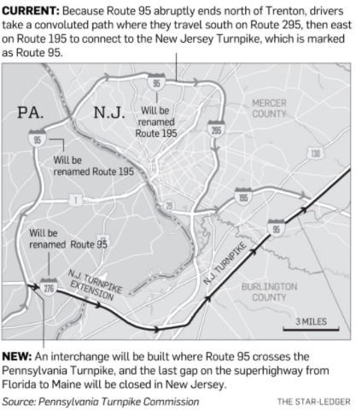
Current I-95 and I-295 Designation
I-95 spans from PA/NJ state line to Route 1 interchange
Current gap results in I-95 motorists traveling on I-295 and I-195
I-95 continues on NJ Turnpike from I-195 interchange to NJ/NY state line
295
295
Current I-95 Route

Slide 3
I-95 and I-295 Redesignation
I-95 will continue on New Jersey Turnpike Extension to new I-95/Pennsylvania Turnpike Interchange
I-95 will be redesignated to I-295 from the I-95/Pennsylvania Turnpike interchange to the Route 1 interchange
295
295
Future I-95 Route

Slide 4
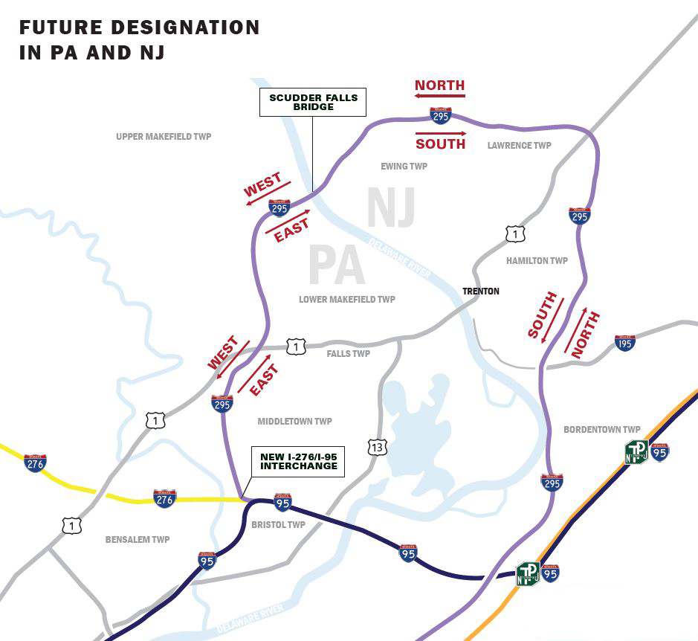
I-95 and I-295 Redesignation
I-295 will be north/south in New Jersey and east/west in Pennsylvania
I-95/PA Turnpike Interchange
Where I-295 Currently Ends
Where I-295 Will End

Slide 5
Renumbering Interchanges

Slide 6
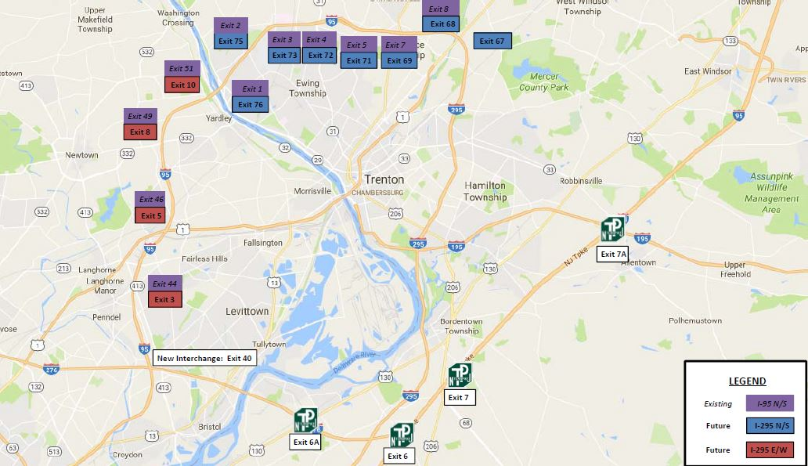
Renumbering of Interchanges
7 interchanges in New Jersey and 4 interchanges in Pennsylvania will be renumbered and signs will be updated to reflect new route designations
Exit numbers will correspond to new milepost markers on redesignated I-295
Intersecting Roadway | Old Exit Number | New Exit Number
Princeton Pike | 8 | 68
Route 206 | 7 | 69
Federal City Rd | 5 | 71
Route 31 | 4 | 72
Scotch Rd | 3 | 73
Route 579 | 2 | 75
Route 29 | 1 | 76
Taylorsville Rd | 51 | 10
Route 332 | 49 | 8
Route 1 | 46 | 5
Route 1 Business | 44 | 3
NJ
Exits
PA
Exits

Slide 7
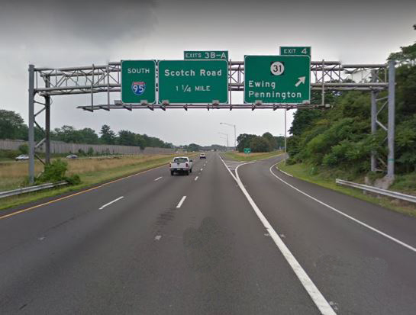
Example of What Renumbering Will Look Like
Exits and overhead signs will change to reflect new exits and route redesignations
Temporary “old exit” sign panels will be installed above overhead mounted signs and adjacent to ground mounted signs
I-95 Old Numbering
I-295 New Numbering

Slide 8
Sign Replacement in New Jersey

Slide 9
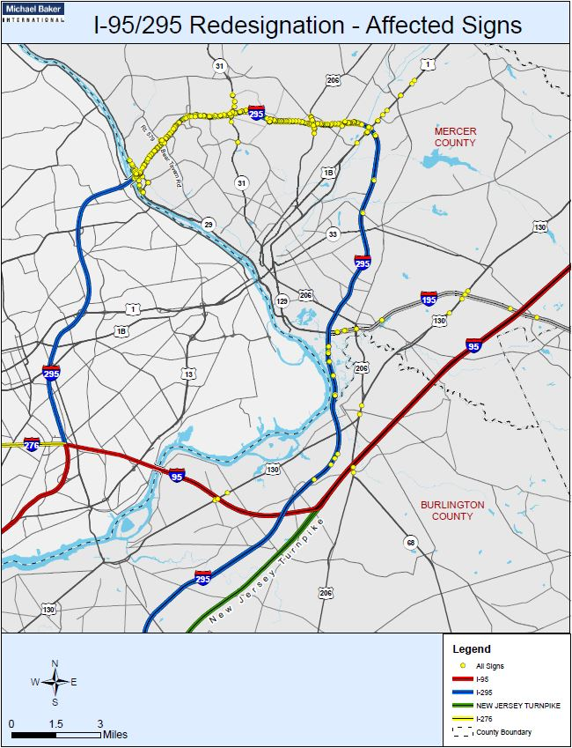
Sign Replacement
Signs along I-295 will be replaced to reflect road designation changes.
Signs will be replaced at approximately 250 locations

Slide 10
Overhead Sign Replacement
Overhead signs will be updated to reflect the redesignation
Guide signs, destination signs, exit subpanels and mile markers will be replaced to reflect redesignation of road and exit numbers

Slide 11
Trailblazer and Mile Post Marker Replacement
Both trailblazer signs and mile posts will be replaced to reflect changes to route designation

Slide 12
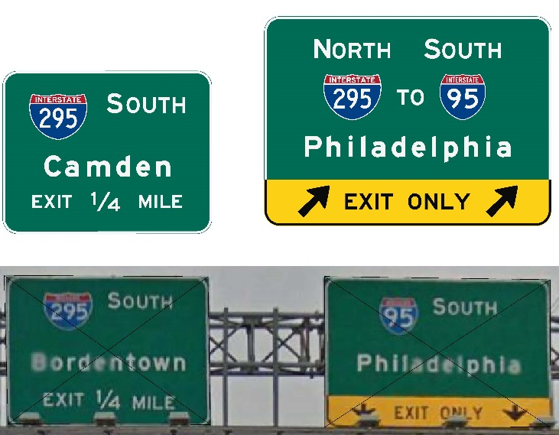
Updating Signs on Intersecting Roadways
Signs will be replaced on intersecting roadways to reflect redesignation

Slide 13
Reflecting NJTP’s I-95 Designation
An I-95 shield will be added to New Jersey Turnpike signs north of exit 6

Slide 14
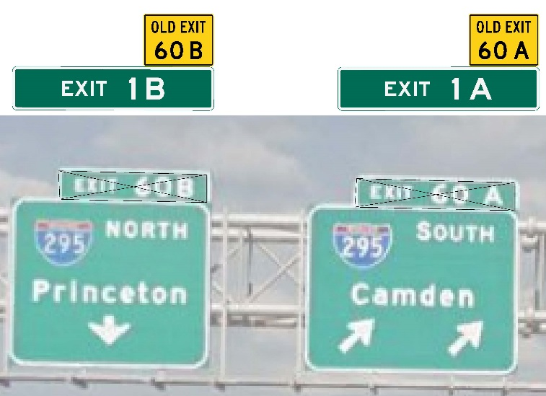
Renumbering Exit 60 to Exit 1 on I-195
Exit numbers on I-195/I-295 interchange will be changed to reflect mile posts on I-195

Slide 15
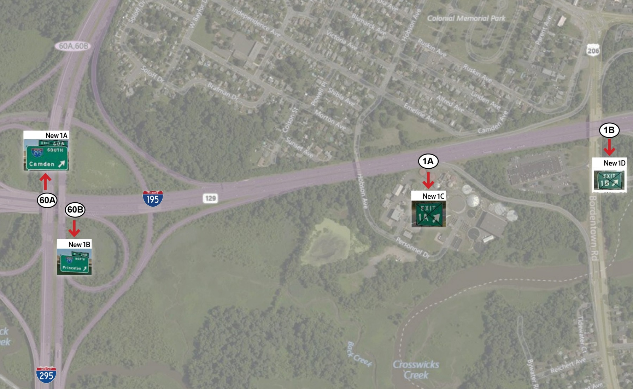
Changes to I-195 Exits
Exit 60 on I-195 will be re-numbered as Exit 1 to follow I-195 mileposts
Exits 60A and 60B will become Exits 1A and 1B
The exits that are currently 1A and 1B will become 1C and 1D
Intersecting Roadway | Old Exit Number | New Exit Number
I-295 SB | 60A | 1A
I-295 NB | 60B | 1B
Route 206 SB | 1A | 1C
Route 206 NB | 1B | 1D

Slide 16
Project Timeline:
Anticipated Construction Timeline | Key Work | Primary Responsible Party
Phase 1: January - March 2018 | Replacing signs in New Jersey starting at existing I-95 Interchange 8/ Princeton Pike and moving west toward the Delaware River | NJDOT
Phase 2: March - April 2018 | Replacing signs on both sides of the Delaware River within the Scudders Fall Bridge project limits (existing I-95 Exit 1 in New Jersey and Exits 51 and 49 in Pennsylvania). | DRJTBC/ PennDOT/ PTC
Phase 3: April - August 2018 | Replacing signs at the remaining interchanges through the new interchange in Bristol, PA | PTC/ PennDOT/ NJTA

Slide 17
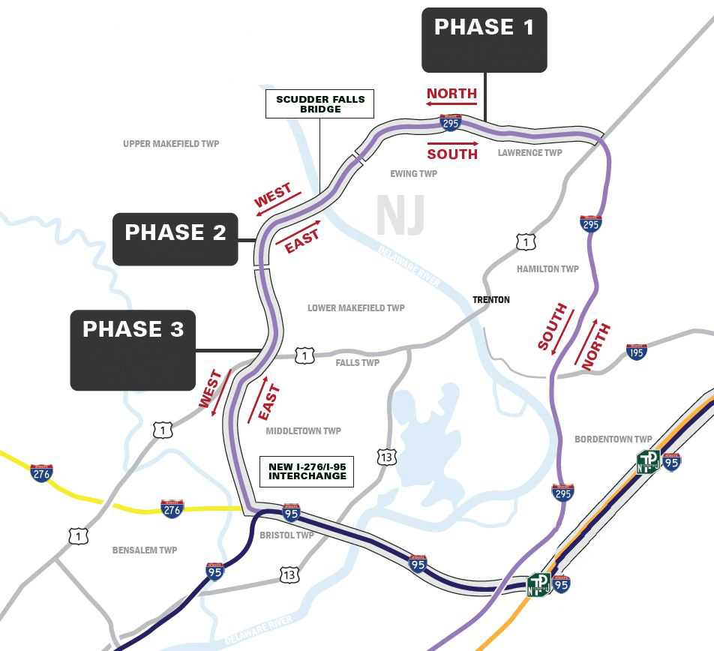
Project Timeline:
January 2018 to Early March 2018
March – April 2018
Late April 2018 to Early August 2018
I-95/PA Turnpike Interchange

Slide 18
Project Timeline for New Jersey I-295 Exits:

