Slide 1
Political Contributions Compliance for State Contracts
State of new jersey
Department of treasury
Division of purchase & property
Contract compliance & audit unit
Contact: CD134@treas.nj.gov
1

Slide 2
Overview
New Jersey law insulates the negotiation and award of State contracts from political contributions that pose a risk of improper influence, purchase of access or the appearance thereof. P.L.2005, c.51, as amended by the Elections Transparency Act, P.L.2023, c.30, codified at N.J.S.A. 19:44A-20.13 to 20.25 (“Chapter 51”) and Executive Order No. 333 (2023).
On April 3, 2023, Governor Murphy signed P.L.2023, c.30 (S2866 (Scutari)/ A4372 (Greenwald)) which established the Elections Transparency Act (“ETA”). The law was effective retroactively to January 1, 2023. In addition to other changes, the law created a new exception to its application for Executive Branch contracts awarded through a “fair and open process”.
ETA defines “fair and open process” as follows:
“Fair and open process" means, at a minimum, that the contract shall be: publicly advertised in newspapers or on the Internet website maintained by the public entity in sufficient time to give notice in advance of the contract; awarded under a process that provides for public solicitation of proposals or qualifications and awarded and disclosed under criteria established in writing by the public entity prior to the solicitation of proposals or qualifications; and publicly opened and announced when awarded. A contract awarded under a process that includes public bidding or competitive contracting pursuant to the “Local Public Contracts Law,” P.L.1971, c.198 (C.40A:11-1 et seq.) shall constitute a fair and open process. The decision of a public entity as to what constitutes a fair and open process shall be final.
2

Slide 3
ETA For Contracts Awarded Pursuant to a Fair and Open Process:
Contracts awarded pursuant to a fair and open process do not require a disclosure of any solicitation or contribution of money, or pledge of contribution, including in-kind contributions.
ETA For Contracts Awarded Pursuant to a Non-Fair and Open Process:
Contracts in excess of $17,500 and awarded pursuant to a non-fair and open process require the disclosure of any solicitation or contribution of money, or pledge of contribution, including in-kind contributions.
The State shall not enter into a Contract to procure services or any material, supplies or equipment, or to acquire, sell, or lease any land or building from any Business Entity, where the value of the transaction exceeds $17,500, if that Business Entity has solicited or made any reportable contribution of money, or pledge of contribution, including in-kind contributions, to a Continuing Political Committee or to a candidate committee and/or election fund of any candidate for or holder of the public office of Governor during certain specified time periods.
If an agency is uncertain whether its contracting process meets the “fair and open process” definition, it should seek guidance from its assigned contact in the Division of Law or if it is not advised by the Division of Law, by its legal counsel.
3

Slide 4
On June 15, 2023, Governor Murphy signed Executive Order (EO) 333 (Murphy) amending prior EOs to align with the newly-enacted ETA relating to political contributions by government contractors. The EO rescinded EO No. 134 (2004), issued by Governor McGreevey, and EO No. 7 (2010), issued by Governor Christie, and supersedes EO No. 117 (2008), issued by Governor Corzine. EO 333 became effective immediately.
The EO continued from Executive Order 117 (2008) the list of those persons whose contributions are attributable to a “business entity” but did not continue EO 117’s previous limitations concerning contributions to Legislative Leadership Committees and Municipal Political Party Committees. As such, contributions to Legislative Leadership Committees and Municipal Political Party Committees are not required to be reported by vendors and would not disqualify a vendor.
The Chapter form should only be submitted to the Chapter 51 Unit for review through the designated mailbox for contracts that are awarded through a legal process that does not meet the “fair and open process” definition in the ETA.
4

Slide 5
DPP is assigned the responsibility of reviewing and approving the Certification and Disclosure of Political Contributions form to determine legal compliance.
Prior to awarding any contract or agreement to any business entity (BE), the BE proposed as the intended awardee of the contract shall submit the form to the contracting agency, certifying that no reportable contributions (in excess of $200) or any currency contribution prohibited by law was made by the BE and reporting all contributions the BE made.
5

Slide 6
Business Entity
Definition of Business Entity includes:
A corporation and any officer of the corporation and any person or business entity that owns or controls 10% or more of the stock of the corporation.
A partnership (GP, LP, LLP) and any partner of the partnership.
A professional corporation and any shareholder or any officer of the professional corporation.
A limited liability company and any member of the limited liability company.
A sole proprietor (natural or legal person).
Any other form of entity organized under the laws of New Jersey or any other state or foreign jurisdiction: the entity and any principal, officer or partner.
Any subsidiary directly or indirectly controlled by the business entity.
Any political organization that falls under section 527 of the Internal Revenue Code that is directly or indirectly controlled by the business entity.
A spouse or civil union partner and any child residing with an individual included within the definition of business entity, however, it does not apply to a contribution for whom the contributor is entitled to vote or to a political committee within whose jurisdiction the contributor resides.
6

Slide 7
Reportable Contributions
Business entity must disclose the following contributions on the form:
All reportable contributions solicited or made during the preceding four (4) years to any political organization organized under Section 527 of the Internal Revenue Code. That also meets the definition of a “continuing political committee” as defined in N.J.S.A. 19:44A-3(n) and N.J.A.C. 19:25-1.7.
All reportable contributions solicited or made during the preceding five and one half (5 1/2) years to any:
Candidate Committee for or Election Fund of any Gubernatorial candidate
7

Slide 8
Reportable and Prohibited Contributions
Contribution(s), including in-kind contributions, in excess of $200 in the aggregate per election made to any gubernatorial election fund.
Currency contribution in any amount to the entities listed above.
8

Slide 9
Periods of Disqualification
Periods of disqualification may range from 18 months to 5 ½ years depending upon the timing and the recipient of the political contribution.
Election Fund of any candidate for Governor = 18 months from date of contribution if made prior to term of office. Applies to winner or loser.
Election Fund of the sitting Governor made during the term of office = remainder of sitting Governor/Lieutenant Governor’s term.
Election Fund of sitting Governor made during the last 18 months of the term of office = remainder of sitting Governor’s term AND to the end of second term if reelected. Potentially 5 ½ years!
9

Slide 10
If any prohibited contribution is made by the vendor during the term of the contract, it must be reported to the Review Unit and may result in a material breach of contract if the State Treasurer determines the contribution poses a conflict of interest.
The vendor will be prohibited from bidding on or receiving any future contracts that do not meet the definition of “fair and open process” exceeding $17,500 until their period of ineligibility has expired. Additionally, penalties may also be assessed up to the value of the contract.
10

Slide 11
Form Submission & Review
The initial Certification and Disclosure of Political Contributions form is submitted by the vendor to the contracting State Agency.
The State Agency forwards the form to the Review Unit for approval.
Upon approval by the Review Unit, the Certification and Disclosure of Political Contributions form is valid for a two (2) year period for purposes of bidding on any new State contract.
11

Slide 12
The “approval” received from the Review Unit lasts for the complete term of the contract even if the contract exceeds the two year certification timeframe.
Example: State Agency receives approval from the Review Unit for a BE it intends to award a 3 year contract with 2 one year extensions. The State Agency does not need to submit a new form for the BE during the 5 years of the contract.
The State Agency would have to request a new form from the same BE before it enters into a new contract with the BE after the BE’s two-year certification expired.
12

Slide 13
Any change in the BE’s ownership structure and/or any political contributions made during the two-year certification period will require the BE to submit a new form to the Review Unit.
Additionally, during the term of the contract the BE has a continuing responsibility to report any change in the ownership structure and/or any political contributions made directly to the Review Unit.
After a vendor has received a two-year certification, it may submit any subsequent form directly to the Review Unit for recertification prior to the expiration date.
13

Slide 14
State Agency’s Role
Prior to requesting a Certification and Disclosure of Political Contributions form from the BE, the State Agency should first check NJSTART to determine whether the vendor is registered and has Chapter 51 Certification information on NJSTART.
The State Agency must confirm the vendor’s current Certification and/or receive notification of a business entity’s approved Two-Year Certification before awarding any contract or agreement to the BE.
If the Review Unit sends an email response that the recommended BE is within an approved two-year period, then the response should be included with the bid/contract documentation. The NJSTART Terms and Categories page of the vendor can also be included.
14

Slide 15
If the response from the Review Unit is that the BE is not within an approved two-year period, then a two-year certification form must be obtained from the vendor and forwarded to the Review Unit.
The State Agency should communicate Chapter 51/EO 333 requirements to the BE.
The State Agency should provide the BE with the Information and Instructions document along with the Vendor Certification and Disclosure of Political Contributions form available at https://www.nj.gov/treasury/purchase/forms.shtml
The State Agency should notify the BE of an ineligibility determination made by the Review Unit.
The State Agency should encourage the BE to register with NJSTART.
15

Slide 16
Certification and Disclosure of Political Contributions form should be sent electronically to CD134@treas.nj.gov.
The “State Agency Use Only” section at the top of the Certification and Disclosure of Political Contributions from must be completed by the contracting State Agency. Forms should not be sent without the top section completed.
The contracting State Agency must answer the “fair and open process” question.
16

Slide 17
The State Agency should conduct a good faith review before sending the form to the Review Unit. The State Agency should:
Review the Certification and Disclosure of Political Contributions form for completeness.
Obtain all missing information from the BE before sending to the Review Unit.
Follow-up communication to remind the BE of outstanding documentation.
17

Slide 18
Review of Form
Form must be completed in its entirety.
Page 1, Part 1: Business Entity Information
Name, address and FEIN
Type of business must be checked
Ownership information must be listed
“N/A” or “Not applicable” is not an acceptable answer.
Page 2, Part 2: Disclosure of Contributions
If not reportable contributions were made, the box must be checked.
18

Slide 19
Page 2, Part 3: Certification – Box A, B, C and D
At least one box must be checked.
BOX A offers the convenience of having a single representative give certification for the BE and any person or entity whose contributions are attributable to the BE. (Only one form needs to be submitted.)
If the BE is a sole proprietor (e.g. a consultant), any box may be checked under Part 3: Certification if the sole proprietor is the person completing the form.
For all other businesses, if Box A is not checked, additional forms are required from the necessary parties.
19

Slide 20
Part 3: Certification- Examples
If a partnership submits its form with BOX C checked, additional forms are required from each of the partners regardless of the partner’s ownership interest.
If a corporation submits its form with BOX B checked, additional forms are required from the officers of the corporation or shareholders of the corporation for which the representative is not certifying. Those additional forms must be included with the submittal.
20

Slide 21
Page 3, Continuation of Part 3: Certification
The representative completing the form must sign and print his/her name, title or position and enter the date.
The State Agency as well as the BE should review the Information and Instructions form for guidance on how to complete the Vendor Certification and Disclosure of Political Contributions form and for definitions pertaining to the statute and Executive Order.
21

Slide 22
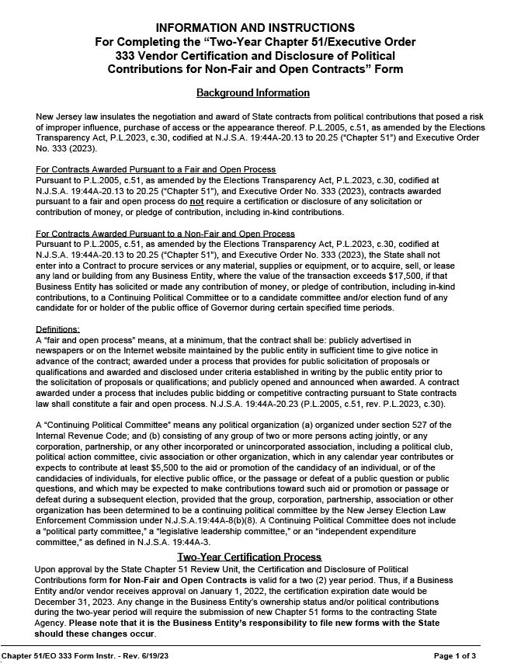
Fair and Open:
Whether a contract award is Fair and Open or not
determines if Chapter 51 is necessary
22

Slide 23
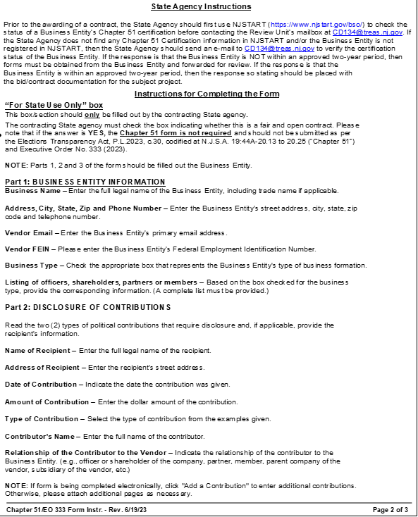
Fair and Open:
Chapter 51 form is not
required if contract award is Fair and Open
23

Slide 24
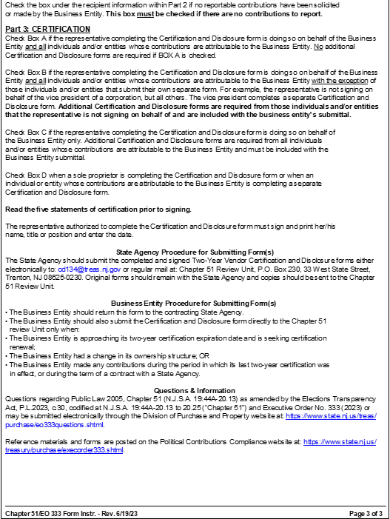
24

Slide 25
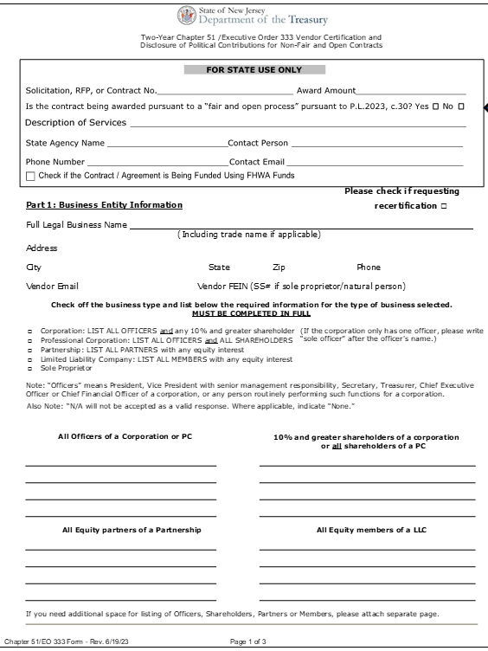
Fair and Open:
State Agency MUST
Answer the question
25

Slide 26
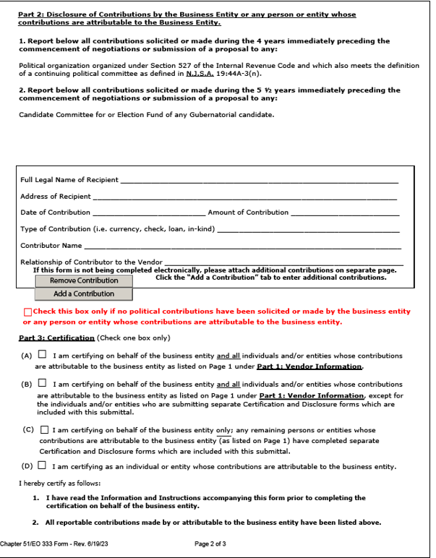
26

Slide 27
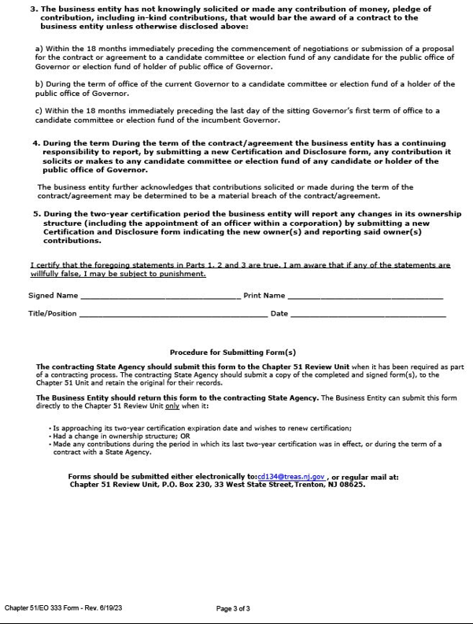
27

Slide 28
Review Unit
Any additional information needed to process the form will be requested from the State Agency. If necessary, the Review Unit will provide guidance to the BE regarding the completion of the form.
28

Slide 29
Once the transaction is reviewed and approved, the Review Unit will send the State Agency an email confirming the BE’s Chapter 51/EO 333 compliance.
Until the State Agency has confirmed the BE’s current certification on NJSTART and/or obtained an email from the Review Unit approving the BE’s form, the BE is not eligible to be awarded a contract.
The NJSTART “Terms and Categories Information” tab/page for a specific BE is proof of Chapter 51 approval for a prior contract awarded with no consideration of whether it was pursuant to a “fair & open” process.
The approval email from Review Unit for a specific BE is proof of Chapter 51 approval for a contract awarded pursuant to a non-fair and open contract process and should be retained by the State Agency.
29

Slide 30
Ineligibility
If the Review Unit determines that a BE is not in compliance with the law, a notice of ineligibility will be forwarded to the contracting State Agency. Note: It is the State Agency’s responsibility to notify the vendor of its ineligibility determination.
BE can cure a disqualifying contribution if it requests and receives a refund of the prohibited contribution within 30 calendar days of the making of the contribution. However, there is no cure for contributions made within 60 days of a gubernatorial primary or general election.
The BE has 10 business days from the receipt of the State Agency’s notice of ineligibility to request reconsideration from the Director of DPP.
30

Slide 31
If the Director upholds the Review Unit’s decision, the BE has 10 days of the notice of the Director’s determination to file an appeal with the State Treasurer.
If the State Treasurer upholds the Director’s decision, the BE may file an appeal of the Treasurer’s final decision with the Appellate Division of the New Jersey Superior Court.
31

Slide 32
Public Exigency
Public exigency: If a State Agency determines that a public exigency requires a particular transaction to proceed without Chapter 51/EO 333 review or despite an ineligibility determination, the State Agency may send a request to the Treasurer explaining why the procurement should be exempted as a public exigency.
It must be an emergency that affects the public health, safety, or welfare OR a critical State Agency mandate which requires the immediate delivery of goods or performance of services.
32

Slide 33
Additional Helpful Information
https://www.nj.gov/treasury/purchase/execorder333.shtml
Link to the Two-Year Chapter 51/Executive Order 333 Vendor Certification and Disclosure of Political Contributions for Non-Fair and Open Contracts form and instructions.
Various additional information.
33

