Slide 1
AmeriCorps 101
The who, what, where, when, why and how for programs
Presented by Vinnie Funelas, AmeriCorps NJ Program Officer
Notes:
Welcome to AmeriCorps 101. You’re on the path to gain more information about AmeriCorps! We here at the State Commission are always excited to expand our portfolio of service programs in our state. We’ll take questions at the end of the presentation, but feel free to put questions in the chat as we go along.
I’m one of those people who did not know what it was. In my former positions, I’ve seem AmeriCorps on resumes, but never really focused on it. After a year and a half, working with AmeriCorps programs in New Jersey and meeting with my colleagues in other states, I have become such a cheerleader for AmeriCorps. It is a rewarding experience for the organizations, members, state commission and communities for which our portfolio of programs are serving. It clearly is a win-win-win-win situation.

Slide 2
AmeriCorps 101 Syllabus
What is AmeriCorps?
AmeriCorps in NJ – Stats
AmeriCorps Focus Areas
AmeriCorps Members’ Benefits
Educational Award
Terms of Service / Term Limits
Prohibited Activities
Member Timeline
AmeriCorps Pledge
Notes:
We’ll be focusing on the topics above to better acquaint you with AmeriCorps.
This portion of the day will concentrate on general information about AmeriCorps…

Slide 3

AmeriCorps Orientation
Terms & Conditions
Criminal History Checks
Online Systems
Pre-Enrollment/Enrollment
Notes:
I’ll be touching on these topics, but a larger deep dive will be presented in a different training.

Slide 4

What is AmeriCorps?
Notes:
Let’s start with this short video. It defines AmeriCorps really well!

Slide 5
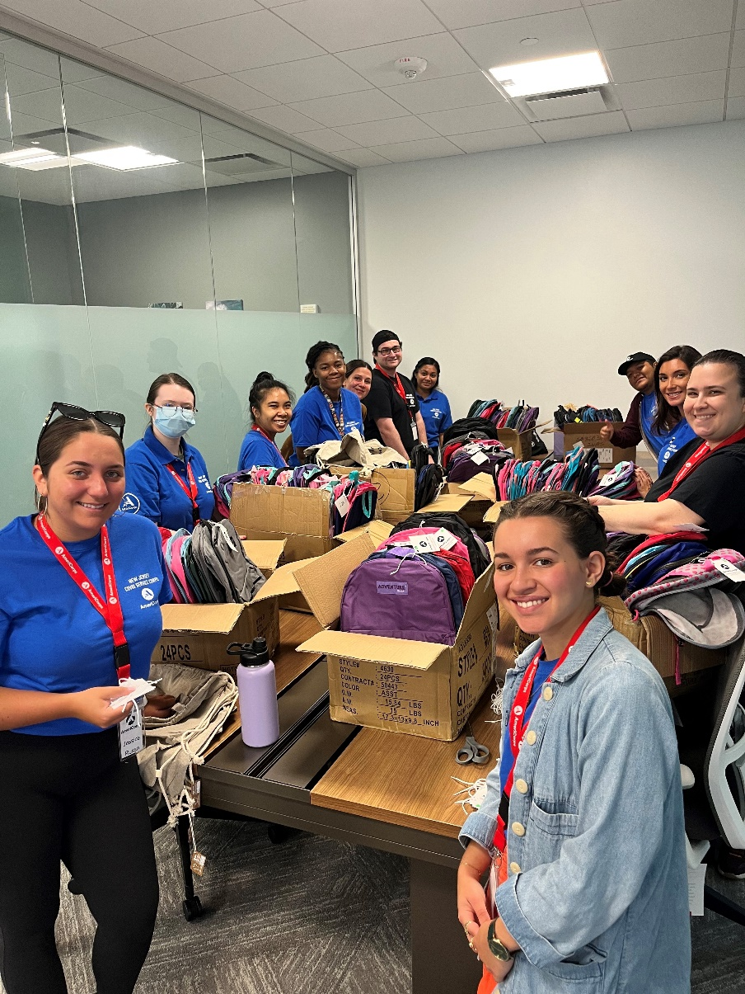
So, what is AH-MER-EE-CORE, again?
Montclair State University Covid-Corps
Backpack distribution event for MLK DEIA MINI Grant, 9/15/22
Notes:
So, let’s recap!
It’s not a job, internship or volunteering opportunity – it is service
You will be recruiting MEMBERS, not employees, interns or volunteers
Members do not earn wages or a salary, you are receiving a living allowance or a stipend
You are not developing a program to have members fill in vacancies, you are utilizing their service to create a change or impact in the community.

Slide 6

History of AmeriCorps
Notes:
President Bill Clinton signs the National and Community Service Trust Act of 1993, creating AmeriCorps and the Corporation for National and Community Service to expand opportunities for Americans to serve their communities.

Slide 7
What do AmeriCorps Members Do?
Educate communities about their environment
Renovate and Rebuild Abandoned Homes
Provide Mentoring During Non-School Hours
Recruit Volunteers
Bridge the Digital Divide
Assist the Homeless
Provide Support to People with Disabilities
Notes:
Members Get. Things. Done.
Your programs will be creating a huge impact in your communities and improving lives. You’ll develop a Theory of Change, propose research that will support that theory of change and provide a logical path to achieving community goals.
Your programs have identified a need in the area and developed a plan to create meaningful change. Your service will help educate students struggling with basic curriculum, teach members of the community to take care of the environment, assist our needy with respect to food insecurity and housing, among other wonderful things.

Slide 8
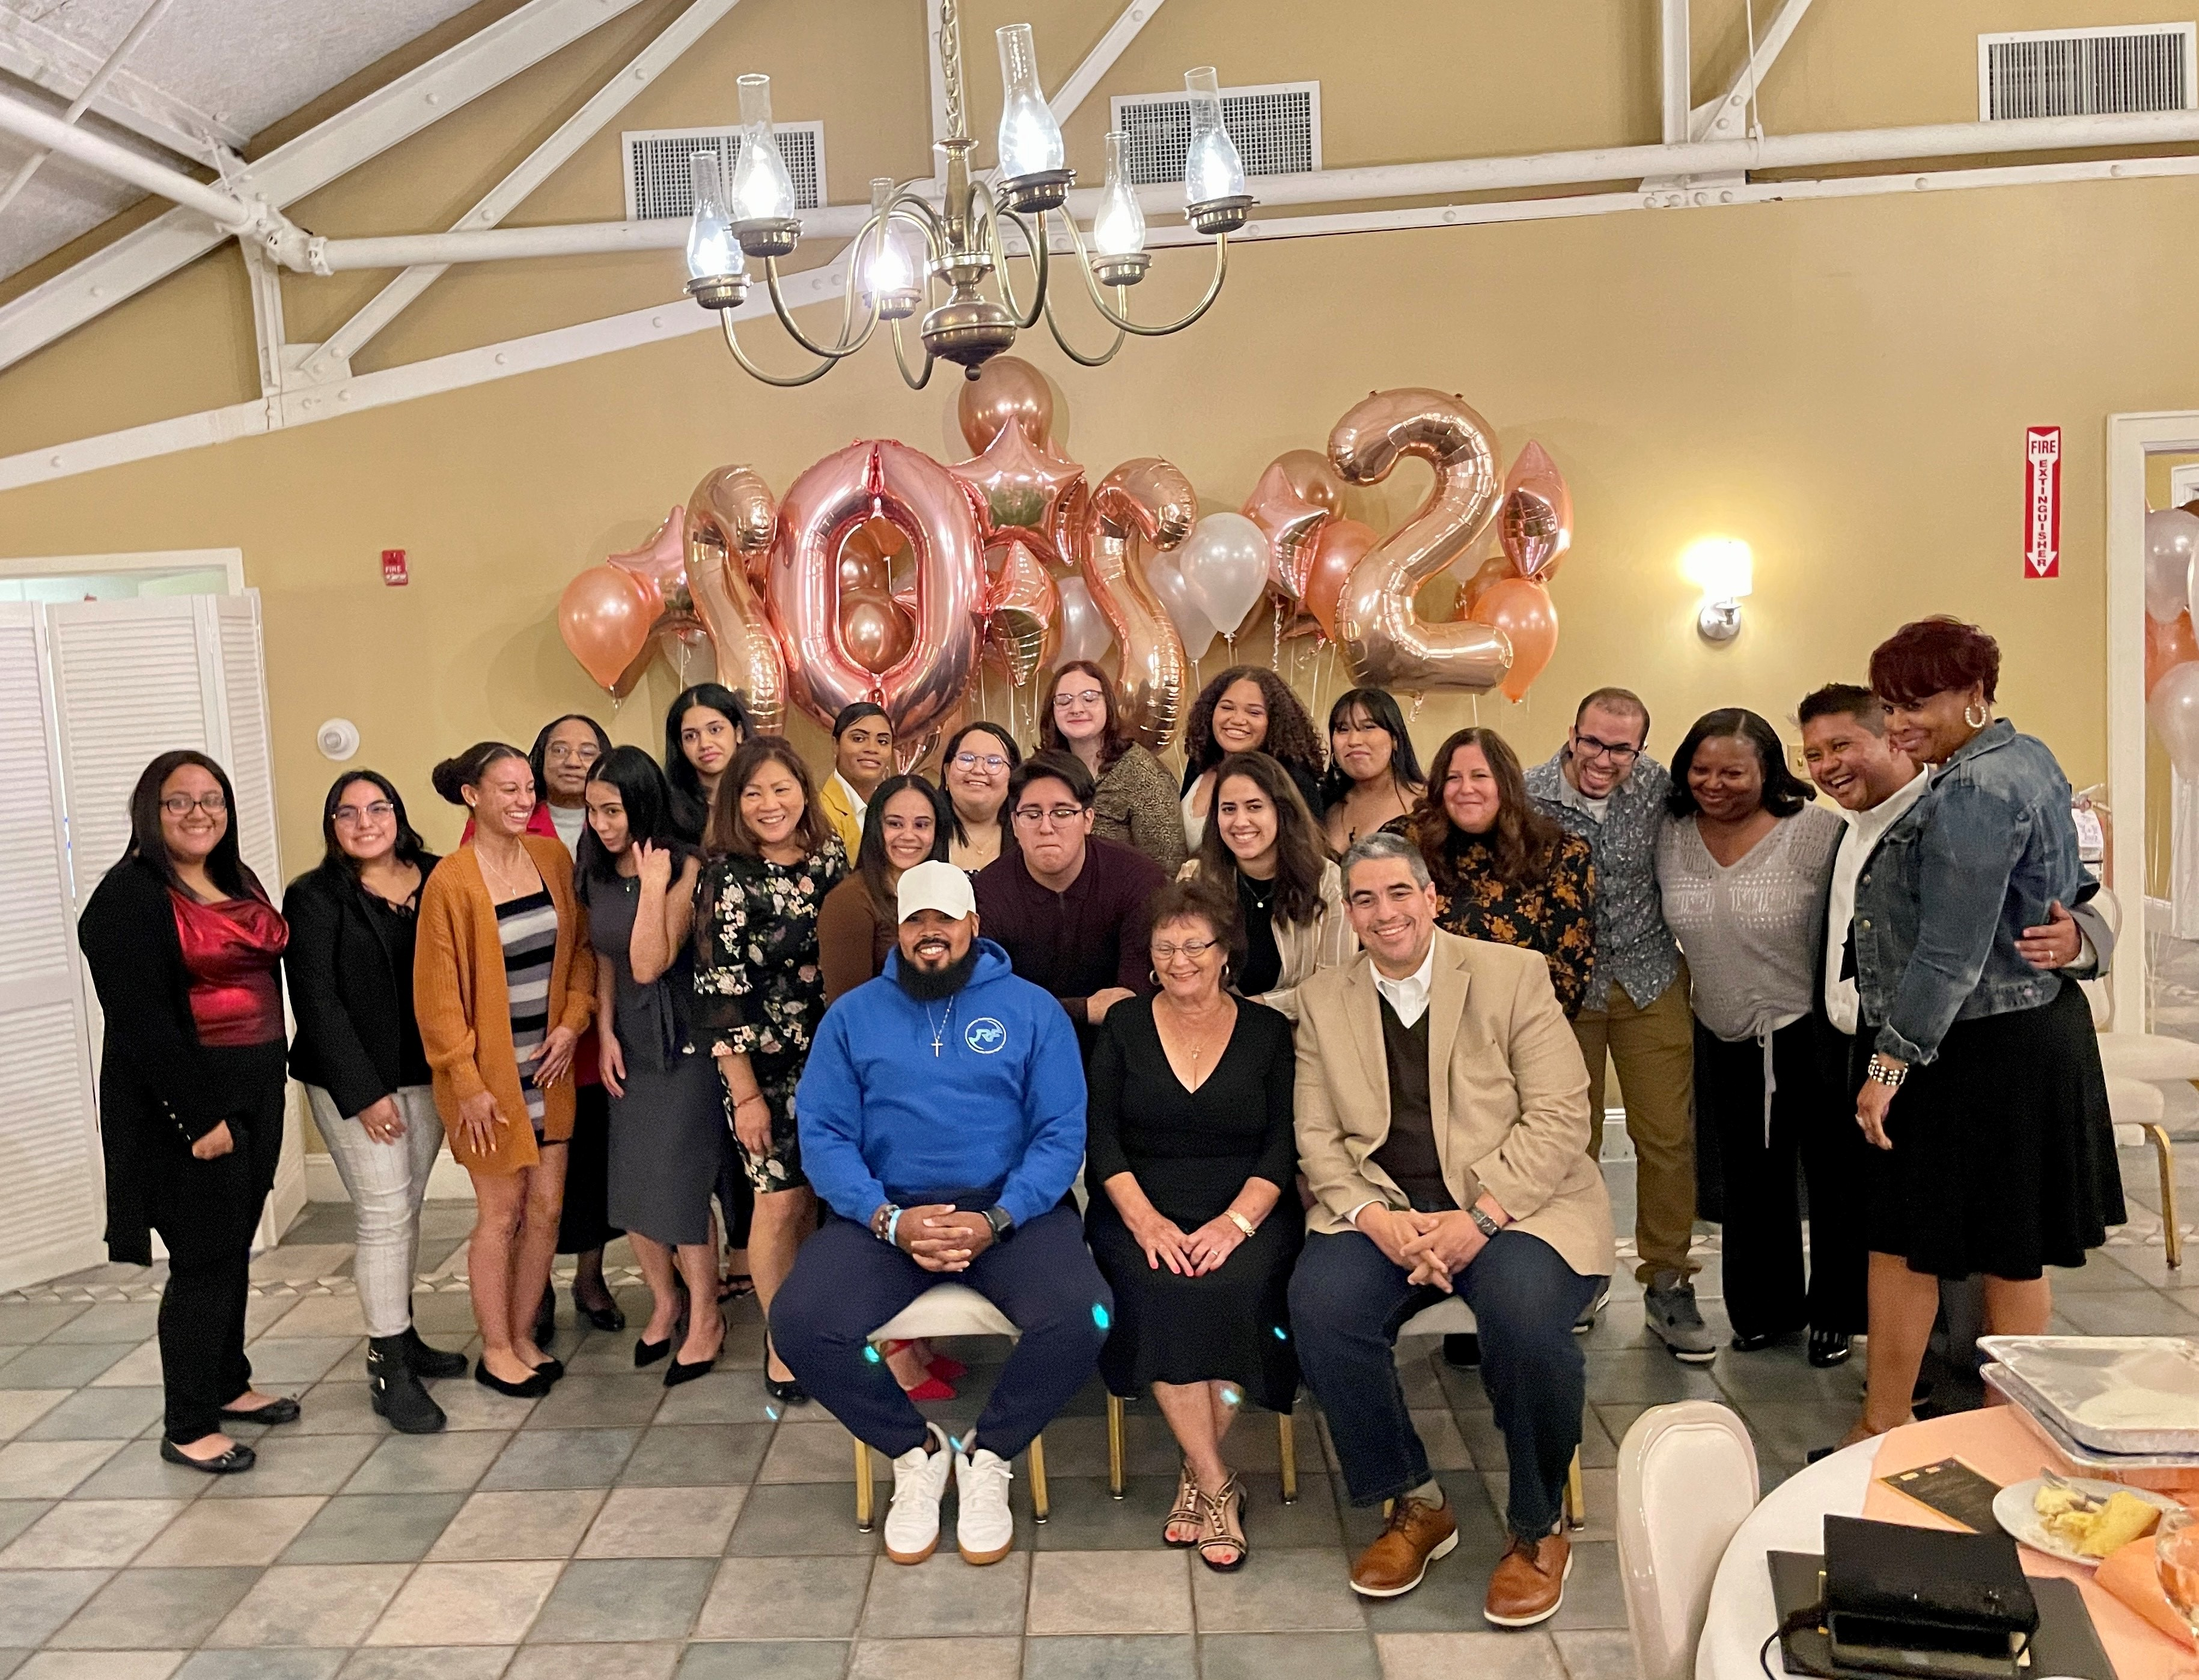
AmeriCorps Member
Fast Facts
90 % of members said they gained new skills while in AmeriCorps.
80% of members said they are more likely to participate in community service after AmeriCorps.
72% of members volunteered after completing their AmeriCorps service.
Since 1994, AmeriCorps alumni have earned more than $3.3 billion in education awards, including $1 billion to repay student debt.
Notes:
Look at these facts – members are gaining new skills that translate into greater opportunities. You’re part of a culture of service that will follow you throughout life.
This goes comes the wonderful benefit of an educational award – since 1994 (Triva alert: AmeriCorps started in September 1993, when President Bill Clinton signed the National and Community Service Trust Act, creating AmeriCorps, to expand opportunities for Americans to serve their communities. Since then, more than $3.3 billion in educational awards have been earned!
Keep in mind that members’ service not only will better the communities, but also provide great skills for members after their terms of service. You’ll want to make sure that members have a great experience.

Slide 9
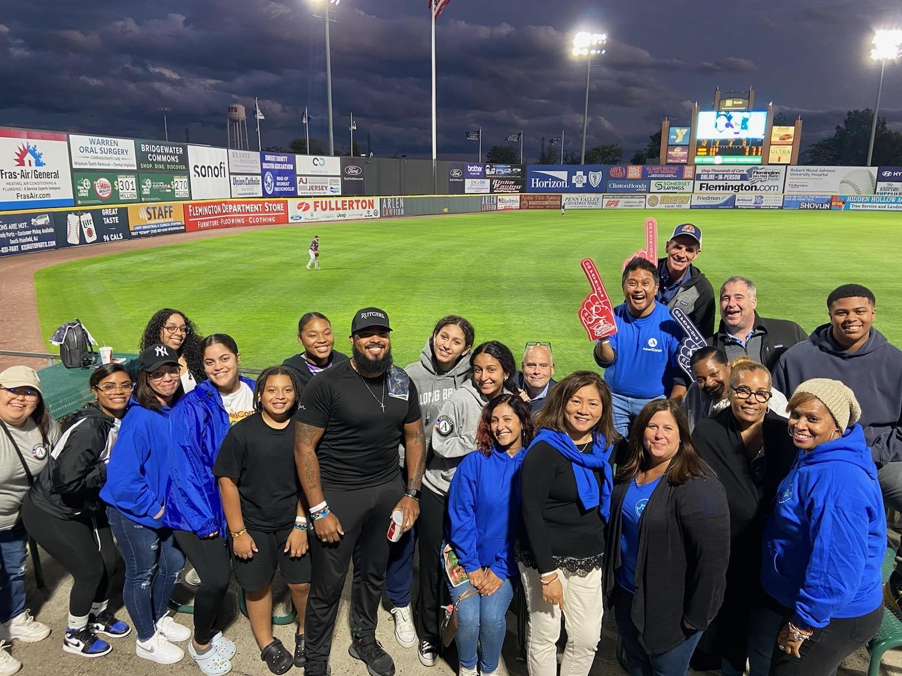
What did AmeriCorps New Jersey Members Accomplish in the 2021/2022 Program Year
Recruited 9,000+ volunteers
Volunteers donated 55,000+ hours
1,700+ individuals affected by disaster served
8,800+ children and youth served
900+ acres of public land improved
Notes:
Getting. Things. Done.
Look at these stats in New Jersey alone!
This was for the program year 2021/2022.

Slide 10

National Service: Funding Tree
Congress
AmeriCorps State & National
NCCC
Vista
AmeriCorps
  State Commissions
    Formula Sub grantees
    Competitive Sub grantees
Notes:
Do you all remember this movie? This was a great scene… I want to take a moment to show you the money!
It all starts with the federal government, it will fund two National Service entities: AmeriCorps and Senior Corps (not listed). AmeriCorps State and National will then fund NCCC, or National Civilian Community Corps: National Civilian Community Corps (NCCC) members range from ages 18 to 24 and serve in a 10-month team-based residential program (teams usually include 10-14 individuals) to complete a variety of projects in the areas of education, disaster services, the environment, and other unmet needs. NCCC members often travel to projects throughout their region. You may either apply for the Fall Class, which begins in the September/October timeframe, or apply for the Winter Class, which begins in January.\
Vista: perform capacity building activities, over a course of a year, through private non-profit organizations and public agencies. VISTA members address issues related to poverty, such as public health, education, the environment, public safety, and employment, by developing and mobilizing resources that create long-term sustainable benefits at a community level.
AmeriCorps: what you’re thinking of applying to; State and National members, ages 17 and older, serve in either teams or individually through national and community-based private and public organizations. Members help solve community problems through direct and indirect service, in the areas of education, public safety, the environment, and other human needs such as health and housing.
State Service Commissions provide CNCS funding to single state AmeriCorps programs operating within their states. Commissions make AmeriCorps awards through a competitive process at the national level or through a state-based formula grant competition.

Slide 11
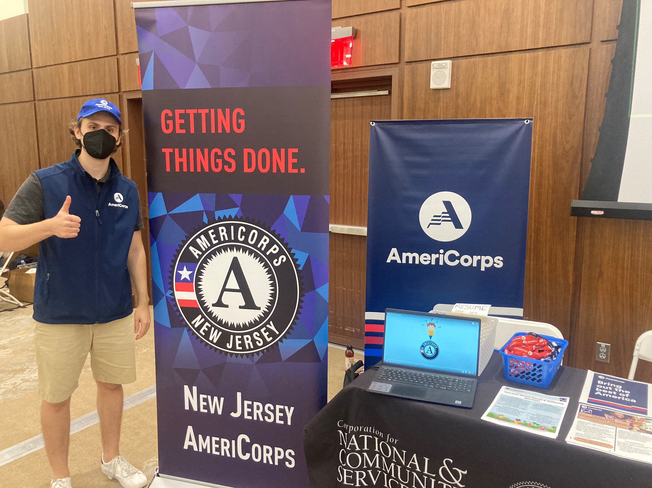
Focus Areas
Education
Economic Opportunity
Environmental Stewardship
Healthy Futures
Notes:
Many programs have members serving in schools and supporting students’ improvement with attendance and engagement.
Programs serve as a pathway to employment opportunities and help develop vital work skills and financial stability.
Members over thousands of acres of public lands throughout the state to help conserve natural habitats, protect clean air and water and promote energy efficiency.
Programs also build capacity at food banks and combat the opioid crisis, tackle homelessness and address food insecurity
Your organization probably has a good idea of what impact you’d like to make in your targeted community. We’ll go over terms and conditions a little later! That’s when we’ll talk about Theory of Change, Logic Models, Data Collection and Performance Measures.

Slide 12
Member Eligibility Requirements
Must be 17 years of age or older.
Must have a High School Diploma or Equivalency; or must be working towards the GED.
Must be a US Citizen or Permanent Resident of the USA.
Proof: Birth Certificate and/or Specific LIMITED Acceptable Documents
Notes:
If a member is 17, there must be parental consent.
All these requirements must be verified prior to service.
A prospective member would be found ineligible if they refuse to participate in a background check.

Slide 13
Background Checks
The following background checks must be cleared by the NJ Commission before AmeriCorps members can be enrolled to begin service:
  State Background (TrueScreen)
  FBI Fingerprint-based (FieldPrint)
All programs must use TrueScreen
Cost is about $33 per member unless there are additional out-of-state residences that must be checked
Notes:
National Service Criminal History Checks (NSCHC) is a baseline screening requirement established by law to protect the beneficiaries of national service.
Truescreen is a vendor approved by AmeriCorps to provide National Sex Offender Public Website and state criminal history checks; research source-level documentation when needed; make adjudication recommendations to recipients; facilitate compliance with the Fair Credit Reporting Act (FCRA), including pre-adverse and adverse action notices; provide time records of relevant compliance steps like adjudication; and maintain records for up to 7 years.
Fieldprint is one of a limited number of vendors, approved by the FBI to offer expedited access to the FBI’s national criminal history information. Fieldprint is a vendor approved by AmeriCorps to provide fingerprint FBI checks and make adjudication recommendations.
Please be advised… under no circumstances should an individual serve without conducting background checks and having them approved by New Jersey AmeriCorps Compliance Officer Vanessa McCall. Anyone receiving any AmeriCorps grant dollars (in salary or living allowance) must have background checks done. Staff on the grant must also have background checks prior to the commencement of the grant. When staff changes, the new staff must be cleared as well.

Slide 14

Members’ Benefits
Child Care (For FT members)
Health Insurance (For FT members)
Loan Forbearance (During time of service)
Living Allowance
Education Award
Interest Accrual Stops
Notes:
Child Care: Child care is available for qualified, active, full-time members who need this benefit to serve.
Health Insurance: Full Time members are offered supplemental health insurance.
Loan Forbearance is temporarily postponing your obligation to make payments on your student loan. As a member, you may be eligible for forbearance on your qualified student loans during your term of service.
Living Allowance: Receive a modest living allowance to cover basic expenses during your service term
Educational Award: The Segal AmeriCorps Educational Award is offered to those who complete a term of service and can be used to pay for a range of educational expenses like repaying qualified student loans or future tuition payments. You can earn up to two full educational awards within multiple service terms.
Interest Accrual, upon completion of service, you may be eligible for all or a portion of the interest that accumulated on your qualified student loan or loans during your term of service. These payments are made in addition to the educational award and are not deducted from your educational award balance.

Slide 15

Educational Award
Notes:
Upon completion of their terms of service, members are eligible for an Educational Award.
The amount of the award corresponds to the slot type they have agreed to serve. Upon enrollment, your program director will have not only worked our their weekly living allowance or stipend, but also the total educational award amount they’ll receive.
Members have up to seven years to use the award and it can be used at more than one institution and can help pay more than one loan.
If a member is 55 years old or older, the educational award can be transferred once to a child, grandchild, foster child or step child and is held for up to 10 years!

Slide 16
Educational Award
Type of Member Position | Min. # of Hours | Educational Award
Full-time | 1,700 | $6,495.00
Three Quarter-time | 1,200 | $4,546.50
Half-time | 900 | $3,247.50
Reduced Half-time | 675 | $2,474.27
Quarter-time | 450 | $1,718.25
Minimum-time | 300 | $1,374.60
Abbreviated-time | 100 | $365.52
Notes:
You’ll see here, depending on the type of member, the educational award reflects that term of service.
Again, members can earn up to two full educational awards within multiple service terms. (For example, a member can serve four half-time slots, that would equal two full0time educational awards.)

Slide 17
Educational Award
  Camden County College
  Monmouth University School of Social Work
  New Jersey City University
  Princeton University Woodrow Wilson School of Public and International Affairs
  Stockton University
  Thomas Edison College
  William Paterson College
  Rutgers University Bloustein School of Public Policy
Notes:
Here is a list of colleges and universities in New Jersey that provide a match to the educational award. A full list of schools throughout the country can be found on the AmeriCorps website.

Slide 18

Terms of Service
A member can serve up to four terms of service… but cannot earn or receive more than the equivalent of 2 full-time awards.
Notes:
Remember, members can serve up to two full-time slots… so that can be broken down in various slot types. These terms do not have to be consecutive, when thinking of earning the educational award.
Please remember also that members’ terms of service cannot exceed 365 days. Most of our veteran programs schedule in holidays and time-off and likely end within nine or 10 months.

Slide 19

Terms of Service
Notes:
You may not know the comic strip, Dilbert. It was first published in 1989 and famous for its satirical office humor about a white-collar, micromanaged office.
AmeriCorps funds come from the federal government and require a lot of administrative reporting. Most will fall on your program directors and site supervisors. One of the most important of all program staff and members’ responsibilities is completing timesheets. Members should identify their service activities in their timesheets. And don’t forget to sign them! If timesheets are not submitted properly and regularly, it may negatively effect members’ in-service and post-service benefits (your living allowance and educational award) and create a disallowance for the programs. Any of the AmeriCorps funds used improperly, which we’ll cover in Terms & Conditions, will result in a disallowance. The funds will have to be paid back and a fine may be implemented.

Slide 20

Terms of Service
Notes:
You should conduct performance evaluations during members’ term of service. All of members will have an End of Year evaluation, but some of them, especially those serving in a full-time slot, will have a mid-year evaluation.
This will be based on conduct, attitude, execution of duties, ability to meet deadlines, problem-solving skills, teamwork and overall client interactions. The purpose of the evaluations is to track members’ personal and professional growth!

Slide 21
Member Timeline
Recruitment
Screening
Enrollment
Orientation & Training
Continuous Support
Acceptance
Exit
Notes:
This is the typical timeline as a member.
Recruitment, some say, should be all-year round. This is the opportunity to spread the word about your program at career fairs, websites, such as Indeed, flyers in the community, etc. Recruitment is a tough concept when you compare service to hourly employment.
Screening…. Your recruitment efforts have been successful! You have potential members! What now? Screen them! If approved for your operational grant, you’ll be responsible for the number of members your application dictates. BUT, it’s important to find quality members who will complete their term of service.
Acceptance will be the first endeavor into your MyAmeriCorps portal in eGrants. You’ll use this web-based portal to send an invitation to service. Once the individual accepts, a series of verifications will start (as we discussed earlier in eligibility requirements) and Enrollment begins. Enrollment should be done in eight days before the start of service – this is an AmeriCorps requirement.
It is your responsibility as the program/organization to onboard your members – this is your opportunity to teach them about AmeriCorps, your organization and if applicable, their sites. AmeriCorps is also about the members’ experience, no more than 20 percent of their service time should be dedicated to training on various skills to that can translate to great job opportunities or service projects in the future. .
Program directors and site supervisors are also responsible for providing continuous support to members. Successful programs meet regularly with members to discuss all aspects of their service, which can also mean how their personal lives are going.
Exiting members correctly is very important. AmeriCorps requires all members to be exited within 30 days of their last day of service.

Slide 22

Completion of Service
Exit * Release from Participation * Compelling Personal Circumstance
Notes:
You’ve all signed your Member Contracts, which outline your start date, end date and living allowance / stipend. You agreed to the terms outlined in the contract in order to receive your living allowance and ultimately your education award.
With the expectation that you’re completing your term of service, there are other reasons for exits. You can be released for cause (e.g., prohibited activities we’ll talk about shortly) or for a Compelling Personal Circumstance.
CPC is defined by a circumstance beyond your control, such as an educational program and the site is closed due to an unforeseen reason).
Your program director will be the best to discuss reason for exiting.

Slide 23
Prohibited Activities
Attempting to influence legislation;
Organizing or engaging in protests, petitions, boycotts, or strikes’;
Assisting, promoting, or deterring union organizing;
Impairing existing contracts for services or collective bargaining agreements;
Participating in, or endorsing, events or activities that are likely to include advocacy for/or against political parties, political platforms, political candidates, proposed legislation, or elected officials;
Census Activities
Election and Polling Activities
Notes:
Prohibited activities – while charging time to the AmeriCorps program, accumulating service or training hours, or otherwise performing activities supported by the AmeriCorps program and staff, members may not engage in the following activities.
You may exercise your rights as private citizens, but no on AmeriCorps time or wearing AmeriCorps gear.
Census and Election/Polling activities has been added this year. Members may not participate in any thing related to these activities during hours of service.

Slide 24

AmeriCorps members are NOT...
Cheap Labor
A Staff Builder
Interns
A Receptionist or Janitor
They ARE a cadre of individuals who are performing DIRECT SERVICE as the intervention to a specific community problem.
Notes:
Funding can not be used to duplicate an activity that is already available in the area of a program. AmeriCorps Agency assistance will not be provided to a private nonprofit entity to conduct activities that are the same or substantially equivalent to activities provided by a State or local government agency in which such entity resides unless the entity complies with the “nondisplacement” requirements.
Members are not allowed to perform an employee’s duties or otherwise displace employees. Please refer to the Mandatory Supplemental Guidance for a full listing of nondisplacement regulations
Each program is required to have an onsite qualified supervisor to provide members with regular and adequate oversight on a daily basis, including certifying time sheets.
Members are prohibited from supervising another member.

Slide 25
AmeriCorps Pledge
I will get things done for America - to make our people safer, smarter, and healthier.
I will bring Americans together to strengthen our communities.
Faced with apathy, I will take action.
Faced with conflict, I will seek common ground.
Faced with adversity, I will persevere.
I will carry this commitment with me this year and beyond.
I am an AmeriCorps member, and I will get things done.
Notes:
Soon after the beginning of the program year, the state commission will hold a training opportunity to talk to members about AmeriCorps, similar to this presentation, but also talk about what they should expect. The pledge can be a moving experience for members as they embark on their journey of service.

Slide 26

AmeriCorps: The Best of America
Notes:
I wanted to end with another quick vide by AmeriCorps.

Slide 27
AmeriCorps 101
The who, what, where, when, why and how for programs
Presented by Vinnie Funelas, AmeriCorps NJ Program Officer
Notes:
Thank you for participating in AmeriCorps 101. It was my absolute pleasure to talk about AmeriCorps with you.

